Slide 1
Complex Challenges cases in Endocrinology:Diabetes Insulin Pump
25/4/26
Dr. Abdulmohsen Bakhsh
MD, SBIM, SBE&M, Fellowship in T1D & technologies and Pancreas/Islet/Stem Cell from University of Toronto
Abdulmohsen.bakhsh@gmail.com
Twitter: @amohsenbakhsh

Slide 2
Disclosures
Co-Investigator in industry trials for Vertex 880, 264
Speaker fees: Sanofi, Dexcom
Advisory board: Sibionics, Syai, Novonordisk

Slide 3
Objectives
In the next 15 minutes you will be able to get a better understanding of…
Different clinical scenarios using technology in diabetes
Tips and tricks with each case to watch out for when you are reading the AGP report next

Slide 4
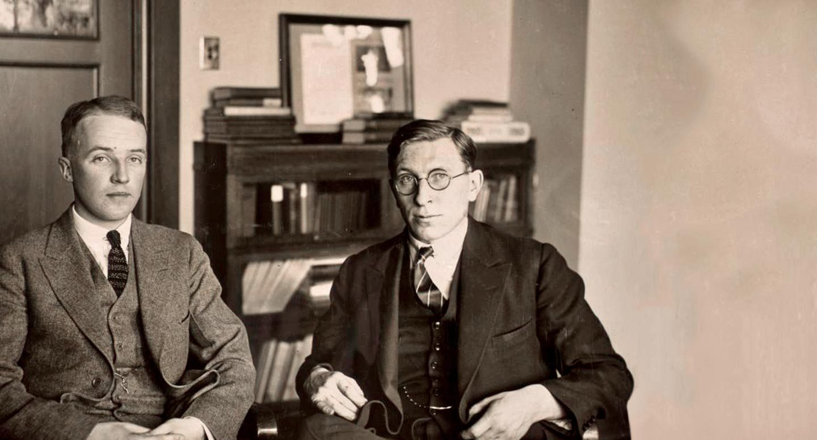
Notes:
Your insulin therapy is ESSENTIAL, but it is not enough.
for those with type 1 diabetes
People living with type 1 diabetes:
FEEL ISOLATED
FEAR COMPLICATIONS
FEAR HYPOGLYCEMIA

Slide 5
Case 1
17 yo girl with T1d since age 7
Outstanding A1c’s, generally in the non-diabetes range
Severe hypoglycemia November 2021* – almost got into a RTA, major anger toward her diabetes team
‘Self-referred’ to me in December 2022
Using CGM
Upset that she needs to “raise her A1c”
On Gla U-100 15 qhs, Lispro estimation range 5-10

Slide 6
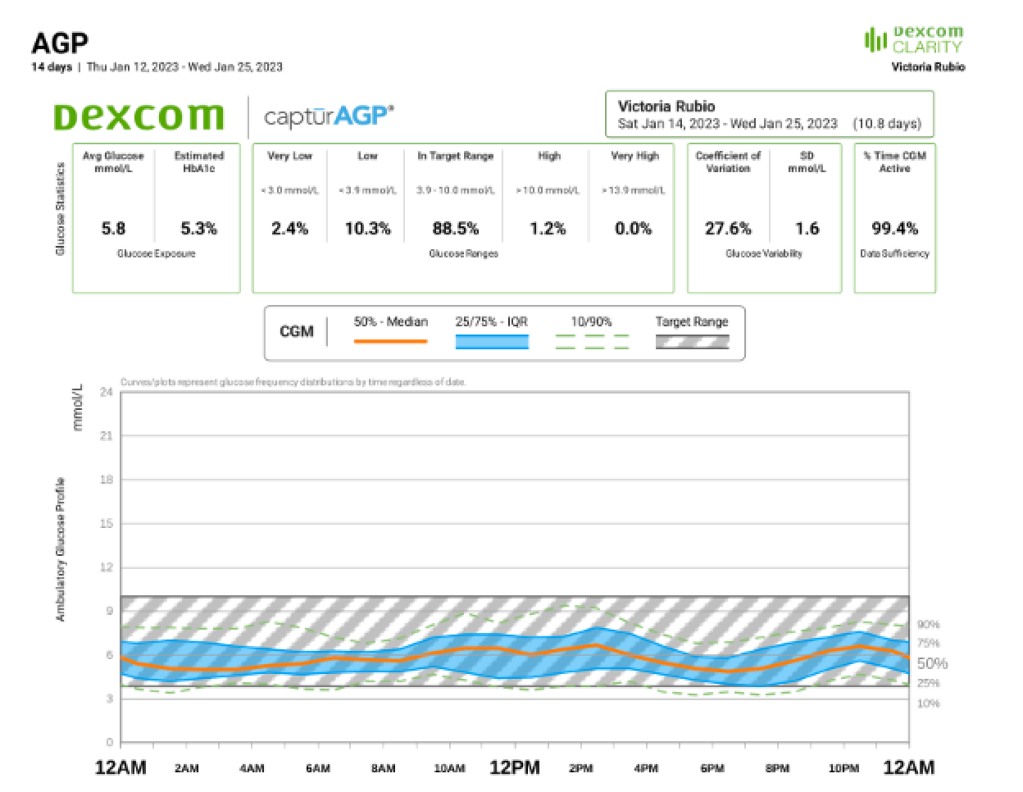
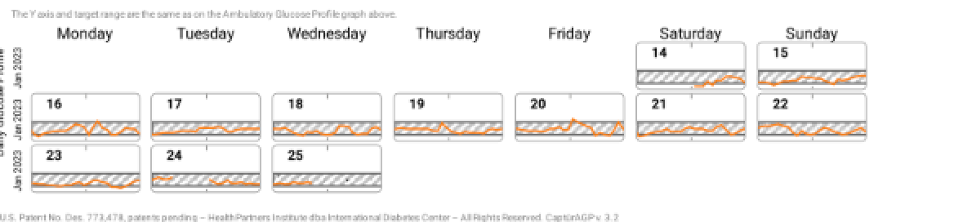

Slide 7
Possible explaination/pattern?
Definite:
Insulin Stacking
Use of greater Gla U-100 for hs hyperglycemia with subsequent daytime drops
No knowledge of ‘TBR’

Slide 8
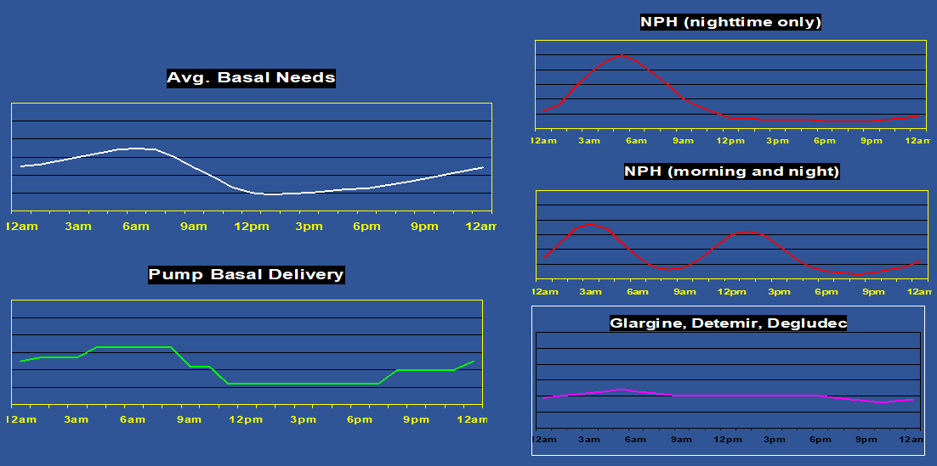
Matching Normal Physiology
Set Basal rates as following
12 AM
3AM
9 AM
5 PM

Slide 9
Case 2
30 year old type 1 DM, hx of repeated admissions to the ER for ongoing hypoglycemia and hyperglycemia
TIR 30% TBR 15% and TAR 55%
Afraid of severe hypoglycemia as she has stayed in hospital admissions for last 1 month
Switched 3 doctors
It was decided she will benefit from HCL(insulin pump)

Slide 10
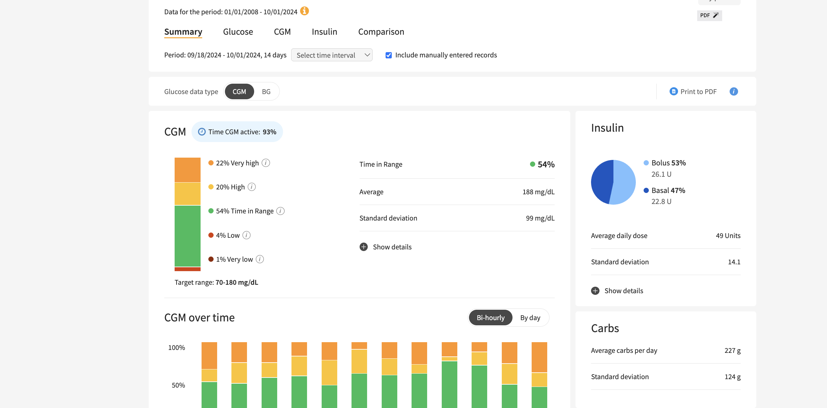
Download to GLOOKO online app

Slide 11
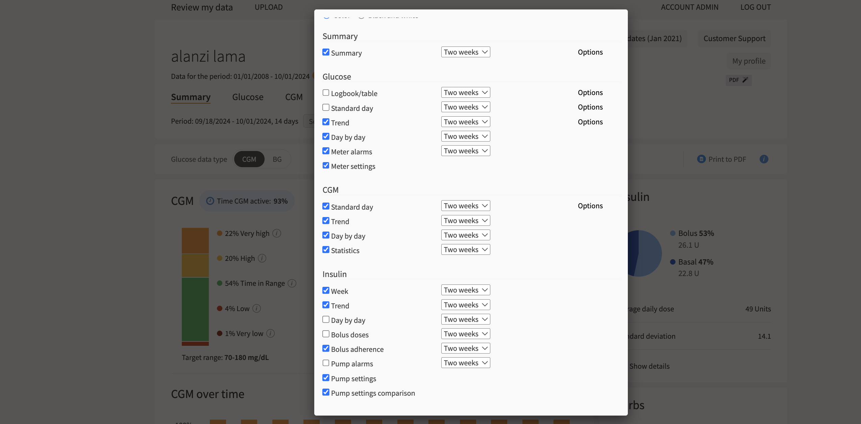

Slide 12
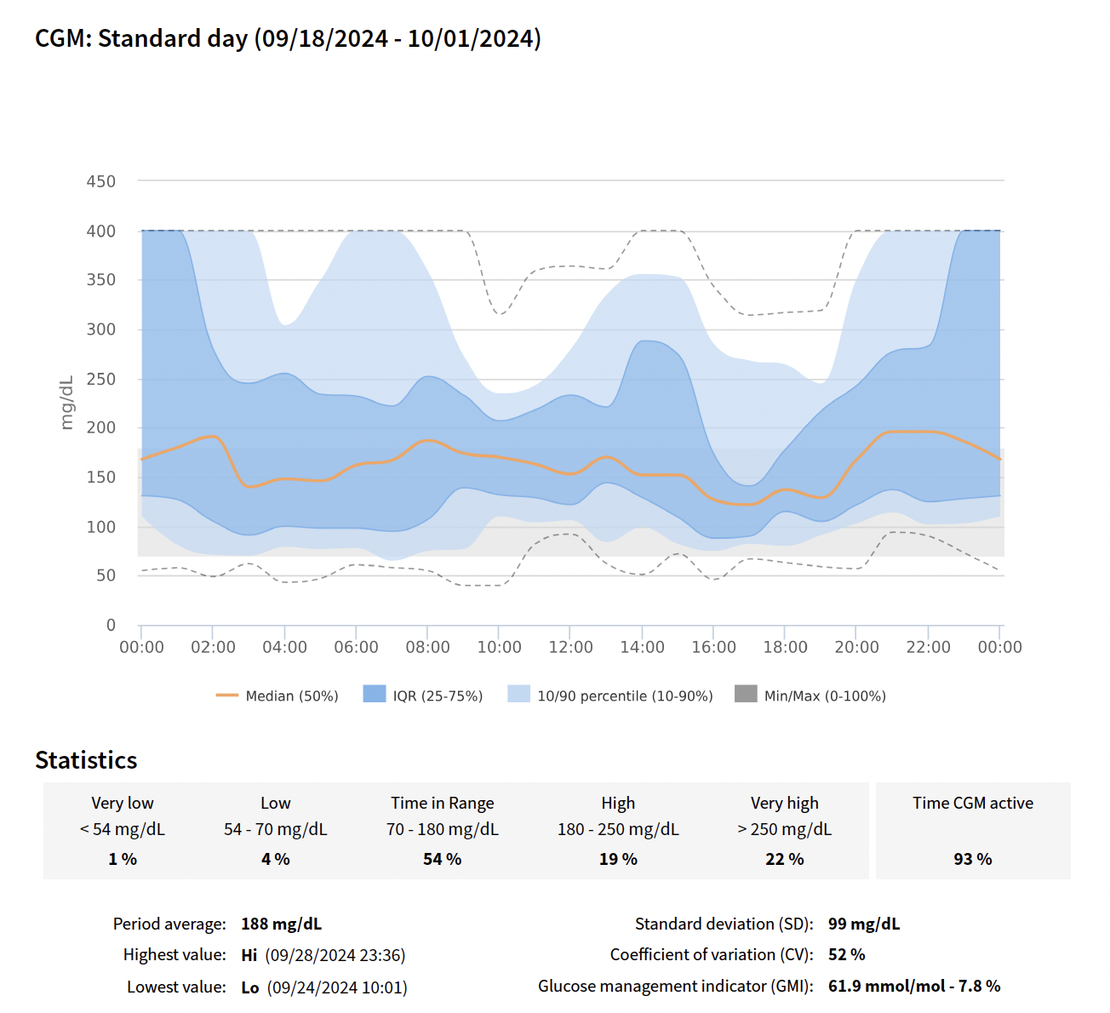
Whats worrisome here?
Notes:
We don’t have time in busy clinics, first thing to look here?

Slide 13
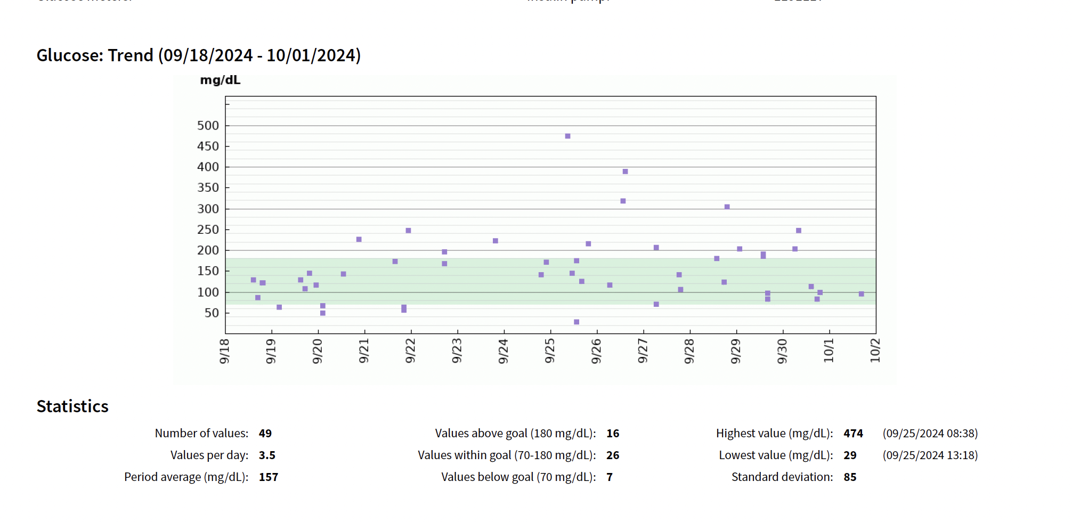
Notes:
Can anyone tell me why I brought this slide?Do you think this is ok?

Slide 14
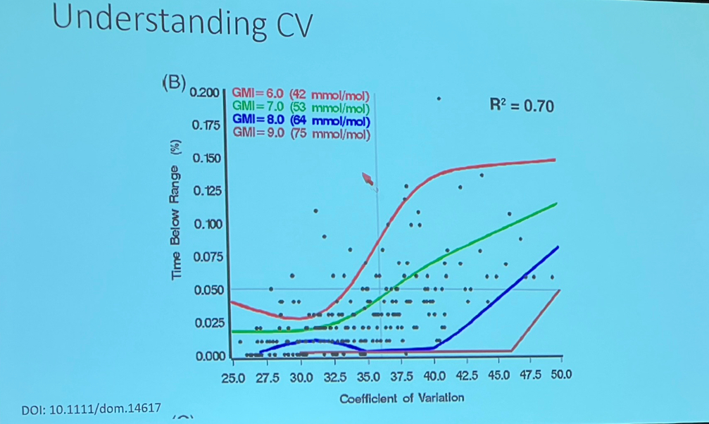
The lower the gmi you have at a given coffecient of variation the higher time below range?
It was set at 36% here from this study
What does a low CV mean in a longstanding T1D?
You maybe making making insulin

Slide 15
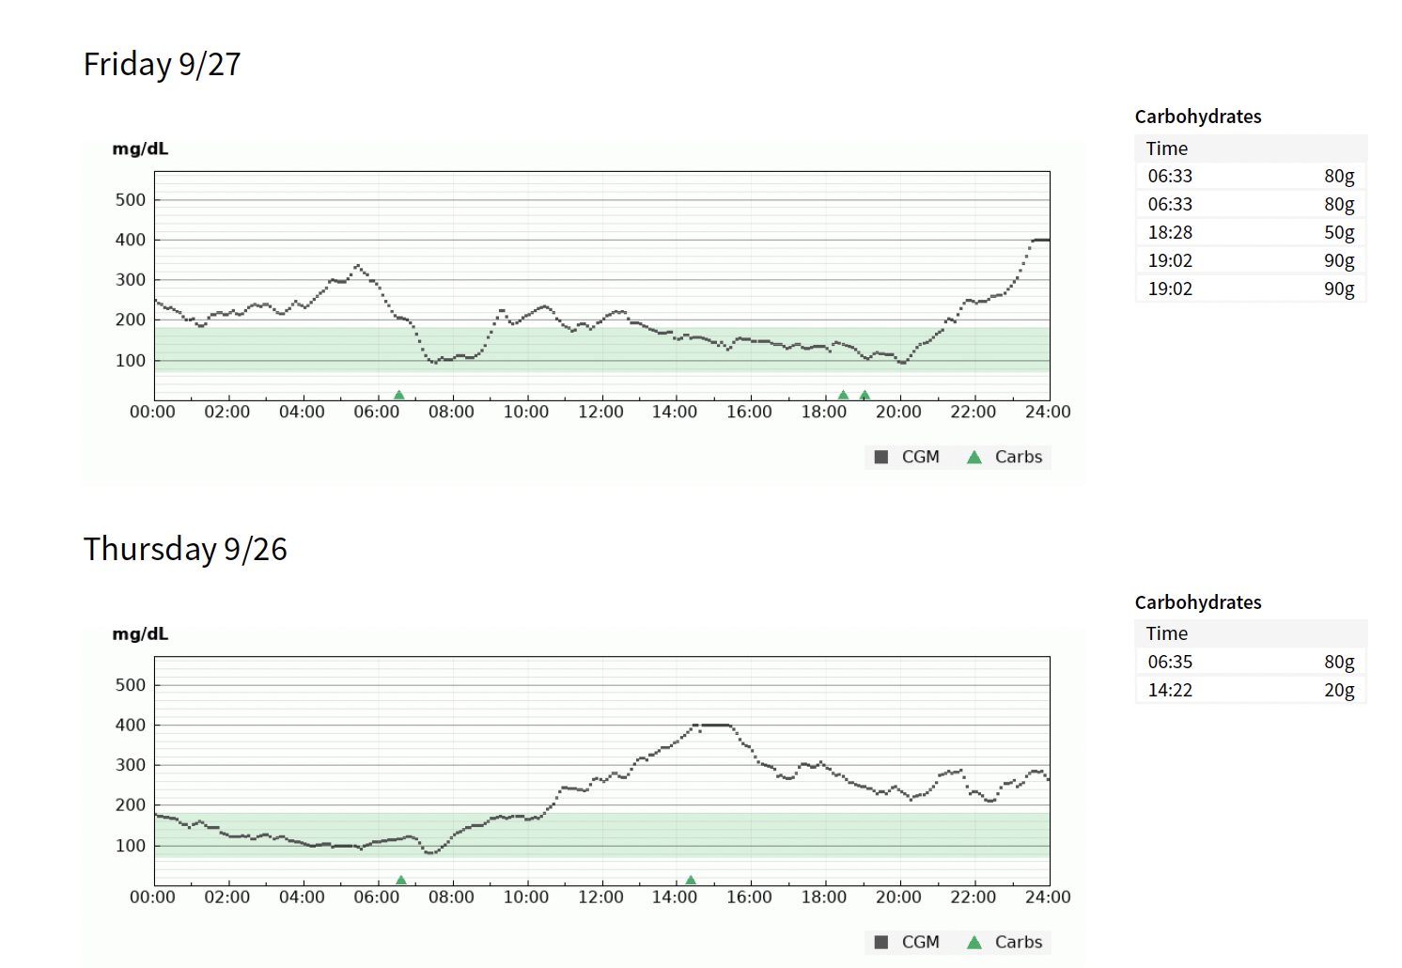
Re-educate about prebolusing well with meals
Check bolus carbs! Nobody eats 20 g unless keto diet
Your role as carb counting expert is ever so important
Waking up with good blood sugars means the rest of the day will be good
Giving late boluses, you will crash

Slide 16
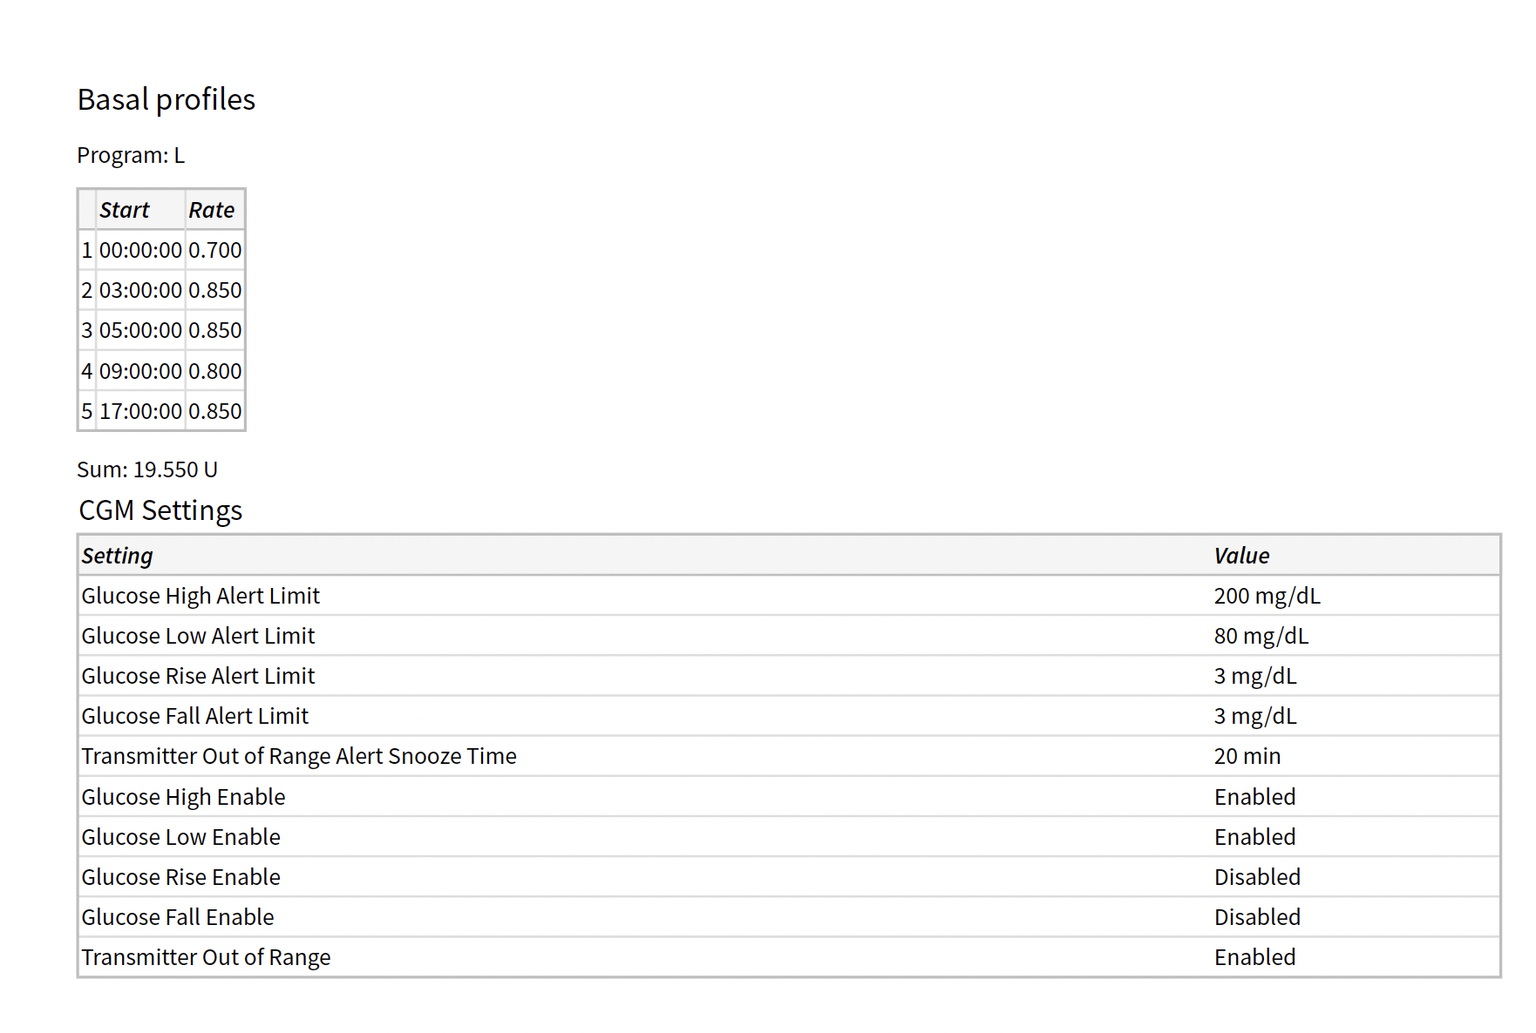
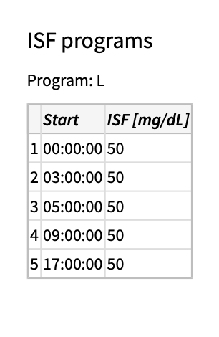
Always check basal rates that they are not way to off
Check for weight changes as TDD insulin dosing may differ with weight changes
Check alerts are on
Especially transmitter out of range
Adjust sensitivity as needed
How is insulin time adjusted in tandem? Autocorrection macrobolus ( if over and above basal increment_ if every hour the predictive glucose going to be 10 or is 10 the insulin onboard is also adjusted as needed from 5 hours to 2 hours for example

Slide 17
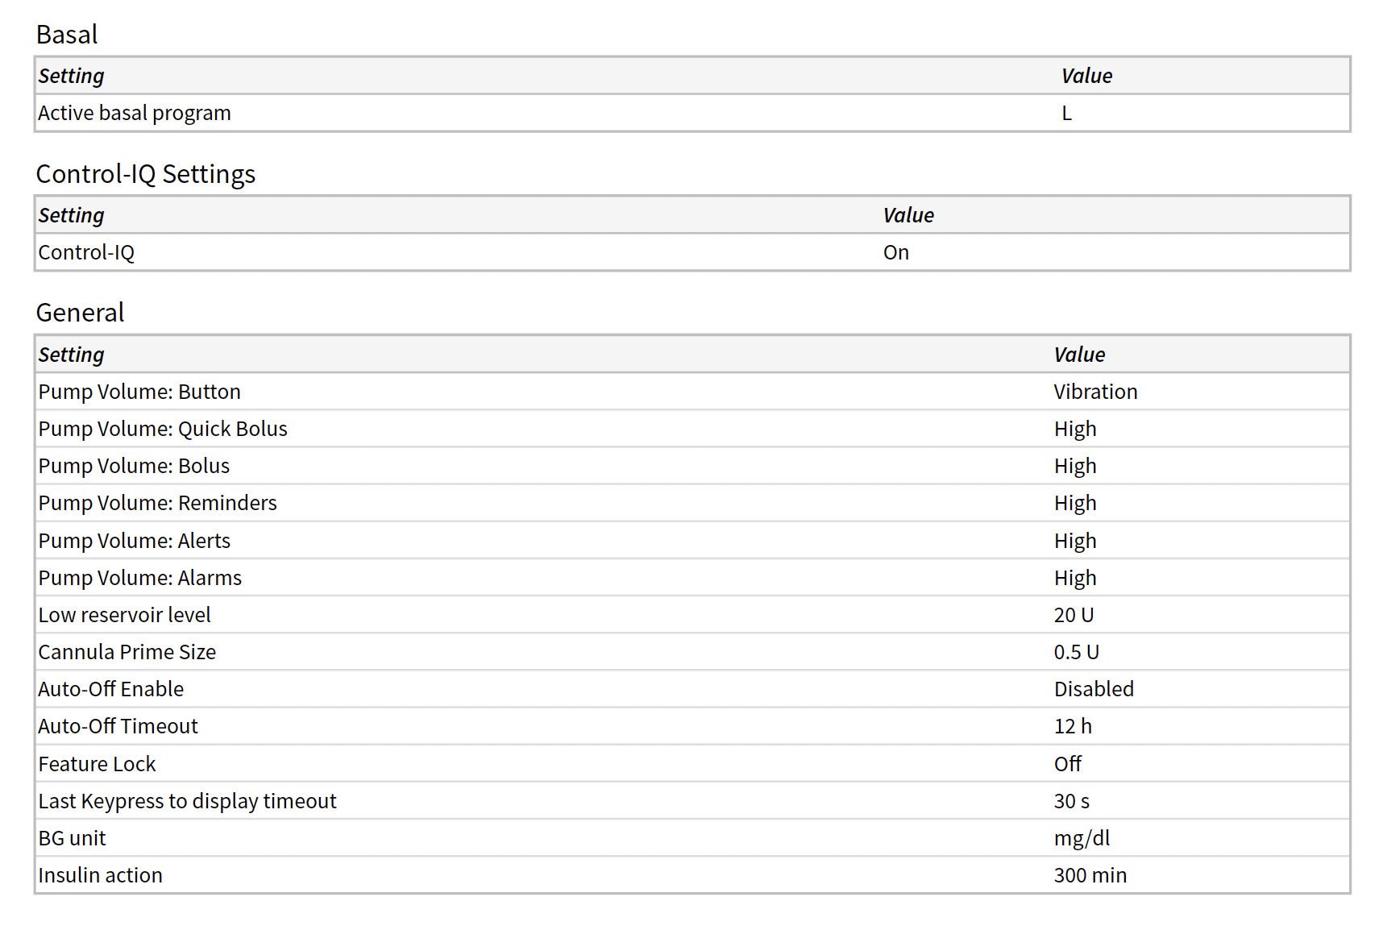
Control IQ setting is on
Insulin action time or active insulin time cannot be edited in Tandem, however it does adjust accordingly to patient needs
System can vary the basal infusion rate from zero to a maximum of 4x the user profile basal rate
If taking 50 units daily and reservoir to be put 200 units (15 u for canula 30 more if getting sick)total 200

Slide 18
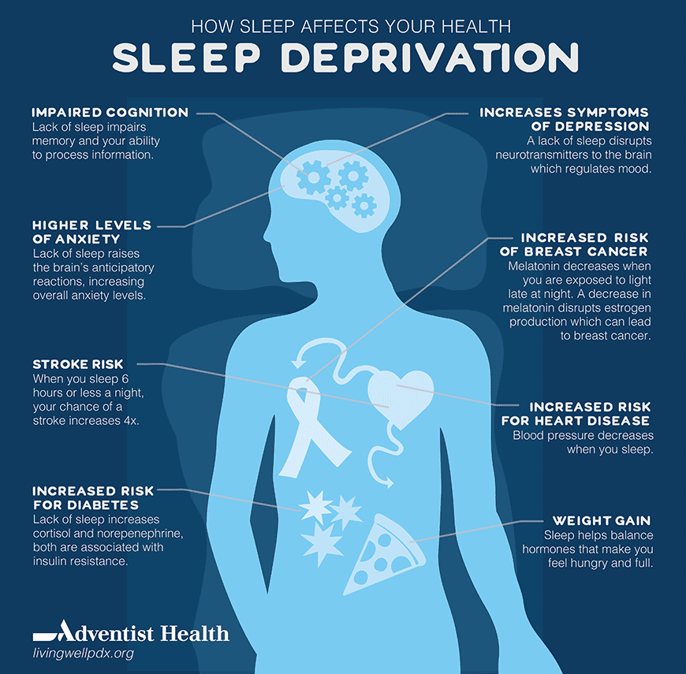

Sleep Activity
(6.25 – 6.7 mmol/L)
Schedules
  Minimum 5 hours
  Consider “food falling asleep/waking up”
Can bolus for food and/or corrections
Basal modulation q5 min (micro corrections)
Monzon AD, Patton SR, Koren D. Childhood diabetes and sleep [published online ahead of print, 2021 Sep 10]. Pediatr Pulmonol. 2021;10.1002/ppul.25651. doi:10.1002/ppul.25651

Slide 19
Getting the best sleep with Control-IQ technology
When optimizing, consider:
Does this patient have a reliable sleep schedule?
Is there a late meal or snack close to bedtime?
How or when is dawn phenomenon occurring?
High stress or current growth spurts?

Slide 20

Exercise Activity
(7.8 – 8.9 mmol/L)
Basal decrease 7.8 mmol/L + basal suspension 4.4 mmol/L
Optimizing tips:
  Consider activating ~1.5 hours prior to scheduled activity
  Consider utilizing another Personal Profile in conjunction
  Consider small manual correction prior (0.05 units)
  If concerned of delayed lows, consider utilizing for up to
  24 hours post activity

Slide 21
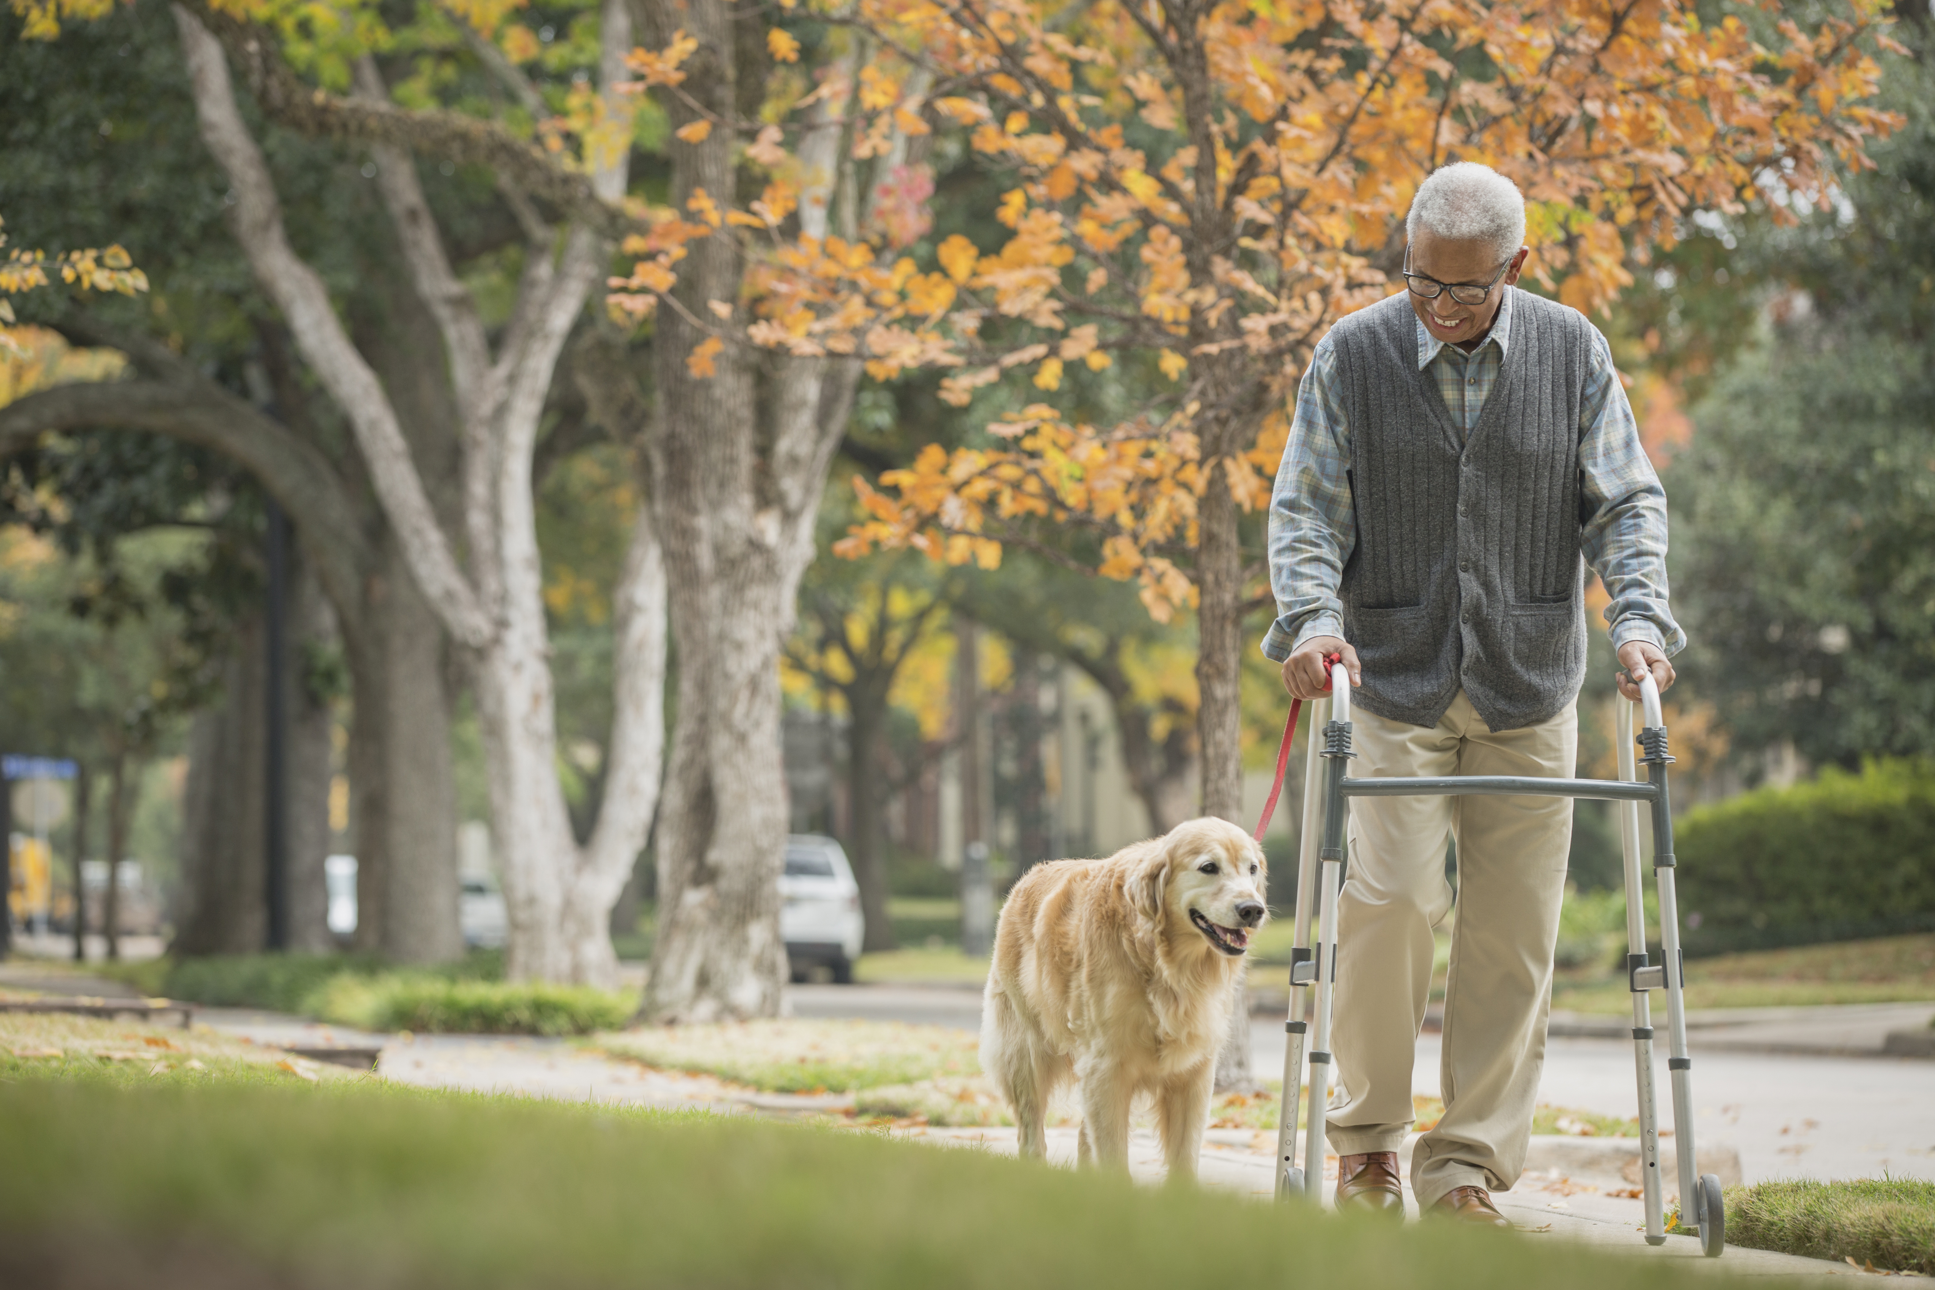
Alternative uses for consideration:
Exercise
Fasting, NPO for medical procedures
Nausea and/or vomiting
Temporary reset for glycemic variability
For hypoglycemia-fearing or unaware patients
For PWD who feel symptoms of hypoglycemia
at higher levels (historically higher A1C)
For those at increased risk for falls
High fat/protein meal before bed
Alcohol related hypoglycemia overnight
Driving, exams, special events

Slide 22
Sleep Activity 24/7
Sleep Activity
Alternative uses for consideration:
Who might benefit?
Some patients want basal modulation at a tight target range
Patients not wanting automatic corrections
Patients who are willing to give meal boluses or corrections as necessary
Who may not benefit?
Patients who routinely forget to bolus for meals
Patients with fear of hypoglycemia
Patients not willing to give correction boluses as needed

Slide 23
Case 3
23 y.o female with t1d since age 12, known to have underlying diabetes related complications: retinopathy, neuropathy and nephropathy. She is currently on Medtronic 780 G with freestyle libre and is admitted for renal transplant and is post op day 2. Transplant nephrologist calls you to handle her diabetes. She is presently on 40 mg prednisone and other immunosuppressive medications.
First thoughts that come to your mind?
Why is she on open loop therapy?
Whats the expected steroid regimen?
Current infections or stressors from ongoing surgery?
How long is the hospital stay?
When to decide to see her after discharge?

Slide 24
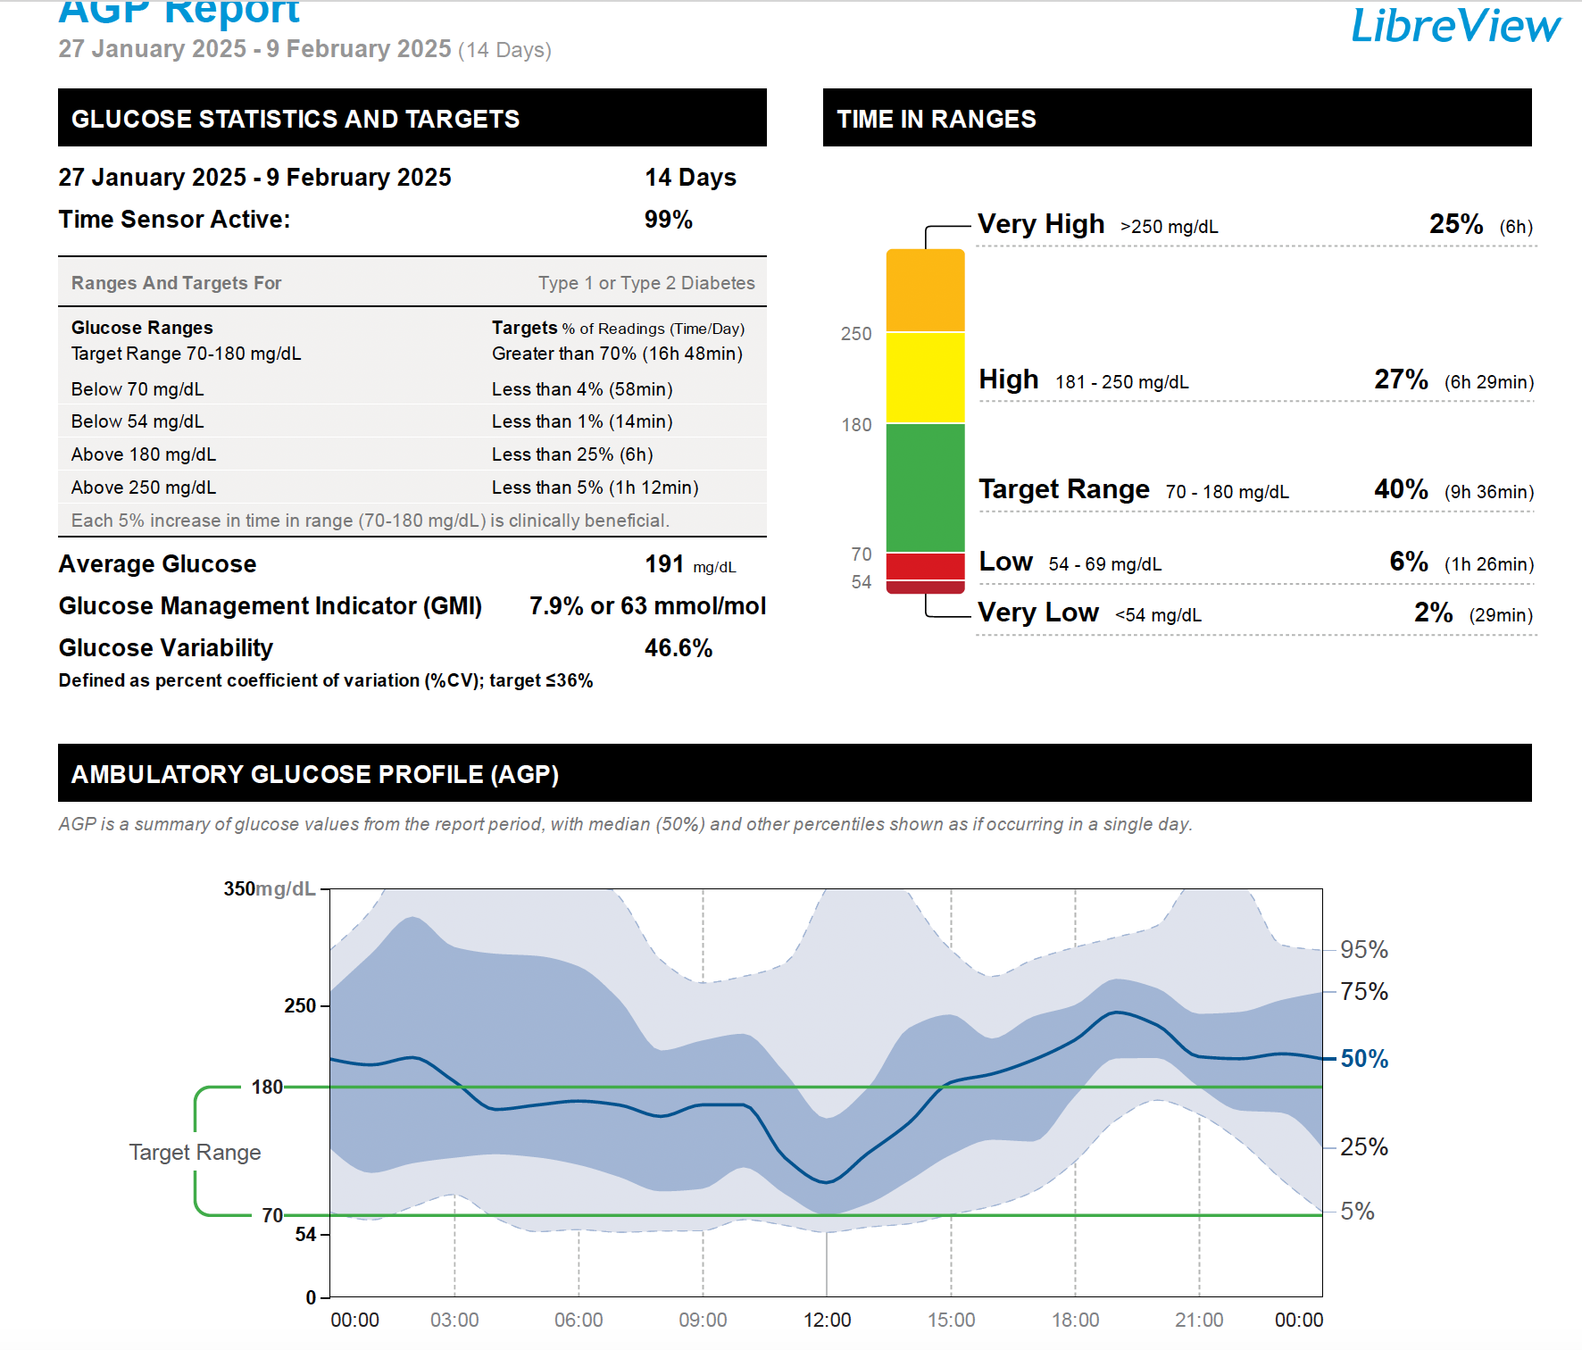
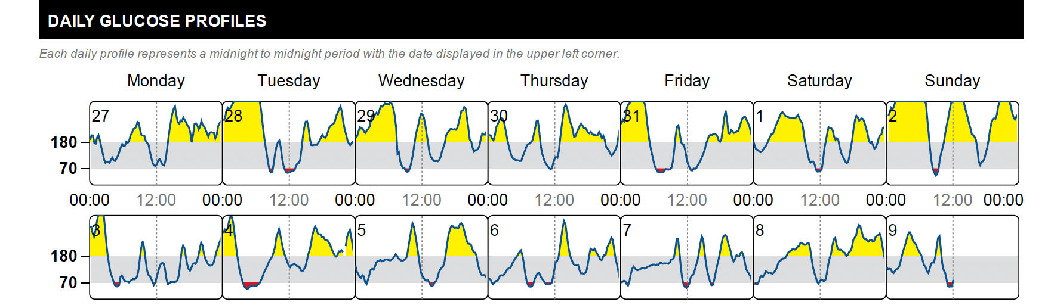
-Too much lows!
-Treat hypoglycemia first
-Modern insulin doesn’t match physiological insulin requirements
-Steroids related evening rises, and post correction lows
-Next best step?

Slide 25
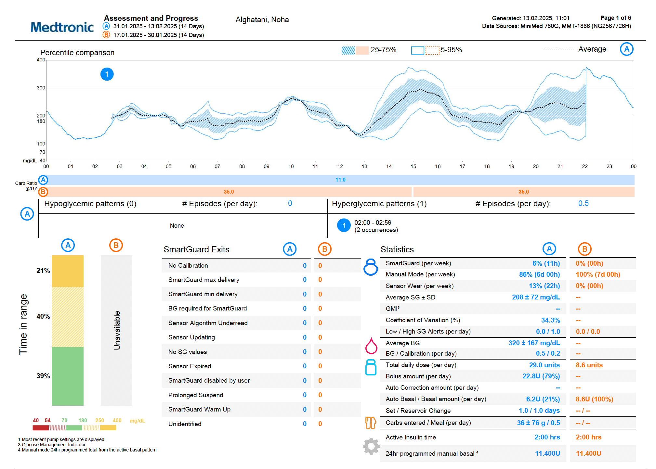
-Put back on pump
-How long before smart guard is switched on?

Slide 26
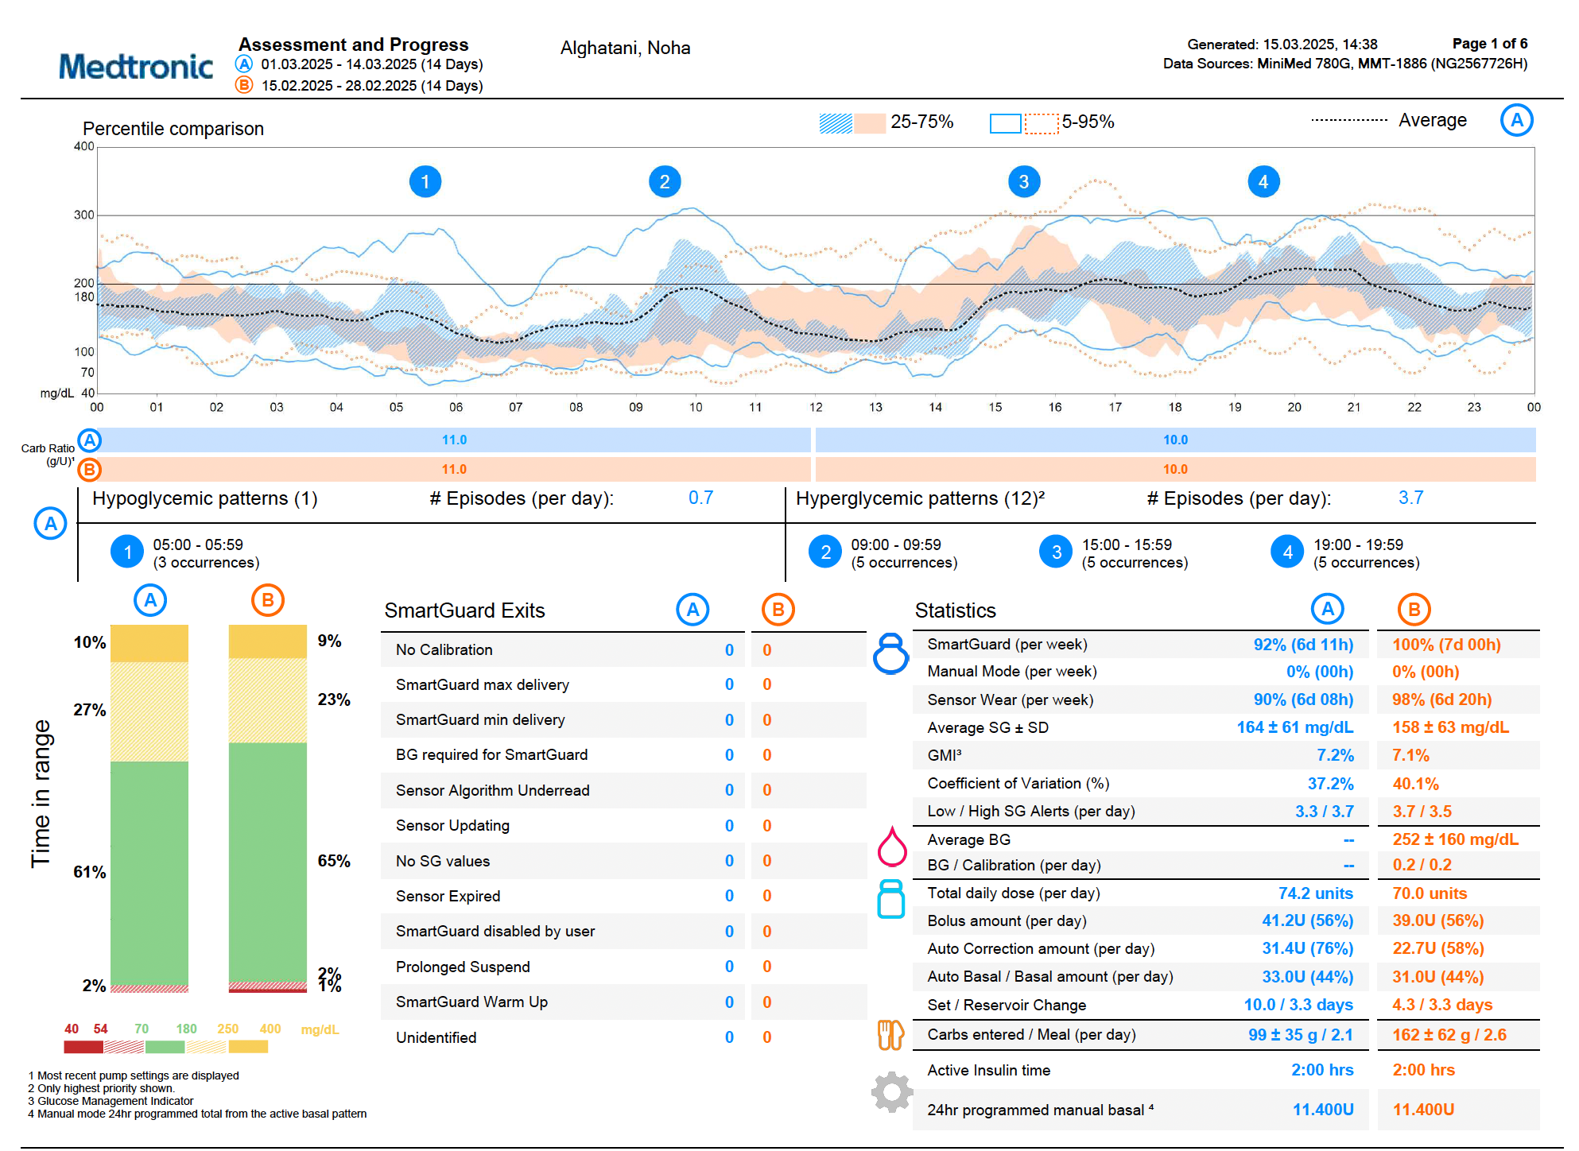
Notes:
Let me give you a quick run down to reading the report
Just 2 week after smart guard from 8 % which is 2 hours of lows to 3 %
What pattern do u see here?

Slide 27
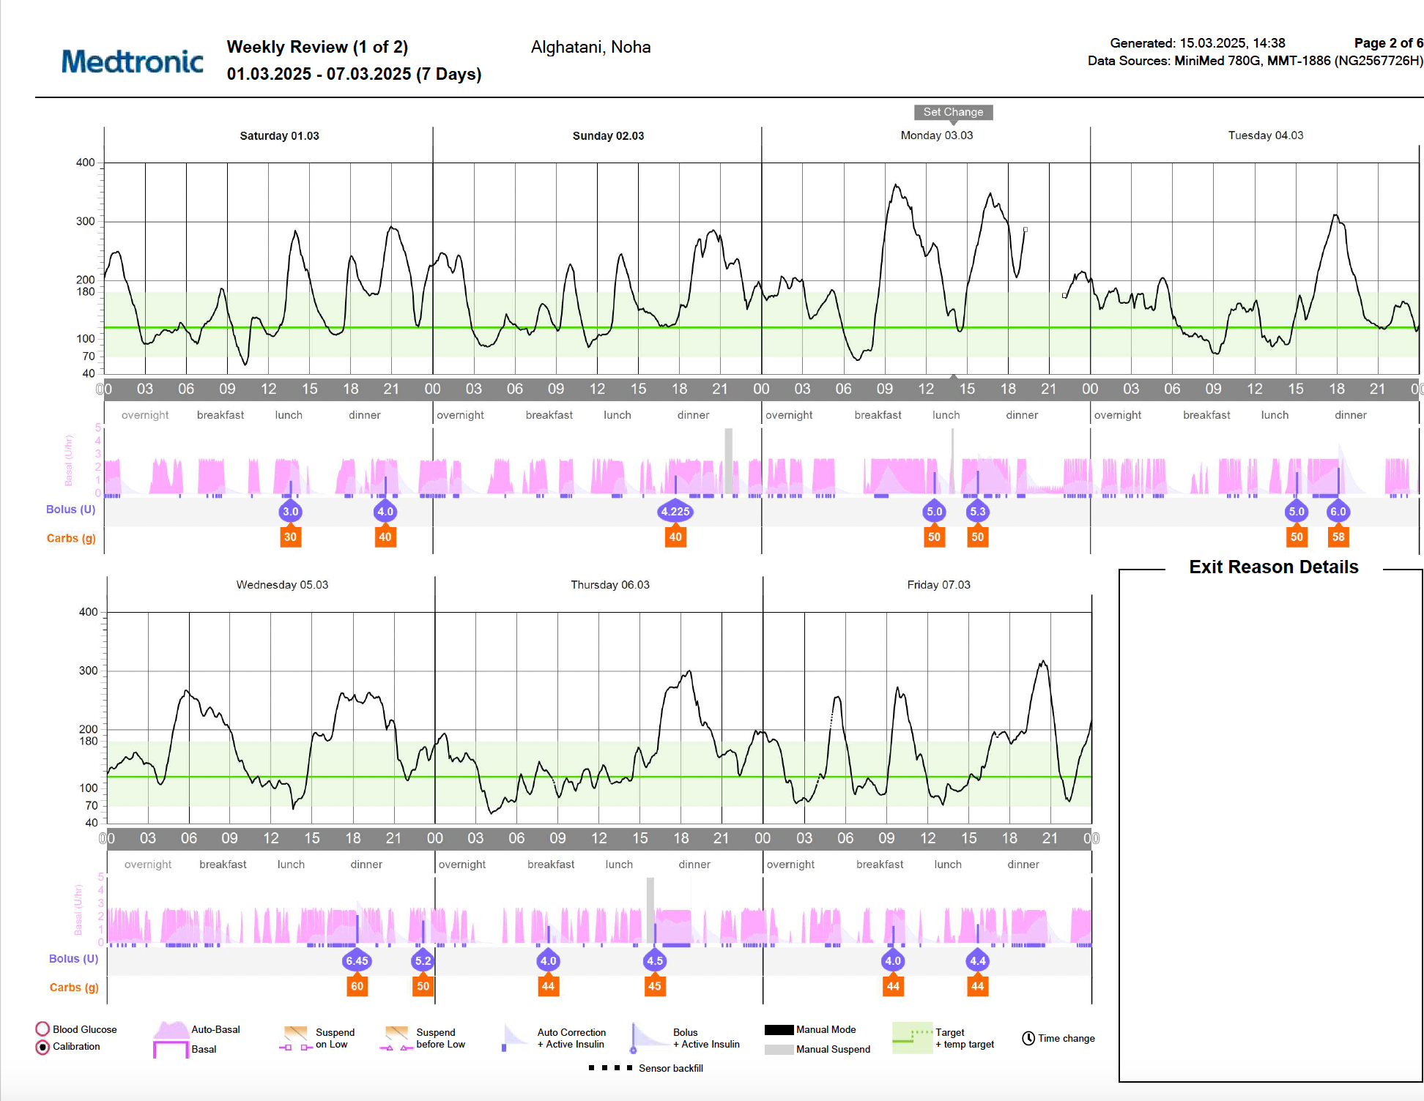
As AGP confirms as well
Lunch needs to be strenghtened- coinciding with the steroids dose
-Needs to prebolus 15 mins before meals to prevent the spikes
-The spikes improve TIR

Slide 28
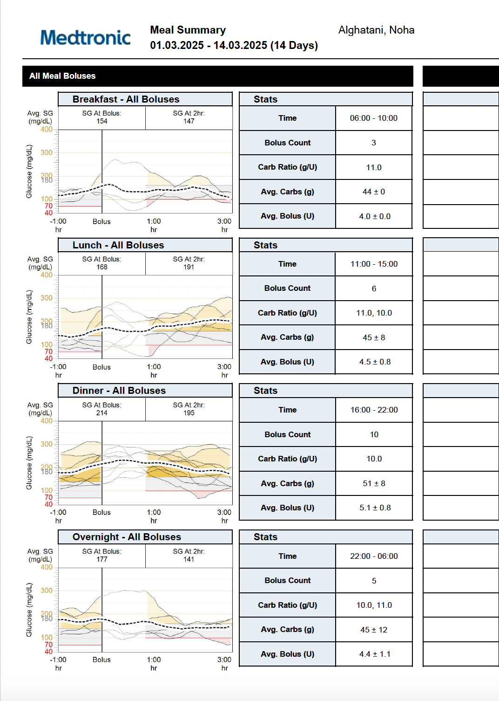
-Confirm your finding on the meal wizard
-Make sure to select it when creating the report
-Probably the most important page, as only few settings that can be changed on medtronic 780 G.
-The spikes at lunch confirm our intial finding

Slide 29
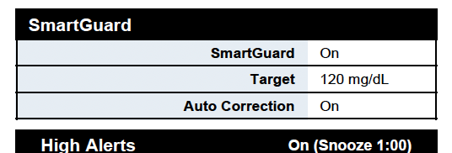
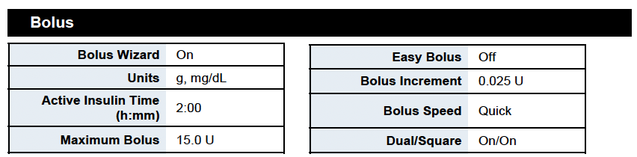
3 targets to choose from in medtronic 780 G
Use highest when patient initially presenting with lows
Bolus increment and active insulin time should be set to 0.025 and 2 hours respectively as the algorithm works best then.

Slide 30
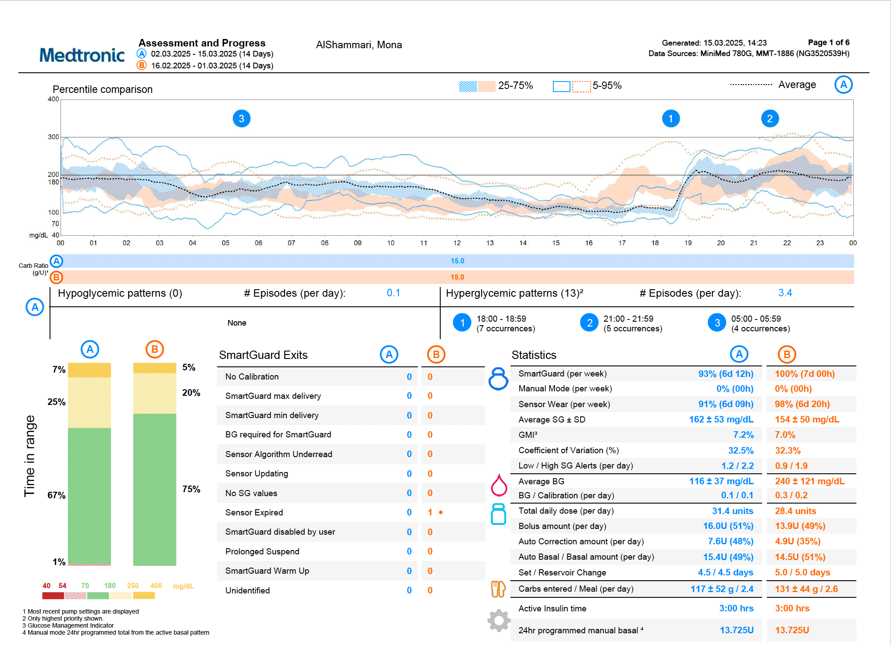
Identify the pattern?
Ramadan pattern/intermittent fasting:
-Always bolus 20-30 more with carbs at futoor time
-Account for fatty meals
-Remember medtronic algorithm= adaptive algorithm

Slide 31
Objectives
In the previous 15 minutes you were able to get a better understanding of…
Different clinical scenarios using technology in diabetes
Tips and tricks with each case to watch out for when you are reading the AGP report next

