Slide 1

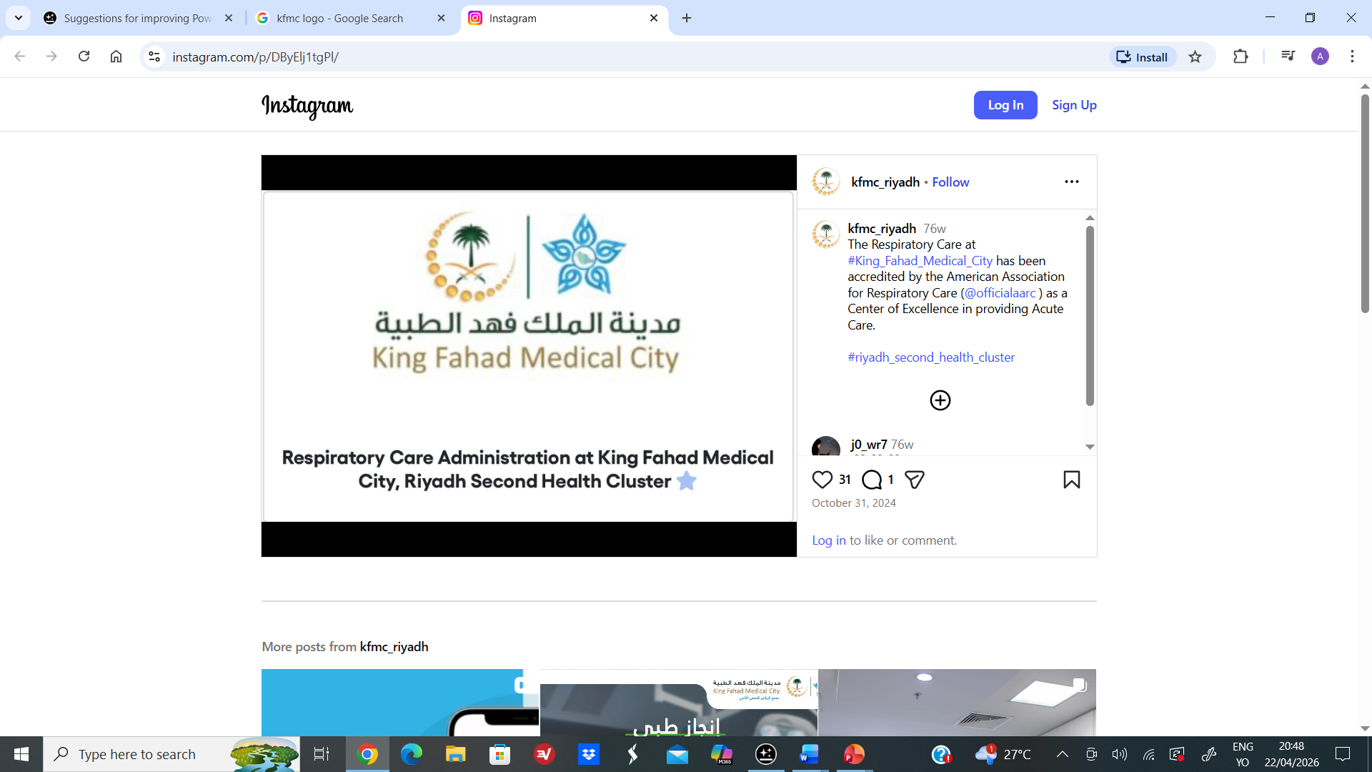
KFMC
Unmasking Hypophysitis in a Teen
Dr. Altaf Mohammed Almoallem
Pediatric Endocrine Fellow 1
King Fahad Medical City (KFMC)

Slide 2


Patient History – Initial Presentation
KFMC
King Fahad Medical City
Pediatric Endocrinology
Case Presentation - Hypophysitis | April 2026
Patient
12-year-old female
12-year-old female referred from other hospital as case of incidental sellar, suprasellar lesion
Incidental sellar/suprasellar lesion detected on imaging
Referred as panhypopituitarism suspicious of germinoma
April 25, 2026

Slide 3
History prior to presentation
KFMC
King Fahad Medical City
Pediatric Endocrinology
Case Presentation - Hypophysitis | April 2026
Patient
12-year-old female
Seen in the referring hospital:
Presented with short stature
She was treated with GH therapy secondary to GH deficiency
Pituitary MRI was done:
showed sellar/suprasellar mass No neurologic deficit was appreciated
April 25, 2026

Slide 4
History prior to presentation
KFMC
King Fahad Medical City
Pediatric Endocrinology
Case Presentation - Hypophysitis | April 2026
Patient
12-year-old female
GH was held .
The patient was started on hydrocortisone at 8 mg/m2/day due to low cortisol level post ACTH stim test for 10 days, which was tapered prior to her referral to our hospital .
April 25, 2026

Slide 5
History prior to presentation
KFMC
King Fahad Medical City
Pediatric Endocrinology
Case Presentation - Hypophysitis | April 2026
Patient
12-year-old female
Early pubertal signs with no appreciated progression .
No symptoms suggestive of:
Hypotension.
Hypoglycemia.
Alactorrhea.
Normal cognition and excellent school performance .
Normal vision .
April 25, 2026

Slide 6
Upon presentation:
KFMC
King Fahad Medical City
Pediatric Endocrinology
Case Presentation - Hypophysitis | April 2026
Patient
12-year-old female
Short stature
Long-standing history of polyuria and polydipsia for more than 6 years:
consuming water around 10x500-ml bottles daily
nocturia on average 3 times/night
diluted urine
- Early morning vomiting was attributed to consuming large amounts of water by the family
- Did not seek medical advice for this issue
April 25, 2026

Slide 7


other history
KFMC
King Fahad Medical City
Pediatric Endocrinology
Case Presentation - Hypophysitis | April 2026
Patient
12-year-old female
Past medical/surgical:
no History of recurrent admissions and no past surgical History -
Family history :
Unremarkable
April 25, 2026

Slide 8


Physical Examination (Initial)
KFMC
King Fahad Medical City
Pediatric Endocrinology
Case Presentation - Hypophysitis | April 2026
Patient
Status
12-year-old female
Generally well, not in distress
General & Neurologic
Pubertal & Systemic
Well-appearing and well-hydrated
Tanner: Breast 2 Pubic 1
Neurologic exam intact - No focal deficits
Systemic exam unremarkable
Capillary refill < 2 seconds
No lymphadenopathy
April 25, 2026

Slide 9
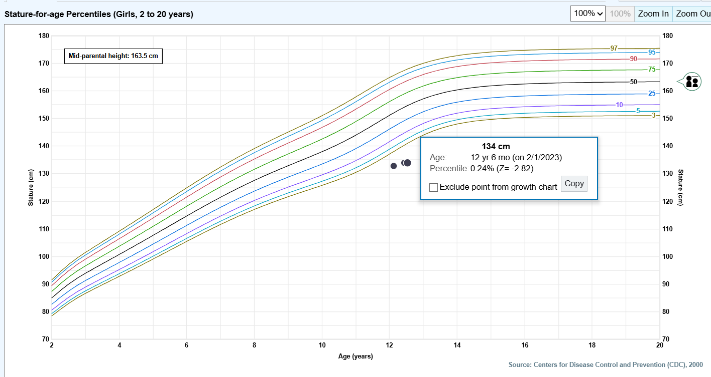
Initial growth chart
KFMC
King Fahad Medical City
Pediatric Endocrinology
April 25, 2026

Slide 10
Initial Laboratory Highlights
KFMC
King Fahad Medical City
Pediatric Endocrinology
Laboratory Results
Parameter | Value | Reference Range | Status
IGF-1 | 59.2 ng/mL (Low) | 105-499 ng/mL | Deficient
FSH | 2.51 IU/L | 0.5-5.0 IU/L | Prepubertal
LH | 0.20 IU/L | 0.1-1.0 IU/L | Prepubertal
ACTH | 2.36 pg/mL | 7-63 pg/mL | Low
Cortisol | 284 nmol/L | 250-700 nmol/L | Normal
Peak Cortisol level post ACTH stim test: 437 nmol/l (normal > 500)
April 25, 2026

Slide 11
Initial Laboratory Highlights
KFMC
King Fahad Medical City
Pediatric Endocrinology
Laboratory Results
Parameter | Value
Tsh | 4.3480 mIU/L
T4 | 14.60 pmol/L
Prolactin | 25 Ug/l 5- 26
HA1c | 5.10
April 25, 2026

Slide 12
Work up for central DI :
Baseline
Parameter | Value
Plasma osmolality | 296 msosm /kg
Urine osmolality | 79
Urine SG | 1.002
Serum sodium | 142
Glucose | 4.4 mmol/L

Slide 13
Post desmopressin
KFMC
King Fahad Medical City
Pediatric Endocrinology
Parameter | Value
Urine osm | 430 msosm /kg
Plasma osm | 283 msosm /kg
Plasma sodium | 137
April 25, 2026

Slide 14
GH Stimulation Test
KFMC
King Fahad Medical City
Growth hormone deficiency confirmation
Pediatric Endocrinology
Test Results - December 2022
Severe GH deficiency confirmed
GH Value ( glucagon ) | Gh (clonidine )
0.59 ng/mL | 0.34 ng/ml
<0.15 ng/mL | 0.25 ng/ml
<0.15 ng/mL | 0.20 ng/ml
0.23 ng/mL | 0.51 ng/ml
Key Finding
Flat GH response at diagnosis - Confirmed Growth Hormone Deficiency
April 25, 2026

Slide 15
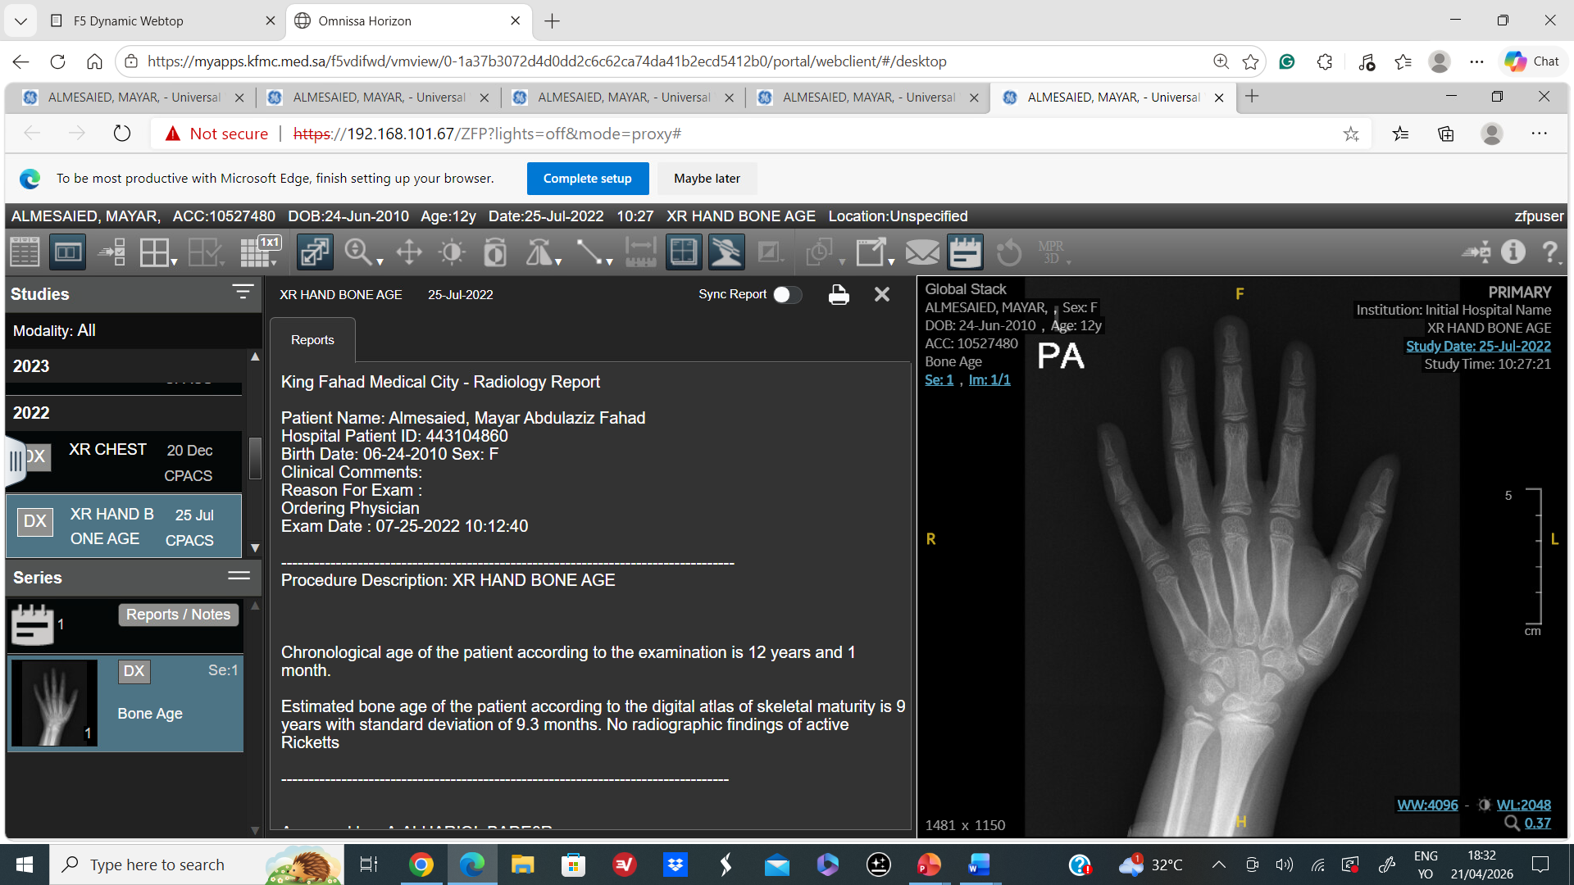

Bone Age – Baseline
KFMC
King Fahad Medical City
Imaging Assessment | July 2022
Pediatric Endocrinology
Bone age 9 years at chronologic age 12 years .
April 25, 2026

Slide 16
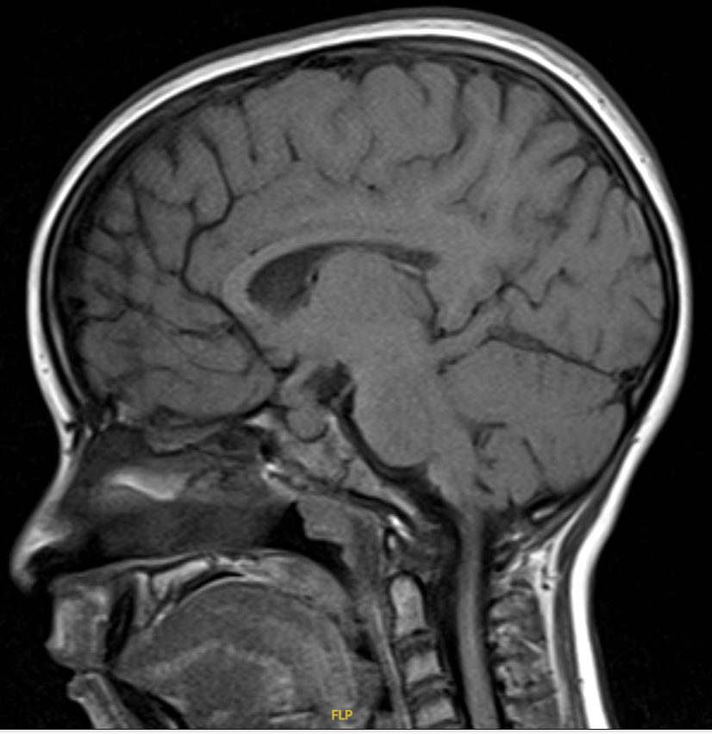

First MRI –done outside
KFMC
King Fahad Medical City
Pituitary Imaging Assessment | Jan 2022 -
Pediatric Endocrinology
Initial imaging identified a sellar/suprasellar lesion .
April 25, 2026

Slide 17
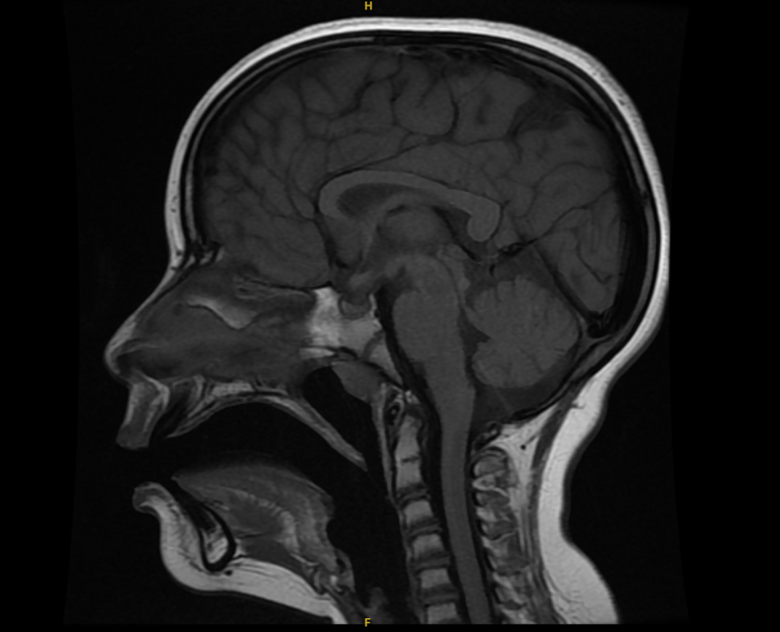
First MRI –in our center
KFMC
King Fahad Medical City
Pituitary Imaging Assessment |jun 2022 -
Pediatric Endocrinology
Interval improvement/resolution in previously noted thickening to the pituitary stalk and edema in both hypothalamus region, finding likely suggesting of improving inflammatory processes.
April 25, 2026

Slide 18



Initial Assessment & Working Diagnosis
KFMC
King Fahad Medical City
Case Presentation - Hypophysitis | April 2026
Pediatric Endocrinology
Working Diagnosis: Hypophysitis
Key Finding:
Spontaneous resolution of the lesion suggests an inflammatory process rather than a neoplasm.
Patient has GHD + CDI ± partial adrenal insufficiency.
Hormone Status
Imaging
Multiple deficits confirmed
Lesion resolved
April 25, 2026

Slide 19
Initial Assessment & Working Diagnosis
KFMC
King Fahad Medical City
Case Presentation - Hypophysitis | April 2026
Pediatric Endocrinology
GHD + CDI ± partial AI
MRI showing resolution favours inflammation over neoplasm
(patient only received a short course of physiologic dose of HC
Working diagnosis: Hypophysitis - Likely secondary in this age group, screening for primary causes needed
Plan: exclude secondary causes –Screen
for granulomatous/inflammatory diseases
April 25, 2026

Slide 20
Initial Assessment & Working Diagnosis
KFMC
King Fahad Medical City
Case Presentation - Hypophysitis | April 2026
Pediatric Endocrinology
Case discussed in Neuro-pituitary tumor board:
Screen for granulomatous, inflammatory diseases including vasculitis, IgG4 mediated hypophysitis, and malignancies.
No surgical intervention.
No biopsy will be performed
April 25, 2026

Slide 21


Comprehensive Workup – Screening Results
KFMC
King Fahad Medical City
Pediatric Endocrinology
Case Presentation - Hypophysitis | April 2026
Patient
Status
12-year-old female
Screening for secondary causes
Laboratory Findings
Imaging Results
Inflammatory markers: normal
Systemic imaging: unremarkable
ESR 12 mm/hr, CRP 2.1 mg/L
Chest X-ray, CT Chest/Abd normal / mri whole spine
Tumor markers: negative
Supports inflammatory process
β-hCG negative, AFP negative
Favors inflammation over neoplasm
Page 13 of 24
April 25, 2026

Slide 22
Comprehensive Workup – Screening Results
KFMC
King Fahad Medical City
Pediatric Endocrinology
Case Presentation - Hypophysitis | April 2026
Patient
Status
12-year-old female
Screening for secondary causes
Laboratory Findings
Imaging Results
ANCA ( vasculitis marker )
Bone scan / scintgraphy
Negative
Normal
IgG4
Optha evalution
Normal
No papilledema
Page 13 of 24
April 25, 2026

Slide 23



Management Plan
KFMC
King Fahad Medical City
Pediatric Endocrinology
Treatment Strategy - Hypophysitis | April 2026
Patient
12-year-old female
Resolving hypophysitits
Treat for panhypopituitarism symptoms
MRI every 6 to 12 month
Multidisciplinary approach with endocrinology, radiology, and rheumatology consultation
( no suspicion of rheumatologic disease)
April 25, 2026

Slide 24

Follow-up Status – Current Medications
KFMC
King Fahad Medical City
Pediatric Endocrinology
Case Presentation - Hypophysitis | April 2026
Patient
Current Status
15-year-old female
Active Medications :
Desmopressin 30 mcg nightly .
+ PRN AM dose if needed
Weekly GH (Sogroya 0.16 mg/kg/wk ) .
April 25, 2026

Slide 25

ACTH Stimulation Test (11/2025)
KFMC
King Fahad Medical City
Pediatric Endocrinology
Adrenal Function Assessment
Test Date
November 2025
Peak cortisol 608 nmol/L - Optimal response achieved
Adrenal insufficiency ruled out - Normal ACTH stimulation response
April 25, 2026

Slide 26
Interval Progress
KFMC
King Fahad Medical City
Pediatric Endocrinology
Follow-up Status - April 2026
Patient
15-year-old female
Stable on therapy
Improved height velocity - Patient noticed herself gaining height
Advancing puberty - Tanner staging progressing appropriately
Tolerating therapy well - No side effects from GH or desmopressin
Persistent CDI, well-controlled - On desmopressin 30mcg daily
Thyroid and prolactin: was normal from the beginning
April 25, 2026

Slide 27
Current Physical Examination
KFMC
King Fahad Medical City
Pediatric Endocrinology
Case Presentation - Hypophysitis | April 2026
Patient
Status
15-year-old female
Generally well, not in distress
Growth & Pubertal Status
Systemic Examination
Growth velocity 4.3 cm/year
Systemic exam normal
Tanner: Breast III; Pubic III; Axillary II
Generally well
Page 18 of 24
April 25, 2026

Slide 28
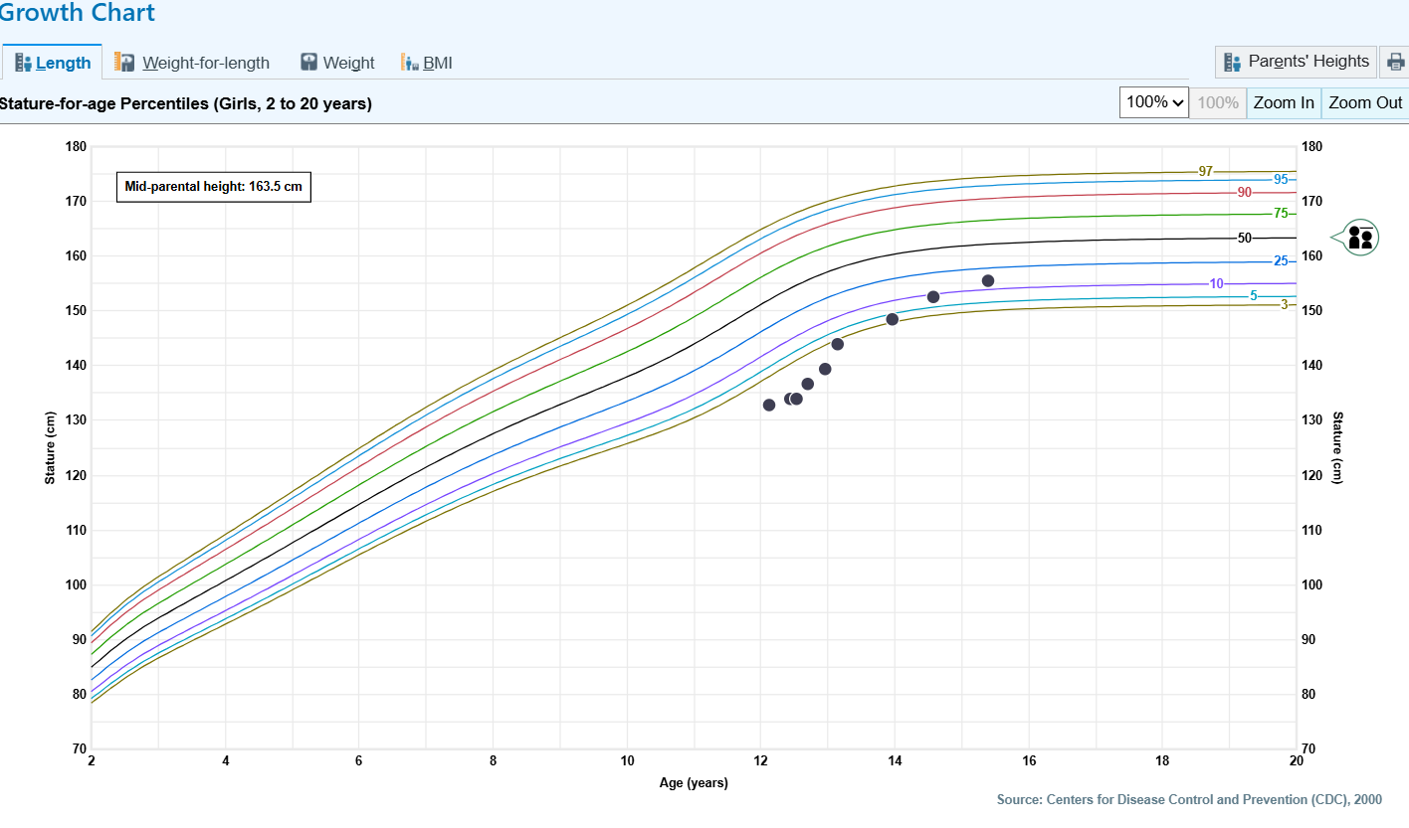
Follow up growth chart
KFMC
King Fahad Medical City
Pediatric Endocrinology
April 25, 2026

Slide 29
Current Laboratory Highlights (04/2026)
KFMC
King Fahad Medical City
Pediatric Endocrinology
Laboratory Results
Parameter | Value | Status
IGF-1 | 200.70 ng/mL | within reference range
FSH | 7.30 IU/L | Pubertal
LH | 3.80 IU/L | Pubertal
TSH | 4.3480 mIU/L | Normal
Free T4 | 12.00 pmol/L | Euthyroid
Na | 138 mmol/L | Normal
April 25, 2026

Slide 30
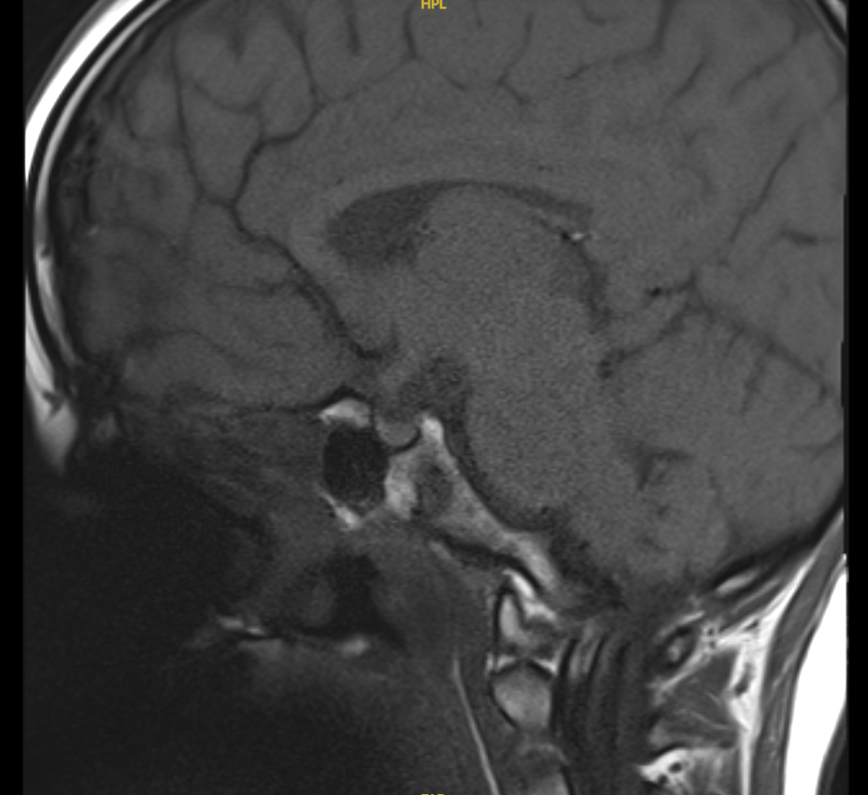
Last MRI
KFMC
King Fahad Medical City
Pituitary Imaging Assessment | nov 2025 -
Pediatric Endocrinology
Stable appearance of the pituitary gland
with no focal lesion
Absent posterior pituitary bright spot (Absent neurohypophysis)
Pituitary stalk is normal in thickness and enhancement.
April 25, 2026

Slide 31


Clinical Timeline
KFMC
King Fahad Medical City
Pediatric Endocrinology
Diagnostic Journey - 12-year-old female | Jan 2022 – 2025
Key Milestones in Patient's Clinical Journey
From initial lesion detection to current stable status
Jan 2022
Lesion detect.
Nov 2025
Jul 2022
Absent posterior pituitary bright
CDI
GHD
Interval improvement in pit stalk thickening and oedema in the hypothalamic region.
April 25, 2026

Slide 32


What Is Hypophysitis?
KFMC
King Fahad Medical City
Pediatric Endocrinology
Understanding the inflammatory process affecting the pituitary gland
Condition
Type
Hypophysitis
Inflammatory disorder of the pituitary
Definition & Anatomy
Diagnosis & Imaging
Inflammatory disorder of pituitary/stalk
Often mimics tumor on MRI
May involve anterior/posterior pituitary
Diagnosis: clinical, imaging, exclusion
Commonly present as CDI and GHD
Requires comprehensive workup
Page 23 of 24
April 25, 2026

Slide 33




Take-Home Messages
KFMC
King Fahad Medical City
Pediatric Endocrinology
Key Learning Points from Case Presentation
In adolescents, hypophysitis can mimic germinoma on imaging
Spontaneous lesion resolution favors inflammation over neoplasm
Early multidisciplinary review guides optimal care.
DI may persist; reassess other axes over time
April 25, 2026

Slide 34
Thank You
Questions & Discussion

