Slide 1
The bread and butter of diabetes
Pediatric Endocrinology Department, Medical City King Saud University
Supervising Consultant: Prof. Reem Alkhalifah
Presented by : Dr. Hajar khalid Alshaqhaa (F2 )
Notes:
Dka compication
Im tired

Slide 2
Case .
L.A is a 4-year-old previously healthy girl who presented to the emergency department as a case of diabetic ketoacidosis. Three months prior to presentation, her family reported progressively worsening symptoms, polyuria, polydipsia, polyphagia, generalized weakness, fatigability, rapid weight loss from 30 kg to 16 kg.
At presentation she had diffuse non-specific abdominal pain, headache, blurred vision, and arthralgia.
Trigger / Infection History: No recent history of…
URTI: No cough, runny nose, sneezing, sore throat
UTI: No dysuria, foul-smelling urine, urgency
Skin infection: No rash, wound, or signs of infection
GI infection: No change in bowel habits

Slide 3
Case .
Past Medical History: No known medical conditions
Past Surgical History: No surgical history
Medications: non
Allergies: No known drug or food allergies
Nutritional History: Used to eat family diet with no restriction, now she has less appetite .
Developmental History Achieved developmental milestones at appropriate age, Attending KG2, No developmental concerns
Vaccination History: Up to date

Slide 4
Case.
Family History
Parents: non consanguineous, Both are healthy
Siblings: 2 older sister and one older brother all healthy
One uncle with Type 2 diabetes,
No family history of: T1DM, Celiac disease, Other autoimmune diseases, Lipid disorders, Liver disease

Slide 5
Examination
Vitals & Measurements
Temperature: 36.5 °C (axillary), RR: 24 breaths/m , BP: 87/63 mmHg, SpO₂: 98% on room air
Weight: 16.6 kg
General Examination: Lying in bed, alert and active, Oriented, responsive, obeying commands, Appears thin and pale, Looks generally well, No respiratory distress.
Cardiovascular: Capillary refill < 2 seconds, Normal S1 and S2, No added sounds
Respiratory: Equal bilateral air entry, No added sounds
Abdominal: Soft and lax, No organomegaly
Musculoskeletal: No deformities
Skin: No skin lesions, No xanthomas

Slide 6
LABS

Slide 7
Initial blood gas at presentation (19/10/2021 )
Venous Blood Gas
Urinalysis
pH :7.21
pCO₂ :22.2 mmHg
HCO₃⁻ : 11.1 mmol/L
Urine glucose: 4+
Urine ketones: 3+
Blood glucose: 43 mmol/L = 774 mg/dL
Notes:
high anion gap metabolic acidosis with appropriate respiratory compensation, going with with DKA.
concentrated urine with marked glucosuria and ketonuria

Slide 8
At presentation labs
Test | Result
WBC | 8.6
RBC | 3.6 (L)
Hemoglobin | 229 (H)
Hematocrit | 30.4 (L)
MCV | 83.2
MCH | 62.7 (H)
MCHC | 754.0 (H)
Platelets | 276
Test | Result
Calcium | <1.25 (artifact)
Chloride | 84 (L)
Glucose | 43.3 (H)
Potassium | 3.8
Sodium | 115 (L)
BUN | 0.3 (L)
Creatinine | 39 (L)
Albumin | 25.10 (L)
ALP | 142 (L)
Amylase | 41
Lipase | 64
Test | Result
ALT | 9.10
AST | 15.90
Albumin | 47.10
Direct bilirubin | 3.20
Notes:
profound hyperglycemia (glucose 43.3 mmol/L 👉 ≈ 780 mg/dL
Sever apparent hyponatremia (Na 115) pseudohyponatremia due to hyperglycemia and lipemia.
Very elevated hemoglobin, MCH, and MCHC, as well as
low calcium and abnormal BUN/creatinine,
Potassium appears normal
No biochemical evidence of acute pancreatitis, liver is normal ( lipase and amaylase normal range )

Slide 9
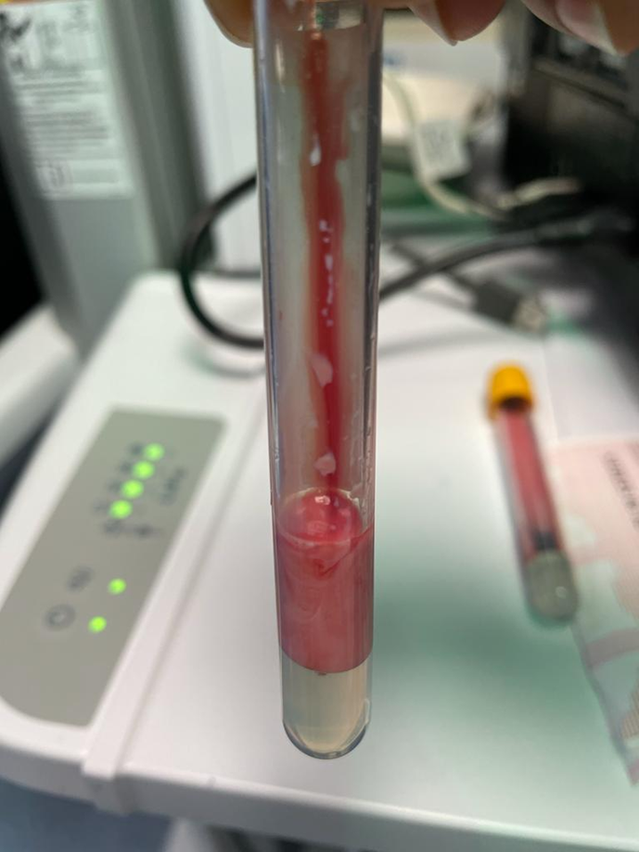
What do you think ?
Notes:
You go to the nurse station and you found the patient blood sample in this picture

Slide 10
Lipemia
Lipemia is a laboratory and clinical term describing the presence of excessive lipids mainly triglyceride-rich lipoproteins (chylomicrons and VLDL) in the blood, resulting in turbid or milky plasma and potential interference with laboratory measurements.

Slide 11

Lipid Profile Trend (mmol/L)
Total Cholesterol | HDL | LDL | Triglycerides
10.50 (H) | 0.75 (L) | 0.23 (L) | 20.94 (H)
11.30 (H) | 1.30 | 0.73 (L) | 20.40 (H)
Notes:
Normal Reference (mmol/L)
Total cholesterol: 3.20–5.20
HDL: > 0.93–1.94
LDL: 1.63–3.63
Triglycerides: 0.34–1.13
severe dyslipidemia
With predominantly hypertriglyceridemia
Total cholesterol is also significantly elevated, 2× the upper normal range, likely reflecting increased VLDL/chylomicron burden rather than true LDL elevation.
HDL is consistently low, which is typical in insulin deficiency states

Slide 12

In summary :
A 4-year-old girl with new-onset T1DM presented with mild DKA and severe hypertriglyceridemia, with no evidence of pancreatitis.
The patient was admitted as a case of newly diagnosed DM1,she was out of DKA after applying the DKA protocol. She was started on MDI .
However, what about the lipemia?

Slide 13
High lipid profile in the sitting of DKA
The cause : Secondary to reduced lipoprotein lipase activity due to severe insulin deficiency at presentation
Family History : no family history of hyperlipidemia and no stigmata of xanthoma or xanthelasma.
Labs issue : lipemia interference, the majority of her laboratory parameters were abnormal despite dilution and ultracentrifugation (calcium, sodium, hemoglobin, LFTs).

Slide 14
How lipemia alters laboratory results
Excess triglyceride-rich particles (chylomicrons/VLDL) make serum turbid (milky).
This causes:
Light scattering → photometric interference
Volume displacement → dilution artifact
Interfere with enzymatic reactions or reagent binding.
Notes:
Lipemia increases light scatter

Slide 15
laboratory results
Falsely elevated Haemoglobin, Markedly elevated MCH / MCHC, ( Not true polycythemia), lipemia artifact
Pseudohyponatremia, False low chloride, False low calcium
Calcium, Phosphate, Glucose ,Urea / Creatinine
Other Commonly affected tests: Bilirubin, AST / ALT, Amylase, Total protein, Albumin

Slide 16
What labs can you relay on ?
Blood gas analyzers: Use direct electrodes, Minimal optical interference, Not diluted
ABG/VBG Na, glucose, pH are trustworthy

Slide 17
Plan:
Recommendation: frequent monitoring of lipid profile, amylase, and lipase over the following 24 hours, then evaluation for the need for plasmapheresis
Intensive insulin therapy, IV fluids, hyperhydration, BG monitoring
Fenofibrate and omega-3
Low-fat diet
Abdominal ultrasound ( done )
The team is prepared in case plasmapheresis is required

Slide 18
Differential Diagnosis to Consider
Extremely high TG levels may suggest:
Familial chylomicronemia syndrome (Type I hyperlipoproteinemia)
LPL deficiency
ApoC-II deficiency
However:
Rapid improvement with insulin therapy
Normalization of TG levels → argues against primary genetic lipid disorders
Genetic testing may be considered if TG remains persistently elevated

Slide 19
Lipid Profile Trend Timeline
Date | Total Cholesterol | HDL | LDL | Triglycerides
Normal range (children) | < 4.4 | > 1.17 | < 2.8 | < 0.85
20/10/2021 (worst) | 9.96 mmol/L (H) | 0.49 mmol/L (L) | 0.23 mmol/L (L) | 20.40 mmol/L (H)
21/10/2021 | 10.26–13.09 mmol/L (H) | 1.09 mmol/L | 0.74–6.96 mmol/L (H) | 10.99–20.20 mmol/L (H)
22/10/2021 | 15.54 mmol/L (H) | 1.13 mmol/L | 7.08–8.92 mmol/L (H) | 11.94–16.12 mmol/L (H)
23/10/2021 | 12.79–14.24 mmol/L (H) | 1.04–1.07 mmol/L | 9.04–9.54 mmol/L (H) | 5.96–7.98 mmol/L (H)
24/10/2021 | 11.24 mmol/L (H) | 0.95 mmol/L | 8.24 mmol/L (H) | 4.52 mmol/L (H)
26/10/2021 | 10.42 mmol/L (H) | 0.99 mmol/L | 8.67 mmol/L (H) | 1.68 mmol/L (H)
31/10/2021 | 6.89 mmol/L (H) | 1.34 mmol/L | 5.25 mmol/L (H) | 0.67 mmol/L
07/11/2021 (improved) | 4.80 mmol/L | 1.49 mmol/L | 3.05 mmol/L | 0.57 mmol/L
14/11/2021 | 3.2 | 1.5 | 1.4 | 0.5
Notes:
Triglycerides: Severe elevation initially → rapid and sustained decline
Total cholesterol & LDL: Markedly elevated early → gradual normalization
HDL: Initially low → progressive improvement
Overall pattern consistent with secondary hyperlipidemia due to insulin deficiency, improving with metabolic control
With close follow-up in the pediatric clinic for diabetes management and serial lipid panel monitoring, her lipid profile normalized. Accordingly, lipid-lowering medications, which had been started on 20/10/2021, were discontinued on 14/11/2021, after a treatment duration of approximately 25 days.
Lab trend

Slide 20
Hypertriglyceridemia in DKA

Slide 21
Prevalence of Hypertriglyceridemia in DKA
Prevalence of mild hypertriglyceridemia is found in about 50~40 % of patients with diabetic ketoacidosis(DKA).
Prevalence of severe hypertriglyceridemia [TG > 22.4 mmol/L (> 1959 mg/dL)] was found in about 1–8% of adults with DKA.
Severe hypertriglyceridemia : Rare in pediatrics, mainly reported as case reports / small case series. Exact incidence in children is not well established

Slide 22
Keep in mind
Routine lipid panels are not always done at DKA presentation, so true prevalence may be underestimated, especially for mild to moderate triglyceride elevations.

Slide 23
Pathophysiology

Slide 24

Cerebral Edema ?
2023 Hansa et al. Cureus 15(9): e45777. DOI 10.7759/cureus.45777
Notes:
Insulin deficiency → ↑ lipolysis (adipose tissue) → ↑ free fatty acids → ↑ hepatic VLDL production → ↓ lipoprotein lipase activity → ↓ triglyceride clearance → accumulation of chylomicrons/VLDL → severe hypertriglyceridemia → lipemic (milky) serum
👉 ↓ HSL activity → ↓ lipolysis → ↓ free fatty acids (FFA) 👉 ↓ hepatic ketogenesis → resolution of DKA 👉 ↑ LPL activity → ↑ clearance of VLDL & chylomicrons 👉 ↓ triglyceride levels (often rapid and significant)

Slide 25
Complication

Slide 26
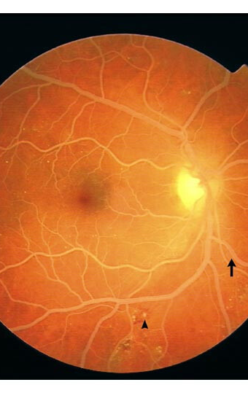
Lipemia Retinalis
Occurs in ~23% of patients with severe HTG Defined as TG > 2,000 mg/dL
Characterized by milky-appearing retinal vessels on fundoscopy
Management target: reduce TG to <500 mg/dL
Clinical implication:Fundoscopic examination is recommended in patients with markedly elevated TG
In the cited pediatric case: no retinal changes detected
Notes:
📖 Source: Hansa et al., Cureus 2023

Slide 27
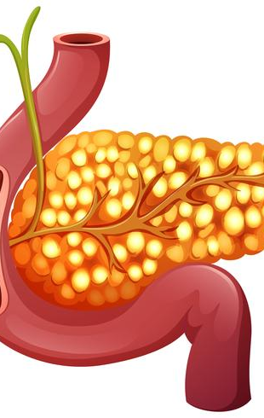
HTG-Induced Pancreatitis
Risk : ~14% of patients with severe HTG develop pancreatitis
Mechanism: Pancreatic lipase hydrolyzes TG → ↑ FFAs
FFAs:
Damage pancreatic acinar cells
Injure capillary endothelium
Trigger local inflammation
DKA further increases risk due to:
Profound insulin deficiency
Exaggerated FFA production
In the reported pediatric case:: Early DKA treatment prevented TG from reaching pancreatitis-risk thresholds

Slide 28
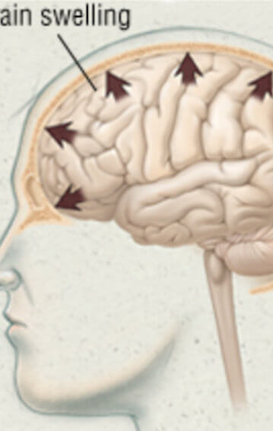
Cerebral Edema
DKA + severe HTG may increase risk of acute cerebral edema
Proposed mechanisms:
Severe dehydration → ↓ cerebral blood flow
Hyperviscosity from high TG levels
This is theoretical but clinically important, especially in children

Slide 29
Management

Slide 30
First thing is : Ruling Out Other Causes of Hypertriglyceridemia (HTG)
Confirm secondary vs primary HTG
Assess if TG elevation is transient and insulin-responsive
Improvement with insulin favors secondary HTG (DKA-related)
Evaluation Strategy
Repeat lipid profile after:
Resolution of DKA WITH Adequate insulin therapy
If TG normalize: -→ Primary genetic HTG unlikely
If TG remain elevated:-→ Consider genetic testing, Refer to lipid/metabolic specialist

Slide 31
Management of DKA-Associated Hypertriglyceridemia
Primary therapy: Standard DKA management
Insulin is the key treatment
Suppresses lipolysis
Reduces free fatty acid production
Restores lipoprotein lipase (LPL) activity
Enhances clearance of triglyceride-rich lipoproteins
Nutritional management
NPO or very low-fat diet in severe hypertriglyceridemia
Avoid simple sugars
Gradual reintroduction of feeds after TG improvement

Slide 32
Management of DKA-Associated Hypertriglyceridemia
Monitoring
Serial triglyceride levels
Serum amylase and lipase (pancreatitis surveillance)
Electrolytes and acid–base status
Fundoscopic examination if TG markedly elevated

Slide 33
Management of DKA-Associated Hypertriglyceridemia
pharmacologic lipid-lowering therapy
Not routinely required in children
Consider only if:
TG remain >1,000 mg/dL despite metabolic control
Evidence of pancreatitis
Fibrates or omega-3 fatty acids: specialist decision

Slide 34
Advanced therapies: Plasmapheresis in DKA-induced Hypertriglyceridemia ?

Slide 35
Advanced therapies: Plasmapheresis in DKA-induced Hypertriglyceridemia
When do we consider plasmapheresis?
1) If there is acute pancreatitis (HTG-AP) : Severe TG elevation (usually ≥1000 mg/dL ) PLUS Clinical/biochemical/imaging evidence of acute pancreatitis
(This is the main accepted indication)
2) Severe pancreatitis / organ failure: Consider early if pancreatitis is present with: Organ failure / shock / ICU course Severe systemic inflammation
3) TG remains extremely high despite insulin therapy : If TG does not improve adequately within ~24–48 hours Despite insulin infusion + aggressive hydration
Especially if complications develop
Notes:
In DKA-induced hypertriglyceridemia, plasmapheresis is reserved for cases with hypertriglyceridemia-induced pancreatitis or refractory/severe disease not improving with insulin and IV fluids.

Slide 36
Outcome
Triglycerides usually normalize rapidly with insulin alone
Long-term management focuses on glycemic control and diet

Slide 37
Conclusion
Always R/O secondary causes first before considering a primary cause.
Primary management focus:
Stabilize circulatory status
Correct acid–base imbalance
Use IV fluids + insulin
Close monitoring for pancreatitis risk is essential
Notes:
Possible publication bias
Severe cases with pancreatitis more likely reported
Small sample size
Limits identification of definitive risk factors
Insufficient data on:
Duration of hypertriglyceridemia
Pre-DKA TG levels

Slide 38
literature review

Slide 39
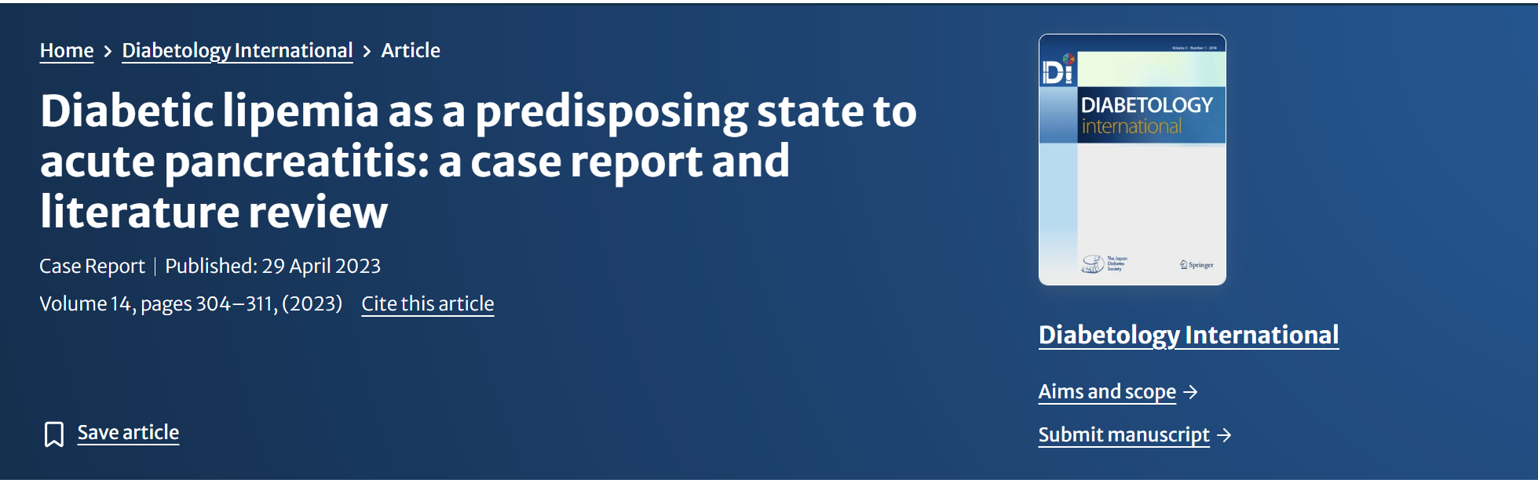
Notes:
Reviewed published pediatric and young adult cases (≤20 years) Total cases: 28, literature review
With pancreatitis: 16 cases
Without pancreatitis: 12 cases

Slide 40
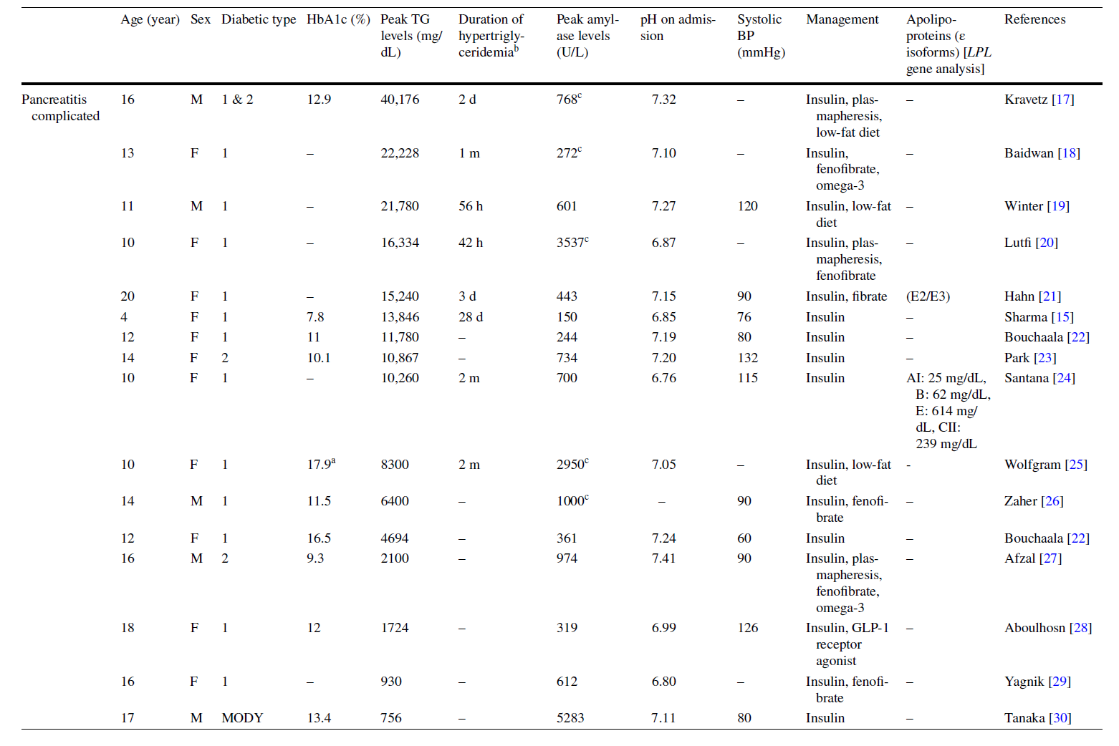

Slide 41
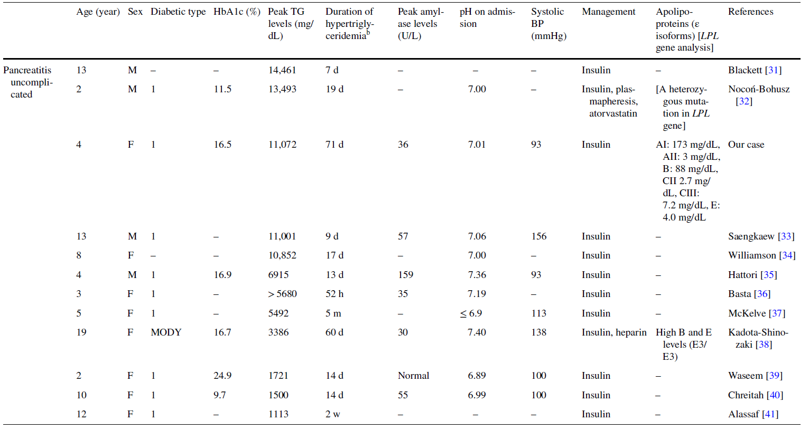

Slide 42
Management Outcomes
Most cases:
TG levels and DKA normalized with IV insulin therapy alone
Additional therapies used:
Heparin: 1 case
Increases lipoprotein lipase (LPL) activity
Lowers TG levels
No established consensus on prophylactic benefit against pancreatitis
Plasma exchange (PE): 4 cases
Role of Lipid-Lowering Therapies: Can reduce TG levels
Effectiveness in preventing pancreatitis remains unclear
Notes:
6 case lipid

Slide 43
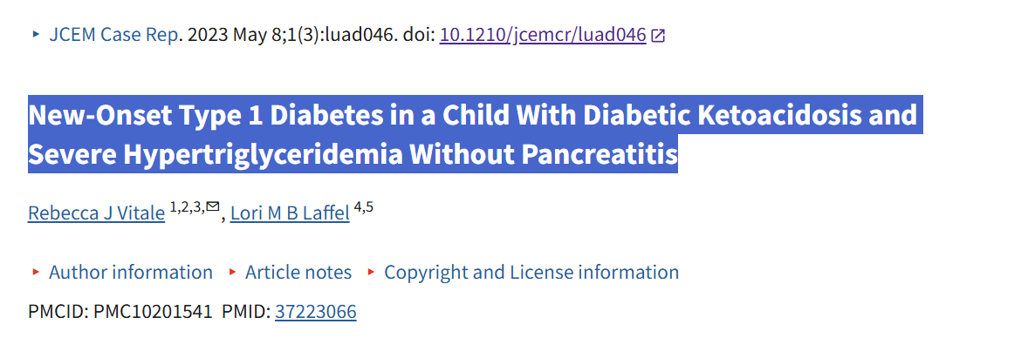

Slide 44
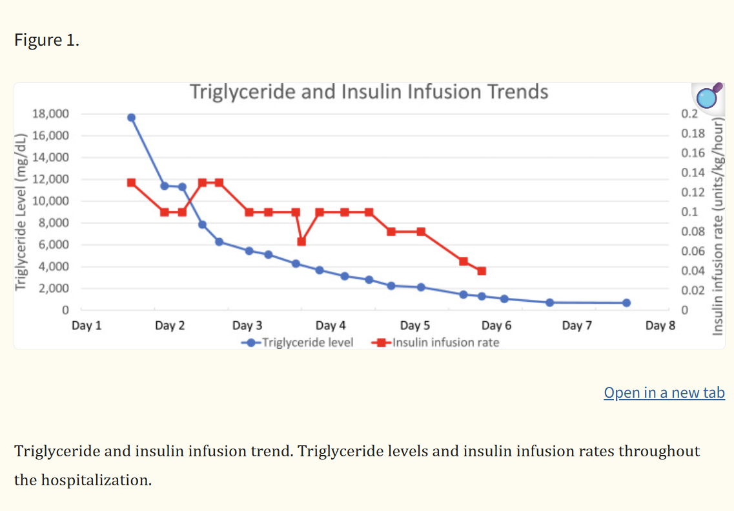

Slide 45
🔗 References
Lipemic Serum in a Child With New-Onset Type 1 Diabetes and DKA
Hypertriglyceridemia-induced acute pancreatitis – UpToDate
Pediatric Hypertriglyceridemia: Lipoprotein Metabolism, Etiology, and Management – PMC
Diabetic lipemia as a predisposing state to acute pancreatitis: A case report and literature review
Severe hypertriglyceridemia in the course of ketoacidosis in a patient with newly diagnosed type 1 diabetes mellitus (Skala-Zamorowska et al.)
Diabetic lipemia in newly diagnosed diabetes mellitus (Al Homyani et al.)
New-onset type 1 diabetes with DKA and severe hypertriglyceridemia without pancreatitis (Vitale & Laffel)
ASFA 2019 Guidelines (Therapeutic Apheresis)

Slide 46
Thank you for listing any Q

