Slide 1



A Child Who Is Always Hungry…
When should we think beyond lifestyle?
Presenter: Dr. Shahad M. Algarni
Pediatric Endocrinology and Metabolism Fellow
King Faisal Specialist Hospital and Research Center

Slide 2

The case
  A 5-year and 6-month-old male previously healthy noted to have progressive excessive weight gain starting at 2 months of age.
  He was diagnosed with central hypothyroidism.
  Recurrent PICU admissions due to severe asthma exacerbations with repeated infections.
  Obstructive sleep apnea (OSA) requiring 0.5–1 L oxygen via nasal cannula during sleep.
  The patient also reported to have hyperphagia.
  Normal developmental milestone.
  Positive consanguinity.
  The rest of history is unremarkable.

Slide 3
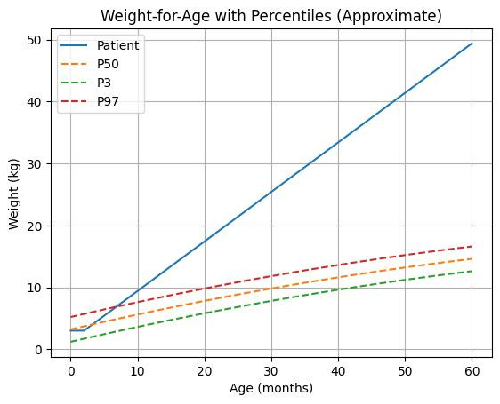
On examination:
  Vital Signs Stable and within normal limits.
  Growth Parameters
  Weight is >99th percentile for age indicating severe morbid obesity. (276% from 95tht centile). Height within upper normal limit.
  No dysmorphic feature.
Functional Status and Disability:
  Difficulty walking long distances, requires wheelchair assistance.
  Using diapers due to mobility limitation.
  Needed multiple assistive Devices.

Slide 4

Given this combination of early-onset hyperphagic obesity, central hypothyroidism, recurrent infections, and consanguinity.
What genetic disease would you prioritize?

Slide 5
The problem
Obesity ≠ always lifestyle
Rare genetic causes are underdiagnosed

Slide 6
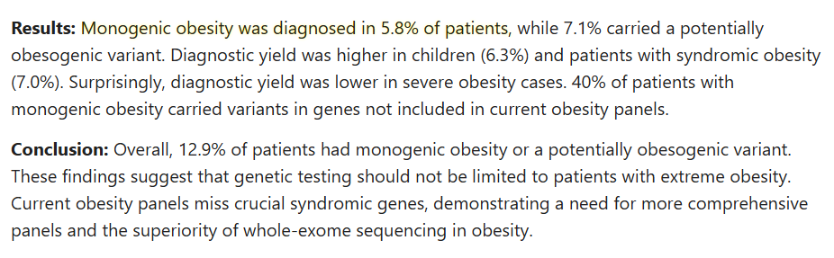
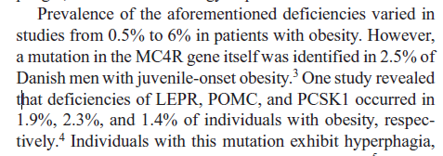
Prevalence
Huvenne, Hélène, et al. “Rare Genetic Forms of Obesity: Clinical Approach and Current Treatments in 2016.” Obesity Facts, vol. 9, no. 3, 2016, pp. 158–173
Pressley, Haley, et al. “Setmelanotide: A Novel Targeted Treatment for Monogenic Obesity.” Journal of Pharmacy Technology, vol. 38, no. 6, 2022, pp. 368–373.
Ferraz Barbosa, Bárbara, et al. “Efficacy and Safety of Setmelanotide, a Melanocortin-4 Receptor Agonist, for Obese Patients: A Systematic Review and Meta-Analysis.” Journal of Personalized Medicine, vol. 13, no. 10, 2023, p. 1460.
Akbari P, et al. Exome-wide analysis identifies monogenic causes of obesity in a large cohort. Int J Obes (Lond). 2025;49:1819–1830.

Slide 7

Genetic obesity

Slide 8

  Monogenic obesity is obesity caused by a mutation in a single gene that plays a critical role in appetite regulation and energy balance.
  Polygenic obesity results from the combined effect of multiple genes, each contributing a small risk, interacting with environmental factors.

Slide 9
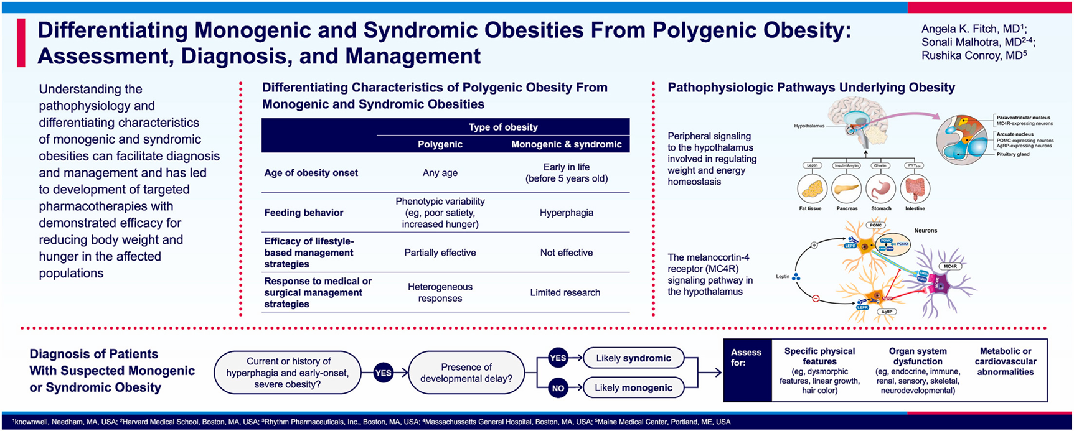


Slide 10
Back to our case...
Investigation:
All his investigated labs were within acceptable limit for age including HBA1C, Lipid and hepatic profile.
Genetic diagnosis
Leptin Receptor (LEPR) Homozygous Mutation.

Slide 11
Let’s talk physiology
Hunger-satiety
and
Energy homeostasis

Slide 12
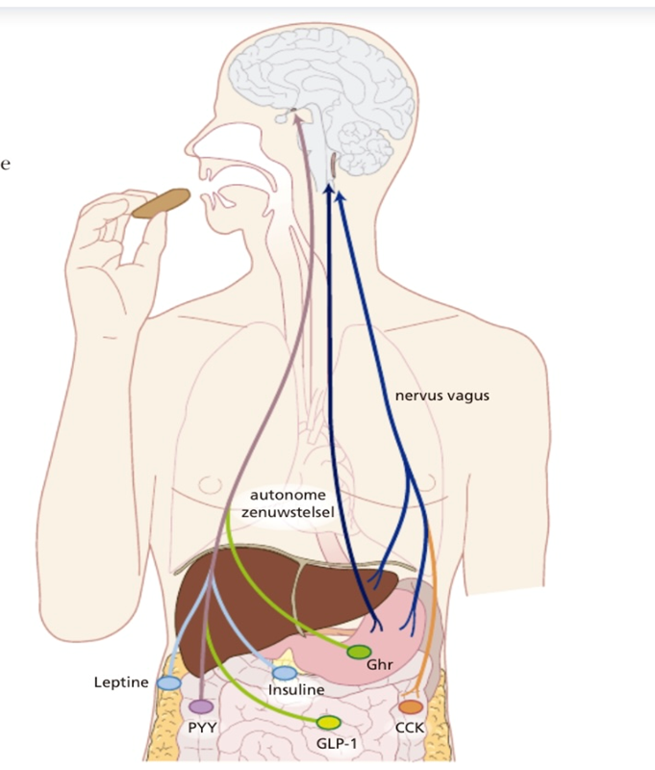
  Afferent signals from the periphery deliver energy status information to the brain, then delivers efferent signals to modulate energy intake and expenditure.
  The hypothalamus integrates peripheral signals: Short-term signals.
  Long-term signals (energy stores) Reflects body fat stores, Suppresses appetite, and Increases energy expenditure.
Van den Akker, E. L. T. (2013). Eetlustregulatie. Kinderen & Wetenschap.

Slide 13
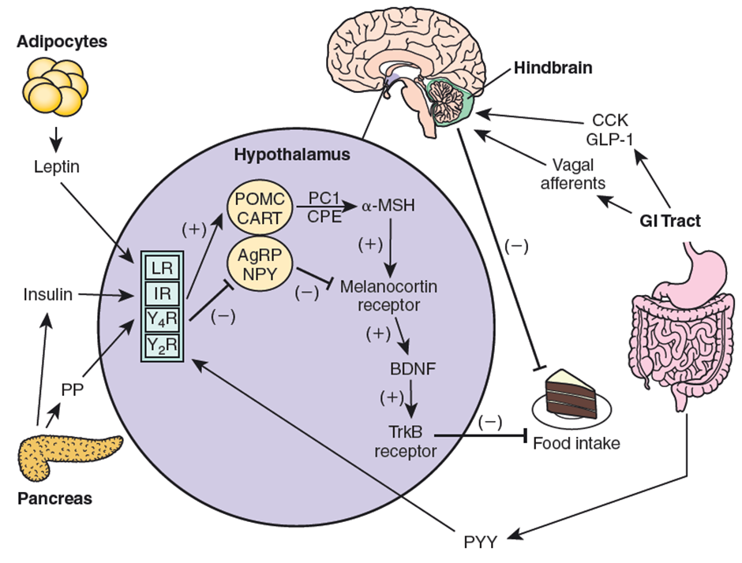
The hypothalamus and energy homeostasis.
Orexigenic (Appetite-stimulating)
- Neuropeptide Y (NPY)
- Agouti-related peptide (AgRP)
Anorexigenic (Appetite-suppressing)
- Proopiomelanocortin (POMC)
- α-Melanocyte-Stimulating Hormone (α-MSH)
- Melanocortin-4 receptors (MC4R)
Sperling, M. A. (Ed.). (2020). Sperling Pediatric Endocrinology (5th ed.). Elsevier.

Slide 14
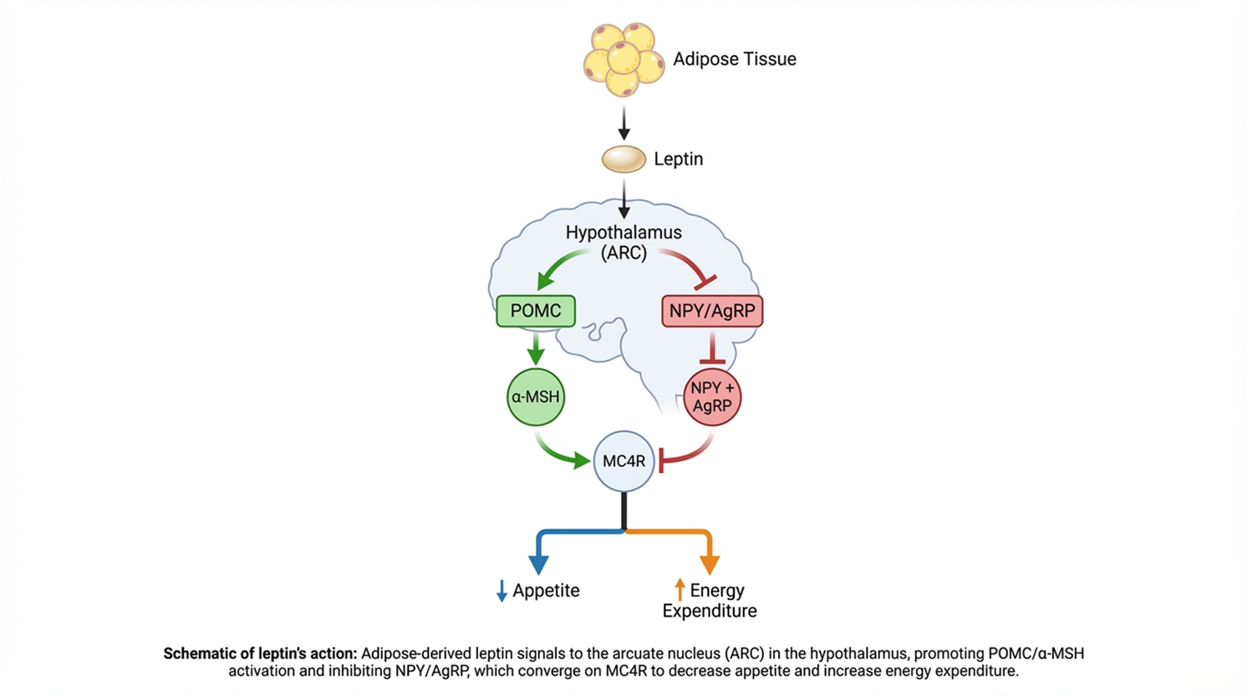

Leptin melanocortin Pathway Defects

Slide 15
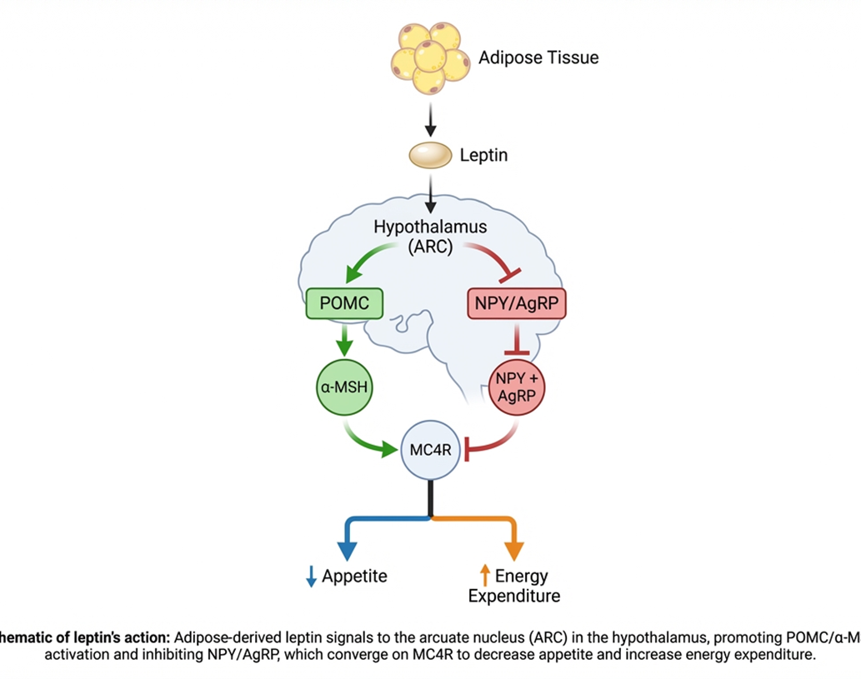

Leptin Deficiency
Defect: Leptin absent or nonfunctional
Key features:
  Severe early-onset obesity
  Extreme hyperphagia (from infancy)
  Hypogonadotropic hypogonadism
  Central hypothyroidism
  Immune dysfunction (↓ T-cell function)
Diagnosis: Very low/undetectable leptin
Treatment: Recombinant leptin (curative)
Huvenne, H., Dubern, B., Clément, K., & Poitou, C. (2016). Rare genetic forms of obesity: Clinical approach and current treatments in 2016. Obesity Facts, 9(3), 158–173. https://doi.org/10.1159/000445061

Slide 16
Leptin Receptor Deficiency Defect:
Leptin present but receptor nonfunctional
Key features:
  Severe obesity + hyperphagia
  Delayed puberty
  Immune dysfunction (Frequent infection 52%)
  High leptin levels
Diagnosis: Genetic testing (leptin levels not reliable)
Treatment:
  Leptin ineffective
  Setmelanotide
Huvenne, H., Dubern, B., Clément, K., & Poitou, C. (2016). Rare genetic forms of obesity: Clinical approach and current treatments in 2016. Obesity Facts, 9(3), 158–173. https://doi.org/10.1159/000445061

Slide 17

POMC Deficiency
Defect: Cannot produce α-MSH or ACTH
Key features:
  Severe obesity
  Red hair / fair skin (↓ MC1R signaling)
  Adrenal insufficiency (↓ ACTH → ↓ cortisol)
Treatment:
  Glucocorticoid replacement
  Setmelanotide
Huvenne, H., Dubern, B., Clément, K., & Poitou, C. (2016). Rare genetic forms of obesity: Clinical approach and current treatments in 2016. Obesity Facts, 9(3), 158–173. https://doi.org/10.1159/000445061

Slide 18
Diagnosis

Slide 19
Diagnostic Recommendations for Genetic Obesity
(Endocrine Society Clinical Practice Guideline)
When to Suspect Genetic Obesity
  Early-onset obesity → less than 5 years.
  Severe hyperphagia (extreme drive to eat).
  Family history of severe/extreme obesity BMI >40.
  Clinical features of genetic/syndromic obesity.
Endocrine Society. (n.d.). Pediatric obesity—Assessment, treatment, and prevention: Clinical practice guidelines. Retrieved April 18, 2026

Slide 20
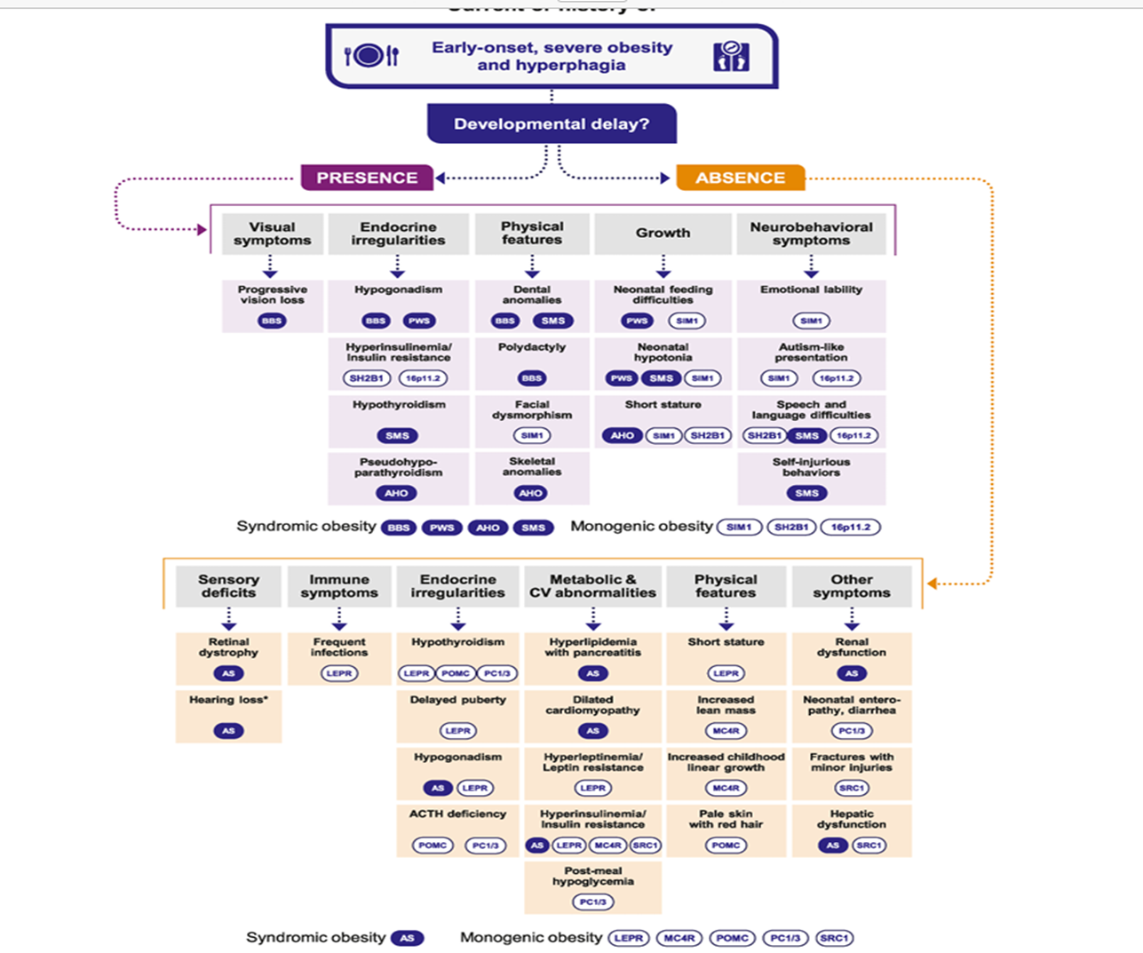
Diagnostic algorithm for patients with suspected monogenic or syndromic obesity
Fitch AK, Malhotra S, Conroy R. Differentiating monogenic and syndromic obesities from polygenic obesity: Assessment, diagnosis, and management. Obesity Pillars. 2024;11:100110. doi:10.1016/j.obpill.2024.100110

Slide 21

Management

Slide 22

The guideline emphasizes lifestyle changes as the foundation, limited medication use, and selective surgery—while acknowledging that specialized treatments for genetic obesity are still evolving.

Slide 23
Targeted Therapy

Slide 24
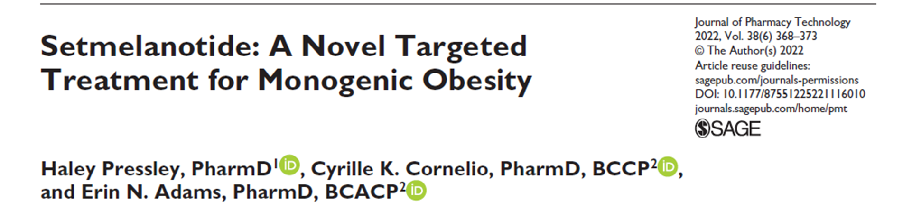

Slide 25
Setmelanotide
  Setmelanotide is a MC4R agonist indicated for chronic weight management in patients ≥ 6 year with obesity due to pathogenic deficiencies in POMC, PCSK1, or LEPR.
  It was approved by the Food and Drug Administration (FDA) in November 2020 for patients with obesity.
Pressley, H., Cornelio, C. K., & Adams, E. N. (2022). Setmelanotide: A novel targeted treatment for monogenic obesity. Journal of Pharmacy Technology, 38(6), 368–373. https://doi.org/10.1177/87551225221116010

Slide 26
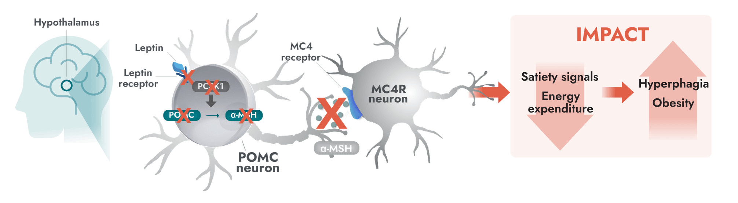
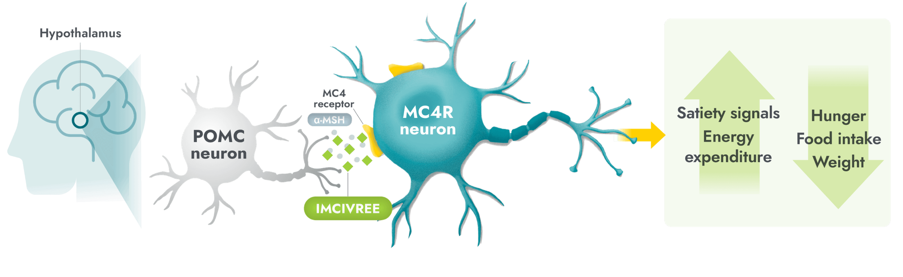

Slide 27
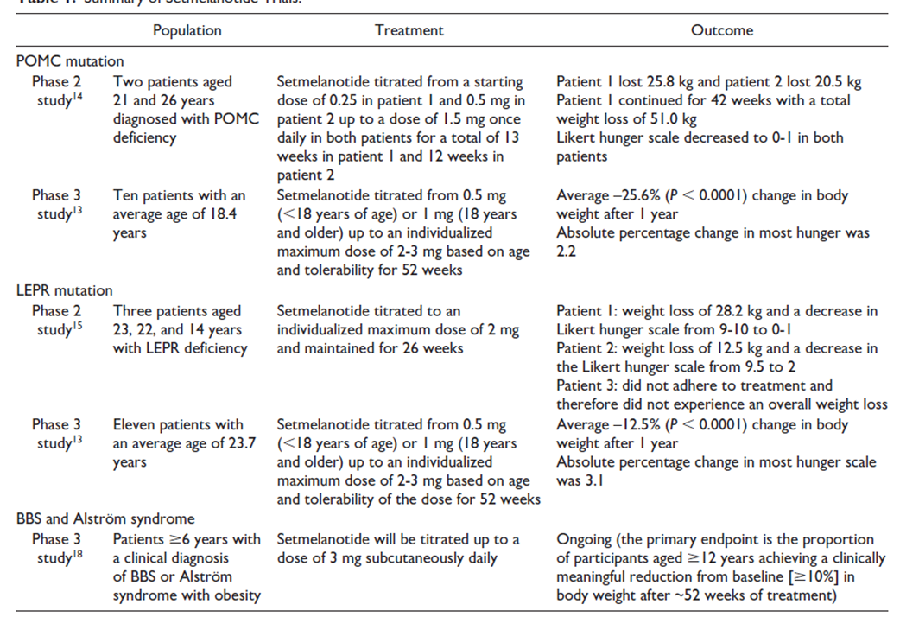
Setmelanotide Trials
Pressley, H., Cornelio, C. K., & Adams, E. N. (2022). Setmelanotide: A novel targeted treatment for monogenic obesity. Journal of Pharmacy Technology, 38(6), 368–373. https://doi.org/10.1177/87551225221116010

Slide 28

Ferraz Barbosa, B. et al. (2023) ‘Efficacy and safety of setmelanotide, a melanocortin-4 receptor agonist, for obese patients: A systematic review and meta-analysis’, Journal of Personalized Medicine, 13(10), p. 1460. doi:10.3390/jpm13101460.

Slide 29
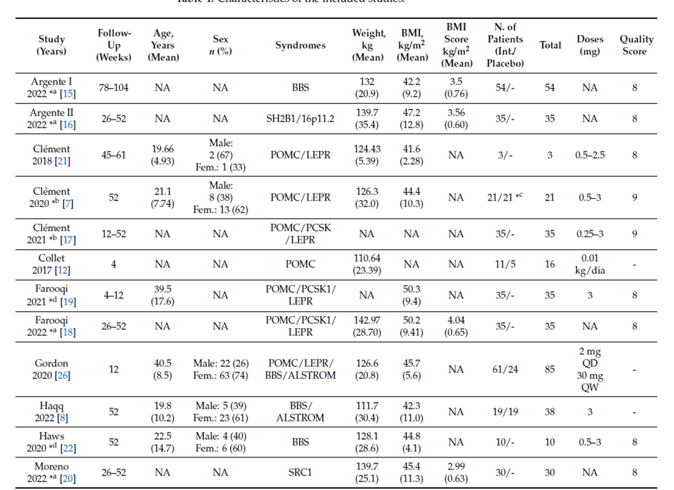
Ferraz Barbosa, B. et al. (2023) ‘Efficacy and safety of setmelanotide, a melanocortin-4 receptor agonist, for obese patients: A systematic review and meta-analysis’, Journal of Personalized Medicine, 13(10), p. 1460. doi:10.3390/jpm13101460.

Slide 30
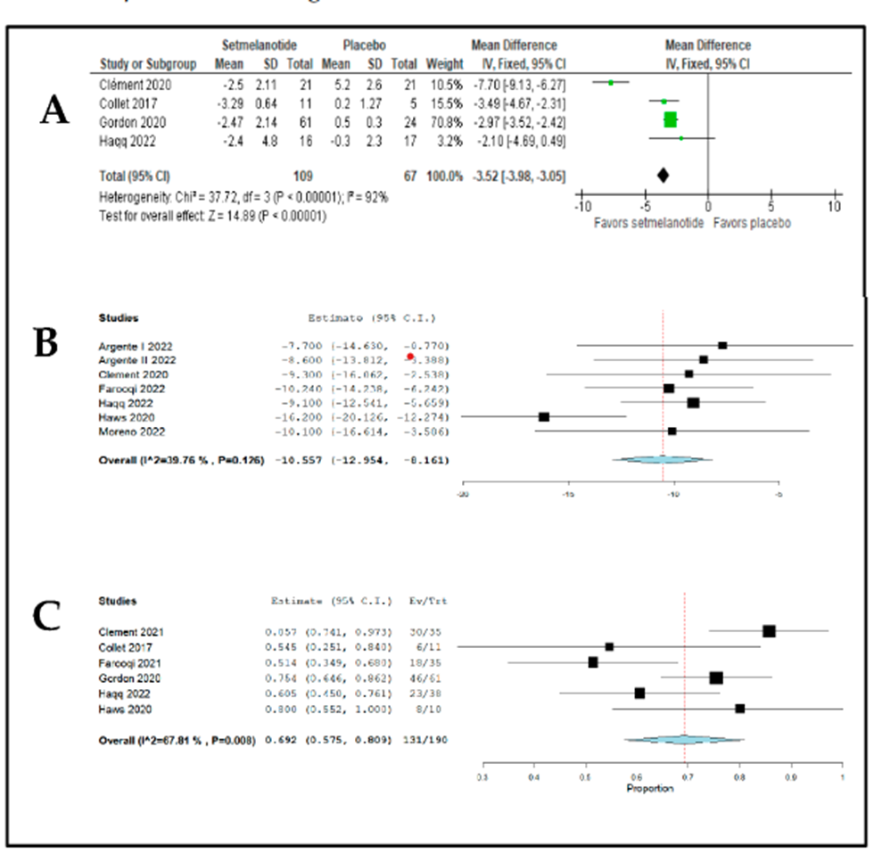
Ferraz Barbosa, B. et al. (2023) ‘Efficacy and safety of setmelanotide, a melanocortin-4 receptor agonist, for obese patients: A systematic review and meta-analysis’, Journal of Personalized Medicine, 13(10), p. 1460. doi:10.3390/jpm13101460.

Slide 31
Advesre effect | Frequency | Severity | Clinical Note
Skin hyperpigmentation | Very common 50-70% | Mild to Moderate | Due to melanocortin receptor stimulation Reversible
Injection site reactions | Very Common | Mild | Pain, Erythmema, Pruruitus
Nasuea | Common | Mild | - Usually transient
Vomiting | Common | Mild | - Improve over time
Diarrhhea | Common | Mild | - Self limited
Ferraz Barbosa, B. et al. (2023) ‘Efficacy and safety of setmelanotide, a melanocortin-4 receptor agonist, for obese patients: A systematic review and meta-analysis’, Journal of Personalized Medicine, 13(10), p. 1460. doi:10.3390/jpm13101460.

Slide 32
Our trial at KFSH&RC
  It involved initiating setmelanotide for our patient at age of 5 year and 6 month who’s known Leptin Receptor (LEPR) Homozygous Mutation.
  A starting dose of 0.5 mg administered subcutaneously once daily.
  The dose was gradually titrated up to 3 mg, with regular assessments of tolerability, side effects, and clinical response.

Slide 33
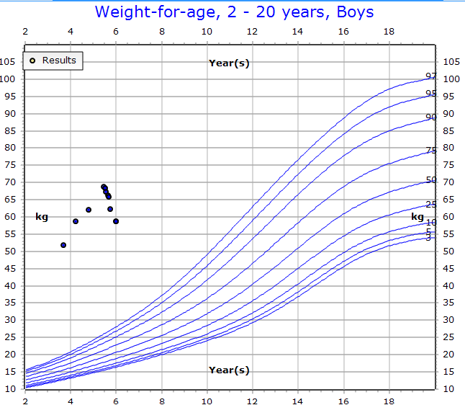
Setmelanotide

Slide 34
Adverse effects:
  Hyperpigmentation.
  Pain and bruising at the injection site.
  Mild mood changes, though these were not severe.
  Nausea and diarrhea, occurring on the day of injection.

Slide 35
Take Home Messages
  Monogenic obesity is a biologically driven disease, not simply behavioral or environmental.
  Early genetic diagnosis is crucial to identify patients who may benefit from targeted therapy.
  The MC4R pathway is a central therapeutic target in energy balance regulation.
  Setmelanotide represents a paradigm shift toward precision therapy in rare obesity.
  Despite progress, access, cost, and genotype eligibility remain important limitations.

Slide 36

Thank You
Let’s connect!
Email: Shahadgarni95@gmail.com

