Slide 1



Type 1 Diabetes Screening Program at KFSHRC
Afaf Alsagheir, MD
Professor of Pediatrics, KFSHRC-Riyadh]
Pediatric Endocrinology Challenging cases , 24-25 April 2026
MAT-SA-2600236- V1 – April 2026

Slide 2
Disclosures
Co-Investigator in industry trials for Vertex 880, 264
Speaker fees: Sanofi, Dexcom
Advisory board: Sibionics, Syai, Novonordisk

Slide 3

A sudden diagnosis —
why screening matters
A 6-year-old girl presented to hospital with diabetic ketoacidosis (DKA). Blood glucose severely elevated, HbA1c 14%, pH 6.8.
ICU admission for 2 days.
At home: hypoglycemia, anxiety, family struggling to adapt.
Mother: anxious, in denial, overwhelmed — daily phone calls to clinic.
Full adaptation to new reality took weeks.
Early screening could prevent this journey.

Slide 4


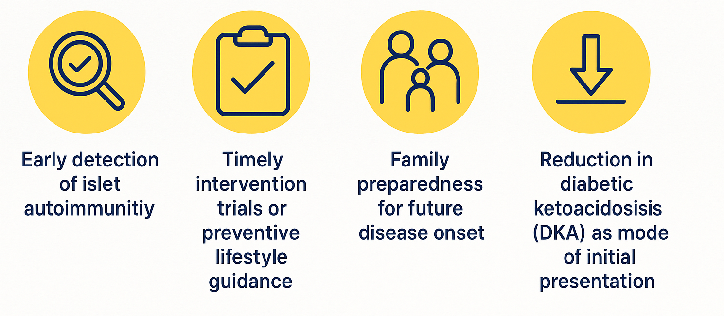

Slide 5



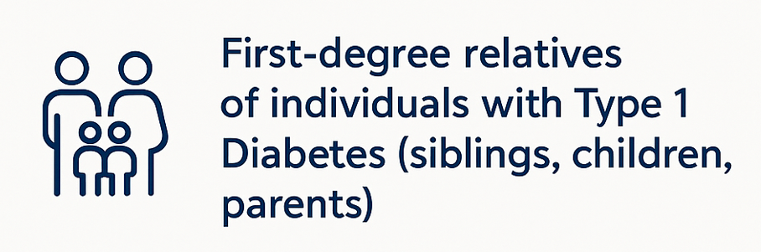
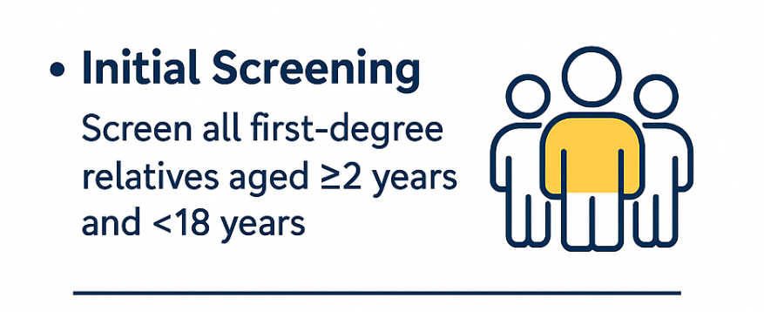
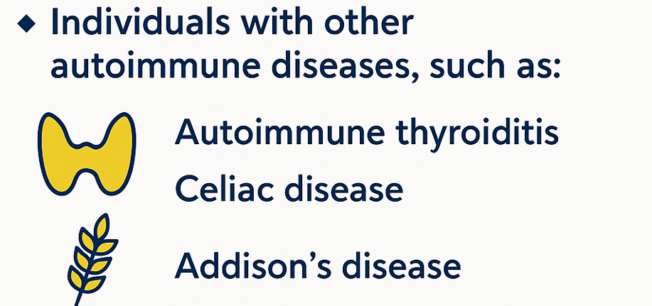

Slide 6
Our screening workflow
Step 1 — Autoantibody panel
Anti-GAD antibodies
Anti-IA2 antibodies
Anti-IAA antibodies
Anti-ZnT8 antibodies
2–3 weeks turnaround
If ≥2 antibodies positive
Step 2 — Glycemic staging
HbA1c
Random glucose
±Continuous glucose monitor (CGM)

Slide 7

T1D screening and follow-up
Stage | Description
Stage 0 | 0–1 autoantibody, normal glucose
Stage 1 | ≥2 antibodies, normoglycemia
Stage 2 | ≥2 antibodies, mild dysglycemia
Stage 3 | Diabetes symptoms appear
Age | Stage 1 | Stage 2
<3 years | Every 3 months | Every 3 months
3–9 years | Every 6 months | Every 3 months
≥9 years (<18) | Every 12 months | Every 6 months

Slide 8
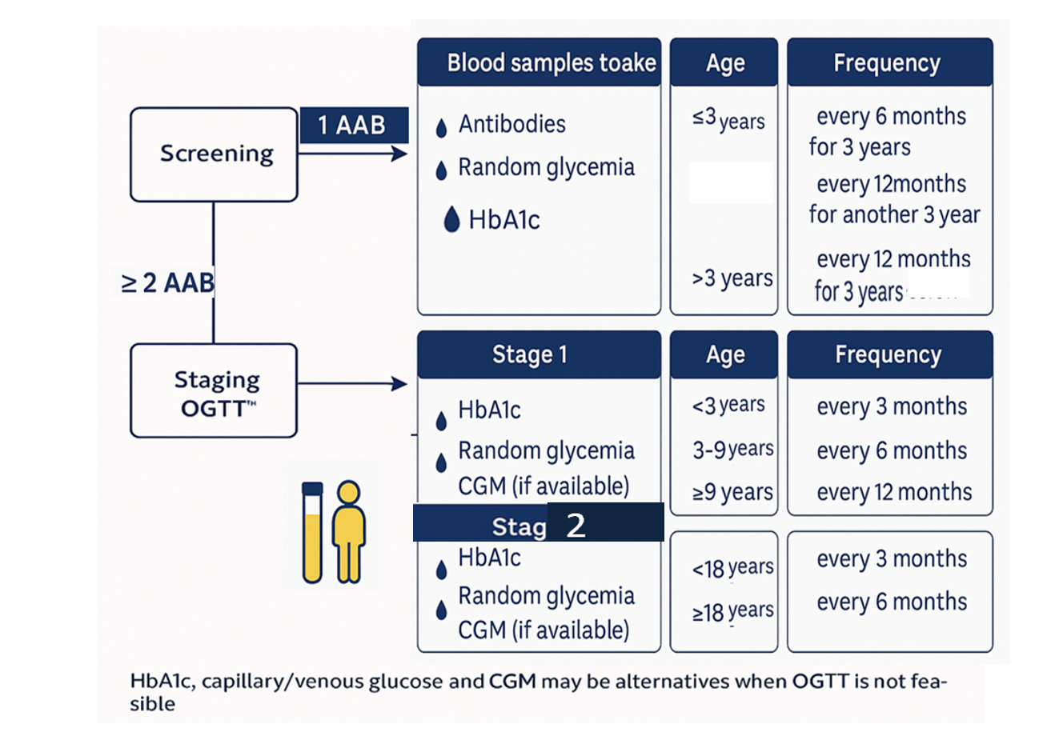
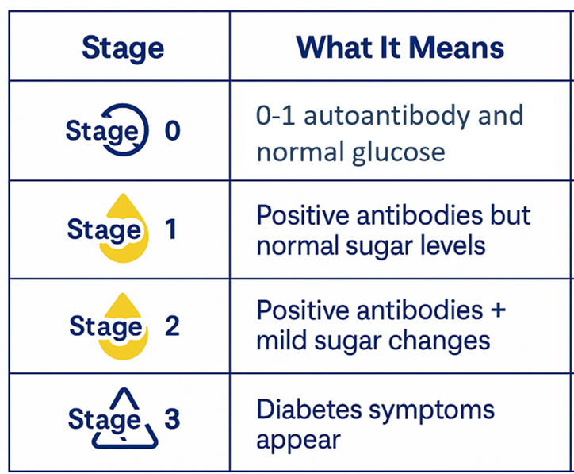
T1D screening and follow-up
If stage 0 consider repeating 2-3 years till age 18

Slide 9
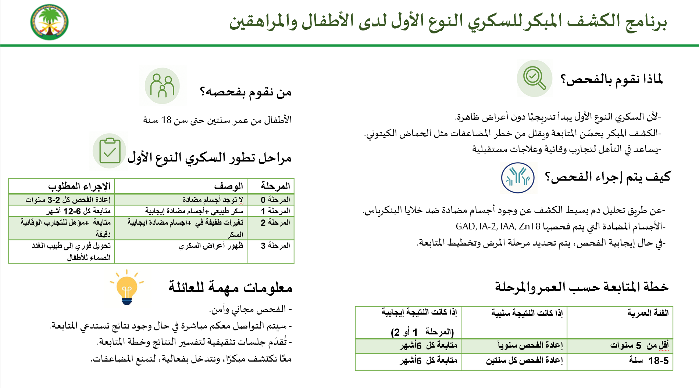

Slide 10

Acceptance rate for screening
85–90%
acceptance rate among eligible families
High acceptance attributed to personalized communication and physician endorsement.

Slide 11
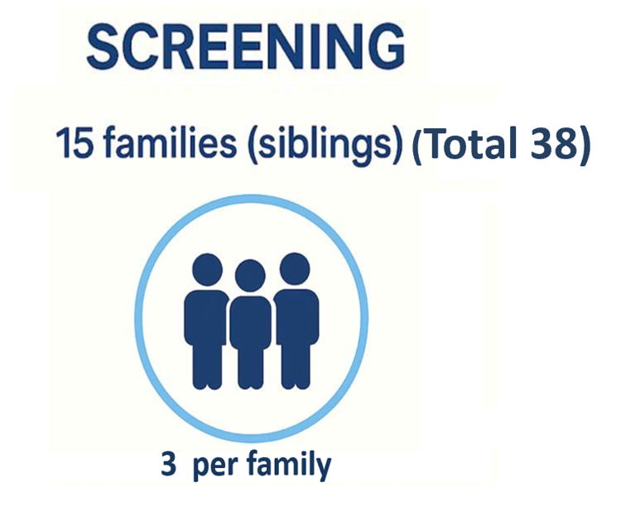



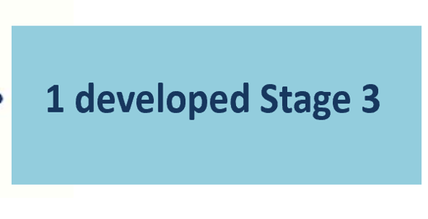
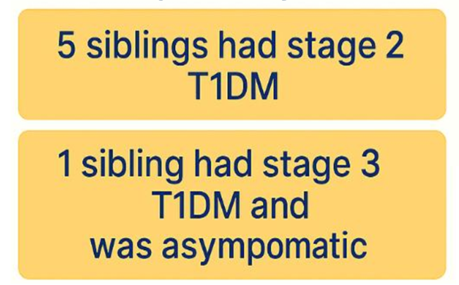
26 % positive
15% were stage 2 or 3
4 siblings had stage 1
TIDM

Slide 12

Our first screening cohort
Follow-up at 3 months
Screening
Of the antibody-positive siblings:
4 at Stage 1
5 at Stage 2
1 at Stage 3 (asymptomatic)
1 progressed from Stage 2 to Stage 3 at 3 months
15 families, 38 siblings screened
26%
autoantibody-positive
15%
Stage 2 or 3

Slide 13
Specialised clinic for T1DM screening
Families referred from Diabetes Clinic
First visit (introduce screening)
Waiting for results
Concerns?
Virtual meeting with psychologist
Counseling for the result
Follow-up

Slide 14


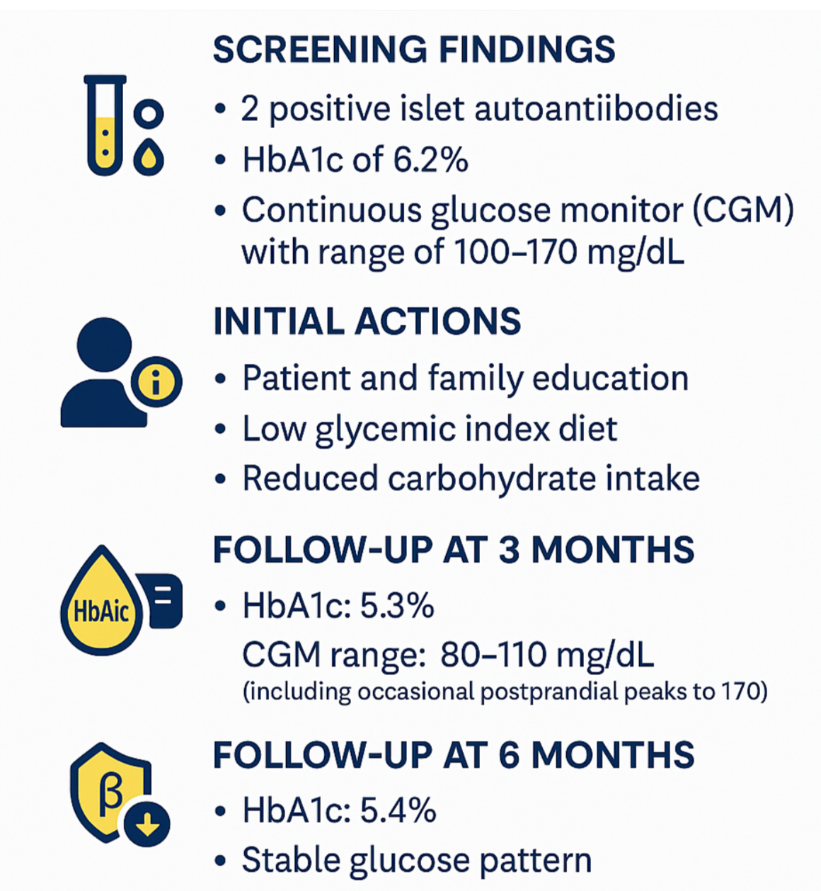
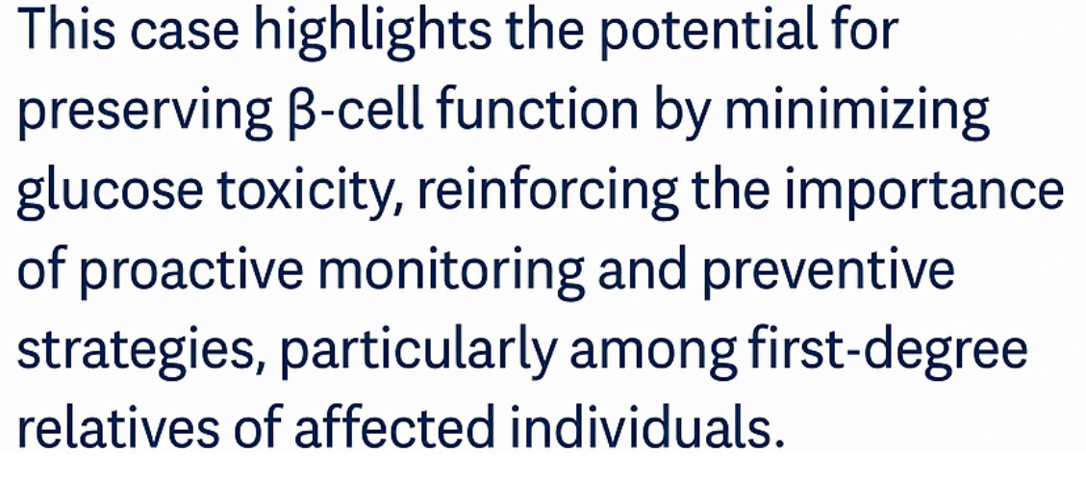

Slide 15
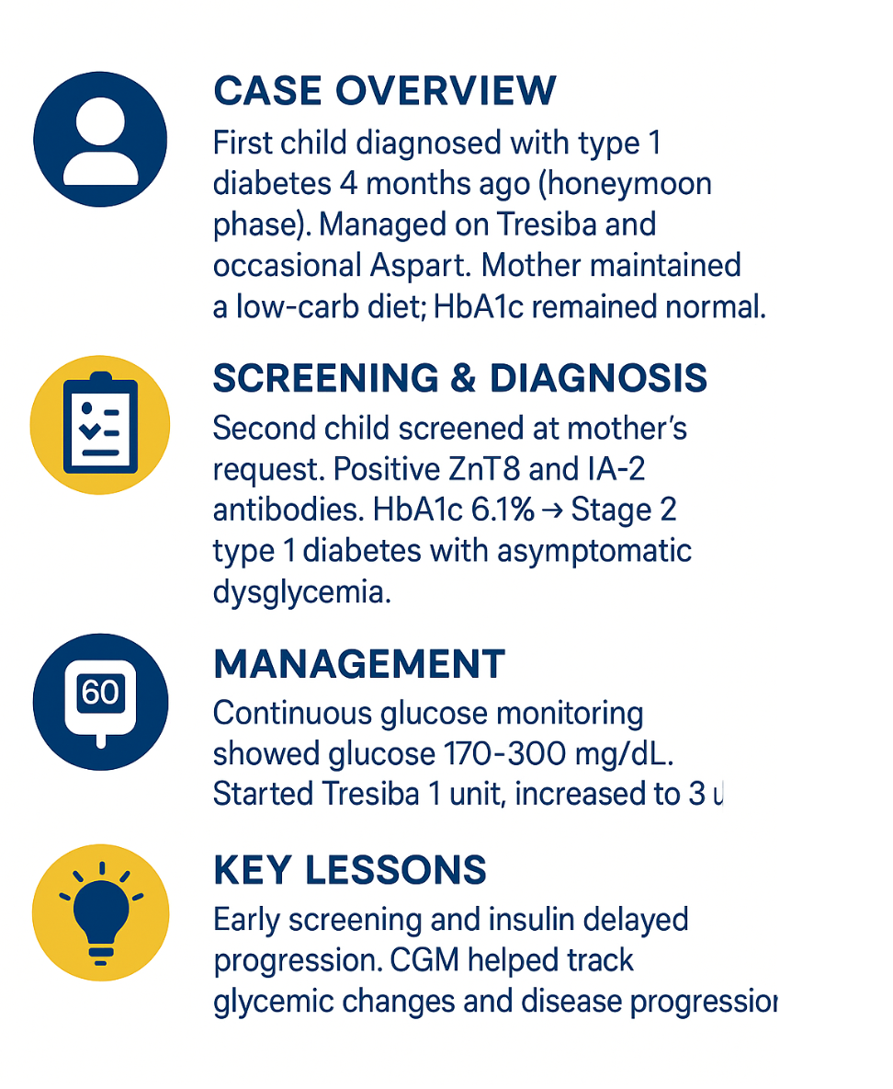
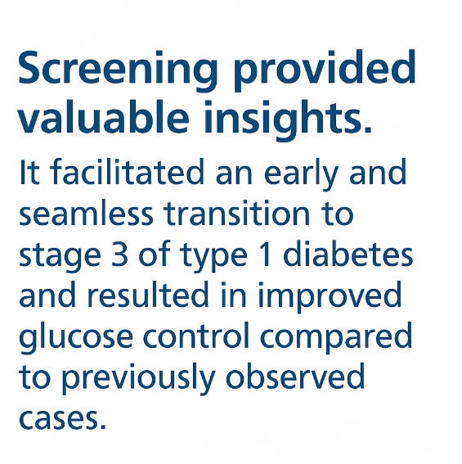

Slide 16


The journey of screening
Detection
Follow-up
Counsel
Support
≥2 antibodies
±dysglycemia
(random glucose, HbA1c, or CGM)
3 months
HbA1c, random glucose, ±CGM
Psychologist and educator
Psychologist, educator, and endocrinologist

Slide 17
Lessons learned from screening
Case 1 — early dietary intervention
Case 2 — early insulin initiation
Screening findings
2 positive islet autoantibodies; HbA1c 6.2%; CGM 100–170 mg/dL
Case overview
First child diagnosed with T1D 4 months prior in honeymoon phase, managed on Tresiba + occasional Aspart, HbA1c normal
Initial actions
Patient and family education; low glycemic index diet; reduced carbohydrate intake
Screening and diagnosis
Second child screened at mother's request; positive ZnT8 and IA-2 antibodies; HbA1c 6.1% → Stage 2 T1D with asymptomatic dysglycemia
Follow-up at 3 months
HbA1c 5.3%; CGM 80–110 mg/dL (occasional peaks to 170)
Management
CGM 170–300 mg/dL; started Tresiba 1 unit, titrated to 3 units
Key lessons
Early screening and insulin delayed progression; CGM tracked glycemic changes and disease progression
Follow-up at 6 months
HbA1c 5.4%; stable glucose pattern
Key learning — early screening enables individualized intervention before symptomatic disease.

Slide 18
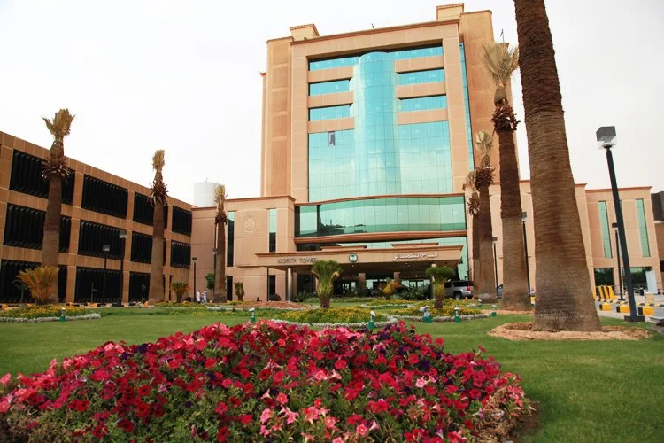
Teplizumab Experience at KFSHRC
First 4 pediatric teplizumab cases in Saudi Arabia

Slide 19
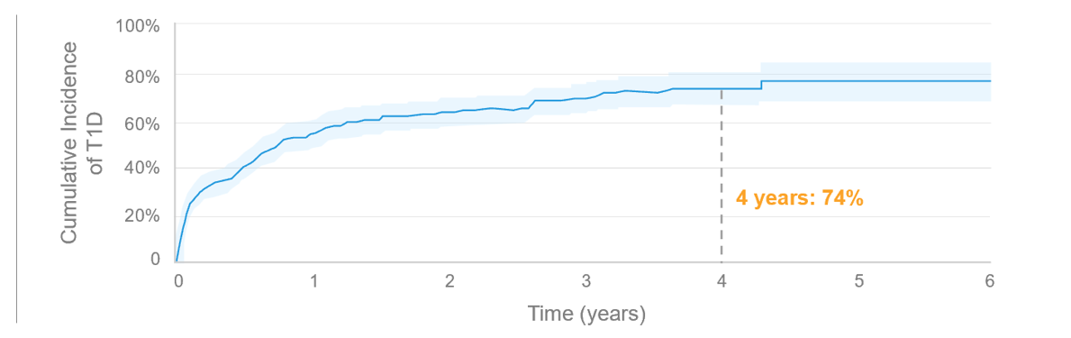
T1D progresses in 3 stages
No Diabetes
0–1 autoantibodies
Stage 1
≥2 autoantibodies, normoglycemia
Stage 2
≥2 autoantibodies, dysglycemia
Stage 3
Insulin-dependent T1D
Lifetime risk approaches 100%
74%
4-year risk of progression from Stage 2 to Stage 3.

Slide 20
Teplizumab — eligibility, protocol, side effects
Eligibility
Protocol
Side effects
Age ≥8 years
Stage 2 T1D
Medical evaluation
Adequate organ function, normal blood counts, no active infections
Exclusions
Active infection, immunodeficiency
Family/patient preparedness
Dosing schedule
Day 1: 65 µg/m²
Day 2: 125 µg/m²
Day 3: 250 µg/m²
Day 4: 500 µg/m²
Days 5–14: 1,030 µg/m²
Route
IV infusion (once daily)
Immunizations
Avoid live vaccines before/during/after
Monitoring
Infection, blood counts, liver enzymes
Rash
Decreased white blood cell count (lymphopenia)
Headache
Fatigue
Nausea
Diarrhea

Slide 21
Our 1st two teplizumab candidates
Patient 1
Patient 2
Age: 8 years girl
Referral: From King Khaled University Hospital for positive diabetes autoantibodies
Investigations:
HbA1c 5.9%
OGTT 2-hr plasma glucose 7.9 mmol/L
CGM: peak postprandial glucose 130–150 mg/dL
Diagnosis: Stage 2 T1D (two positive antibodies, dysglycemia on OGTT and CGM)
Age: 10 years male
Referral: Incidental HbA1c 5.7% during acute illness
Investigations:
All four autoantibodies positive (IAA, GAD, IA-2, ZnT8)
OGTT 2-hr plasma glucose 6.9 mmol/L
Diagnosis: Stage 2 T1D

Slide 22
Delivery and monitoring
Premedication — Acetaminophen ± antihistamine per infusion-day protocol.
Safety and outcomes
Both patients tolerated the full course.
Transient lymphopenia observed.
● Mild rash in 1 patient.
● No serious adverse events.
Both remain in Stage 2 T1D under close follow-up with periodic CGM, HbA1c, and C-peptide evaluation.
On-therapy monitoring — Daily vitals; CBC (watching for lymphopenia) and LFTs (ALT/AST) at baseline, mid-course, end of course; glucose/CGM review.
Post-therapy follow-up — Clinic visits at weeks 2, 4, 12, then every 3–6 months with HbA1c, OGTT or CGM, and stimulated C-peptide if feasible.
Vaccinations — Defer live vaccines during treatment.

Slide 23
Closing remarks
The successful completion of the first 4 teplizumab cases at KFSHRC represents a new era of preventive therapy for type 1 diabetes in Saudi Arabia.
Systematic expansion
Registry development
Regional collaboration
Scale to more KFSHRC cases
Track outcomes prospectively
Serve as national referral hub
The program aims to establish KFSHRC as a national referral and research hub for early-stage T1D immunotherapy.

Slide 24



The journey of T1DM care at KFSH&RC
Early detection
Intervention
Comprehensive care
Future directions
≥2 antibodies detected
Follow-up in 3 months with HbA1c, random glucose, ±CGM
Dysglycemia identified
Counsel by endocrinologist and psychologist
Stage 3 diabetes
High-technology diabetes care
Stem cell and cellular therapy
Trials for adults

Slide 25
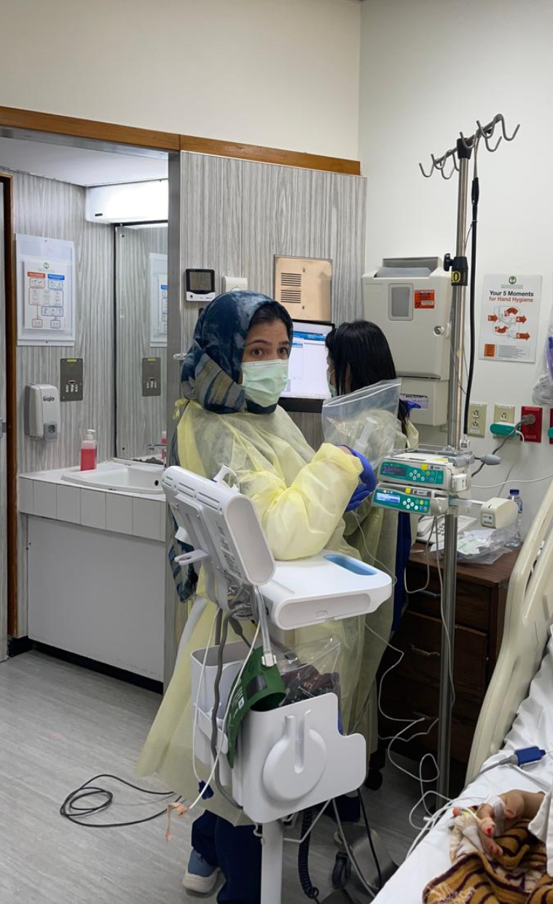

Acknowledgements
We gratefully acknowledge:
Our patients — for their courage in being among the first to receive this treatment
Pharmacy team — for their vital support in obtaining the medication
[KFSHRC institutional photo —
use consented team photo or campus photo]
Nurses in B3 — for their dedication and continuous support throughout the journey
Our fellows — for their commitment in delivering clinical care and learning this novel therapy

Slide 26

[50-year mark]
Thank you
asagheir@kfshrc.edu.sa

Slide 27
Selected Safety Information. These highlights do not include all the information needed to use TZIELD safely and effectively. Before prescribing TZIELD™ (teplizumab-mzwv) see full prescribing information. INDICATIONS AND USAGE: TZIELD is a CD3-directed antibody indicated to delay the onset of Stage 3 type 1 diabetes (T1D) in adults and pediatric patients aged 8 years and older with Stage 2 T1D. DOSAGE AND ADMINISTRATION • Confirm Stage 2 T1D by documenting at least two positive pancreatic islet autoantibodies in those who have dysglycemia without overt hyperglycemia using an oral glucose tolerance test (OGTT) or alternative method if appropriate and OGTT is not available. • In patients who meet criteria for a diagnosis of Stage 2 type 1 diabetes, ensure the clinical history of the patient does not suggest type 2 diabetes. • Prior to initiating TZIELD, obtain a complete blood count and liver enzyme tests. Use of TZIELD is not recommended in patients with certain laboratory abnormalities. • Must dilute TZIELD in 0.9% Sodium Chloride Injection, USP. See full prescribing information for detailed preparation and administration instructions. • Premedicate with: (1) a nonsteroidal anti-inflammatory drug (NSAID) or acetaminophen, (2) an antihistamine, and/or (3) an antiemetic before each TZIELD dose for at least the first 5 days of the 14-day treatment course. • Administer TZIELD by intravenous infusion (over a minimum of 30 minutes) once daily for 14 days. See full prescribing information for the dosing schedule. Recommended Dosage and Administration: Administer TZIELD by intravenous infusion (over a minimum of 30 minutes), using a body surface area-based dosing, once daily for 14 consecutive days as follows: Day 1: 65 mcg/m2. Day 2: 125 mcg/m2. Day 3: 250 mcg/m2. Day 4: 500 mcg/m2. Days 5 through 14: 1,030 mcg/m2. Do not administer two doses on the same day. Recommendations Regarding Missed Dose(s) If a planned TZIELD infusion is missed, resume dosing by administering all remaining doses on consecutive days to complete the 14-day treatment course. DOSAGE FORMS AND STRENGTHS: Injection: 2 mg per 2 mL (1 mg/mL) single-dose vial. WARNINGS AND PRECAUTIONS • Cytokine Release Syndrome (CRS): Premedicate, monitor liver enzymes, discontinue in those that develop elevated ALT or AST more than 5 times the upper limit of normal, and if severe CRS develops consider temporarily pausing dosing. • Serious Infections: Use of TZIELD is not recommended in patients with active serious infection or chronic infection. Monitor for signs and symptoms of infection during and after TZIELD treatment. If a serious infection develops, discontinue TZIELD. • Lymphopenia: Monitor white blood cell counts during the treatment period. If prolonged severe lymphopenia (10%) were lymphopenia, rash, leukopenia and headache. USE IN SPECIFIC POPULATIONS• Pregnancy: May cause fetal harm. • Lactation: A lactating woman may consider pumping and discarding breast milk during and for 20 days after TZIELD administration. PHARMACOLOGICAL PROPERTIES: CD3-directed monoclonal antibody ATC Code: A10XX01. MARKETING AUTHORIZATION HOLDER: Sanofi Arabia LTD. LEGAL CATEGORY: Medicinal product subject to medical prescription. For full prescribing information please refer to the full SmPC dated March 2025 before prescribing Tzield to your patient. .

Slide 28
Sanofi Greater Gulf MCO
To report any side effect(s): Saudi Arabia: The National Pharmacovigilance and Drug Safety Centre (NPC)
SFDA call center : 19999
E-mail: npc.drug@sfda.gov.sa
Website: https://ade.sfda.gov.sa/
Full Prescribing Information is available upon request:
SANOFI, Kingdom of Saudi Arabia, P.O. Box 9874, Jeddah 21423, K.S.A. Tel: +966-12-669-3318, Fax: +966-12-663-6191
For Medical Information, Please contact: +966-12-669-3318, ksa.medicalinformation@sanofi.com
For Pharmacovigilance, Please contact: +966-54-428-4797, ksa_pharmacovigilance@sanofi.com
To report any Product Technical Complaint, please contact SANOFI Quality Department: Email: KSA_PTC_Reporting@sanofi.com
SANOFI, Level 3, One JLT, Jumeirah Lake Towers (JLT), DMCC, PO Box 53899, Dubai, UAE | Tel.: +971 4 550 3600 | Fax: +971 4 5521050
For further medical information, please contact: For UAE ✆ 800 MEDICAL Toll-Free Number.
For all Gulf countries ✆ +971 45 50 38 63 or email: medical-information.gulf@sanofi.com.
To report an adverse events please call: +971 561747001 or email: Gulf.Pharmacovigilance@sanofi.com

