Slide 1
Hypogonadotropic Hypogonadism: Implications of Pathogenic Variants
By Dr Zahra Alrubeh

Slide 2
01
Case Presentation

Slide 3
Chief complain
A 14-month-old boy was referred to KFSHRC for further evaluation and management of micropenis and cryptorchidism.

Slide 4
History of Presenting illness
Full-term male, delivered via NVD at local Hospital
Antenatal care was adequate with no reported complications
No history of neonatal jaundice or neonatal hypoglycemia
abnormal genitalia were noted however,
the patient was discharged home without further evaluation

Slide 5
History of Presenting illness
At 4 months of age, the family became concerned about son abnormal genitalia and
sought medical advice at the same hospital
The patient was referred to pediatric endocrinology but was lost to follow-up
Re-presented at 1 year of age First documented SPL was 1.25 cm
(as reported by the father) with Bilateral undescended testes noted
No history of adrenal crisis

Slide 6
Cont. History
Developmental History: Appropriate to his age
Nutritional history: Sharing family food
Family history
Parents are non-consanguineous.
Negative for CAH , DSD, or primary amenorrhea
Positive for infertility on the maternal side
He has a 5-month-old brother with a similar presentation

Slide 7
Systematic Review
Systemic examination was unremarkable, including CNS, CVS, respiratory,
gastrointestinal and renal systems.

Slide 8
Physical Examination
Vital Signs: within normal limits include BP
Growth parameter :
Weight WHO : 10 kg at 30th percentile for age
Height WHO : 77 cm at 30th percentile for age

Slide 9
Physical Examination
General Appearance: Well-nourished, adequately hydrated, normal Body belt
No Dysmorphic Features, No Midline defect , No hyperpigmentation
CVS: Normal first and second heart sounds, no murmurs
RS: EBAE, no added sounds
GI : Abdomen soft, lax, non-tender, No organomegaly
CNS: normal tone , power and reflex

Slide 10
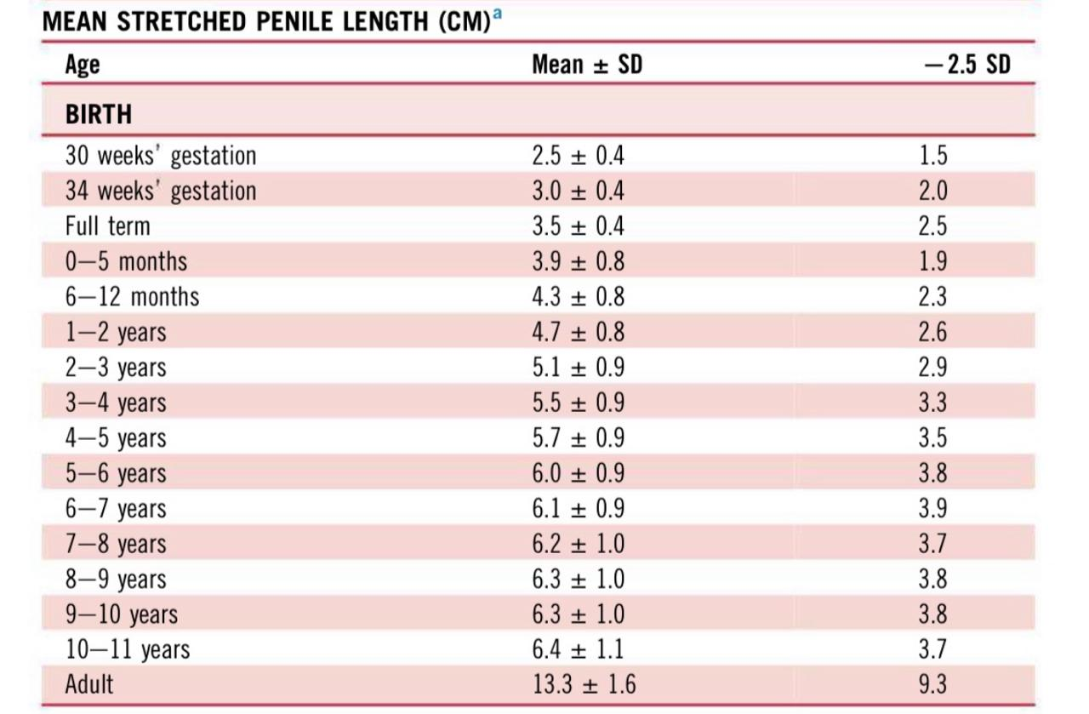
Physical Examination
Genital examination:
Phallus: Micropenis with SPL of 1.6 cm
Urethral opening: normal at tip no hypospadias
Scrotum: Underdeveloped
Testes: Rt And left testicles could not be palpated
Gonads: non-palpable
Pigmentation: No hyperpigmentation noted
Harriet Lane Handbook, 2024 by Elsevier Inc

Slide 11
DDX
Congenital hypogonadotropic hypogonadism ( most likely)
Deficient GnRH secretion/action
Presents with micropenis + cryptorchidism
Partial Androgen Insensitivity Syndrome/ 5α-reductase deficiency
Microphallus + penoscrotal hypospadias + bifid scrotum + palpable inguinal testes
Complete Anorchia
Normal male genitalia + absent testes + ↑ gonadotropins
CAH
Ambiguous Genitalia + Adrenal crisis + Hyperpigmentation/hypertension

Slide 12
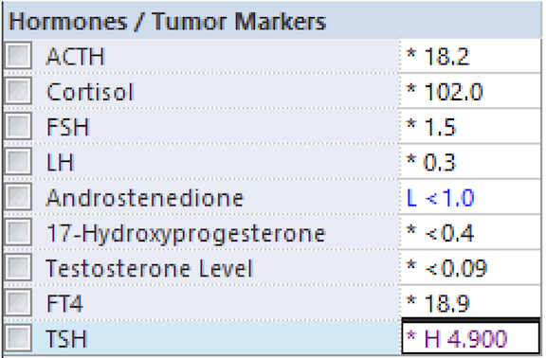
Investigations
Basic labs (CBC, chemistry): within normal limits
Karyotype: 46 XY
Genetic testing was requested to evaluate for an underlying genetic cause

Slide 13
Investigations
Scrotal ultrasound
Empty scrotal sac bilaterally
Both testes located in the proximal inguinal canals
Normal homogeneous echotexture with preserved vascularity Right testis: 1.1 × 0.3 × 0.9 cm (volume ~0.18 mL) Left testis: 1.3 × 0.4 × 0.9 cm (volume ~0.23 mL)
No testicular masses detected

Slide 14
Micropenis + bilateral cryptorchidism → ↓ indicates reduced fetal testosterone production
No hypospadias / bifid scrotum → not PAIS / 5α-RD
Testes present → not anorchia
No adrenal signs + Normal Adrenal Function → not CAH
Most consistent with CHH

Slide 15
Management
IM testosterone (25 mg every 4 weeks for 3 months) prior to undergoing bilateral orchidopexy and circumcision at 18 months of age.

Slide 16
Follow up
At age of 21 months, he was clinically doing well
SPL was 3.7 cm
and both testes were palpable in the scrotum

Slide 17
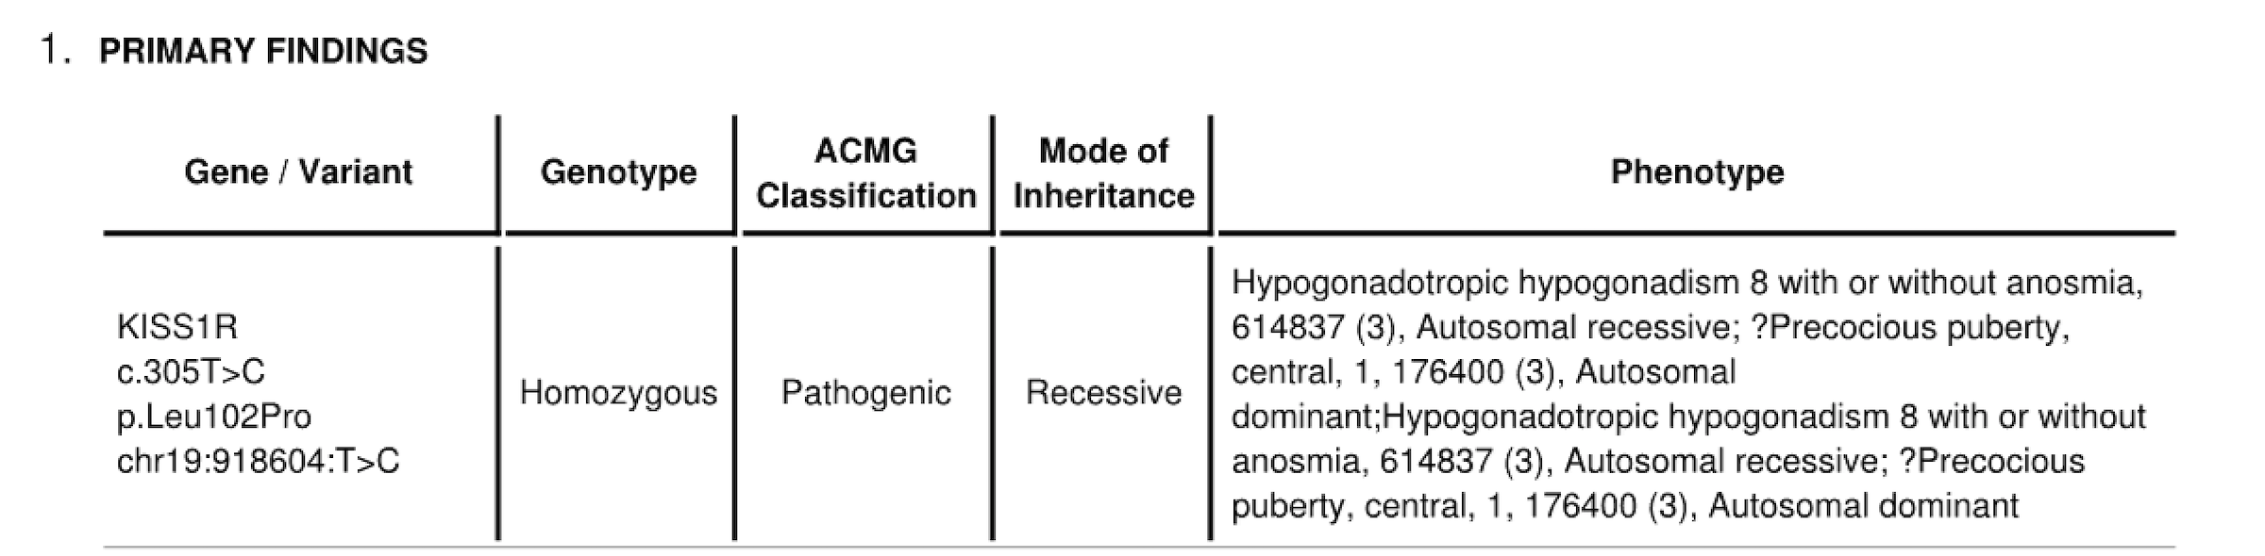
Whole Exome Sequence :

Slide 18
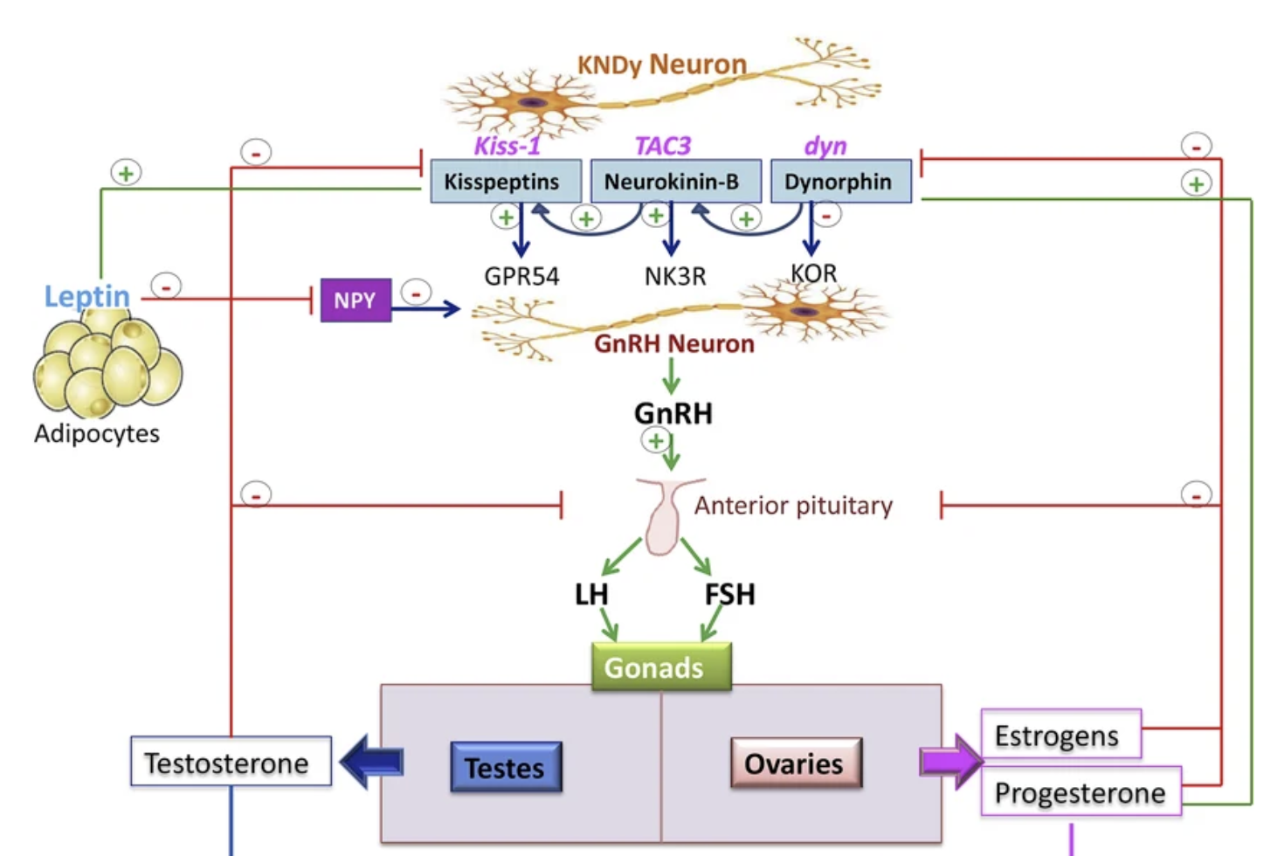
KISS1R mutations:
Rare, autosomal recessive congenital normosomic hypogonadotropic hypogonadism by disrupting the kisspeptin receptor
CHH due to KISS1R loss-of-function mutations may present with cryptorchidism, micropenis, absent or incomplete puberty, and infertility.
Notes:
- primary stimulator of GnRH neurons via the GPR54 receptor.

Slide 19
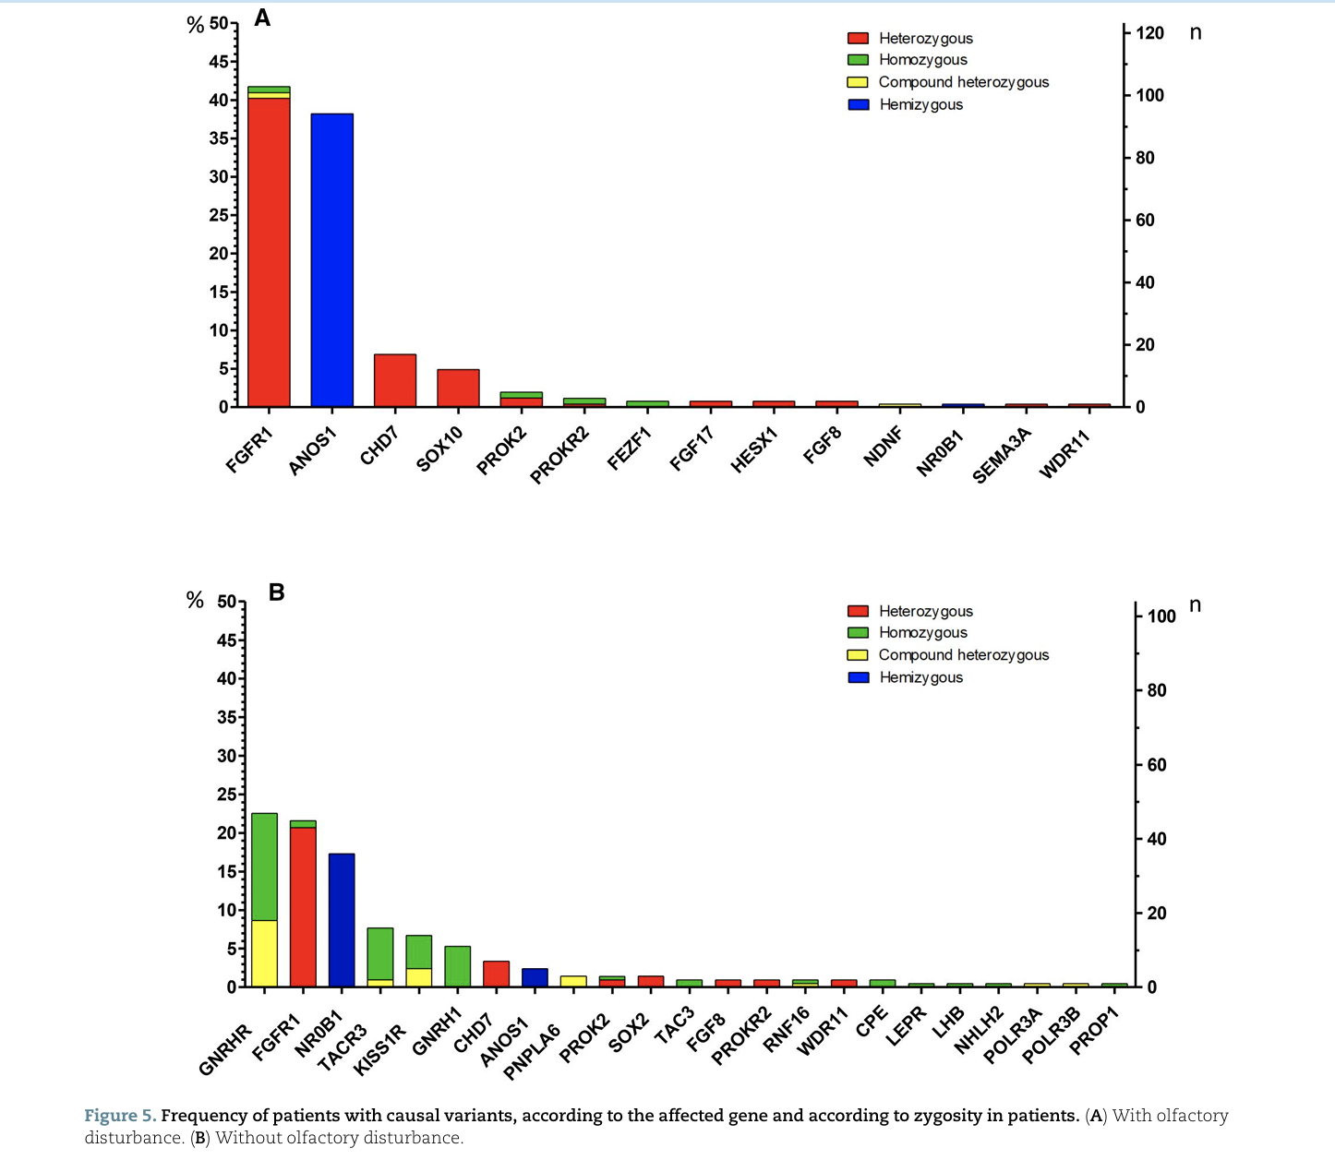
Genetic Etiology of Congenital Hypogonadotropic Hypogonadism:
Castro S, Brunello FG, et al. Clinical presentation of congenital hypogonadotropic hypogonadism in males according to genetic etiology: a systematic review and meta-analysis. Human Reproduction. 2025;40(5):904–918.

Slide 20
Management Approach
Intramuscular testosterone is the most frequently used therapy to :
→ Induces penile growth in infancy
→ Promotes secondary sexual characteristics in adolescence

Slide 21
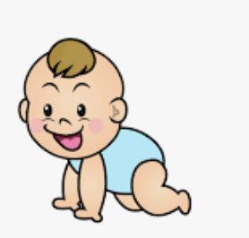


Management Approach
Neonatal / infancy
Childhood
Adolescent
Induces penile growth
Observation and Re-evaluation
Consider an additional course of testosterone if the response is suboptimal
Puberty induction
Testosterone → secondary sexual characteristics
Pulsatile GnRH → fertility induction

Slide 22
Management Guideline
Neonatal treatment of CHH
main goals of hormonal treatment are to increase the penile size and to stimulate testicular growth
Standard therapy is with either IM testosterone enanthate 25mg every 3 to 4 weeks for 3 months, or topical therapy with either 5% testosterone cream or DHT
Management of cryptorchidism is with surgical correction, with the use of hCG or GnRH therapy adjuncts only likely to provide a small additional benefit
Neonatal / infancy
Induces penile growth
Howard, S. R., & Dunkel, L. (2018). Management of hypogonadism from birth to adolescence. Best Practice & Research Clinical Endocrinology & Metabolism, 32(4), 355–372.

Slide 23
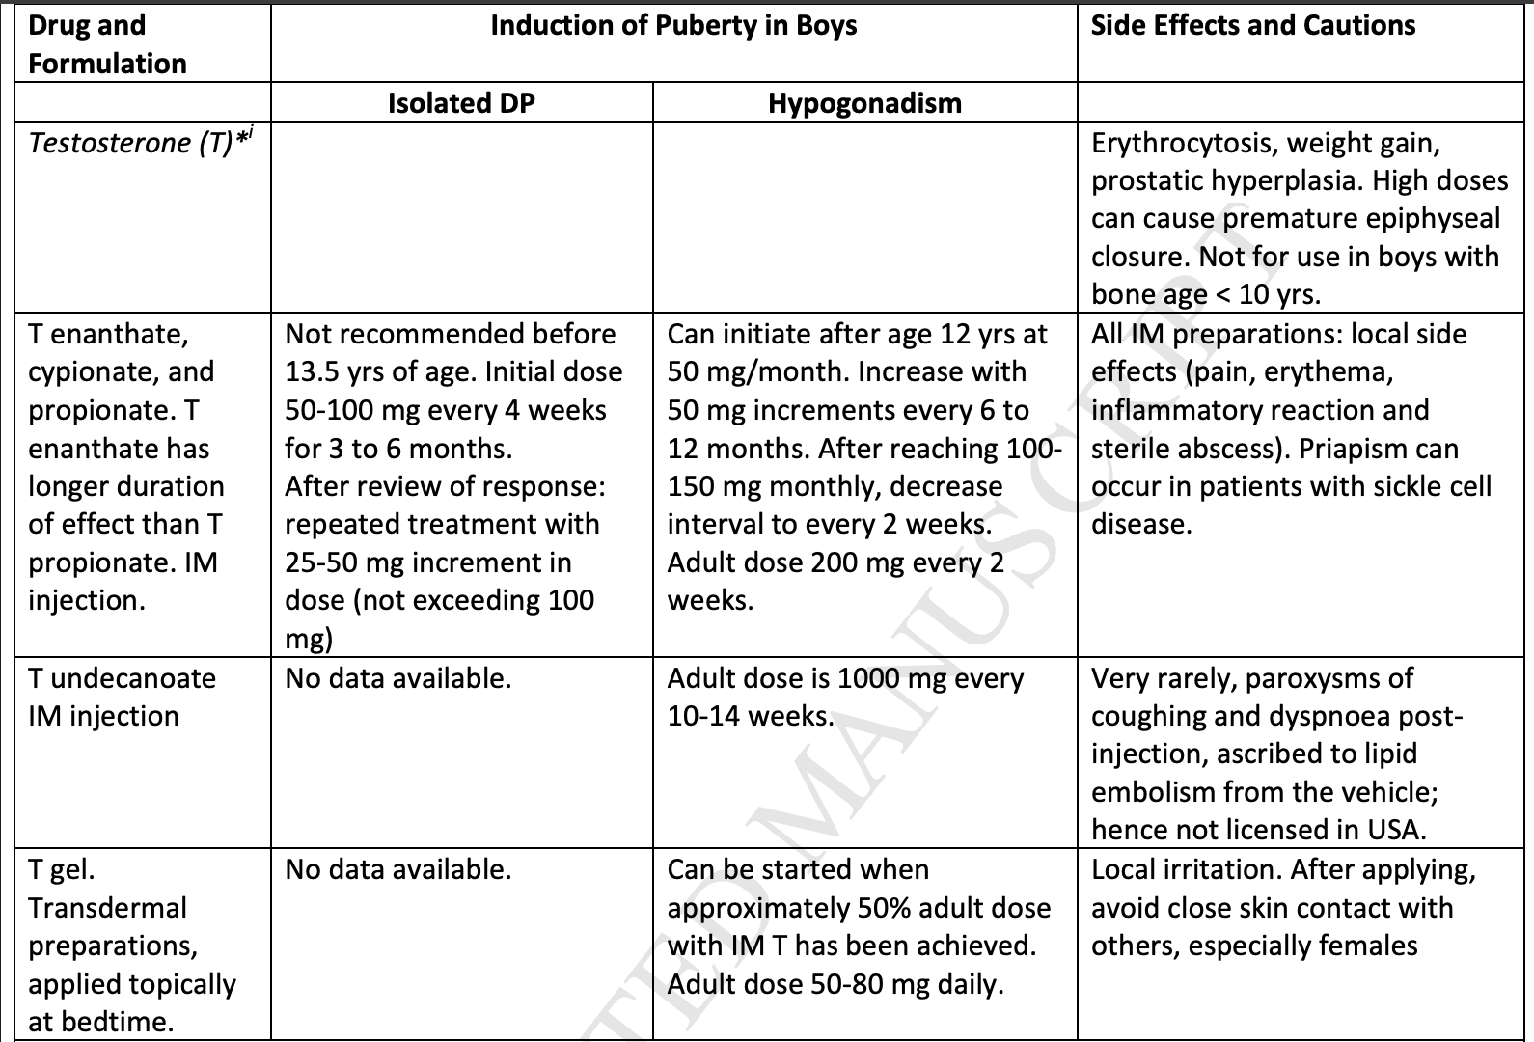
Management Guideline
Childhood
Observation
Adolescent
Puberty induction
Howard, S. R., & Dunkel, L. (2018). Management of hypogonadism from birth to adolescence. Best Practice & Research Clinical Endocrinology & Metabolism, 32(4), 355–372.

Slide 24
Management Guideline
Childhood
Observation
Adolescent
Puberty induction
Howard, S. R., & Dunkel, L. (2018). Management of hypogonadism from birth to adolescence. Best Practice & Research Clinical Endocrinology & Metabolism, 32(4), 355–372.

Slide 25
Management Guideline
Childhood
Observation
Adolescent
Puberty induction
Howard, S. R., & Dunkel, L. (2018). Management of hypogonadism from birth to adolescence. Best Practice & Research Clinical Endocrinology & Metabolism, 32(4), 355–372.

Slide 26
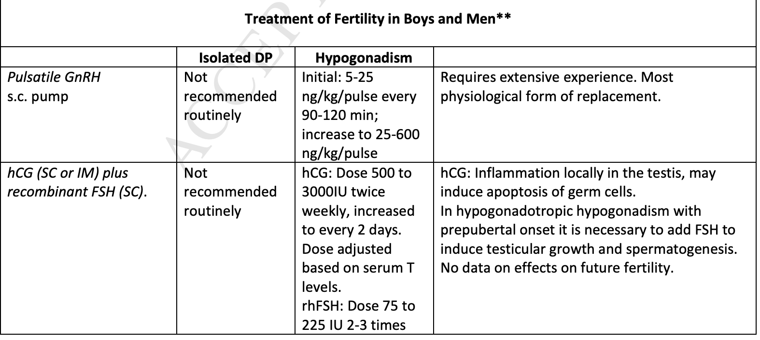
Management Guideline
Adult
Induce Fertility
Howard, S. R., & Dunkel, L. (2018). Management of hypogonadism from birth to adolescence. Best Practice & Research Clinical Endocrinology & Metabolism, 32(4), 355–372.

Slide 27
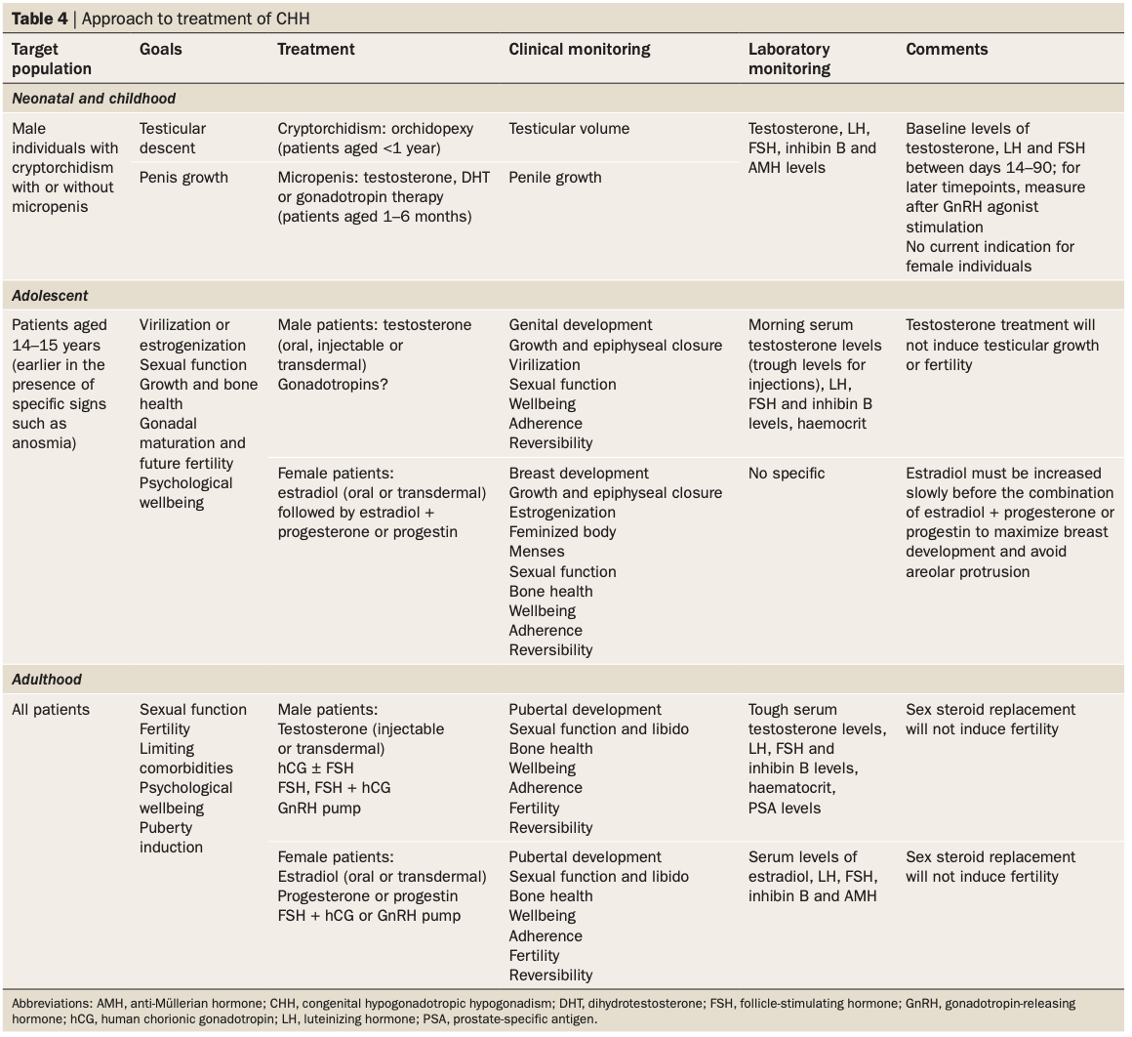
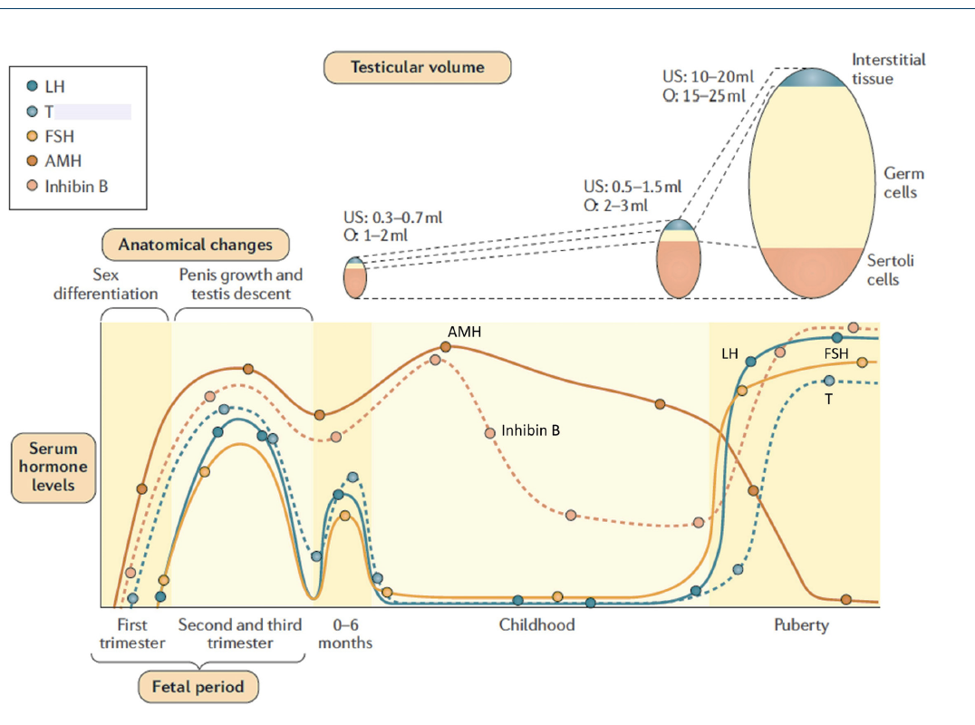
Management Guideline
Boehm U et al. European consensus statement on CHH—
pathogenesis, diagnosis and treatment. Nature Reviews Endocrinology. 2015.

Slide 28
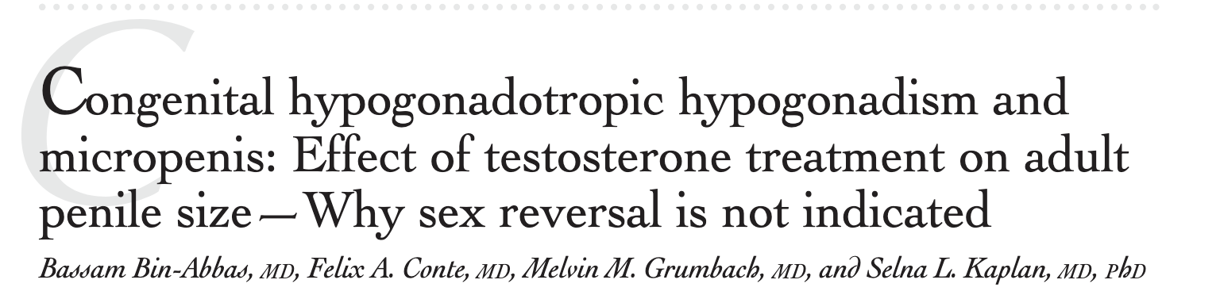
Management Guideline
Study Overview
8 male patients with micropenis due to hypogonadotropic hypogonadism
Divided based on age at testosterone initiation:
Early treatment (<2 years)
Later treatment (6–13 years)
Treatment Protocol
Patients received 1–2 courses of testosterone:
  Dose: 25–50 mg IM monthly × 3 doses (infancy/childhood)
At puberty:
  Testosterone started at 50 mg monthly
  Gradually increased to 200–400 mg every 4 weeks

Slide 29
Management Guideline
Results
Testosterone therapy significantly increased penile length in all patients
Mean penile length improved from:
Severely below normal (−3 to −4 SD) → closer to normal range
Final adult penile length: Within normal range (within 2 SD)
No correlation between:
Initial penile size
Age at treatment
Final outcome
Conclusion
Testosterone therapy in patients with micropenis due to
fetal testosterone deficiency leads to normal or near-normal
adult penile length and preserved erectile function

Slide 30


