Slide 1
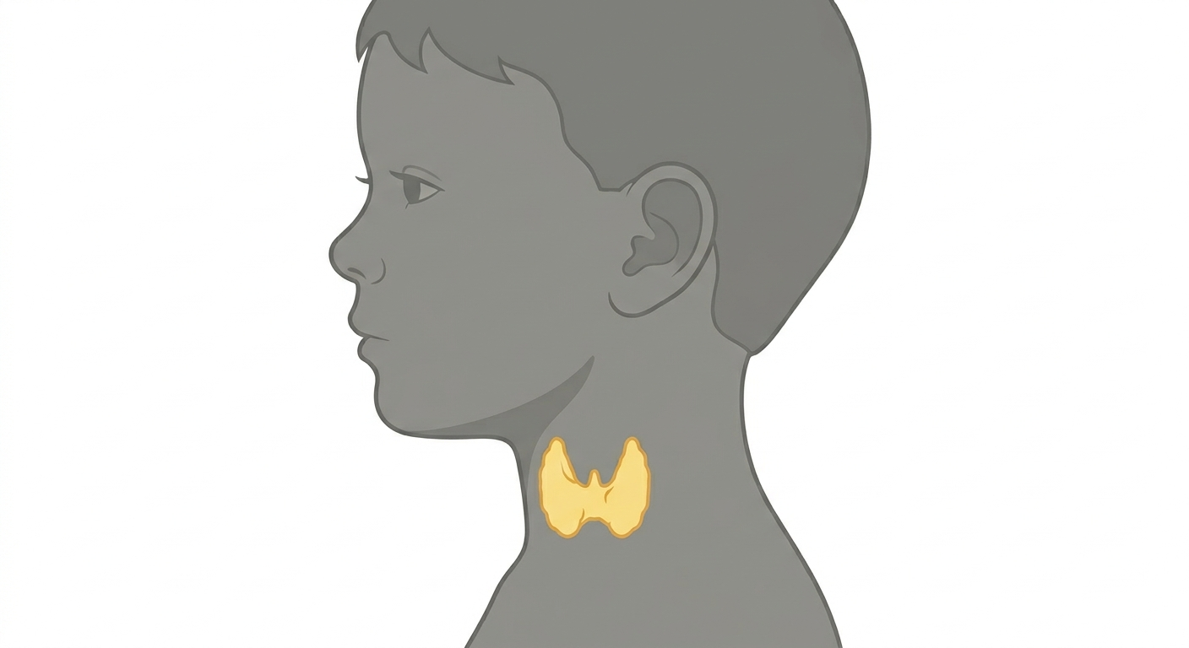


A Stormy Course of Thyroidal illness
Presented By:
Dr. Reema Alswaid
Pediatric Endocrine Fellow
King Abdullah Specialized Children Hospital, Riyadh
Ministry of National Guard Health Affairs
Supervised by:
Dr. Mohsen Alatawi
Pediatric Endocrine Consultant
King Abdullah Specialized Children Hospital, Riyadh
Ministry of National Guard Health Affairs

Slide 2
Case Presentation
This an 11 years old boy, who was brought to the emergency department with an acute episode of abnormal movement and altered level of consciousness.
Notes:
This an 11 years old boy, known case of hyperthyroidism on carbmaezol.
Brought to ER with tonic posturing of upper limp with altered level of

Slide 3
History of Presenting Illness
Event: tonic upper limb posturing, for 1 minute, upward eye deviation, tongue biting and urinary incontinence, resolving spontaneously.
Post-ictal confusion and agitation persisted until hospital arrival.
On arrival, he remained agitated and did not return to baseline, with fluctuating consciousness.
He developed three additional seizures of similar semiology, requiring repeated midazolam for control.
Notes:
he patient was in his usual state of health until the day of presentation when he developed sudden loss of consciousness associated with generalized tonic movements involving both upper and lower limbs, accompanied by upward rolling of the eyes, tongue biting, and urinary incontinence.

Slide 4
Related History
Diagnosed with hyperthyroidism 2 years ago in Jordan and following regularly with endocrinologist.
Graves disease with positive TRAbs & thyroid US showing thyroiditis with no nodules.
The disease was controlled after initial diagnosis with carbimazole.
Over the past 2 months, carbimazole (5 mg) frequency weaned to only twice per week with frequent missing doses.
He started to experience a relapse of hyperthyroid symptoms:
  Sweating, palpitations, weight loss, and poor concentration
  Starting expression and increase in goiter size.
Thyroid function was repeated and showed biochemical hyperthyroidism.
He returned back to take carbamizole once daily for the last 4 days before presenting to ER.
Notes:
According to the mother, over the past year the dose and frequency of carbimazole were gradually reduced in the context of frequent laboratory monitoring demonstrating near-normalization of thyroid function. Over the preceding two months, carbimazole was administered only twice weekly, with reported frequent missed doses. During this period, the patient experienced a relapse of hyperthyroid symptoms, including increased sweating, intermittent palpitations, unintentional weight loss, and poor concentration.
The mother also noted the development of exophthalmos and a mild increase in goiter size.
Noticable starting expresion
By mother
Over the past year, thyroid function tests were measured regularly and the carbimazole dose and frequency were adjusted accordingly.

Slide 5
Negative History
  Fever
  Neck stiffness, photophobia or phonophobia
  Limb weakness, numbness or gait disturbance
  Visual disturbances or speech difficulties
  Skin rashes
  Toxin or drug exposure
  Head trauma or recent history of infections
  No history of contact to sick patients
  Similar episodes before
Notes:
Cough, chest pain or shortness of breath
Vomiting, abdominal pain or change in bowel habits
Changes in urine color, amount or odor

Slide 6
Detailed History
Developmental:
Attends school in 6th grade with good school performance, as he is the first on his class.
  Family history:
    Negative history of consanguinity.
    Father with Primary HTN and dyslipidemia,
    Mother and 4 siblings all are healthy.
    Positive family history of hyperthyroidism (paternal aunt and a cousin).
    No known family history of epilepsy or other autoimmune diseases.

Slide 7
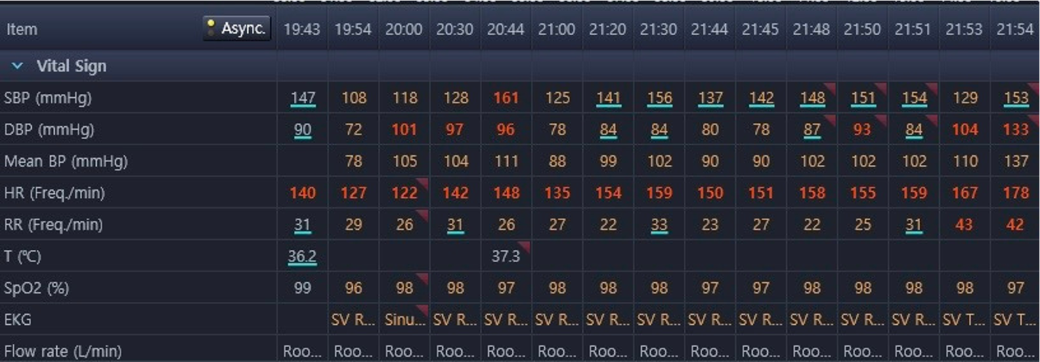
Physical Examination
General appearance: looks unwell, disoriented, and agitated.
Glucocheck: 4.9 mmol/l
Vital signs:
Fever 38.5 C
After couple of hours
Notes:
The blood pressure persisted even after he required intubation and sedated.
He spiked fever 38.5 C (not shown here)

Slide 8
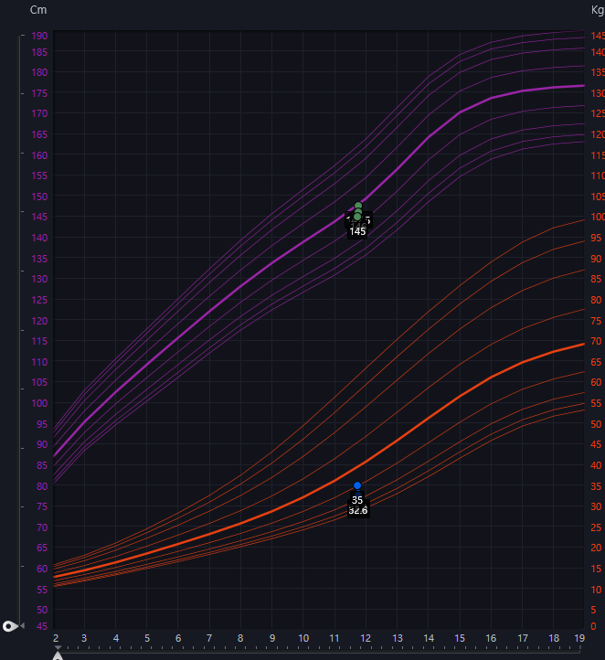
Physical Examination
Growth parameters:
Height: 145cm (25th - 50th centile)
weight: 35kg (10th - 25th centile)
BMI: 16.6kg/m (5th - 10th centile)

Slide 9
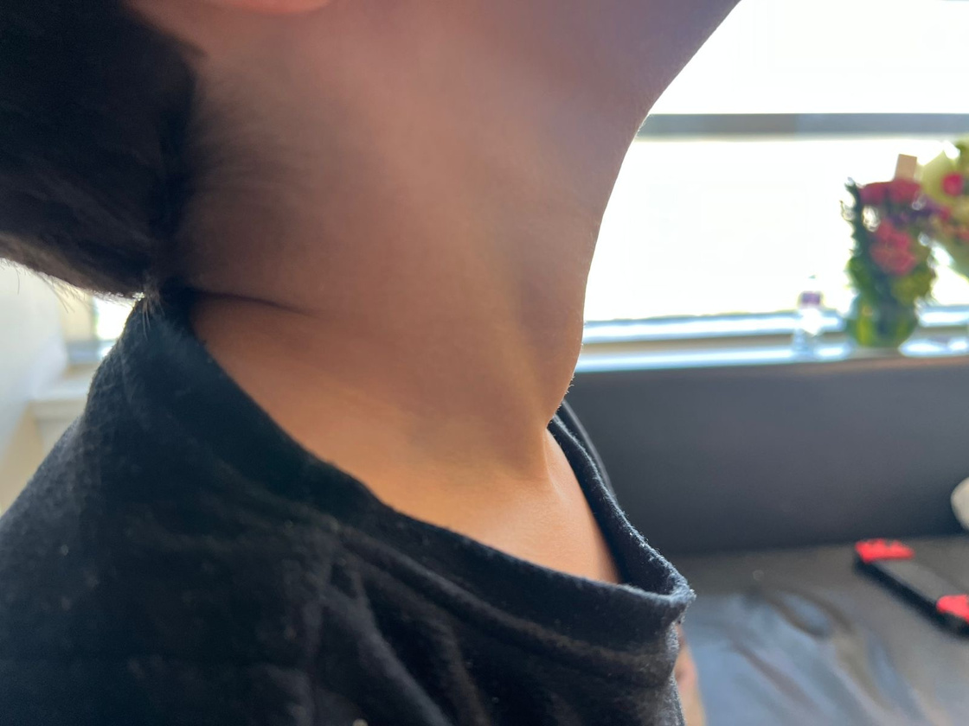
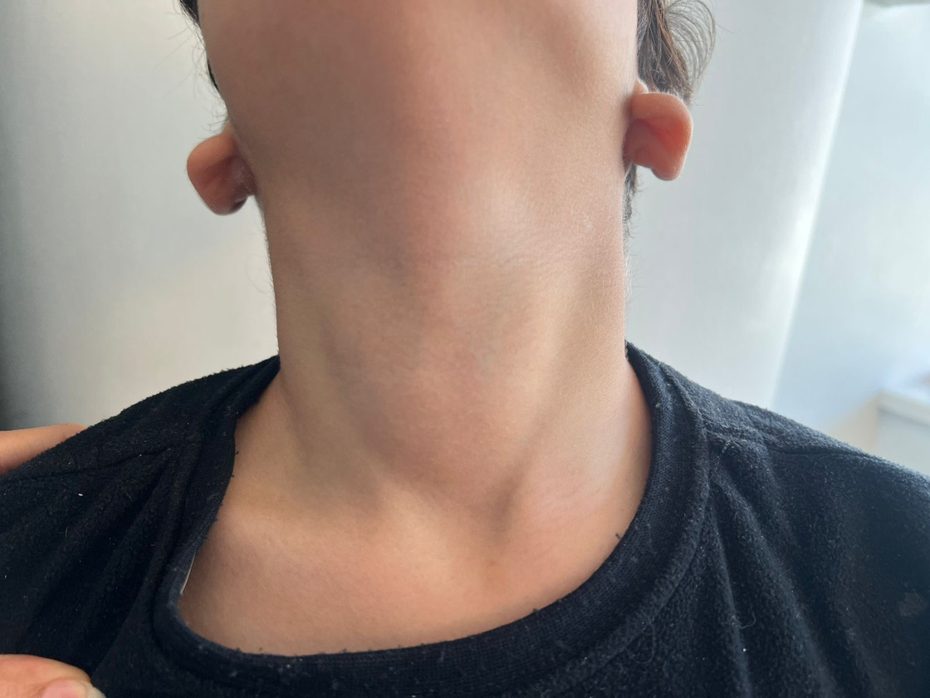
Physical examination
CNS:
  Disoriented, agitated and irritable
  GCS 11/15
  Pupils were equal and reactive bilaterally
  Not able to complete the neurological exam due to severe agitation, however patient was moving his limps with no noted weakness, DTR +2.
Thyroid examination:
  Mild, diffuse, non-tender goiter
  No palpable nodules and no local warmth or bruit.
  No signs of cervical lymphadenopathy.
  Mild exophthalmos.
CVS, Respiratory and Skin examination was unremarkable.

Slide 10
New Onset seizure
+
Change in sensorium
Should Not Delay Standard Emergency Stabilization:
Hypoglycemia and electrolyte disturbance
Toxin ingestion was considered
Infectious encephalitis/meningitis
Hypertension with wide pulse pressure
Persistent Tachycardia
Thyroid Storm
Fever
History of Graves disease with recent change in his medication doses
+
Recurrence of hyperthyroidism symptoms
Notes:
Pediatric reports emphasize that thyroid storm may be mistaken for febrile seizure, and persistent tachycardia plus thyrotoxic signs are the biggest bedside clues.
seizure is accompanied by persistent:
• Marked tachycardia out of proportion to fever.
• Wide pulse pressure.
• Hyperthermia.
• Irritability, delirium, agitation, or altered mental status.
• Goiter, tremor, weight loss, exophthalmos, diarrhea, vomiting, or heart failure signs.

Slide 11
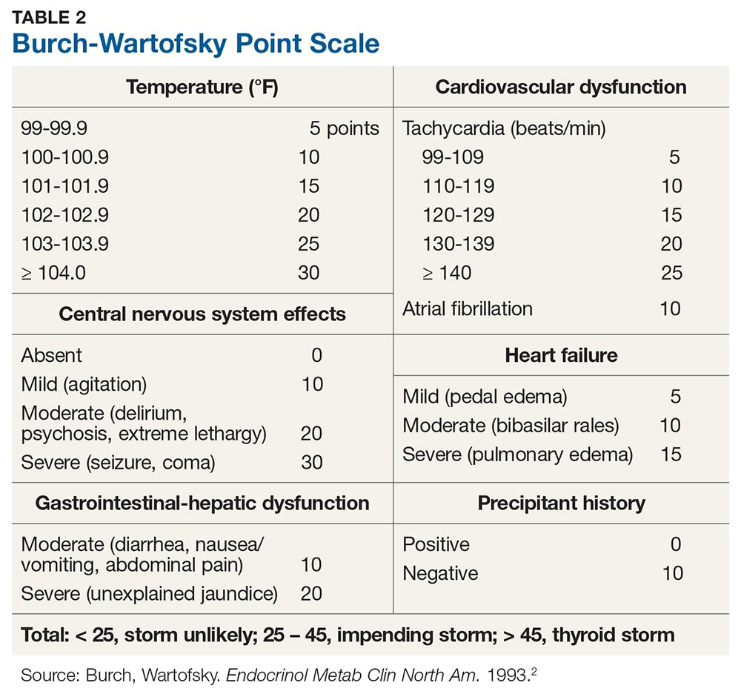

< 37.2 °C
37.2 – 37.7 °C
37.8 – 38.2 °C
38.3 – 38.8 °C
38.9 – 39.2 °C
39.3– 39.9 °C
$≥ 40$°C
Total 75

Slide 12
Investigations
CBC: WBC 9.7, Platelet 353, Hgb 144
Electrolytes & Renal profile & Liver enzymes: Normal
Inflammatory Markers: ESR 4 , CRP < 5 (unremarkable)
Toxicology Screen: Negative
CSF Analysis: TNC < 1.00, RBC 16, Protein 0.20, Glucose 4.50 (unremarkable)
Brain CT: Normal

Slide 13
Investigations
Thyroid function test
TSH | <0.01 mlU/L (0.35-4.49 mlU/L)
Free T4 | 26.67 pmol/L (9.00-19.00 pmol/L)
Free T3 | 13.44 pmol/L (2.90-4.90 pmol/L)
Notes:
To remove thyroid antibodies to the other slide of DDX that included autoimmune encephalitis

Slide 14
New Onset seizure
+
Change in sensorium
Should Not Delay Standard Emergency Stabilization:
Hypoglycemia and electrolyte disturbance (rule out using rapid testing)
Toxin ingestion was considered
Infectious encephalitis/meningitis
Hypertension with wide pulse pressure
In Emergency Room:
  He required intubation due to fluctuating GCS and agitation.
  Started thyroid storm management:
  Methimazole (15 mg once daily)
  IV hydrocortisone (100 mg/m2/day)
  Esmolol infusion
  Empiric antibiotics
  PICU Admission
At Third Day of Admission:
  Baseline consciousness
  No Seizure
  Remained Afebrile
  Switched to oral Propranolol
  Negative infectious workup
  Negative Brain MRI , EEG
  Transferred from PICU to High dependency unit
  Started Weaning steroid
Persistent Tachycardia
Thyroid Storm
Fever
History of Graves disease with recent change in his medication doses
+
Symptoms suggestive of hyperthyroidism
Suppressed TSH
Markedly high T3 & T4
Notes:
Electolytes and toxin ingestion was ruled out by initial investigations.
CNS infection was still in picture till culturs is out
With the presence of suppressed TSH and markedly high T3 and T4
Thyroid storm was highly suspected.
What happened in the emergency room.
Thyroid storm management was started by endocrine team.
Lugols solution was not available at that time in the hospital.
———————————-
Day 0 – Emergency Department
11-year-old boy, known Graves disease on carbimazole with poor adherence
Presented with acute generalized tonic seizure with eye rolling and urinary incontinence
Followed by persistent altered level of consciousness (GCS 9–11/15)
Vitals: tachycardia, hypertension with wide pulse pressure, agitation
Initial labs:
TSH <0.01
Markedly elevated Free T4 and Free T3
Brain CT: no acute intracranial pathology
Impression: thyroid storm with CNS involvement vs CNS infection
Admitted to PICU
Day 1 – PICU Management
patient was agitated with fluctuating GCS → intubated to protect hime and prepare him for MRI.
Endocrine , neurology & endocrine were involved.
Started on thyroid storm management:
Methimazole
IV hydrocortisone (stress dose)
Esmolol infusion
Empiric meningitic-dose antibiotics ± acyclovir
Brain MRI: unremarkable
EEG: diffuse slowing, no epileptiform activity
Lumbar puncture: CSF unremarkable
Day 2 – Improvement
Hemodynamics normalized
No further seizures
Extubated successfully
Esmolol discontinued → switched to oral propranolol
Mental status improving toward baseline
Infectious workup remained negative
Antibiotics de-escalated
Day 3 – Step-Down Care
Transferred from PICU to HDU/ward
Continued on methimazole and propranolol
Hydrocortisone tapered
Thyroid antibodies returned markedly positive
Remained:
Afebrile
Hemodynamically stable
Seizure-free
Neurologically appropriate
"Everything pointed toward thyroid storm… and he improved & WE THOUGHT WE WERE DONE.
Day 4 – New Neurological Event (Key Turning Point)
Developed recurrent prolonged seizures
Associated with:
Drop in GCS
Dilated pupils during events
Occurred despite clinical stabilization
No features of active thyrotoxicosis:
No fever
No tachycardia or hypertension
No agitation
Repeat TFTs not consistent with thyroid storm
Current Assessment:
Neurological relapse despite improvement of thyroid status
Thyroid-related encephalopathy now less likely
Differential expanded to include:
Autoimmune encephalitis
EAAT (less likely)
PRES (less likely)
Neurology recommendations:
Escalation of antiseizure therapy
Further EEG monitoring
Autoimmune encephalitis workup

Slide 15
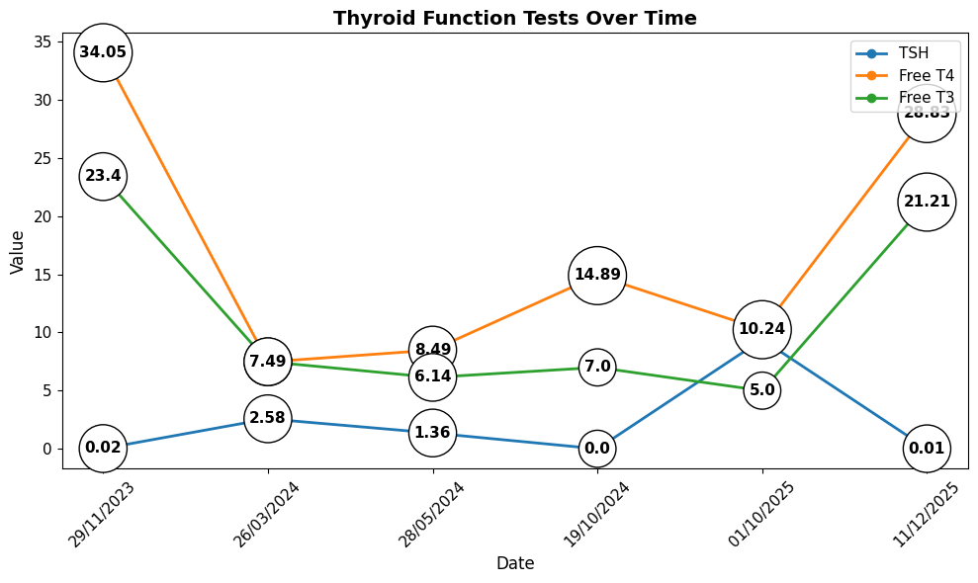
A Second Look at The Diagnosis!
Notes:
We paused a little
And we took a second look at the diagnosis
We had some questions in mind:
Is it thyroid storm or we are missing the hint?
Why he came with thyroid storm only now and not at his initially diagnosis.
Why today and not 4 days ago when he had the relapse of his symptoms.
We asked the family to bring his previous thyroid function readings
You can see higher reading at time of diagnosis and a another one couple of days prior to his presentation to our ER.
faster raise in his readings. Than the one he presented with.

Slide 16
Thyroid Storm
Exact pathophysiology of thyroid storm is poorly understood.
Acute increase in release of T4 or T3 from thyroid gland
Acute illness causes decrease in protein binding of T4 and T3
Role of sympathetic nervous system activation
Augmentation of cellular responses to thyroid hormone
The mortality rate of thyroid storm is 10% - 30%. ¹
Not
associated
with
Severity of thyroid hormone elevation
1. Abisad DA et al. Thyroid storm in pediatrics: a systematic review. Journal of Pediatric Endocrinology & Metabolism : JPEM. 2023.
Notes:
This bring us to thyroid storm pathophysiology:
A review of the literature indicates that it remains incompletely understood
But it is still not related to the:
The severity of thyroid hormone elevation alone.
Some patients with very high hormone levels remain compensated, whereas others with more modest hormone levels develop a crisis.
Several hypotheses have been postulated for the storm, which are as follows:
Is it associated with Concomitant precipitating factors? Yes frequently but not always identifiable.
Increased tissue responsiveness and β-adrenergic receptor activity play key roles, explaining the clinical efficacy of beta-blockers.
The mechanisms underlying why only a subset of thyrotoxic patients progress to thyroid storm despite comparable hormone levels remain incompletely understood (13).
We still not sure about it
But we are sure of the high mortality!
————————-
Acute increase in T4 or T3 hormones is seen after radioiodine therapy, thyroidectomy, discontinuation of antithyroid drugs, and administration of iodinated contrast agents or iodine [18]. Rapid improvements in clinical condition after reduction in T4 or T3 concentration after peritoneal dialysis or plasmapheresis support this theory [19].
Dramatic improvement in symptoms following beta blocker administration supports this hypothesis [24].
In patients with condition of hypoxemia, ketoacidosis, lactic acidosis, and infection, there is augmentation of cellular response to thyroid hormone [25]. There is uncoupling of oxidative phosphorylation leading to generation of ATP, which results in excess utilization of substrate, increased oxygen consumption, thermogenesis, and hyperthermia [26]. Excess heat is dissipated by increased sweating and cutaneous vasodilation, the most common symptoms of thyroid storm.

Slide 17
The Unexpected Turn
  After 3 days of clinical stability:
    Developed recurrent seizure episodes.
    Drop in his GCS.
    No signs of active thyrotoxicosis:
      No tachycardia or hypertension
    No Fever
    Repeated thyroid function test showed improvement of fT4 and fT3
At that stage, he was:
    Weaned off Hydrocortisone (for 1 day)
    Methimazole (15 mg OD)
    Propranolol (Dose )
    Thyroid antibodies results came out

Slide 18
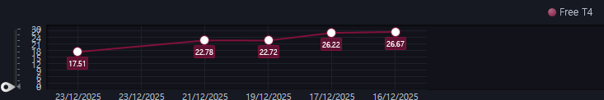
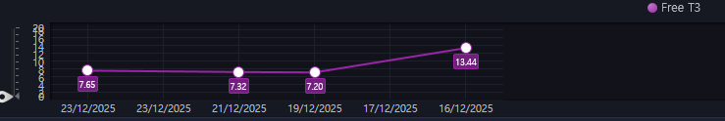
The Unexpected Turn
Notes:
Neurological relapse despite improvement of thyroid status
Differential expanded to include:
Autoimmune encephalitis
Neurology recommendations:
Escalation of antiseizure therapy
Further EEG monitoring
Autoimmune encephalitis workup

Slide 19
The Unexpected Turn
Thyroid Antibodies
Thyroglobulin Ab | 1087 IU/mL (5-100 IU/mL)
Thyroid peroxidase (TPO) Ab | 1339 IU/mL (1-16 IU/mL)
Anti- TSH Receptor Ab | 9.8 IU/L (~1.75 IU/L)
Notes:
Neurological relapse despite improvement of thyroid status
Differential expanded to include:
Autoimmune encephalitis
Neurology recommendations:
Escalation of antiseizure therapy
Further EEG monitoring
Autoimmune encephalitis workup

Slide 20
New Onset seizure
+
Change in sensorium
Rethinking The Diagnosis
Hypertension with wide pulse pressure
Recurrent seizure
+
Change in sensorium
Thyroid Storm
Autoimmune Encephalitis
Persistent Tachycardia
No Hypertension
No Tachycardia
Fever
No Fever
History of Graves disease with recent change in his medication doses
+
Symptoms suggestive of hyperthyroidism
Improving thyroid function test
Background of autoimmune disease
Suppressed TSH
Markedly high T3 & T4
Notes:
Was it a thyroid storm from the start? Or we are dealing with two things

Slide 21
Steroid –Responsive Encephalopathy with Autoimmune Thyroiditis (SREAT)
Hashimoto's encephalopathy
Encephalopathy associated with autoimmune thyroid disease(EAATD)
Nonvasculitic autoimmune inflammatory meningoencephalitis” (NAIM)
Notes:
When we talk about autoimmune encphalitis in a backgroun of autoimmune thyroid disease .
Were mainly talking about
Contraversial entity
Hashimoto's encephalopathy
Encephalopathy associated with autoimmune thyroid disease(EAATD)
An entity that has been known by several names. With a lot of confusion and countraversies around it.

Slide 22
Steroid –Responsive Encephalopathy with Autoimmune Thyroiditis (SREAT)
Pathogenesis is not well understood; autoimmune mechanism is suspected.
Antithyroid antibody-positive encephalopathy developing nonspecific neurological manifestation.
Most present with sub-acute manifestation, and rarely with acute onset.
In most cases, the thyroid function & serum antibody titer is not correlated with disease severity.
Anti-TPO; marker of autoimmunity or pathogenic antibody?
Most cases have been reported good response to corticosteroid.
Falb, Vladimir et al. “Autoimmune Encephalopathy Associated With Anti-thyroid Antibodies: A Case Report.” Cureus 2022
Shah SD et al. Steroid-responsive encephalopathy and autoimmune thyroiditis in a young boy. Pediatr Neurol. 2011
Notes:
Although this condition's pathophysiological mechanism has not been clarified, most cases of SREAT have been reported as showing good response to corticosteroid administration.
Encephalopathy in context of positive antithyroidal antibodies
It had non specific neurological manifestation
The reamined question
The anti-TPO may serve as a marker of autoimmunity rather than a disease-specific or pathogenic antibody.
Anti-TPO positive in 10-20% of normal population.
However, the presence of anti-TPO antibodies or additional nonspecific thyroid antibodies should prompt clinicians to consider SREAT in patients with suggestive signs and symptoms.
elevated protein may be the only cerebrospinal uid abnor-
mality in patients with steroid-responsive encephalopathy with
autoimmune thyroiditis [2]. An elevated immunoglobulin-G index,
oligoclonal bands, anti-thyroperoxidase antibodies, and anti-
thyroglobulin antibodies are observed inconsistently in cerebro-
spinal uid. Pleocytosis was described in some patients.
Nonspeci c brain abnormalities on magnetic resonance imaging
and computed tomography were reported. Single photon emission
computed tomography studies may indicate nonspeci c patterns of
reduced cerebral blood ow in parts of the brain [2].

Slide 23
Case Updates
Received pulse steroid of IV Methylprednisolone for 5 days.
CSF autoimmune panel could not be sent.
Discharged home on oral prednisolone with neurology team follow up, for management of autoimmune encephalopathy.
Prednisolone was weaned gradually over 3 weeks after hospital discharge.
He was back to his baseline cognition and remained seizure free since starting pulse steroid.
Methimazole and propranolol dose was adjusted during clinic follow up.
Notes:
Although this condition's pathophysiological mechanism has not been clarified, most cases of SREAT have been reported as showing good response to corticosteroid administration.
Encephalopathy in context of positive antithyroidal antibodies
It had non specific neurological manifestation
The reamined question
The anti-TPO may serve as a marker of autoimmunity rather than a disease-specific or pathogenic antibody.
Anti-TPO positive in 10-20% of normal population.
However, the presence of anti-TPO antibodies or additional nonspecific thyroid antibodies should prompt clinicians to consider SREAT in patients with suggestive signs and symptoms.
elevated protein may be the only cerebrospinal uid abnor-
mality in patients with steroid-responsive encephalopathy with
autoimmune thyroiditis [2]. An elevated immunoglobulin-G index,
oligoclonal bands, anti-thyroperoxidase antibodies, and anti-
thyroglobulin antibodies are observed inconsistently in cerebro-
spinal uid. Pleocytosis was described in some patients.
Nonspeci c brain abnormalities on magnetic resonance imaging
and computed tomography were reported. Single photon emission
computed tomography studies may indicate nonspeci c patterns of
reduced cerebral blood ow in parts of the brain [2].

Slide 24
Take Home Messages
In the absence of confirmatory testing, both conditions demand a high index of suspicion; Given the risk of severe outcomes and safety of initial treatment, early empiric management is justified.
The importance of considering autoimmune encephalopathy in all patients with signs of encephalopathy and autoimmune thyroid disease.
Thyroid storm are almost always fatal, without proper treatment; Understanding the typical and atypical clinical features of this disease help in suspecting thyroid storm early.
Notes:
This case highlight

Slide 25
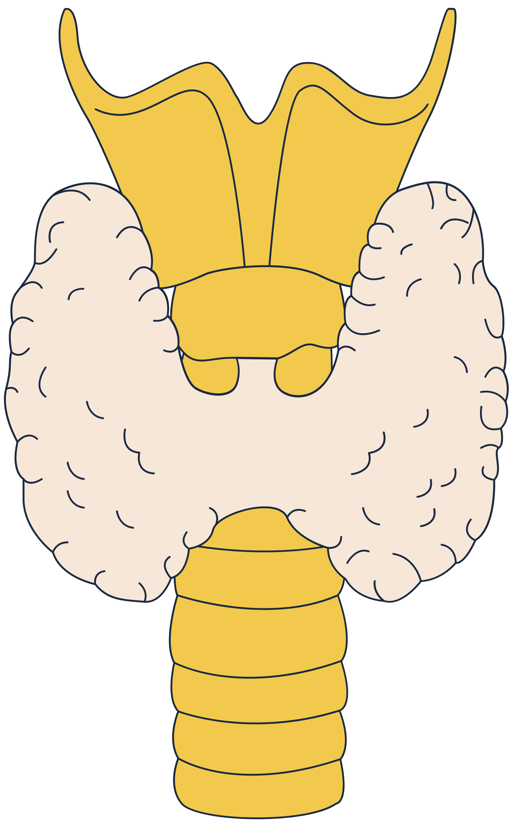
Thank You

