Slide 1
What’s Behind Simple Looking Thyroid Nodule
Dr.Safiah Mohammed AlShehaili
Pediatric Endocrinologist
Saudi Board in General Pediatrics
Saudi Fellowship in Pediatric Endocrine and Metabolism

Slide 2
Thyroid Nodules in Children
Higher malignancy risk vs adults
Papillary carcinoma most common
Follicular carcinoma requires histology
Consider genetic syndromes

Slide 3
Case Presentation

Slide 4
HPI - History
10 years old girl referred to our service on Jan 2024 at age of 8 years as case of Neck mass for further work up
The Neck mass started at around 4 months prior her presentation
There was no hx of pressure effect on the airway or esophegous There was no B symptoms
There was hx of hypothyroidism symptoms for 2 months

Slide 5
Past medical and surgical - History
The child was seen by many GP physicians for the same complain with many impressions related to infection related neck mass (Lymph node)
No history of head/neck irradiation exposure
No history of surgical intervention

Slide 6
Medication - History
Not using any medicine and no herbals as well

Slide 7
Family history - History
38y
42y
13 y
8y
4 y
Her mother has vertigo , Hypothyroidism on treatment (diagnosed to have autoimmune thyroid disease)
Auntie from maternal side had history of thyroid malignancy (thyroidectomy and radiation)
Uncle from paternal side had history of thyroidectomy 2ry to hyperthyroidism (benign)

Slide 8
Examination
Well looking Vitals within normal for age
Height: 137.6 cm (93rd centile)
Weight: 36.5 kg (97th centile)
BMI: 19.3 kg/m² (95th centile)
No signs of distress. No tremors of the outstretched hands. No sweating or agitation. Skin is not dry. No periorbital edema. No visible goiter. No scars, redness, or skin changes. No visible pulsations. small non tender firm thyroid nodule at the isthmus , not mobile No buries
No palpable cervical lymphadenopathy.
DTR normal

Slide 9
Thyroid nodule
Non-neoplastic lesions
Benign neoplasms
Malignant neoplasm
Nodule with autoimmune thyroiditis
Colloid cyst
Multi-nodular
goiter
Hyperplastic
Non-functioning follicular adenoma
Toxic Adenoma
Primary carcinoma (papillary/follicular/ medullary/anaplastic)
Lymphoma Metastasis from another site

Slide 10
Differential diagnosis
Pediatric patient
with thyroid nodule
Concerning features
(age, firm, FHx)
Likely:
• Multinodular disease
•Malignant thyroid nodule
Possible:
•Benign thyroid nodule
Less likely:
• TG cyst
• Reactive LN
• Thyroiditis
Notes:
At this stage, based on clinical assessment, we stratified our differential diagnosis as follows…”

Slide 11
Investigations - Labs
TSH | 4.9
T4 | 15.6
Thyroid antibodies | Negative

Slide 12
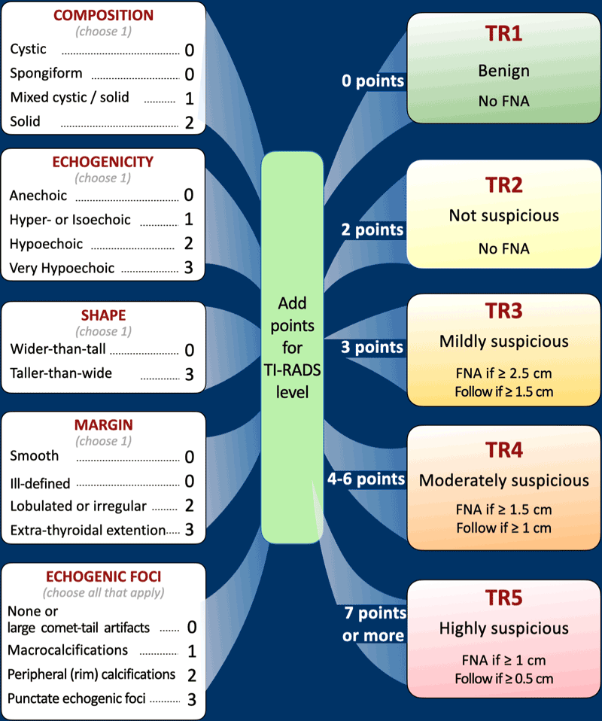
Investigations - Ultrasound
The thyroid gland is of average size and shows homogeneous echopattern and average vascularity.
Right thyroid lobe measures 36 x 14 x 11 mm
Left thyroid lobe measures 31 x 11 x 7 mm * There are about four bilateral thyroid nodules with increased vascularity and irregular margins
The largest is in right thyroid lobe measuring 15 x 13 x 09 mm with internal mixed hypo and hyper echogenicities and compositions. no calcific foci seen * There are two nodule in left lobe; hypoechoic nodule measuring 7 x 6 x 5 mm and hyperechoic nodule measuring 8 x 6 x 3 mm. . * Isthmus thickness measures 2.3 mm with no cysts or nodules. * No retrosternal extension. - There are prominent cervical and submandibular reactive lymph nodes with preserved fatty hilum. The largest is in right neck measuring 11 x 4 mm.

Slide 13
Investigations - FNA
The smears are hypercellular and show crowded sheets of atypical follicular cells with micro follicle formations, tight clusters with transgressing blood vessels in a background of some colloid. The features are in keeping with follicular neoplasm in appropriate clinical and radiological settings.
No LNs were biopsied given their small size and non suspicious features Diagnosis: Follicular neoplasm - Bethesda Diagnostic Category IV
Risk of malignant transformation: 15-30%

Slide 14
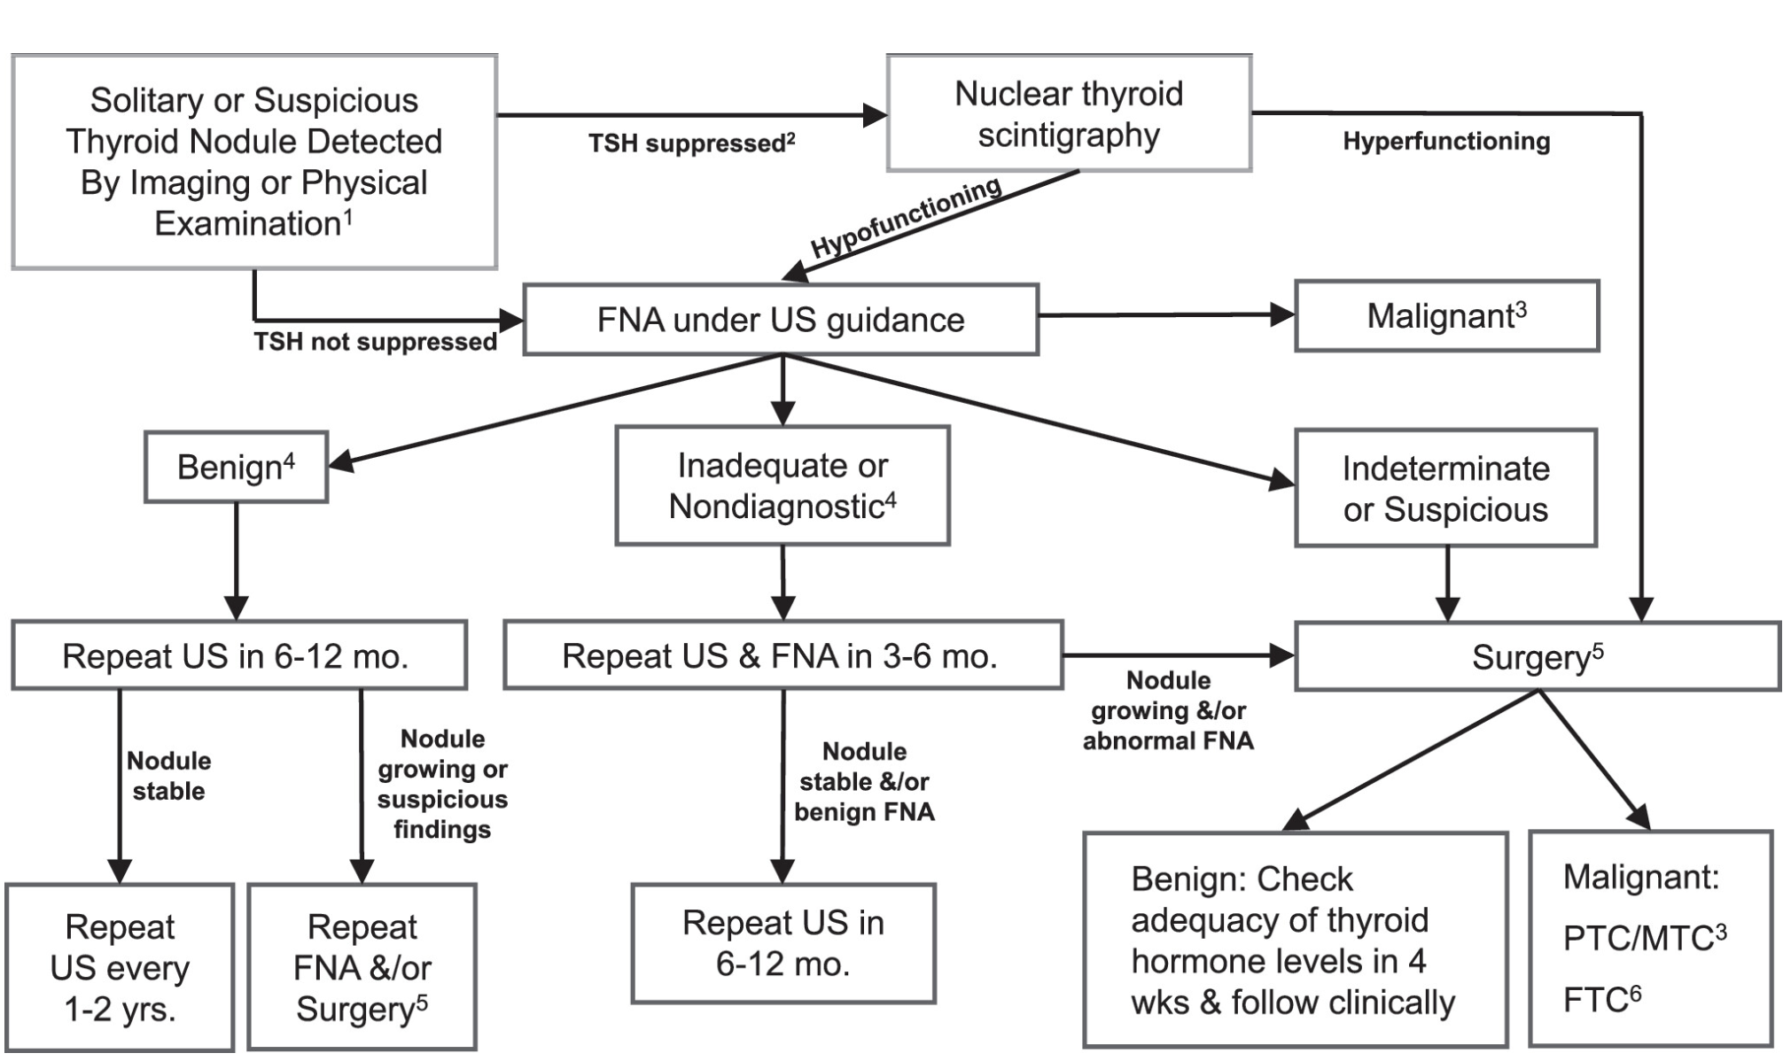
Investigations - FNA
The smears are hypercellular and show crowded sheets of atypical follicular cells with micro follicle formations, tight clusters with transgressing blood vessels in a background of some colloid. The features are in keeping with follicular neoplasm in appropriate clinical and radiological settings. Diagnosis: Follicular neoplasm - Bethesda Diagnostic Category IV
Risk of malignant transformation: 15-30%
Management Guidelines for Children with Thyroid Nodules and Differentiated Thyroid Cancer
The American Thyroid Association Guidelines Task Force on Pediatric Thyroid Cancer - 2015

Slide 15
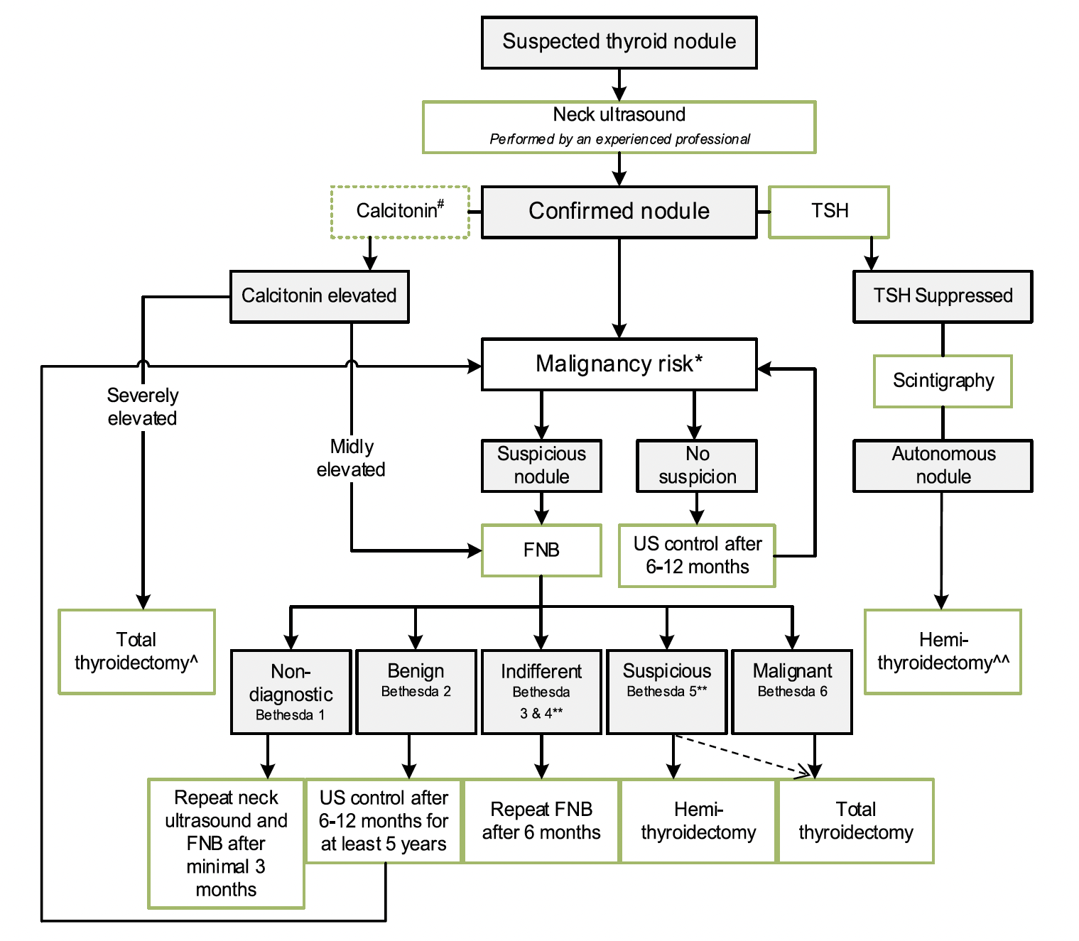
Investigations - FNA
The smears are hypercellular and show crowded sheets of atypical follicular cells with micro follicle formations, tight clusters with transgressing blood vessels in a background of some colloid. The features are in keeping with follicular neoplasm in appropriate clinical and radiological settings. Diagnosis: Follicular neoplasm - Bethesda Diagnostic Category IV
Risk of malignant transformation: 15-30%
2022 European Thyroid Association Guidelines for the management of pediatric thyroid nodules and differentiated thyroid carcinoma

Slide 16
Pre-operative evaluation
Detailed US neck :
All regions of the neck examined
LN were found in the central compartment of the neck region
Non of which have suspicious characteristics of metastasis
ENT for baseline vocal cord assessment :
Normal
Baseline serum thyroglobulin (Tg) level and Tg AB level
Tg 40
Tg ab – negative
Notes:
Indicated US Findings are suggestive of metastasis to a lymph node:
Increased size
Rounded shape
Loss of central hilum
Cystic appearance
Peripheral vascularity on Doppler imaging
Microcalcifications

Slide 17
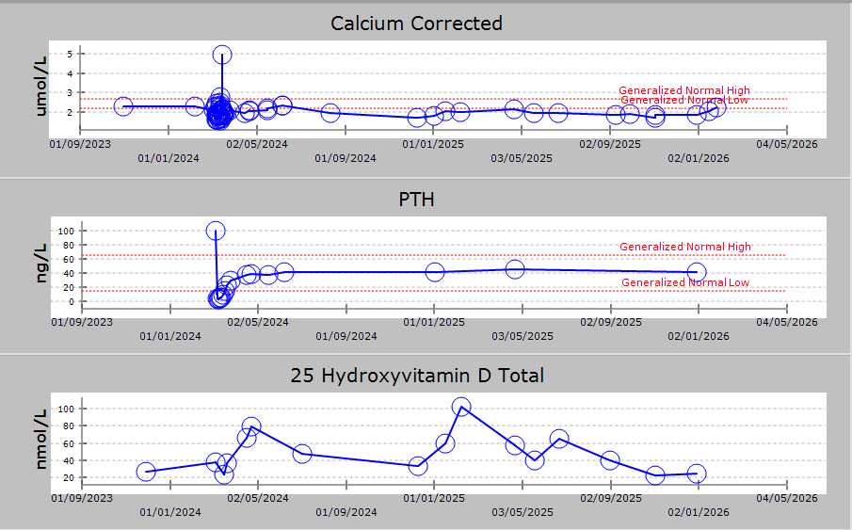
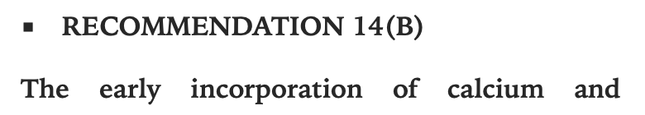
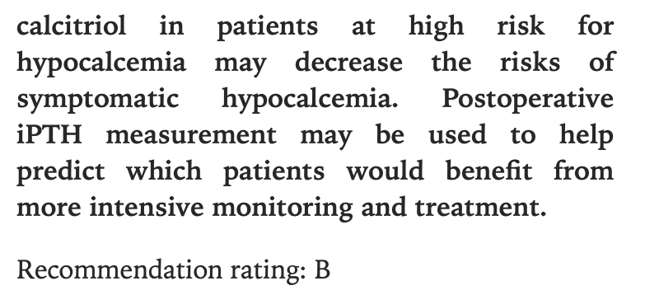
Pre-operative evaluation
Management Guidelines for Children with Thyroid Nodules and Differentiated Thyroid Cancer
The American Thyroid Association Guidelines Task Force on Pediatric Thyroid Cancer - 2015
At risk for hypocalcemia
Started on supplemental calcium and Calcitriol
Post -operative plan bone profile ( monitor ca level q 4-6 hrs )
Stand by calcium infusion to correct expected hypocalcemia
Notes:
Bone profle ( CCa 2.09 , Po4 not done , PTH 100) Vit D 37

Slide 18
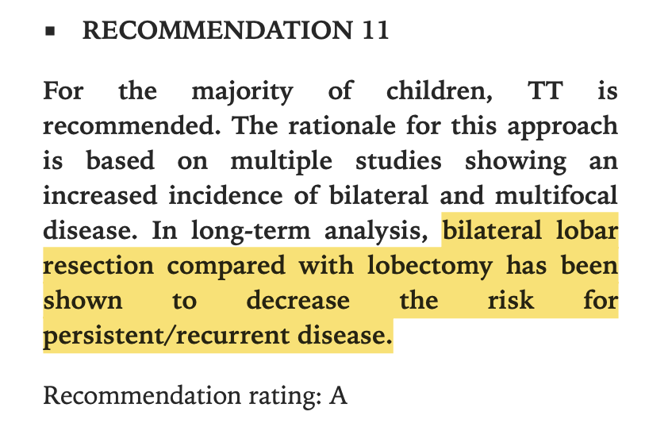
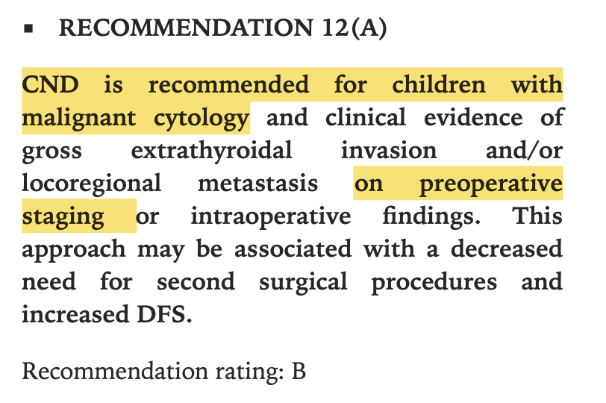
Management
Age
Firm consistency
Family history of thyroid malignancy
Bilateral presence of suspicious nodules
Management Guidelines for Children with Thyroid Nodules and Differentiated Thyroid Cancer
The American Thyroid Association Guidelines Task Force on Pediatric Thyroid Cancer - 2015

Slide 19
Surgery
Total thyroidectomy with central lymph node dissection
Histopathology finding:
–Minimally invasive follicular thyroid carcinoma, both lobes, 1.2 cm. –Mild follicular nodular disease (nodular hyperplasia). –1 benign lymph node (0/1).
Notes:
Evaluated by an expert pediatric surgeon and planned for
“CND is associated with
decreased risk of persistent/ recurrent locoregional disease
decreased need for second surgical procedures and increased DFS
the potential to increase the efficacy of 131I treatment for distant metastases”

Slide 20
Staging
stage classification: pT1 N0

Slide 21
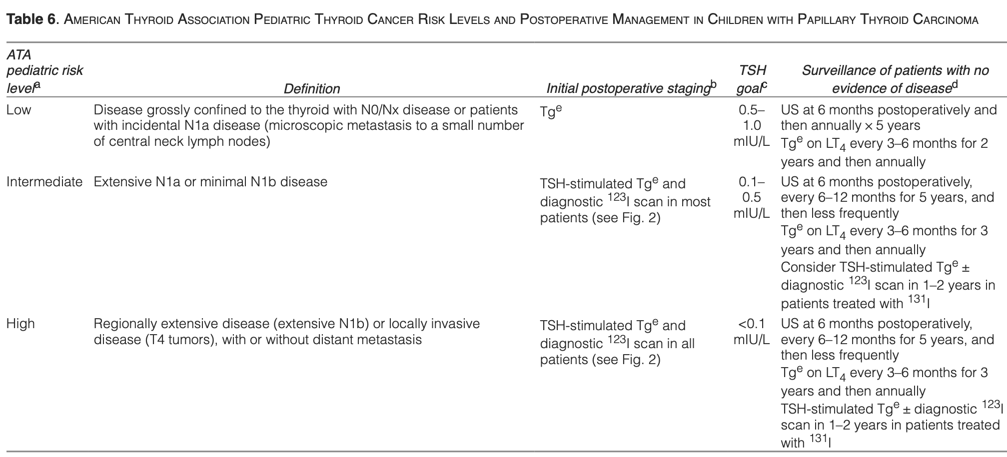
Post-operative follow up

Slide 22
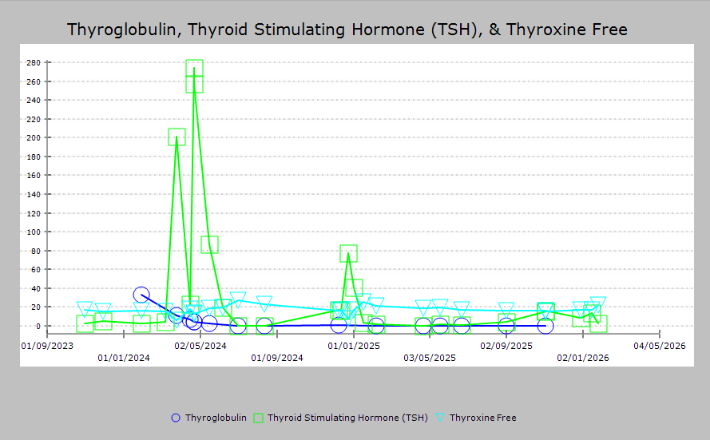
Post-operative follow up

Slide 23
Post-operative follow up
US Neck after 6 months
Both thyroid lobes bed are unremarkable with no definite sonographic evidence of any residual thyroid tissue or recurrence noted
Notes:
FTC low risk stratification and Disease free after surgical intervention

Slide 24
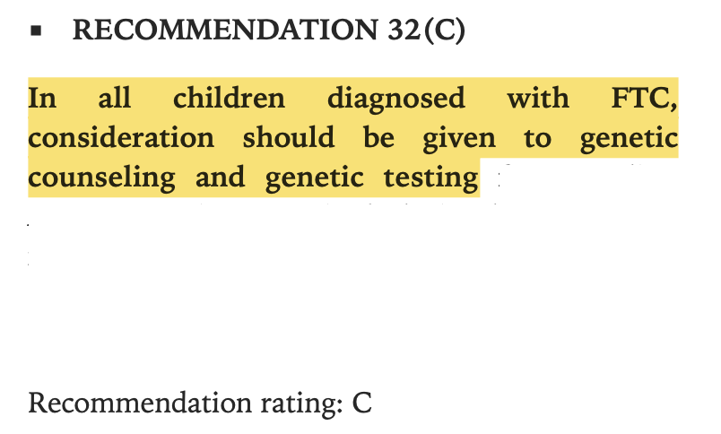
Do we need to consider genetic testing ?
Management Guidelines for Children with Thyroid Nodules and Differentiated Thyroid Cancer
The American Thyroid Association Guidelines Task Force on Pediatric Thyroid Cancer - 2015

Slide 25
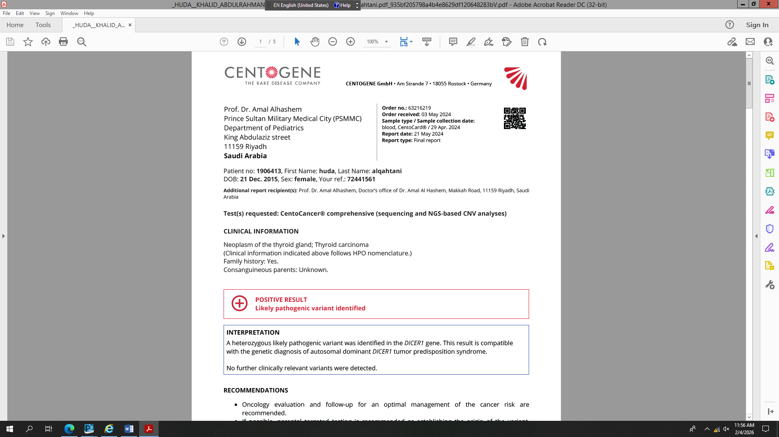

Slide 26
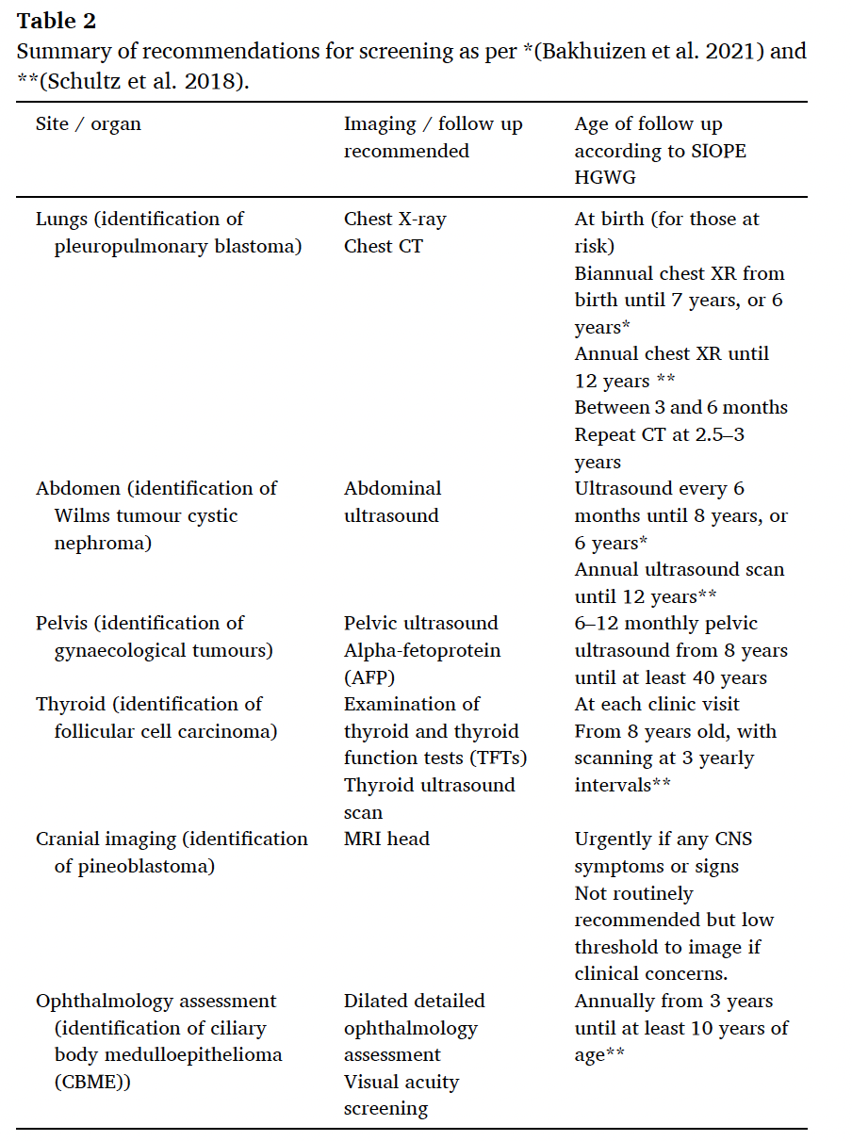
DICER1 syndrome and its various paediatric presentations: Case series and review of the literature
Notes:
Identification of an underlying DICER1 mutation has significant implications
for long-term surveillance and family counseling.

Slide 27
Follow-Up
38y
42y
13 y
8y
4 y

Slide 28
Conclusion
Pediatric FTC rare
Excellent outcome
Genetics
Surveillance is multisystem and age-dependent, requiring long-term follow-up and family screening.

