Slide 1
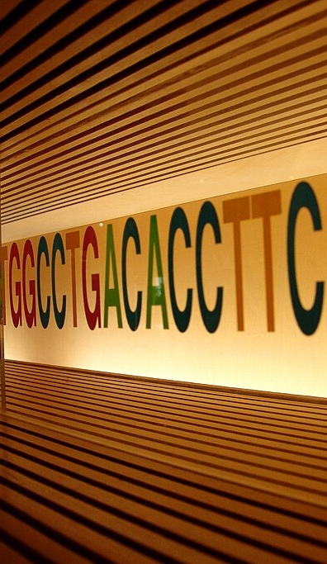
INSR Mutation:
When Common Signs Point to a Rare Diagnosis
Severe hyperinsulinemic hyperandrogenism revealing an INSR receptoropathy
Normal BMI • Marked hyperinsulinemia • Amenorrhea • Virilization
Presented by
Jude AlGhanbar, PGY2, Pediatrics, SFH
Under the guidance of
Nourah Almutlaq, Program Director, Pediatric Endocrinology Fellowship, and Consultant Pediatric Endocrinologist & Pediatric Bone Specialist.
Faisal Alshareef, Division chief of pediatric and Pediatric Consultant.
Abdallah Alfaris, Pediatric Endocrinologist
Faisal Alwady, Pediatric Endocrinologist.
Security Forces Hospital, Ministry of Interior, Riyadh,KSA
Notes:
Open by naming the case and setting the clinical tension. This looked at first like common adolescent hyperandrogenism, but the combination of normal BMI, marked hyperinsulinemia, amenorrhea, and virilization pushed the evaluation toward a receptoropathy. Keep the introduction short and let the next slides build the diagnostic story.
Today im presenting an unusual case of patient presenting with typically metabolic disease related symptoms like acanthosis nigricans and masculinization over the span of a years with a normal body habitus
[Sources]
- Uploaded case presentation: page 1
- Uploaded case presentation: Type A Insulin Resistance Case Presentation.pdf
- DNA sequence image: Wikimedia Commons, File:DNA_sequence.jpg https://commons.wikimedia.org/wiki/File:DNA_sequence.jpg

Slide 2
CLINICAL SIGNIFICANCE
Why this case matters
01
Common presentation, uncommon mechanism
Acanthosis nigricans, hirsutism, and amenorrhea can be misclassified as routine PCOS or HAIR-AN.
Core message
In a normal-weight pubertal girl with marked acanthosis nigricans, virilization, and profound endogenous hyperinsulinemia, an insulin receptoropathy should be considered early.
02
Disproportionate biology
Insulin 488 and C-peptide 8.95 with HbA1c 6.5% suggested severe endogenous insulin resistance out of proportion to common adolescent dysmetabolism.
03
Morphology can mislead
This case teaches recognition of a receptor-level severe insulin resistance phenotype before overt diabetes becomes the dominant problem.
Enlarging hands and feet with voice deepening widened the differential and raised concern for pseudoacromegaloid change in severe insulin resistance.
2
Notes:
Use this slide to tell the audience why the case matters clinically. The message is that the diagnosis was not difficult because the signs were rare; it was difficult because the first signs looked common. Emphasize the mismatch between normal body habitus and the degree of endogenous insulin resistance.
---------
The goal with presenting this case is to highlight the importance of considering other differentials even when the patients present with common symptoms
This patient has reported symptoms such as acanthosis nigricans, hirsutism, and amenorrhea. Upon presentation, the patient had marked peripheral acromegaly despite the otherwise normal body habitus of the patient.
Laboratory evaluation revealed hyperinsulinism and conservative dysglycemia relative to the rise in insulin
in a normal-weight adolescent with severe insulin resistance features, its helpful to think beyond routine causes.
Pigeonholing the differential diagnosis and labeling this presentation as PCOS can be a pitfall, but this clinical picture of dysmetabolism despite a normal body habitus raised concern for insulin receptoropathy
[Sources]
- Uploaded case presentation: Type A Insulin Resistance Case Presentation.pdf
- Mesika A, Klar A, Falik Zaccai TC. INSR-Related Severe Insulin Resistance Syndrome. GeneReviews®. Updated 2024. https://www.ncbi.nlm.nih.gov/books/NBK476444/

Slide 3
HISTORY
From dermatology clues to an endocrine phenotype
Initial entry point
Evolution
Age 12 presentation after nearly 2 years of acanthosis nigricans, hirsutism, and recurrent skin tags
Dermatology review began because skin tags recurred despite laser treatment
Primary amenorrhea
Increasing hand and foot size
Voice change without major weight change
Acanthosis nigricans
Cutaneous progression
Background / family
Acanthosis involved flexural and external skin surfaces
Hirsutism was concentrated under the chin, neck, and cheeks and worsened over time
No known medical or surgical history; no medication or herbal exposure
Full-term birth to non-consanguineous parents; 13-day NICU stay for TTN
Seven healthy siblings; no known endocrine disorders; mother and sisters had menarche at 10-11 years
Hirsutism
Pseudoacromegaly
3
Notes:
Present the history as a progression from common dermatologic complaints to a broader endocrine phenotype. Do not read every bullet. The main point is that the symptoms worsened over time and became hard to explain by routine adolescent hyperandrogenism alone. Mention the family history briefly because the delayed menarche relative to female relatives becomes important later.
----------
Starting with the patient’s history: a 12 year old previously healthy female presented to a dermatology clinic due to reoccurring skin tags for 2 years for laser ablation therapy. Upon further evaluation, the patient had acanthosis nigricans, hirsutism on the face and voice changes. The patient reports that all of the following symptoms have been worsening over the past 2 years.
The patient also reports delayed menarche with a fam hx of menstruation at the age of 10-11 in mother and siblings
[Sources]
- Uploaded case presentation: pages 4-7
- Representative acanthosis nigricans image: Open-i / PMC3005665 https://openi.nlm.nih.gov/detailedresult.php?img=PMC3005665_JCRPE-2-39-g2&req=4
- Representative hirsutism image: Wikimedia Commons / PMC4103002 https://commons.wikimedia.org/wiki/File:PMC4103002_ircmj-16-9410-g001.png
- Representative skin tags image: Wikimedia Commons, File:NeckAcrochordons.jpg https://commons.wikimedia.org/wiki/File:NeckAcrochordons.jpg

Slide 4
PHYSICAL EXAMINATION
Normal body habitus with disproportionate endocrine clues
Weight
Height
BMI
52 kg
164 cm
19.33
Phenotypic summary
75th centile
85th centile
50th centile
Normal-weight pubertal hyperandrogenism with severe insulin resistance and acromegaloid features
Abnormal phenotype
Exam otherwise unrevealing
Marked acanthosis nigricans, especially on the posterior neck
Deep hoarse voice
Acral enlargement of hands and feet
Tanner stage V with normal female external genitalia
Vitals within normal limits; alert, oriented, normal body habitus
ENT otherwise unremarkable; no visible or palpable neck mass
Abdomen soft with no organomegaly
Neurological exam normal; no edema
This mismatch between body habitus and phenotype is what made routine PCOS insufficient as an explanation.
4
Notes:
Use the examination slide to emphasize the mismatch the audience should notice immediately: normal BMI, but severe cutaneous and androgen-related findings. The exam was not dramatic because of obesity or syndromic appearance. It was dramatic because the phenotype was too severe for the body habitus.
------
Notably on exam: the patient has severe AN on the posterior of the neck and extensor surfaces of the skin
She also had acral enlargement of the peripheries, with tanner stage 5
Examination of the patient was remarkable for an otherwise normal body habitus, with a BMI of 19.3 despite prominent AN insulin resistance features noted previously
[Sources]
- Uploaded case presentation: pages 8-9

Slide 5
KEY INVESTIGATIONS
Pattern recognition rather than a lab dump
Severe endogenous insulin resistance
Biochemical hyperandrogenism
Context and exclusionary studies
Insulin
C-peptide
HbA1c
Total T
Free T
DHT
IGF-1: 107
17-hydroxyprogesterone: 148
Chromosomal analysis: 46,XX
Pituitary MRI: normal
CT abdomen/pelvis: no suspicious adrenal lesion
Anti-insulin antibody: 0
488
8.95
6.5%
630
11.9
772
The insulin burden was marked while glycemia was only modestly abnormal.
Androstenedione 505
This supported clinically significant androgen excess rather than isolated cosmetic hirsutism.
5
Notes:
Do not read this slide as a list of isolated values. Explain the pattern: very high endogenous insulin, significant hyperandrogenism, and only modest dysglycemia in a normal-weight adolescent. The supporting studies help show what the workup excluded, but the message is the biology, not the spreadsheet.
-----------
Investigation including labs show hyperinsulinemia and a moderately elevated HbA1C of 6.5%
Androgen workup was also done shows high testosterone and Dihydrotestosterone with a chromosomal analysis of genotypically normal female
Ruling out
[Sources]
- Uploaded case presentation: pages 11-13

Slide 6
DIFFERENTIAL DIAGNOSIS
Why the common labels were not enough
Condition considered
Why it was not sufficient
Routine PCOS / HAIR-AN
The phenotype overlapped, but normal BMI and very severe endogenous hyperinsulinemia made a routine explanation incomplete.
Acromegaly
Acral enlargement and voice change raised concern, but IGF-1 was not elevated and pituitary MRI was normal.
Androgen-secreting tumor
Virilization warranted evaluation, but CT abdomen and pelvis showed no suspicious adrenal lesion.
Nonclassical congenital adrenal hyperplasia
17-hydroxyprogesterone did not support this diagnosis.
Type B insulin resistance
Autoimmune receptor-mediated insulin resistance was considered; anti-insulin antibody was not the decisive exclusion test.
Genetic insulin receptoropathy
This best fit the phenotype and was later confirmed by whole-exome sequencing.
The differential moved from common pubertal hyperandrogenism toward receptor-level severe insulin resistance because the biology was disproportionate to body habitus.
6
Notes:
This is the reasoning slide. Walk through the differential in a disciplined way and show why routine PCOS was not enough. The audience should hear that acromegaly and tumor were taken seriously, but the pattern increasingly favored severe insulin resistance at the receptor level.
The differential considered for this case include
- PCOS: the patient matched the features phenotypically, but hyperinsulinemia and normal BMI are unusual in cases of polycystic ovarian syndrome
Acromegaly and the voice hoarseness but normal lab values of IGF-1 and normal pituitary MRI rules out pituitary tumors
Ruling out androgen secreting tumors is vital given the presence of obvious masculinization, but a normal abdominal and pelvic CT were unremrakble
Nonclassical congenital adrenal hyperplasia was considered but the patient had a normal 17-hydroxyprogesterone upon lab workup
Autoimmune receptor-mediated insulin resistance such a type b insulin resistance was considered but lower on the differential due to anti-insulin antibody was 0
A diagnosis of genetic insulin receptoropathy was considered so a whole exome sequencing was sent
[Sources]
- Uploaded case presentation: pages 11-13
- Uploaded case presentation: pages 15-18
- Mesika A, Klar A, Falik Zaccai TC. INSR-Related Severe Insulin Resistance Syndrome. GeneReviews®. Updated 2024. https://www.ncbi.nlm.nih.gov/books/NBK476444/
- Giustina A, et al. Consensus on criteria for acromegaly diagnosis and remission. Pituitary. 2024;27:7-22. https://pmc.ncbi.nlm.nih.gov/articles/PMC10837217/
- Jialal I, et al. Syndromes of autoantibodies to the insulin receptor. StatPearls/NCBI Bookshelf. 2022. https://pmc.ncbi.nlm.nih.gov/articles/PMC9884337/

Slide 7
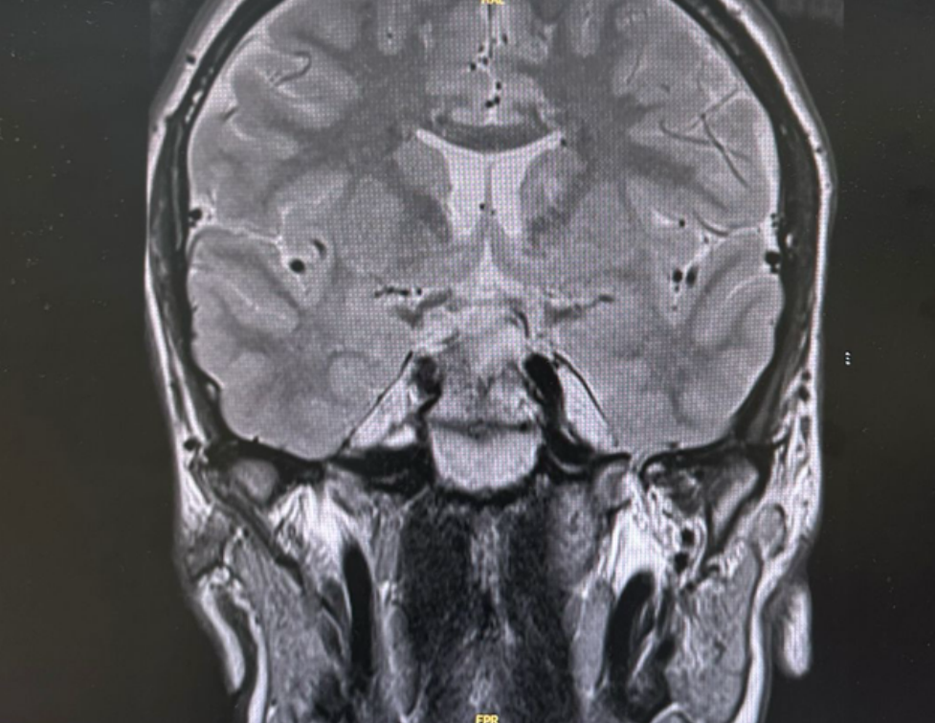
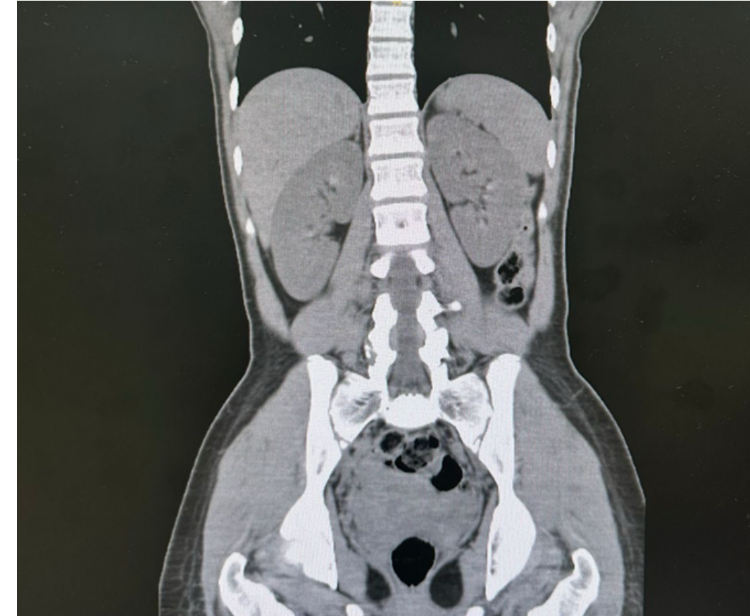
IMAGING WORK-UP
Radiology excluded the main structural alternatives
Pituitary MRI
CT abdomen and pelvis
Normal
No suspicious adrenal lesion
7
Notes:
Show the audience that the structural work-up was appropriate and negative. The MRI matters because acromegaloid features raised concern for pituitary disease, and the CT matters because virilization raised concern for adrenal pathology. These images help the audience see that the common structural alternatives were actively excluded.
The patient’s late onset presentation of masculinization and hyperinsulinemia raised serious concern for maligannacy so a pituitary MRI and abdominal and pelvic CT were done to rule out any tumors of the pituitary and adrenal glands
Imaging was unremarkable for both
[Sources]
- Uploaded case presentation: pages 11-13

Slide 8
GENETIC CONFIRMATION
Whole-exome sequencing identified a homozygous pathogenic variant in the INSR gene.
Final diagnosis
Type A insulin resistance due to insulin receptor dysfunction
The phenotype fit because of pubertal onset, hyperinsulinemia out of proportion to body habitus, amenorrhea, hyperandrogenism, acanthosis nigricans, and acromegaloid features.
8
Notes:
This is the reveal slide. Pause briefly after showing the sequencing result, then name the final diagnosis clearly. After that, connect the genotype back to the phenotype so the audience understands why the diagnosis makes clinical sense, not just genetic sense.
-------------------
Results of the WES showed a pathogenic variant in the iNSR gene:
With the clinical picture, our patient had severe insulin resistance clinical features, hyperinsulinemia, mild dysglycemia, hypyertestosteronemia, and a normal BMI which can be explained due to a defect in the insulin receptor function
[Sources]
- Uploaded case presentation: pages 15-18
- Mesika A, Klar A, Falik Zaccai TC. INSR-Related Severe Insulin Resistance Syndrome. GeneReviews®. Updated 2024. https://www.ncbi.nlm.nih.gov/books/NBK476444/
- DNA sequence image: Wikimedia Commons, File:DNA_sequence.jpg https://commons.wikimedia.org/wiki/File:DNA_sequence.jpg

Slide 9
CASE SUMMARY
How the phenotype reads in retrospect
Age 12
Biochemistry
Genetics / follow-up
Primary care and dermatology evaluation for acanthosis nigricans, hirsutism, and recurrent skin tags.
Marked hyperinsulinemia with biochemical hyperandrogenism and only modest dysglycemia.
Whole-exome sequencing showed a homozygous pathogenic INSR variant; follow-up showed strong metabolic improvement with persistent biochemical hyperandrogenism.
Progression
Imaging
Primary amenorrhea, enlarging hands and feet, and voice deepening without major weight change.
Pituitary MRI was normal; CT abdomen and pelvis showed no suspicious adrenal lesion.
The case evolved from common dermatologic and menstrual complaints into a recognizable phenotype of severe insulin resistance.
9
Notes:
Now that the diagnosis is known, this slide lets you summarize the case without spoiling the mystery too early. Walk from first presentation to follow-up in a straight line. The purpose is to help the audience see the overall arc and remember the sequence of clues.
-----------
Looking back, the progression becomes clear
To summarize the case this patient had presented with a year long history of progressive of acanthosis nigricans hirsutism and recurrent still skin tags
A closer look at the history revealed delete menarche progressive deepening of the voice and peripheral acromegaly with no changes in BMI
Investigations including Investigations including labwork and imaging showed hyperinsulinaemia, bio chemical hyperandrogenism, and imaging helped rule out pituitary and adrenal malignancies
Finally a genetic study performed showed a mutation in the INRS gene providing the definitive diagnosis

Slide 10
TYPE A INSULIN RESISTANCE
Phenotype in context
Overview
Variable phenotype
Clinical red flags
Severe insulin resistance caused by defects in insulin receptor signaling
Usually becomes clinically apparent around puberty
Often resembles polycystic ovary syndrome
Caused by heterozygous, homozygous, or compound heterozygous INSR mutation
Few reports describe treatment and long-term follow-up
Acanthosis nigricans, hirsutism, skin tags
Acral hypertrophy and voice change
PCOS-like presentation
Dental anomalies and protrusion of the eyeballs can be reported
Acanthosis nigricans without obesity
Delayed menarche compared with family members
Severe hirsutism with a normal female phenotype
10
Notes:
Here you briefly step back from the individual patient and define the disorder. Keep it practical: what is it, when does it tend to present, and what clues should make clinicians think about it. This slide turns the case into a reusable diagnostic pattern for the audience.
----------
Moving onto the disorder
What is type a insulin resistance?
A disorder characterized by severe insulin resistance due to defects in insulin receptor signaling
Often linked to mutations of the INSR gene
Patient often presents around puberty as many symptoms mimic those of polycystic ovarian syndrome
The phenotype is variable, but more often than not patients presents with marked acanthosis nigricans and other dermatological manifestations such as skin tags
Many also report hirsutism and acral hypertrophy, with noticeable voice changes
A few reported cases described dental anomalies and protrusion of the eyeballs
These symptoms presents often in endocrine clinics but findings of acanthosis Nigerians in the context of this patient with a normal BMI as well as delayed menarche in comparison to family members was a red flags
[Sources]
- Uploaded case presentation: pages 15-18
- Mesika A, Klar A, Falik Zaccai TC. INSR-Related Severe Insulin Resistance Syndrome. GeneReviews®. Updated 2024. https://www.ncbi.nlm.nih.gov/books/NBK476444/
- Hacıhamdioğlu B, Baş EG, Delil K. Homozygous Mutation in the Insulin Receptor Gene Associated with Mild Type A Insulin Resistance Syndrome: A Case Report. J Clin Res Pediatr Endocrinol. 2021. https://jcrpe.org/articles/homozygous-mutation-in-the-insulin-receptor-gene-associated-with-mild-type-a-insulin-resistance-syndrome-a-case-report/jcrpe.galenos.2020.2019.0213

Slide 11
PATHOPHYSIOLOGY
How one receptor defect explains the phenotype
INSR dysfunction
Impaired metabolic insulin signaling
Compensatory hyperinsulinemia
Skin
Ovary
Soft tissue
Glucose homeostasis
Acanthosis nigricans
Skin tags
Hyperandrogenism
Amenorrhea
Acromegaloid
change
Prediabetes /
diabetes risk
The phenotype is driven less by adiposity and more by receptor failure plus compensatory hyperinsulinemia.
11
Notes:
Explain this slide in very simple physiology. The receptor defect weakens the metabolic insulin signal, so the body compensates by making much more insulin. That high insulin level then helps explain the skin findings, ovarian androgen excess, soft-tissue change, and later metabolic risk.
----------------------
Going back to the physiology of insulin receptors function, signs of hyperinsulinemia often mimic those of adiposity
In this disorder, the receptor defect weakens the body’s response to a rise in insulin in compensatory mechanisms, cause a release of more insulin than needed
High insulin then drives:”
“Skin changes → acanthosis”
“Ovarian androgen production → hyperandrogenism”
“Soft tissue growth → pseudoacromegaly”
and finally on a biochemical level this in manifestations such as pre-diabetes/diabetes risk similar to those present in adiposity but without obesity
[Sources]
- Mesika A, Klar A, Falik Zaccai TC. INSR-Related Severe Insulin Resistance Syndrome. GeneReviews®. Updated 2024. https://www.ncbi.nlm.nih.gov/books/NBK476444/

Slide 12
LITERATURE SYNTHESIS
Selected evidence relevant to this case
Study
Phenotype / genetics
Treatment focus
Main relevance to this case
Hacıhamdioğlu et al., 2021
Adolescent girl with mild Type A insulin resistance caused by a homozygous INSR variant
Metformin and lifestyle; later OCP with cyproterone; insulin added when glycemia worsened
Shows that homozygous INSR variants can present with a relatively mild pubertal phenotype
Chen et al., 2022
Type A insulin resistance with 5-year follow-up
Pioglitazone and flutamide
Reported metabolic improvement and reduced masculinization
Huang-Doran et al., 2021
Primary severe insulin resistance with ovarian hyperandrogenism
GnRH analogue in selected refractory cases
Supports gonadotropin dependence of ovarian hyperandrogenism in severe insulin resistance
GeneReviews, 2024
INSR-related severe insulin resistance spectrum
Multidisciplinary evaluation and surveillance
Highlights that management is individualized and the evidence base is limited
Overall evidence base: case reports, small series, and expert opinion rather than controlled trials.
12
Notes:
This slide should sound balanced and honest. The literature supports the diagnosis and offers treatment examples, but the evidence base is still limited. The key takeaway is that management is individualized because most of the evidence comes from case reports, small series, and expert reviews.
-------------
As there are no systemic reviews or meta-analyses of clinical trials studying the clinical course and management of INSR mutations it’s difficult to describe a management plan
A few case, reports and series published help guide diagnosis and management, such as the following
1. Published in 2021 a case report describes an adolescent female type A insulin resistance, with a prediabetic HBA 1C, marked hirsutism with a Modified Ferriman-Gallwe score of 30.. the novel elements of this paper is the homozygous inheritance pattern as most identified mutations were heterozygous.
2. Second is a case report following a patient with an identified INSR heterozygous mutation that was treated with a combination of pioglitazone and flutamide over the course of five years. Evidently the use of flutamide helps decrease some of the masculinization both clinically and lab wise with the decrease in serum testosterone and the start of menstruation nine months after the initiation of treatment
3. the third case Is a retrospective case study of primary insulin resistance with ovarian hyperandrogenism. The focus of the study lied in using GNRH analogue for the management of hyperandrogenism and showed great improvement in serum testosterone and free testosterone in patients with insulin resistance without lipodystrophy
4. finally a study published in gene review describes the pathogenesis, clinical course and suggested management plans of other related genetic insulin resistance disorders like Donahue syndrome and Rabson-mendenhall syndrome. Due to similarities in the pathogenesis it’s a helpful guide to constructing a case by case management plan depending on patient’s needs and response to therapy
[Sources]
- Hacıhamdioğlu B, Baş EG, Delil K. Homozygous Mutation in the Insulin Receptor Gene Associated with Mild Type A Insulin Resistance Syndrome: A Case Report. J Clin Res Pediatr Endocrinol. 2021. https://jcrpe.org/articles/homozygous-mutation-in-the-insulin-receptor-gene-associated-with-mild-type-a-insulin-resistance-syndrome-a-case-report/jcrpe.galenos.2020.2019.0213
- Chen YH, Chen QQ, Wang CL. Treatment and Five-Year Follow-Up of Type A Insulin Resistance Syndrome: A Case Report. World J Clin Cases. 2022. https://pmc.ncbi.nlm.nih.gov/articles/PMC8968608/
- Huang-Doran I, et al. Ovarian Hyperandrogenism and Response to Gonadotropin-Releasing Hormone Analogues in Primary Severe Insulin Resistance. J Clin Endocrinol Metab. 2021. https://academic.oup.com/jcem/article/106/8/2367/6253797
- Mesika A, Klar A, Falik Zaccai TC. INSR-Related Severe Insulin Resistance Syndrome. GeneReviews®. Updated 2024. https://www.ncbi.nlm.nih.gov/books/NBK476444/

Slide 13
MANAGEMENT FRAMEWORK
Problem-based approach
1
Glycemia and insulin resistance
2
Hyperandrogenism and reproductive protection
3
Genetics and family
4
Surveillance
Metformin as a first insulin-sensitizing strategy
Consider thiazolidinedione if response is incomplete
Aim to reduce insulin burden and delay progression of dysglycemia
Induce or regulate cycles
Protect the endometrium
Use OCP or antiandrogen strategies when appropriate
Laser is an adjunct, not definitive endocrine treatment
Genetic counseling and recurrence-risk discussion
Consider family testing when available
Address future reproductive counseling early
Follow HbA1c, glucose profile, insulin, and C-peptide
Track clinical and biochemical hyperandrogenism separately
Monitor ovarian, endometrial, and diabetes-related complications
13
Notes:
Present management as four linked problems rather than one generic treatment list. This structure sounds more mature and helps the audience see that metabolic control, androgen burden, reproductive protection, counseling, and surveillance all have to move together.
--------
The goal of therapy is to create a management framework that targets both the patient's current clinical manifistations as well as prevention of deterioration and complications
Insulin sensitizers such as metformin can help achieve normoglycemia and reduce the insulin burden as first line therapy
Reducing hyperandrogenism is essential for both reproductive protection and and cosmetic management. Inducing or regulating cycles, using oral contraceptives or antiandrogens can I help protect the endometrium and decrease free serum testosterone preserving feritily for future family planning
Laser hair removal therapy in conjunction with anti-androgens can improve the manifestations of hirsutism reducing psychological stress
Future planning is necessary and genetic counseling can help with recurrence and risk reduction when appropriate
Follow up is essential to monitor both the progression of the disease and help prevent diabetes related complications
[Sources]
- Uploaded case presentation: pages 21-25
- Semple RK, Williams RM, Dunger DB. What Is the Best Management Strategy for Patients With Severe Insulin Resistance? Clin Endocrinol (Oxf). 2010. https://pubmed.ncbi.nlm.nih.gov/20455892/
- Mesika A, Klar A, Falik Zaccai TC. INSR-Related Severe Insulin Resistance Syndrome. GeneReviews®. Updated 2024. https://www.ncbi.nlm.nih.gov/books/NBK476444/

Slide 14
MANAGEMENT IN OUR PATIENT
Case-specific application
Implemented
Early response
Ongoing issues
Metformin
Menstrual induction or cycle-management strategy in progress
Spironolactone
Cosmetic treatment of hirsutism, including laser
Routine endocrine follow-up and counseling
HbA1c improved
Insulin and C-peptide fell markedly
Hirsutism improved clinically after Spironolactone
Total testosterone remained elevated
Reproductive and endometrial management still required
Continued monitoring needed for dysglycemia and phenotype progression
Management addressed metabolic control and androgen-related morbidity in parallel.
14
Notes:
This slide brings the management framework back to the actual patient. Keep the explanation concrete: what was done, what improved early, and what still needed work. The important point is that metabolic improvement was strong, but androgen control remained incomplete.
------------------
In our patient, the previously mentioned management to framework was applied
The patient was started on metformin with a favorable response in HbA1C levels
Spironolactone was also used for androgen control and with concurrent laser therapy. The hirsutism markedly improved, although testosterone levels were still elevated.
Menstrual induction using medroxyprogesterone was started and is currently in progress. Future family planning is critical to keep in mind early and throught the disease course
[Sources]
- Uploaded case presentation: pages 21-25

Slide 15
RESPONSE TO THERAPY
Follow-up outcomes
Parameter
Presentation
Follow-up
Interpretation
HbA1c (%)
6.5
5.8
Improved glycemia
presentation
follow-up
Insulin
488
56.8
Marked fall in hyperinsulinemia
presentation
follow-up
C-peptide
8.95
2.62
Improved endogenous insulin burden
presentation
follow-up
Total testosterone
630
639
No clear biochemical improvement
presentation
follow-up
Clinical follow-up: hirsutism improved with concurrent laser treatment. Menstruation induction was in progress, and no further clinical progression of acromegaloid features was reported during follow-up.
Overall summary: strong metabolic improvement, but incomplete biochemical androgen control.
15
Notes:
This slide is where you show outcome honestly. The metabolic response was clearly strong, but the biochemical androgen response was not. Say that clearly. It makes the presentation more credible and sets up the discussion about why metabolic and androgen endpoints should be reported separately.
------
Follow up was crucial to monitor disease outcomes using this framework
Her HbA1C improved from 6.5 to 5.8
So did insulin levels which went from 488 to 56.8
C peptide levels also went down from 8.95 to 2.62
Her response to insulin sensitizers was prosing, however, there was minimal biochemical improvement in androgenic response
Total testosterone levels upon presentation and follow up for nearly identical despite clinical improvement
[Sources]
- Uploaded case presentation: pages 21-25

Slide 16
DISCUSSION
Key clinical points
01
Normal BMI does not exclude severe insulin resistance when the defect is receptor-level.
04
Acromegaly was approached with IGF-1-centered reasoning and pituitary imaging, not by relying on a random GH value alone.
02
This phenotype should not be labeled routine PCOS too early.
05
Type B insulin resistance is receptor-antibody mediated; anti-insulin antibody is not the key exclusion test.
03
Acromegaloid features in this context should raise pseudoacromegaly as well as pituitary disease.
06
Metabolic improvement and androgen control should be reported separately.
The diagnostic shift occurred when the severity of the biology was recognized as disproportionate to the common label.
16
Notes:
Use the discussion slide to sound thoughtful rather than repetitive. These are the six points you want the audience to remember after the case details fade. The most important ones are the mismatch with BMI, the danger of premature PCOS labeling, and the need to separate metabolic and androgen outcomes.
------------
This case highlights several important clinical lessons.
First, normal BMI does not exclude severe insulin resistance — particularly in cases of receptor defects.
Second, this should not be prematurely labeled as routine PCOS.” “The severity of hyperinsulinemia was disproportionate to typical PCOS
Third, acromegaloid features in this context are misleading — this was pseudoacromegaly, not true acromegaly as it was appropriately using IGF-1 and MRI, not random GH levels.
Type B insulin resistance is autoimmune, and anti-insulin antibodies are not the key diagnostic test.
Finally, always separating the metabolic and androgen outcomes is essential as they don’t always improve at the same rate even with appropriate management
[Sources]
- Mesika A, Klar A, Falik Zaccai TC. INSR-Related Severe Insulin Resistance Syndrome. GeneReviews®. Updated 2024. https://www.ncbi.nlm.nih.gov/books/NBK476444/
- Giustina A, et al. Consensus on criteria for acromegaly diagnosis and remission. Pituitary. 2024;27:7-22. https://pmc.ncbi.nlm.nih.gov/articles/PMC10837217/
- Jialal I, et al. Syndromes of autoantibodies to the insulin receptor. StatPearls/NCBI Bookshelf. 2022. https://pmc.ncbi.nlm.nih.gov/articles/PMC9884337/
- Uploaded case presentation: pages 21-25

Slide 17
MONITORING AND LONGITUDINAL PLAN
What should be followed over time
Metabolic
Androgen / reproductive
Genetics / family
Complications and support
HbA1c
Glucose profile or CGM when needed
Insulin and C-peptide
Progression toward diabetes
Menstrual pattern
Hirsutism severity
Testosterone / androgen profile
Endometrial protection
Genetic counseling
Segregation or family testing if available
Future fertility and pregnancy counseling
Diabetes-related complications as indicated
Psychosocial support
Adherence and lifestyle reinforcement
17
Notes:
This slide shows that the case does not end with diagnosis or the first therapeutic response. Follow-up must remain structured across metabolic, androgen, reproductive, genetic, and psychosocial domains. That is especially important in rare disorders where long-term data are limited.
---------
Management doesn’t stop at diagnosis — this condition requires long-term follow-up
we monitor progression to diabetes using labs such as HbA1c, glucose profile, insulin levels
reproductive health is a mainstay: achieving a physiological menstrual pattern, reducing hirsutism, and decreasing androgen biochemical leevls levels can make a big difference especially when it comes to endometrial protection and future fertility counseling
As this is a multidisciplinary, lifelong condition family counseling and genetic testing should be offered when available as well as psychosocial support, to improve quality of life
----------------
- Mesika A, Klar A, Falik Zaccai TC. INSR-Related Severe Insulin Resistance Syndrome. GeneReviews®. Updated 2024. https://www.ncbi.nlm.nih.gov/books/NBK476444/
- Semple RK, Williams RM, Dunger DB. What Is the Best Management Strategy for Patients With Severe Insulin Resistance? Clin Endocrinol (Oxf). 2010. https://pubmed.ncbi.nlm.nih.gov/20455892/

Slide 18
TAKE-HOME MESSAGE
In a normal-weight pubertal girl with severe acanthosis nigricans, hyperandrogenism, amenorrhea, and marked endogenous hyperinsulinemia, think beyond routine PCOS.
Acromegaloid features in this setting may represent pseudoacromegaloid change related to severe insulin resistance.
An INSR mutation can unify the phenotype and guide counseling, treatment, and follow-up.
This case showed a strong metabolic response, but biochemical androgen control remained incomplete.
The lesson is not just the mutation. The lesson is recognizing the pattern before overt diabetes dominates the case.
18
Notes:
End with the diagnostic pattern, not just the mutation name. The audience should leave remembering that normal BMI does not protect against severe insulin resistance when the defect is at the receptor level. Also reinforce that clinical improvement and biochemical androgen control are not always the same thing.
-------------------
“If there’s one message from this case, it’s this:” “In a normal-weight pubertal girl with severe acanthosis, hyperandrogenism, and marked hyperinsulinemia — think beyond the common, beyond PCOS
The presence of acromegaloid features should raise suspicion for severe insulin resistance syndromes.” “An INSR mutation can unify the entire phenotype.” To be patient with progress as even with treatment, and adequate metabolic control, androgenic clinical response may be faster than the biochemic response
→ Recognizing the pattern early prevents delayed diagnosis and complications
-------------
[Sources]
- Mesika A, Klar A, Falik Zaccai TC. INSR-Related Severe Insulin Resistance Syndrome. GeneReviews®. Updated 2024. https://www.ncbi.nlm.nih.gov/books/NBK476444/
- Uploaded case presentation: pages 21-25

Slide 19
Thank you
Questions?
INSR mutation case presentation
19
Notes:
End cleanly and pause for questions. If discussion becomes detailed, the appendix slides can be used as backup for raw numbers and references.
[Sources]
- Uploaded case presentation: Type A Insulin Resistance Case Presentation.pdf

Slide 20
APPENDIX
Raw laboratory values at presentation
Parameter
Value
Parameter
Value
Sodium
144
Vit D
29.9
Potassium
4.6
ACTH
15.77
Chloride
107
Aldosterone
9.6
Urea
2.7
Renin
4.9
Creatinine
46
Androstenedione
505
Calcium
2.55
Dihydrotestosterone
772
Corrected calcium
2.39
17-hydroxyprogesterone
148
Phosphorus
1.06
Testosterone, free
11.9
Alkaline phosphatase
94
Testosterone, total
630
HbA1c (%)
6.5
Chromosomal analysis
46,XX
Anti-insulin antibody
0
FSH
8.1
Insulin
488
Procalcitonin
228
C-peptide
8.95
Estrogen
322
IGF-1
107
Growth hormone
3.7
LH
8.54
20
Notes:
This is a backup slide for questions about the raw numbers at presentation. It is not necessary to present routinely unless someone asks for details that were intentionally simplified in the main deck.
[Sources]
- Uploaded case presentation: pages 11-13

Slide 21
APPENDIX
Follow-up raw values
Parameter
Presentation
Follow-up
HbA1c (%)
6.5
5.8
Clinical follow-up from the source deck
Anti-insulin antibody
0
N/A
Reduced virilization
Improved hirsutism with concurrent laser treatment
Induction of menstruation trial in progress
Insulin
488
56.8
C-peptide
8.95
2.62
IGF-1
107
N/A
Dihydrotestosterone
772
N/A
FSH
8.1
7.7
LH
8.54
10.8
Estradiol (pg/mL)
367
377
Total testosterone
630
639
17-hydroxyprogesterone
148
N/A
21
Notes:
This is another backup slide. It can be used if someone asks for the raw follow-up values or wants to see exactly which biochemical parameters changed and which did not.
[Sources]
- Uploaded case presentation: pages 21-25

Slide 22
SELECTED REFERENCES
Key sources used in this presentation
1. Mesika A, Klar A, Falik Zaccai TC. INSR-Related Severe Insulin Resistance Syndrome. GeneReviews®. Updated 2024.
2. Hacıhamdioğlu B, Baş EG, Delil K. Homozygous Mutation in the Insulin Receptor Gene Associated with Mild Type A Insulin Resistance Syndrome. J Clin Res Pediatr Endocrinol. 2021.
3. Huang-Doran I, et al. Ovarian Hyperandrogenism and Response to Gonadotropin-Releasing Hormone Analogues in Primary Severe Insulin Resistance. J Clin Endocrinol Metab. 2021.
4. Chen YH, Chen QQ, Wang CL. Treatment and Five-Year Follow-Up of Type A Insulin Resistance Syndrome: A Case Report. World J Clin Cases. 2022.
5. Semple RK, Williams RM, Dunger DB. What Is the Best Management Strategy for Patients With Severe Insulin Resistance? Clin Endocrinol. 2010.
6. Giustina A, et al. Consensus on criteria for acromegaly diagnosis and remission. Pituitary. 2024.
7. Jialal I, et al. Syndromes of Autoantibodies to the Insulin Receptor. 2022.
22
Notes:
This slide is mainly a backup reference list. The main literature message has already been covered in the body of the talk.
[Sources]
- Mesika A, Klar A, Falik Zaccai TC. INSR-Related Severe Insulin Resistance Syndrome. GeneReviews®. Updated 2024. https://www.ncbi.nlm.nih.gov/books/NBK476444/
- Hacıhamdioğlu B, Baş EG, Delil K. Homozygous Mutation in the Insulin Receptor Gene Associated with Mild Type A Insulin Resistance Syndrome: A Case Report. J Clin Res Pediatr Endocrinol. 2021. https://jcrpe.org/articles/homozygous-mutation-in-the-insulin-receptor-gene-associated-with-mild-type-a-insulin-resistance-syndrome-a-case-report/jcrpe.galenos.2020.2019.0213
- Huang-Doran I, et al. Ovarian Hyperandrogenism and Response to Gonadotropin-Releasing Hormone Analogues in Primary Severe Insulin Resistance. J Clin Endocrinol Metab. 2021. https://academic.oup.com/jcem/article/106/8/2367/6253797
- Chen YH, Chen QQ, Wang CL. Treatment and Five-Year Follow-Up of Type A Insulin Resistance Syndrome: A Case Report. World J Clin Cases. 2022. https://pmc.ncbi.nlm.nih.gov/articles/PMC8968608/
- Semple RK, Williams RM, Dunger DB. What Is the Best Management Strategy for Patients With Severe Insulin Resistance? Clin Endocrinol (Oxf). 2010. https://pubmed.ncbi.nlm.nih.gov/20455892/
- Giustina A, et al. Consensus on criteria for acromegaly diagnosis and remission. Pituitary. 2024;27:7-22. https://pmc.ncbi.nlm.nih.gov/articles/PMC10837217/
- Jialal I, et al. Syndromes of autoantibodies to the insulin receptor. StatPearls/NCBI Bookshelf. 2022. https://pmc.ncbi.nlm.nih.gov/articles/PMC9884337/

