Slide 1
Challenging case
Done by:
Dr.Alaa Bokhari
Paediatric endocrine consultant, HMG Arrayan

Slide 2
History
2yrs and 10m old Sudanese girl presented at age of 17m to our ER with hx of polyuria, polydipsia for one week admitted in 01/2025 as newly diagnosed T1DM without DKA.
Mother is working as a NICU nurse, so she checked her RBS and was 500mg/dl.
She is one of twins, twin II, 34 weeks ,birth wt=2.1kg, monochorionic/diamniotic twins.
No hx of previous medical illnesses or admissions.
had URTI one week prior to her symptoms.
No hx of previous Covid-19 infection.
Other Systemic review were all unremarkable.

Slide 3
History
Family Hx:
No consanguinity, she is the first affected member with T1DM.
Her grandparents have T2DM, she has two elder twin sisters who are healthy.
Development, Allergy, Immunization >>Unremarkable.
On Examination:
Wt=9.2kg>> on 10th % CDC chart
Ht=81cm>> on 50th % CDC chart
Normal Systemic examination.

Slide 4
Investigations
Labs | Result | Normal range
HgbA1C | 7.7% | <5.7%
CBC | Unremarkable
TSH | 0.38 | 0.4-5.5 mIU/L
Free T4 | 12.54 | 9-19 pmol/l
C peptide | 0.32 | 1.11-4.43 noml/l
GAD abs | 43.47 | <10 IU/ml
ICA abs | 1:10 | <1:10
IAA | 9.1 | <1:0.4 U/ml
IA-2 | 367 | <10 IU/ml
ZnT8 | 1497 | <15 U/ml
TTG IgA abs | Negative
Renal +liver profile | Unremarkable

Slide 5
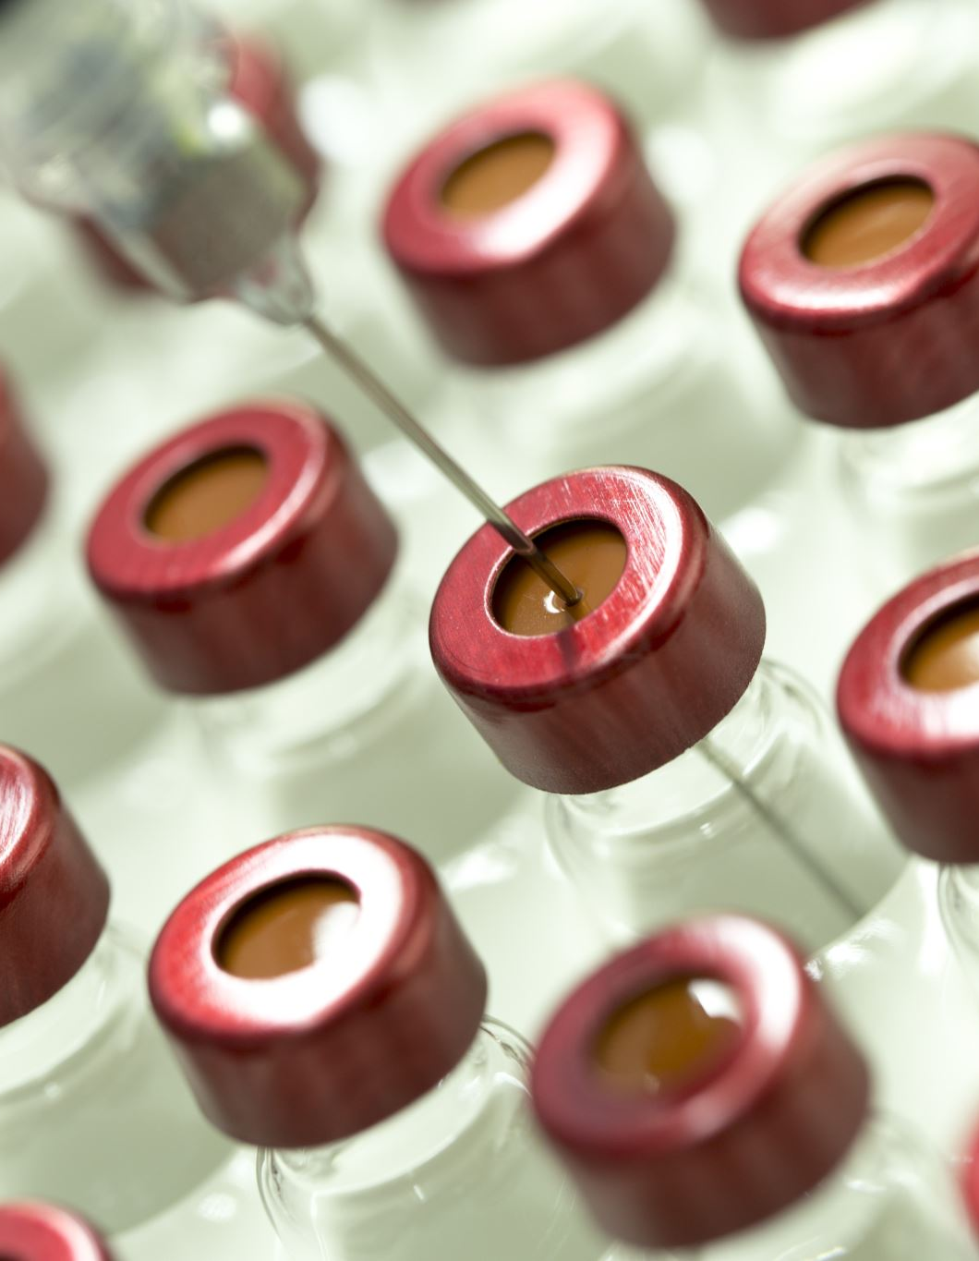
Management
Started on multiple daily injection of 0.7 U/kg/day total insulin (Insulin Tresiba 60% + Insulin Novorapid 40%).
ISF= 1:100>200 mg/dl , ICR=1:25gm
She was on bottle feeding ,mother tried to give it twice daily with change to Glucerna milk.
She is compliant on treatment and mother was covering both main meals and snacks.
She was followed in OPD and was on Dexcom CGM sensor.

Slide 6
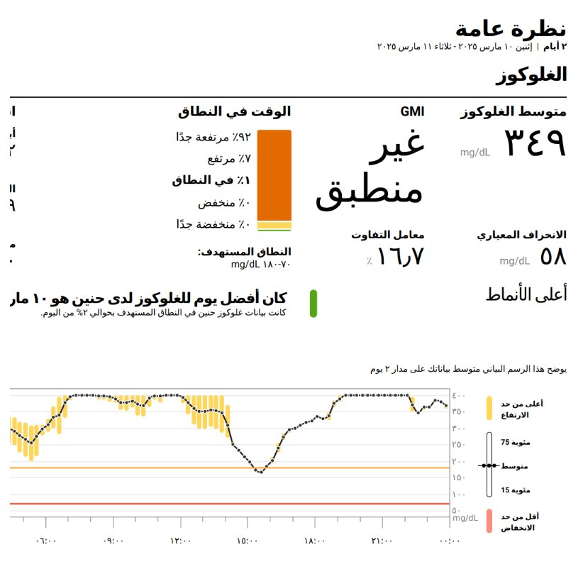
CGM report

Slide 7
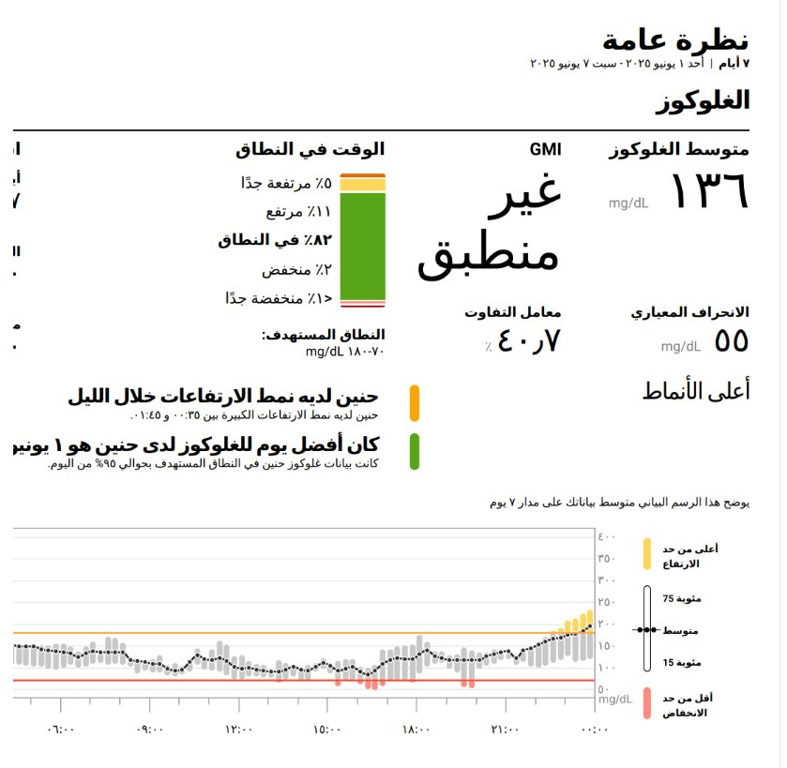
CGM report

Slide 8
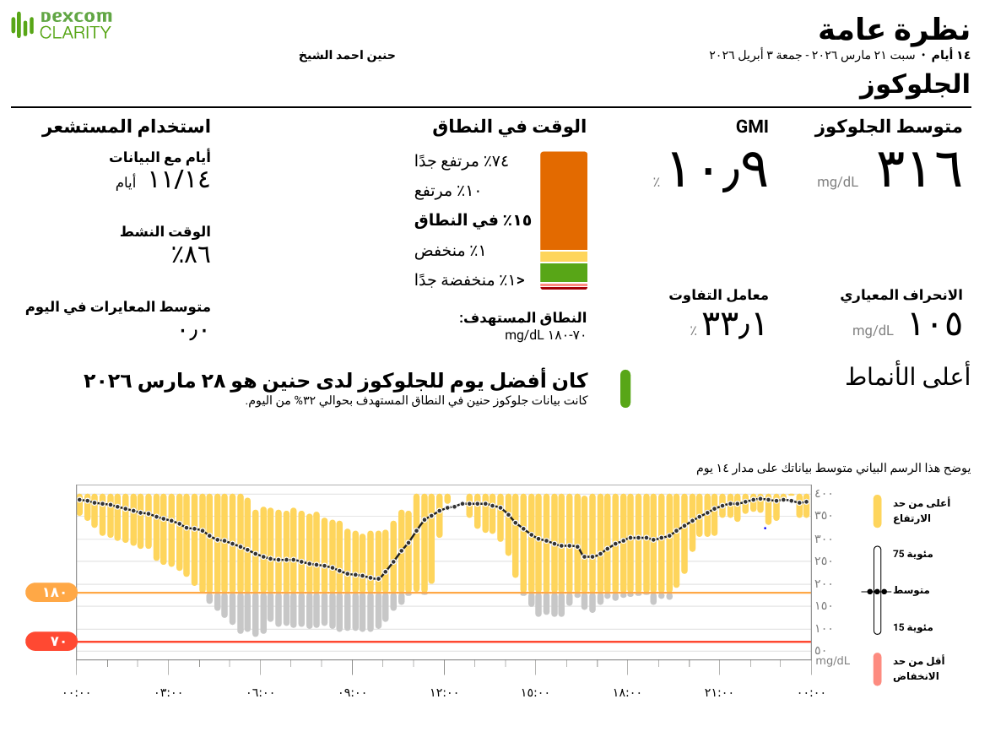
CGM report

Slide 9
Follow up
Family are CASH patient and followed every 3-4 months.
Mother is a busy worker and has many shifts.
Her grandmother is also her care giver at home, but she missed many insulin injections, so her father at breaktime goes back home to give insulin injections.
She is attached to bottle feeding at night and has multiple snacks throughout daytime.
Her parents were instructed that they need more compliance, they were taught and followed by our dietitian about carb counting.
She was very poorly controlled and her HgbA1C was never below 10% since her diagnosis.

Slide 10
Follow up
How can this patient have a better plan to control her blood glucose??
Insulin pump was discussed and started on 04/2026.
Started on Medtrum Patch pump.

Slide 11
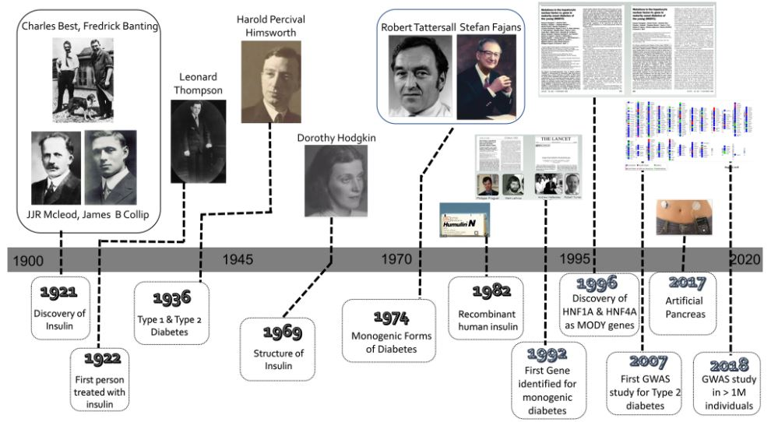
Overview of insulin

Slide 12
Insulin pump innovation

Slide 13
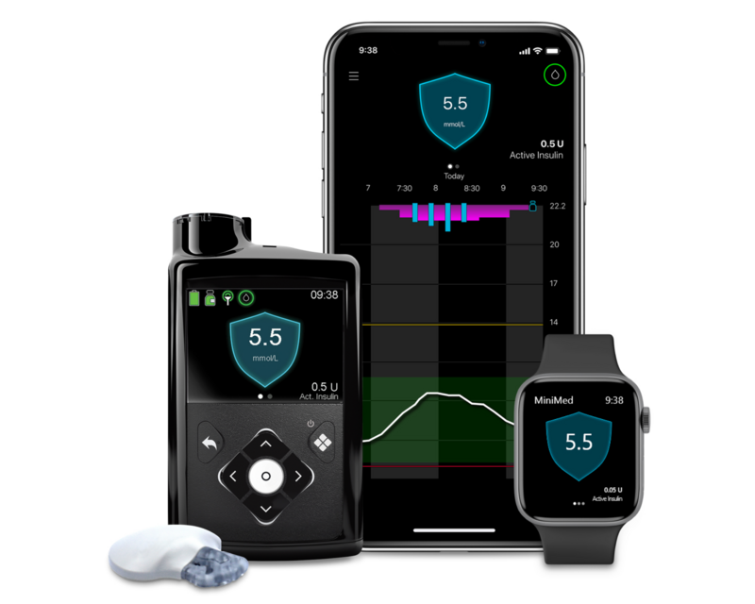
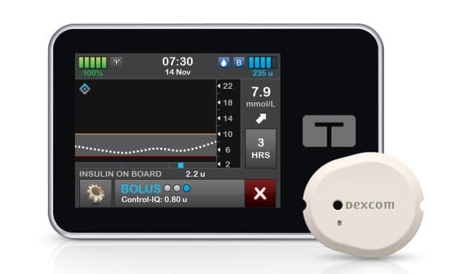
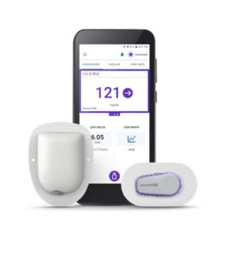
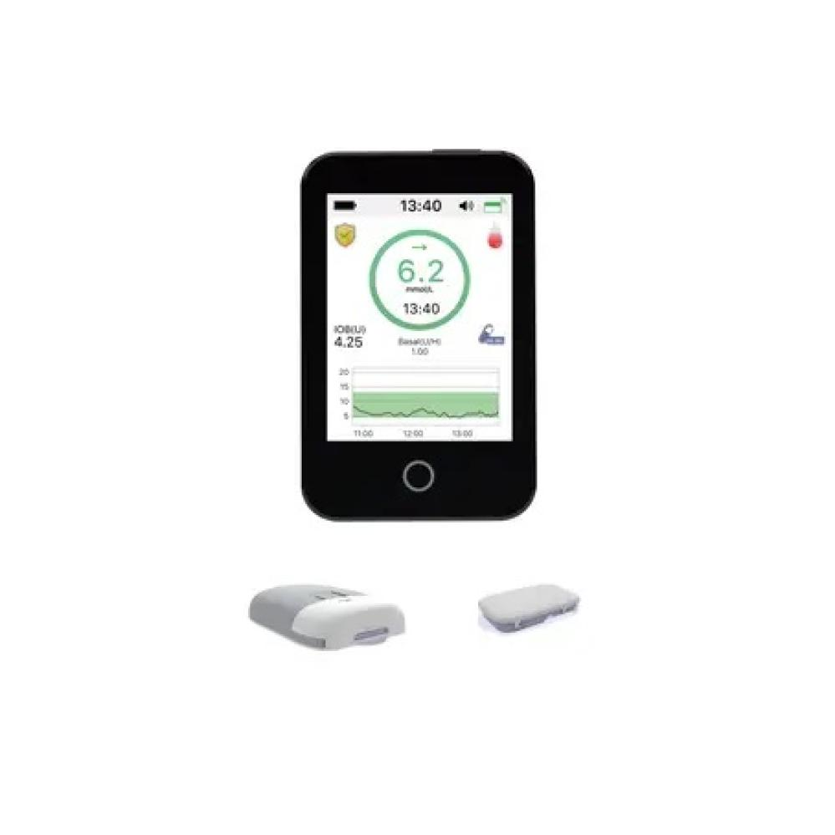
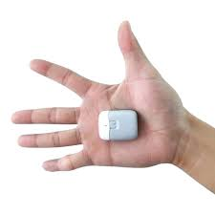
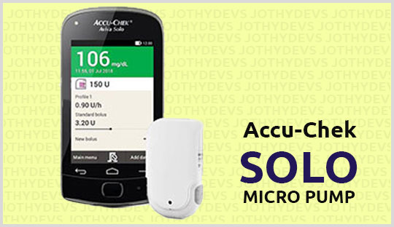
Insulin pumps available in KSA
Tube pumps:
Medtronic 780G HCL
Medtronic 670 CLS
Tandem X2 HCL
Tubeless pumps
(Patch pump):
Omnipod 5 HCL
Medtrum HCL
Accucheck solo

Slide 14
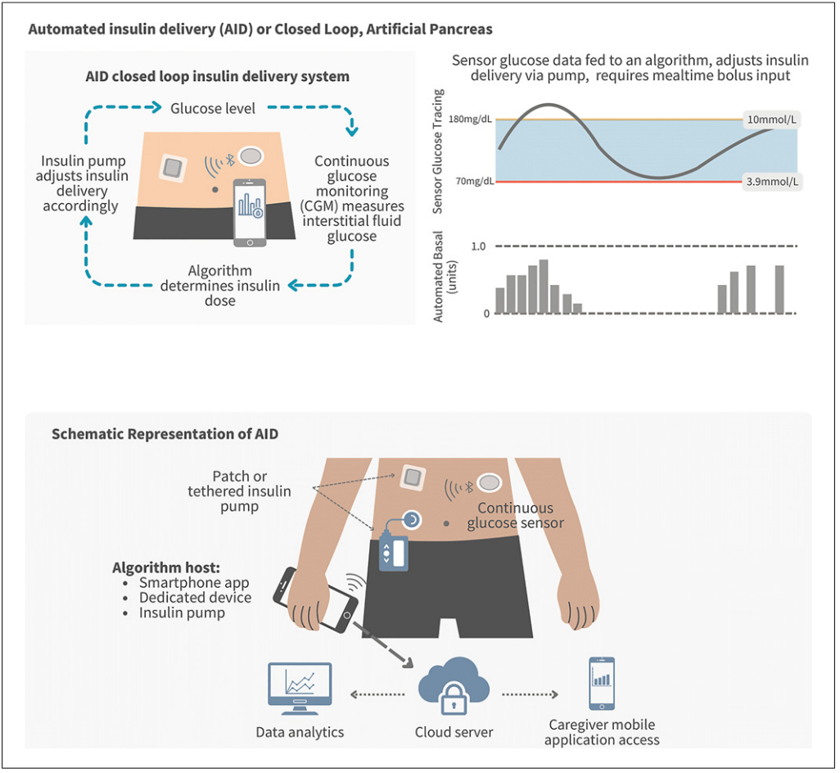
AID/HCL

Slide 15
Pump features | Medtronic 780 | Tandem t slim X2 | Omnipod 5 | Medtrum
licensing | >7yrs of age | >6yrs of age | >2yrs of age | >2yrs of age
CGM senosor | Guardian sensor 4 (need calibration once-twice a day) | Dexcom G6/G7 | Dexcome G6/G7 | Medtrum sensor
Algorhythm configuration | On pump (Smart guard) | On pump (control IQ) | On pump (automated) | On pump (ABG go)
Algorhythm target | Treat to target 5.6 or 6.7 mmol/l (100 or 110 or 120 mg/dl) | Treat to target 6.2 - 8.9 mmol/l (110 -160 mg/dl) | Treat to target 6.1-8.3 mmol/l (110-150 mg/dl) | Treat to target 5.6 or 6.7 mmol/l (100 or 110 or 120 mg/dl)
Additional features (Exercise/Sleep) | Temprary target 8.3 mmo/l (150mg/dl) upon exercise No sleep mode | Sleep mode (target 6.3-6.7 mmol/l, 113-120 mg/dl) Exercise mode (target 7.8-8.8 mmol/l ,140-160 mg/dl) | Customized sleep target. Exercise mode (target 8.3 mmol/l 150 mg/dl) | Customized sleep target No fixed exercise target
Mini bolus correction | Yes (every 5 minutes) | Yes (every one hour) | Yes (every 5 minutes) | Yes (every 2 minutes)
Data review | Automated upload to Carlink | Automated upload to glooko | Automated uploaded to glooko | Automated uploaded to easy view
Remote monitoring capacity | Yes | Yes | Yes | Yes

Slide 16
Insulin therapy evidence
In a comparisons of large diabetes registries with nearly 55,000 pediatric people with diabetes (PWD) reported pump use was associated with lower mean HbA1c (pump 8.0 ± 1.2% [64 ± 14 mmol/mol] vs. injection: 8.5 ± 1.7% [69 ± 17 mmol/mol], p < 0.001).
One prospective examination of nearly 1000 youth on either pump or MDI therapy found lower retinopathy and peripheral nerve abnormality rates in the insulin pump-treated group despite similar HbA1c values.
Further data have also shown pump therapy is associated with lower rates of SH and DKA than MDI.

Slide 17
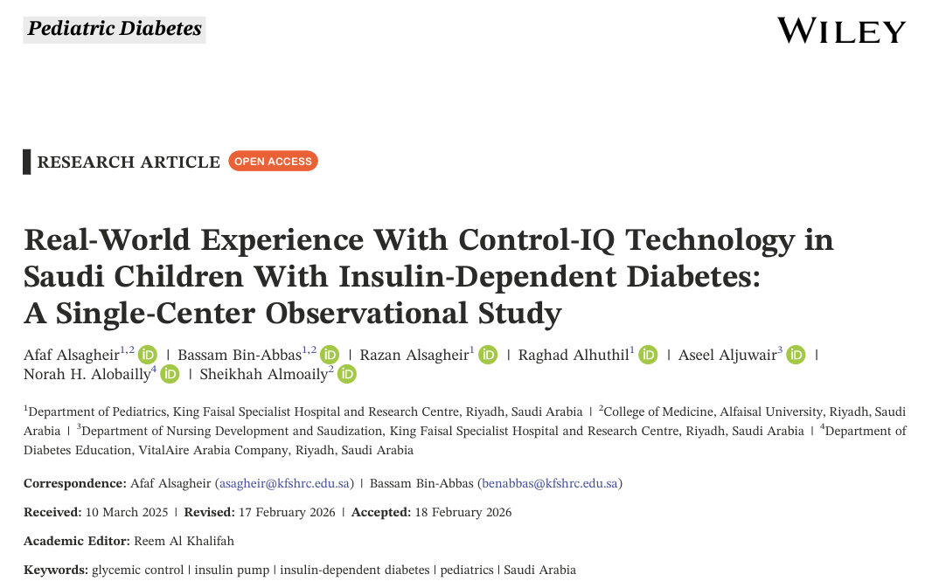
Pump experience in KSA

Slide 18
Objectives
Aim of the study:
Evaluate the efficacy and safety of Control-IQ therapy in children with insulin-dependent diabetes and previously treated with multiple daily injections(MDIs).
Primary outcome:
Assessment of the change in HbA1c 6months after initiating Control-IQ technology.
Study design:
Prospective observational study included children aged 2–14years with insulin-dependent diabetes who transitioned from treatment with MDI to the Control-IQ technology.

Slide 19
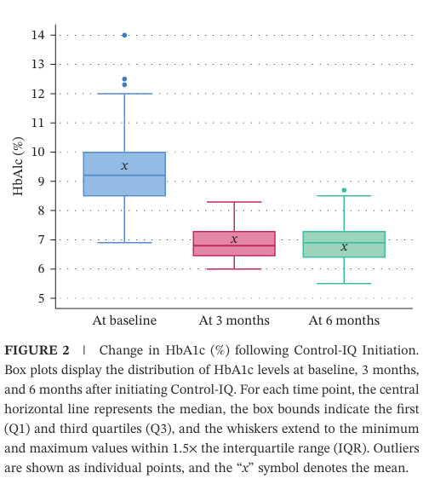
Results
Total of 100patients (44boys and 56girls) were included.
Mostly (82%) had a history of severe hypoglycemia.
Following Control-IQ initiation:
Median HbA1c significantly decreased from 9.2% to 6.9% at 6months (25.0%; p<0:001), accompanied by a 24.4% reduction in the daily insulin dose.
(TIR) (70–180mg/dL) improved from 45.6% to 68.8% (+23.2%;p<0:001).
Time in significant hypoglycemia (<54mg/dL) decreased by 88.9% (p<0:001).
At 6months:
83% achieved ≥60%TIR, and 54%reached≥70%.
Adherence and engagement were high, with no severe hypoglycemia or incontinuations.
Only 3% experienced mild/moderate ketoacidosis due to technical issues in the Control-IQ.

Slide 20
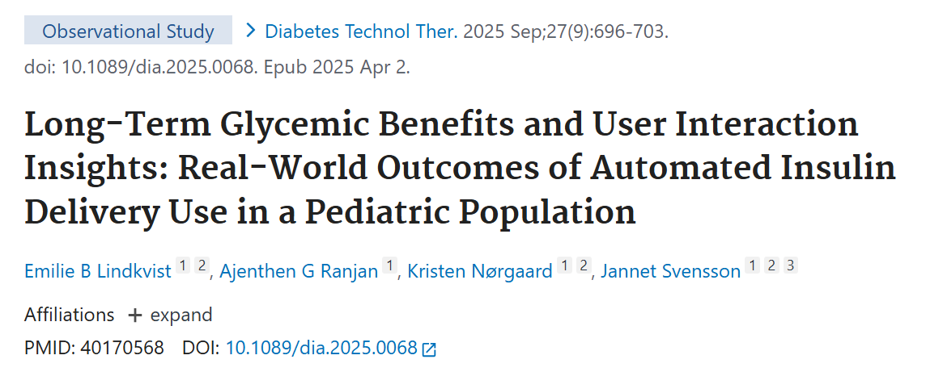
Real world Pump Experience

Slide 21
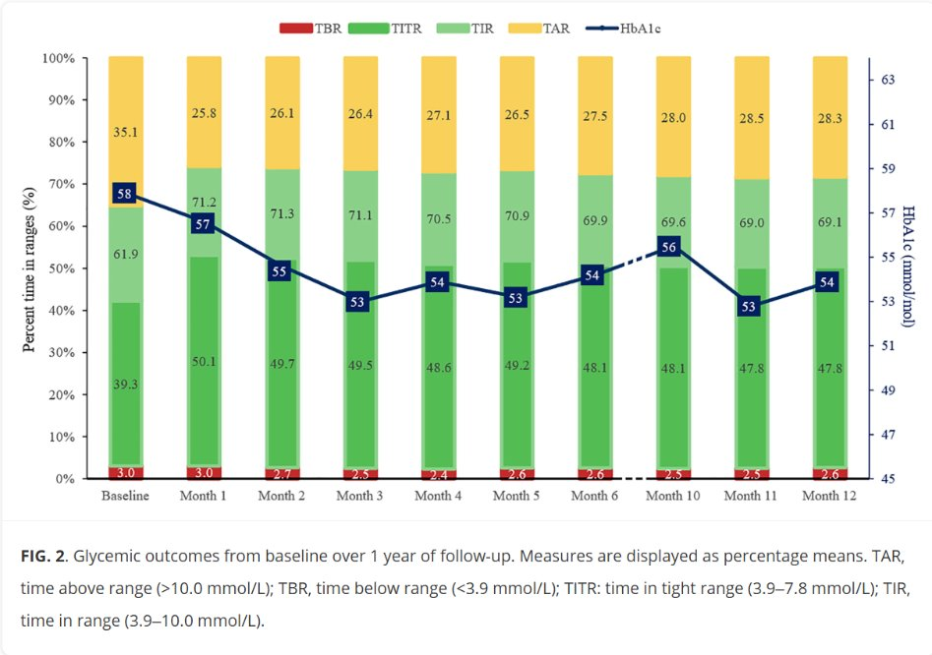
Summery
Objective:
To investigate how AID initiation influenced glycemic outcomes over a year and assess the impact of user behaviour and insulin pump settings.
Results:
Percentage of time in range (TIR: 3.9–10.0 mmol/L) improved after AID initiation and remained stable over the follow-up year (baseline: 61.9% vs. month 12: 69.1%, P < 0.001).
The percentage of individuals reaching target (TIR >70%) declined after an initial increase (baseline: 29.5% vs. month 1: 60.0% vs. month 12: 43.7%, P < 0.005).
The predefined measures for user interaction also increased over a year:
User-initiated insulin boluses (baseline: 53.7% of total daily dose [TDD] vs. month 12: 59.9% of TDD, P = 0.034).
Reduced carbohydrate intakes relative to body weight (baseline: 5.0 g/[kg·d] vs. month 12: 4.6 g/[kg·d], P = 0.004).
Longer active continuous glucose monitoring (CGM) wear time (baseline: 87.2% vs. month 12: 94.1%, P = 0.011).

Slide 22
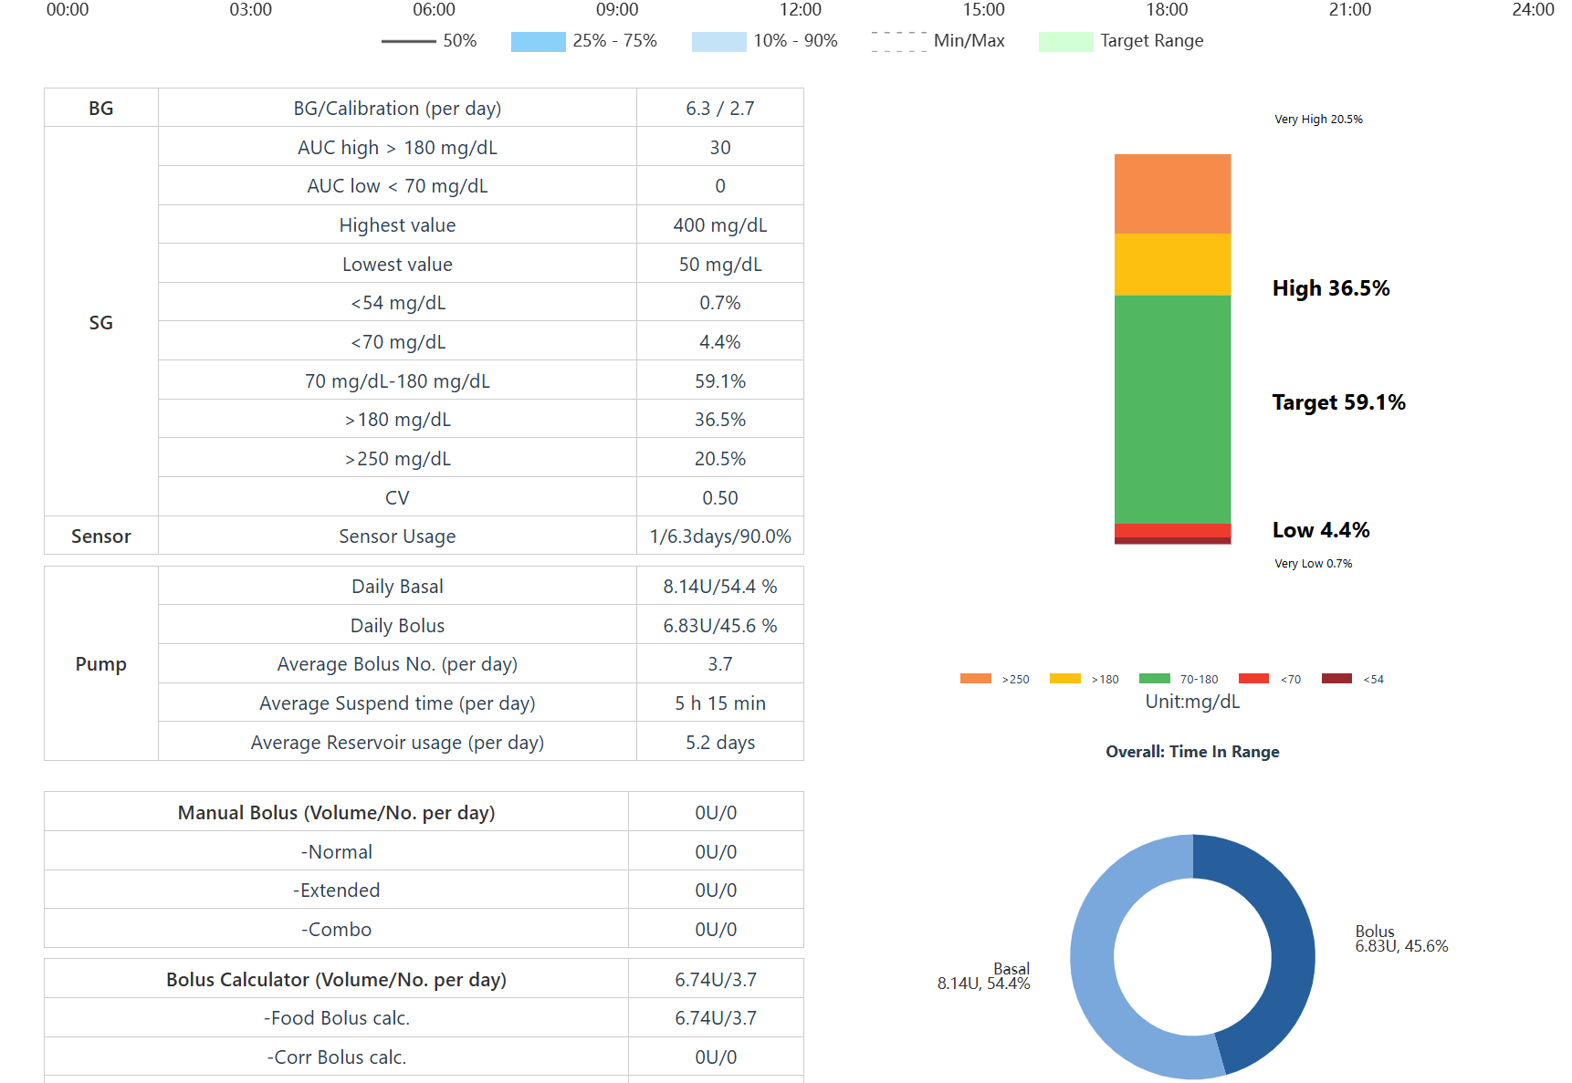
Back to our case

Slide 23
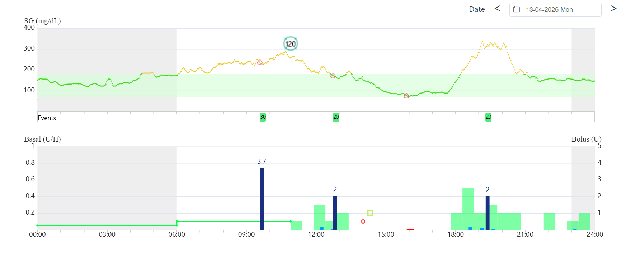
Follow up

Slide 24
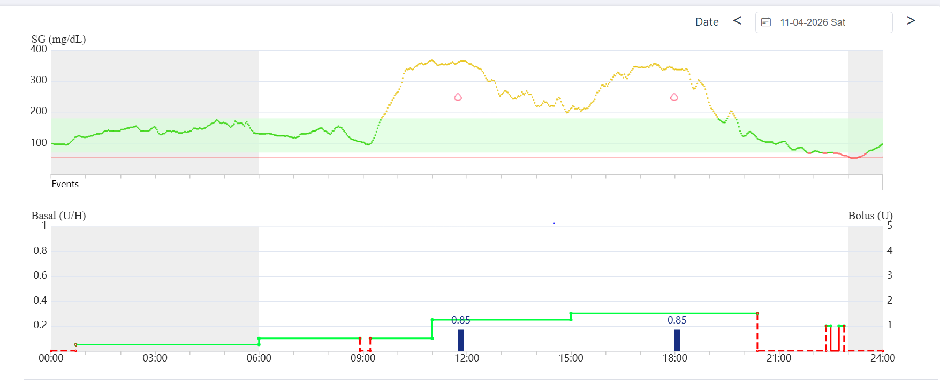
Follow up

Slide 25
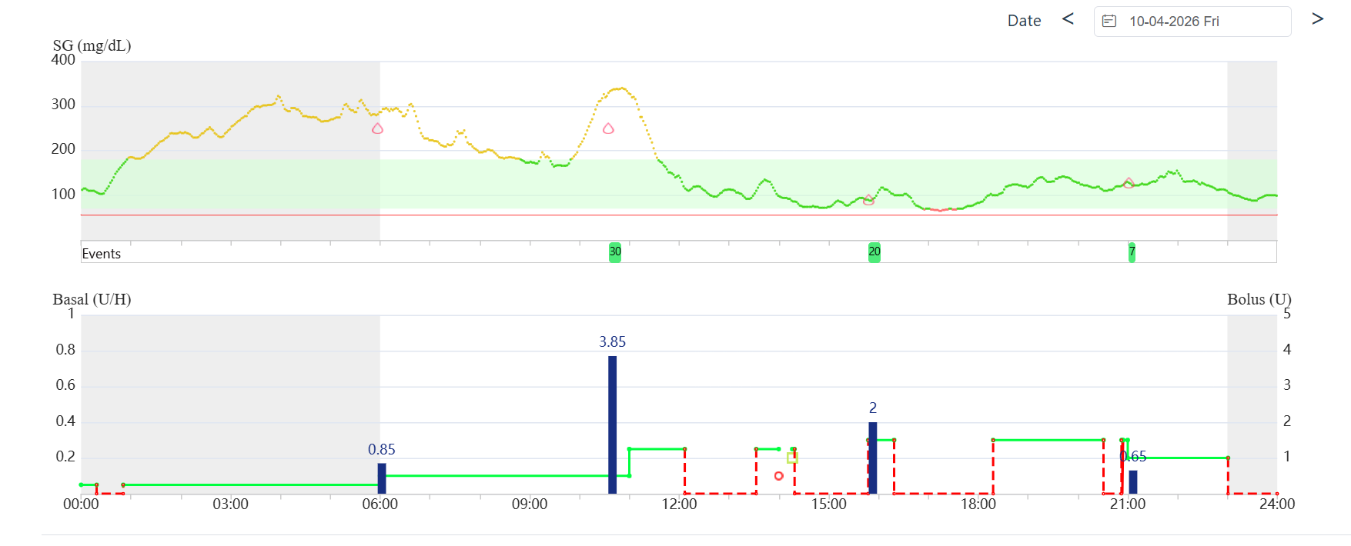
Follow up

Slide 26
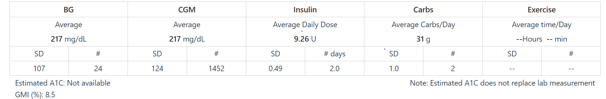
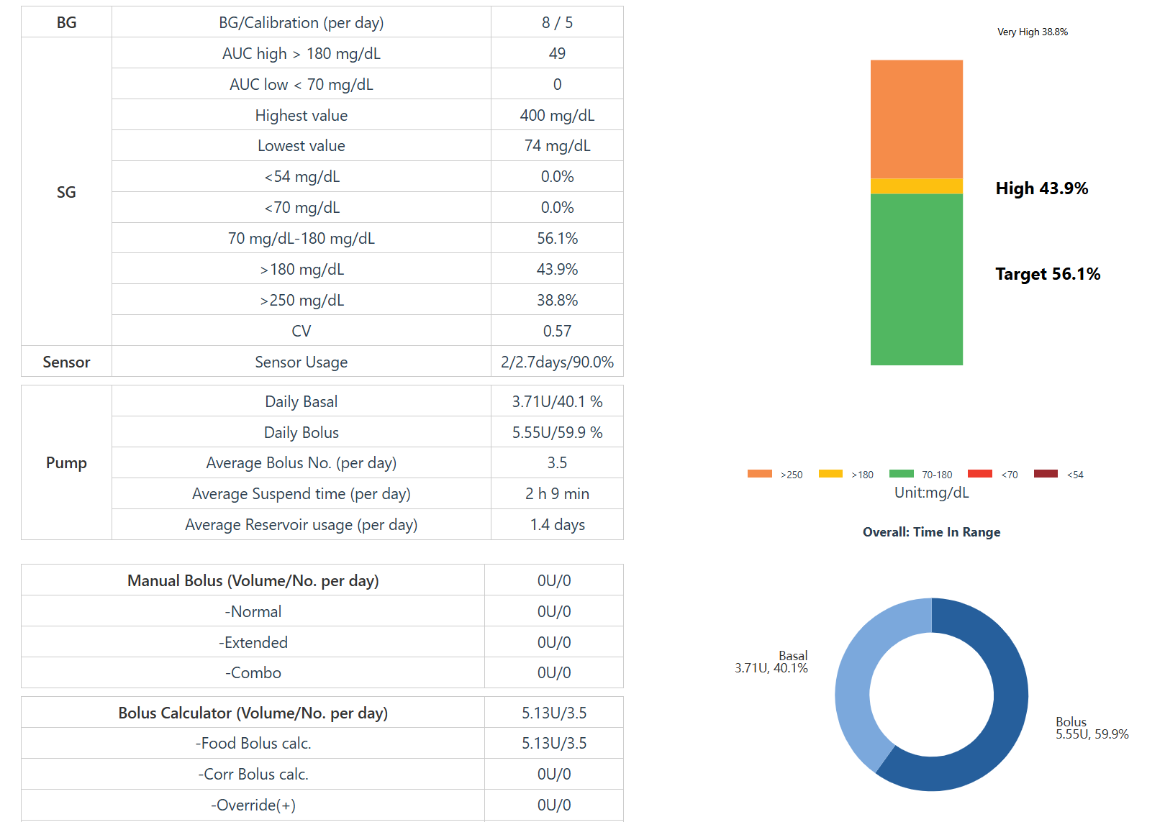
Shifted to auto-mood

Slide 27
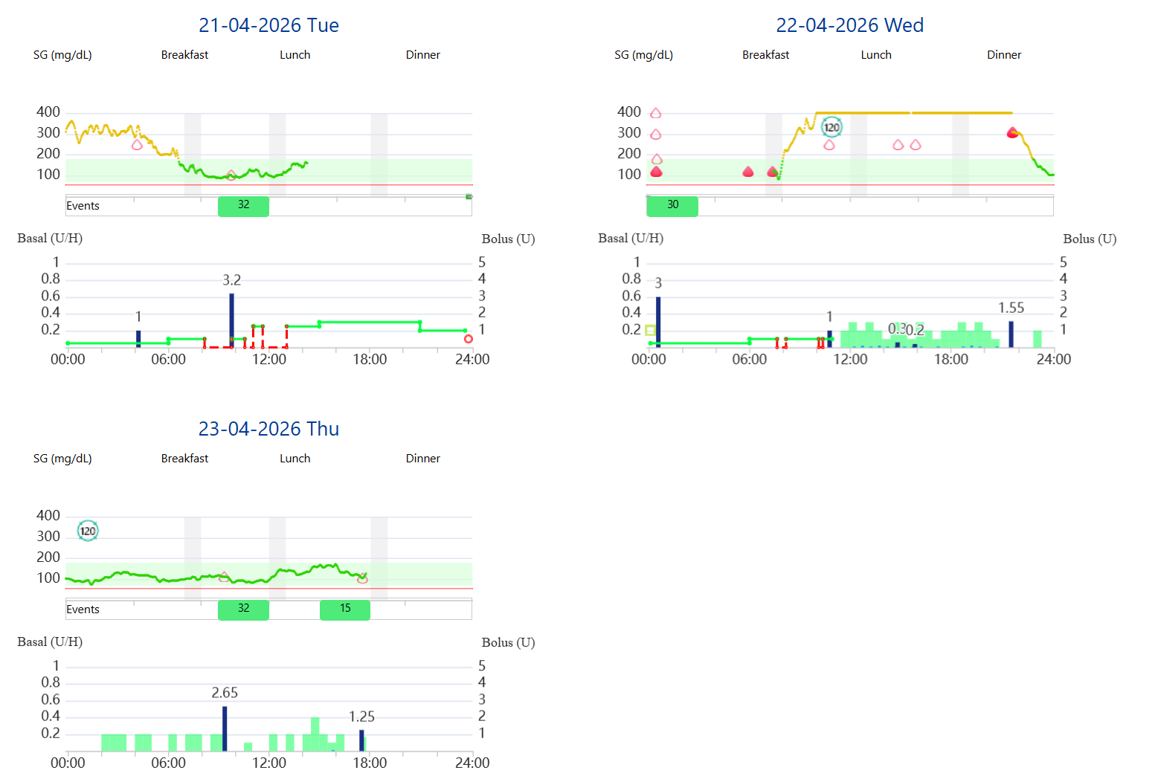
Follow up

Slide 28
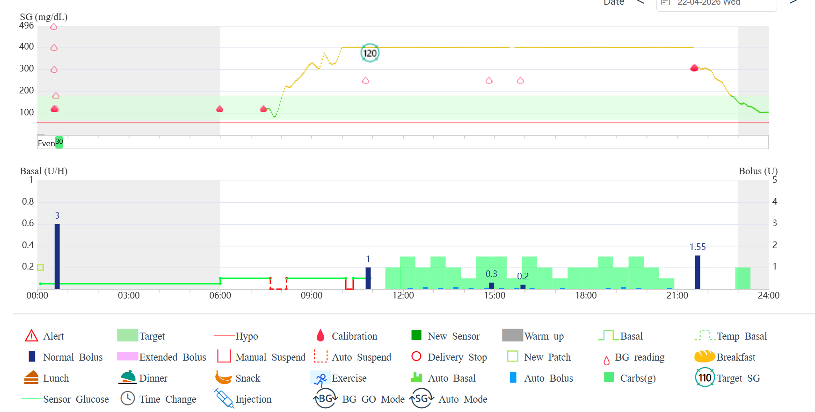
Follow up

Slide 29
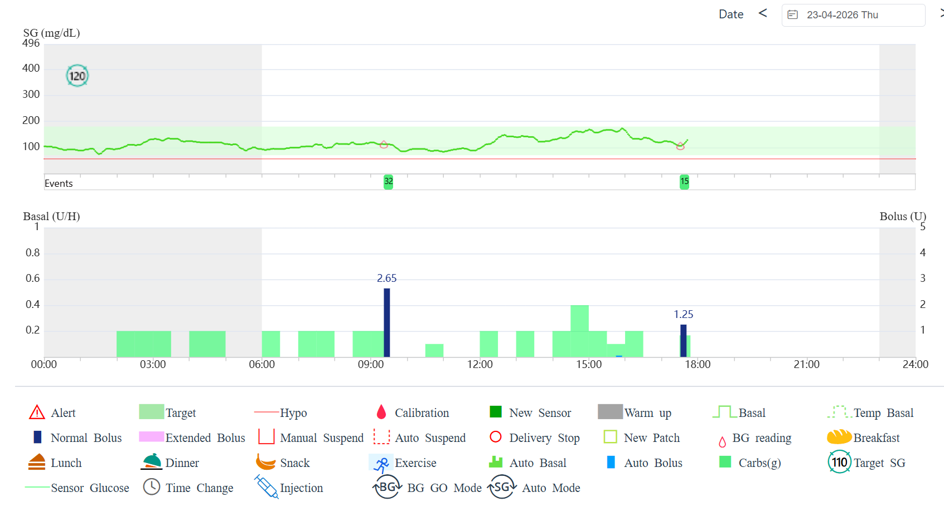
Follow up

Slide 30
Take a home message
Choose what is convenient to you patient as each one is an individualize case after discussion and complete education of the chosen device.
AID is an established therapy and has become the standard of care in diabetic patients and healthcare settings where it is available and accessible.
Clinicians engaged in the care of PWD have an obligation to remain abreast of recent technology developments to optimize uptake and use.
Multiple visits and follow up is necessary to ensure the ultimate capability of the AID machine.

