Slide 1


Pediatric Gigantism due to Growth Hormone Excess
From ”Large Genitalia" Referral To Pituitary Hyperplasia Diagnosis
Presenter: Dr. Miral Mohammed Abdulghfar
Pediatric Endocrine Fellow (F1)
2nd Riyadh conference on pediatric endocrine & diabetes, Riyadh
25/4/2026
Email: m0324543@gmail.com

Slide 2






Objectives:
1- Approaching pediatric patients with abnormal growth
2- Developing a differential diagnosis
3- Investigations and genetic testing
4- Management

Slide 3
Initial Presentation - Chief Complaint
🏥
Patient Referral Information
📋
Chief Complaint
Referred to: Pediatric Endocrinology from General Pediatrics
2-years-old boy referred for ”Unusually large genitalia and phallus size for age"
🔍
History of Presenting Illness
⚡
Mother has 3 other sons, and she hasn't noticed the rapid increasing in genitalia size before
Also, parents noticed he has been growing Fast since early infancy (not just large genitalia)

Slide 4

🔍 Initial Differential Diagnosis – Apparent Large Genitalia
📋
What We Consider First
Primary Considerations
Other causes
Central Precocious Puberty
Genetic Macroorchidism
Peripheral Androgen Excess
Family History Large Genitalia
Exogenous Androgen Exposure
Hyperthyroidism/ Sever Hypothyroidism

Slide 5
History
Important Negative/Positive History
Have recurrent headache (nocking his head all the time) and sweating since age of 14months
No abnormal movements ,vision changes/no Polyuria ,Polydipsia
No history of recurrent vomiting or dehydration
No body odor, acne, or pubic hair
No palpitation, Heat intolerance, Tremor, weight loss and polypaghia
No androgen or topical steroid used, testosterone gels or creams exposed and herbal medications intake
No oral steroid used
No bony pain or skin changes

Slide 6
History – Antenatal and Natal
🏥
Antenatal History
Prenatal Information
👶
Delivery Details
📋
No prior documentation available
Spontaneous vaginal delivery at 36 weeks
1.6 kg (very low birth weight, < 10th percentile)
Delivery complications: None reported
🔍
Neonatal Course
⚡
Initial Assessment
📊
Outcome
NICU stay: 45 days for respiratory support and monitoring
No major complications after discharge
Discharge: In stable condition after recovery

Slide 7
🏥 History
📋
Medical / Familial History
Family Stature
Uncontrolled Asthma Currently on inhaled corticosteroids
Positive consanguinity
Parents are healthy (50 YO father, 34 YO mother)
6 siblings are healthy (3 males, 3 females)
No family history of large genitalia,Precocious puberty and endocrine and pituitary diseases
Resolved Gastroesophageal Reflux
Closed Patent foramen Ovale based on Echocardiogram
📋
History
⚕️
🧠
Surgical Procedures
Developmental history
None reported
Echolalia with speech delay and aggression emerged
Allergic Conditions
General health otherwise unremarkable
No known allergies to medications
No developmental delays in motor skills

Slide 8
Physical Examination Findings
🏥
Important Examination
📊
Vital Signs
Genitalia examination
Patient vitally stable appropriate for age
Normal male genitalia
👶
Uncircumcised with palpable descended testes
General appearance
Tanner stage I - no pubertal signs
Well-appearing toddler, alert and active
Normal stretched penile length for age (4cm)
No dysmorphic features noted
Testicular volume within normal range (2-3ml)
• No neurocutaneous stigmata
No evidence of virilization/hyperpigmentation
No hydrocele, increase fat
Rest of exam was unremarkable

Slide 9
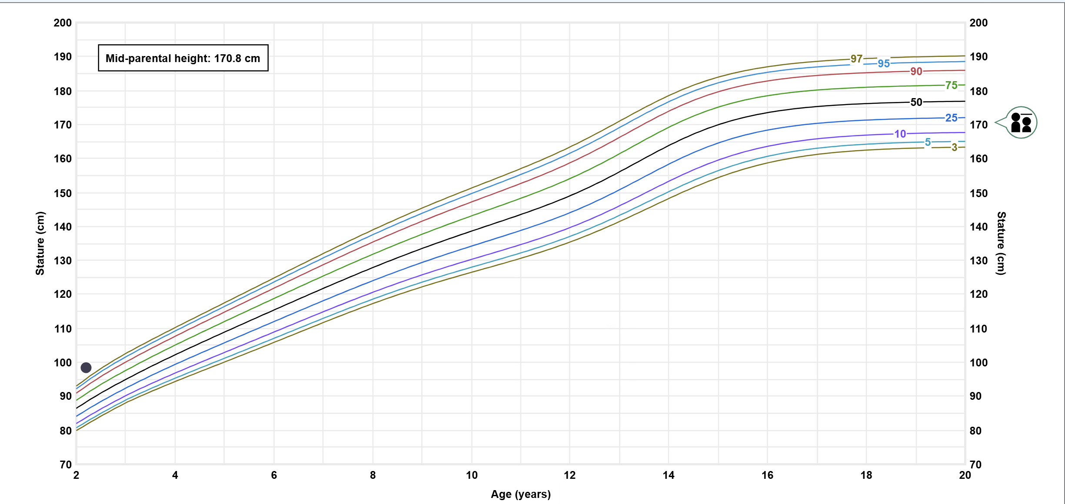
Examination – Growth Chart
📊
Growth Chart Analysis at age 26 months and 2 weeks
Height: 98.5CM >th99.71 percentile (Z 2.76)
Mother 162cm, father 166cm

Slide 10
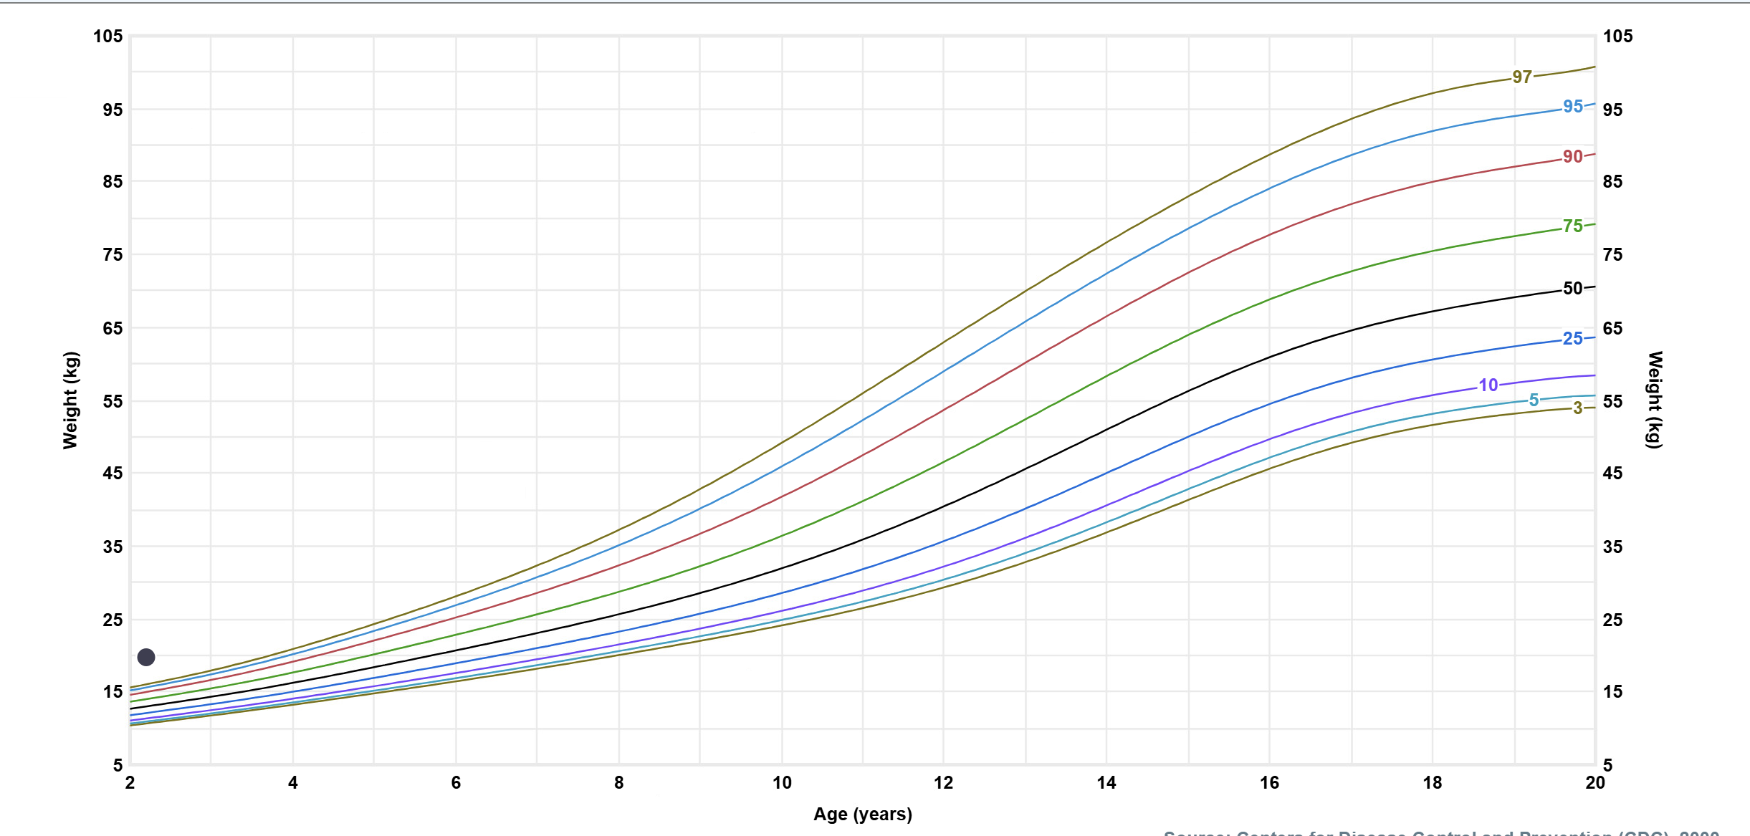
Examination – Growth Chart
📊
Growth Chart Analysis at age 26 months and 2 weeks
Weight: 19.8 KG >th99.99 percentile (Z 3.66)

Slide 11
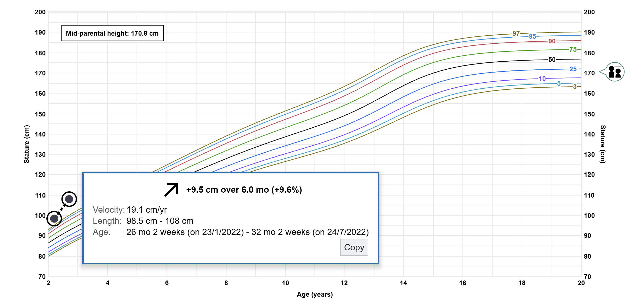
Examination – Growth Chart
📊
Growth Chart Analysis

Slide 12
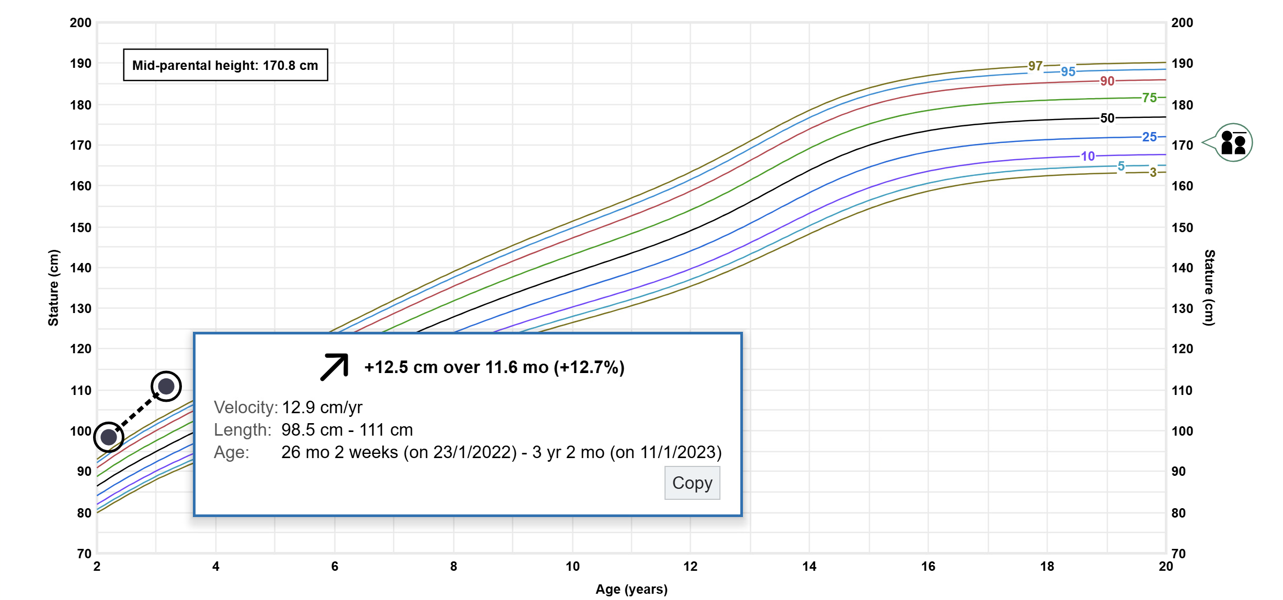
Examination – Growth Chart
📊
Growth Chart Analysis

Slide 13
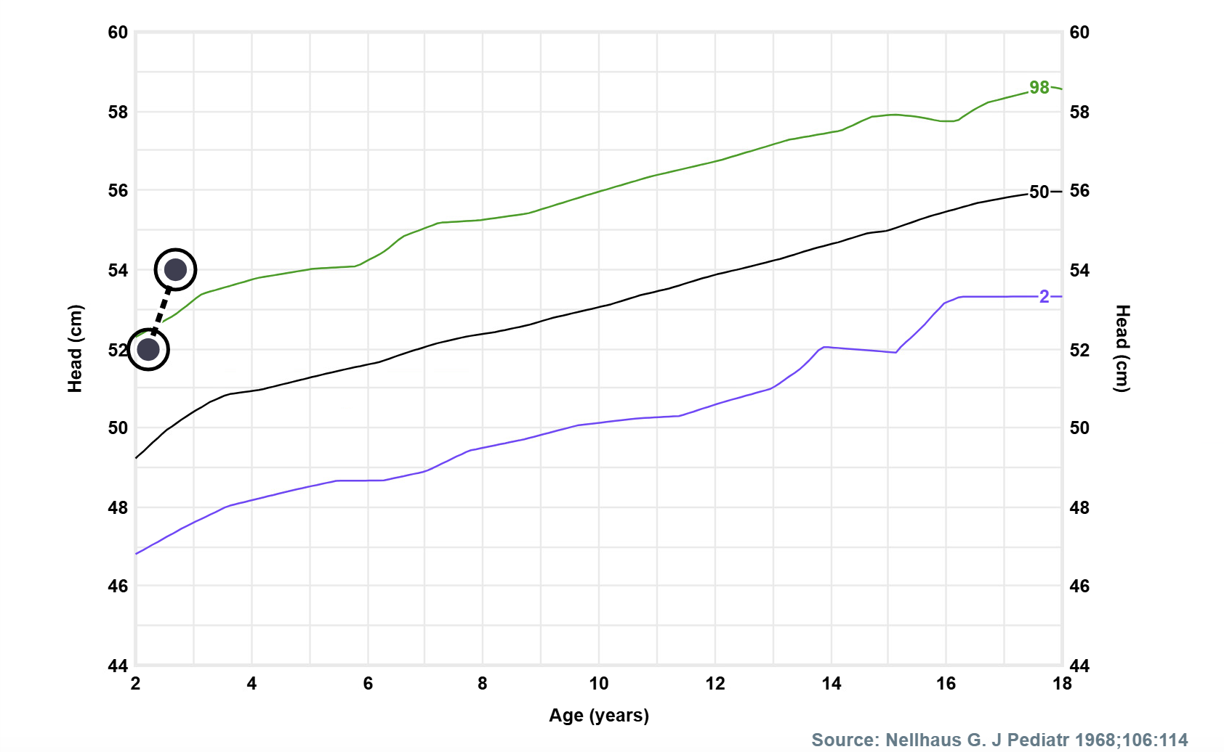
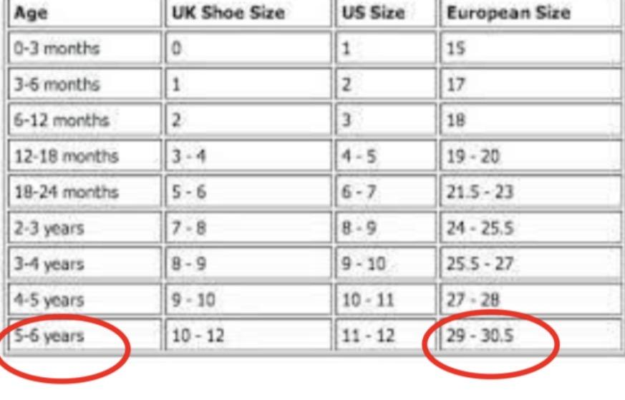
Examination – Head Circumference and Foot Size
📏
Anthropometric Measurements at 26 Months and 2 weeks
🧠
👣
Foot Size
Head Circumference
52 cm (macrocephaly > th99 percentile)
Increasing (2 cm) in 6 months
He wears size 30 in shoes which fit well.

Slide 14


Revised Differential Diagnosis - Accelerated Growth
🔍
Favored Diagnosis: Growth Hormone Excess
🎯
Primary Diagnosis Considerations
Pituitary adenoma, Hyperplasia (Growth hormone excess)
Idiopathic tall stature
🧬
Growth-Related Syndromes to Consider
🧬
Specific Growth Syndromes
📌
Sotos Syndrome (Cerebral Gigantism)
Characteristic features: macrocephaly, dysmorphic facial features (high forehead, prominent jaw), learning disabilities, advanced bone age
📌
Beckwith-Wiedemann Syndrome
Key features: macrosomia, macroglossia, hemihypertrophy, ear creases, umbilical hernia. Not consistent with our case presentation

Slide 15
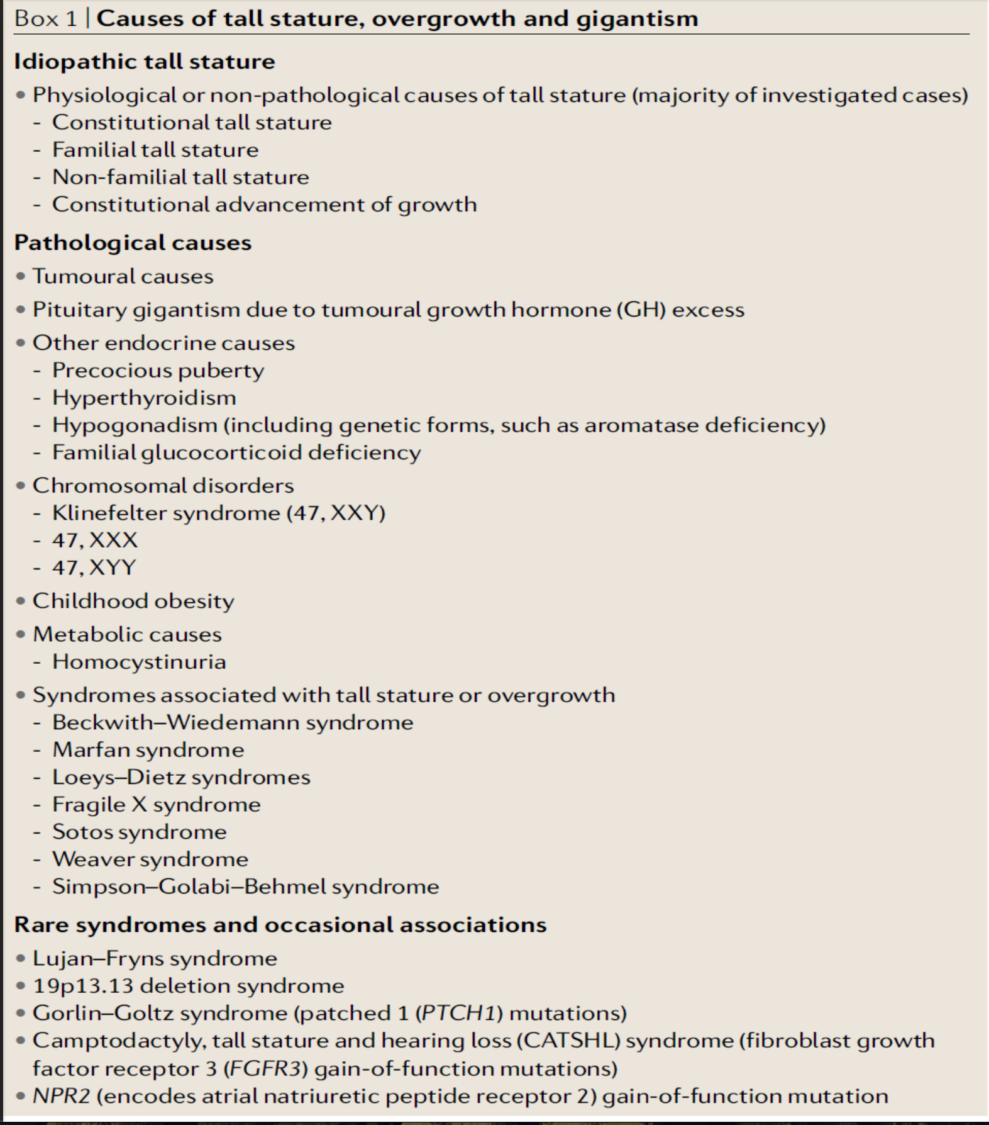
Differential Diagnosis
Beckers, A., Petrossians, P., Hanson, J. et al. The causes and consequences of pituitary gigantism. Nat Rev Endocrinol 14, 705–720 (2018).

Slide 16
Further history
🏠
📋
No similar presentation
Obesity and tall stature among adult relatives
Medication History
No hormonal medications or GH therapy exposed
Family started to struggle with him. He become more aggressive and hit other kids due to his bigger body build in comparison to children in his age
He Wears clothes size 6-7 years while he is a 3 years old

Slide 17

🔬 Investigations
Initial Test
Normal
Normal
HbA1c Random Glucose
CBC and differential
Electrolytes (Na,K)
5.13 %
Normal
ACTH Stimulation test
(Random cortisol 164nmol/l)
Normal
4.9mmol/l
Normal
Cortisol 568 nmol/L
Normal
TSH
Prolactin
Free T4
Normal
4.5 pmol/L
ACTH
14.4 pmol/L
2.0 mIU/L
12.5-14.8 µg/L ( 3.4-19.4)
Normal
Normal

Slide 18
🔬 Investigations / Hormonal Profile
📊
Hormonal Test
Random
Random
5.53 ng/ml Elevated (RR <1ng/ml)
Growth Hormone
LH
<0.12 IU/LPrepubertal
0.44 IU/LPrepubertal
FSH
209 ng/ml Elevated (RR 33.9-183.9)
IGF-1
<0.45 nmol/L
Testosterone
Prepubertal
Growth Hormone Suppression Test
Gonadotropin Stimulation Test
GH ng/ml | 1.2 | 6.6 | 6.8 | 10.1 | 8.4
LH Peak
2 IU/LPrepubertal
3.19 IU/LPrepubertal
FSH Peak
<0.45 nmol/L
Testosterone
Prepubertal
LH/FSH ratio
0.6 (RR<0.66)

Slide 19


🧬
Investigations – Imaging
Bone age Findings
Bone age 4.5 – 5 years
chronological age 3 years and 9 months

Slide 20
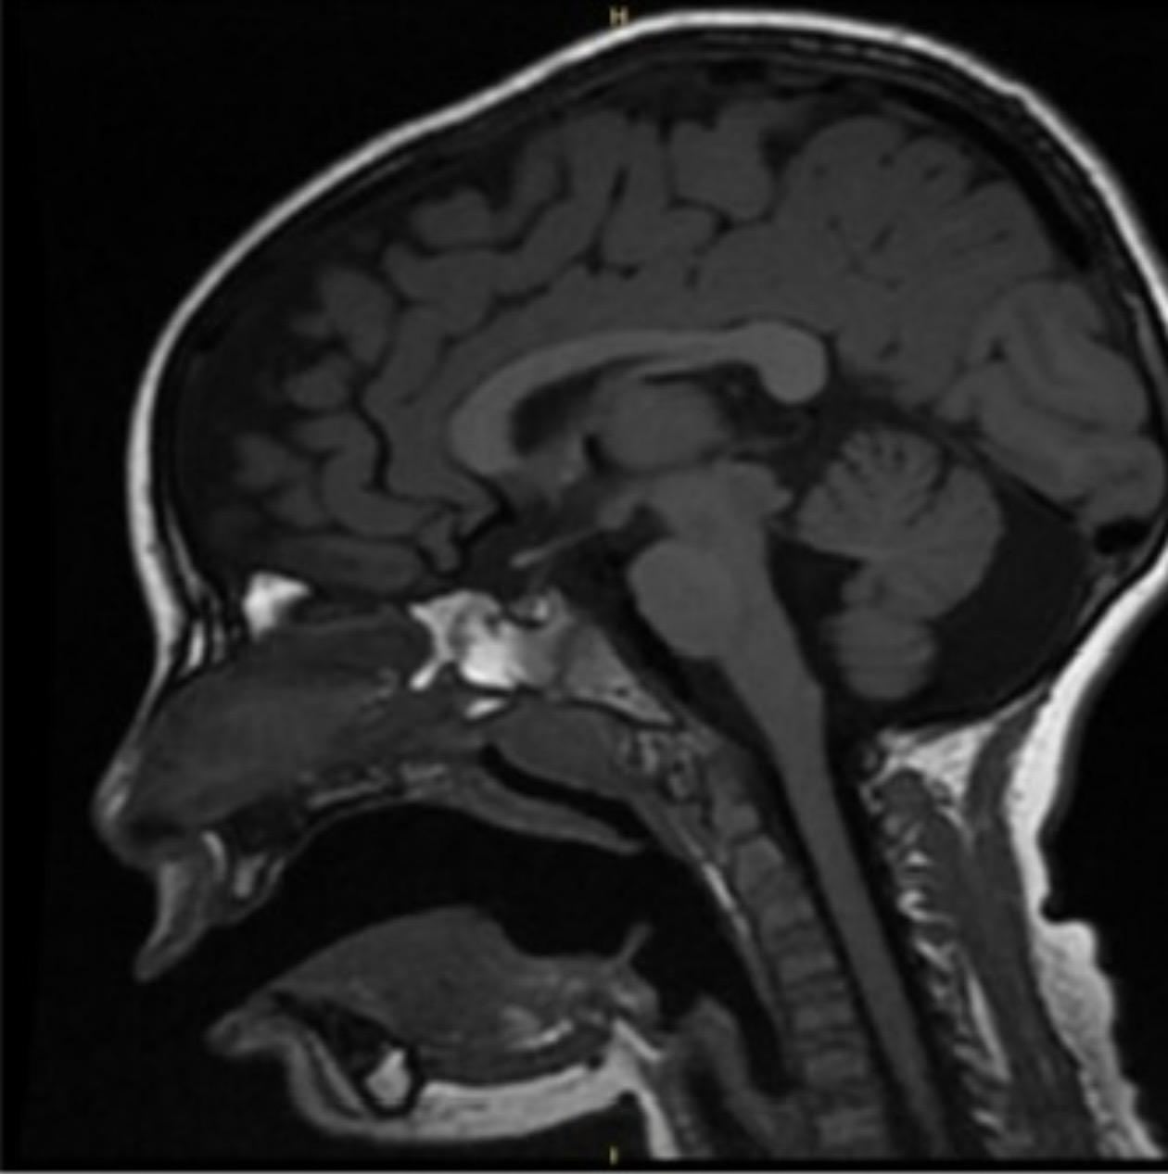
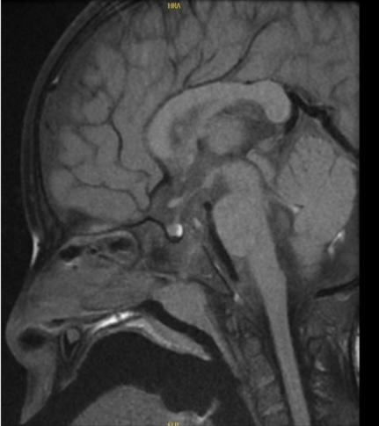
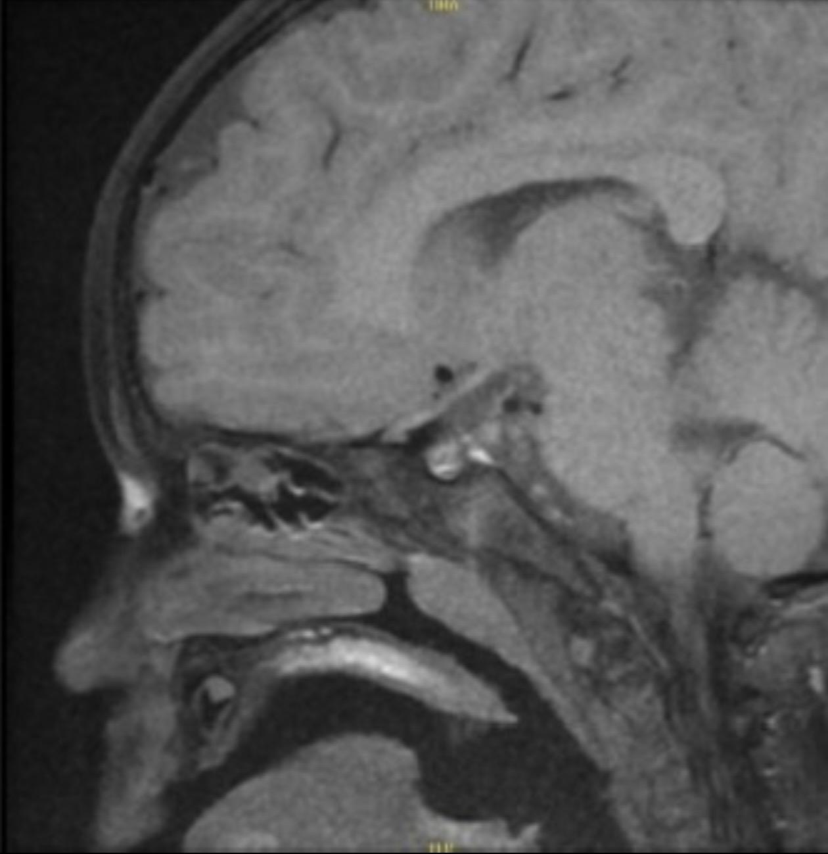
Investigations – Imaging and Genetics
🧬
Pituitary MRI Findings
🧠
🧬
Genetic Testing Results
Initial read: Possible microadenoma
Microarray ,WES , WGS : No pathogenic variants identified
Dynamic MRI & tumor board: Diffuse pituitary hyperplasia; no focal lesion
Clinical correlation: No syndromic phenotype to support pathogenicity
Homogeneous enhancement pattern
No evidence of cavernous sinus invasion
Optic chiasm appears normal

Slide 21

🚫
Why Certain Diagnoses Were Ruled Out
Systematic evaluation to narrow down the differential diagnosis
RULED OUT
Central Precocious Puberty
Hypo/Hyperthyroidism
RULED OUT
Familial Tall Stature
RULED OUT
LH/FSH/testosterone were suppressed
Tanner stage I with no pubertal signs.
Gonadotropins remained prepubertal.
TSH and Free T4 were within normal range; no clinical features of hypothyroidism present.
Parental heights were ~10-25th percentile; child's growth exceeded significantly.
Exogenous Androgen Exposure
RULED OUT
Peripheral Androgen Excess
RULED OUT
Syndromic Overgrowth
RULED OUT
No consistent syndromic phenotype
Denied by parents; examination showed prepubertal genitalia; no virilization signs.
Prepubertal gonadotropins/testosterone; no adrenal or gonadal tumor findings on imaging.
💡
Key Finding: The combination of prepubertal gonadotropins, normal thyroid function, and absence of androgen excess helped narrow down to GH-related pathology.

Slide 22

🎯
Final Diagnosis
🔬
Pediatric Gigantism due to Growth Hormone Excess
Etiology: Diffuse pituitary hyperplasia (no focal adenoma identified on dynamic MRI)
Diagnosis Supported By:
✅
Rapid linear growth with advanced bone age (4.5-5 years at chronological age ~3 years)
Tall toddler > +2 SD not going with his genetic potential (MPH 10%- 25%)
Large feet and head
Elevated random GH and IGF-1 with failure to suppress on Growth Hormone Suppression Test
Prepubertal gonadotropins exclude puberty-driven growth
Imaging consistent with pituitary hyperplasia (diffuse enhancement, no focal lesion)

Slide 23

💉
Management
🎯
Therapy Initiation
Lanreotide (Somatostatin analogues) 60 mg subcutaneous every 4 weeks (initial dose)
Started at age 3 years and 7 months
Patient tolerated treatment well
Follow up every 3-6 months
Seen by Neurosurgery, cardiology and genetics team
Presented in the Neuropit tumor board
No surgical intervention required
Repeat MRI in 6-12 months after treatment
Multiple consultations done with experts in the field
⚠️
•
•

Slide 24
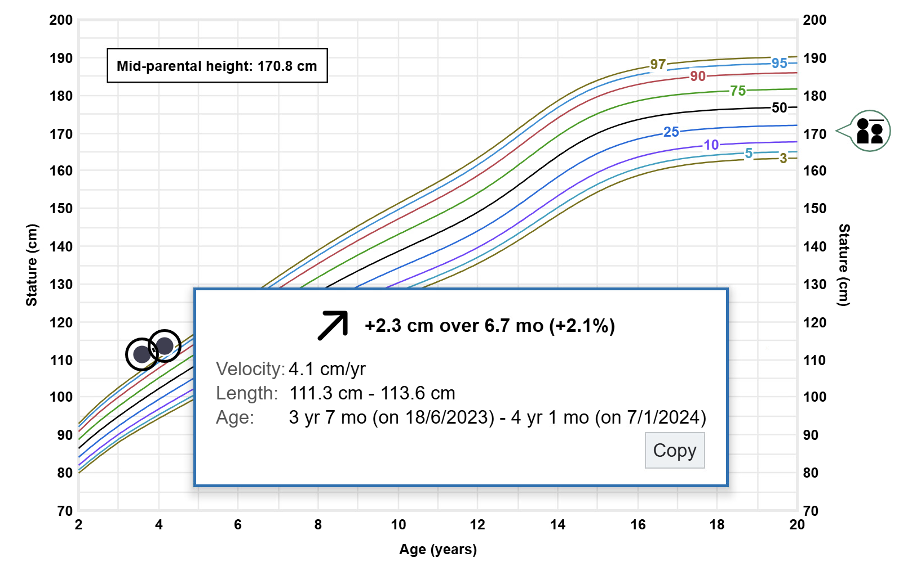
Examination – Growth Chart (1/3)
📊
Growth Chart Analysis

Slide 25
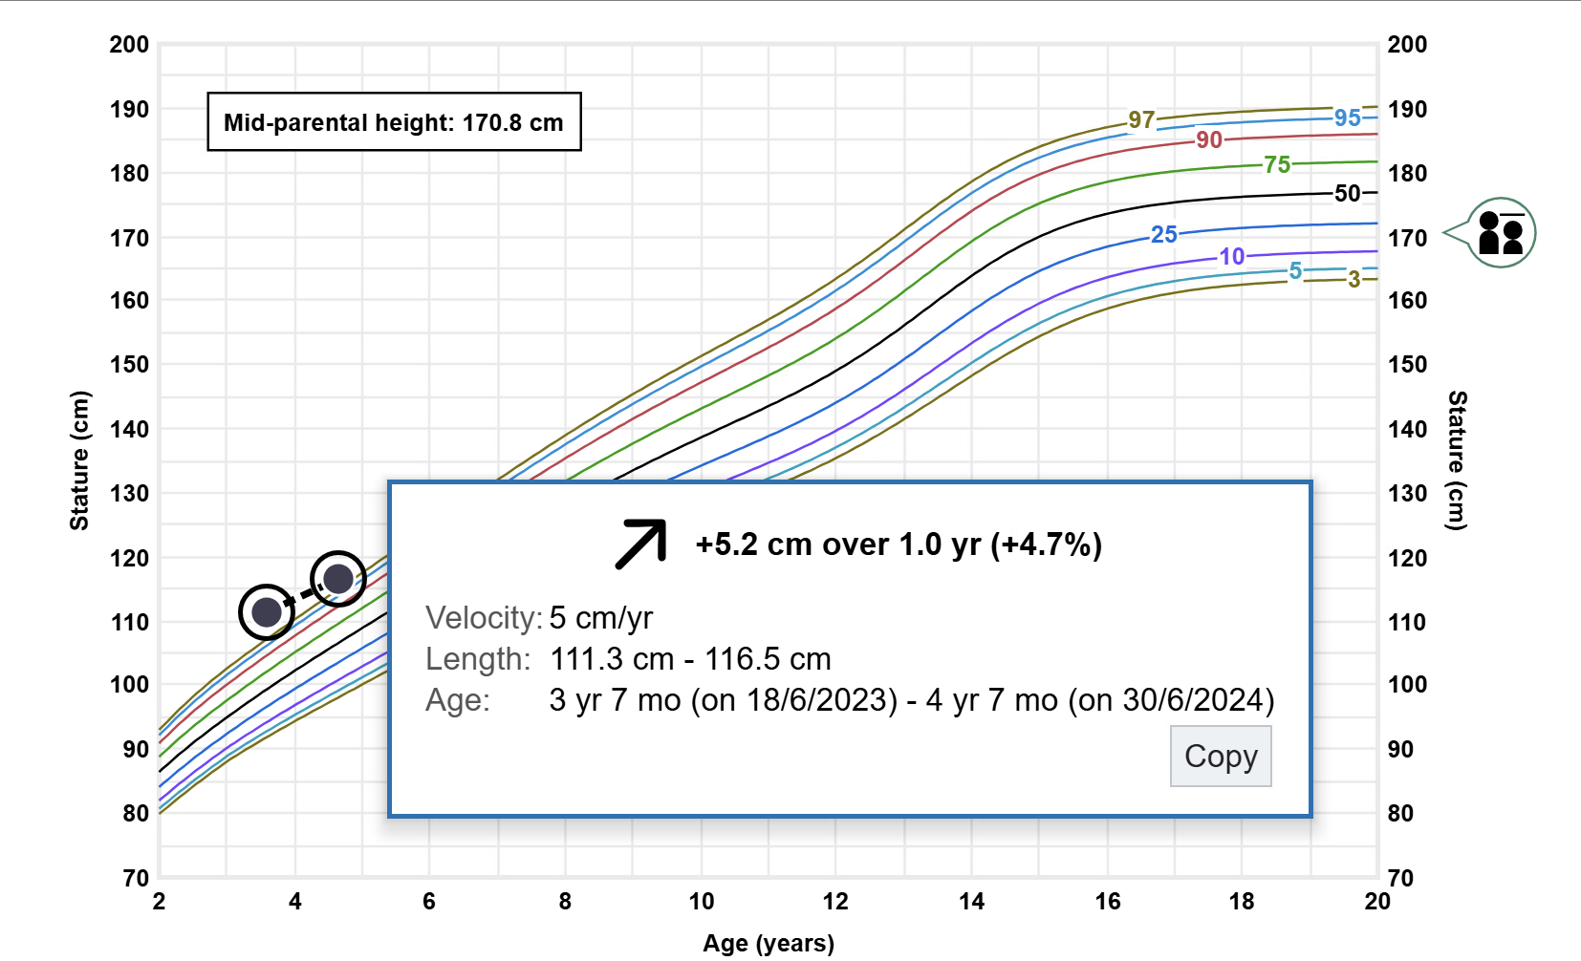
Examination – Growth Chart (2/3)
📊
Growth Chart Analysis

Slide 26
💉
Time From Treatment
Age | Time | GH <1ng/L | IGF-1
3 years | Baseline | 5.53 ng/ml | 209.5 ng/ml ( 33.9-183.9)
4 years | 3 months | 0.8 ng/ml | 103.2 ng/ml ( 44-225 )
5 years | 1 year | 0.13 ng/ml | 128.9 ng/ml ( 50-245.5)
Recent at 6 years | 2 years | 0.14 ng/ml | 149.8 ng/ml ( 56-267)
1.2 ng/ml ( suppressed )
•
•

Slide 27
💉
Follow up
Prolactin ( 4.2-23 ) | 11 µg/L | 7.10 µg/L | 21.8µg/L | 5.8 µg/L | 7 µg/L
Thyroid function tests within normal range
Cortisol level within normal range
Prepubertal ranges of LH,FSH,testosteron
•
•

Slide 28

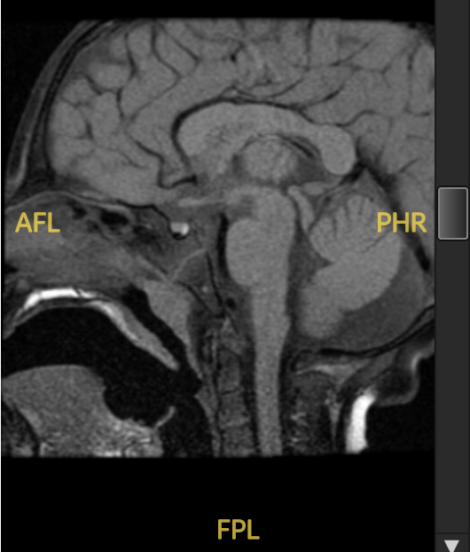
Follow-up and Outcomes
📈
Course 2023–2026
Outcome:
Excellent biochemical and clinical response to somatostatin analog therapy
Normalization of growth velocity and stabilization of linear growth
Maintained biochemical control for over 2 years
No evidence of progression.
🧠
Behavioral Support
Resolved echolalia with improving speech delay and aggression
⚠️
Adverse Events
Injection-site hematoma after ~1.5 years
Minimal GI symptoms ( abdominal pain, diarrhea) during the initial 2-3 days post injection

Slide 29
Literature review
(Early-Onset Gigantism)
Growth hormone excess before epiphyseal closure causes excessive linear growth and markedly elevated IGF-1.
Early-onset disease often presents in childhood; the most severe genetic forms may appear in infancy or before age 10.
Recent reviews report that roughly 30–50% of pediatric gigantism cases have an identifiable genetic defect; the diagnostic yield is highest in familial and very early-onset disease.
The most important causes include AIP variants and X-linked acrogigantism due to GPR101 duplication; other syndromic causes include MEN1, CDKN1B, PRKAR1A, GNAS, and SDHx-related disease.
Medical options include first-generation somatostatin analogues (octreotide LAR, lanreotide), pasireotide for resistant disease, pegvisomant for IGF-1 normalization, and cabergoline as adjunctive therapy, especially in mixed GH–PRL tumors.
References: Korbonits M, et al. Nat Rev Endocrinol. 2024;20:277–301. Ramírez-Rentería C, Hernández-Ramírez LC. Best Pract Res Clin Endocrinol Metab. 2024;38:101892.
References: Ramírez-Rentería C, Hernández-Ramírez LC. Best Pract Res Clin Endocrinol Metab. 2024;38:101892. Bogusławska A, Korbonits M. J Clin Med. 2021;10:1379. Korbonits M, et al. Nat Rev Endocrinol. 2024;20:277–301.
References: Korbonits M, et al. Nat Rev Endocrinol. 2024;20:277–301. Melmed S, et al. Nat Rev Endocrinol. 2025;21:718–737. MacFarlane J, et al. Best Pract Res Clin Endocrinol Metab. 2024.

Slide 30

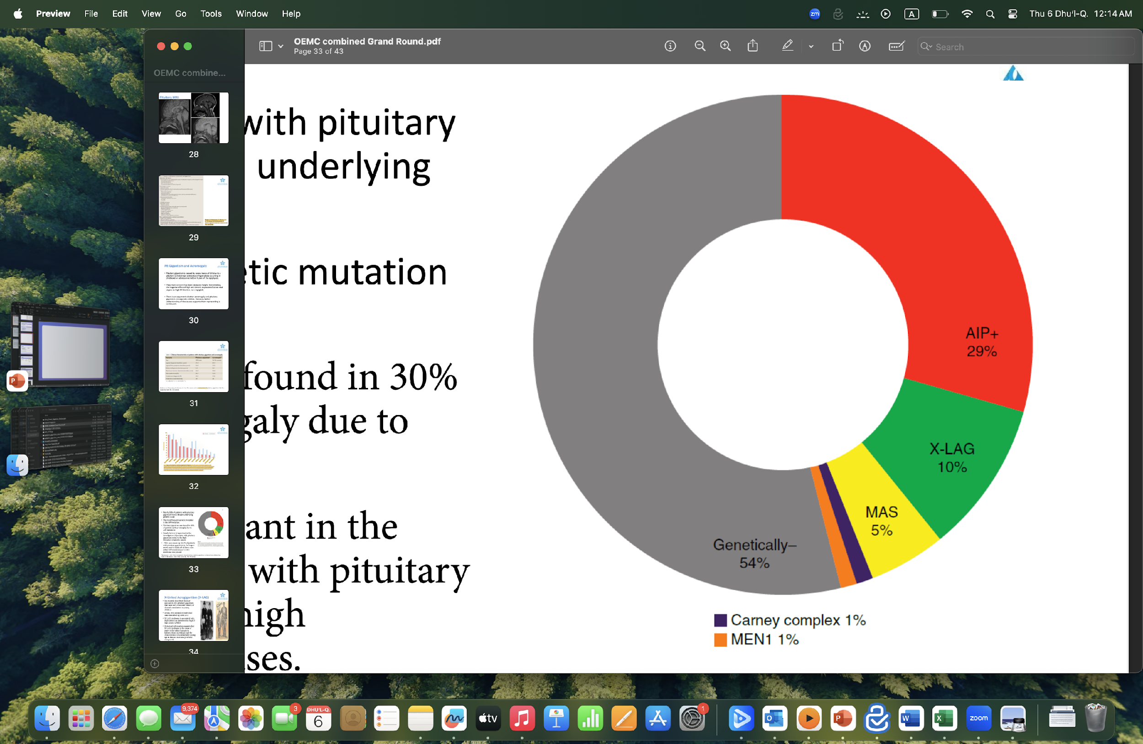
Literature review
Beckers, A., Petrossians, P., Hanson, J. et al. The causes and consequences of pituitary gigantism. Nat Rev Endocrinol 14, 705–720 (2018).
Rostomyan, L. et al. Clinical and genetic characterization of pituitary gigantism: an international collaborative study in 208 patients. Endocr. Relat. Cancer 22, 745–757 (2015)

Slide 31

💡
Key Learning Points from This Case
Below 50% of pediatric gigantism cases have an identifiable genetic defect
1️⃣
Don’t just focus on Referral Complaint
2️⃣
Real issue was accelerated linear growth
Look beyond the obvious complaint
Multidisciplinary follow-up is essential
for outcomes and family-centered care in rare pediatric endocrine conditions.
This case demonstrates the diagnostic complexity and therapeutic responsiveness of early-onset gigantism
3️⃣
4️⃣

Slide 32
Thank you
Email: m0324543@gmail.com

