Slide 1
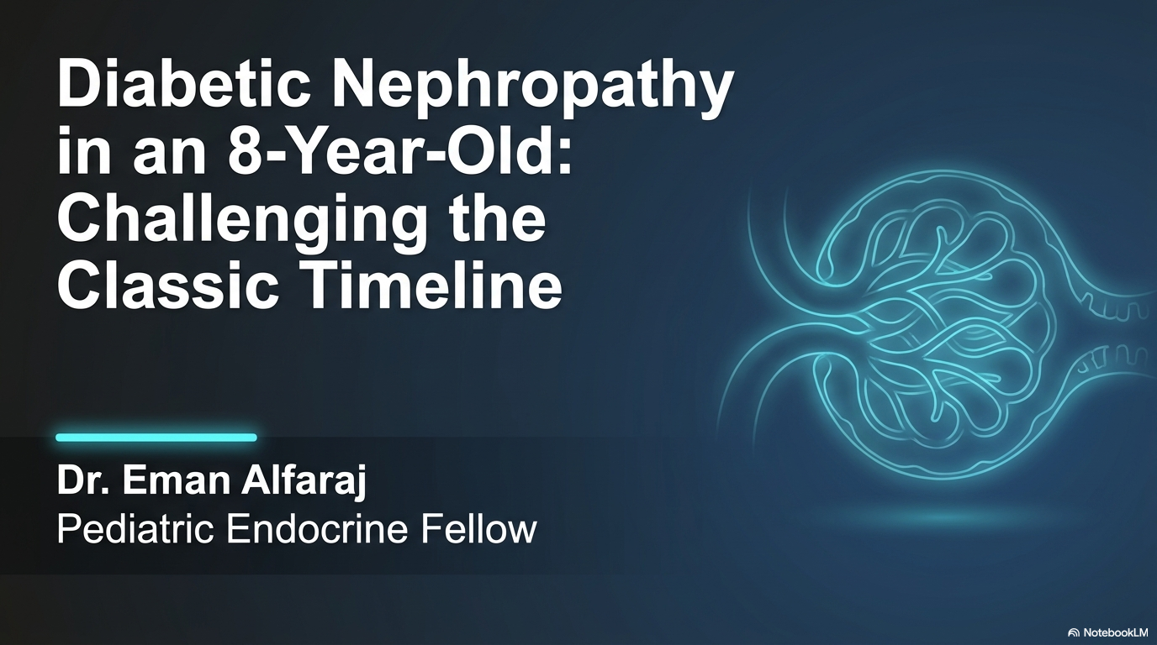
King Saud university Medical city

Slide 2
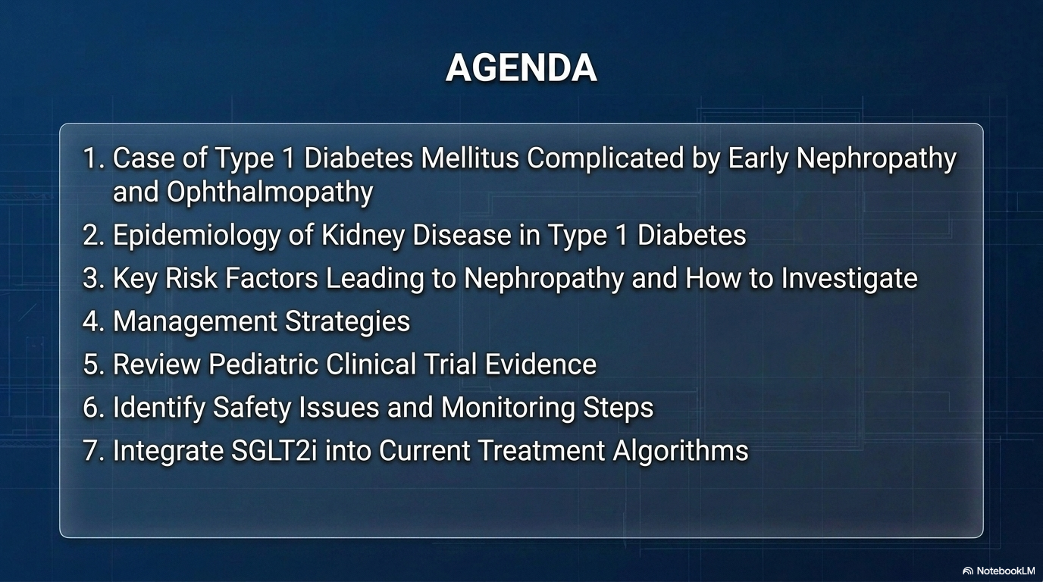

Slide 3
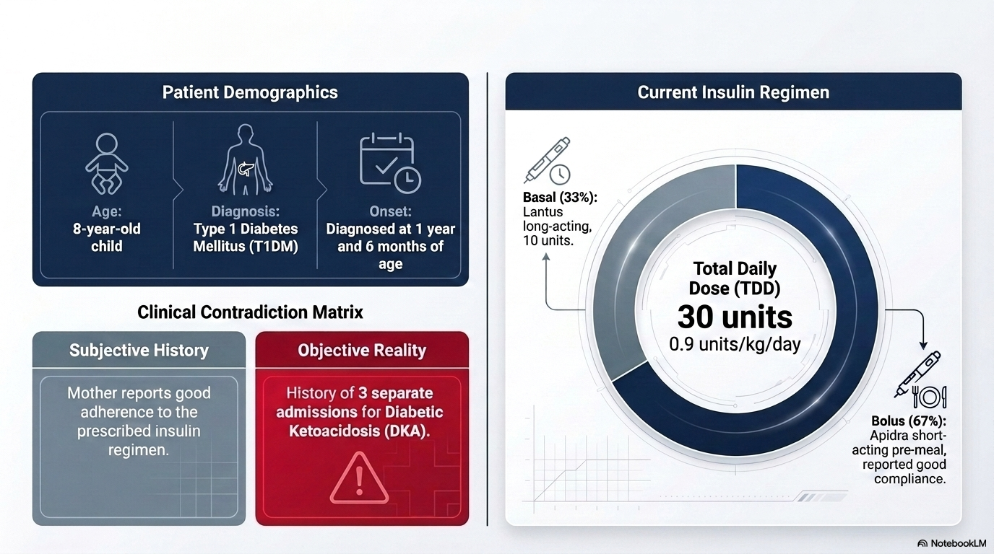

Slide 4
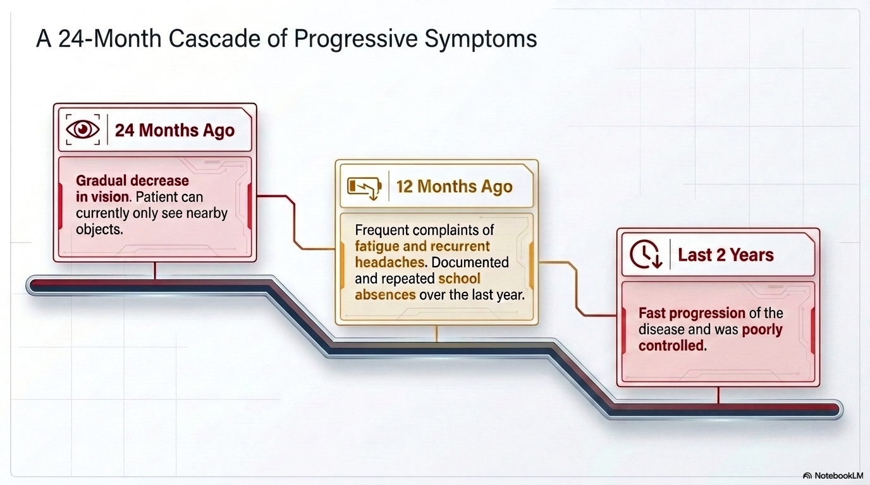

Slide 5
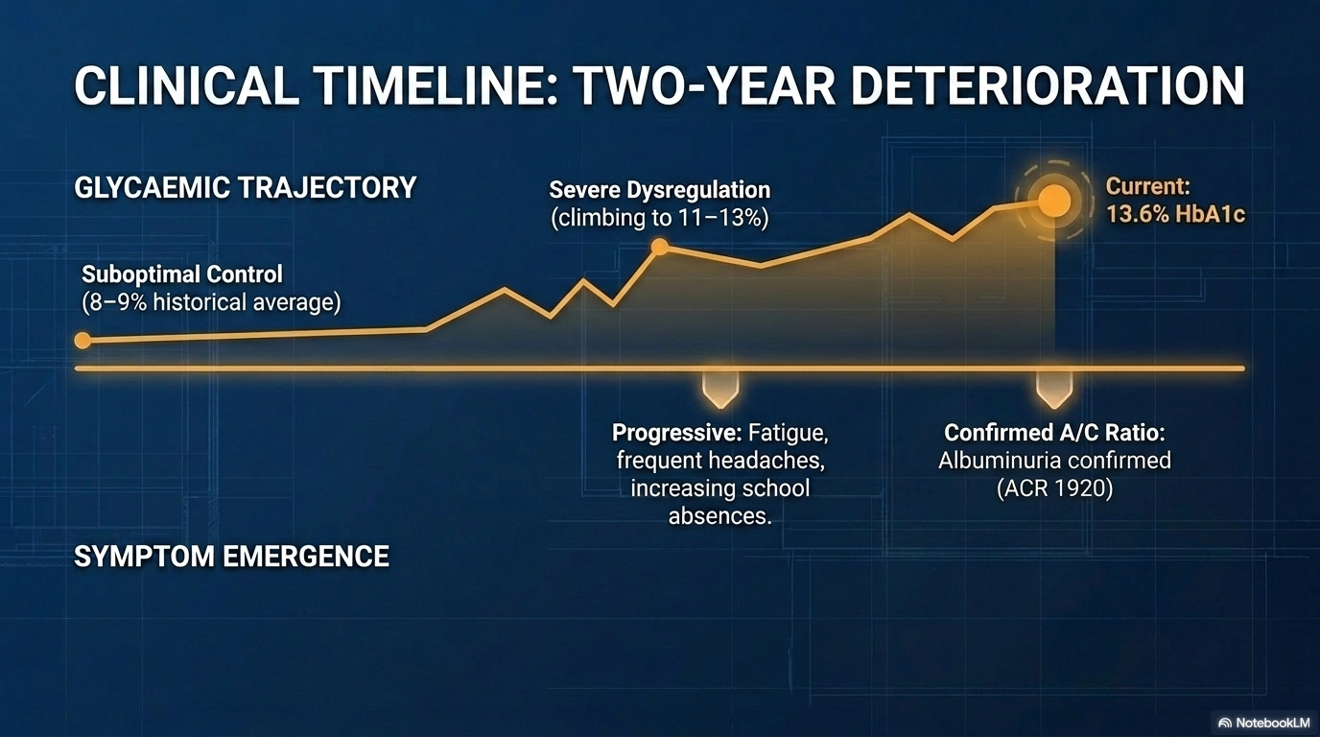

Slide 6
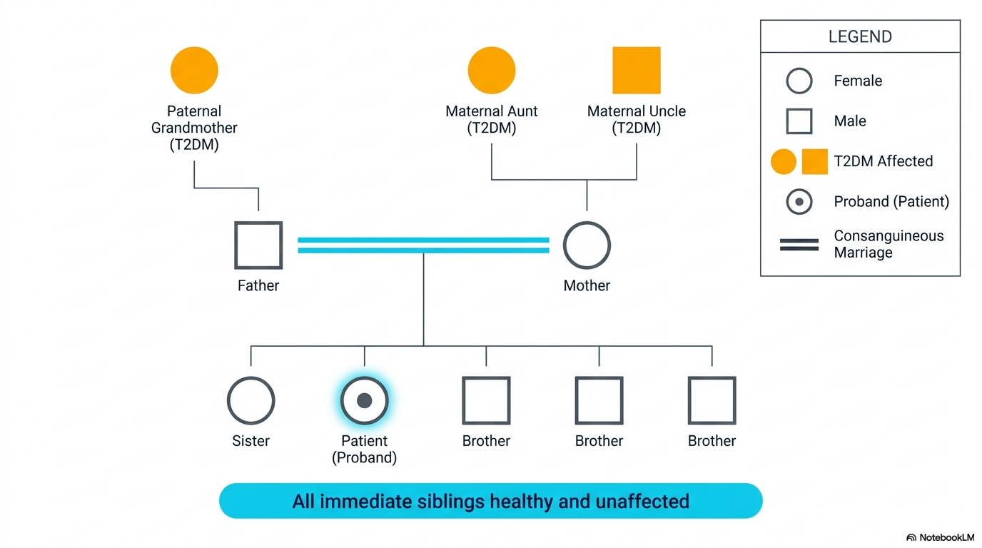

Slide 7
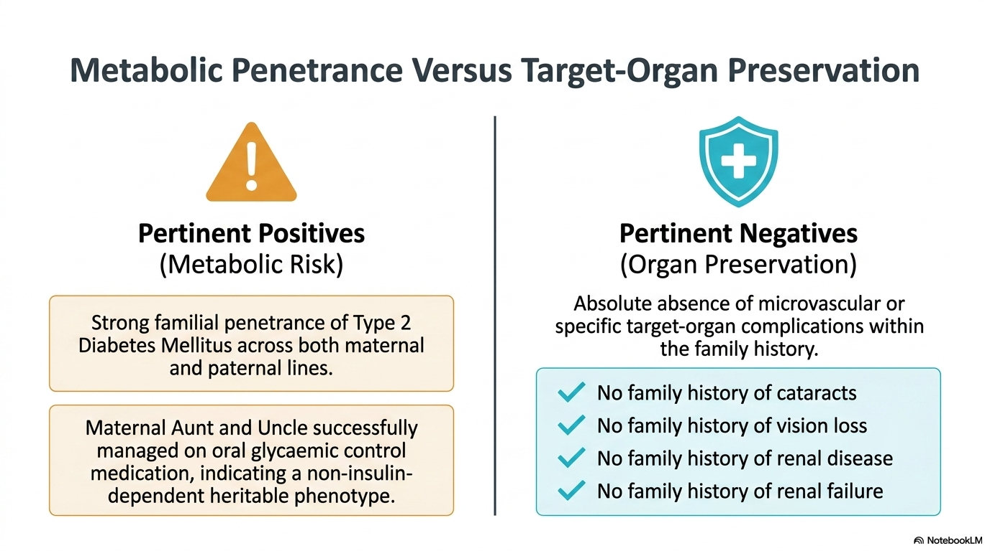

Slide 8
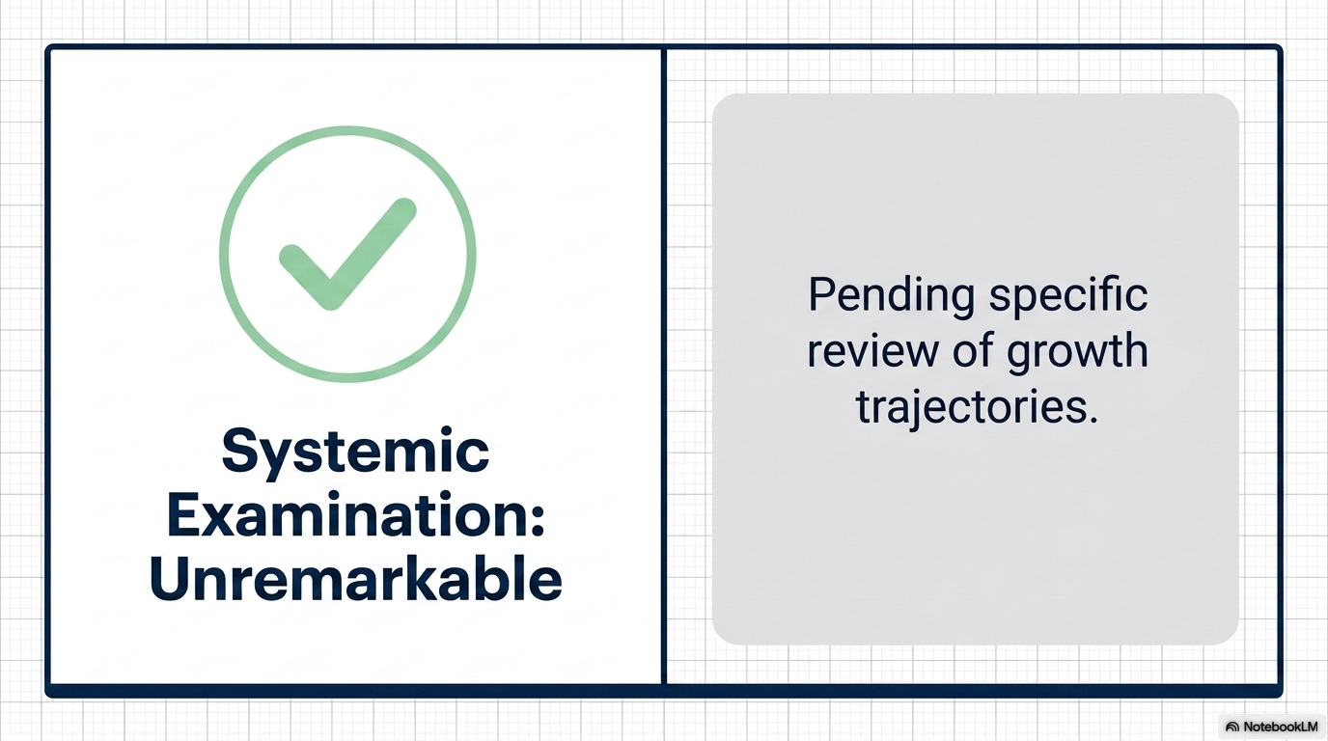
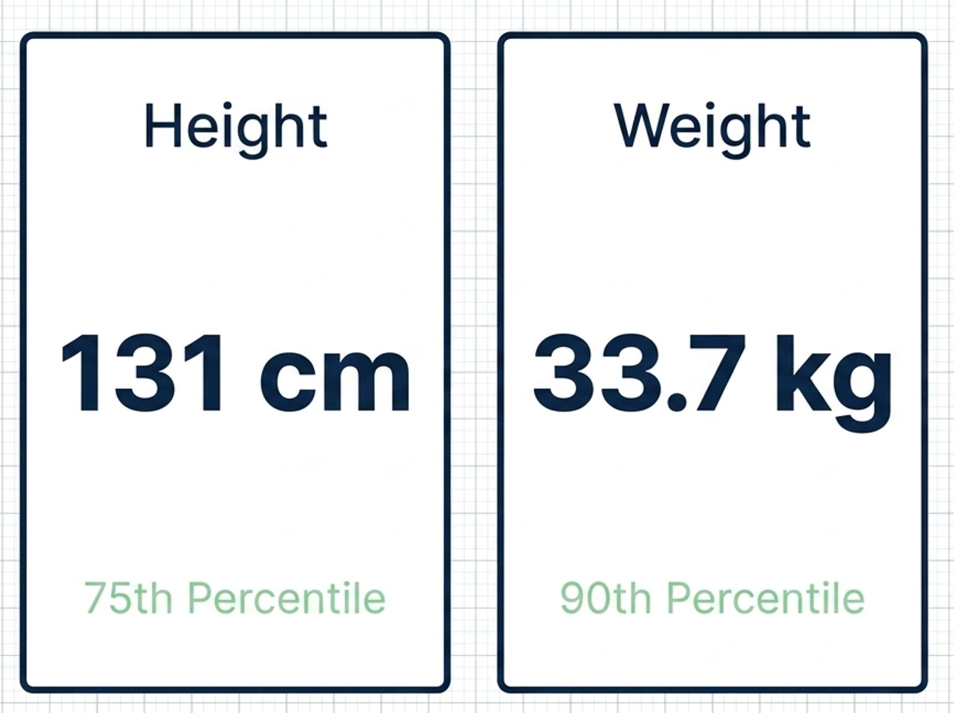
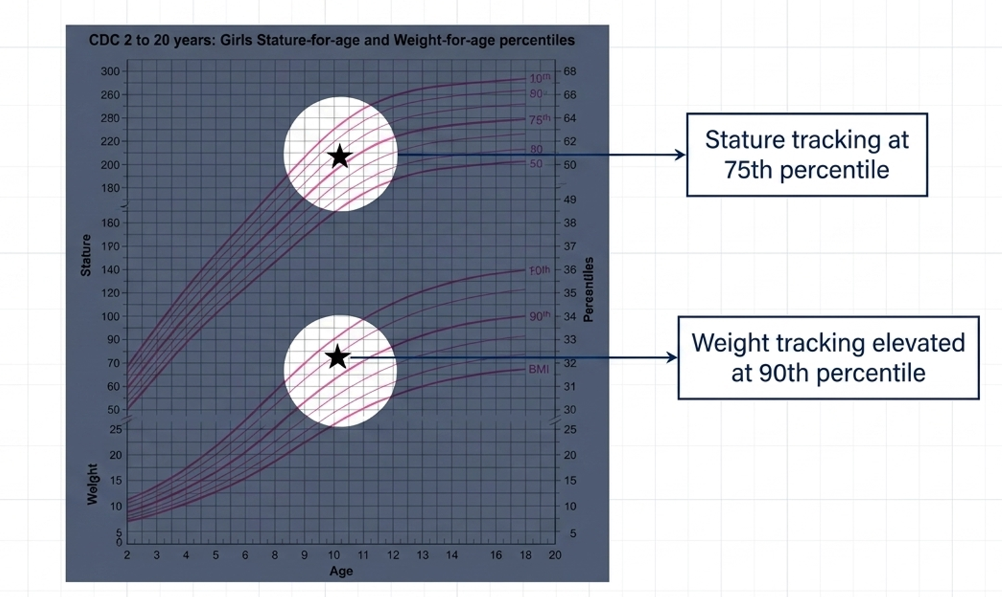

Slide 9
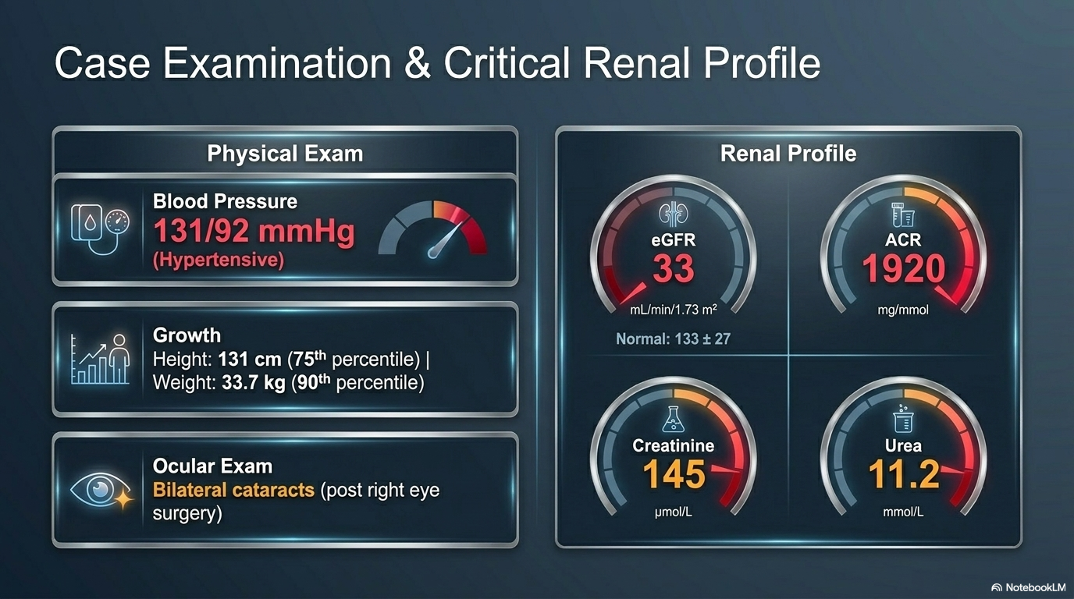

Slide 10
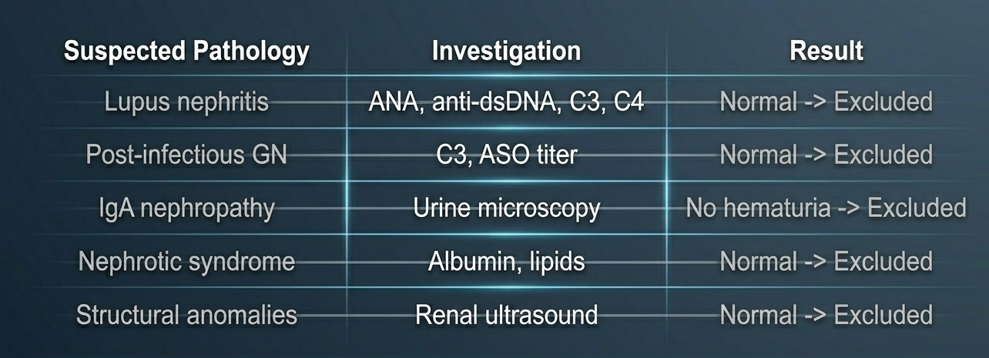
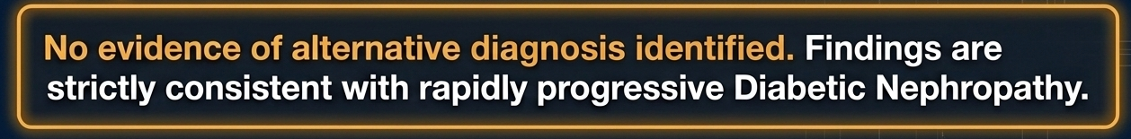

Slide 11
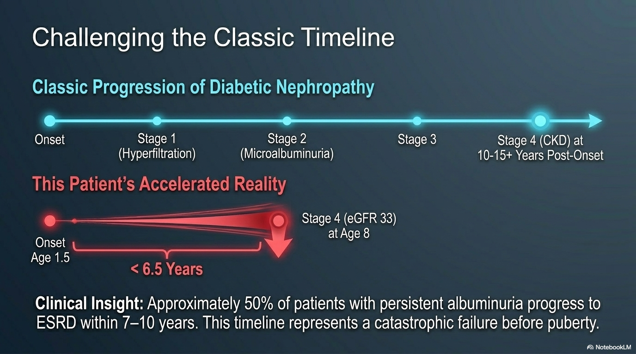

Slide 12
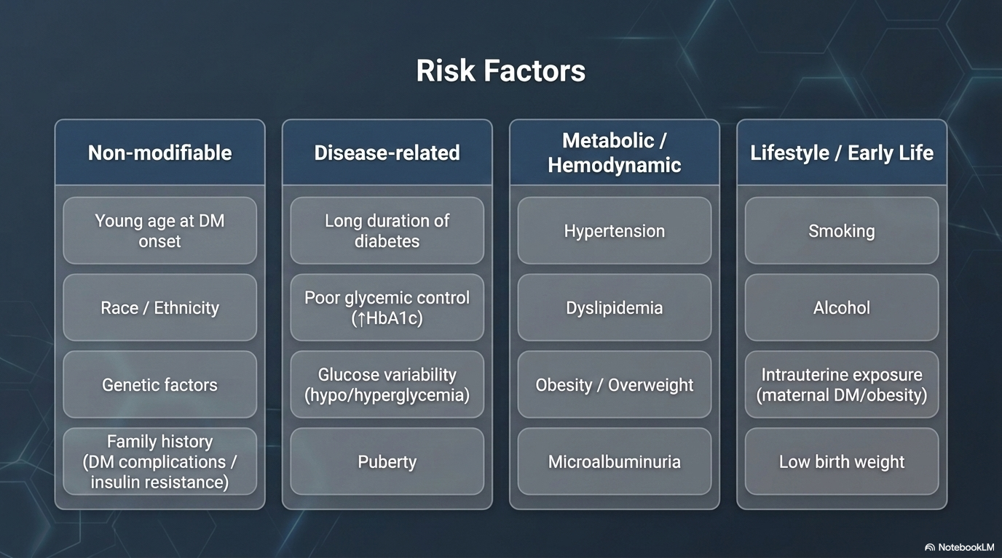

Slide 13
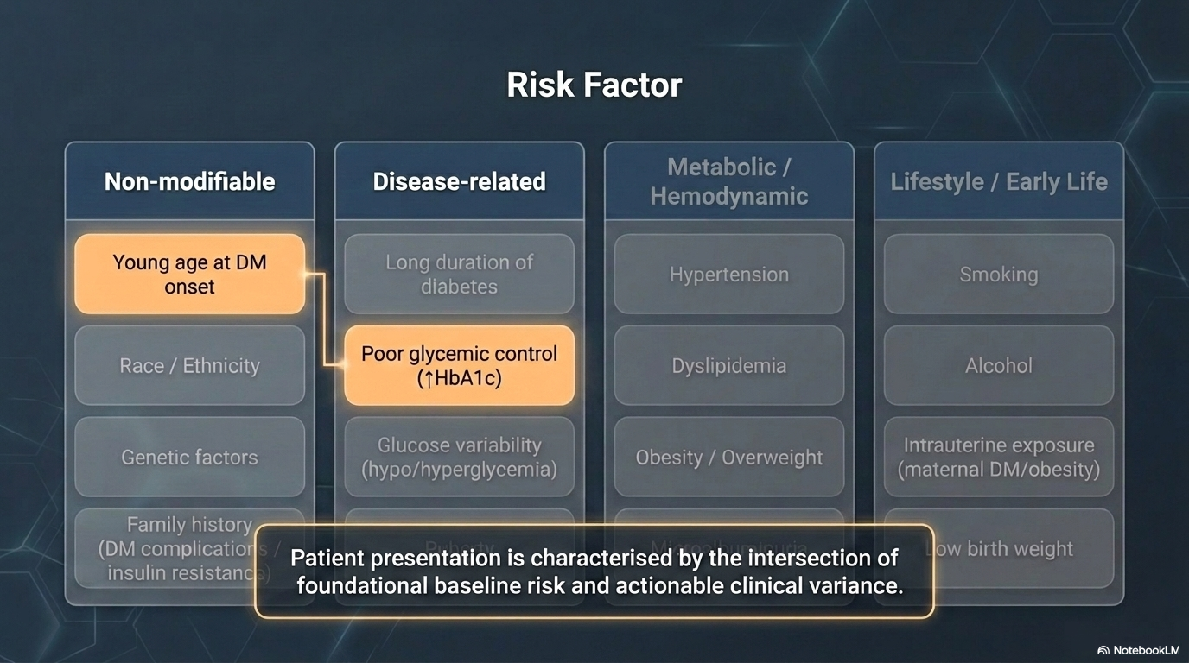

Slide 14
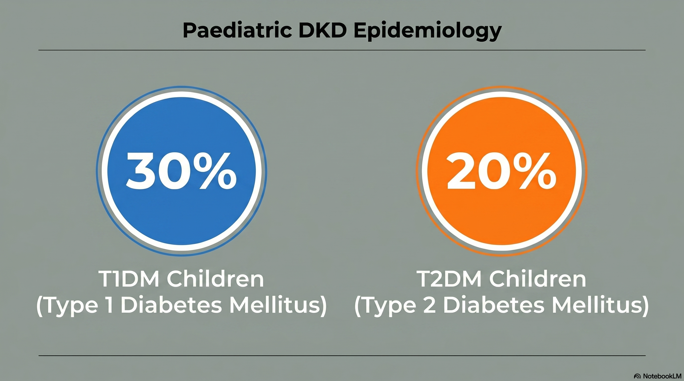

Slide 15
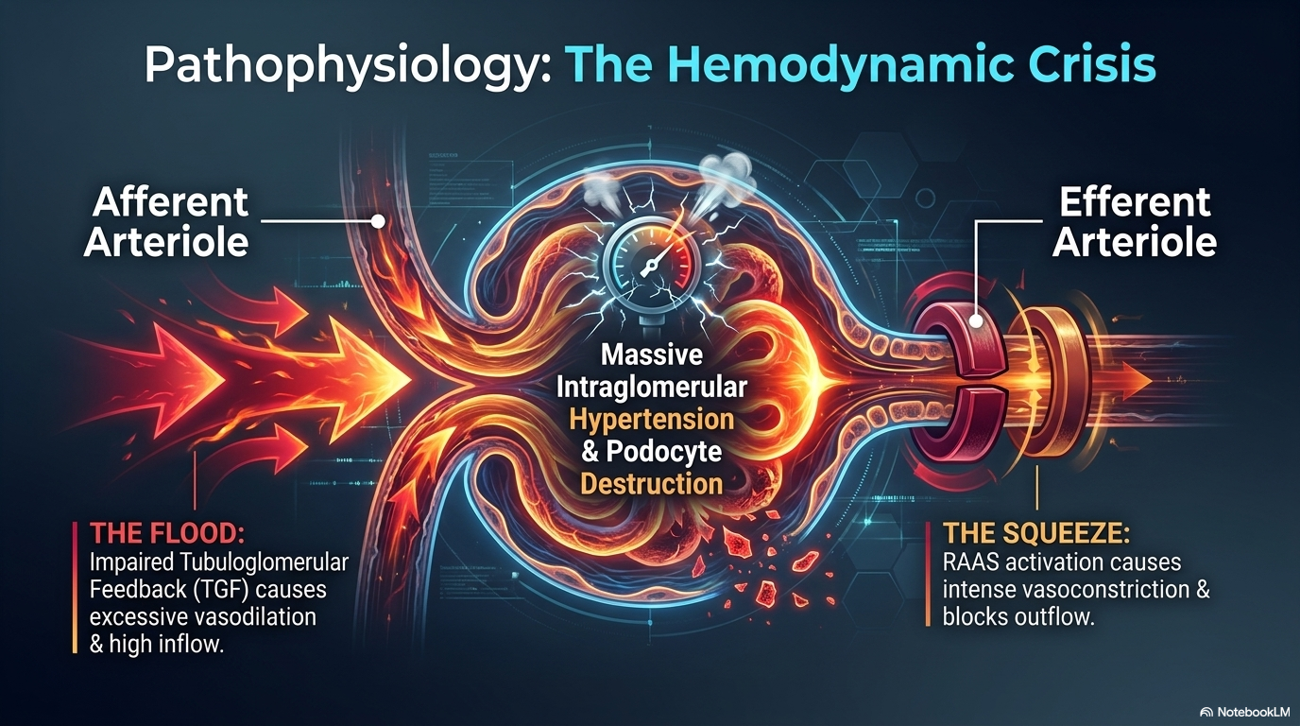
Notes:
One of the earliest functional changes is glomerular hyperfiltration as mentioned, due to increased renal blood flow, altered afferent and efferent arteriolar tone (afferent dilatation, efferent constriction) and elevated intraglomerular capillary pressure
The increased intraglomerular pressure forces more filtration and shear stress on the glomerular capillary wall, promoting damage to podocytes and endothelial cells.
Activation of the renin–angiotensin–aldosterone system (RAAS) is fundamental: angiotensin II contributes to constriction of efferent arteriole, mesangial contraction, and promotes glomerular hypertension and fibrosis.

Slide 16
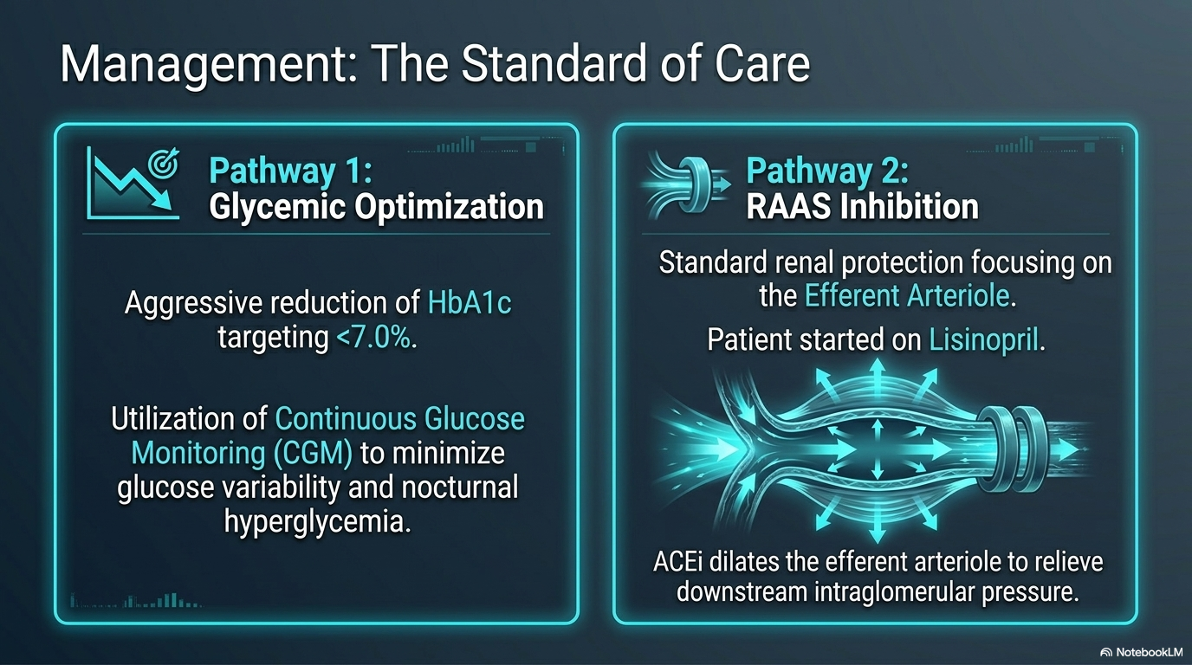

Slide 17
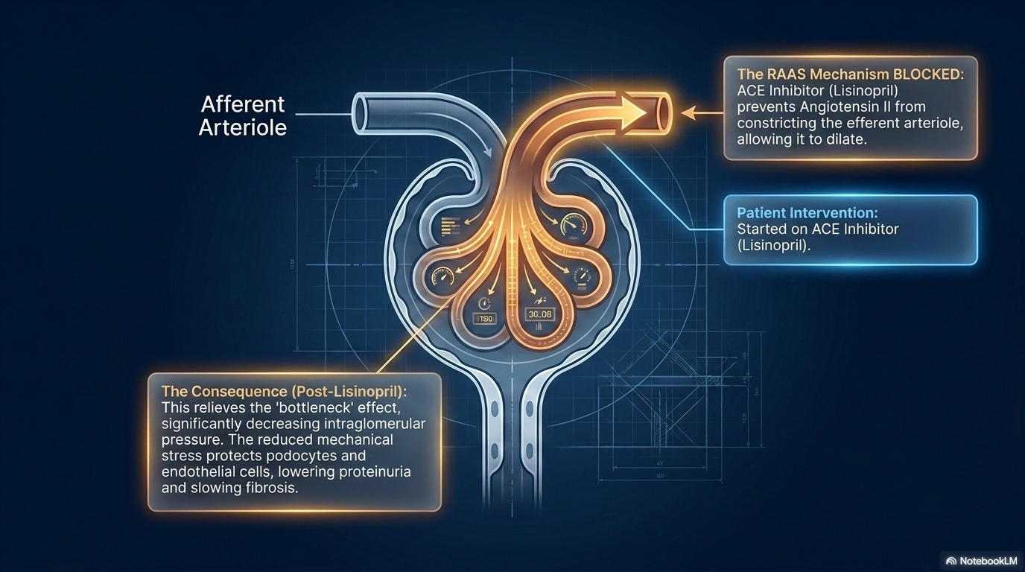
When to use ACE Inhibitor
-Persistent microalbuminuria
-Hypertension
-Macroalbuminuria

Slide 18
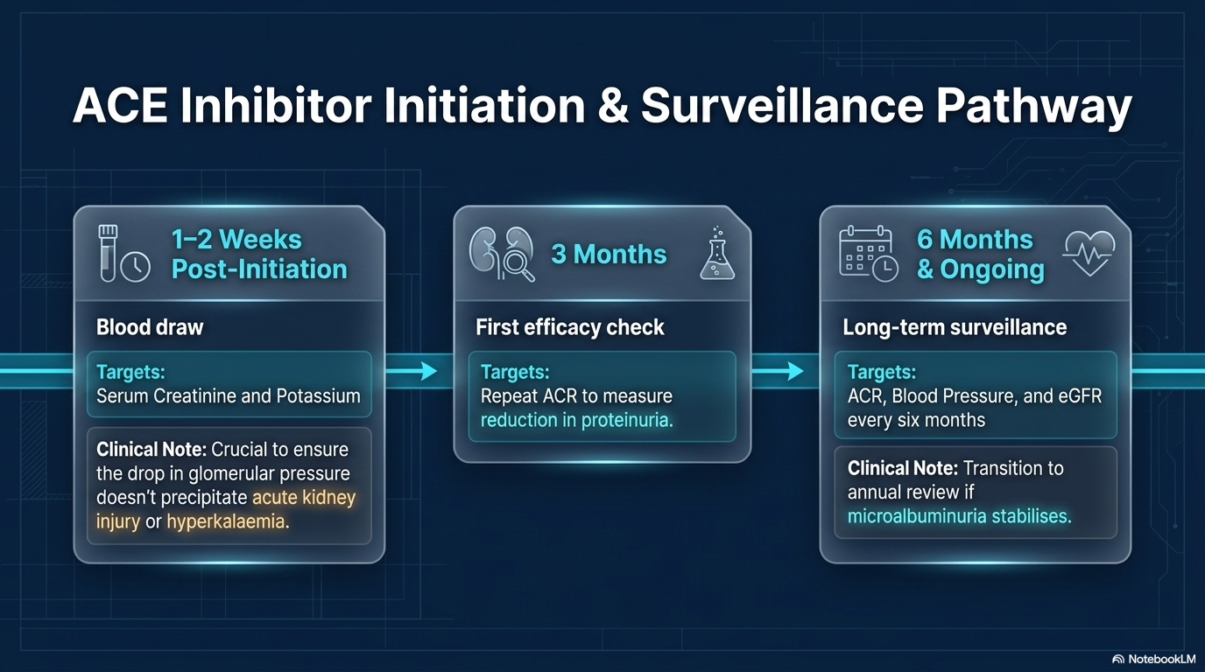

Slide 19
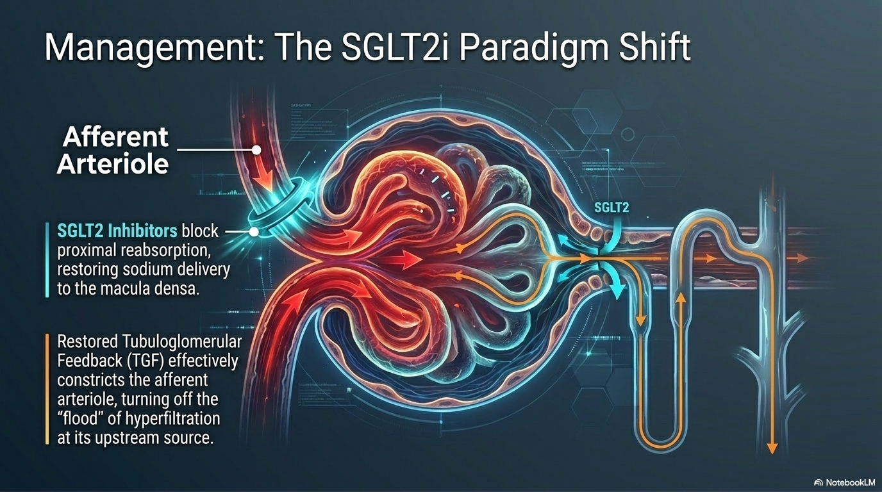
Notes:
In addition to the activation of the renin-angiotensin-aldosterone system, renal tubular factors, including SGLT2, contribute to glomerular hyperfiltration in diabetes.

Slide 20
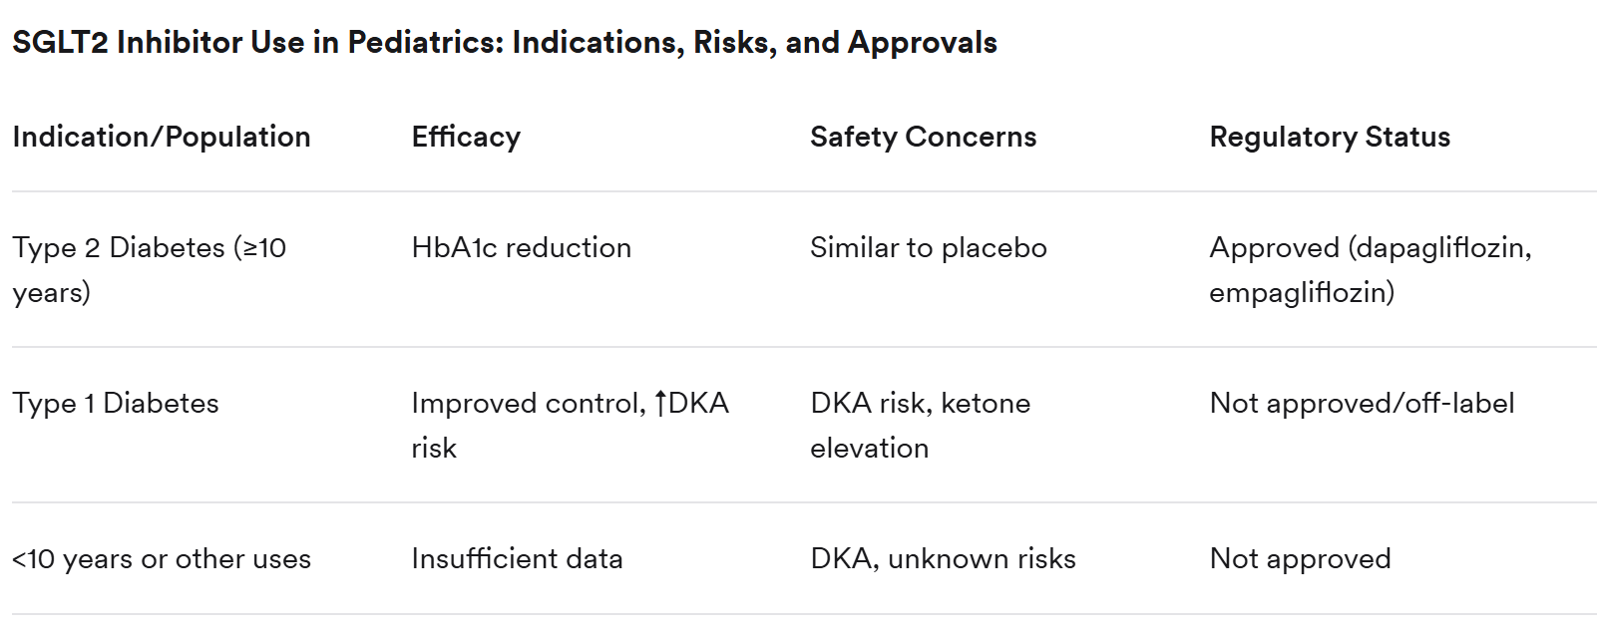

Slide 21
Review From adult study effect of the SGL2I medication
Metabolic and Cardiovascular Effects
HbA1c ↓ 0.7–1 %
Weight ↓ 2–3 kg
SBP ↓ 3–5 mmHg
Improved LV diastolic function
Notes:
“Across adult and pediatric trials, these are the consistent average effects. Modest but durable reductions in glucose, body weight, and systolic blood pressure, with favorable ventricular remodeling on imaging studies.”

Slide 22
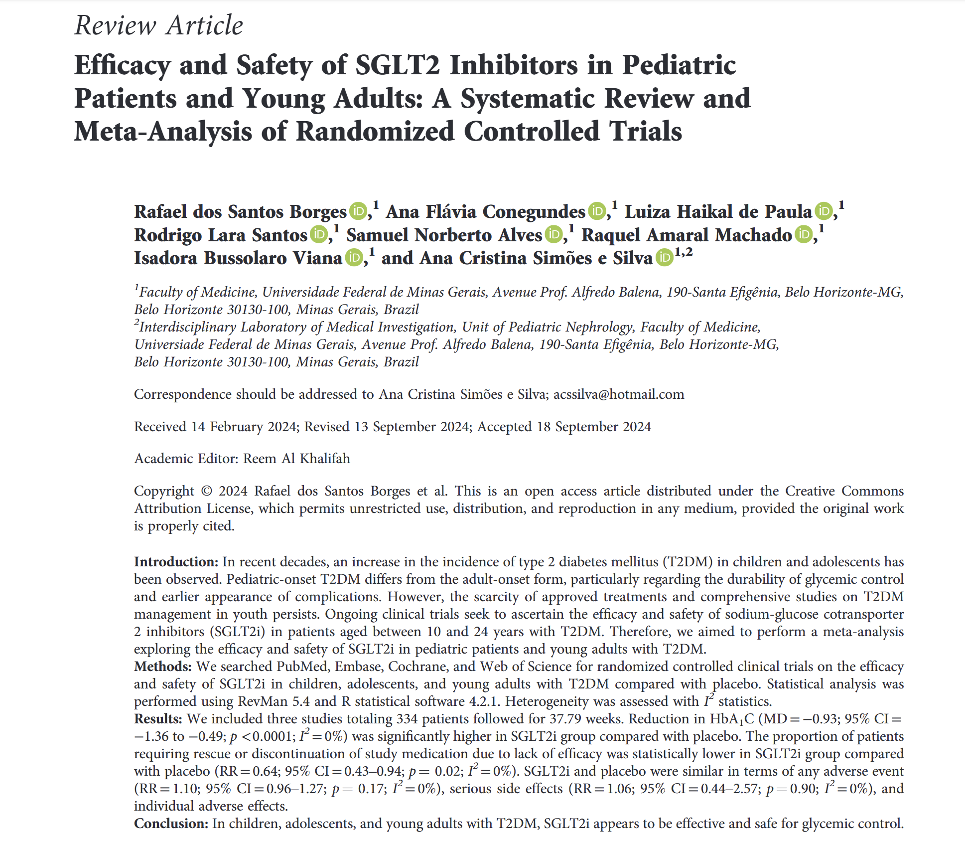

Slide 24
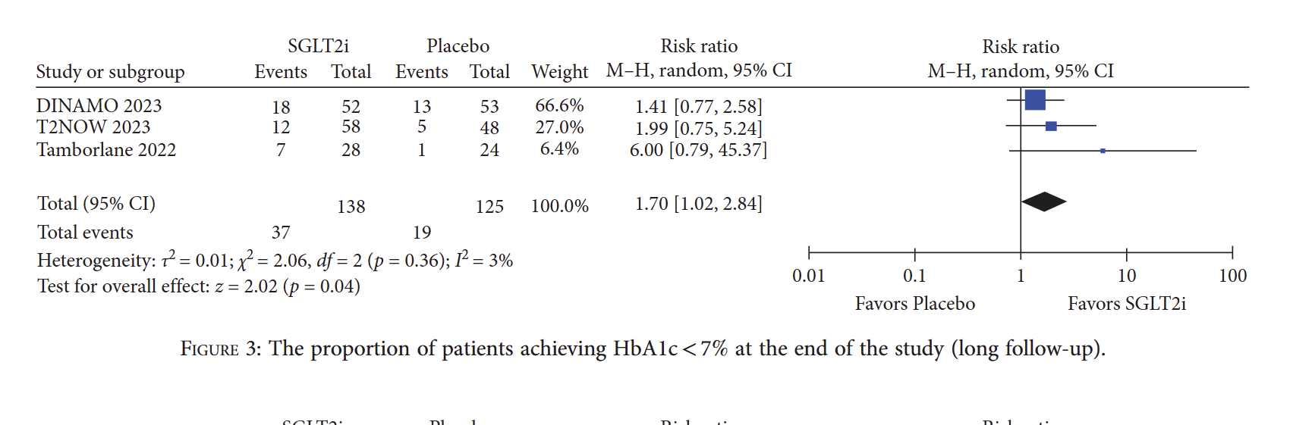
“This means that patients on SGLT2 inhibitors were about 70% more likely to achieve an HbA1c below 7% compared to placebo.
Importantly, the confidence interval does not cross 1, so the overall result is statistically significant (p = 0.04).”
Notes:
Very wide CI reflect very small sample size

Slide 25
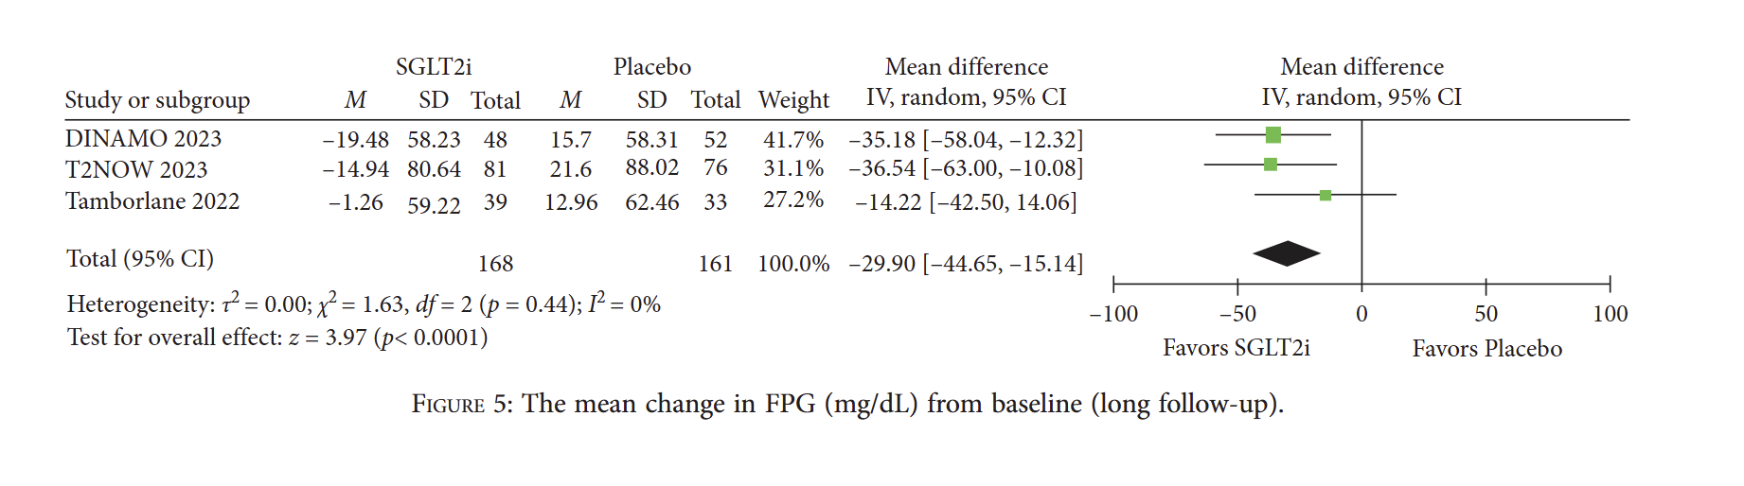
“When we pool all three trials, the overall mean difference in fasting plasma glucose is:
–29.90 mg/dL
(95% CI –44.65 to –15.14),
with a highly significant p-value (p < 0.000
1).
So overall, SGLT2 inhibitors lower fasting glucose by about 30 mg/dL.
“When we pool all three trials, the overall mean difference in fasting plasma glucose is:
–29.90 mg/dL
(95% CI –44.65 to –15.14),
with a highly significant p-value (p < 0.000
1).
So overall, SGLT2 inhibitors lower fasting glucose by about 30 mg/dL compared to placebo.”
Notes:
“When we pool all three trials, the overall mean difference in fasting plasma glucose is:
–29.90 mg/dL
(95% CI –44.65 to –15.14),
with a highly significant p-value (p < 0.000
1).
So overall, SGLT2 inhibitors lower fasting glucose by about 30 mg/dL compared to placebo.”

Slide 26
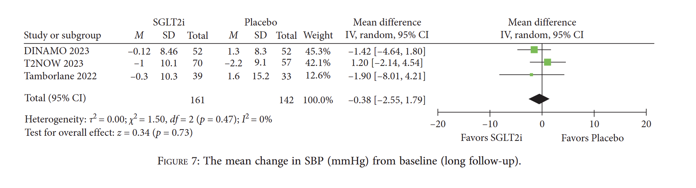
“When we combine all three studies (161 patients in SGLT2i groups and 142 in placebo), the overall mean difference is: –0.38 mmHg
(95% CI –2.55 to 1.79),
with p = 0.73.
This tells us that there is no significant difference in systolic blood pressure between SGLT2 inhibitors and placebo.”

Slide 27
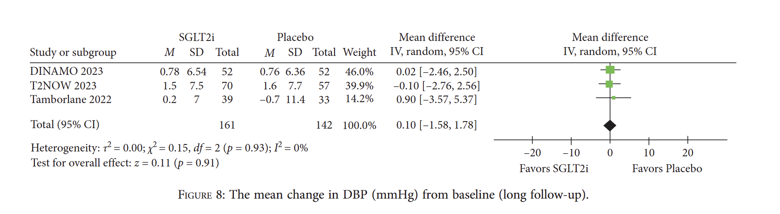
“When we combine all trials (161 children on SGLT2i, 142 on placebo), the pooled mean difference is: +0.10 mmHg
(95% CI –1.58 to 1.78),
with p = 0.91.
This indicates No significant difference in diastolic blood pressure between SGLT2 inhibitors and placebo.”

Slide 28
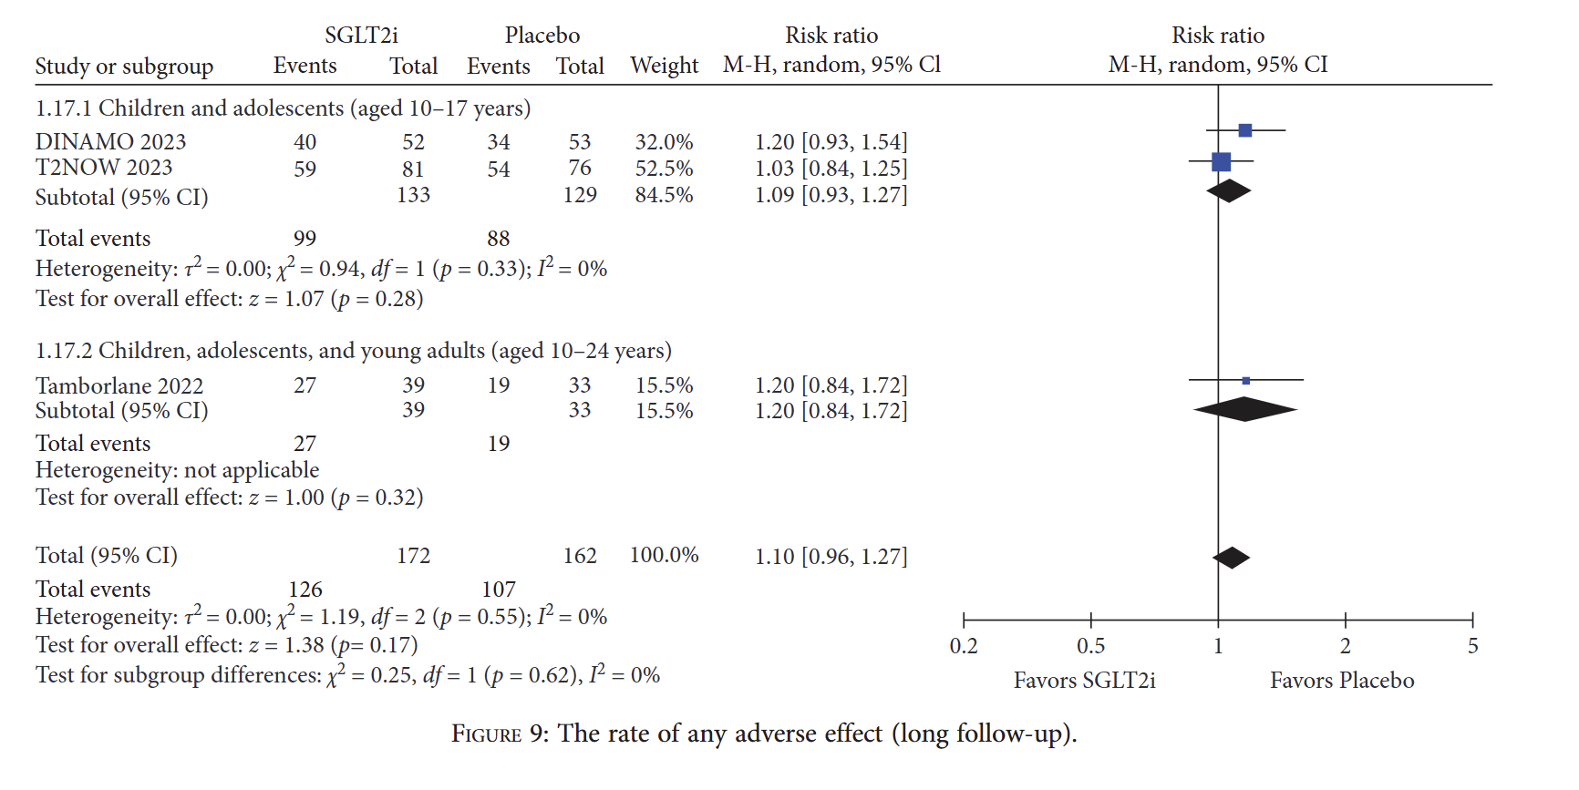
“SGLT2 inhibitors do not appear to increase the overall risk of adverse events compared with placebo in the pediatric and young adult population. Across all trials, most adverse events were mild and comparable to placebo.”
“This supports that SGLT2 inhibitors have a generally safe profile in youth, at least in the short- to medium-term follow-up used in RCTs.”

Slide 29
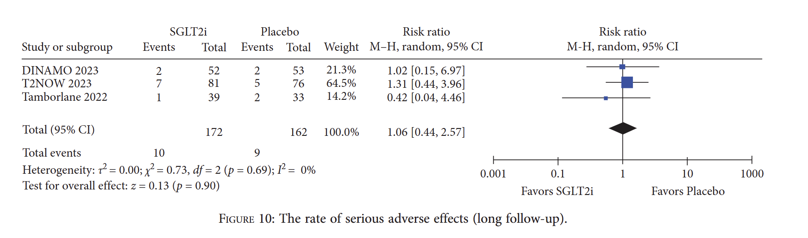
Overall Conclusion
SGLT2 inhibitors do not increase or decrease the risk of serious adverse events compared with placebo.
Evidence is limited and imprecise because:
  The number of events is small (10 vs 9).
  Confidence intervals are wide.
But importantly:
No signal of harm is seen in long-term follow-up of pediatric patients.

Slide 30
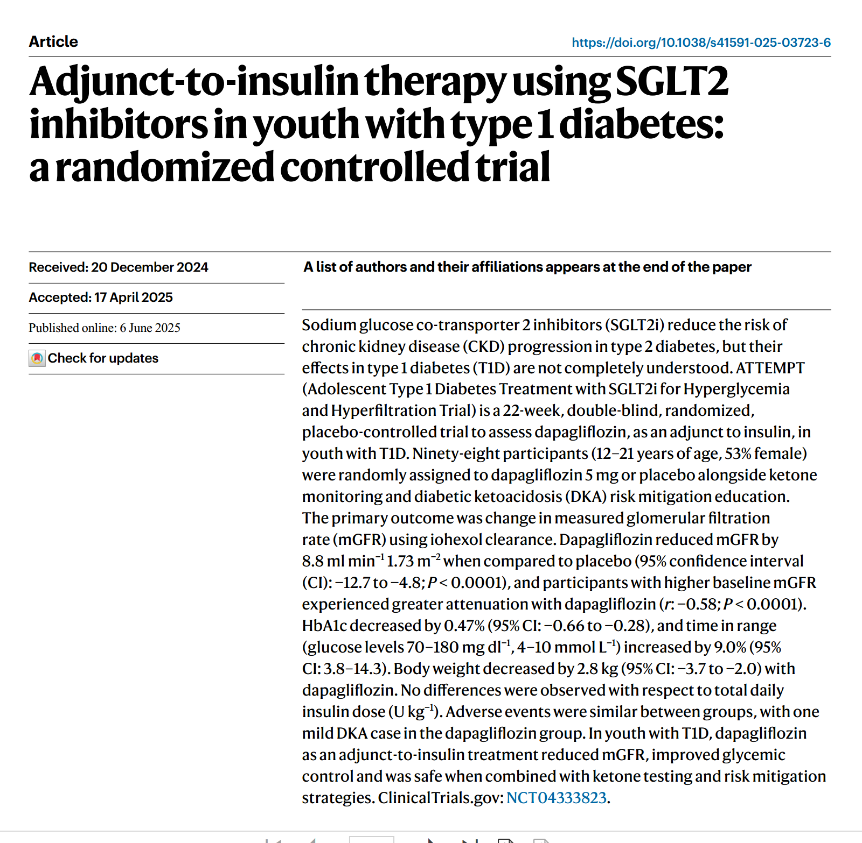
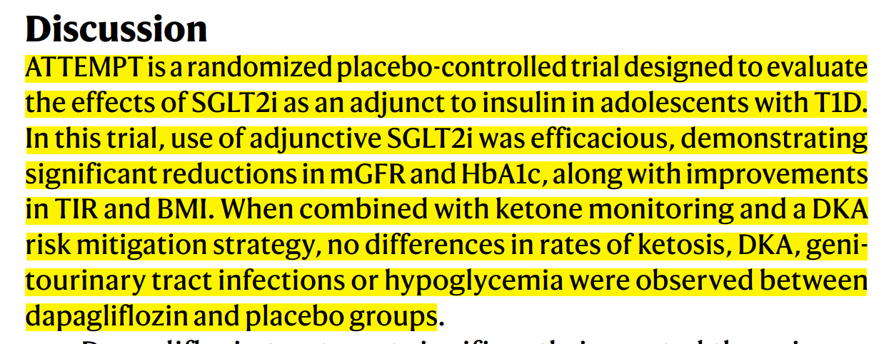

Slide 31
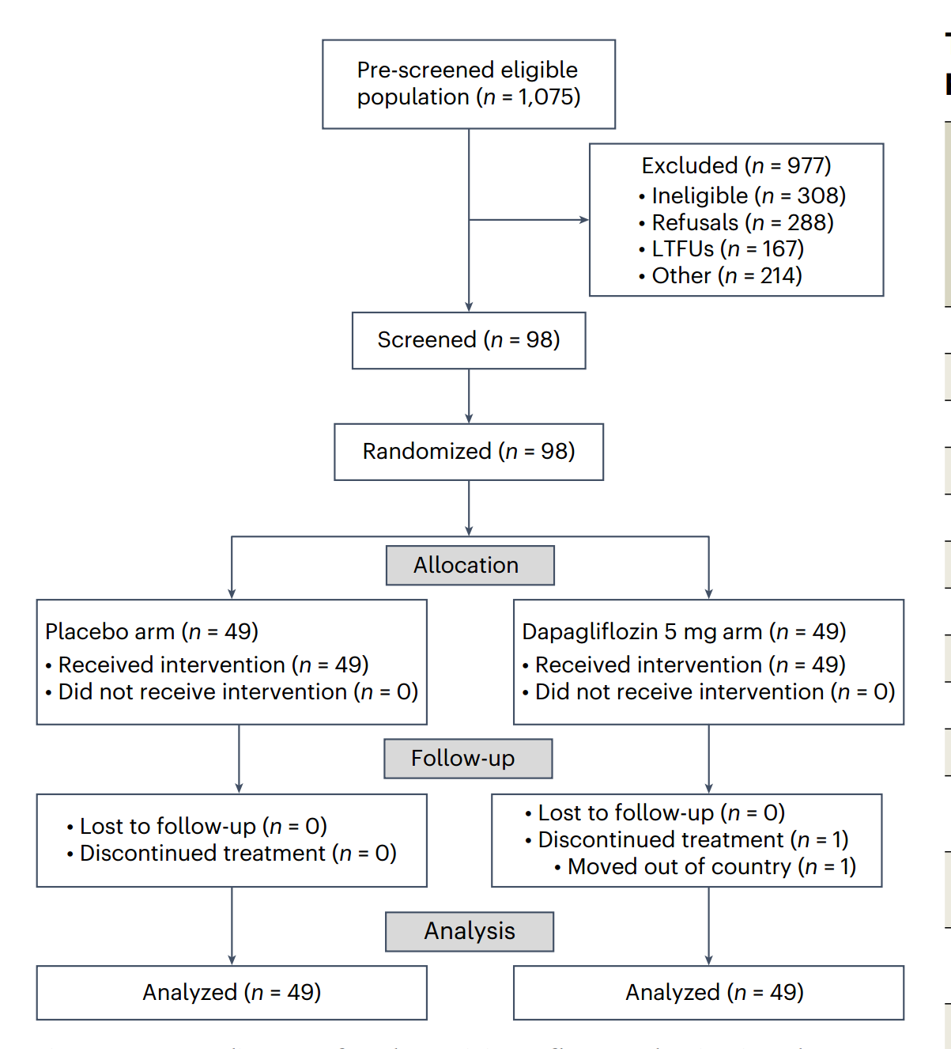

Slide 32
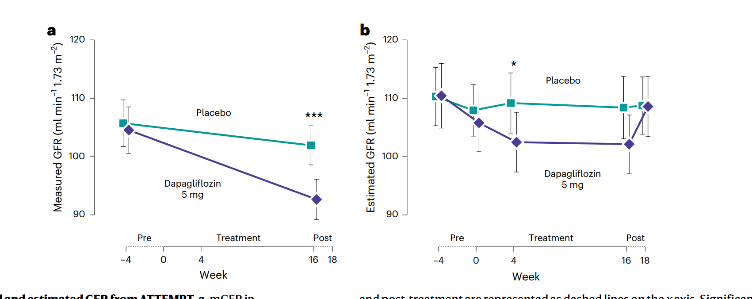

Slide 33
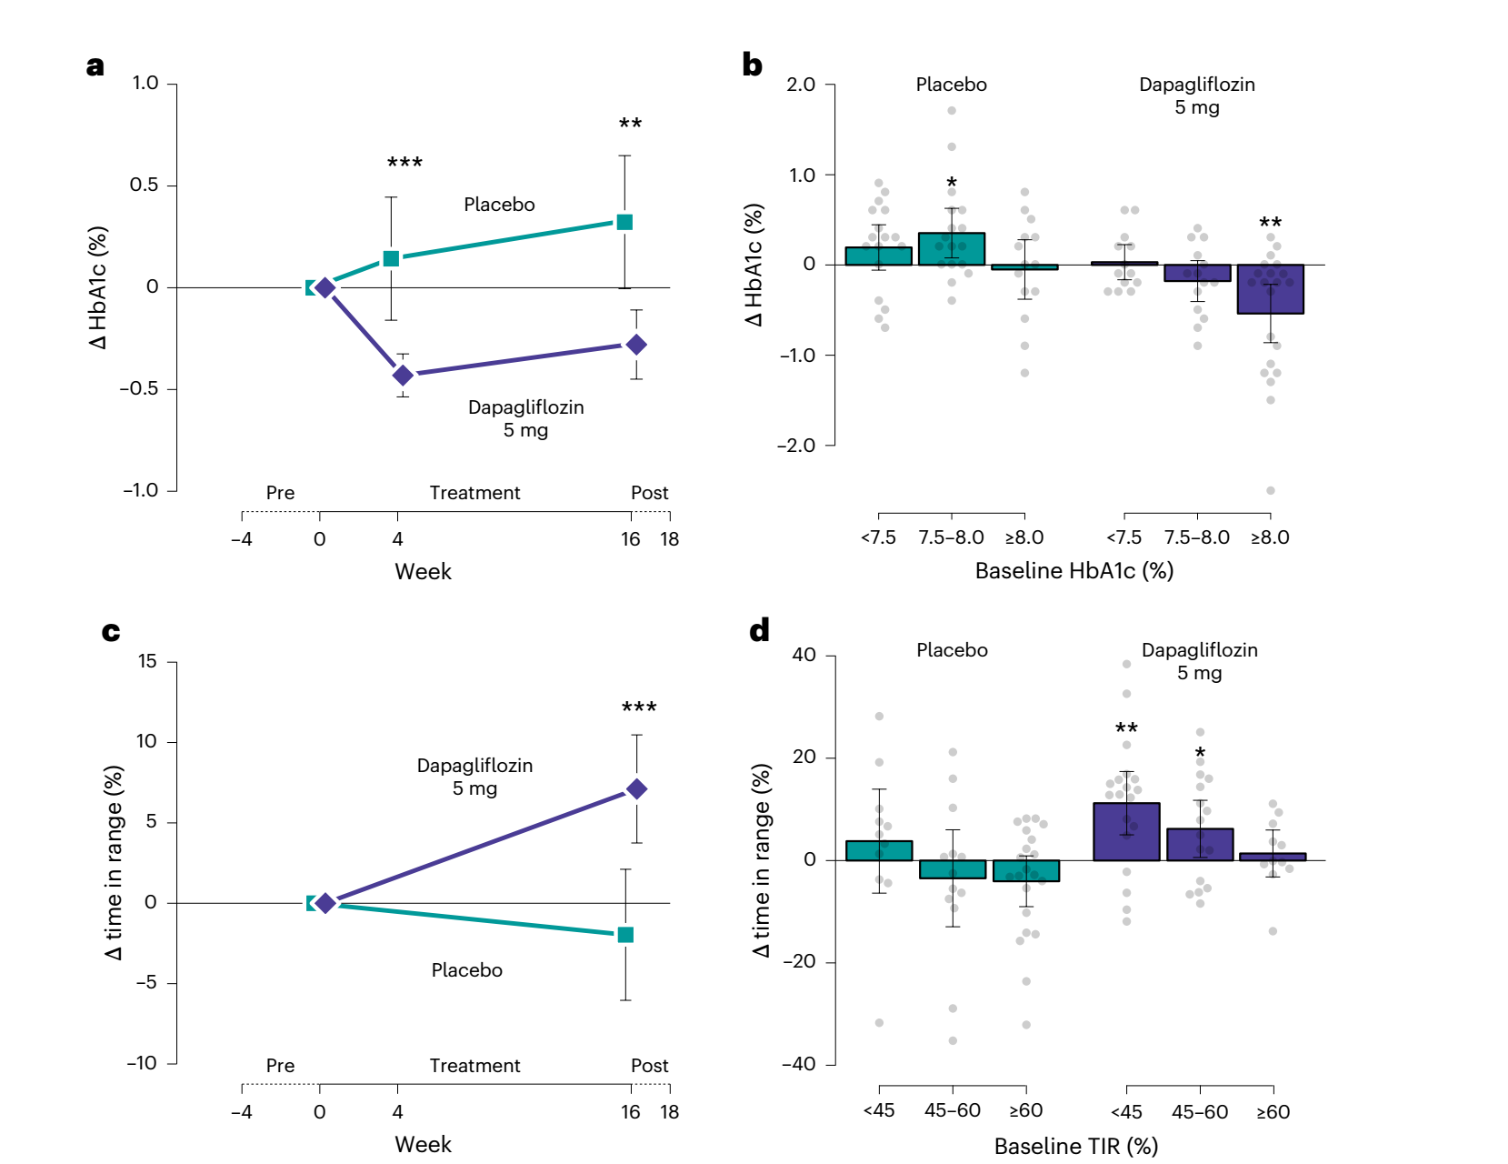

Slide 34
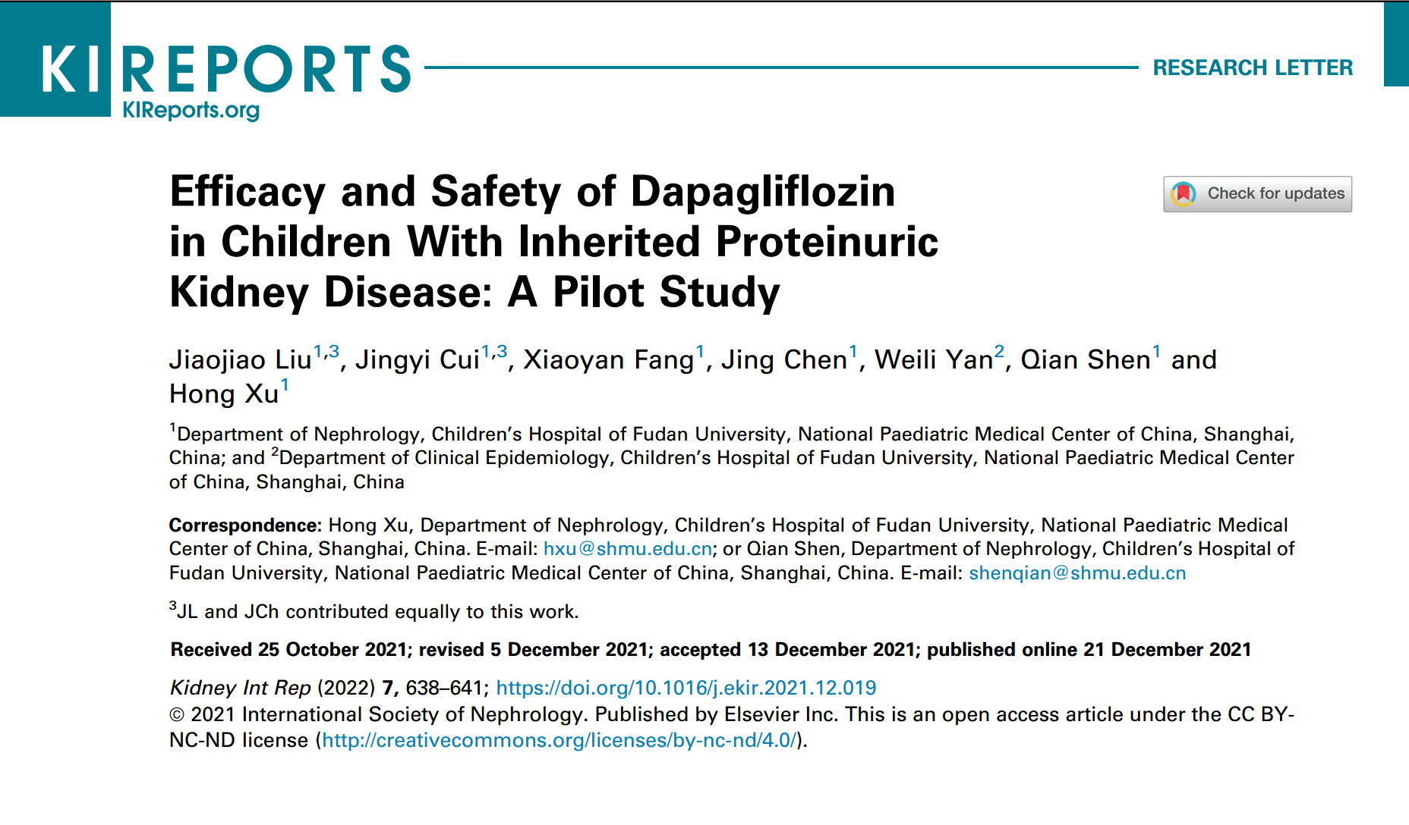

Slide 35
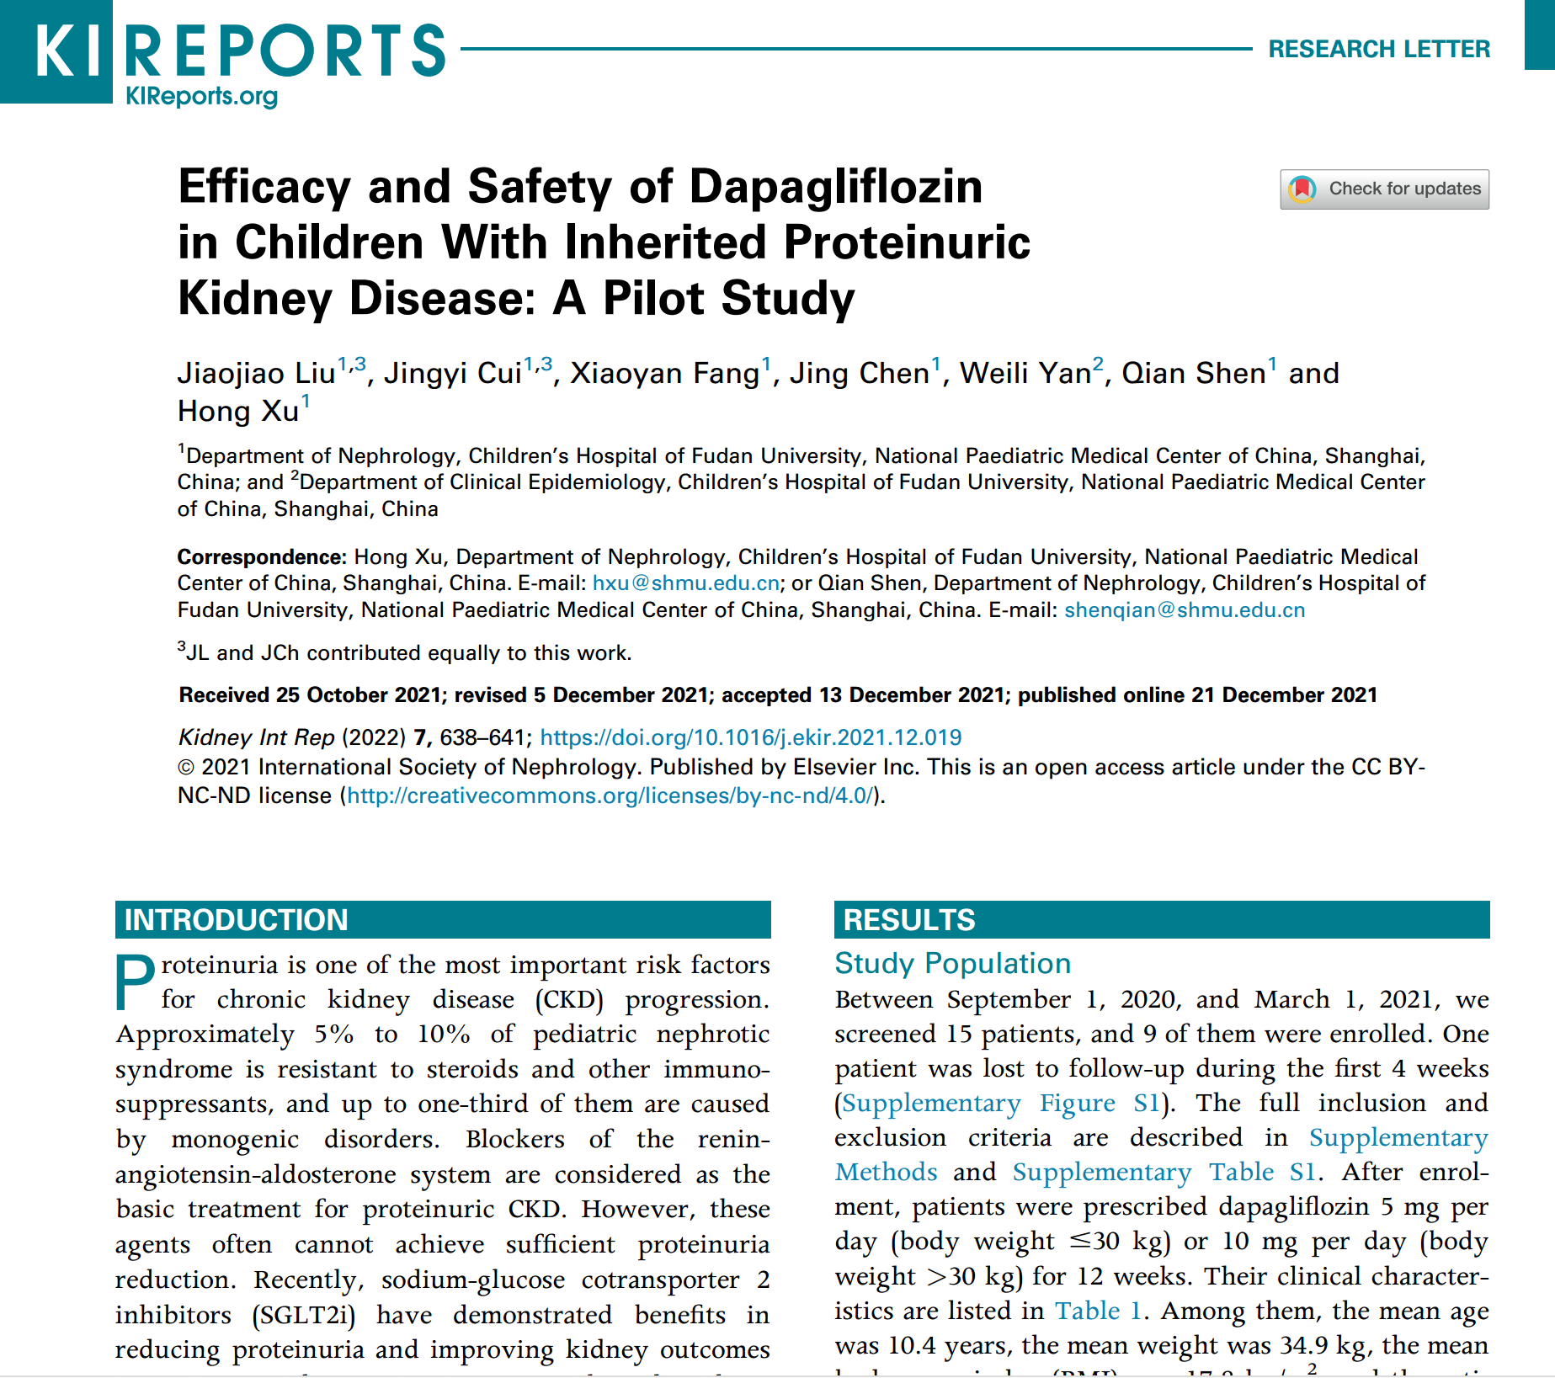

Slide 36
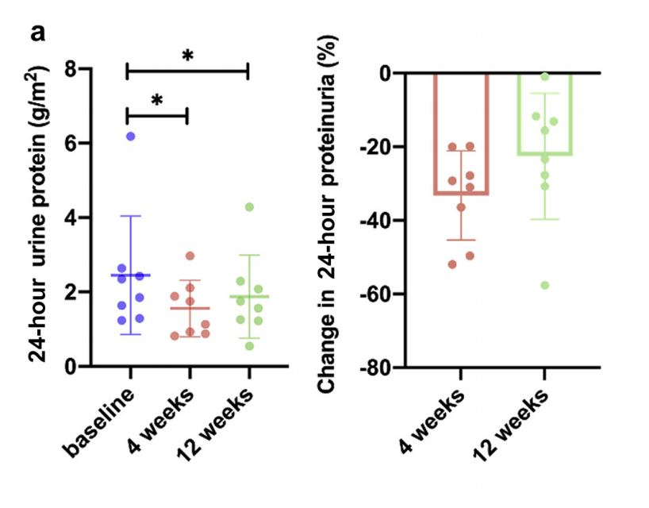
The therapy leads to a consistent decline in proteinuria, with many patients achieving 20–40% reduction, and several showing more than 40–60% improvement by 12 weeks.

Slide 37
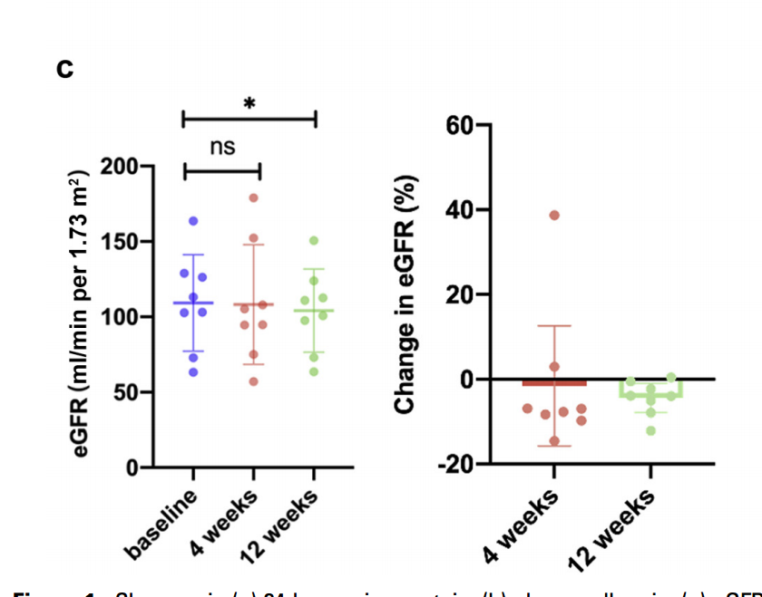
There is no significant early drop (baseline to 4 weeks), but a small statistically significant decrease by 12 weeks — though eGFR remains within a clinically acceptable range.

Slide 38


