Slide 1



A Tale of two girls with tall stature
A Case Presentation
Presented by: Malak Almelhem. Pediatric endocrinology fellow.
king Abdullah specialized children’s hospital
Supervised by Prof: Amir Babiker.

Slide 2

Case presentation:
A 13-Year-Old Girl Referred for Delayed Puberty and Tall Stature
Marfan syndrome (MFS) Referred from Cardiology to Endocrinology for
evaluation of delayed puberty and tall stature
FHX: MFS in mother and younger 8-year-old sister
Medical history: multiple systemic manifestations: mitral valve prolapse, aortic root dilatation associated with premature ventricular contractions, myopia, scoliosis, and severe pectus excavatum.
Endocrine evaluation: limited (she had been treated with conjugated estrogen at a
relatively high dose of 0.625 mg daily for 7 months upgraded to 1.2mg recently with no significant clinical response in terms of reduction in growth velocity.
Delayed puberty (Absent Breast tissue) -not a frequent feature of MFS making this case particularly complex.
Notes:
With the addition of cyclic oral progesterone (10 mg), she experienced withdrawal bleeding.
On examination, her height was 168 cm (>90th percentile). She exhibited a marked chest wall deformity and remained prepubertal with Tanner stage I breast development. Bone age assessment demonstrated appropriate skeletal maturation for chronological age. Family history revealed normal pubertal timing in both her mother and younger sister, with maternal menarche reported at 13 years.

Slide 3
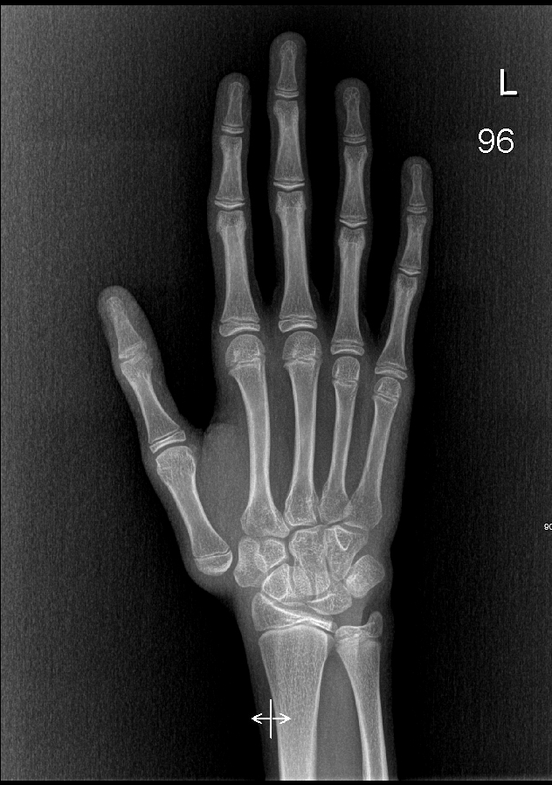
Examination Revealed Prepubertal Status Despite Age
Height: 168 cm (>90th centile)
Marked chest deformity consistent with pectus excavatum
Prepubertal Tanner staging for breast development
Bone age: appropriate skeletal maturation for chronological age

Slide 4
Estrogen Therapy Required Dose Escalation for Clinical Response
Initial dose: Conjugated estrogen 0.625 mg/day for 7 months
Dose escalated to 1.25 mg/day: Resulted in withdrawal bleeding when combined with alternating 10 mg oral progesterone
High estrogen doses posed additional vascular risk in the context of pending cardiac surgery
Balancing pubertal induction against cardiovascular safety was the central clinical challenge
Notes:
Management: two months after operation
Escalate her therapy to: 1.2 then uteriane (Withdrawl bleeding)
Added progesterone that induced her period after slowdown in growth
Height velocity decreased with BA closing epiphysis
Case report for amastia
Conflict of interest, fix her (heart, chest) stop her height induce mestration and amastia
Additional her sister ( at that time her age/height) now (height and age)
She had pubertal charestristic , no period yet (No cardiac problem) ortopedics for ephiysiodysis and awating forther collaboration

Slide 5
Significant Comorbidities Complicated the Management Approach
Key Comorbidities
Surgical History & Impact
Mitral valve prolapse
Aortic root dilatation
with premature ventricular contractions
Ectopia Lentis
Scoliosis
Severe pectus excavatum
Pending thoracic and cardiac surgical interventions related to MFS
These comorbidities created significant constraints on the choice and dosing of hormonal therapy

Slide 6

Marfan Syndrome at a Glance
Autosomal dominant connective tissue disorder caused by mutations in the FBN1 gene (chromosome 15), encoding fibrillin-1
Prevalence: approximately 1 in 5,000 individuals; affects males and females equally
Systemic manifestations span cardiovascular, musculoskeletal, and ocular systems
Tall stature with disproportionately long limbs (dolichostenomelia) is a hallmark feature
Life-threatening complications include aortic root dilatation and dissection

Slide 7

Recognising the Clinical Spectrum of Marfan Syndrome
System
Manifestations
Cardiovascular
Aortic root dilatation, mitral valve prolapse, arrhythmias
Musculoskeletal
Tall stature, scoliosis, pectus excavatum/carinatum, joint hypermobility
Ocular
Myopia, ectopia lentis
Other
Dural ectasia, stretch marks, spontaneous pneumothorax
Diagnosis based on the revised Ghent nosology (2010), incorporating systemic score, aortic Z-score, and FBN1 mutation
Tall stature in girls raises concern for final adult height and warrants early endocrine evaluation

Slide 8
Central Puberty Confirmed via GnRH Stimulation Testing
Initial evaluation distinguished true (central) vs. peripheral delayed puberty
GnRH stimulation test confirmed Normal GNRH Axis Possibly (partially suppressed)
FSH | 7.63
LH | 3.4
Estridiol | 220
Pelvic us:
Uterus measured: 4.9 x 3.4 x 2cm without focal leasions
Endometrial thickness: 0.6cm
Right ovary measured: 2.4 x 1 x 2.4cm with colume of 3.2ml
Left ovary measured: 2.8 x 0.9 x 3.2cm with voloume of 4.2mls
Both showed normal sizes and echogenisty
Notes:
It was difficult to assess her puberty and GNRH acess because she was already on estrogen treatment to close her epiphysis along with cardiac and chest issues
For feasible reasons she did a joined operation another instatuon *it was difficult Prolonged for 17hours
At that time the patient stopped estrogen and post surgery it was esier to assess her puberty
Prior surgery estrogen has to be discontinued and we took that opprtonity to assess the puberty
Acceptable uterine size (Pelvic US)
a prepubertal uterus is usually about 2.5 to 4 cm long and relatively thin/tubular, while at puberty the uterus enlarges and commonly reaches about 5 to 8 cm in length with a more mature configuration. Premenarchal ovaries are often around 2 to 4 cm in size, and mean ovarian volumes in girls/adolescents are roughly around 4 to 5 mL on average.
She came already on estrogen therapy

Slide 9
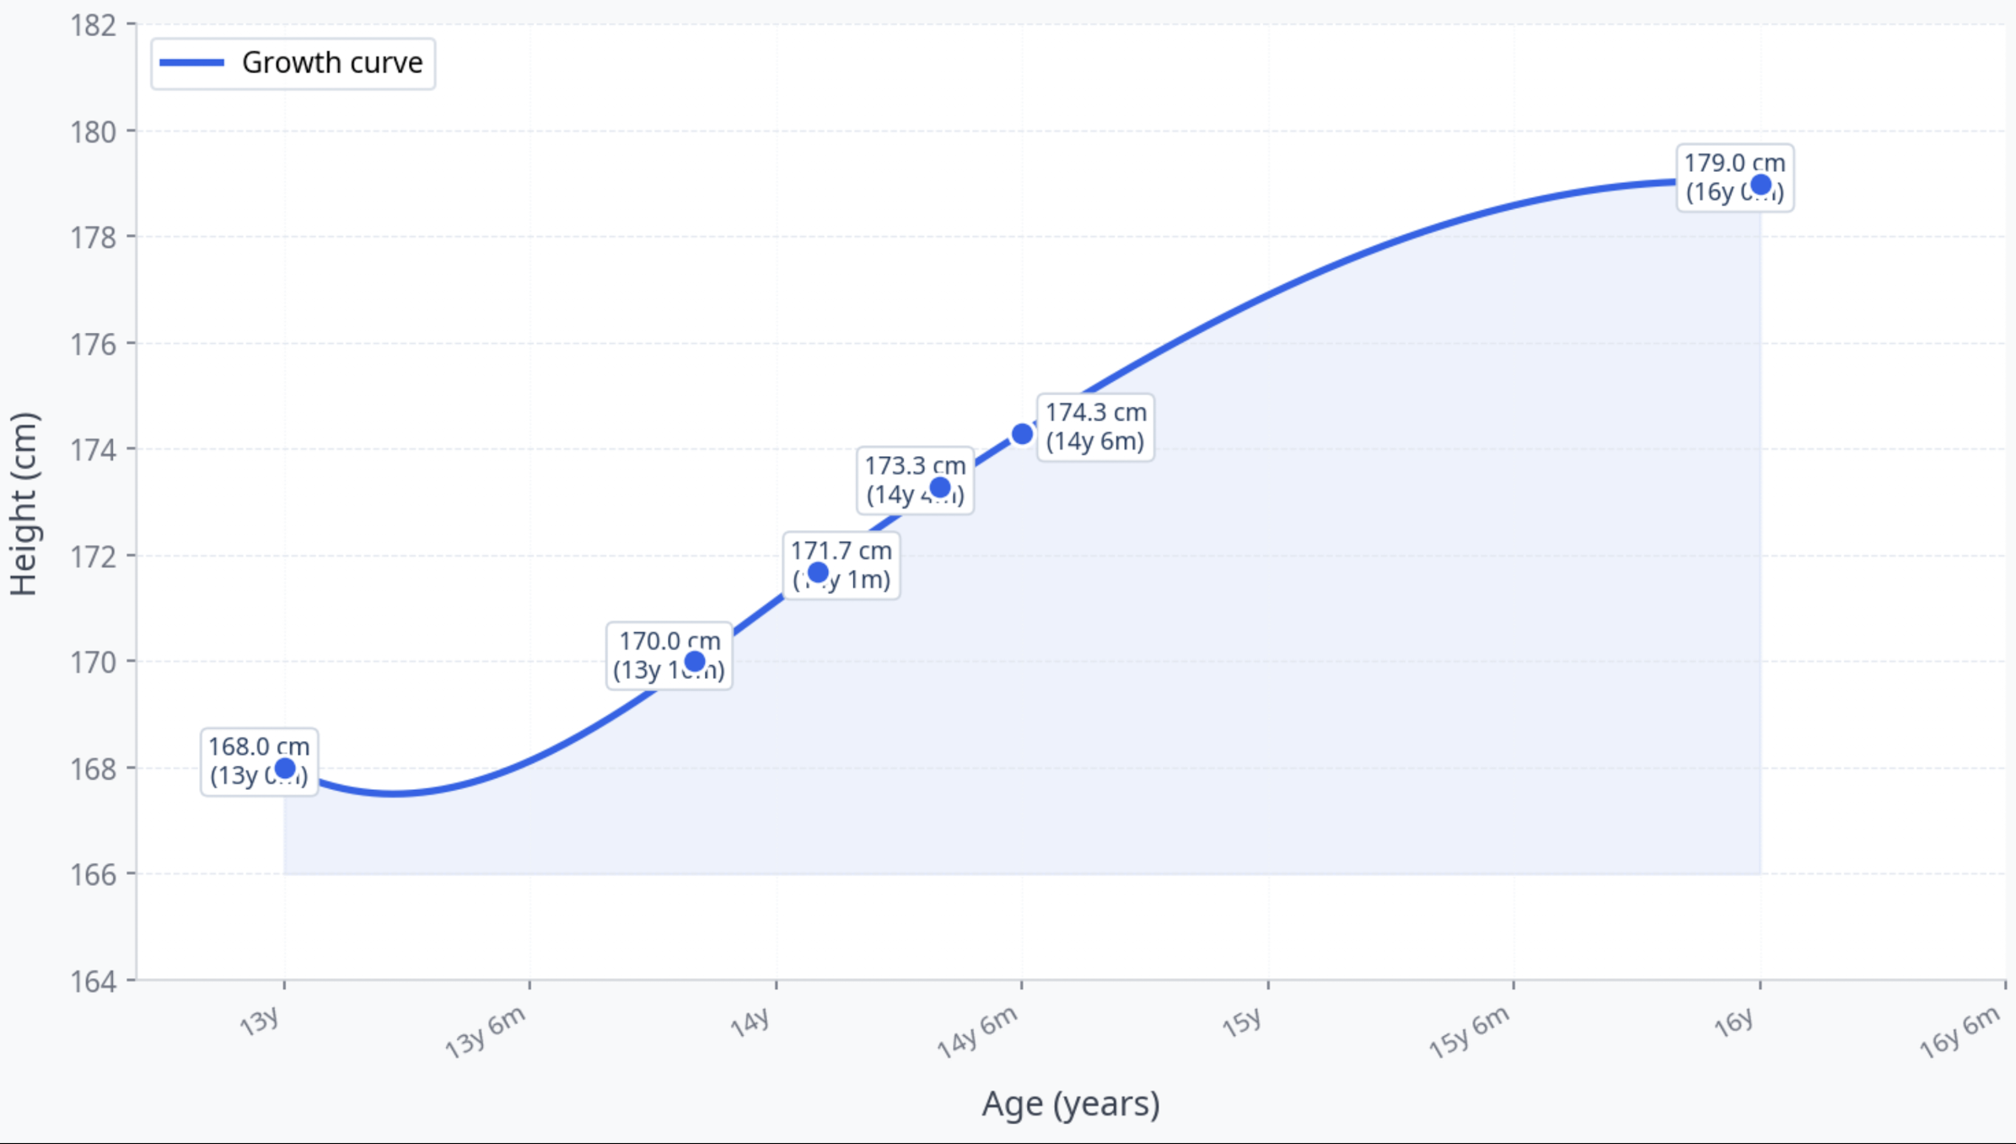
Height Timeline and GV
Notes:
On follow-up, epiphyseal closure was achieved at 17 years of age, with a final adult height of 179 cm, reflecting an approximate 11 cm gain following intervention.
Referred to plastic surgery for breast implants however, it was preferred to proccede due to the patient cardiac underlying issues, implant migration, wound healng and infections.

Slide 10
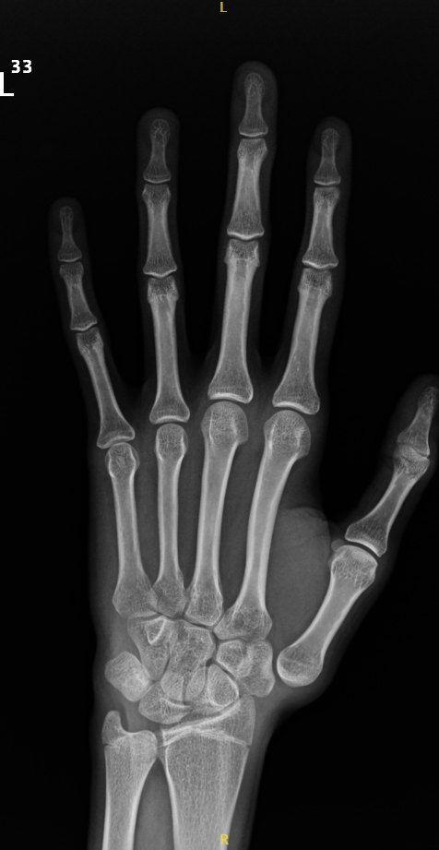
Epiphyseal Closure at Age 17 with a Final Height of 179 cm
Epiphyseal closure occurred at 17 years of age
Final adult height: 179 cm
Total height gain with intervention: 11 cm
Patient eventually achieved menarche
Remained with amastia — absent breast tissue despite hormonal therapy
Outcome underscores the difficulty of achieving typical pubertal endpoints in MFS
with multiple comorbidities
Notes:
On follow-up, epiphyseal closure was achieved at 17 years of age, with a final adult height of 179 cm, reflecting an approximate 11 cm gain following intervention.
Puberty happens as 11.5 as shown in studies
After this stage she continued for to months on artificial period under HRT – however, this was discontinued upo agrrement with the family to allow her to progress in her puberty and eventually to achieve menarche eventually
Referred to plastic surgery for breast implants however, it was preferred to proccede due to the patient cardiac underlying issues, implant migration, wound healng and infections.

Slide 11
Estrogen Resistance and Cardiac Risk Created a Dual Clinical Dilemma
Suboptimal response to high-dose estrogen (poor breast development despite withdrawal bleeding and ongoing linear growth) raised the possibility of estrogen resistance
Continued linear growth despite therapy reflected the challenge of halting height progression in MFS
High estrogen doses carry cardiovascular risk in patients with aortic root dilatation awaiting surgery
Amastia — a rare anatomical condition of absent breast tissue , was ultimately identified as a possible consequence however, it was reported to be associated with MVP.
The case illustrates that standard pubertal induction protocols may be insufficient in MFS with complex comorbidities
Notes:
Fortounatly reported not have any thrombosis right descetion to discontinue her therapy despite the porpose outcome

Slide 12
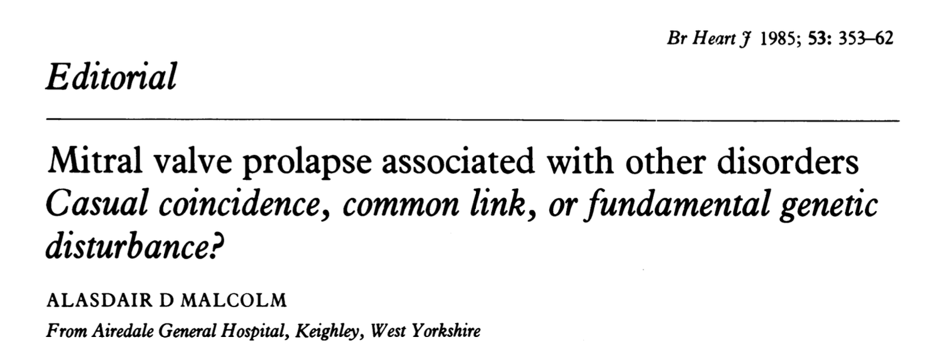
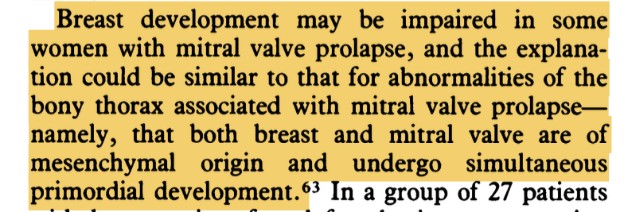
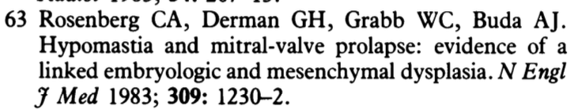

Slide 13
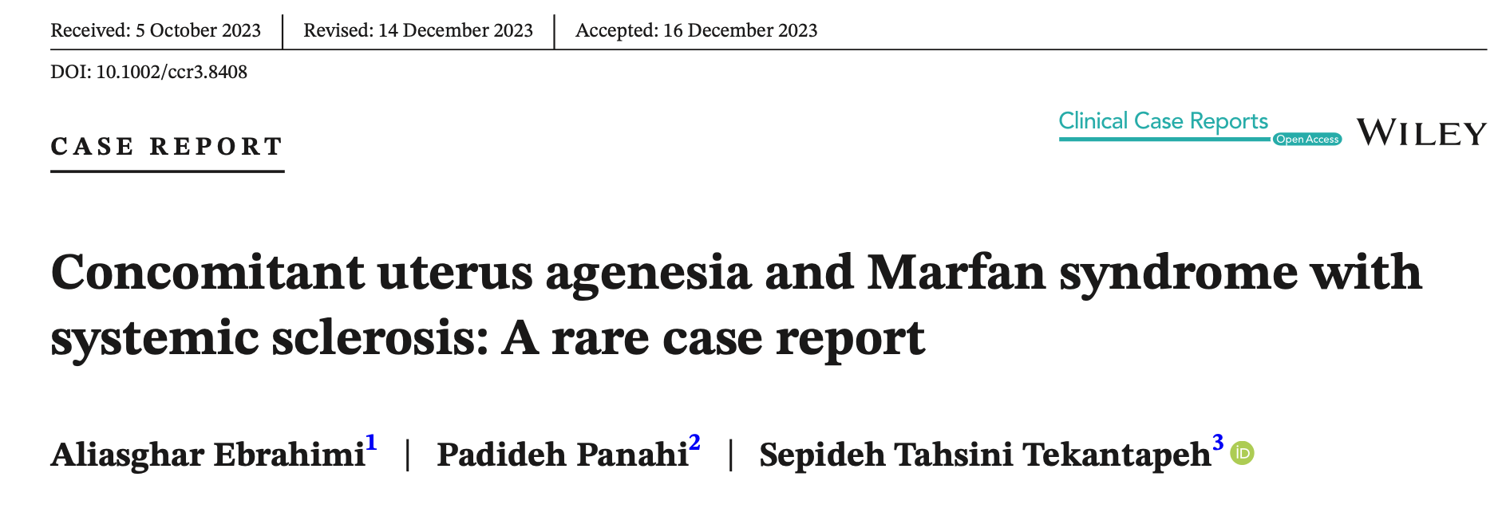
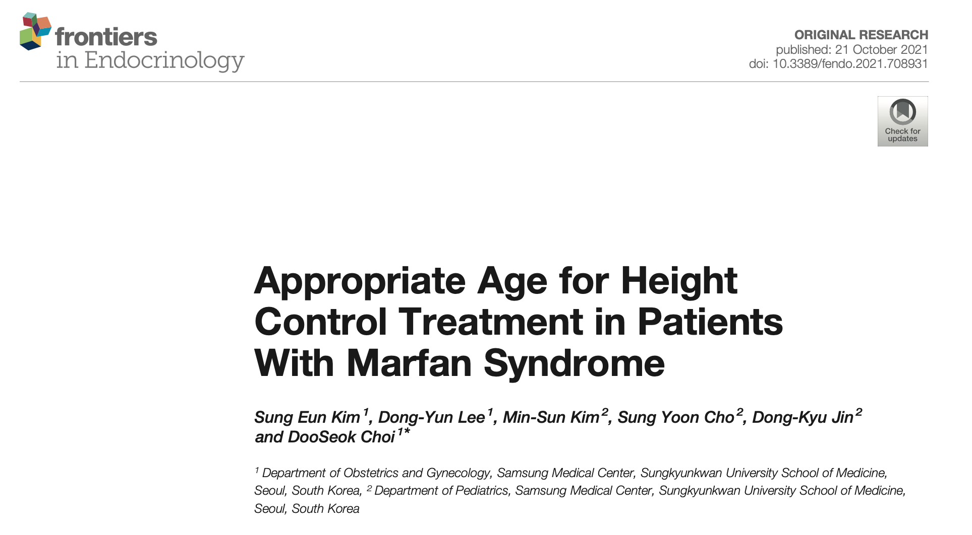

Slide 14
Highlighting The tale of the other sister
11-year-old girl with MS
Severe tall stature and delayed puberty.
Ht (143) cm at 7 years – (158.8) cm at 9 years – (168–168.3) cm by 10–11 years, remaining >97th centile, with documented accelerated GV up to 10 cm/year and increased arm span.
Prepubertal, with only minimal breast development and no menarche.
Estrogen therapy to promote epiphyseal closure - side effects/intolerance She continued to grow fast + Still early stage of puberty, Family were concern and asked for alternative approach – Referred to orthopedic growth-limiting management, with plan for permanent epiphysiodesis.

Slide 15
This Case Highlights Three Critical Lessons in MFS Management
Delayed puberty in MFS is uncommon and warrants thorough evaluation to distinguish central from peripheral causes
Estrogen resistance should be considered when clinical response is suboptimal despite dose escalation, even with evidence of hormonal activity (withdrawal bleeding)
Cardiovascular comorbidities in MFS must guide the risk-benefit assessment of high-dose estrogen therapy, particularly in patients with aortic pathology or pending cardiac surgery
Notes:
Estrogen resistance was considered given suboptimal clinical response
Amastia (absent breast tissue) was also considered as a contributing anatomical factor
Comprehensive workup was essential to guide safe and effective hormonal management

Slide 16
THANK YOU

