Slide 1

Vosoritide :
From Scientific Evidence to Clinical Excellence
Dr. MOHAMMED ALKHALDI
CONSULTANT, PEDIATRIC ENDOCRINOLOGIST
PEDIATRIC ENDOCRINE FELLOWSHIP TRAINING PROGRAM DIRECTOR
PRINCE SULTAN MILITARY MEDICAL CITY, RIYADH
▼This medicinal product is subject to additional monitoring. This will allow quick identification of new safety information. Healthcare professionals are asked to report any suspected adverse reactions.
COM-SC-1395
April 2026
For Health Care Profssionals Only
Organized and sponsored by

Slide 2
Important Notes
I have received honoraria for this presentation from BioMarin.
Informed consent was obtained from patient for case used in this presentation.
This presentation mentions a BioMarin product for educational purposes.
BioMarin product for the management of Achondroplasia are locally registered in KSA. This may vary in the Middle East countries. Please check your local registration status
If you have any questions regarding any of BioMarin’s products or therapeutic areas, please email: medinfo@bmrn.com
COM-SC-1395
April 2026

Slide 3
Agenda
Patient Case Study
Overview of Achondroplasia
Multi-System Comorbidities
Natural History: Normal Height Development in ACH
Multidisciplinary Management
Treatment Modalities
Vosoritide Deep Dive:
Patient Follow-up
COM-SC-1395
April 2026

Slide 4







From my clinic
Patient Case Study
Clinical Findings
Patient Profile
Name:
Nora
Typical ACH phenotype
Age:
10 year old girl
Positive gene: active mutation FGFR3
Birth:
Full Term
Severe Recurrent chest infection and Ear infection
Birth Weight:
3.2 kg
Underwent Adenoidectomy and myringotomy
Birth Length:
47.8 cm
Family concern about the height
Speaker’s Personal data, Individual Experience with achondroplasia complications may vary
Patinet’s name is changed
COM-SC-1395
April 2026

Slide 5
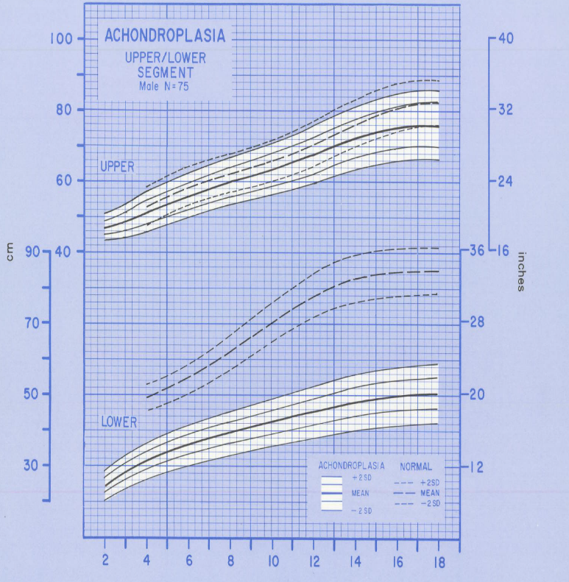







Overview of Achondroplasia
Key Characteristics
Most common skeletal dysplasia
Incidence: 1 in 30,000 live births annually worldwide
Upper segment
Caused by gain-of-function FGFR3 mutation
Failure of normal cartilage conversion into bone
Complications from bone compression of neurologic tissues
Disproportionate short stature due to rhizomelic shortening (proximal segment shorter than distal)
Lower segment
Adapted from Horton WA, et al. J Pediatr. 1978 Sep;93(3):435-438
Upper and lower segment lengths (mean ± 2 SD) for
males with achondroplasia (stippled area) compared
to normal upper and lower segments (mean ± 2 SD)
Shirley ED, et al. J Am Acad Orthop Surg. 2009;17:231-241.,Horton WA, et al. Lancet. 2007;370:162-172
COM-SC-1395
April 2026

Slide 6




Inheritance of Achondroplsia
80%
Inheritance Distribution
of individuals have parents of average stature
Genetic Pattern
Result of "de novo" spontaneous genetic change
20% inherited from an affected parent
Autosomal dominant inheritance pattern
Most cases involve FGFR3 gene mutation
Webb BD, Hoover-Fong JE, Jabs EW. (2020).,Ireland PJ, et al. Appl Clin Genet. 2014;7:117-125.,Hunter AGW, et al. J Med Genet. 1998;35:705-712.,Horton WA, et al. Lancet. 2007;370:162-172.
COM-SC-1395
April 2026

Slide 7
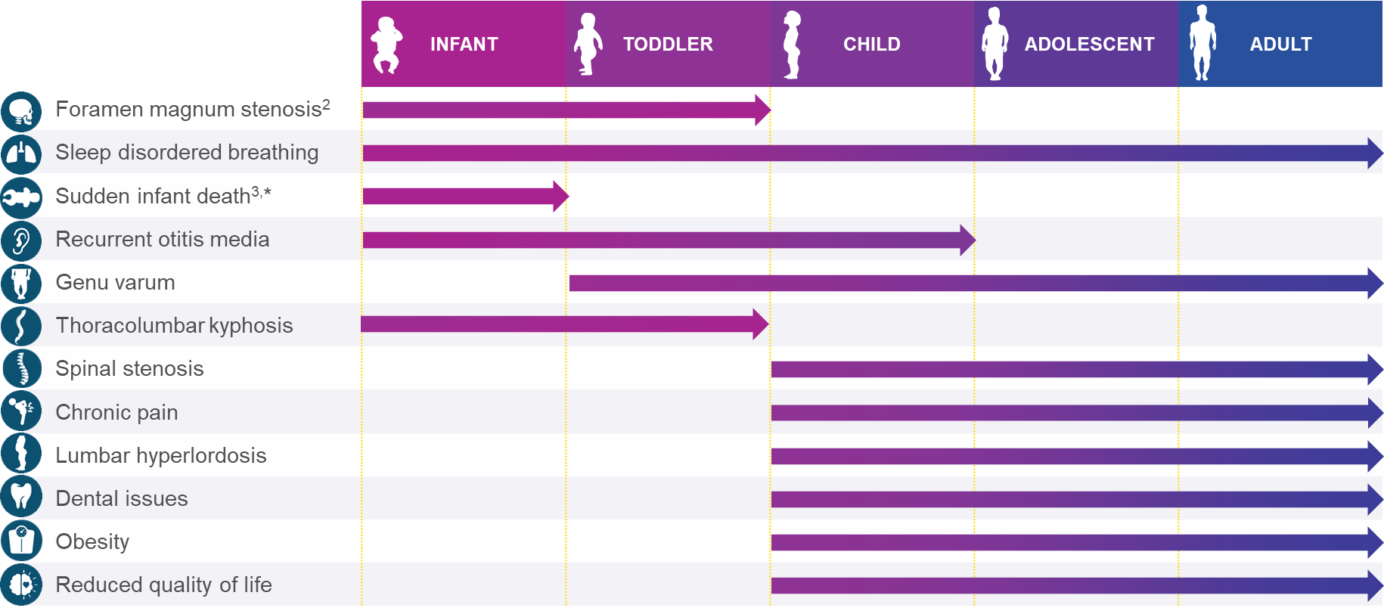
Achondroplasia is Associated With Medical Complications & Functional Challenges Throughout Life1
This table is not intended to be an indication of what, when, or if an individual with achondroplasia will experience complications. Vosoritide has not shown efficacy in addressing all of the listed complications.
*Six times higher than in the general population,⁴ impacting ~2% of young children with achondroplasia⁵
*Six times higher than in the general population,⁴ impacting ~2% of young children with achondroplasia⁵
1. Hoover-Fong J et al. Bone 2021;146:115872; 2. Irving M et al. Orphanet J Rare Dis 2023;18:219; 3. Savarirayan R et al. Nat Rev Endocrinol 2022;18:173–89;
4. Simmons K et al. Birth Defects Res A Clin Mol Teratol. 2014;100:247–9; 5. Armstrong JA et al. Dev Med Child Neurol 2022;64:989–97
COM-SC-1395
April 2026
Notes:
ACH-Master-Deck_Update_May-2024-Approved-for-Use_120624
Slide 7

Slide 8

EAR, NOSE,
AND THROAT
Recurrent otitis media
Hearing loss
Dental malocclusion
NERVOUS
SYSTEM
Cervicomedullary compression
Craniocervical junction anomalies
CARDIOPULMONARY COMPLICATIONS
Sleep-disordered breathing
Cardiovascular disease
BACK
Spinal stenosis
Thoracolumbar kyphosis
Lumbar hyperlordosis
EXTREMITIES
Rhizomelic shortening of upper and lower extremities
Trident hand
Radial head subluxation
Genu varum
Lateral discoid meniscus
Hip flexion contractures
Limitation of elbow exten
Metabolic
Obesity
Ireland PJ, et al. Appl Clin Genet. 2014;7:117-125. Hunter AGW, et al. J Med Genet. 1998;35:705-712.Horton WA, et al. Lancet. 2007;370:162-172., Legare & Modaff Gene Reviews 2025, Achondroplasia - GeneReviews® [Internet] – NCBI Bookshelf
COM-SC-1395
April 2026

Slide 9
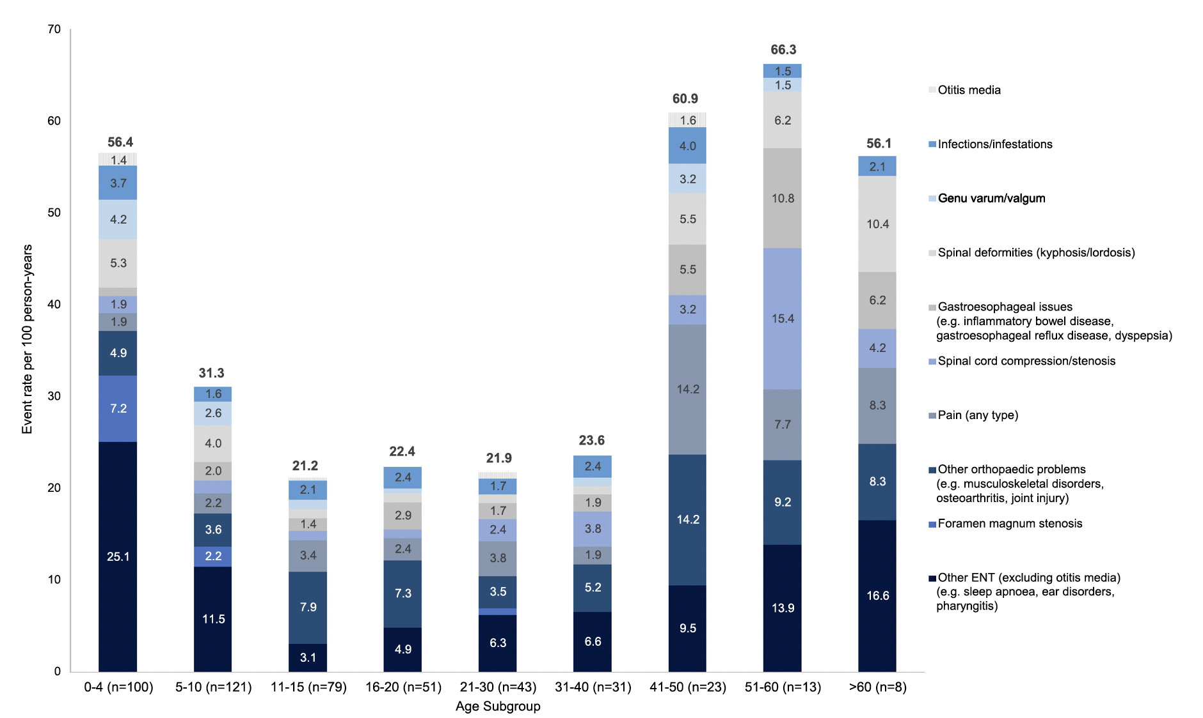
Features of Achondroplasia
Burden of medical and surgical complications by age at time of event
Shirley ED, et al. J Am Acad Orthop Surg. 2009;17:231-241. 2Al-Saleem A, et al. Saudi Dent J. 2010;22:195-199. Maghnie M, et al. Orphanet J Rare Dis. 2023 Mar 15; 18(1):56
COM-SC-1395
April 2026

Slide 10
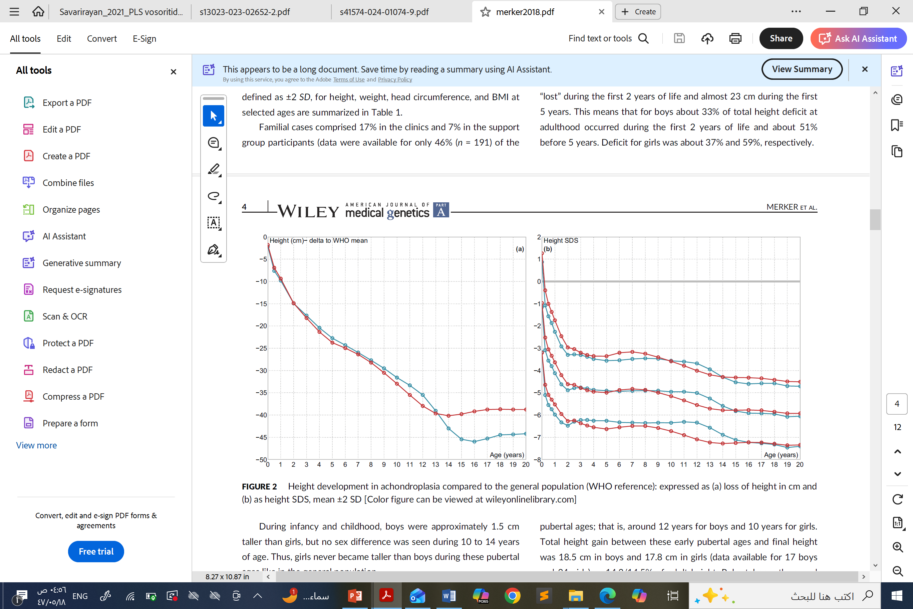
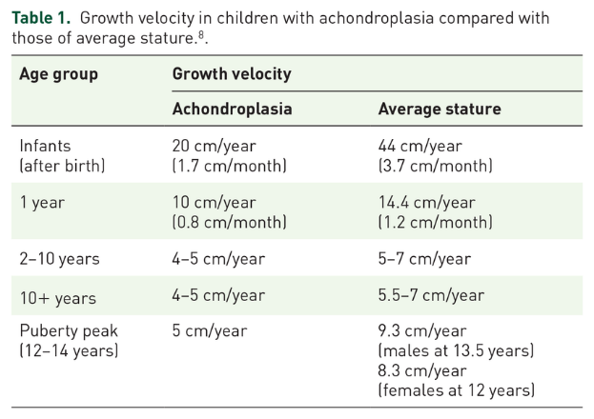
Normal Height Development
Birth length
47.7cm boys 47.3cm girls
SD: -2 to -3
Reduction in height occurred mainly during
first 2 years of life while pubertal growth seemed
normal if related to adult height.
First 2 years, relative to general
population
- 15cn height
SD: -5
Final Adult height
132 cm in boys ,124 cm in girls
SD: -6
Merker A, et al. Am J Med Genet A 2018,176:1723-1734
COM-SC-1395
April 2026

Slide 11

Management
Multidisciplinary Team
Hoover-Fong J, Scott CI, Jones MC; Committee on Genetics. Health supervision for people with achondroplasia. Pediatrics. 2020;145(6):e20201010.
COM-SC-1395
April 2026

Slide 12




















Management
Infant
Toddlers
Children
Teenager
Neurosurgeon - Foramen magnum monitoring
Orthopedist - Kyphosis monitoring
Endocrinologist - Growth management
Psychiatrist - Mental health
Spine specialist - Spinal stenosis
Pain specialist - Chronic pain
Audiologist - Hearing assessment
Cardiologist - Cardiovascular health
Physical therapist - Functional mobility
Genetic counselor - Family planning
Pulmonologist - Sleep apnea screening
Psychologist - Developmental support
Social worker – School integration
Physical therapist - Motor development
Nutritionist - Growth optimization
Orthotist - Custom orthotics
Hoover-Fong J, Scott CI, Jones MC; Committee on Genetics. Health supervision for people with achondroplasia. Pediatrics. 2020;145(6):e20201010.
COM-SC-1395
April 2026

Slide 13



Treatment Modalities
Growth Hormone
Limb Lengthening
VOXZOGO®
C-type natriuretic peptide analog
Recombinant GH therapy
Surgical intervention
Growth hormone therapy is not approved for achondroplasia in most regions (exception: Japan) and is not supported by high-level evidence for improving final adult height.
VOXZOGO is indicated for the treatment of achondroplasia in patients 4 months of age and older whose epiphyses are not closed. The diagnosis of achondroplasia should be confirmed by appropriate genetic testing.
Savarirayan R. (2022). Emerging drug targets for achondroplasia. Expert Opinion on Therapeutic Targets, 26(2), 103-105.
Zakheim E, Sachdeva S, Moon D, Ortiz MN, Mistry N, Culler F. Achondroplasia treatments in children aged 5 and older. Mol Cell Pediatr. 2025;12(1):17. doi:10.1186/s40348-025-00202-3
https://www.ema.europa.eu/en/documents/product-information/voxzogo-epar-product-information_en.pdf
COM-SC-1395
April 2026

Slide 14
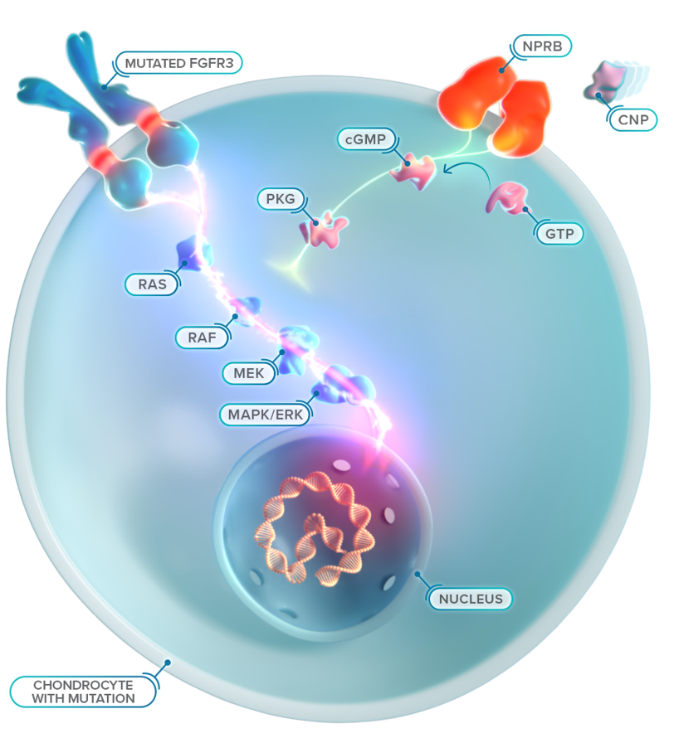
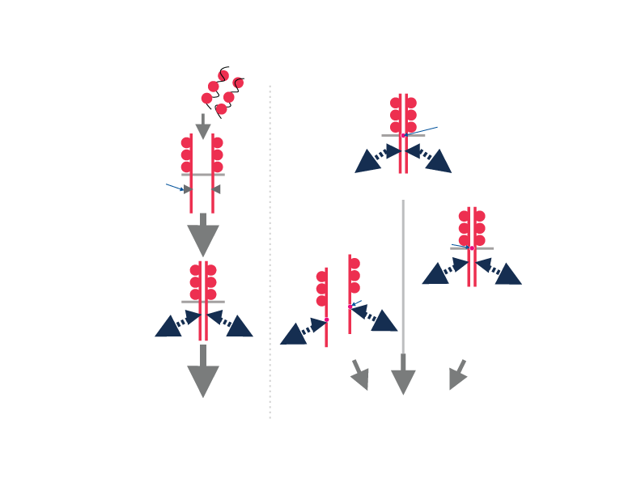
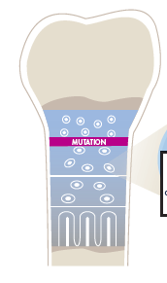
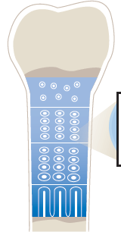
Pathophysiology
VOSORITIDE: C-type natriuretic peptide analog
Normal
Achondroplasia
Normal
Overactive receptor
VOSORITIDE (rhCNP)
FGF
Block FGFR3
CNP pathway
Mutation
Kinase
Mb
TDI
TDII
Mutation
Inhibitory signals
Mutation
Signals
Decrease proliferation
Adapted from Hoover-Fong et al [poster] 2016
LYSOSOMAL DEGRADATION
LYSOSOMAL DEGRADATION
Adapted from The Lancet, Horton WA, Hall JG, Hecht JT. 2007; 370: 162-172, with permission from Elsevier.
COM-SC-1395
April 2026

Slide 15
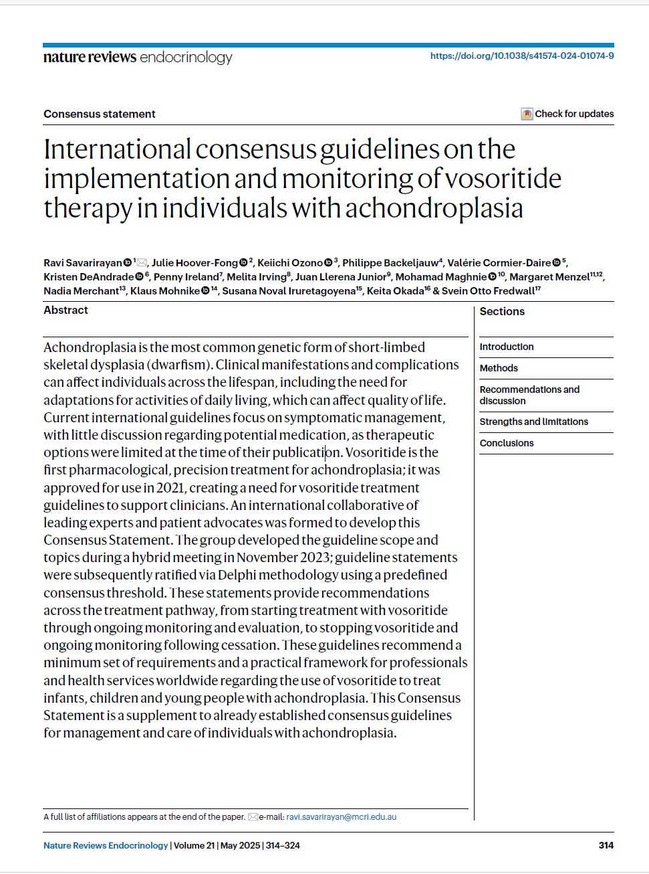




International Consensus Guidelines on the implementation and monitoring of Vosoritide Therapy in individuals with achondroplasia
2021
Vosoritide Approval Status
First approved drug for Achondroplasia by U.S.FDA & EMA
EMA: Approved from 4 months of age and older
Australia, Japan & USA: Approved from birth
in patients whose epiphyses are not closed.
U.S FDA:American Food and Drug Administration
EMA: European Medicine Agency
Savarirayan R, Irving M, Bacino CA, et al. International consensus guidelines on the implementation and monitoring of vosoritide therapy in individuals with achondroplasia. Nat Rev Endocrinol. 2025;21(5):314-324. doi:10.1038/s41574-024-01074-9
COM-SC-1395
April 2026

Slide 16









111-301/302 Phase 3 Studies
Study Objectives
Primary Objective: Change in annualized growth velocity at 52 weeks
111-301/302 Phase 3 Studies
Secondary Objectives: Height Z-score, body proportion ratios, bone morphology
Randomized, double-blind, placebo-controlled multi-center global study
Exploratory: Sleep study scores, biomarkers, genomic biomarkers
52-week study with subsequent open-label extension
Children with achondroplasia and opened growth plated aged 5 to < 18 years
Study Disposition
121 patients enrolled into 111-301
Required participation in 111-901 to establish baseline growth velocity
119 of 121 rolled over into the 111-302 extension study
https://clinicaltrials.gov/ct2/show/study/NCT03197766. https://clinicaltrials.gov/ct2/show/NCT03424018 .BioMarin R&D Day investor presentation. November 14, 2019; New York, USA.
COM-SC-1395
April 2026

Slide 17
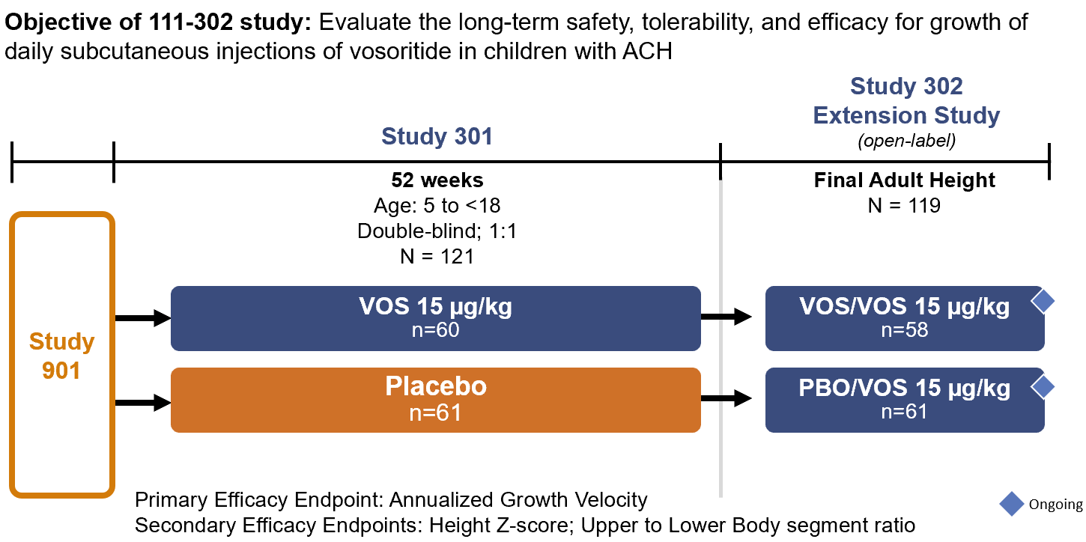
111-301/302: Study Design and Disposition
https://clinicaltrials.gov/ct2/show/study/NCT03197766. https://clinicaltrials.gov/ct2/show/NCT03424018 .Savarirayan R, et al. Lancet. 2020. Savarirayan R. ENDO. 2021.
COM-SC-1395
April 2026

Slide 18
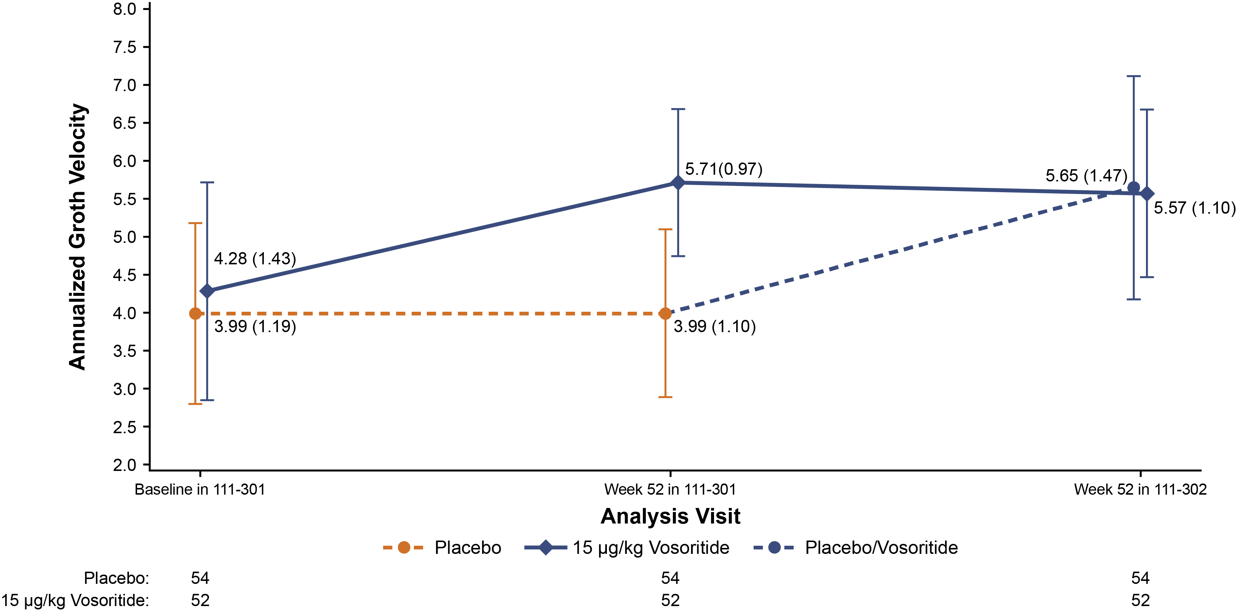
111-301: AGV OVER 2 YEARS OF TREATMENT WITH VOSORITIDE
(With 52 Completer Analysis)
https://clinicaltrials.gov/ct2/show/study/NCT03197766. https://clinicaltrials.gov/ct2/show/NCT03424018 .Savarirayan R, et al. Lancet. 2020. Savarirayan R. ENDO. 2021.
COM-SC-1395
April 2026

Slide 19
111-301: TOP LINE SAFETY SUMMARY
1,2
Subject Category | Placebo N=61 |  | Vosoritide 15 µg/kg N=60
 | Incidence* n (%) | Event† m (rate) | Incidence* n (%) | Event† m (rate)
Any AEs | 60 (98.4) | 2121 (34.8) | 59 (98.3) | 7345 (126.7)
Any AEs Leading to Study Drug Discontinuation | 0 | 0 | 1 (1.7) | 0
Any AEs with Grade ≥ 3 | 3 (4.9) | 5 (0.1) | 3 (5.0) | 5 (0.1)
Any SAEs | 4 (6.6) | 5 (0.1) | 3 (5.0) | 4 (0.1)
Any SAEs assessed by Investigator as Related | 0 | 0 | 0 | 0
The most common adverse reactions to vosoritide were injection site reactions (85%), vomiting (27%), and decreased blood pressure (13%).
Data are n (%) or m (rate).*Percentages were calculated using the total number of patients in the safety population (n for each treatment group) as the denominator. Patients with more than one adverse event of the same preferred term were counted only once for that preferred term. †Exposure-adjusted event rates were calculated by dividing the total number of events (m) by the total treatment exposure in each treatment group. Multiple occurrences of an adverse event with the same preferred term for a patient were counted for each occurrence for that preferred term.
https://www.ema.europa.eu/en/documents/product-information/voxzogo-epar-product-information_en.pdf
COM-SC-1395
April 2026

Slide 20
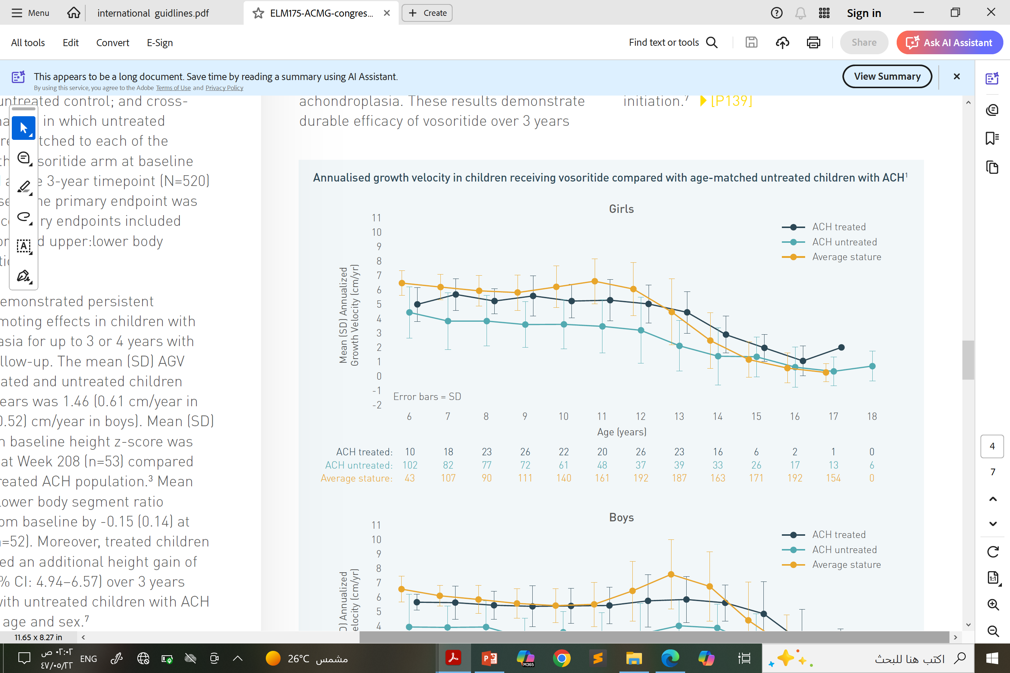
Annualized growth velocity in children receiving vosoritide compared with age-matched untreated children with ACH and average-stature children
Data from a phase 3, open- label extension study
At least 3 years follow up
Aged ≥5 and <18 Years at treatment initiation
Mean (SD) differences in AGV across each integer age (6-16 years) between treated and untreated children were 1.84 (0.38) cm/year in boys and 1.44 (0.63) cm/year in girls
AGV was consistently higher in the treated vs untreated group.
Savarirayan R, et al. Med. 2025 May 9;6(5):100566.
COM-SC-1395
April 2026

Slide 21
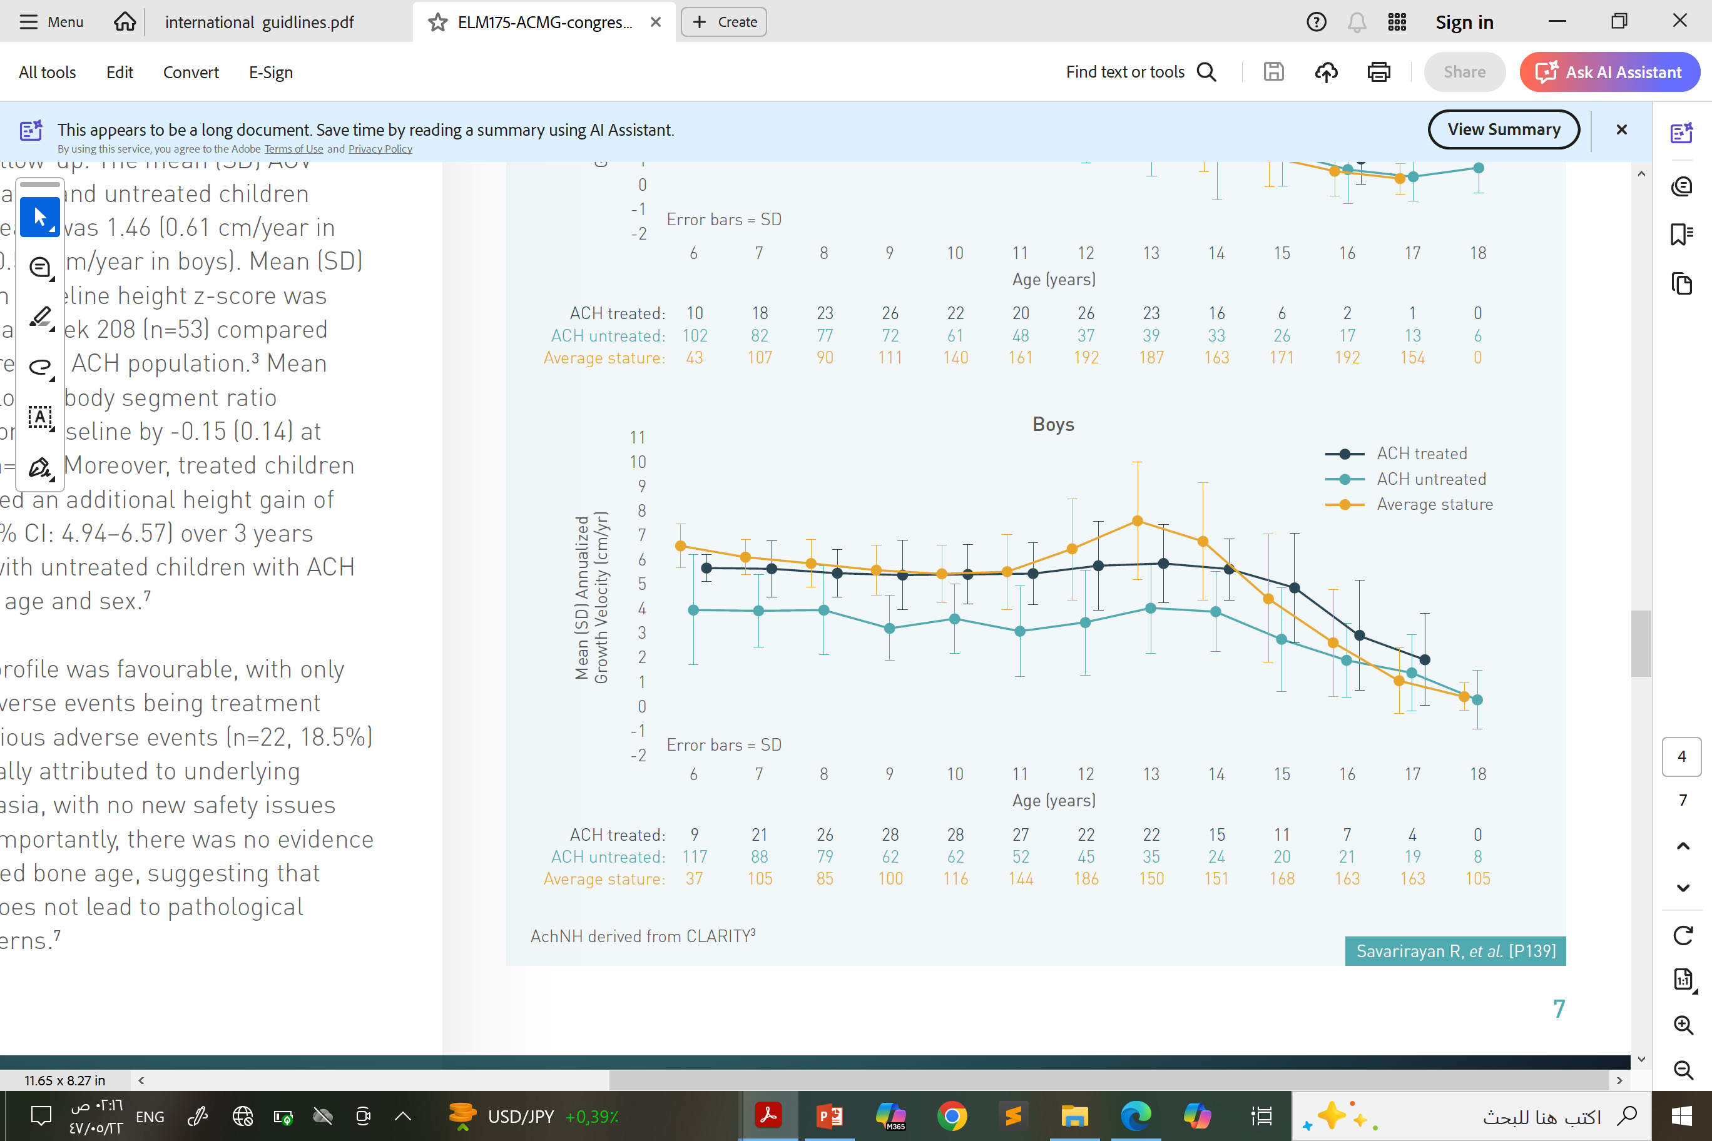
Annualized growth velocity in children receiving vosoritide compared with age-matched untreated children with ACH and average-stature children
Aged ≥5 and <18 Years at treatment initiation
Mean (SD) differences in AGV across each integer rage (6-16 years) between treated and untreated children were 1.84 (0.38) cm/year in boys and 1.44
(0.63) cm/year in girls
AGV was consistently higher in the treated vs untreated group.
Savarirayan R, et al. Med. 2025 May 9;6(5):100566.
COM-SC-1395
April 2026

Slide 22
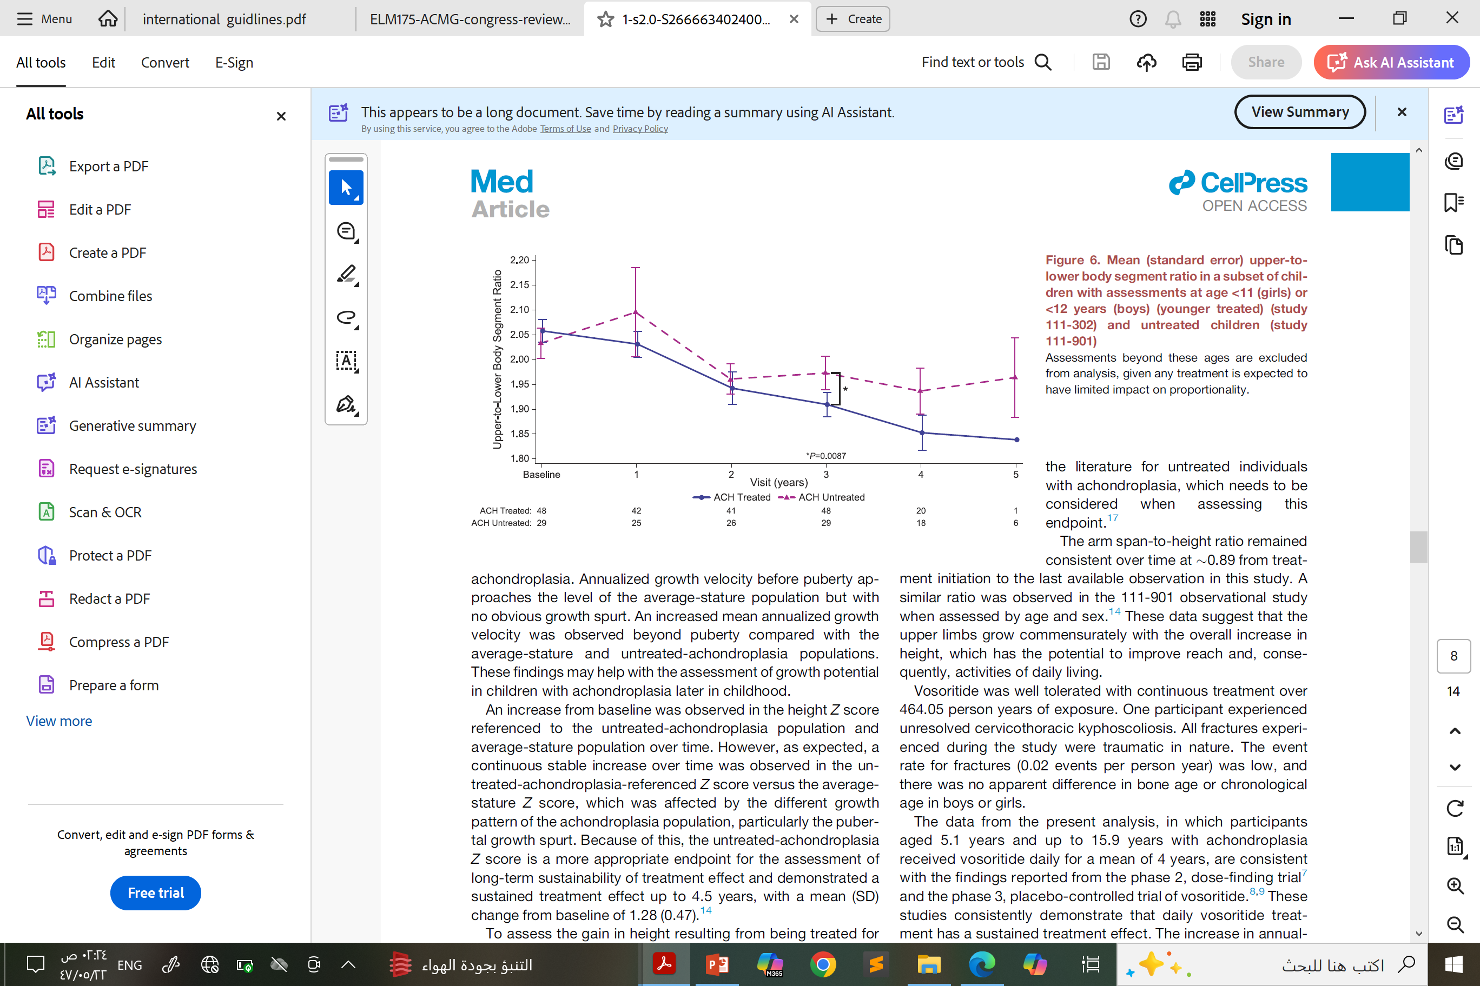
Mean upper-to lower body segment ratio in a subset of children with assessments at age <11 (girls) or <12 years (boys)and untreated children.
Body proportionality in treated and untreated children with Achondroplasia
U:L segment reach in Achondroplasia
1.94 for girls
1.84 for boys
Greatest change from baseline in the upper-to-lower body segment ratio is observed in younger participants at 3 years treatment compared to untreated controls.
May improve functionally and quality of life
Savarirayan R, et al. Med. 2025 May 9;6(5):100566.
COM-SC-1395
April 2026

Slide 23




Beyond Height Benefits
Neurological Benefits
Orthopedic Benefits
Secondary analysis with participants from a placebo‑controlled, randomized phase 2 trial
after 1 year of treatment, compared to baseline
44%
5.2°
increase in foramen magnum surface area in infants (0-6 months) in treated groups vs 25% in placebo
decrease in exaggerated lumbar lordosis
Genu Varum: Improved mechanical axis angle (MAA) by 3.4°
Measurable widening of spinal canal
Reduced severity of spinal curvature
IPD at L4 increased by 0.98 mm vs 0.47 mm in placebo
At 52 weeks, only 33% of treated children had kyphosis >20° vs 57% in placebo
Sagittal canal width at L4 increased by 1.6
mm in vosoritide vs 0.19 mm in placebo
Prevents kyphosis progression in early childhood
Reduces risk of neurogenic claudication
Reduces risk of permanent vertebral wedging and chronic back pain
Addresses spinal stenosis, potentially delaying or preventing need for surgical laminectomies
IPD:Interpedicular distance
White, K. K. et al. ASBMR Annual Meeting (Poster). 2025. | Sawamura, K. et al. Journal of Pediatric Orthopaedics. 2025.
COM-SC-1395
April 2026

Slide 24
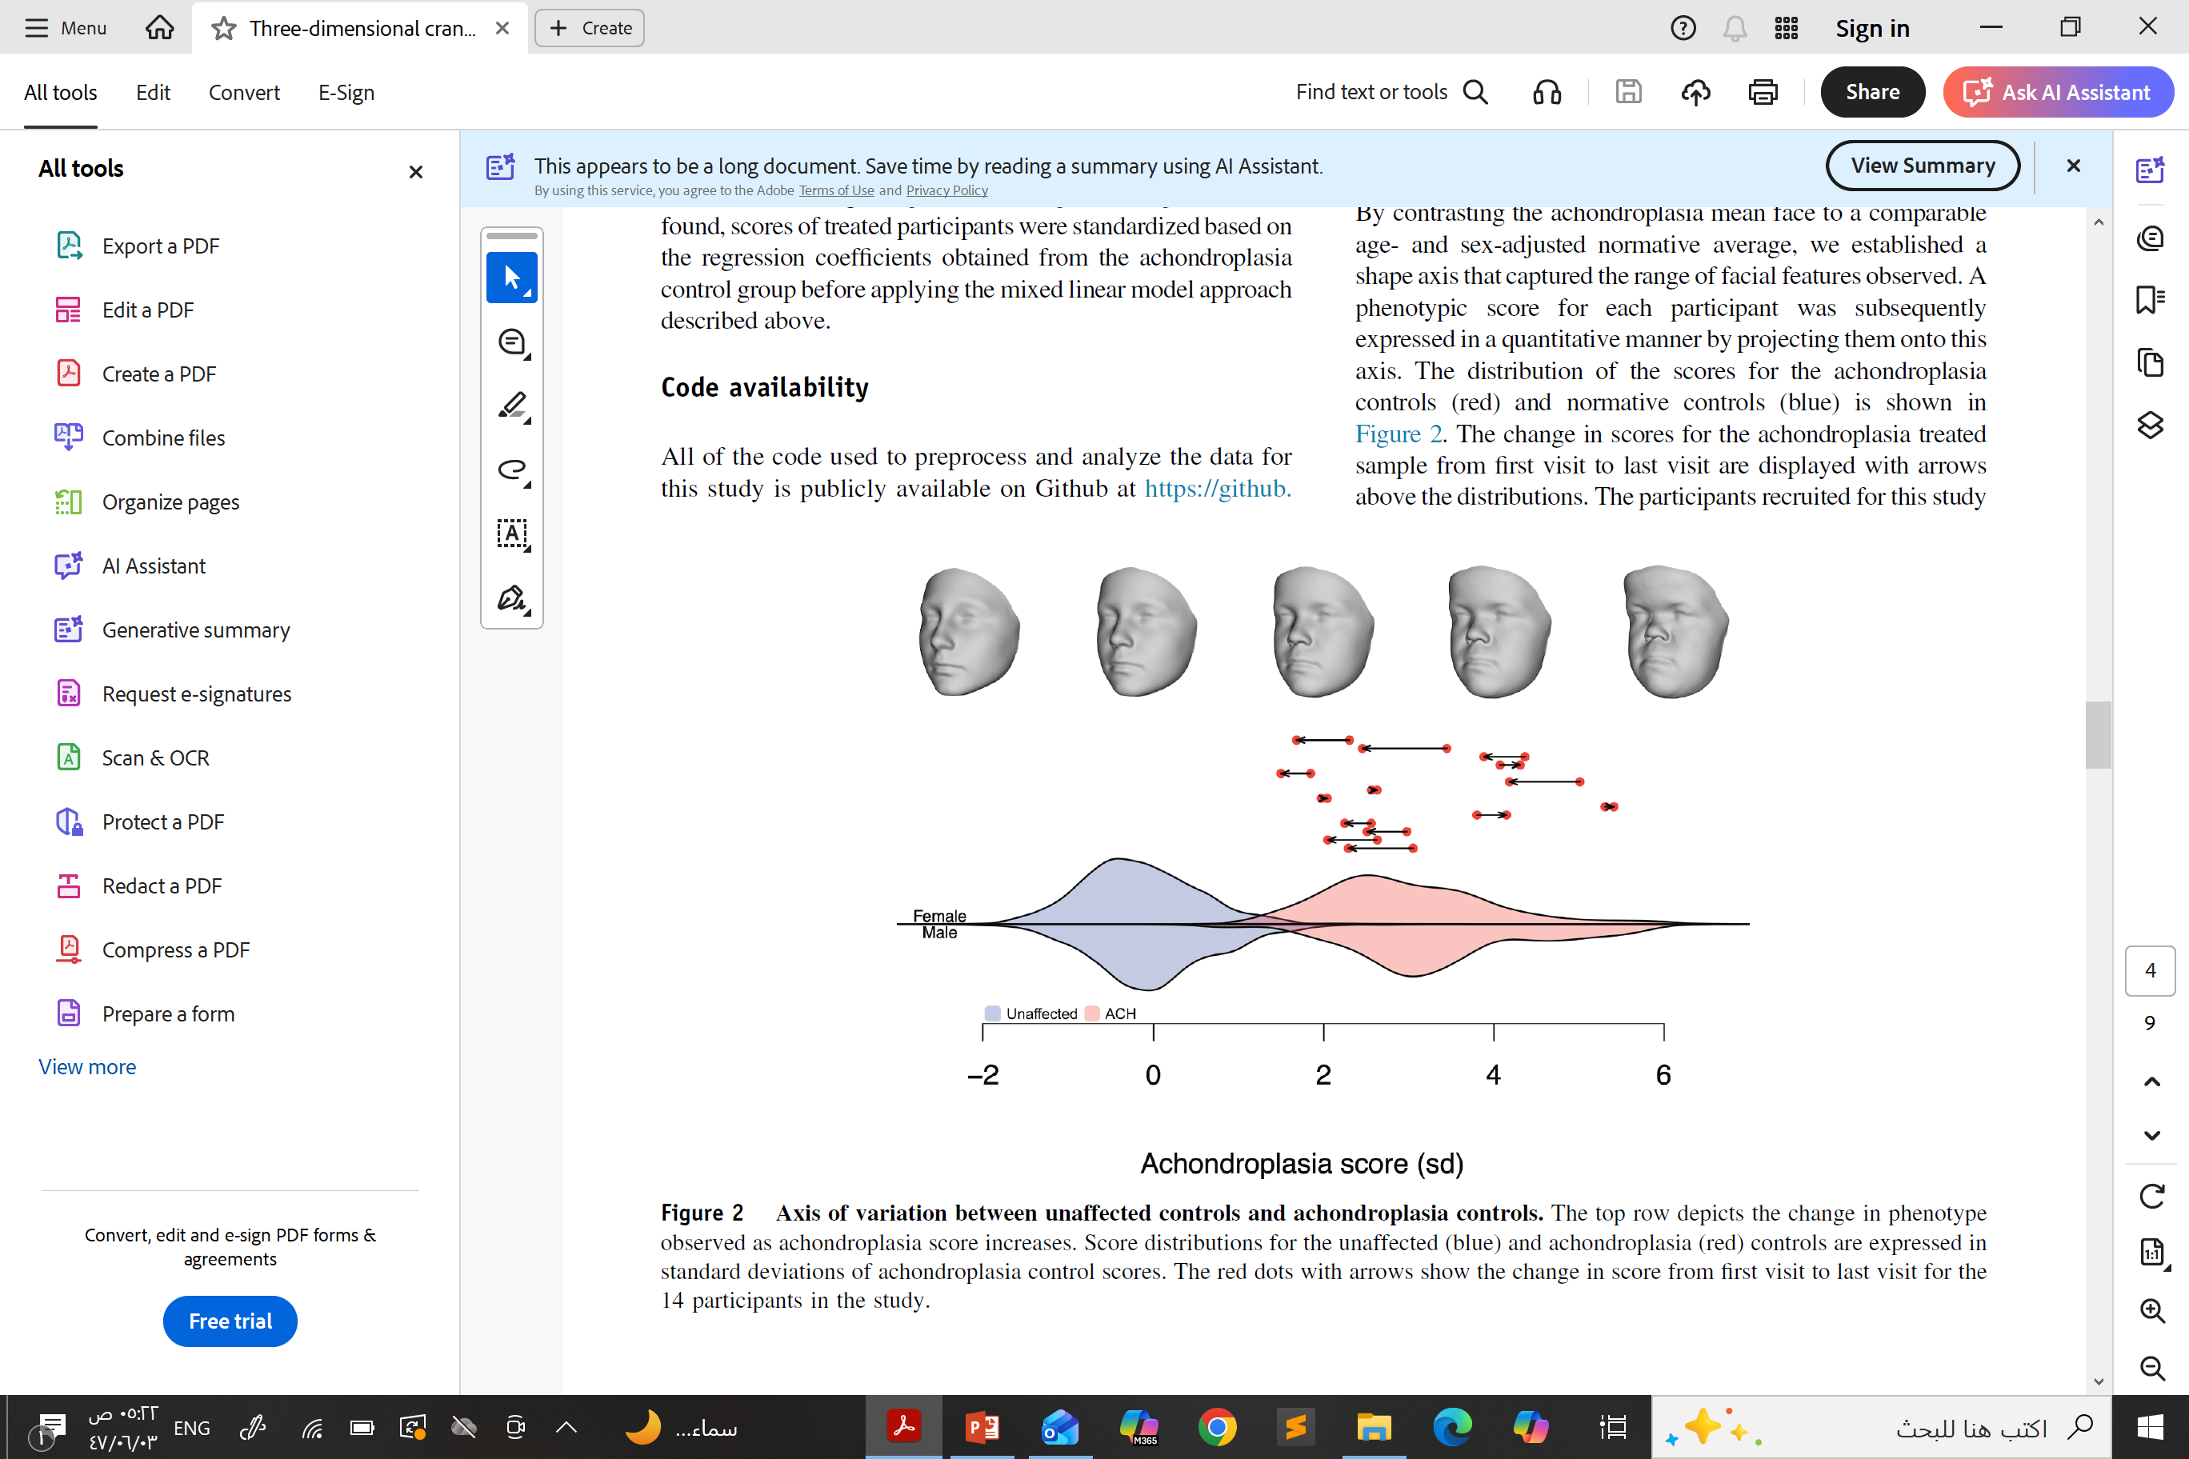

Beyond Height Benefits
3D facial surface images and demographic data (age, sex) before treatment and at successive follow-up visits
142 images in total
35 achondroplasia controls, who did not receive any treatment
2200 Unaffected normative control
Facial Morphology
14
individuals aged 5-10 years in facial study
Results:
most responses toward normative facial shape in the orbital region and chin.
Less common change in cheek and forehead
facial bone morphology has responded to treatment, further cementing its use in treating complications of achondroplasia other than height.
Hoskens H, et al. Genet Med Open. 2025 Oct 13;3:103463
COM-SC-1395
April 2026

Slide 25
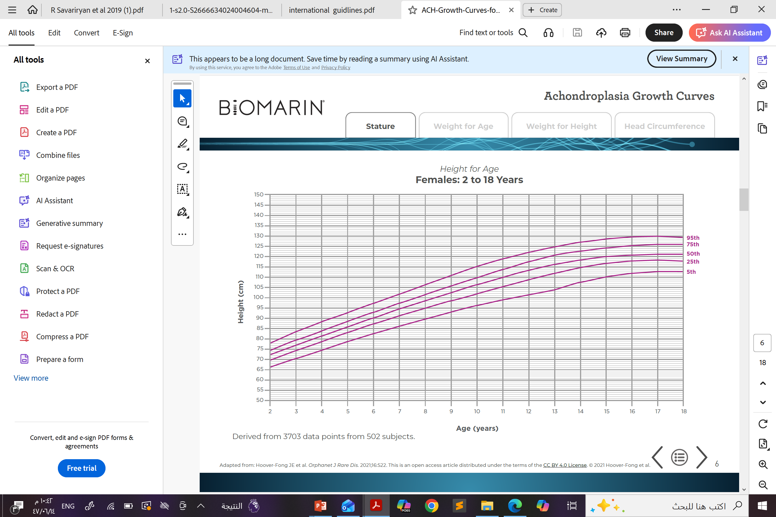


Back to Nora - Patient Follow-up
Achondroplasia Chart
Current Status
Normal MRI brain - No signs of foramen magnum stenosis or cervicomedullary compression
Bone age appropriate - Skeletal development consistent with chronological age
•
•
•
No side effects documented - Well tolerated medication with no adverse reactions
Speaker’s Personal data
Patient’s name is changed
COM-SC-1395
April 2026

Slide 26






Back to Nora - Patient Follow-up
Treatment
Patient started on vosoritide (0.4 mg /day)
Annual Growth velocity
 | Before vosoritide | 6 month follow up | 1 year follow up
Height | 107 cm (-6.25 SD) | 109 cm (-4.8 SD) | 113.6 cm (-4.58 SD)
Weight | 25.9 kg (-1.38 SD) | 27.6 kg (-1.34 SD) | 31 kg (-1.31 SD)
Key Outcomes
Increased Growth Velocity
Psychological Improvement
Increased Satisfaction
Improved Function
Speaker’s Personal data
Patient’s name is changed
COM-SC-1395
April 2026

Slide 27

VOXZOGO SMPC
COM-SC-1395
April 2026

Slide 28

Thank You

