Slide 1

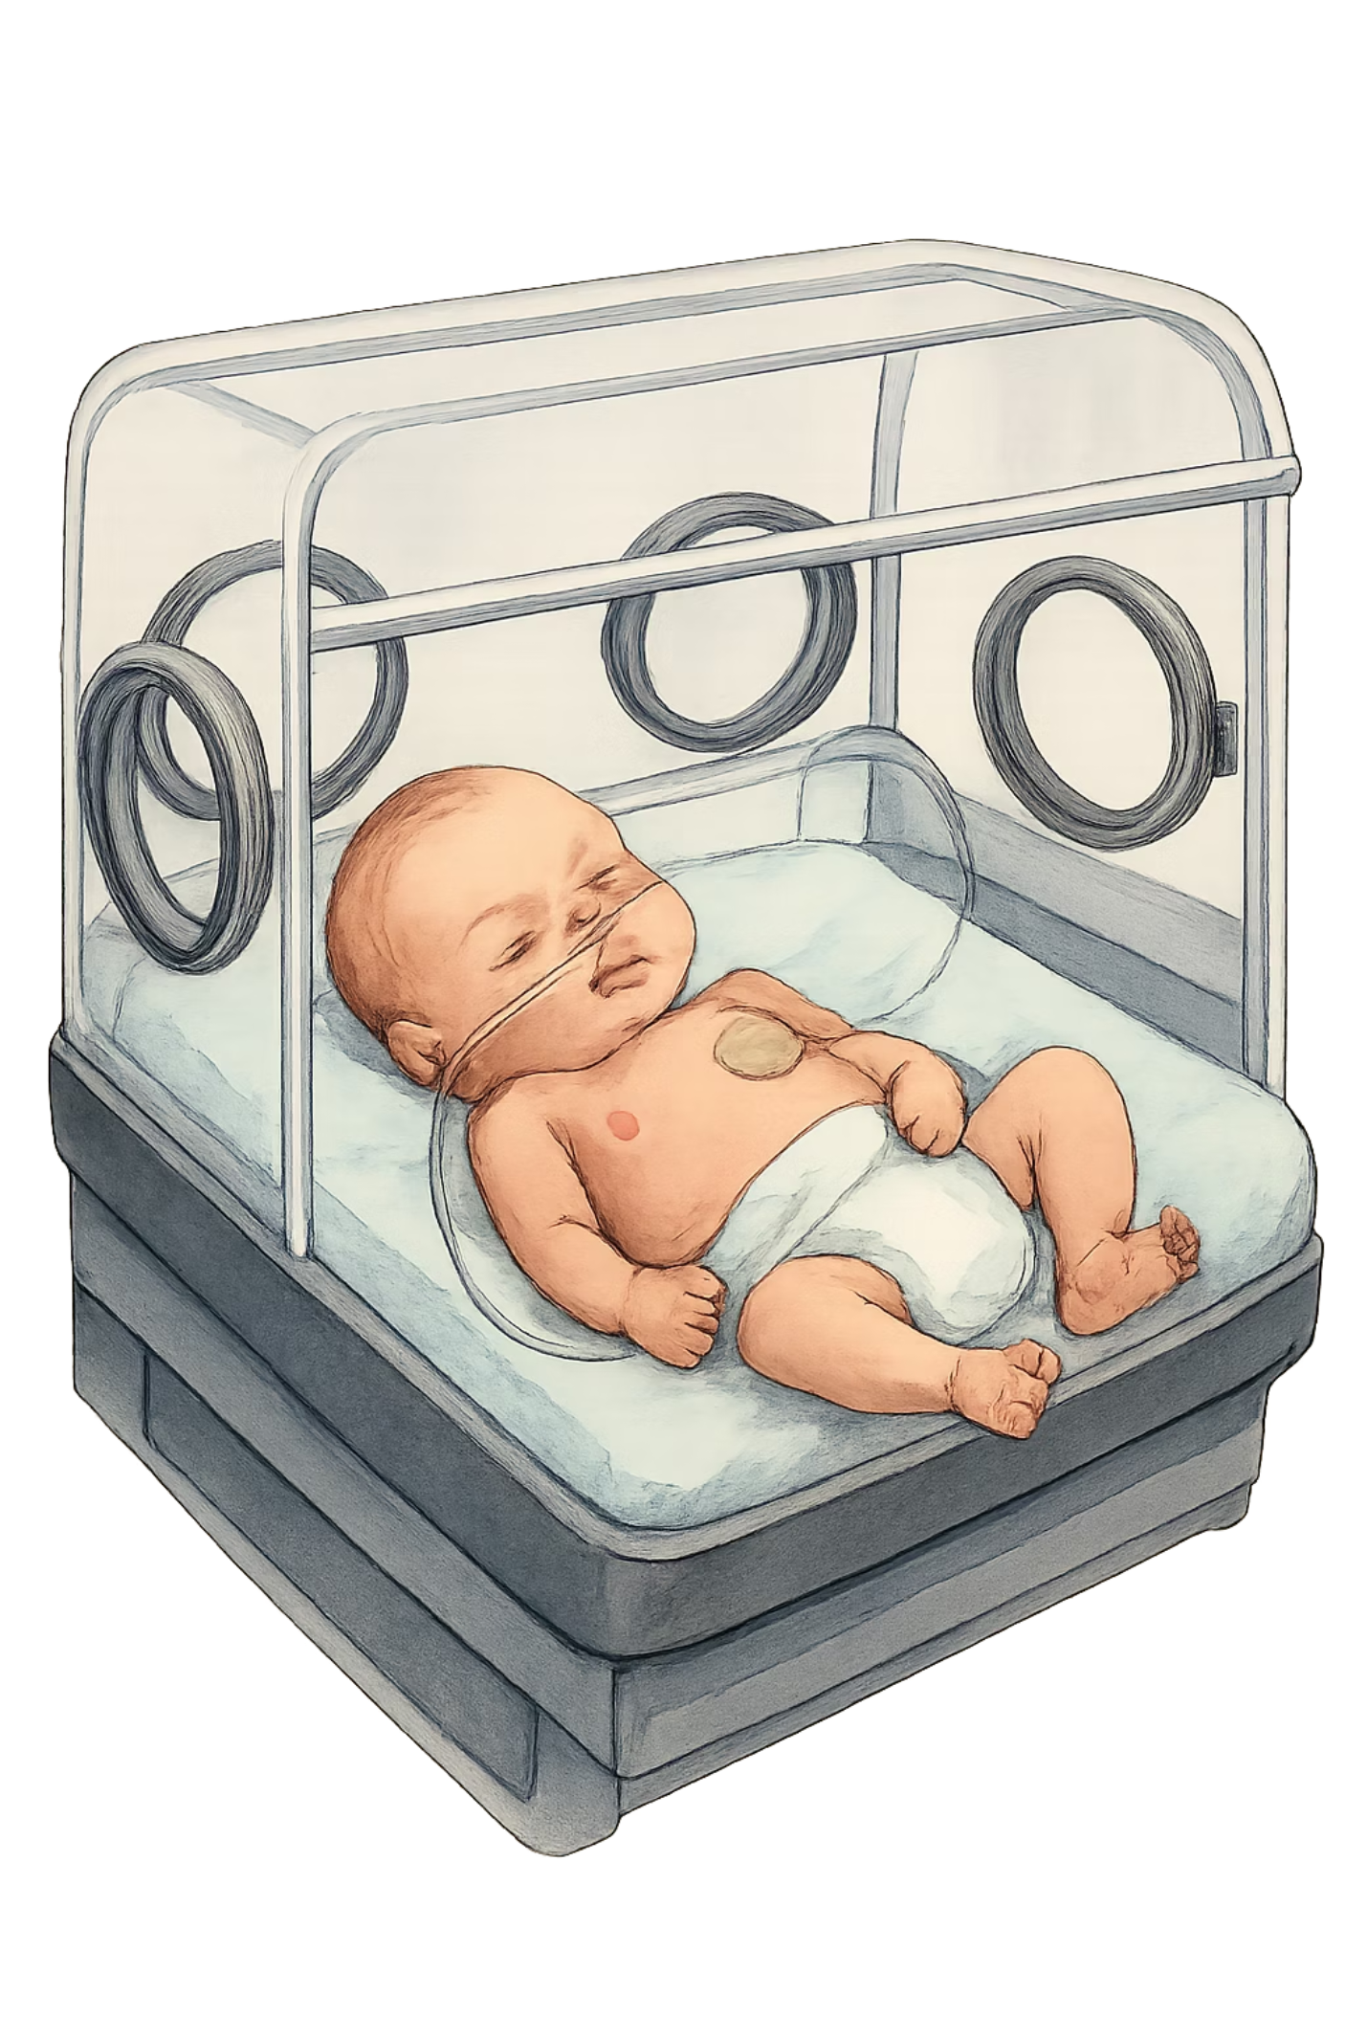
Neonatal Severe Hyperparathyroidism: A Case Presentation
A clinically complex case of genetically confirmed NSHPT in a 2-week-old male infant — highlighting diagnostic workup, management challenges, and surgical decision-making.
Presented By Dr Amal Moshebah
Supervised By Prof.Afaf Alsaghir

Slide 2

Patient Information
Demographics
Reason for referral to KFSH&RC
Baby boy presents antenatally confirmed NSHPT(by target gene study ) & a strongly positive family history, Two older siblings have been previously diagnosed with NSHPT
Age: 2 weeks
Sex: Male
From : Southern Region of Saudi Saudi Arabia
The presence of two affected siblings raises strong suspicion for autosomal recessive CASR mutation inheritance, necessitating urgent workup and expedited management planning.

Slide 3
Family History
The family history is highly significant and central to both the diagnosis and the anticipated management trajectory .
Both older siblings carry confirmed diagnoses of NSHPT, establishing a clear familial pattern of severe calcium-sensing receptor dysfunction presenting in the neonatal period
Both siblings required total parathyroidectomy as definitive management, indicating failure of medical therapy to maintain safe calcium levels
Biallelic CASR mutations causing homozygous or compound heterozygous loss-of-function follow an autosomal recessive pattern

Slide 4
Antenatal and Neonatal history
Spontaneous twin pregnancy with a positive family history; antenatal targeted genetic testing identified a CASR gene mutation, with fetus A (male) affected and fetus B (female) an unaffected.
Delivered at 35 weeks by C/S. Admitted to NICU for low birth weight and management of hypercalcemia with hyperparathyroidism, without complications of prematurity.
Managed for two weeks with intravenous hydration, calcitonin, furosemide (Lasix), Discharged against medical advice and presented to clinic the following day.
Twin sister had normal laboratory findings.

Slide 5
Physical Examination
Vital signs: temperature 37, heart rate 130, respiratory rate 32, oxygen saturation 99 in room air, blood pressure 83/53.
length 45.5 cm on 10-25th centile on fenton growth chart .
His weight 1.8 kg 3rd centile on fenton growth chart .
General look : Hypoactive infant
Respiratory: Clear to auscultation no chest deformity
CNS : Normal tone and reflexes Pupils equal and reactive.
Cardiovascular: Normal S1 and S2, regular rhythm, no murmurs.
Gastrointestinal: Soft, non-tender, non-distended. Normal bowel sounds.
Musculoskeletal: No deformities

Slide 6
Diagnostic Workup
A comprehensive laboratory and imaging evaluation was undertaken to quantify the degree of end-organ involvement and guide management decisions.
Laboratory Investigations
Imaging
Parameter
Value
Reference
Skeletal radiographs: Assess for demineralization, subperiosteal resorption, metaphyseal irregularity, or pathological fractures
Serum Calcium
3.8 mmol/L
2.1–2.75 mmol/L
Renal ultrasound: Evaluate for nephrocalcinosis, a known complication of chronic neonatal hypercalcemia
Ionized Calcium
1.8
1.12–1.32 mmol/L
Intact PTH (iPTH)
2214
10–65 pg/mL
Cardiac ECHO -ECG : Screen for hypercalcemia-associated structural or functional abnormalities
Phosphorus
0.9
1.6–2.6 mmol/L
ALP
423
Age appropriate
Parathyroid ultrasound:were not visualized
Creatinine & Urin crea/ca ratio
Within limits

Slide 7
Hospital course
The patient transferred from the outpatient clinic to the ED for further management
He was subsequently admitted to the ICU due to low Body weight The patient was kept (NPO) Started on (TPN).
Pediatric surgery was consulted early; however, surgical intervention was deferred at that time due to the patient’s low weight and poor operative candidacy.

Slide 8
Hospital course
Pharmacological Management Initiated
Patient started on aggressive hydration and calcitonin 4 IU/kg for 1 day.
Corrected calcium then was 3.61, so calcitonin increased to 6 IU/kg.
Next corrected calcium 3.26; due to limited response, pamidronate was started (3 doses over 3 consecutive days).
Corrected calcium then 2.36 while on calcitonin and pamidronate.

Slide 9
Hospital course
Pharmacological Management Initiated
On day 8 of calcitonin and 3 days after the last pamidronate dose, corrected calcium dropped to 1.96
At that time, the patient (weight 2 kg) was planned and booked for surgery the next day, having become fit for surgery ,calcitonin Discontinue and had already been off pamidronate for 3 days, and was maintained on IVF and TPN only.
After 6 hours of close monitoring, corrected calcium rose to 2.60.
prior to OR, corrected calcium was 2.90.

Slide 10
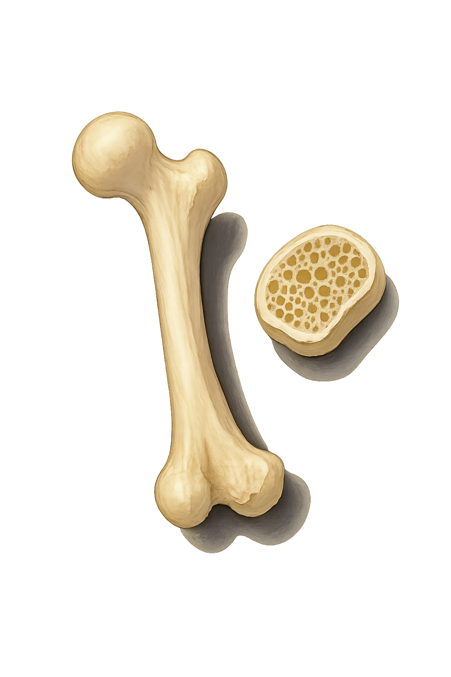
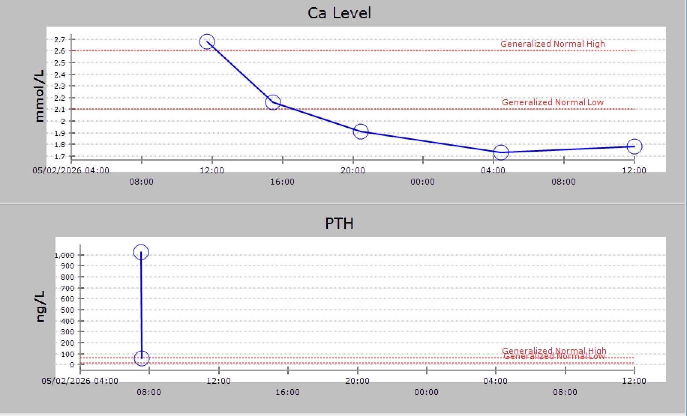
He underwent total parathyroidectomy, with autotransplantation of half of the superior parathyroid gland into the left sternocleidomastoid muscle.

Slide 11
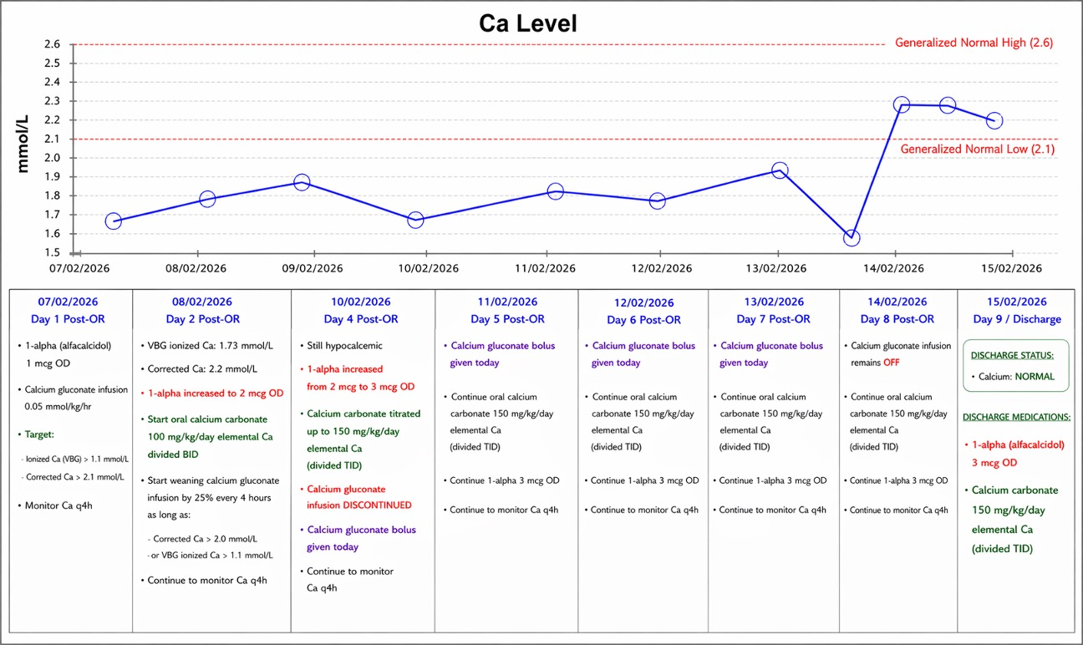

Slide 12
Clinical Course & Outcomes
Based on the confirmed antenatal diagnosis, refractory hypercalcemia, and established family precedent, the following clinical course was anticipated and initiated.
Admission (Day 0)
1
Direct clinic admission; serum Ca 3.8 mmol/L; IV hydration and calcitonin
2
Days 3
Started on pamidronate for total 3 doses Persistent hypercalcemia despite medical therapy; skeletal radiographs and renal ultrasound performed; surgical team consulted
Days 4–7
3
Pre-operative optimization; anesthesia assessment; calcium partially stabilized; operating room scheduling coordinated
4
Surgery
Total parathyroidectomy performed; postperative PTH confirmed fall >50%; all four glands excised; autotransplantation of 1 gland
Post-operative
5
Hungry bone syndrome management; continuous IV calcium; calcitriol initiated; gradual transition to oral supplementation

Slide 13
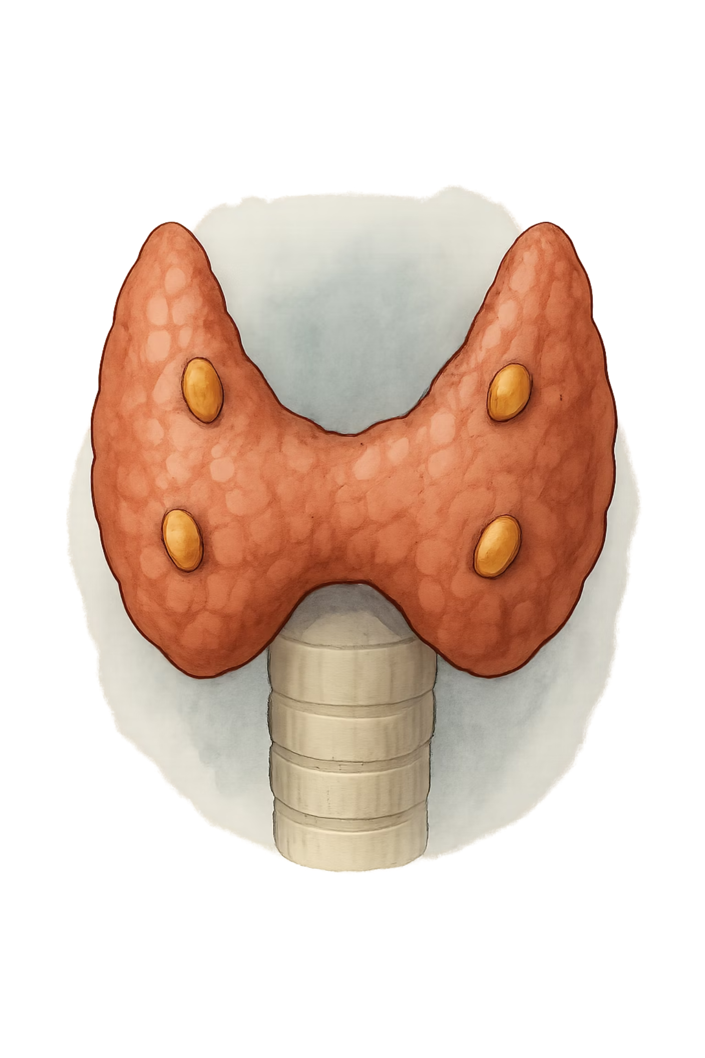

Introduction
(NSHPT) is a rare, life-threatening endocrine emergency presenting within the first weeks of life. It is caused most commonly by biallelic inactivating mutations in the CASR gene, encoding the calcium-sensing receptor, resulting in unrestrained parathyroid hormone secretion.
Severe Hypercalcemia
Bone Demineralization
often exceeding 3.5 mmol/L, refractory to conservative measures
excessive PTH-driven bone resorption
Neuromuscular Compromise
Hypotonia, lethargy, seizures, and respiratory insufficiency reflecting end-organ hypercalcemic toxicity
Family history of hypercalcemia or prior parathyroidectomy in siblings is a critical diagnostic clue warranting urgent genetic evaluation.

Slide 14

Pathophysiology of NSHPT
CASR Mutation
End‑Organ Injury
Failed Suppression
Biallelic inactivating CASR mutation in parathyroid
Massive bone resorption, nephrocalcinosis, neuromuscular toxicity
Parathyroids do not suppress PTH despite hypercalcemia
This is pharmacologically distinct from secondary or tertiary hyperparathyroidism and
explains the resistance to calcimimetic agents in severely affected neonates.

Slide 15
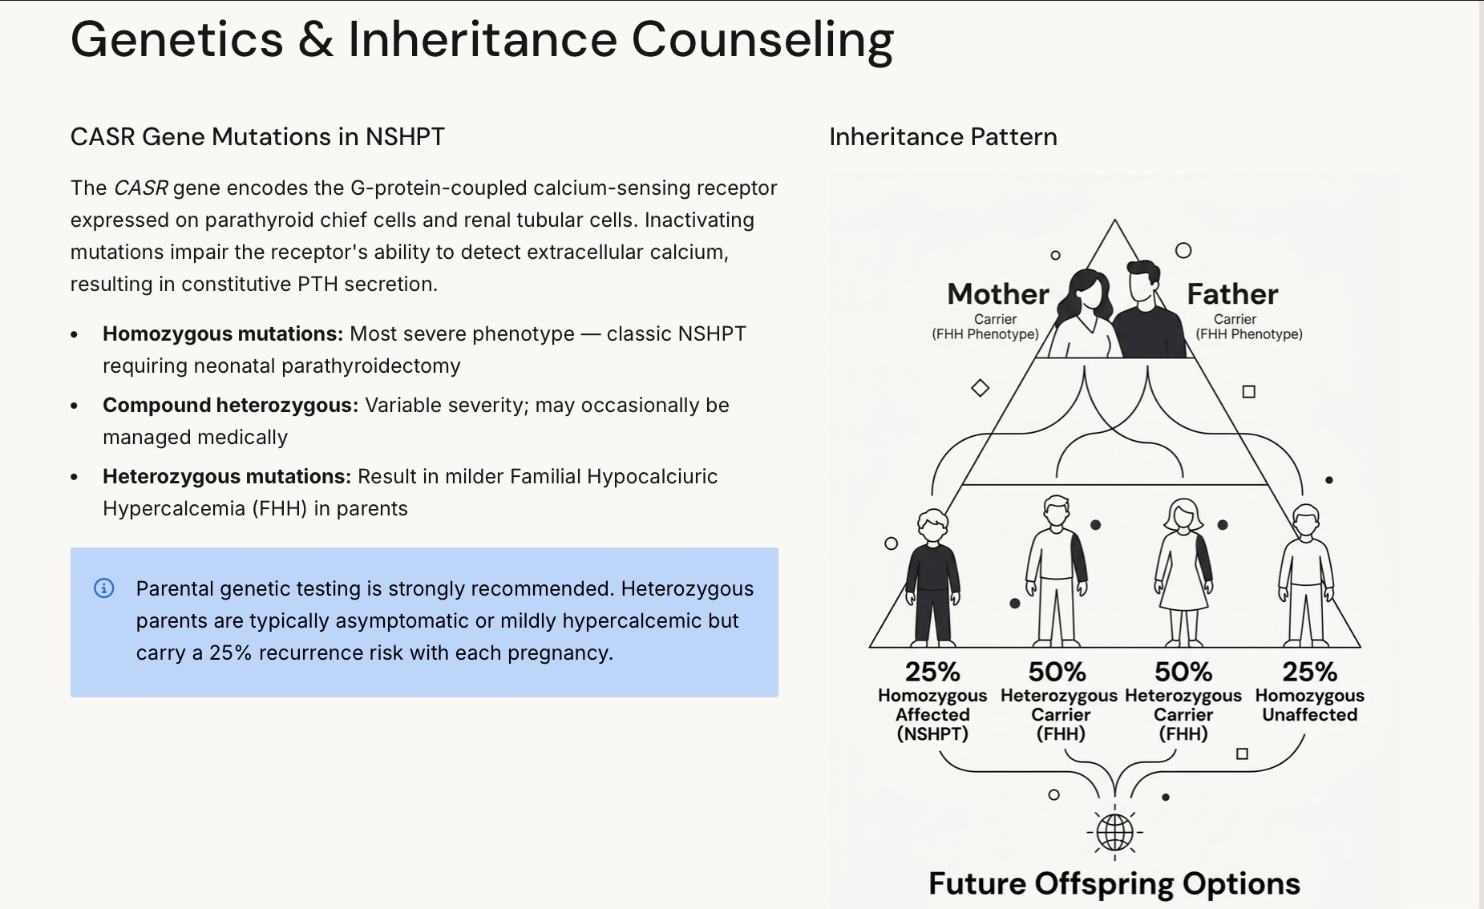


Slide 16
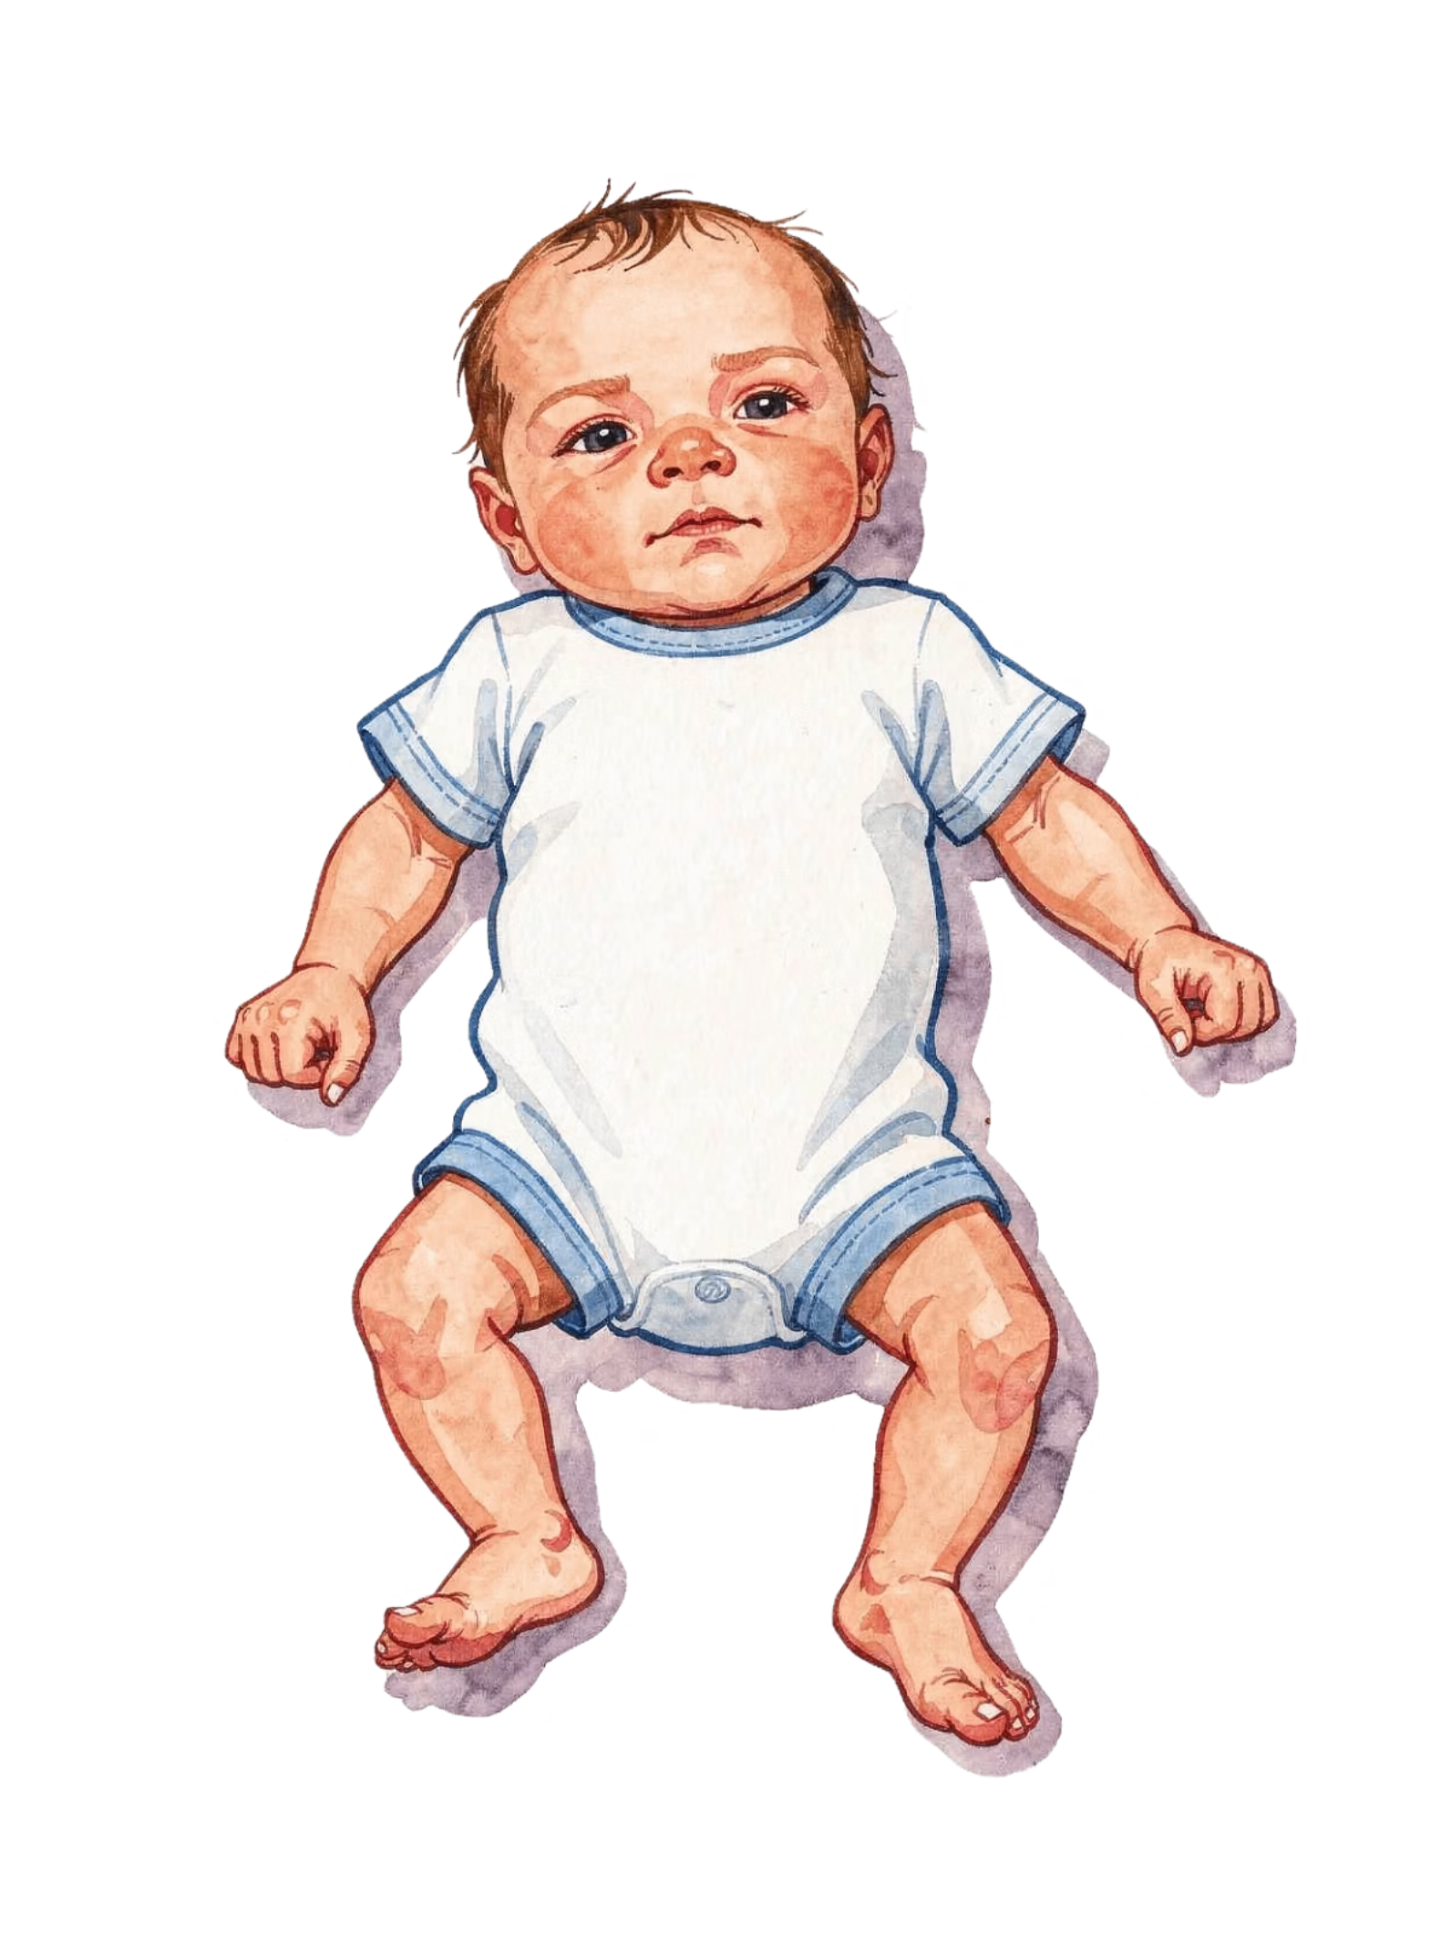
Clinical Manifestations
Neurological
Hypotonia and lethargy
Feeding difficulties
Seizures (in severe cases)
Skeletal
Generalized demineralization
Subperiosteal bone resorption
Pathological fractures
Cardiovascular
Shortened QT interval on ECG
Bradycardia or arrhythmia
Hypotension in severe cases
Renal
Hypercalciuria
Nephrocalcinosis
Risk of acute kidney injury

Slide 17


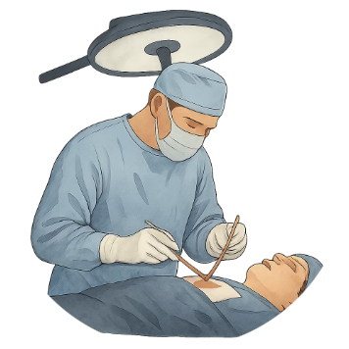

Multidisciplinary Team Approach
Optimal management of NSHPT demands seamless collaboration across multiple specialties. No single discipline can address the full clinical complexity of this condition in isolation.
Pediatric Endocrinology
Neonatology / NICU
Pediatric Endocrine Surgery
Clinical Genetics

Slide 18

Medical Management: Bridging to Surgery
Medical therapy in NSHPT is temporizing by nature. The goal is to reduce serum calcium sufficiently to stabilize the neonate and mitigate end-organ damage while surgical planning proceeds.
01
02
IV Hydration
Calcitonin
promotes urinary calcium excretion and dilutes extracellular calcium. Careful fluid balance monitoring is essential in neonates.
Provides rapid but transient inhibition of osteoclast activity and promotes renal calcium excretion. Efficacy typically wanes within 48–72 hours due to tachyphylaxis.
03
04
Bisphosphonates
Cinacalcet
Pamidronate or zoledronic acid may be considered to inhibit bone resorption. Use with caution in neonates; long-term skeletal effects require careful risk-benefit assessment.
A calcimimetic agent that activates the CaSR. May be trialed but is typically ineffective in homozygous NSHPT where the receptor is non-functional. Limited neonatal pharmacokinetic data.
Medical management rarely sufficient in confirmed biallelic NSHPT. Surgical intervention remains the only definitive treatment.

Slide 19

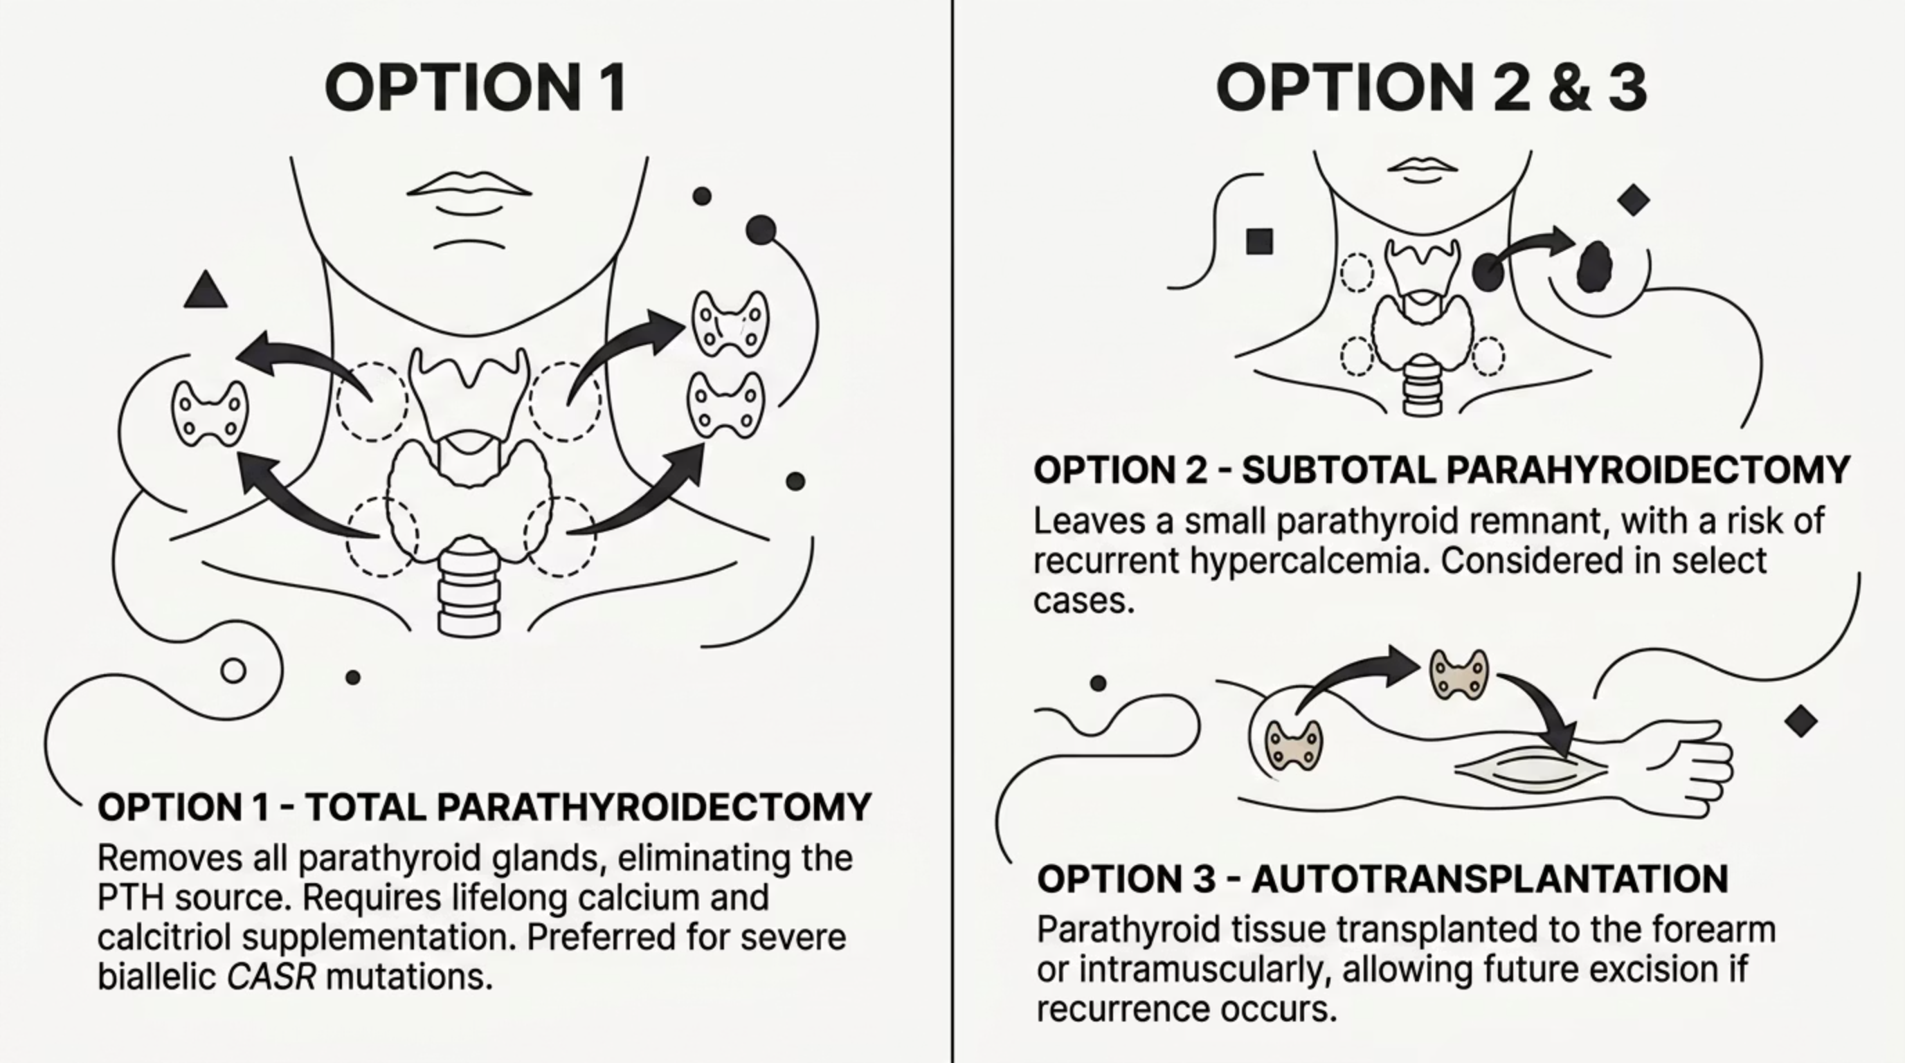
Total Parathyroidectomy: The Definitive Intervention

Slide 20
Surgical Planning Considerations
Pre-operative Workup
Post-operative Priorities
Optimize serum calcium below 3.5 mmol/L if feasible prior to general anesthesia
Following total parathyroidectomy, the clinical team must anticipate and manage "hungry bone syndrome" — a precipitous drop in serum calcium as the skeleton rapidly reuptakes calcium in the absence of PTH-driven resorption.
Anesthesia risk assessment: neonatal airway, cardiac status, respiratory reserve
Ultrasound neck imaging to identify parathyroid gland anatomy where possible
Continuous calcium infusion post-operatively
Frequent ionized calcium monitoring (q2–4h)
Active calcitriol supplementation
Phosphate and magnesium repletion as needed
Long-term calcium and vitamin D regimen
Intraoperative PTH monitoring protocol to confirm successful gland removal
Coordinate with experienced pediatric endocrine surgery team

Slide 21
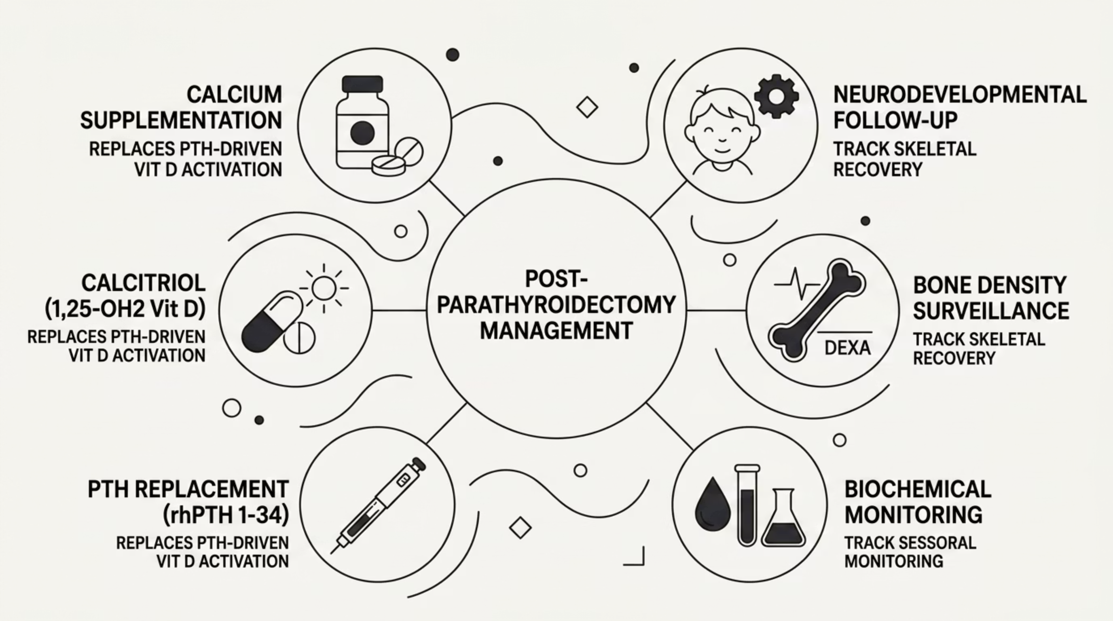
Long-term Management After Parathyroidectomy

Slide 22
Differential Diagnosis
Neonatal hypercalcemia has a broad differential. Accurate diagnosis of NSHPT requires systematic exclusion of other etiologies and correlation with genetic findings.
Condition
PTH Level
Key Distinguishing Features
NSHPT (biallelic CASR)
Markedly elevated
Severe hypercalcemia, family history, confirmed CASR mutation
FHH (heterozygous CASR)
Normal to mildly elevated
Mild hypercalcemia, Ca/Cr clearance ratio <0.01, benign course
Maternal hypoparathyroidism
Elevated (transient)
Resolves spontaneously; maternal history of hypocalcemia
Williams syndrome
Suppressed
Elfin facies, supravalvular aortic stenosis, 7q11.23 deletion
Subcutaneous fat necrosis
Suppressed
Birth trauma, skin lesions, elevated 1,25-OH2D
Vitamin D toxicity
Suppressed
Dietary/supplementation history, elevated 25-OHD

Slide 23
Key Learning Points
1
Recognize the Diagnosis Early
2
Medical Therapy is a Bridge, Not a Cure
NSHPT should be suspected in any neonate with severe hypercalcemia, hypotonia, and a family history of hypercalcemia or parathyroidectomy. Urgent CASR genetic testing should be initiated without delay.
Calcitonin, hydration, bisphosphonates, and cinacalcet may temporarily reduce serum calcium but are insufficient as definitive therapy in confirmed biallelic NSHPT. Early surgical referral is essential.
3
Total Parathyroidectomy is Definitive
4
Family-Centered Genetic Counseling is Critical
Surgical removal of all parathyroid tissue remains the only curative intervention. Intraoperative PTH monitoring confirms successful excision. Post-operative hungry bone syndrome must be anticipated and aggressively managed.
With 25% recurrence risk per pregnancy, the family requires comprehensive genetic counseling, parental CASR testing, and guidance on prenatal diagnostic options for future pregnancies.

Slide 24
King Faisal Specialist Hospital Experience with SNHPT

Slide 25
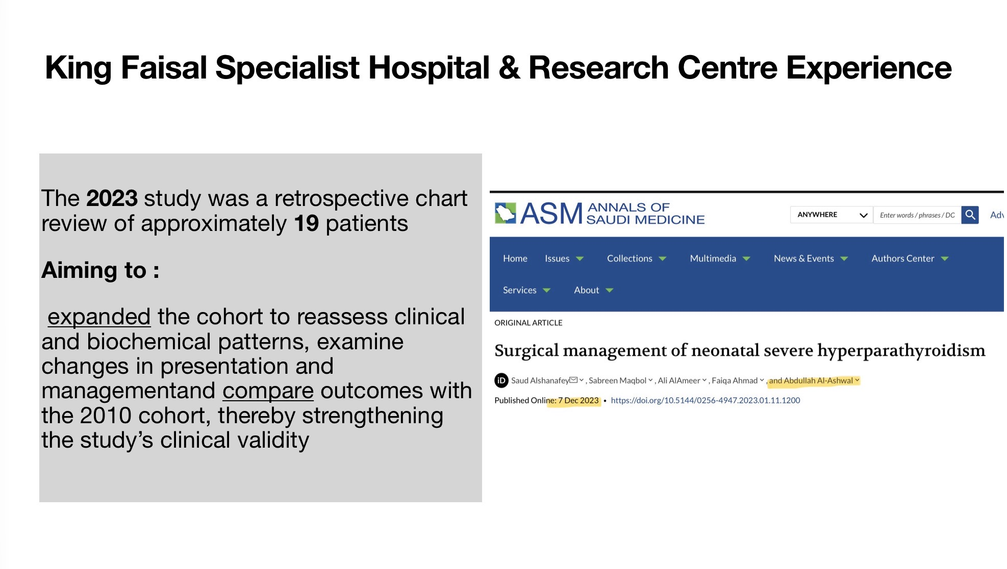

Slide 26
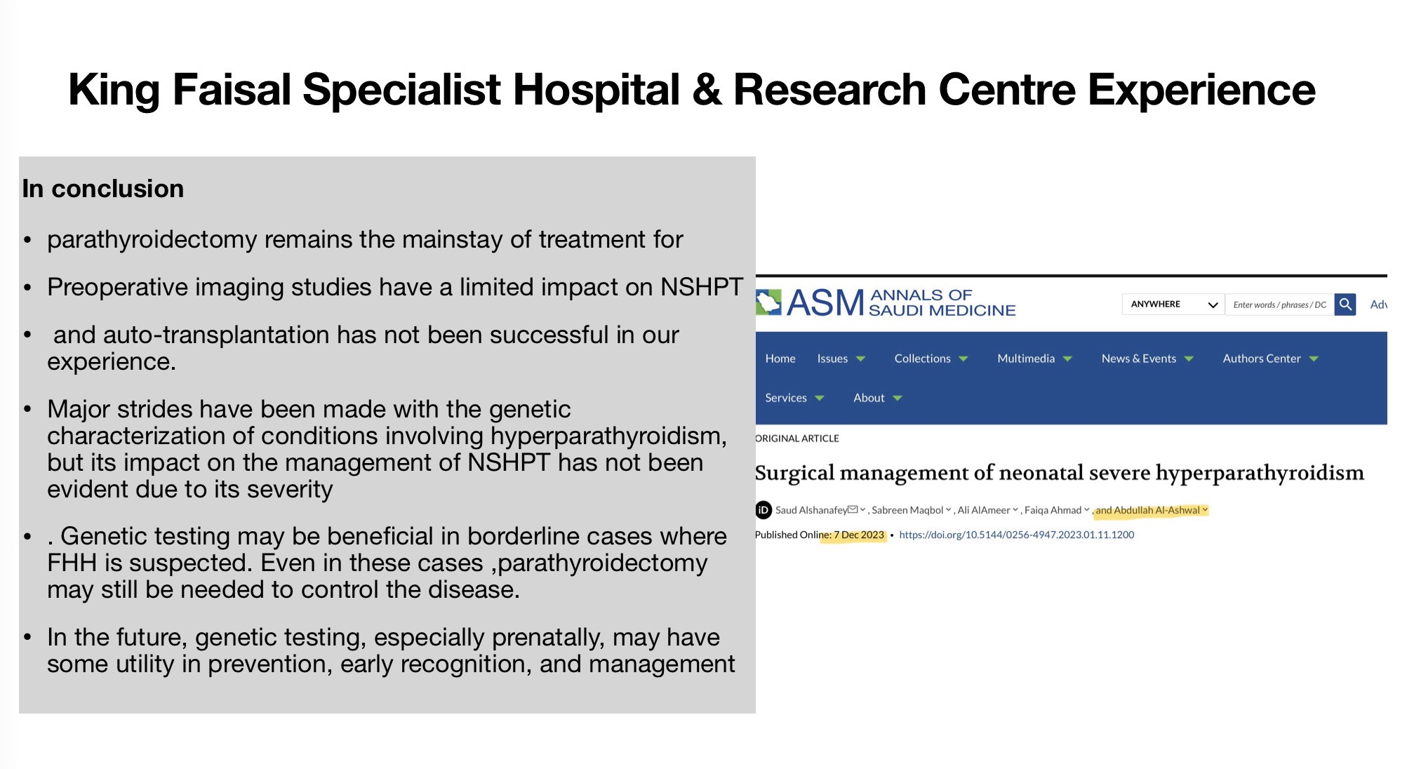

Slide 27

The ongoing study is a large retrospective cohort spanning approximately 25 years at KFSHRC, anticipated to be the largest NSHPT dataset to date, aiming to define genotype–phenotype correlations, evaluate long-term outcomes, and compare medical versus surgical management, with the goal of providing comprehensive longitudinal insights to inform clinical practice and guidelines.

Slide 28
Thank you

