Slide 1

CHALLENGING CASE:
X-LINKED HYPOPHOSPHATEMIA (XLH)
Dr.Musaab AlSaad
Pediatric Endocrinologist
King Faisal specialized hospital and research center ( KFSH)

Slide 2
CASE PRESENTATION

Slide 3
CHIEF COMPLAINT
A 1-year-old girl referred to KFSH for persistent low serum phosphate detected during routine evaluation

Slide 4
HISTORY
No bone pain, delayed walking, fracture
No chronic vomiting/diarrhea , constipation , polyuria
She achieved gross motor milestones at appropriate ages, including independent walking within the expected age range.
Known congenital heart disease ( mild pulmonary stenosis )
Notes:
No feature suggest Fanconi syndrome , nutritional rickets

Slide 5
FAMILY HISTORY
The child is born to a consanguineous marriage
The father has short stature and was diagnosed with X-linked hypophosphatemia ( PHEX mutation confirmed genetically)
No other affected sibling or mother
Notes:
Fhx suggestive of XLH dominant inheritance

Slide 6
PHYSICAL EXAMINATION
Patient is alert , active, and in no distress
Vitals signs were within normal limit for age
Growth parameters-including weight , height , HC-were appropriate for age
She walks independently with a normal gait, with no clinically evident lower limb deformity
No frontal bossing/ abnormal head shape , widening of wrist or ankles , rachitic rosary

Slide 7
DIFFERENTIAL DIAGNOSIS
X-linked hypophosphatemia (XLH)
Nutritional rickets ( vit D deficiency )
FGF23-mediated hypophosphatemic rickets ( ADHR, ARHR)
Proximal Renal tubular dysfunction ( Fanconi syndrome )
Notes:
“Overall, while nutritional rickets remains the most common etiology, the positive family history raises early suspicion for a hereditary cause.”
1.X-linked hypophosphatemia (XLH)
– Strongly suggested by positive family history in the father
– Early stage disease may present without obvious skeletal deformities
– Normal growth and development do not exclude mild/presymptomatic disease
2. Nutritional rickets (vitamin D deficiency)
– Most common cause in this age group
– Less supported here due to adequate diet, normal growth, and absence of risk factors
3. Other hereditary hypophosphatemic rickets (ADHR, ARHR)
– Considered, but less likely given known familial XLH pattern
4. Renal tubular disorders (e.g., Fanconi syndrome)
– Unlikely without polyuria, dehydration, or growth failure

Slide 8
INVESTIGATION
Calcium 2.5 mmol ( normal )
Phosphate 1.13 mmol/L ( low for age )
Alkaline phosphatase 444 IU/L ( high )
PTH 39 pg/mL ( normal )
25(OH) Vitamin D 69 nmol/L ( normal )
1,25(OH) 42 ng/L ( 20-80 ) ( inappropriately normal )
Magnesium 0.85 mmol/L ( normal )
Bicarbonate and creatinine/urea is within limits
Notes:
High alk phos suggest of increase bone turnover
Interpretation:
The biochemical profile shows hypophosphatemia with elevated alkaline phosphatase and normal calcium, PTH, and vitamin D levels, against nutritional rickets.
In the context of a positive family history, these findings are highly suggestive of X-linked hypophosphatemia (XLH).

Slide 9
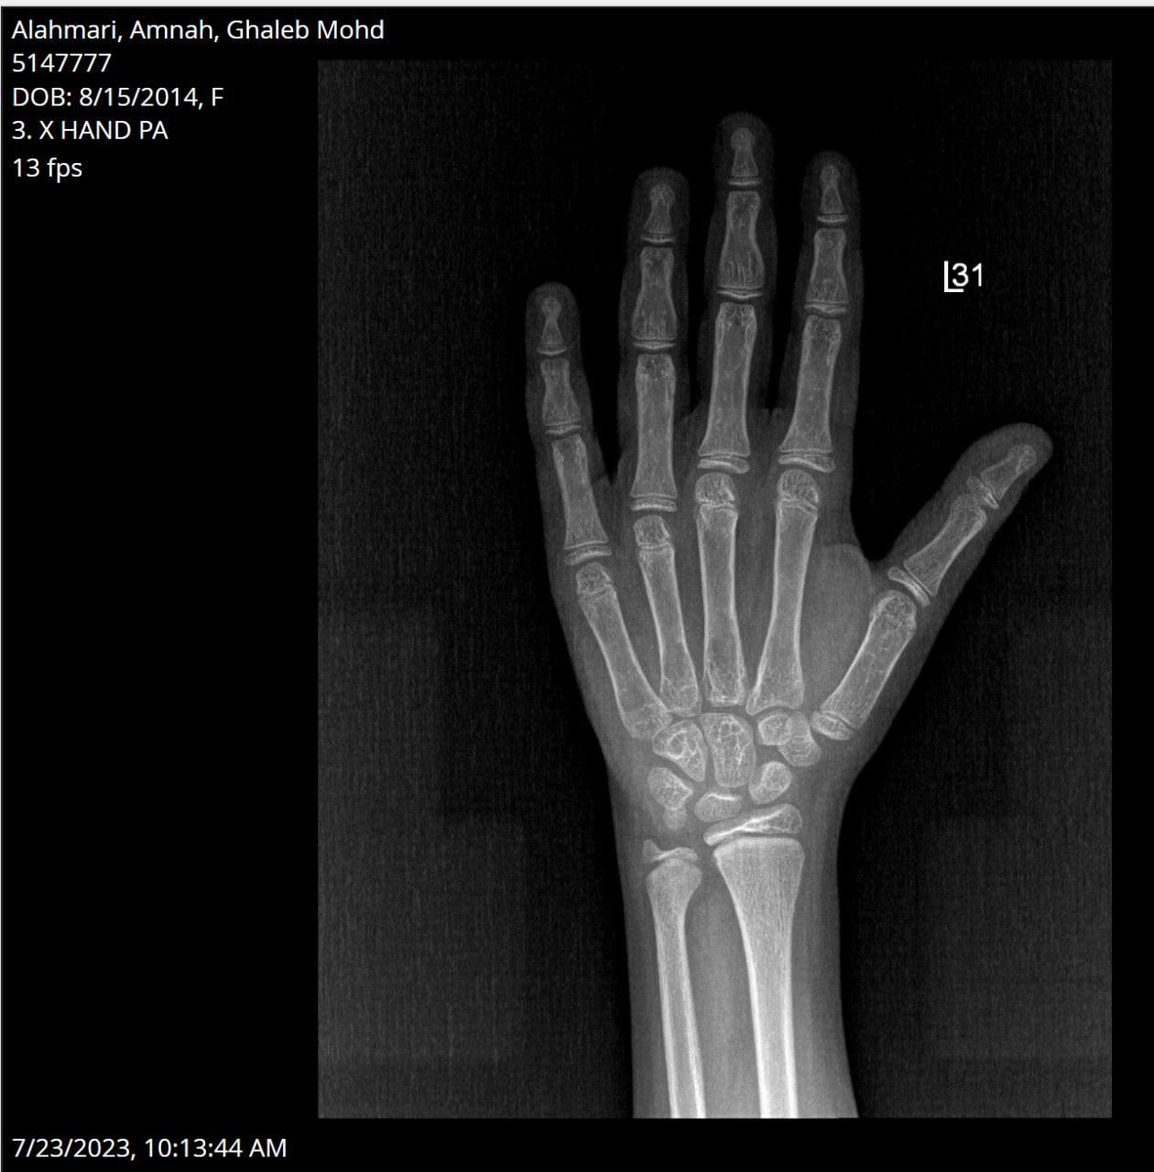
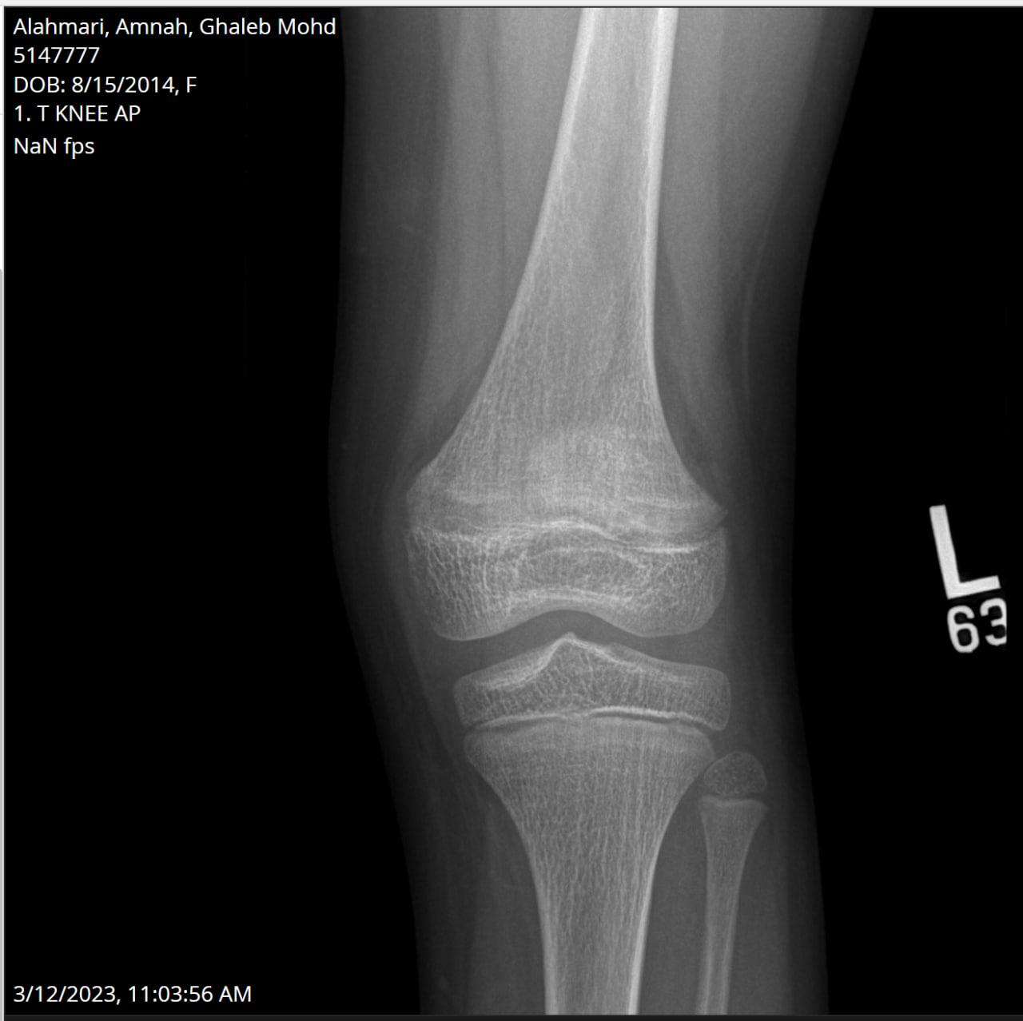
IMAGING
Notes:
Skeletal imaging showed : There is mild flaring and splaying of the distal femoral metaphysis with metaphyseal lucency/sclerosis and to lesser extent the proximal tibial and fibular metaphysis, likely related to mild healing rachitic changes. Minimal cupping noted within the left distal radial metaphysis, related to mild rickets changes.
No fracture or dislocation.
Don’t say this unless asked :
Baseline radiographs prior to treatment were not available.
“Findings may underestimate initial disease severity as imaging was performed after treatment initiation.”
Radiographs obtained after initiation of conventional therapy) (phosphate and active vitamin D) before burosumab

Slide 10
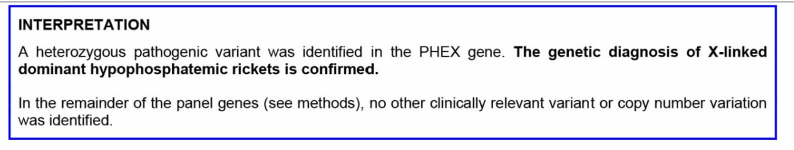
INVESTIGATION
Intact FGF23: 104 pg/mL
Laboratory reference range: 44–215 pg/mL
Expected in hypophosphatemia: suppressed (<27-30 pg/mL)
Genetic testing: Pathogenic mutation in PHEX gene identified
Notes:
Interpretation:
Inappropriately normal (not suppressed) FGF23 in the setting of hypophosphatemia → consistent with FGF23-mediated renal phosphate wasting.

Slide 11
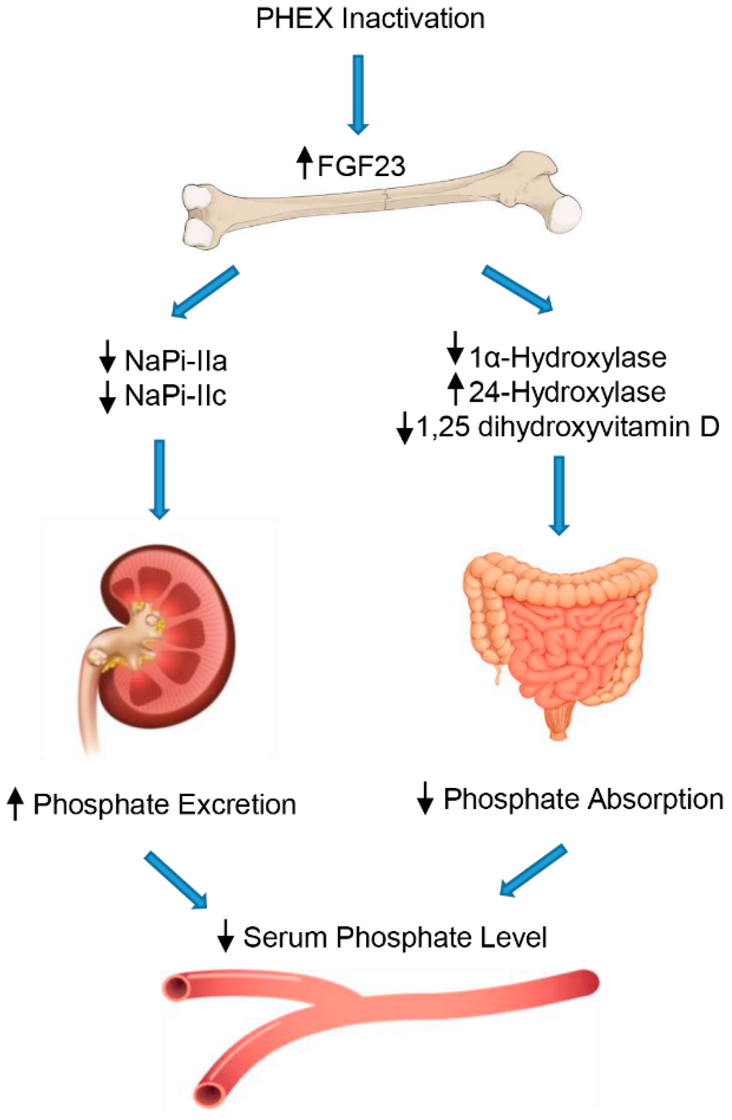
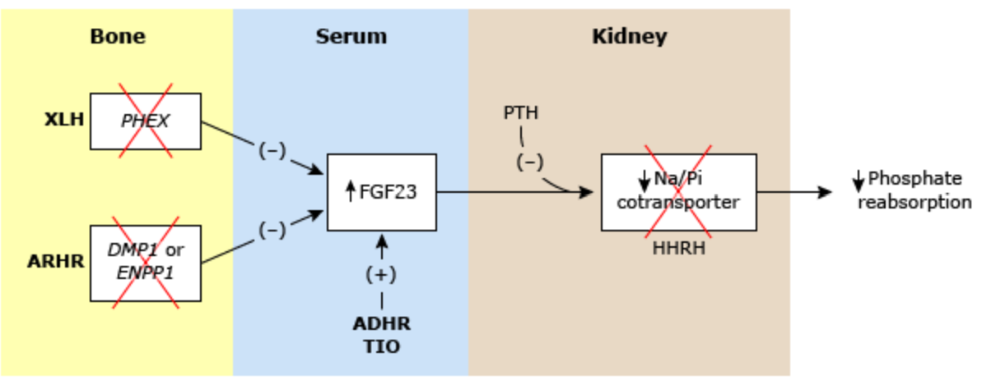
PATHOGENESIS OF XLH
Notes:
Levels of FGF23 are increased by inactivating mutations in PHEX (as in XLH) or DMP1 (as in ARHR), by activating mutations in FGF23 (as in ADHR), or by tumor production of FGF23 (as in TIO tumor induced osteomalacia ). Each of these disorders leads to excessive activity of FGF23, which suppresses the Na/Pi cotransporter and causes renal phosphate-wasting. In HHRH, the renal phosphate-wasting is caused by a mutation in the Na/Pi cotransporter itself.

Slide 12
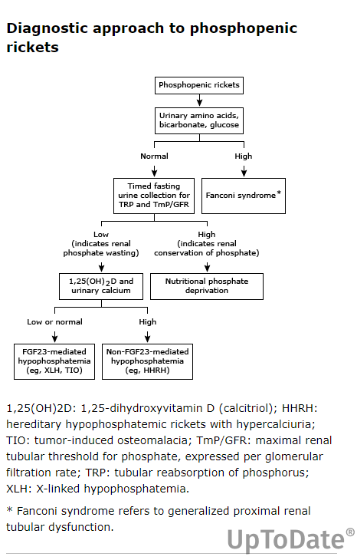
Notes:
In a child with suspected rickets, the initial step is to confirm the diagnosis clinically and biochemically, particularly with elevated alkaline phosphatase.
The next step is to differentiate between calcipenic and phosphopenic causes.
In phosphopenic rickets is characterized by low phosphate levels,

Slide 13
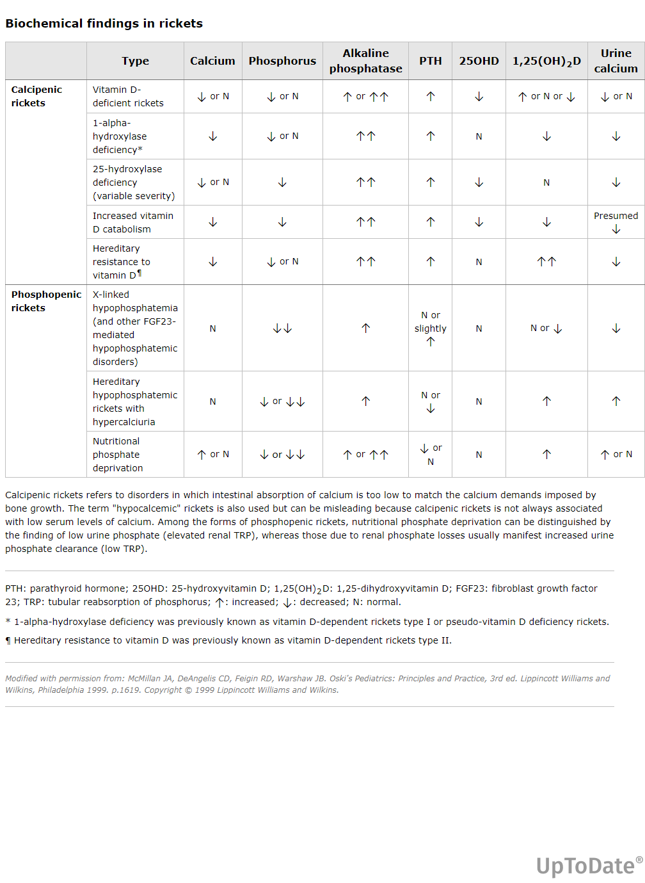

Slide 14
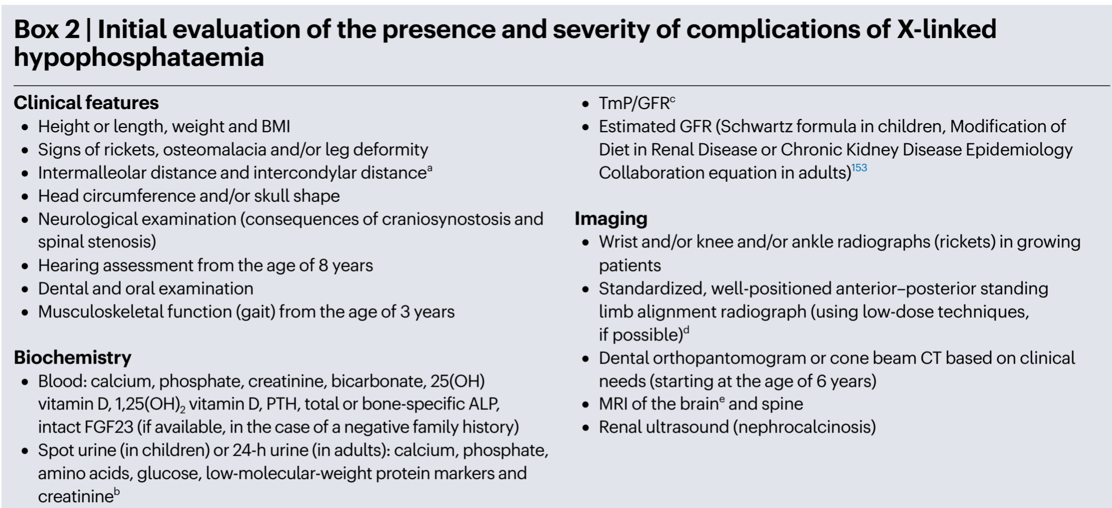
EVALUATION & DIAGNOSIS

Slide 15
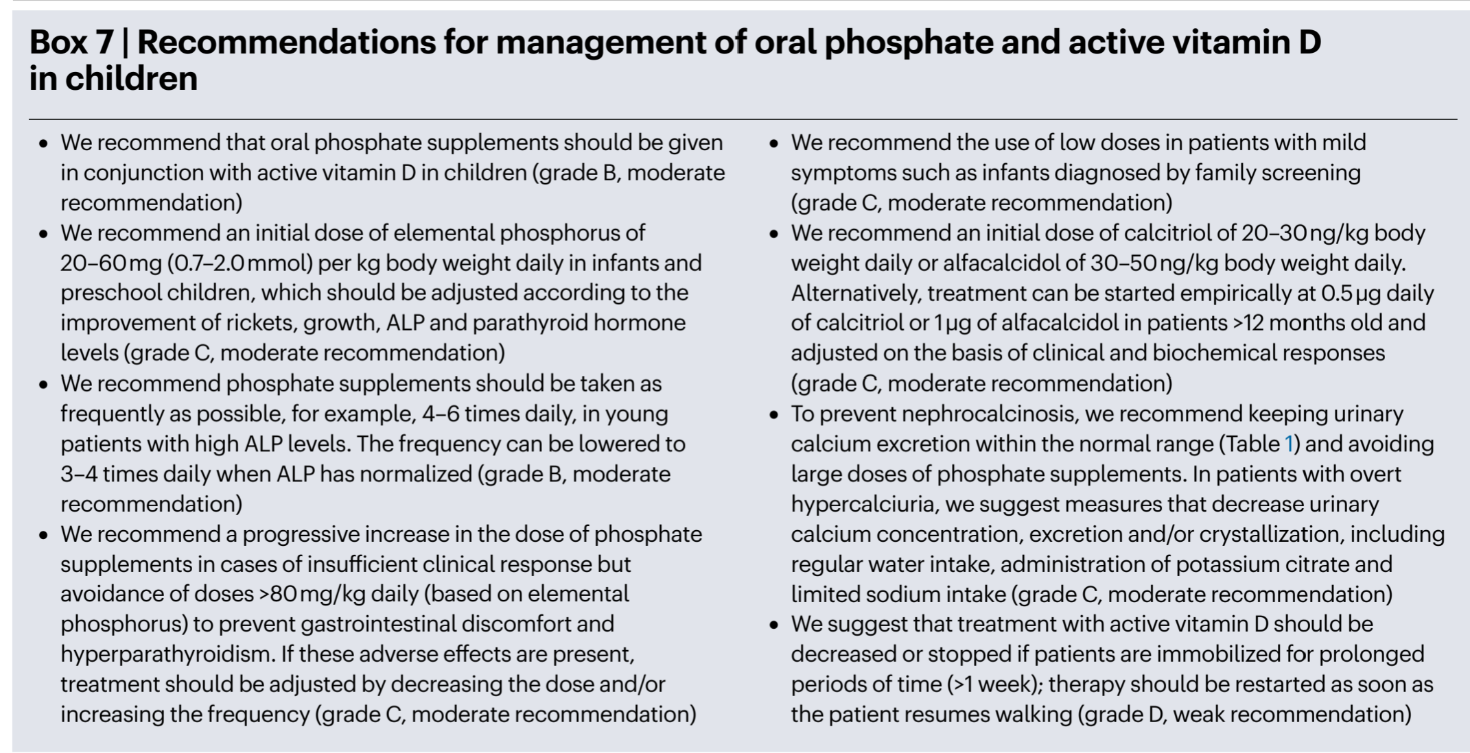
INITIAL MANAGEMENT
Started on conventional therapy:
Oral phosphate 250 mg BID = 40mg/kg/day and Active vitamin D (alfacalcidol) 1mcg

Slide 16
FOLLOW-UP (UNDER CONVENTIONAL THERAPY):
Persistent bone pain with limited mobility
No clinically evident bone deformity
Suboptimal growth velocity on growth chart
Serum phosphate: within age-adjusted range
Alkaline phosphatase: persistently elevated
PTH: within normal limits
Renal ultrasound: no evidence of nephrocalcinosis
Notes:
“Despite normalization of serum phosphate, the patient continued to have significant bone pain, limited mobility, and suboptimal growth. Alkaline phosphatase remained elevated, while radiographs demonstrated persistent rachitic changes, indicating ongoing active disease.”

Slide 17
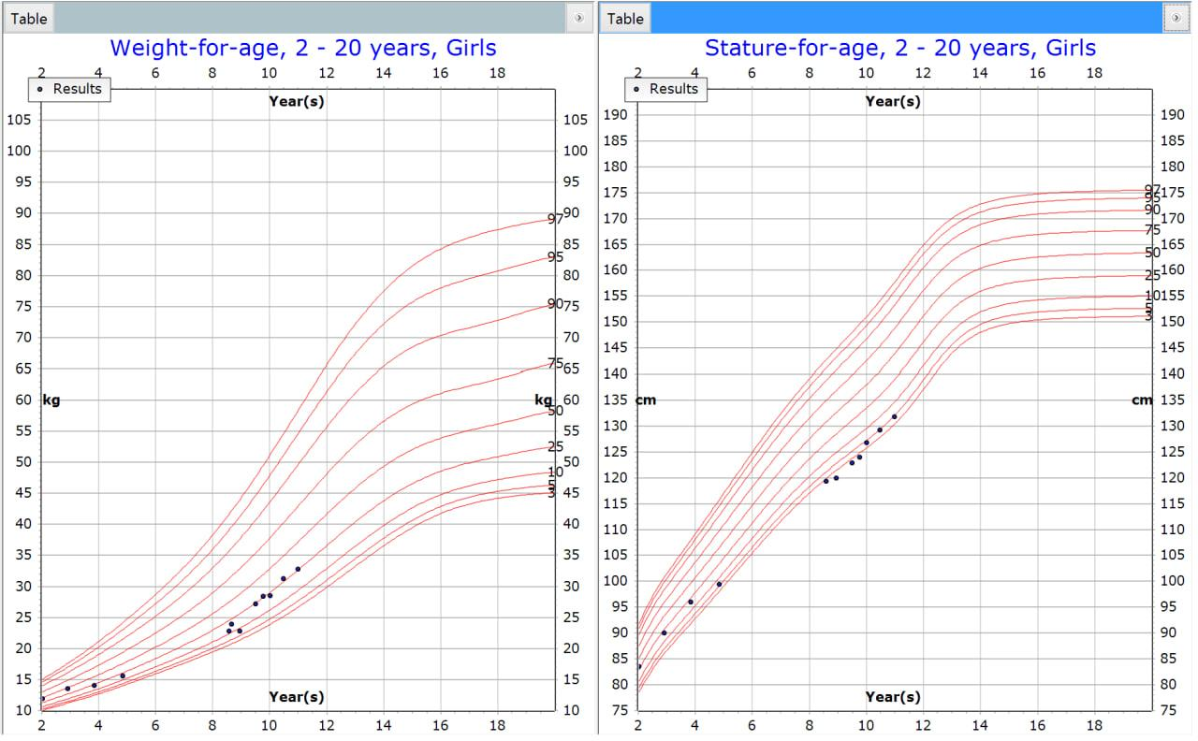
FOLLOW UP
Notes:
“This growth chart shows a decline in growth velocity over time, with the patient crossing percentiles downward.

Slide 18
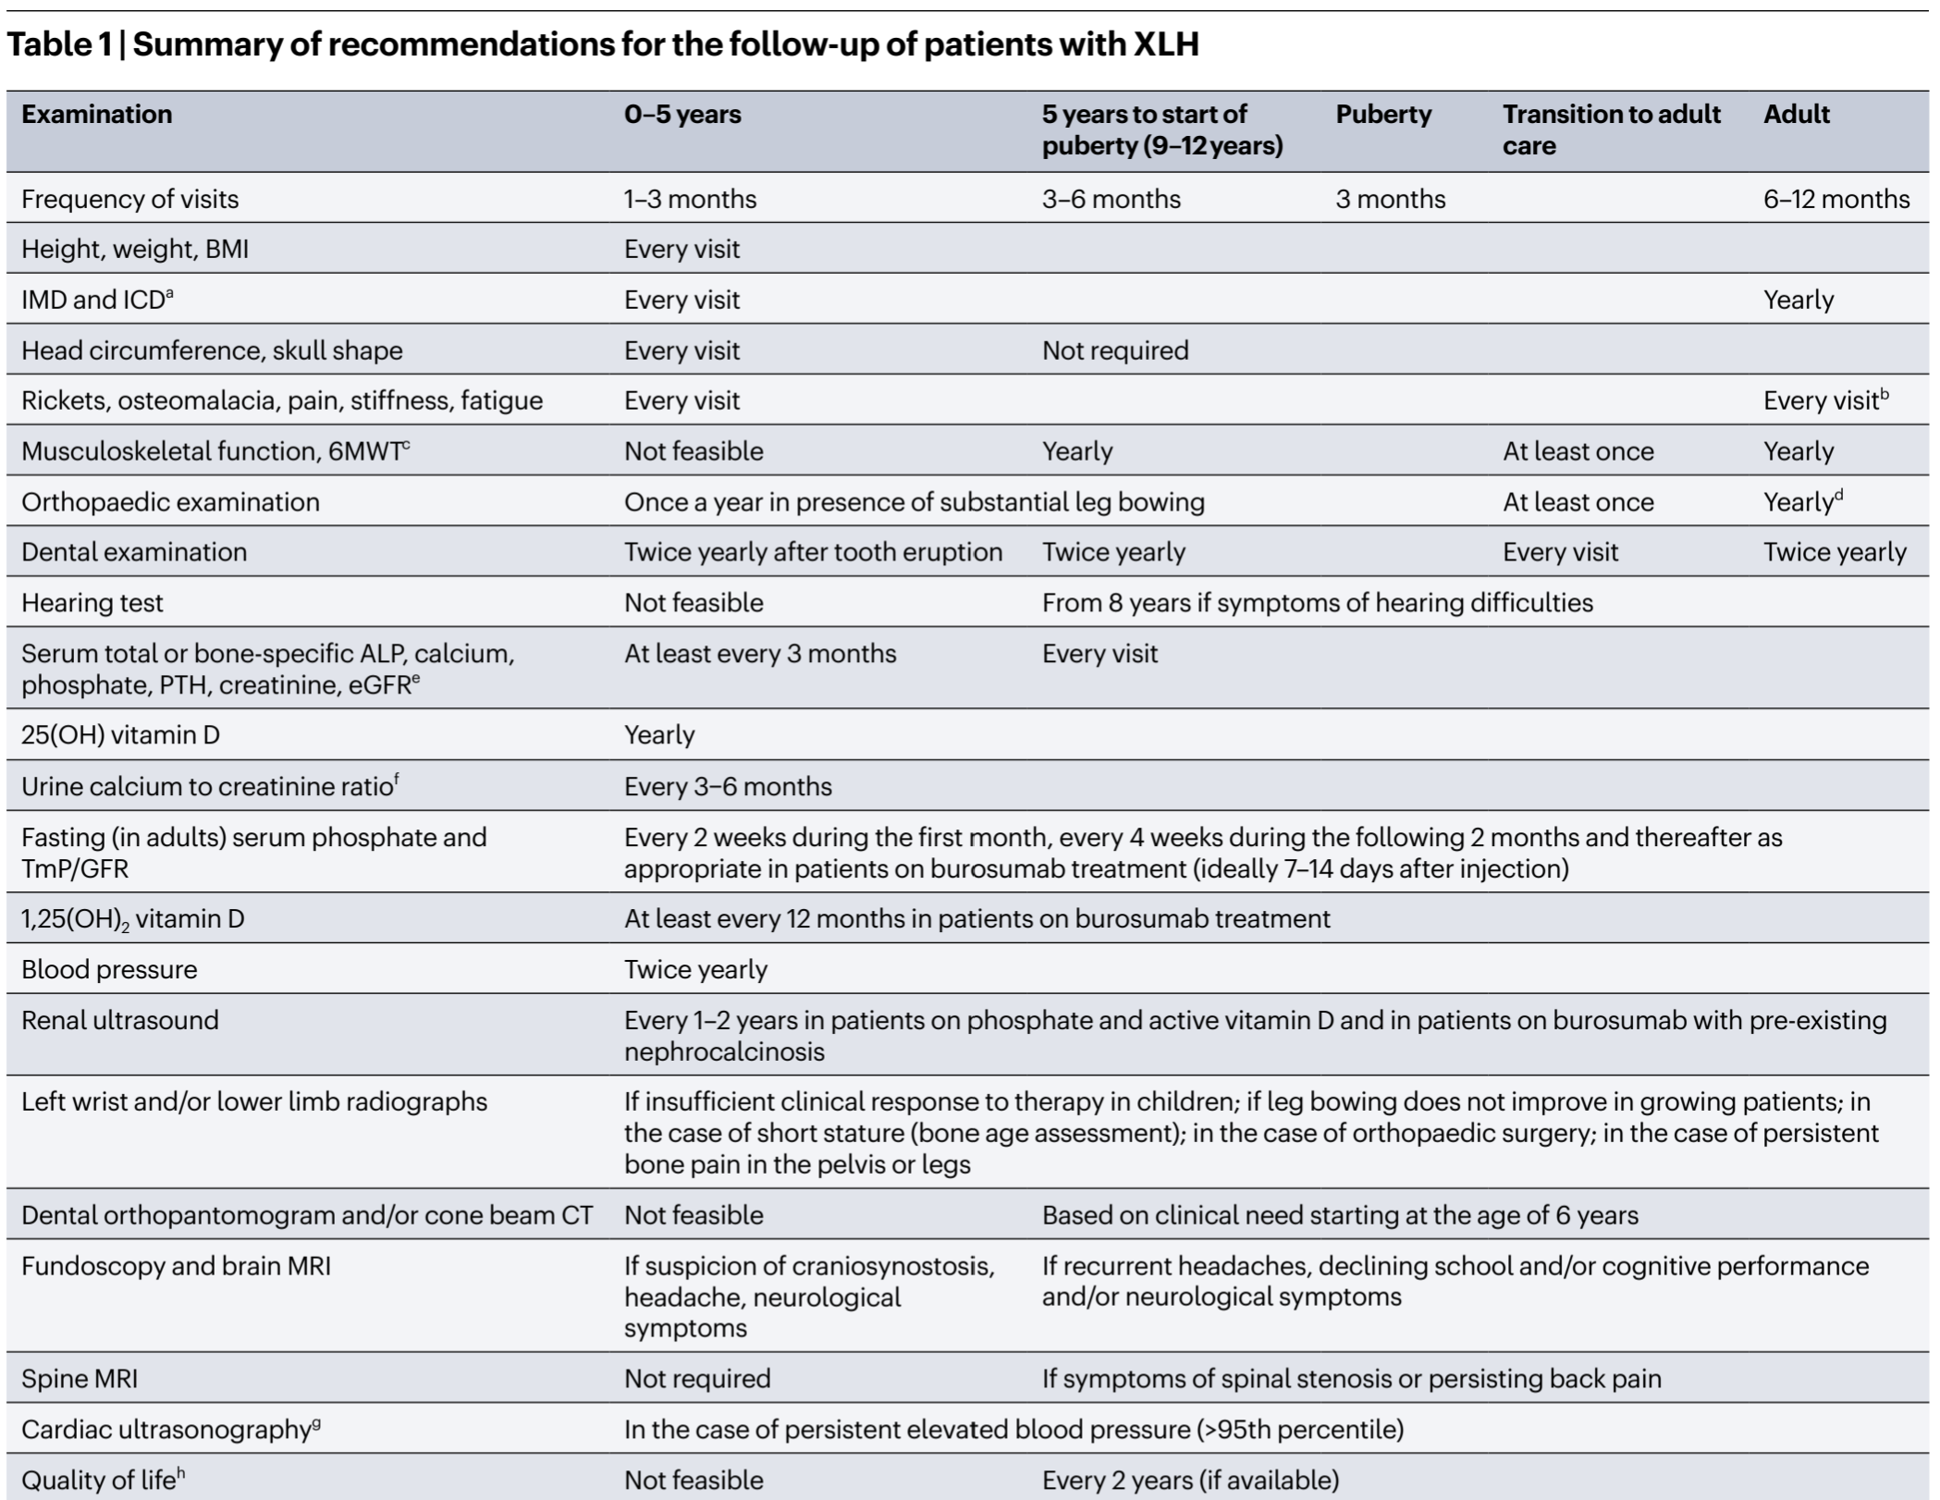
FOLLOW UP

Slide 19
INITIATING OF BUROSUMAB THERAPY
Burosumab started at 20 mg (~0.8 mg/kg)
Mechanism: Anti-FGF23 monoclonal antibody → ↑ renal phosphate reabsorption and ↑ 1,25(OH)₂D
Continued monitoring of:
Serum phosphate and ALP, Growth parameters, Skeletal radiographs, Renal ultrasound surveillance
Notes:
Given persistent symptoms of bone pain , suboptimal growth , elevated ALP, and ongoing radiologic rickets despite conventional therapy, burosumab was initiated at approximately 0.8 mg/kg.”

Slide 20
RESPOND TO BUROSUMAB
Marked improvement in bone pain and mobility
Improved growth velocity on growth chart
Serum phosphate maintained within target range
Decline in alkaline phosphatase levels
Radiographs: healing of rachitic changes
Notes:
Following initiation of burosumab, the patient showed clear clinical improvement with reduced pain and better mobility, improved growth trajectory, biochemical improvement with decreasing ALP, and radiologic evidence of rickets healing.”

Slide 21
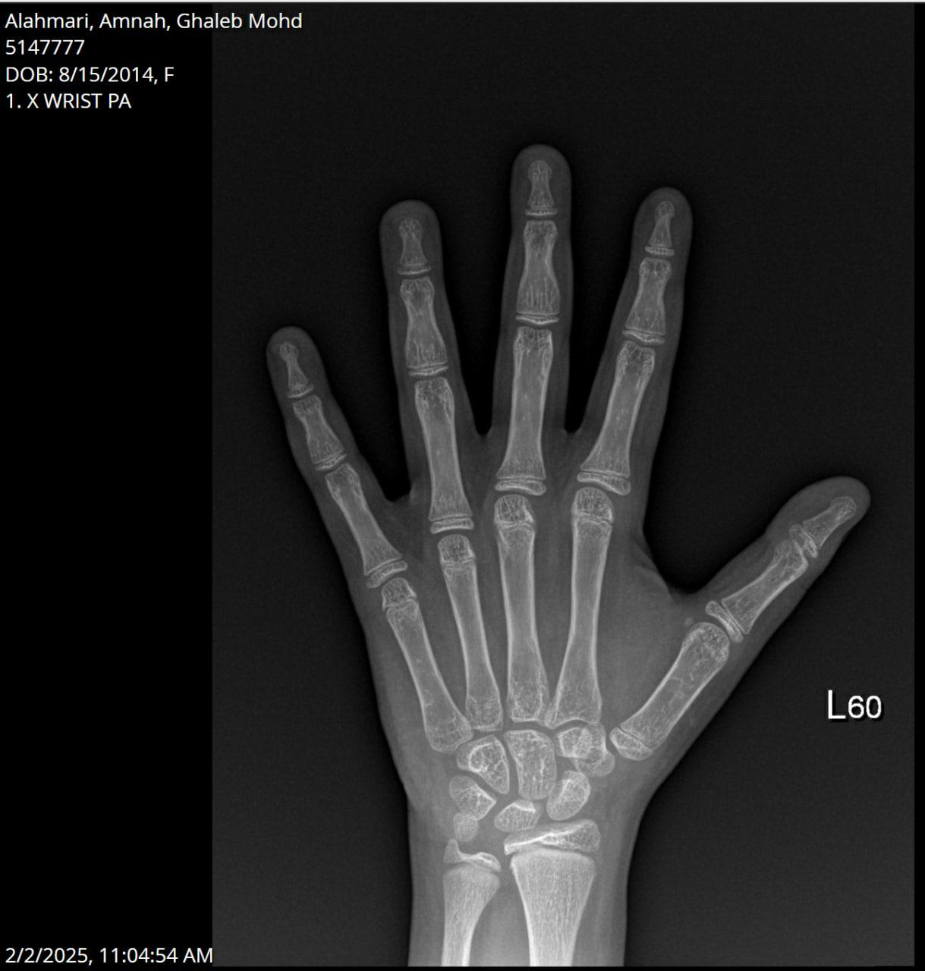
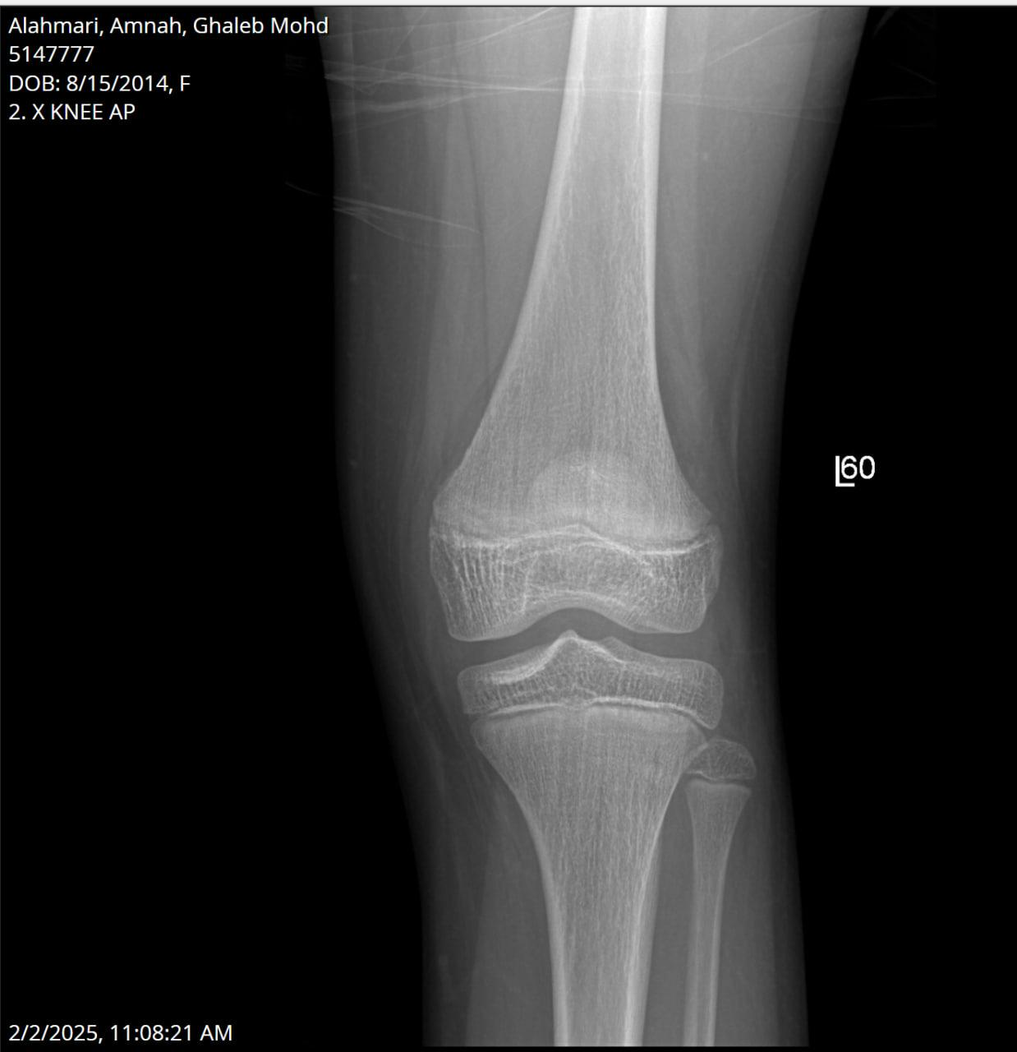
RESBOND TO BUROSUMAB
Notes:
Improved generalized osteopenia with no radiographic evidence of active rickets , no bone fracture

Slide 22
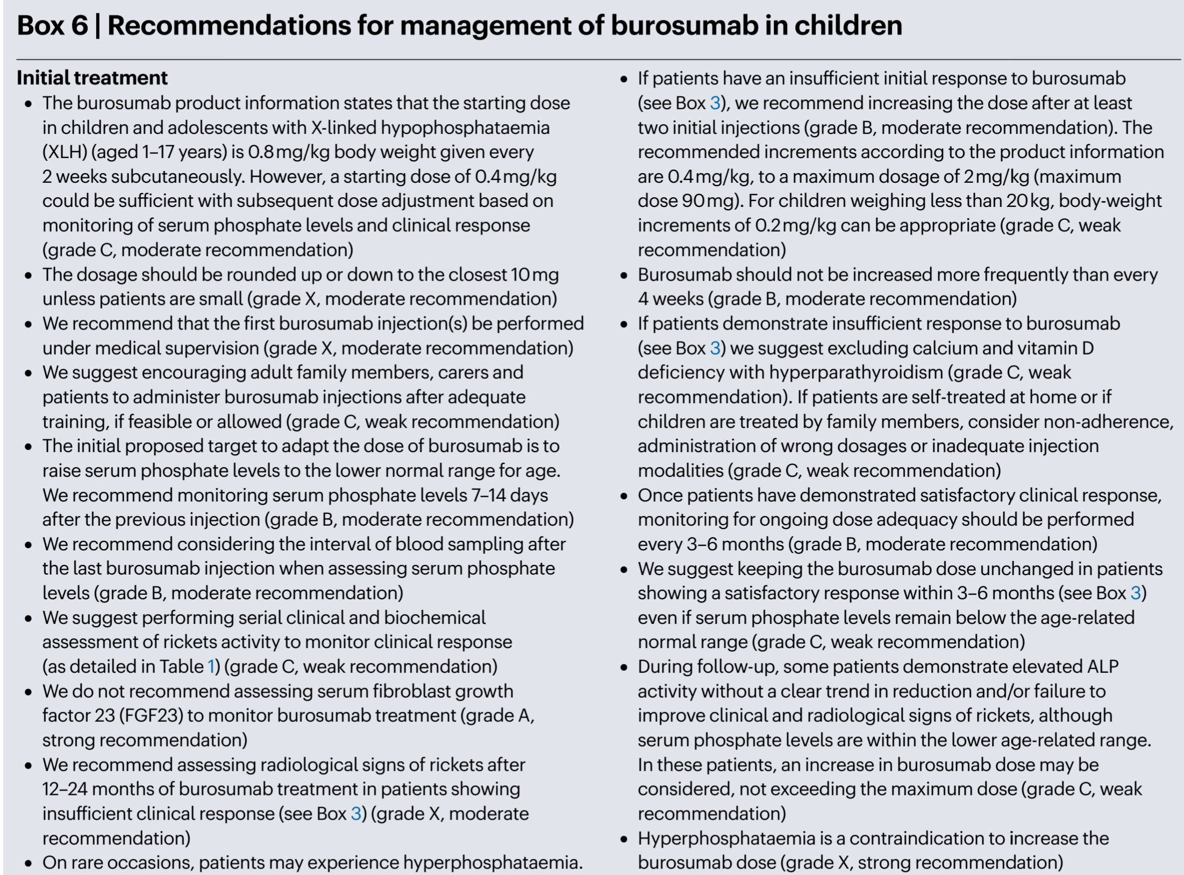
RECOMMENDATION FOR BUROSUMAB
Notes:
Importantly, FGF23 levels should not be measured or used to monitor response during burosumab therapy, as the drug causes falsely elevated readings due to analytical interference in the assays.“
Burosumab must not be given in conjunction with oral phosphate or active vitamin D, when fasting phosphate levels are within the age-related normal reference range before initiation of treatment or when severe renal impairment is present (estimated glomerular filtration rate <30 ml/min/1.73 m 2
Compared to conventional therapy, burosumab directly targets excess FGF23, leading to improved phosphate homeostasis, better rickets healing, and improved physical function and growth outcomes.”

Slide 23
ROLE OF GROWTH HORMONE IN XLH
Short stature common in XLH despite metabolic control
Recombinant GH may be considered in selected patients with:
Persistent growth failure
Controlled rickets and adequate phosphate levels
Evidence shows:
Modest improvement in height velocity
Variable long-term impact on final height
Limitations:
Does not correct underlying phosphate wasting
Role remains adjunctive, not first-line therapy
Notes:
Growth hormone has been used in children with XLH and persistent short stature, but it does not address the underlying phosphate-wasting pathophysiology, so its role remains adjunctive rather than primary.”

Slide 24
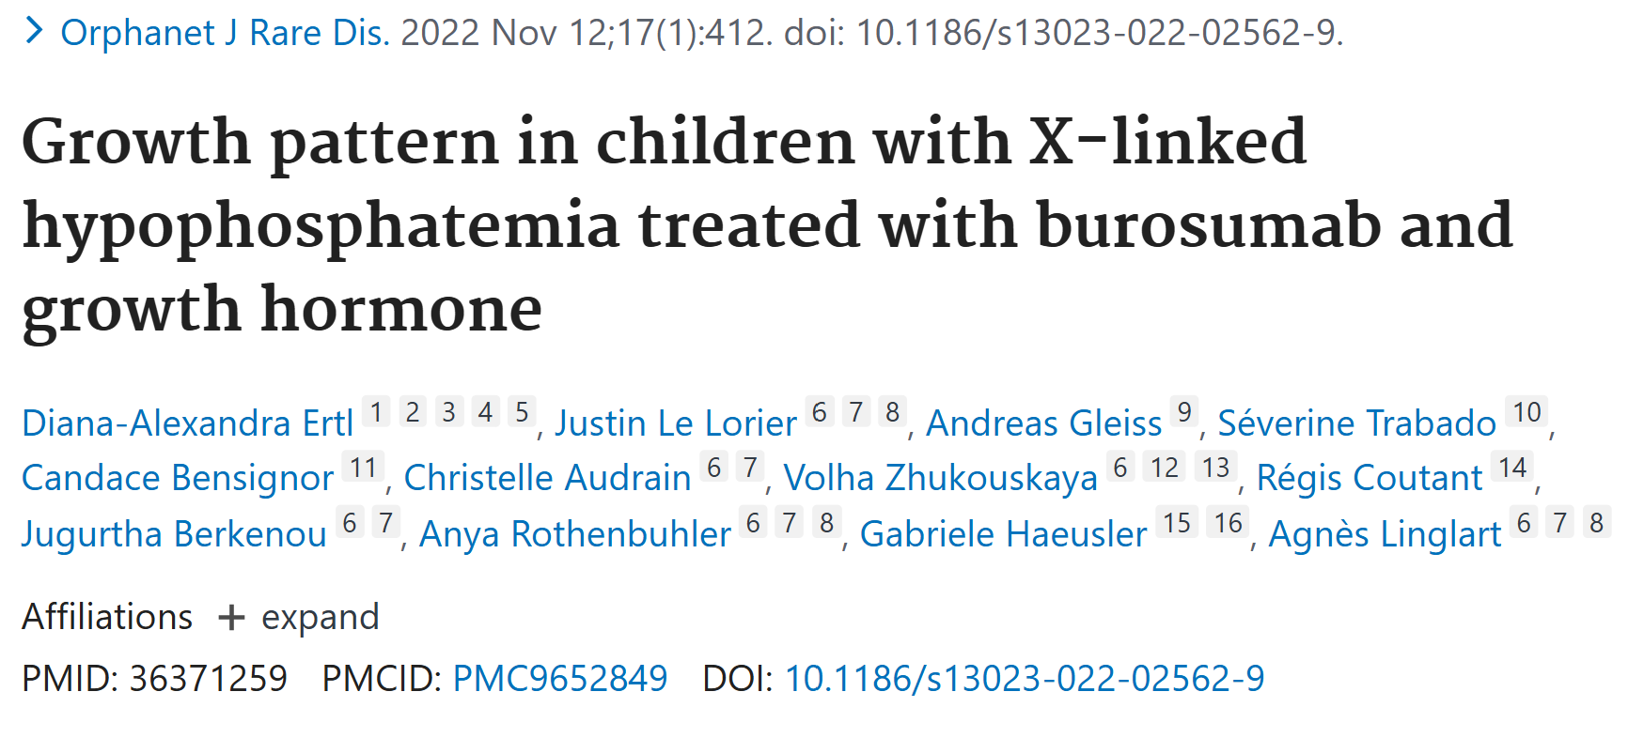
ROLE OF GROWTH HORMONE IN XLH

Slide 25
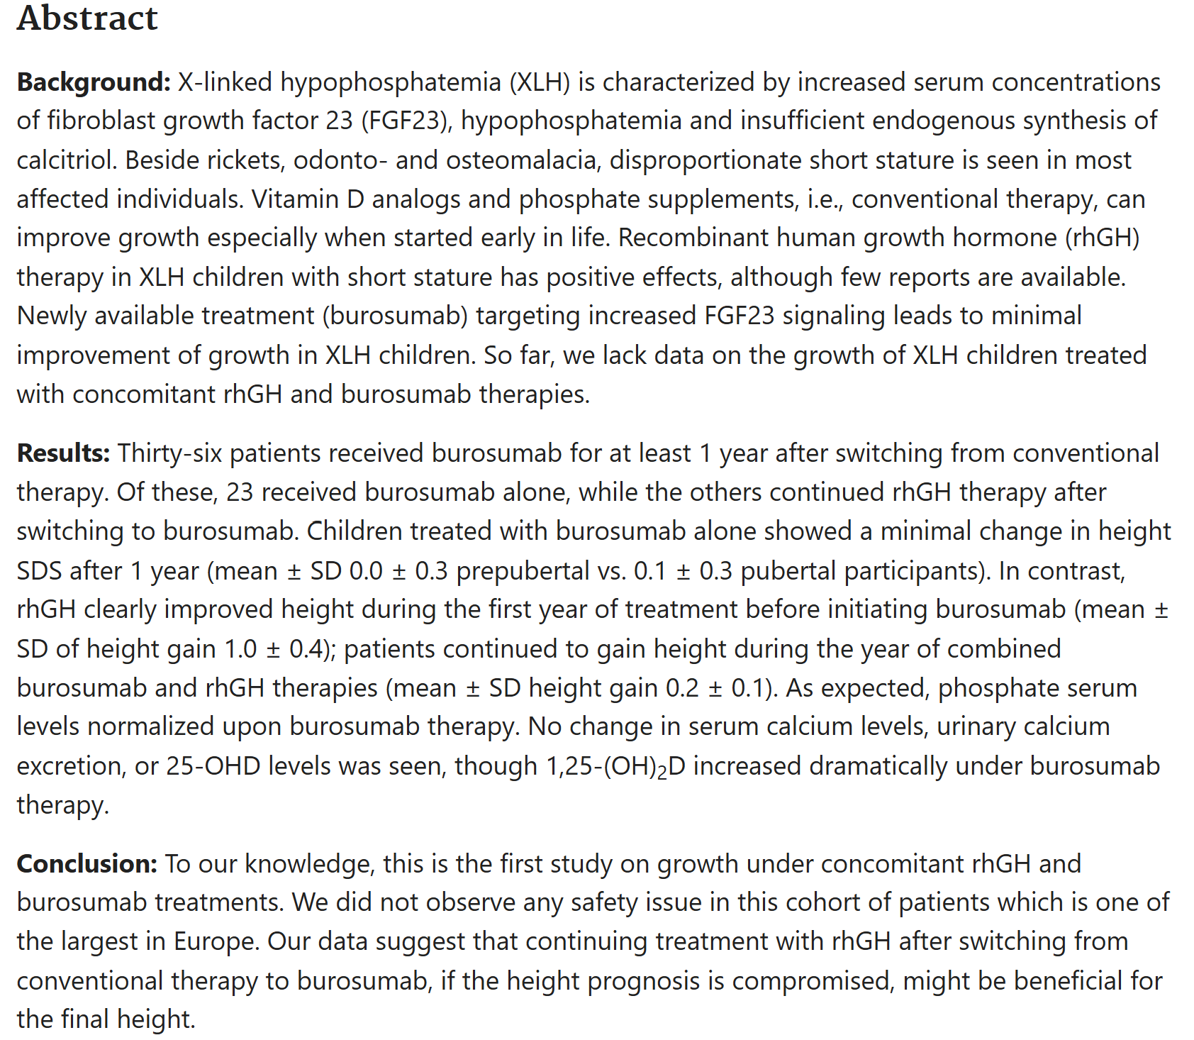
ROLE OF GROWTH HORMONE IN XLH

Slide 26
TAKE HOME MESSAGE
Early screening catches XLH presymptomatically: Family history + low phosphate + low TmP/GFR + PHEX mutation.
Conventional therapy (phosphate + active vitamin D) often falls short: Persistent high ALP, poor growth, pain despite normalized phosphate.
Switch to burosumab early for superior outcomes: Improves phosphate, growth, mobility, pain relief, and rickets healing (as seen in this case).
On burosumab: Monitor phosphate (7–14 days post-injection), ALP, growth, and symptoms — Avoid FGF23 testing (falsely elevated due to interference).
Adjunctive rhGH for short stature if needed; early burosumab optimizes long-term quality of life in pediatric XLH.

Slide 27
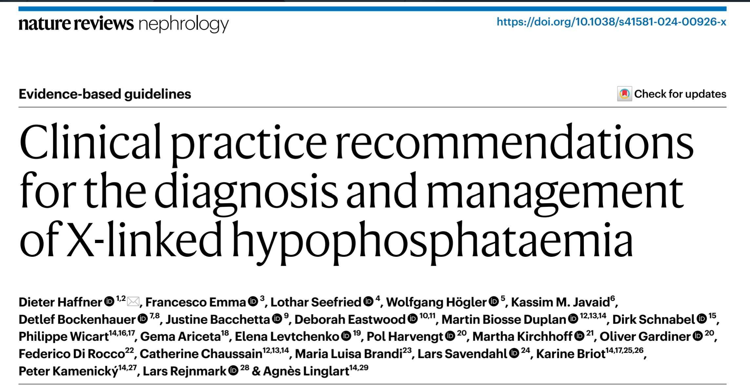
REFERENCE

Slide 28
REFERENCE
Haffner D, Emma F, Seefried L, et al. Clinical practice recommendations for the diagnosis and management of X-linked hypophosphataemia. Nat Rev Nephrol. 2025;21(5):330-354. doi:10.1038/s41581-024-00926-x
Carpenter TO, Whyte MP, Imel EA, et al. Burosumab versus conventional therapy in children with X-linked hypophosphataemia: a randomised, active-controlled, open-label, phase 3 trial. Lancet. 2019;393(10189):2416-2427. doi:10.1016/S0140-6736(19)30654-3
Ertl DA, Le Lorier J, Gleiss A, et al. Growth pattern in children with X-linked hypophosphatemia treated with burosumab and growth hormone. Orphanet J Rare Dis. 2022;17(1):397. doi:10.1186/s13023-022-02562-9
Insogna KL, Briot K, Imel EA, et al. A randomized, double-blind, placebo-controlled, phase 3 trial evaluating the efficacy of burosumab, an anti-FGF23 antibody, in adults with X-linked hypophosphatemia: week 24 primary analysis. J Bone Miner Res. 2018;33(8):1383-1393. doi:10.1002/jbmr.3475
Haffner D, Emma F, Eastwood DM, et al. Clinical practice recommendations for the diagnosis and management of X-linked hypophosphataemia. Nat Rev Nephrol. 2019;15(7):435-455. doi:10.1038/s41581-019-0152-5

Slide 29
THANK FOR YOUR ATTENTION
Question ?

