Slide 1

When physiology fails
Refractory hypercalcemia in CYP24A1 deficiency and the role of rifampicin
Hassan Shaker Albohassan
Pediatric Endocrinology Fellow
Supervised by:
Nourah Almutlaq, Program Director, Pediatric Endocrinology Fellowship, and Consultant Pediatric Endocrinologist & Pediatric Bone Specialist.
Faisal Alshareef, Division chief of pediatric and Pediatric Consultant.
Abdallah Alfaris, Pediatric Endocrinologist
Faisal Alwady, Pediatric Endocrinologist.
Security Forces Hospital, Ministry of Interior, Riyadh,KSA

Slide 2

OPENING
The dilemma
An infant with severe hypercalcemia — and every standard answer is incomplete.
BIOCHEMISTRY
RENAL RISK
DECISION
Ca 4.33 mmol/L
Hydrate?
Steroids?
Azole?
Rifampicin?
suppressed PTH
low phosphate signal
nephrocalcinosis
+ hypercalciuria
What would you do next?
2/26

Slide 3
LEARNING OBJECTIVES
What I want the audience to leave with
Recognize
Interpret
1
the biochemical signature of vitamin-D–mediated, PTH-independent hypercalcemia.
2
CYP24A1 deficiency as failure of vitamin D degradation — not simply “too much vitamin D.”
Critique
Define
3
why standard therapy can fail and why rifampicin is mechanistically attractive but evidence-limited.
4
a monitoring plan that prioritizes renal protection, not only serum calcium correction.
3/26

Slide 4
CASE
The patient story in one line
8-month-old girl
Endocrinology consult:
known CCLD / SLC26A3
Severe hypercalcemia
admitted for acute gastroenteritis on chronic diarrhea
Ca 4.33 mmol/L
Phosphate 1.07 mmol/L
Date: 11/2023
Clinical clue: hypercalcemia had already been noted at 3 months, and vitamin D had been stopped.
4/26

Slide 5
CASE CHRONOLOGY
Timeline: the problem was chronic before it became dramatic
Antenatal
3 months
06/2024
01/2026
Polyhydramnios
Hypercalcemia
Vitamin D stopped
WES: CYP24A1
+ SLC26A3
MDT: start
rifampicin
Birth
8 months
11/2023
2024–2025
Preterm 33 w
NICU 2 w
Ca 4.33
Nephrocalcinosis
Persistent Ca ~2.8
Steroids not sustained
The diagnostic opportunity was present early; the renal risk accumulated over time.
5/26

Slide 6
CASE DATA
Initial data: the pattern is PTH-independent
CALCIUM
PHOSPHATE
PTH
4.33
1.07
7.57
mmol/L
mmol/L
pg/mL
25(OH)D
URINE CA/CR
RENAL US
259
2.75
bilateral
nmol/L
high
medullary nephrocalcinosis
Interpretation: vitamin-D–mediated, PTH-independent hypercalcemia until proven otherwise
6/26

Slide 7
DIAGNOSTIC REASONING
Diagnostic lock: this is not “just dehydration”
Hypercalcemia
Why CYP24A1 rose to the top
Recurrent/persistent hypercalcemia
Medullary nephrocalcinosis
PTH suppressed?
Suppressed PTH
Vitamin D pathway signal
YES
Hypercalciuria
Genetic confirmation
Think vitamin D / malignancy / granulomatous / genetic
Dehydration may amplify severity — but it does not explain suppressed PTH + hypercalciuria + nephrocalcinosis by itself.
CYP24A1-related hypercalcemia
7/26
Notes:
- CYP24A1 phenotype supported by Hawkes CP et al. JCEM 2017;102:1440–1446 and Lenherr-Taube N et al. J Steroid Biochem Mol Biol. 2023;231:106301.

Slide 8
CLINICAL STAKES
The kidney is the outcome organ
Clinical implication
Serum calcium
tells you acute toxicity risk
Urinary calcium
tells you ongoing renal exposure
Nephrocalcinosis is not a footnote.
Renal ultrasound
tells you cumulative damage trend
It is the signal that chronic calcium exposure has already reached the kidney.
So the response question becomes: “Are we protecting the kidney?”
8/26

Slide 9
DIAGNOSTIC TURNING POINT
Genetic reveal: two rare inherited conditions, one difficult phenotype
SLC26A3
CYP24A1
Congenital chloride-losing diarrhea
Infantile hypercalcemia type 1
Chronic watery diarrhea
fluid/electrolyte vulnerability
acute dehydration risk
Failure of vitamin D inactivation
↑ calcium absorption
↑ urine calcium
Risk amplifier
Primary driver
Interpretation: CCLD likely magnifies renal vulnerability; CYP24A1 explains the calcium physiology.
9/26
Notes:
- Congenital chloride diarrhea features: Cendal I et al. Front Pediatr. 2021;9:758006. - CYP24A1 phenotype: Hawkes CP et al. JCEM 2017;102:1440–1446.

Slide 10
CASE INTERPRETATION
Why CCLD made the case harder
Chronic diarrhea
Dehydration episodes
CYP24A1 disease
Kidney exposure
fluid + chloride losses
reduced renal reserve
high calcium load
hypercalciuria + nephrocalcinosis
Clinical stance
CCLD is not presented as the primary cause of this biochemical pattern. It is a clinically important amplifier: hydration vulnerability, nutrition/electrolyte complexity, and renal-risk accumulation.
This nuance strengthens the talk: do not overclaim causality.
12/26
Notes:
- Cendal I et al. Front Pediatr. 2021;9:758006.

Slide 11
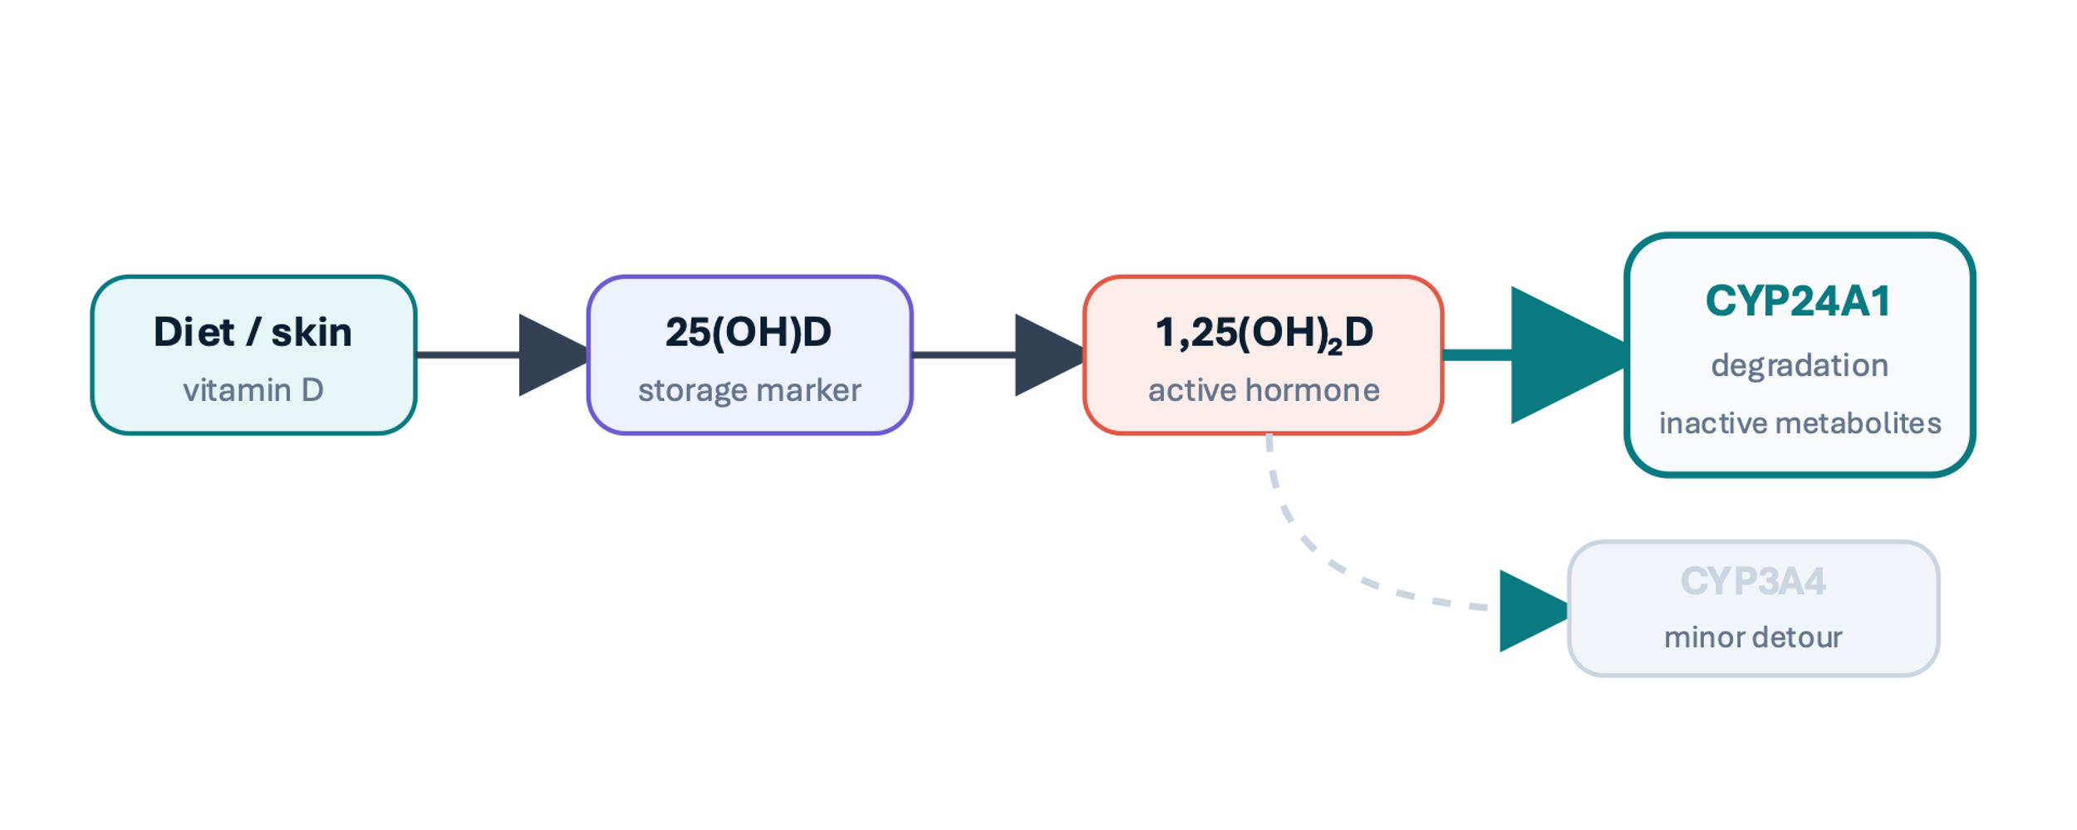
PATHOPHYSIOLOGY
Normal physiology: CYP24A1 is the “brake”
Key idea: CYP24A1 prevents calcitriol excess by degrading active vitamin D metabolites
10/26
Notes:
- Hawkes CP et al. JCEM 2017;102:1440–1446.

Slide 12
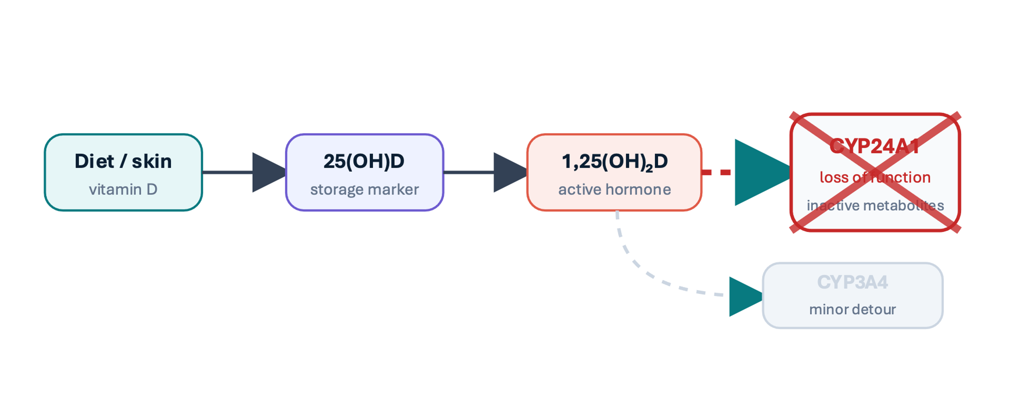
PATHOPHYSIOLOGY
CYP24A1 deficiency: failure of degradation
Reframe the disease
Not simply:
“too much vitamin D”
More precisely:
“failure to clear vitamin D activity”
Consequence
↑ active vitamin D effect → ↑ intestinal calcium absorption → hypercalcemia + hypercalciuria
This wording makes rifampicin understandable.
CYP24A1-related hypercalcemia
11/26

Slide 13
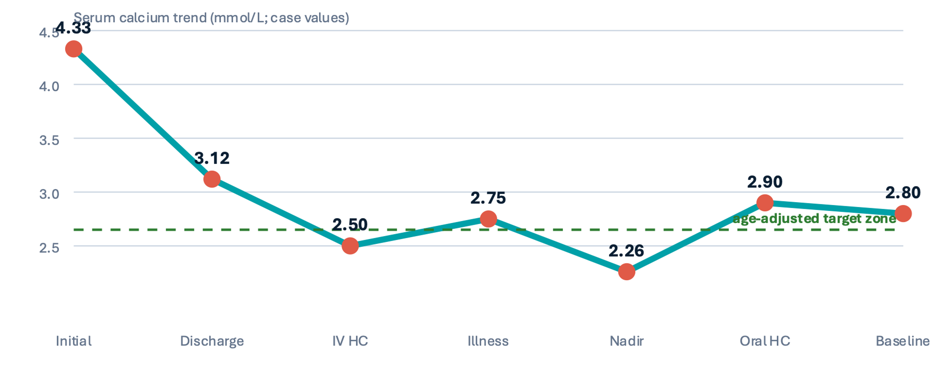
MANAGEMENT COURSE
Treatment chronology: standard measures lowered calcium, but did not control the disease
Supportive
hydration + diet + avoid D
partial
IV HC
during admissions
transient
Oral HC
3-week trial
failed
Renal risk
ongoing nephrocalcinosis
Pattern: acute interventions helped temporarily; outpatient control remained incomplete.
persistent
The question became: what therapy targets the mechanism rather than the crisis?
CYP24A1-related hypercalcemia
13/26

Slide 14
THERAPEUTIC REASONING
Decision battlefield: why rifampicin became reasonable
Option
Why consider it
Why hesitate
Fit here
Steroids
Rapid anti–calcitriol effect in some vitamin D–mediated states
No sustained oral response; growth/adrenal/infection concerns
Low
Azole
Can suppress vitamin D synthesis (reported in CYP24A1 cases)
Hepatic/drug-interaction burden; not a degradation bypass
Selective
Thiazide
Can lower urinary calcium in selected patients
May increase serum calcium; not primary treatment during active hypercalcemia
Caution
Rifampicin
Induces CYP3A4: alternative vitamin D catabolism
Off-label; limited pediatric evidence; interactions/LFTs
Best mechanistic fit
Note: Treatment choices should be individualized with endocrinology, nephrology, gastroenterology, and clinical pharmacology input.
CYP24A1-related hypercalcemia |
14/26
Notes:
- Azole experience in CYP24A1: Sayers J et al. Clin Kidney J. 2015;8:453–455. - Rifampicin mechanism: Hawkes CP et al. JCEM 2017;102:1440–1446.

Slide 15
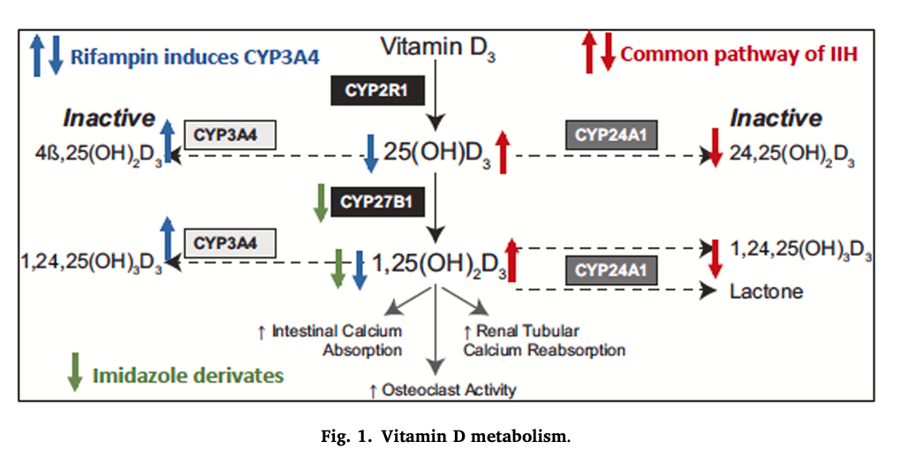
THERAPEUTIC REASONING
Decision battlefield: why rifampicin became reasonable
CYP24A1-related hypercalcemia |
14/26
Notes:
- Azole experience in CYP24A1: Sayers J et al. Clin Kidney J. 2015;8:453–455. - Rifampicin mechanism: Hawkes CP et al. JCEM 2017;102:1440–1446.

Slide 16
LITERATURE
Evidence 1: proof-of-mechanism, not proof-of-guideline
Hawkes et al.
JCEM 2017
What improved?
Serum calcium
normalized / improved
n = 2 case report
PTH
recovered from suppression
Rifampin 10 mg/kg/day
(max 600 mg)
follow-up up to 13 months
Urinary calcium
reduced
Clinical course
rebound after stopping
Safety
no liver/adrenal signal reported
Interpretation: biologically compelling — but still case-report evidence.
CYP24A1-related hypercalcemia
16/26
Notes:
- Hawkes CP et al. CYP3A4 Induction by Rifampin: An Alternative Pathway for Vitamin D Inactivation in Patients With CYP24A1 Mutations. JCEM 2017;102(5):1440–1446.

Slide 17
LITERATURE
Evidence 2: pediatric nuance — response may not mean serum calcium normalization
Lenherr-Taube et al.
2023
Critical takeaways
open-label pilot
1
CYP3A4 induction occurred
rifampicin did what it was expected to do pharmacologically
5 completed patients
HCINF1 control + HCINF3 group
5 → 10 mg/kg/day phases
with washout
1,25(OH)₂D fell
primary biochemical pathway moved
2
Serum calcium response varied
do not promise normalization
3
4
Urinary calcium may improve
especially in HCINF3 at higher dose in the study
This is why your clinical question is excellent: serum calcium and urine calcium may not move together.
CYP24A1-related hypercalcemia
17/26
Notes:
- Lenherr-Taube N et al. Rifampin monotherapy for children with idiopathic infantile hypercalcemia. J Steroid Biochem Mol Biol. 2023;231:106301.

Slide 18
LITERATURE
Evidence 3: durability and rare-disease uncertainty
Long-term signal
Contemporary case context
Brancatella et al. JCEM 2022
NEJM Case Records 2024
•
Single adult HCINF1 case
A 10-month-old boy with vomiting, weight loss, and hypercalcemia highlighted the same diagnostic challenge: severe infant hypercalcemia can require genetic reasoning and rare-disease trial pathways.
•
Rifampin 600 mg/day for 24 months
•
Calcium normalized within 2 months
•
eGFR improved; nephrolithiasis resolved; nephrocalcinosis stable
•
Asthenia, daytime sleepiness, reduced concentration / difficulty focusing
at 15 months; no liver, renal or adrenal impairment identified
Academic conclusion: the evidence supports a monitored trial — not a universal protocol.
CYP24A1-related hypercalcemia
18/26
Notes:
- Brancatella A et al. Long-term efficacy and safety of rifampin in a patient carrying a CYP24A1 loss-of-function variant. JCEM 2022;107(8):e3159–e3166. - Jacobsen CM et al. Case 21-2024: A 10-Month-Old Boy with Vomiting and Hypercalcemia. N Engl J Med. 2024;391(2):167–176.

Slide 19
LITERATURE / TRIALS
Trial landscape: the evidence gap is real
NCT03384121
Pediatric IIH rifampin study
Open-label, escalating-dose design; small sample; washout structure.
NCT03301038
CYP24A1-related hypercalcemia / hypercalciuria
Phase 2 registry activity.
The absence of large completed trials is not a reason to do nothing; it is a reason to be explicit about goals, consent, monitoring, and stopping rules.
ClinicalTrials.gov
CYP24A1-related hypercalcemia
19/26
Notes:
- ClinicalTrials.gov record NCT03384121. - ClinicalTrials.gov record NCT03301038.

Slide 20
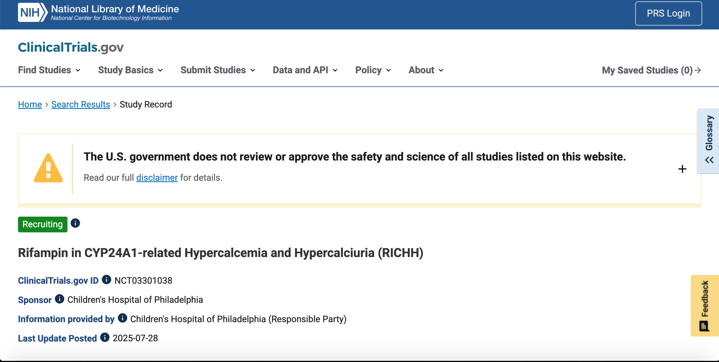
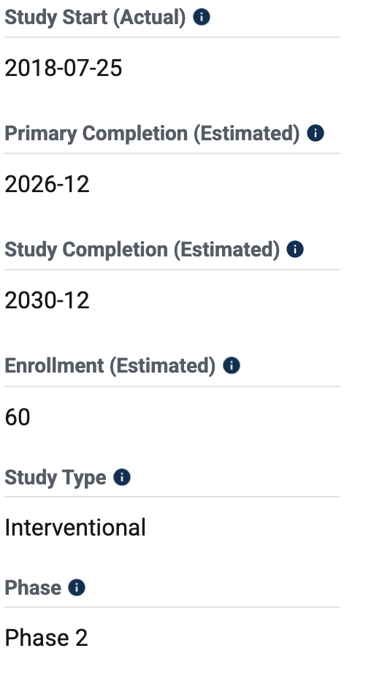
LITERATURE / TRIALS
Trial landscape: the evidence gap is real
NCT03301038
NCT03384121
CYP24A1-related hypercalcemia
19/26
Notes:
- ClinicalTrials.gov record NCT03384121. - ClinicalTrials.gov record NCT03301038.

Slide 21
CLINICAL DECISION
Our MDT decision: a structured off-label trial
Why we proceeded
Conditions for safety
Persistent PTH-independent hypercalcemia
MDT
Endocrinology + Nephrology + GI + Clinical Pharmacology
Hypercalciuria + nephrocalcinosis
Consent
Off-label use, evidence limits, alternatives, risks
Standard measures not sustained
Baseline
Biochemistry + urine + CBC/LFT + medication review
Genotype matches mechanism
Renal-protection rationale
Follow-up
Predefined intervals and stop/hold criteria
Message: off-label does not mean casual.
CYP24A1-related hypercalcemia |
20/26

Slide 22
MONITORING
Monitoring plan: make the trial measurable and safe
Baseline
Early follow-up
Monthly / renal
Hold / stop triggers
Ca/P/Mg/albumin
Serum Ca trend
Urine Ca/Cr response
Significant LFT rise
Creatinine/eGFR
Symptoms / hydration
PTH recovery
Hypersensitivity
PTH
LFT + CBC
Vitamin D metabolites
Severe GI intolerance
25(OH)D + 1,25(OH)₂D
Adherence + interactions
Renal ultrasound trend
Concerning adrenal symptoms
Urine Ca/Cr
BP + growth
Nephrology review
No benefit + ongoing risk
CBC + LFT
Medication interactions
Also monitor: rifampicin drug interactions via CYP induction; orange discoloration counseling; adherence; nutrition/calcium intake.
CYP24A1-related hypercalcemia
21/26
Notes:
- Monitoring domains informed by Hawkes CP et al. JCEM 2017;102:1440–1446 and Brancatella A et al. JCEM 2022;107:e3159–e3166. - Patient monitoring plan from user-provided case deck.

Slide 23
CLINICAL ENDPOINTS
How will we define response?
Serum endpoint
Renal endpoint
Sustained age-adjusted normalization or clinically meaningful reduction without recurrent admissions/rescue therapy.
Fall in urine Ca/Cr and stabilization or improvement of nephrocalcinosis / stone burden.
Important — may be variable
May matter more long-term
Clinical question for this patient:
“Does rifampicin protect the kidney even if serum calcium only partially improves?”
CYP24A1-related hypercalcemia
22/26

Slide 24




FUTURE PLAN
Planned course: treatment → washout → decision
1 Baseline
2 Rifampicin trial
3 Washout
4 Decision
labs + urine + imaging + interaction review
planned 4 months with close monitoring
2 months to test true treatment effect
continuous vs intermittent strategy if response + safety acceptable
Decision inputs: biochemical response • urinary calcium response • renal ultrasound trend • safety • effect on CCLD/hydration burden • family preference
CYP24A1-related hypercalcemia |
23/26

Slide 25
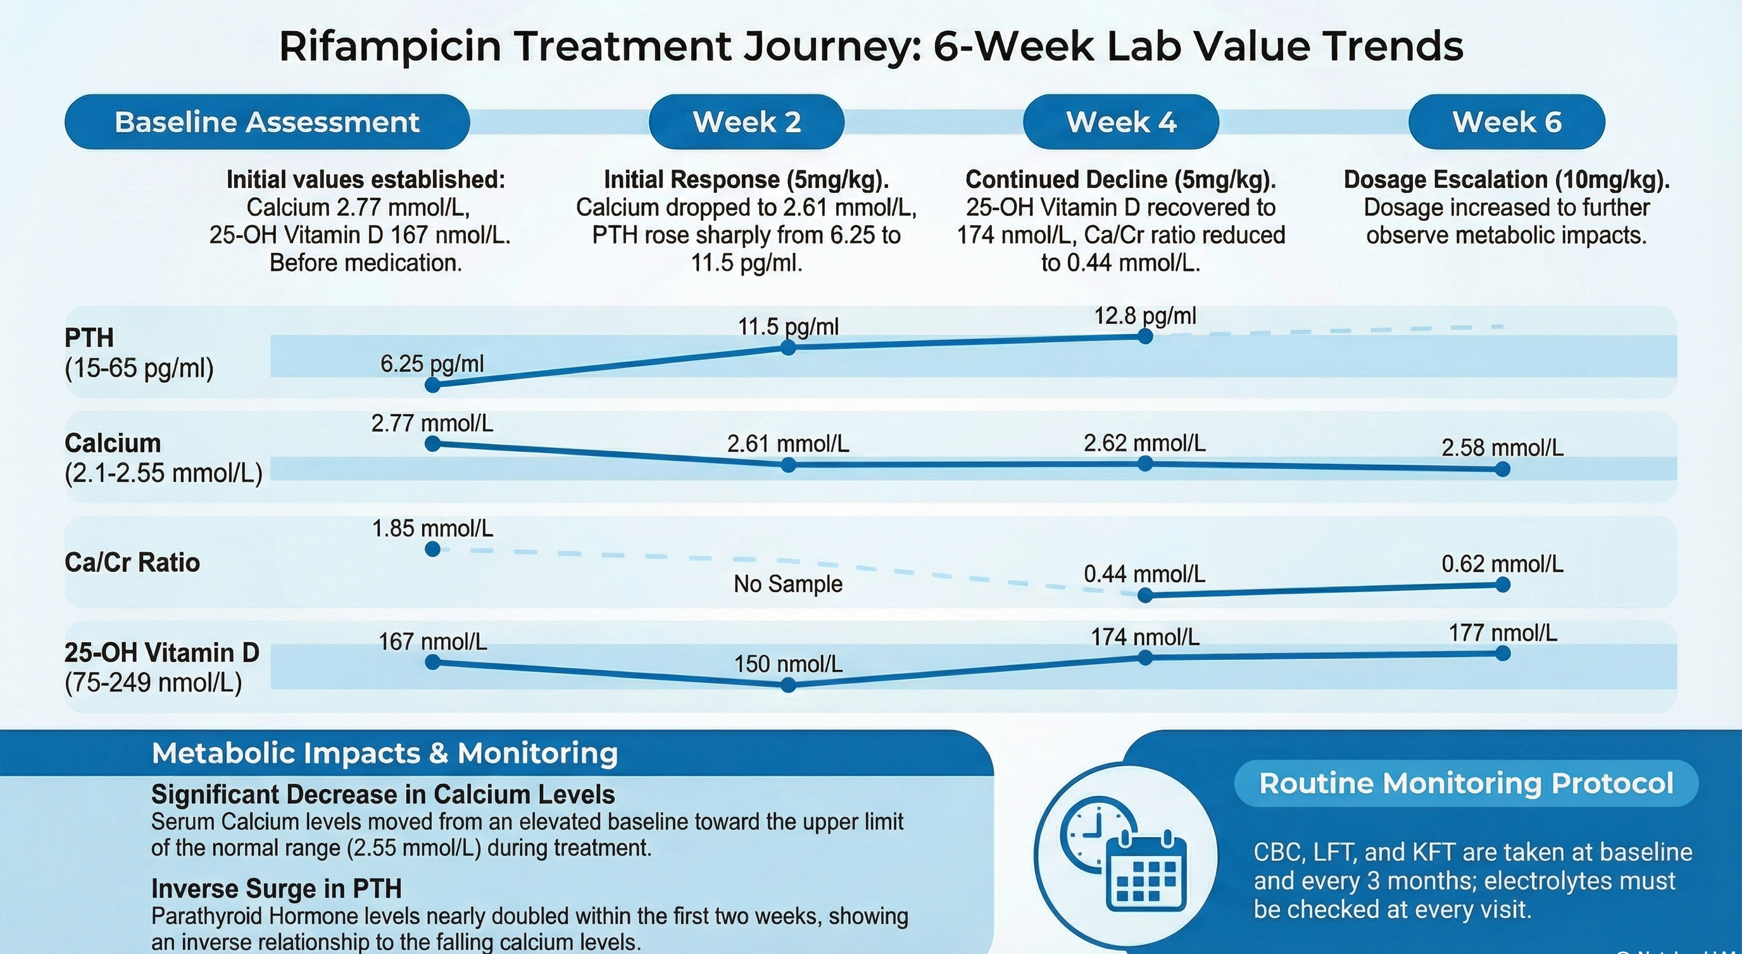

Slide 26
SUMMARY
Four take-home messages
Pattern recognition
Mechanism matters
1
Suppressed PTH + hypercalciuria + nephrocalcinosis should trigger vitamin-D metabolism thinking.
2
CYP24A1 disease is failure of degradation; treatment should match the pathway.
Rifampicin is rational, not proven
Define success before treatment
3
It induces CYP3A4 as an alternative catabolic route; evidence remains small and heterogeneous.
4
For this child, urinary calcium and renal trajectory may be as important as serum calcium.
CYP24A1-related hypercalcemia
24/26

Slide 27

“We are not only lowering calcium.
We are bypassing a broken metabolic pathway —
and protecting the kidney while evidence catches up.”
Thank you
Questions
25/26

Slide 28
BACKUP
Selected references
1.
Hawkes CP, Li D, Hakonarson H, Meyers KE, Thummel KE, Levine MA. CYP3A4 induction by rifampin: an alternative pathway for vitamin D inactivation in patients with CYP24A1 mutations. J Clin Endocrinol Metab. 2017;102(5):1440–1446.
2.
Brancatella A, et al. Long-term efficacy and safety of rifampin in the treatment of a patient carrying a CYP24A1 loss-of-function variant. J Clin Endocrinol Metab. 2022;107(8):e3159–e3166.
3.
Lenherr-Taube N, Furman M, Assor E, Thummel K, Levine MA, Sochett E. Rifampin monotherapy for children with idiopathic infantile hypercalcemia. J Steroid Biochem Mol Biol. 2023;231:106301.
4.
Jacobsen CM, Jüppner HW, Mitchell DM. Case 21-2024: A 10-month-old boy with vomiting and hypercalcemia. N Engl J Med. 2024;391(2):167–176.
5.
Sayers J, Hynes AM, Srivastava S, et al. Successful treatment of hypercalcaemia associated with a CYP24A1 mutation with fluconazole. Clin Kidney J. 2015;8(4):453–455.
6.
ClinicalTrials.gov: NCT03384121 and NCT03301038. Verify current status before live delivery.
7.
User-provided de-identified case presentation deck, April 2026.
Backup / references
26/26

