Slide 1

Case Presentation
Tamam Alshammari
Pediatric Endocrinology Fellow
King Abdullah Specialized Children Hospital (KACSH) MNGHA-Riyadh
Supervisor: Dr. Angham Almutair
Pediatric Endocrine consultant KASCH-MNGHA-Riyadh

Slide 2
History
Late preterm baby girl , born to a mother with GDM.
Shortly after birth, admitted to NICU because she developed persistent neonatal hypoglycemia requiring a high glucose infusion rate reached to 17 mg/kg/min.
She required glucagon support and nasogastric tube feeding due to poor oral intake.
At age 10 days , octreotide therapy was initiated and gradually escalated; however, hypoglycemic episodes persisted.
Notes:
** • “I’d like to present a case of a
One of our consltant he prefered to start octreotide especially if patient had atypical picture and he think its GDM he like to start octreotide
Persistence episode of hypoglycemia glucose, glucagon and octreotide

Slide 3
History
At age 13 days , trial of diazoxide was initiated at 5 mg/kg/day and increased to 8 mg/kg/day, resulting in resolution of hypoglycemia. However, therapy was discontinued prior to discharge because of hyperglycemia, and she was discharged on 4-hourly feedings .
She passed up to 6 hrs prolong fasting
Notes:
Parents insisted on discharge , despite medical advice to continue inpatient observation;

Slide 4
History
Family history:
- Parents are non‑consanguineous but from the same tribe.
- Mother, 40 years old, with a history of gestational diabetes mellitus.
- Father, 46 years old, healthy.
- The patient has nine siblings, all healthy.
- No family history of unexplained infant deaths or recurrent hypoglycemia.

Slide 5
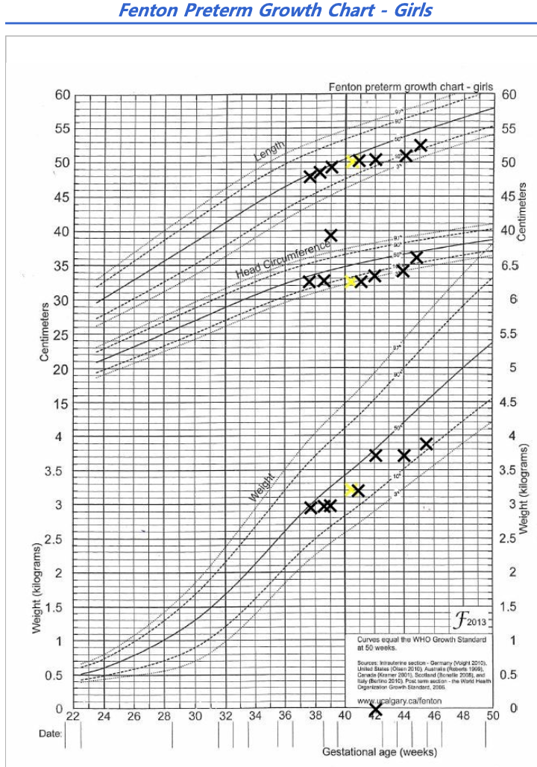
Physical Examination
Growth parameter :
Ht: 48cm
Wt: 2.90 kg
Head: 32.50 cm

Slide 6
Physical Examination
Head and Neck: Micrognathia, sparse lateral eyebrows, broad and depressed tip of nose and a high-arched palate.
Cardiovascular: Hemodynamically stable with warm extremities and good peripheral perfusion. Normal first and second heart sounds (S1 and S2).
Gastrointestinal: Abdomen soft and lax with no organomegaly.
Genitourinary: Normal female genitalia.
Musculoskeletal: No skeletal deformities or joint hyperlaxity.
Neurological: Mild hypotonia with partial head lag.

Slide 7
Case summary :
Infants of diabetic mother (IDM) with CHI , diazoxide responsiveness 5mg/kg/day
The clinical picture is subtle dysmorphic features
IDM vs CHI
Notes:
infants of gestational diabetic mothers (IGDM)
This is a late-preterm female infant born to a mother with GDM.”
• “Soon after birth, she developed persistent hypoglycemia requiring NICU admission.”
• “Her glucose infusion rate increased to 17 mg/kg/min, which suggests marked hyperinsulinism.”
• “She required glucagon support and nasogastric feeds because of poor oral intake.”
• “Octreotide was started on day 10 and escalated gradually, but hypoglycemia persisted.”
At age 13 days , trial of diazoxide was initiated at 5 mg/kg/day and increased to 8 mg/kg/day, resulting in resolution of hypoglycemia
• “On examination, there were subtle dysmorphic features.”
• “So the key question in this case was whether this represented transient hyperinsulinism related to maternal diabetes or congenital hyperinsulinism.”

Slide 8


IDM vs CHI
Findinges | IDM | CHI
Hx of GDM
Normal Birth weight
Subtle dysmorphic features
Hypoglycemia while on glucose, glucagon and octreotide
Diazoxide responsive
Notes:
Hx of GDM
Weight
Examination
Diazo
Glucose

Slide 9
Hypoglycemia.
" Critical sample" Bicarbonate, Lactate, Ketones (BOHB), and Free Fatty Acids (FFA)
↓ BOHB
↑ FFA
↓ BOHB
↓ FFA
Fatty Acid Oxidation Defect
Hypo-Ketotic hypoglycemia
↑ BOHB
Ketotic Hypoglycemia
↑ Lactate
Gluconeogenesis Defects
Acidemia HCO3 < 16–18 mmol/L
No Acidemia
HCO3 > 18-16mmol/L
Notes:
This flowchart outlines the diagnostic approach to Hypoglycemia using a 'critical sample.’
When a patient presents with low blood glucose, it is vital to draw labs—specifically Bicarbonate, Lactate, Ketones (BOHB), and Free Fatty Acids (FFA)—at the time of the event to differentiate between metabolic causes
The first step in our assessment is looking at the Bicarbonate level to check for Acidemia
If the HCO_3 is low (less than 16–18 mmol/L), we have an acidotic state. We then look at whether this is driven by ketones or lactate."
• High BOHB (Ketotic Hypoglycemia): "If ketones are elevated, we consider normal physiological responses, growth hormone or cortisol deficiencies, or Glycogen Storage Diseases (GSD)."
• High Lactate: "If lactate is the primary driver, this points toward Gluconeogenesis Defects, such as G-6-Pase deficiency or issues with ethanol and neonatal metabolism.”
Second Branch: No Acidemia
"Conversely, if there is No Acidemia (HCO_3 > 18), we look at the relationship between Ketones (BOHB) and Free Fatty Acids (FFA)."
• High FFA / Low BOHB: "If the FFAs are high but ketones are low, this is a classic indicator of Fatty Acid Oxidation Defects. The body is mobilizing fat but cannot convert it into ketones."
• Low FFA / Low BOHB (Hypo-Ketotic): "If both are low, we are likely looking at. High insulin suppresses both glucose production and the breakdown of fats, commonly seen in conditions like AKT2 or PI3K mutations."Hyperinsulinism

Slide 10
Investigations
Age in days | 3 | 56 | 80
Serum glucose(mmol/L) | 2.6 | 2.4 | 2.5
Insulin (Pmol/L) | 338.86 | 19.96 | 43.51
Urine ketones | Negative
C- peptid | 0.50 |  | 1.82
Notes:
These levels of insulin are inappropriately high given the low blood sugar.
This indicates Hyperinsulinism—the pancreas is secreting insulin when it shouldn't be.
Negative urine ketone , This is a hallmark of hyperinsulinism.
High insulin prevents the breakdown of fats into ketones.
presence of C-peptide (1.82 and 0.50) confirms that the insulin is "endogenous"

Slide 11
Investigations
Echo :
- Tiny PFO with mild dialted and hypertrophied LV
Hearing assessment:
- Pass

Slide 12
Genetic test result
Gene | NM Number | Nucleotide alterations | Amino acid changes | Zygosity
KDM6A | NM_001291415.1 | c.564+1delG | P.(?) | Heterozygous
A novel splice-site variant (c.564+1delG) in KDM6A causing Kabuki syndrome type 2 presenting with CHI responsive
Notes:
She was readmitted shortly thereafter due to poor oral intake and recurrent hypoglycemia at home, triggered by RSV bronchiolitis.
Management focused primarily on optimizing nutritional intake.
At 3 months of age, whole-exome sequencing (WES) identified a novel pathogenic variant in KDM6A (c.564+1delG), confirming KS type 2.
Diazoxide was reinitiated at 3 mg/kg/day, resulting in complete resolution of hypoglycemic episodes with good tolerance.
She is currently 11 months old and remains euglycemic on diazoxide 2 mg/kg/day with 4-hourly feedings.

Slide 13
Diagnostic Challenges
Maternal history of GDM , initially suggesting transient neonatal hypoglycemia rather than a congenital or syndromic cause.
Persistent hypoglycemia despite appropriate management and lack of response to octreotide, raising suspicion for congenital hyperinsulinism.
KS-related HI may not be detected on routine HI gene panels and therefore requires a high index of suspicion and consideration of broader genetic testing such as WES when initial gene panel testing is unrevealing.

Slide 14
Kabuki Syndrome Type 2
Kabuki syndrome (KS) is a multisystem genetic disorder characterized by distinctive facial features, intellectual disability, and various systemic manifestations, including abnormalities in glucose metabolism.
Hyperinsulinaemism (HI) associated with Kabuki syndrome is a rare but increasingly recognized cause of persistent neonatal hypoglycemia, reported in approximately 0.3–4% of affected individuals, clinical features evolve with time
Around 30 cases with KS has been associates with HI has been described, nearly half related to pathogenic variants in KDM6A.
“In the Männistö et al. 2025 JCEM study of three probands with KDM6A duplications

Slide 15
Kabuki Syndrome Type 2
Most reported cases are diazoxide responsive, typically at doses ranging from 7–15 mg/kg/day.
“In the Männistö et al. 2025 JCEM study of three probands with KDM6A duplications

Slide 16
CHI IN KS
She is currently 11 months old and remains euglycemic on diazoxide 2 mg/kg/day
On frequent feeding Q4 hours
No fasting test done

Slide 17
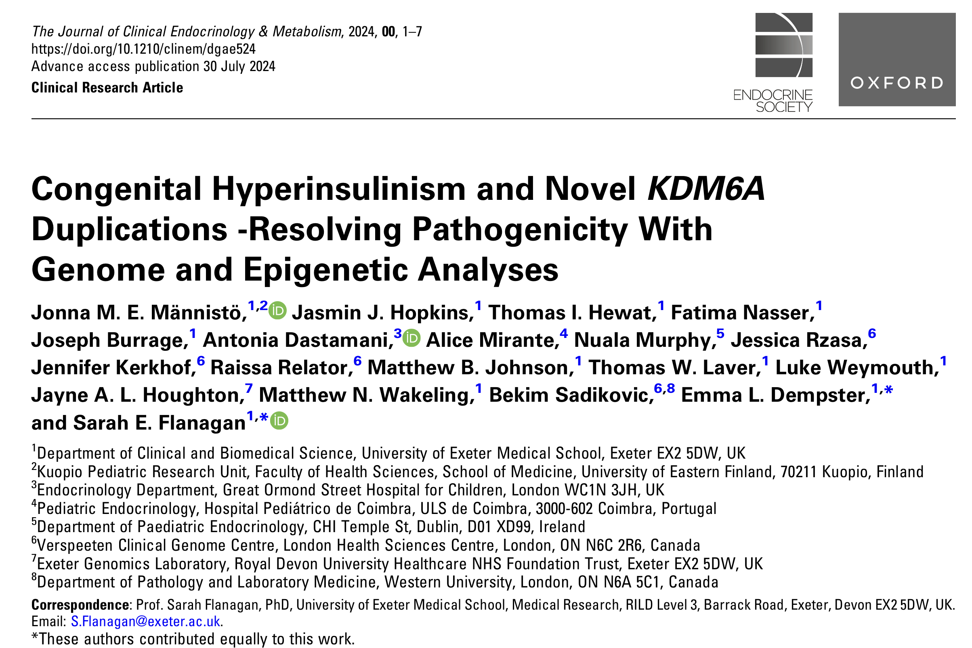
Notes:
In 2024 study published in The Journal of Clinical Endocrinology & Metabolism by Männistö and colleagues.
مَانِّيستو

Slide 18
Genomic data from the 3 individuals with partial duplications of the KDM6A gene along with variant interpretation and Diazoxide responsive
Feature | Proband 1 | Proband 2 | Proband 3
Gene variant | Hemizygous duplication of exons 3-26 of KDM6A. | Heterozygous duplication of exons 3-6 of KDM6A | Duplication of exons 2-29 of KDM6A
Diazoxide exposure over time | Treated with diazoxide and still on therapy at latest follow‑up (5 mg/kg/day) | Diazoxide about 5 mg/kg/day, stopped at age 3.4 years | Diazoxide about 4 mg/kg/day, stopped at age 2 years
Current treatment for hyperinsulinism | Diazoxide 5 mg/kg/day (ongoing) | None | None
“In the Männistö et al. 2025 JCEM study of three probands with KDM6A duplications
Notes:
They referred 3individuals identified with KDM6A duplications. to the Exeter Genomics Laboratory for routine genetic testing for HI
this table highlights their specific genetic variants and their response,and duration of Diazoxide
We are adding one more case of Kabuki syndrome to literature with hyperinsulinemia , a novel splice-site variant (c.564+1delG) in KDM6A causing Kabuki syndrome type 2 associated with CHI responsive to low-dose diazoxide.
Proband 1 : male proband was born at 40 weeks gestation weighing
There was a history of diet-controlled gestational diabetes, fetal distress
HI was diagnosed on the first day of life and showed a rapid response to diazoxide treatment.
The patient was referred for routine screening of the known HI genes at the age of 2 weeks, which identified a hemizygous duplication of exons 3-26 of KDM6A.
At the age of 4.5 years, the HI was being treated successfully with 5 mg/kg/day of diazoxide.
Proband 2: female was born at 39 weeks gestation weighing 3225 g (−0.23 SDS
On the first day of life, she presented with HI, which responded to diazoxide (4.7 mg/kg/d).
At the age of 6 months, genetic testing for HI was undertaken, which identified a heterozygous duplication of exons 3-6 of KDM6A.
At 3 years 5 months of age, diazoxide was successfully discontinued.
Proband 3: The female proband was born at 41 weeks gestation weighing 2600 g (−2.36 SDS)
Hypoglycemic episodes were observed at that time and initially considered as sepsis-related. At the age of 6 weeks, biochemistry suggested HI.
Diazoxide treatment was started (4 mg/kg/day)
patient was referred for genetic testingof the known HI genes, which identified a duplication of exons 2-29 of KDM6A, which was confirmed as de novo

Slide 19
Conclusion
This case emphasizes the importance of considering syndromic causes when routine HI panels are negative and supports early use of comprehensive genetic testing to enable timely diagnosis and management.
CHI can be a presenting feature of a syndrome, although some feautres evolve with time , a detailed throu clinical exam is crucial
Early recognition is essential to prevent neurodevelopmental injury, particularly in a condition already associated with developmental delay.

Slide 20
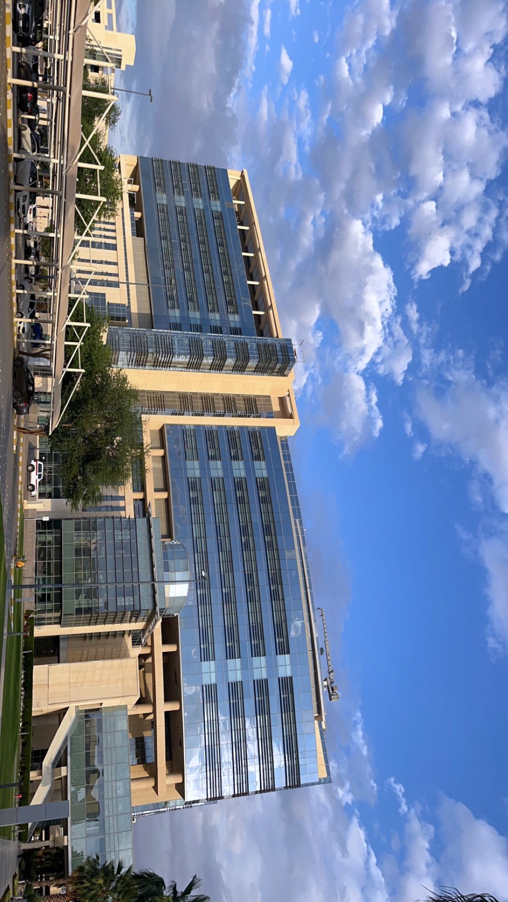
Thank you
Any Question ?

