Slide 1

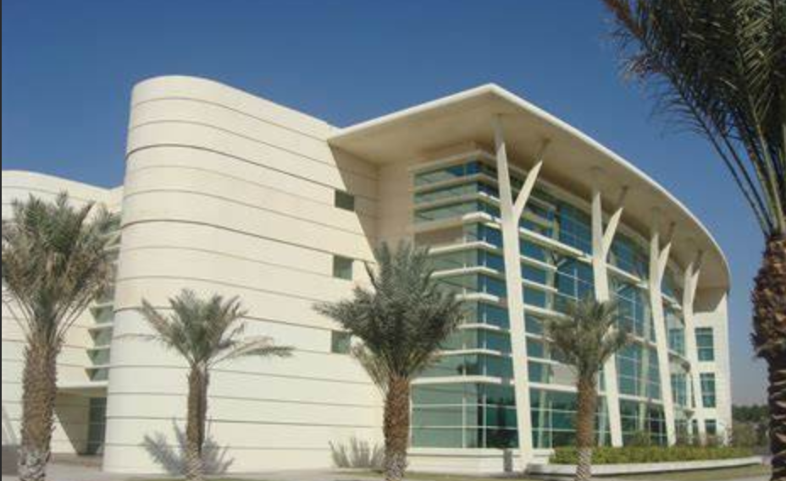

Overview Hypophosphatasia
Afaf AlSagheir , MD
Professor of Pediatric AlFaisal medical school
Consultant pediatric endocrinologist at KFSHRC-Riyadh

Slide 2


Disclosure
AstraZeneca
Disclaimer
AstraZeneca abides by the IFPMA Code of Pharmaceutical Marketing Practices, the Middle East & Africa LAWG Code of Practices and AstraZeneca Global Policies, and as such will not engage in the promotion of unregistered products or unapproved indications
Presentations are intended for educational purposes only and do not replace independent professional judgment. Statements of fact and opinions expressed are those of the speakers individually and, unless expressly stated to the contrary, are not the opinion or position of AstraZeneca. AstraZeneca does not endorse or approve, and assumes no responsibility for, the content, accuracy or completeness of the information presented
Please refer to the appropriate approved Product Information before prescribing any agents mentioned in this presentation

Slide 3
KSA AE/Med Info Disclaimer
Saudi Arabia
Al Nalkhlah Tower, 13th Floor, 7198 Prince Mohammed Ibn Salman Ibn Abdulaziz Road, Al Sahafa District, Unit No. 20, Riyadh 13315 - 3642, Kingdom of Saudi Arabia
For Reporting Adverse Events and/or Product Quality Complains:
Website: https://contactazmedical.astrazeneca.com
E-mail: Ksa.ae@astrazeneca.com
Call ASTRAZENECA (U.K.) LTD. CO. land line: +966 (11) 2249235
For Medical Information Enquires :
Website: https://contactazmedical.astrazeneca.com
E-mail: medinfo-ksa@astrazeneca.com
Call AstraZeneca (U.K.) LTD. CO land line : +966 (11) 2249235

Slide 4
Hypophosphatasia – caused by mutations in ALPL gene
HPP is a rare, inherited, metabolic disorder caused by deficiency in the ALPL gene^{1,2}
Loss-of-function mutations in ALPL cause the deficiency of tissue-nonspecific ALP activity which leads to the extracellular accumulation of its substrates¹
Products of ALP enzymatic activity^{1,3}
Key substrates³
Inorganic pyrophosphate (PPi)
Pyridoxal 5′-phosphate (PLP)
Phosphoethanolamine (PEA)
Inorganic phosphate (Pi)
Pyridoxal (PL)
ALP^{4,5}
In HPP, low serum ALP activity results in accumulation of
PPi^{1,4,a}
PLP (vitamin B6)^{1,3,4}
PEA⁵
Cell membrane
Figure used from (Millán JL, Whyte MP. Alkaline Phosphatase and Hypophosphatasia. Calcif Tissue Int. 2016;98(4):398–416^{)6.} Published by Springer Nature under CC BY 2.0 License.
ªPhosphate and calcium may be elevated or remain within normal limits. ALP, alkaline phosphatase; ALPL, alkaline phosphatase gene liver/bone/kidney; HPP, hypophosphatasia
1. Rockman-Greenberg C. Pediatr Endocrinol Rev 2013;10(suppl 2):380–88; 2. Whyte MP. In: Thakker et al, eds. Genetics of Bone Biology and Skeletal Disease 2013:337–60; 3. Mornet E. Best Pract Res Clin Rheumatol 2008;22:113–27; 4. Millán JL et al. J Bone Miner Res 2008;23:777–87; 5. Whyte MP. Endocr Rev 1994;15:439–61; 6. Millán JL, Whyte MP. Calcif Tissue Int 2016;98(4):398–416
Notes:
Review slide as stated.

Slide 5


Inheritance of HPP
The ALP gene, ALPL, is located on the short arm of chromosome 1 (1p36.1-34) and is ~50 kb in length, consisting of 12 exons^{1,2}
HPP is caused by loss-of-function mutations in the ALPL gene, leading to persistently low serum ALP activity³
HPP can be inherited through either autosomal dominant or recessive modes³
Autosomal Recessive Inheritance Pattern⁴
Autosomal Dominant Inheritance Pattern⁴
Father is a carrier (no condition)
Mother is a carrier (no condition)
Functional gene
Father has the condition
Mother does not have the condition
Non-functional gene
Child does not have condition and not a carrier
Children do not have condition but are carriers
Child has condition
Children do not have the condition
Children have the condition
75% of children do not have the condition
25% have the condition
50% of children do not have the condition
50% of children have the condition
Figure adapted from (Hypophosphatasia. Health Jade. Available from: https://healthjade.net/hypophosphatasia/#google_vignette [Accessed on April 18, 2024]).
ALP, alkaline phosphatase; ALPL, alkaline phosphatase gene liver/bone/kidney; HPP, hypophosphatasia
1. Rockman-Greenberg C et al. Am J Hum Genet 1990;46:286–292; 2. Mornet E. Best Pract Res Clin Rheumatol 2008;22:113-127; 3. Mornet E. Arch Pediatr 2017;24:5S51–S5; 4. Hypophosphatasia. Health Jade. Available from: https://healthjade.net/hypophosphatasia/#google_vignette (Accessed on April 18, 2024)
Notes:
Review slide as stated.

Slide 6
Low serum ALP activity leads to a range of skeletal and nonskeletal clinical manifestations
Low serum ALP activity
Low serum ALP activity allows its substrates to accumulate¹
PPi
PLP
PEA
PPi is a potent inhibitor of bone mineralization. It has the potential to impair calcium/phosphate homeostasis, resulting in bone hypomineralization and other systemic consequences^{2,3}
Low serum ALP activity results in impaired PLP dephosphorylation and PL transport across the blood-brain barrier. This in turn leads to a deficiency of vitamin B6 in the CNS resulting in vitamin B6-responsive seizures and impaired neurotransmitter synthesis^{1,2}
PEA is a diagnostic marker for HPP, but its relation to disease pathophysiology is not fully understood³
Dental
Skeletal
Muscular/ rheumatologic
Respiratory
Renal
Neurologic
Figure created by/for Alexion Pharmaceuticals, Inc. for illustrative purposes only.
Deficient ALP activity leads to accumulation of key substrates (PPi, PLP, PEA) resulting in an array of clinical manifestations involving multiple organ systems.¹
ALP, alkaline phosphatase; CNS, central nervous system; HPP, hypophosphatasia; PEA, phosphoethanolamine; PL, pyridoxal; PLP, pyridoxal 5’-phosphate; PPi, inorganic pyrophosphate
1. Khan AA et al. Osteoporosis Int 2024;35:431–8; 2. Rockman-Greenberg C. Pediatr Endocrinol Rev 2013;10(suppl 2):S380–8; 3. Linglart A, Biosse-Duplan M. Curr Osteoporos Rep 2016;14:95–105
Notes:
Review slide as stated.

Slide 7
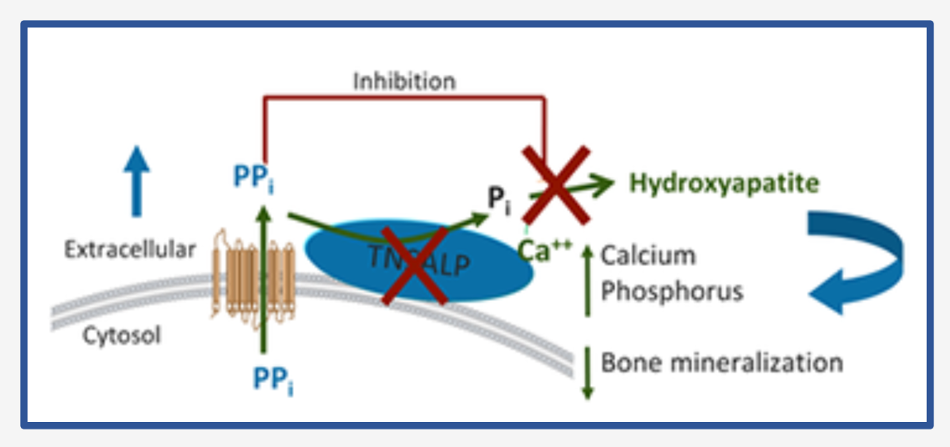
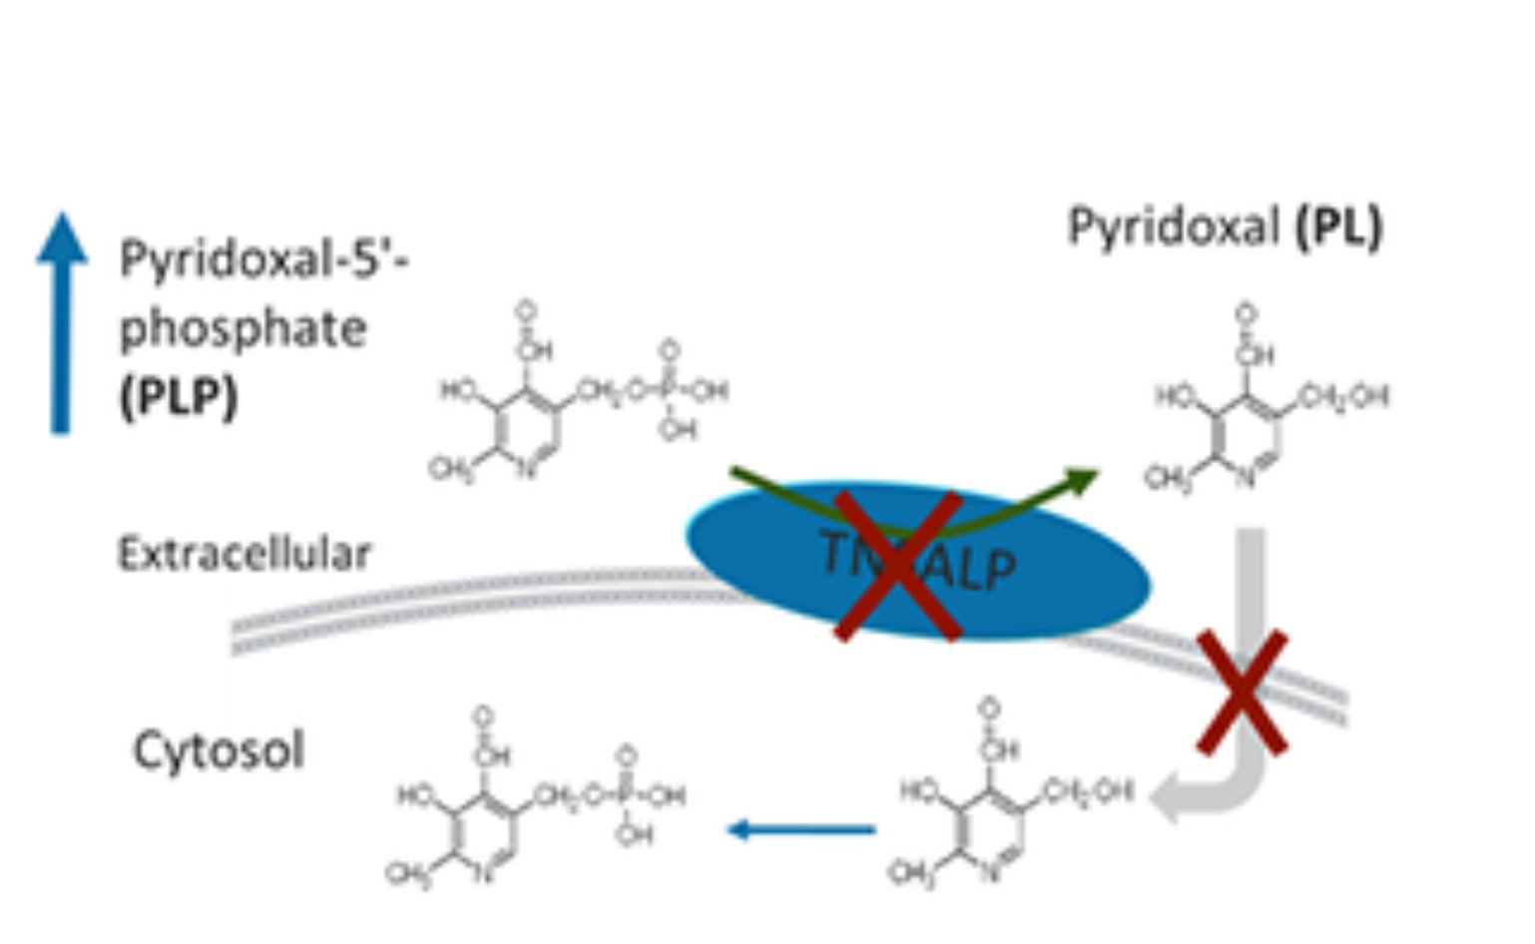
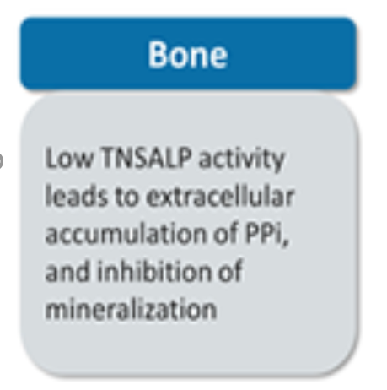
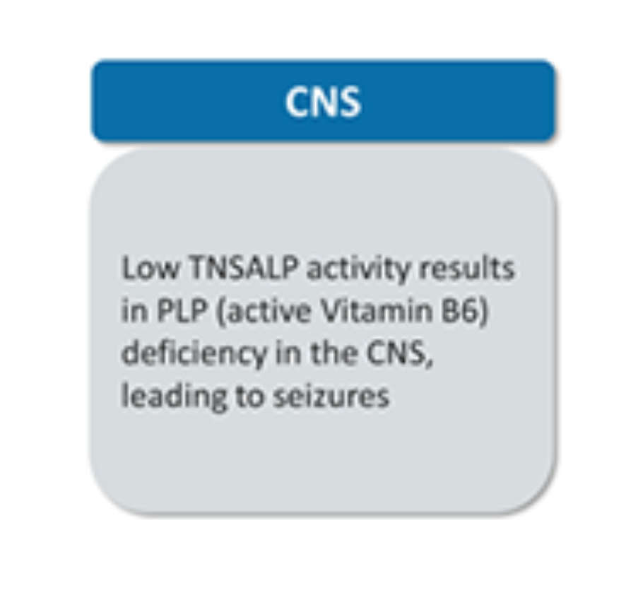
Mechanism of Hypophosphatasia (HPP) HPP Pathophysiology

Slide 8
Features of HPP
Clinical symptoms vary with age and severity, and the disease is usually classified into 5 clinical disease forms :
Perinatal severe [lethal]
Infantile HPP
Childhood HPP Severity
Adult HPP
Odontohypophosphatasia

Slide 9
HPP manifestations among infants
Hallmarks of HPPª in infants include the following¹⁻³:
Bone deformity (including rachitic-like chest deformity)
Rickets
Failure to thrive
Vitamin B6–responsive seizures
Hypercalcemia
Craniosynostosis
Respiratory failure
Pain
Vitamin B6–responsive seizures may be the first symptom in infants and are predictive of a poor prognosis.^{4,5}
Premature fusion of cranial sutures often causes craniosynostosis and subsequent increase in intracranial pressure.⁷
Respiratory failure requiring ventilatory support manifests only in infants (perinatal lethal).⁶
Although rickets is a hallmark of HPP in infants and children, it is not always detectable.¹
Skeletal, neurological and respiratory complications are the most common manifestations among infants with HPP.¹
ªThe list is not exhaustive.
HPP, hypophosphatasia
1. Martos-Moreno GÁ et al. Horm Res Paediatr 2023;97(3):233–42; 2. Szabo SM et al. Orphanet J Rare Dis 2019;14(1):85; 3. Vogt M et al. Orphanet J Rare Dis 2020;15(1):212; 4. Whyte MP et al. J Pediatr 2019;209:116–24; 5. Baumgartner-Sigl S et al. Bone 2007;40(6):1655–61; 6. Salles JP. Clin Biochem Rev 2020;41(1):13–27; 7. Collmann H et al. Childs Nerv Syst 2009;25(2):217–23
Notes:
Review slide as stated.

Slide 10
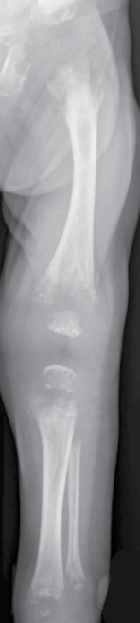
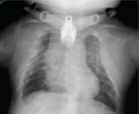
Radiographic features of HPP: Infants <6 months of age
Skeletal characteristics evaluated in infants at baseline^{1,2}
Metaphyseal flaring
and fraying
Thin ribs
Chest deformity
Physeal widening
Irregularity of the provisional zone of calcification
Radiolucencies
Gracile bones
2 months old
6 months old
These radiographs are from 2 different patients with HPP
Images used from (Whyte MP et al. J Bone Miner Res 2018;33:868–74). With permission from Oxford University Press.
Skeletal deformities in the chest and limbs due to hypomineralization are the characteristic symptoms of HPP in infants¹
HPP, hypophosphatasia
1. Whyte MP et al. J Bone Miner Res 2018;33:868–74; 2. Whyte MP et al. N Engl J Med (Supplementary material) 2012;366:904–13
Notes:
Review slide as stated.

Slide 11
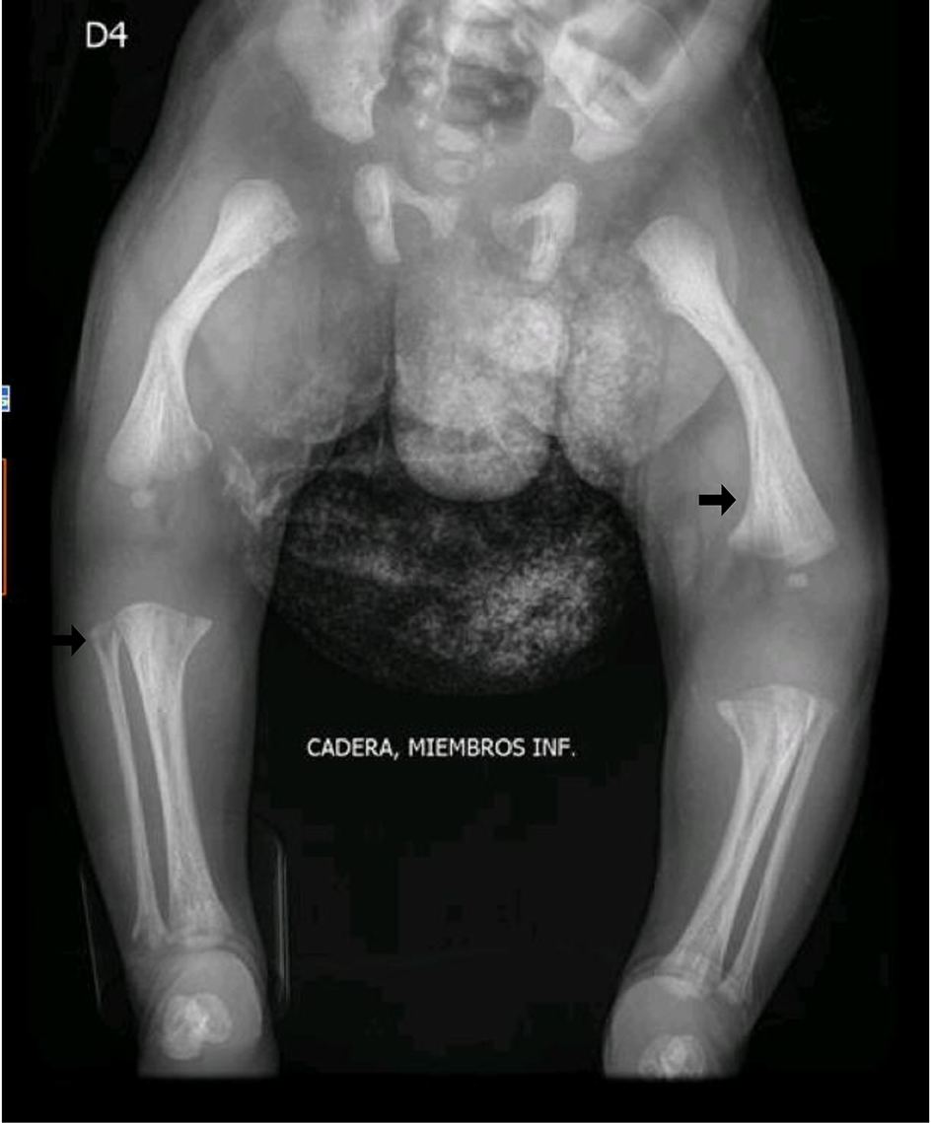
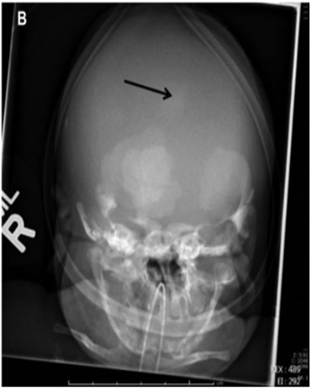
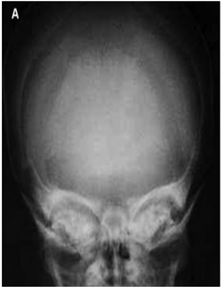
Skeletal manifestations of HPP in infants
Patient 1 (26-month-old)
Patient 2 (At birth: 36 weeks gestation)
Patient 3 (At birth: 32 weeks gestation) and normal newborn
Tulip-shaped radiolucencies¹
Hypomineralized bone²
Anteroposterior plain skull radiograph
Normal newborn skull radiograph
Posteroanterior left wrist radiograph. A central metaphyseal lucency (arrows) is in the distal metaphyseal radius and ulna. The carpus, metacarpus and phalanges are spared¹
Posteroanterior left knee radiograph. A central metaphyseal lucency (arrows) is present in the distal metaphyseal femur. The epiphysis of both the distal femur and proximal tibia is heterogeneous (asterisks)¹
Alteration in the morphology of femurs with angulation of the diaphysis, mineralization defects in the bilateral metaphyses of the femurs, tibia and fibula; alteration in the density and morphology of the long bones of the lower limbs (arrows)²
Generalized poor ossification of skull noted in infant with hypophosphatasia (black arrow)³
Images of patient 1 used from (Mannes I, et al. Pediatr Radiol. 2022;52(5):998–06). With permission from Springer Nature.
Image of patient 2 used from (Zarante AM et al. J Endocrinol Metab. 2021;11(2):56-64). With permission from Elmer Press Inc.
Images of patients 3 and 4 used from (Sankaran D, et al. AJP Rep. 2020;10(2):e139-e147). With permission from Thieme Medical Publishers.
Bone hypomineralization often leads to alteration of bone morphology, bone density, and poor ossifiction.^{2,3}
HPP, hypophosphatasia
1. Mannes I, et al. Pediatr Radiol 2022;52(5):998–06; 2. Zarante AM et al. J Endocrinol Metab 2021;11(2):56-64; 3. Sankaran D, et al. AJP Rep. 2020;10(2):e139-e147
Notes:
Review slide as stated.

Slide 12
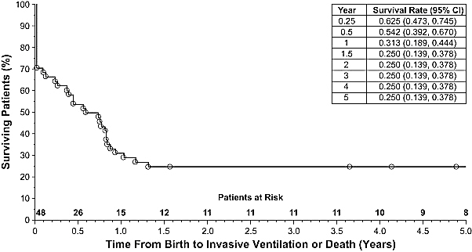
Patients with perinatal and infantile HPP have reduced survival ratesª
Median Invasive Ventilation-Free Survival Time was 7.8 months (95% CI 2.6-9.9) (n=48)¹
Respiratory failure is the most common cause of death in infants and neonates with HPP^{2,3}
Vitamin B6–responsive seizures are a fatal prognostic indicator in neonates and infants with HPP¹⁻³
Figure adapted from Whyte MP et al. J Pediatr. 2019;209:116–24.e4. With permission from Elsevier.
ªBased on a multinational, noninterventional, retrospective chart review of the natural history of perinatal and infantile HPP concerning clinical characteristics such as signs, symptoms, and complications; medical history and routine clinical laboratory values and ALPL mutations (n=48).¹
ALPL, alkaline phosphatase gene liver/bone/kidney; HPP, hypophosphatasia
1. Whyte MP et al. J Pediatr 2019;209:116–24.e4; 2. Rockman-Greenberg. Pediatr Endocrinol Rev 2013;10(suppl 2):380–8; 3. Baumgartner-Sigl S, Haberlandt E et al. Bone 2007;40:1655-61
Notes:
Review slide as stated.

Slide 13
Disease burden among children
Among children (n=59) who completed the HIPS and the HOST survey instruments, frequently reported clinical manifestations included^{1,a}
Among children (n=197) in the Global HPP Registry^{2,c}
86%
71%
Dental and skeletal
Pain
Pain
Muscle weakness
Constitutional/
metabolic
Neurologic
64%
59%
Muscular
Renal manifestations
Difficulty gaining weight
Delayed walking
Fracture was reported by 36% (21) of HIPS/HOST respondents; multiple fractures (2 or more fractures) were also reported (15% of patients).^{b}
The above symptoms were present in ≥20% of patients, indicating that manifestations of HPP extend beyond the skeletal system in these patients.
≥1 skeletal HPP manifestation was observed in 79% patients with bowing of long bones of the legs and rickets being most common.
36% of pediatric patients in this analysis required medications for bone pain.
ªBased on a cross-sectional survey-based study of 59 pediatric patients (<18 years) with HPP between September 2009 and June 2011. ^{b}15% of patients reported two or more fractures. ^{c}Based on the study involving 197 children from the Global HPP registry which is an observational, prospective, multinational study of patients with HPP.²
HIPS, Hypophosphatasia Impact Patient Survey; HOST, Hypophosphatasia Outcomes Study Telephone interview; HPP, hypophosphatasia
1. Rush ET et al. Orphanet J Rare Dis 2019;14(1):201; 2. Högler W et al. Endocr Connect 2023;12(5):e220240
Notes:
Review slide as stated.

Slide 14
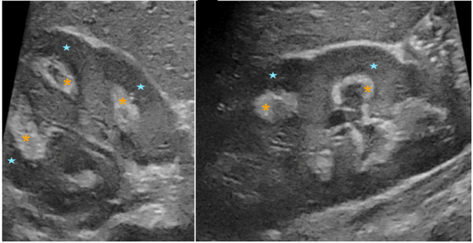
Renal complications result from impaired calcium and phosphate homeostasis
Nephrocalcinosis in a 3-year-old girl with HPP³
Accumulation of serum calcium can overload the renal resorptive mechanisms, resulting in calcium deposition in the kidneys¹
Hypercalcemia is relatively common in infantile HPP but is less common in childhood and adult forms of HPP²
Hypercalcemia is associated with¹:
Nephrocalcinosis
Apnea
Anorexia
Vomiting
Polydipsia
Polyuria
Dehydration
Constipation
Hypotonia
Transverse ultrasound view of the right kidney with a linear probe
Longitudinal ultrasound view of the right kidney with a linear prob
Diffused increased echogenicity of the renal medulla (orange-colored asterisks) was noted, compared to the cortex (blue-colored stars).³
Images of patient 1 used from (Mannes I, et al. Pediatr Radiol. 2022;52(5):998–06). With permission from Springer Nature.
Hypercalcemia leads to a number of renal complications including nephrocalcinosis which can result in kidney failure.¹
In a chart review of patients ≤5 years of age with HPP, 52% (16/31) of patients had nephrocalcinosis^{4,a}
ªData from a noninterventional, retrospective chart review study designed to understand the natural history of 48 patients with perinatal- and infantile-onset HPP ≤5 years of age.⁴
HPP, hypophosphatasia
1. Rockman-Greenberg C. Pediatr Endocrinol Rev 2013;10(suppl 2):380–88; 2. Ramage IJ et al. J Clin Pathol 1996;49:682–4; 3. Mannes I, et al. Pediatr Radiol 2022;52(5):998–06; 4. Whyte MP et al. J Pediatr 2019;209:116–24
Notes:
Review slide as stated.

Slide 15
Diagnosis of HPP in children and adolescents
Diagnosis may be relatively straightforward when:
Clinical, laboratory, or radiologic signs and symptoms of HPP are present^{1,2}
Serum laboratory tests show persistently low levels of serum ALP activity adjusted for age- and sex-matched controls, accompanied by:²
Frequently low levels of 25-hydroxy vitamin D3³
Frequently elevated calcium and phosphate¹
Normal or reduced PTH levels¹
25-hydroxy vitamin D3 | Calcium | ALP | Phosphate | PTH
Normal or low <30 ng/mL³ | ¹ | ⇩ ^{1,2} | ¹ | Normal^{1,a}
However, the diagnosis is often not so simple¹
ªAlthough PTH may be low in patients with hypercalcemia.
ALP, alkaline phosphatase; HPP, hypophosphatasia; PTH, parathyroid hormone
1. Rockman-Greenberg C. Pediatr Endocrinol Rev. 2013;10(suppl 2):380–8; 2. Whyte MP. Nat Rev Endocrinol. 2016;12:233–46; 3. Biasucci G et al. Nutrients. 2024;16:416
Notes:
Review slide as stated.

Slide 16
Consensus recommendations to diagnose HPP in children and adults (2 of 2)^{1-3,a,b}
Children | Adults
Obligate diagnostic criterion for HPP
Persistently low serum ALP activity adjusted for age and sex | Persistently low serum ALP activity adjusted for age and sex
Major diagnostic criteria for HPP
Children | Adults
ALPL gene variant(s) | ALPL gene variant(s)
Elevation of natural substrates of ALP | Elevation of natural substrates of tissue-nonspecific ALP
Early nontraumatic loss of primary teeth | Atypical femur fractures
Presence of rickets on radiograph | Recurrent metatarsal stress fractures
Minor diagnostic criteria for HPP
Children | Adults
Chronic musculoskeletal pain | Chronic musculoskeletal pain
Nephrocalcinosis | Nephrocalcinosis
Delayed motor milestones | Early atraumatic loss of teeth
Short stature | Poorly healing fractures
Impaired mobility | Chondrocalcinosis
Genu valgum/varum³
Craniosynostosis
Low muscle tone
B6-responsive seizures
Recently published Global HPP Registry (Dahir KM et al. 2023) article complements the diagnostic criteria.⁴
ªEither 2 major criteria, or 1 major criterion and 2 minor criteria. ^{b}Based on consensus recommendations developed by the HPP International Working Group.
ALP, alkaline phosphatase; ALPL, alkaline phosphatase gene liver/bone/kidney; HPP, hypophosphatasia
1. Brandi ML et al. Osteoporosis Int. 2024;35(3):439–49; 2. Khan AA et al. Osteoporosis Int. 2024;35(3):431–8; 3. Rush et al. Orphanet J Rare Dis. 2019:14:201; 4. Dahir KM et al. Front Endocrinol. 2023;14:1138599
Notes:
Review slide as stated.

Slide 17
Serum ALP activity varies by age and gender
Age- and Sex-Adjusted ALP Reference Ranges, U/L¹⁻³
600
FEMALES¹
MALES¹
Normal ALP
500
518
518
517
Low ALP in females
460
460
Low ALP in males
400
369
369
365
ALP activity, U/L
Low ALP in adults
300
273
280
273
200
156
141
156
141
164
100
134
128
134
127
120
90
95
90
89
62
54
48
59
40
0
Age
0-14 d
15 d-<1 y
1-<10 y
10-<13 y
13-<15 y
15-<17 y
17-<19 y
0-14 d
15 d-<1 y
1-<10 y
10-<13 y
13-<15 y
15-<17 y
17-<19 y
Adults^{2,3.a}
Note: Graph adapted from the Canadian Laboratory Initiative on Pediatric Reference Intervals (CALIPER) project (Colantonio et al. 2012). Caliper samples from 1072 male and 1116 female participants (newborn to 18 years) were used to calculate age- and gender-specific reference intervals. No variation in ALP based on ethnic differences was observed. Reference intervals shown were established on the Abbott ARCHITECT c8000 analyzer
ªThe age- and sex-adjusted ALP reference range provided is approximate. ALP reference ranges vary based on laboratory. Refer to your laboratory for the appropriate reference ranges.^{2,3} ALP, alkaline phosphatase; CALIPER, Canadian Laboratory Initiative on Pediatric Reference Intervals; d, days; U/L, units per liter; y, years
1. Colantonio DA et al. Clin Chem 2012:58(5):854–68; 2. Adeli K et al. Clin Chem 2015;61(8):1049–62; 3. Schumann G et al. Clin Chem Lab Med 2011;49(9):1439–46
Notes:
Review slide as stated.

Slide 18
Management of calcium and vitamin D
Vitamin D is a threshold nutrient that is vital for human health¹
Challenges in children²:
Tendency to develop hypercalcemia in HPP
Prevent vitamin D/calcium deficiency and bone resorption
Optimal 25-OHD level in patients with a metabolic bone disease is 25 ng/ml^{1,3}
PTH is inversely correlated to 25-OHD^{4,5}
Suggested treatment actions²
Prevent additional morbidity
Do not supplement 25-OHD until PTH rises
Target 20-25 ng/mL
Follow international guidelines for supplementation 400-600 UI/day
25-OHD, 25-hydroxyv-vitamin D; HPP, hypophosphatasia; PTH, parathyroid hormone
1. Lewiecki EM et al. J Clin Densitom 2023;26:101432; 2. Nunes ME. Hypophosphatasia. 2007 Nov 20 [updated 2023 Mar 30]. In: Adam MP et al., editors. GeneReviews® [Internet]. Seattle (WA): University of Washington, Seattle; 1993–2024; 3. Ross AC et al. J Clin Endocrinol Metab. 2011;96:53–58; 4. Harkness L, Cromer B. Osteoporos Int. 2005;16:109–13; 5. Steingrimsdottir L et al. JAMA. 2005;294:2336–41
Notes:
Review slide as stated.

Slide 19
Surgical management of craniosynostosis in HPP
Surgical treatment of craniosynostosis
Complications of craniosynostosis surgery in HPP patients
Surgical treatment of craniosynostosis in HPP aims to increase cranial volume and ameliorate elevated ICP^{1,2}
The literature on craniosynostosis surgery in HPP is limited¹
Craniectomy and cranial vault expansion have been utilized in patients with HPP and craniosynostosis¹
Use of endoscopy-assisted suturectomy has not been reported in patients with HPP^{1,2}
Craniosynostosis surgery for patients with HPP should involve a multidisciplinary team that includes neurosurgeons and plastic surgeons²
Surgical interventions in patients with HPP may be more challenging due to HPP-related complications, including:^{1,2}
Extensive dural ossification and adherence to inner cranial vault
CSF leaks
Impaired calvarial bone formation
CSF, cerebrospinal fluid; HPP, hypophosphatasia; ICP, intracranial pressure
1. Collmann H et al. Childs Nerv Syst 2009;25:217–23; 2. Kosnik-Infinger L et al. Neurosurg Focus 2015;38:E10
Notes:
Review slide as stated.

Slide 20
Asfotase alfa molecular structure
Asfotase alfa is a soluble glycoprotein composed of 2 identical polypeptide chains.¹
Each chain contains 3 domains:²
Asfotase alfa is a tissue-nonspecific ALP produced by recombinant DNA technology in a Chinese hamster ovary cell line.¹
Each chain contains 726 amino acids.¹
Each chain consists of:¹
Catalytic domain of human tissue-nonspecific ALP.
Human IgG1 Fc domain.
Deca-aspartate peptide used as a bone targeting domain.
Human tissue-nonspecific ALP
IgG1 Fc
Deca-aspartate
Three-dimensional modelling of asfotase alfa
Figure used from (Millán JL, Whyte MP. Calcif Tissue Int. 2016;98(4):398–416).² Published by Springer Nature under CC BY 4.0 License
ALP, alkaline phosphatase; CCDS, Company Core Data Sheet; DNA, deoxyribonucleic acid; Fc, fragment crystallizable; IgG1, immunoglobulin G1
1. Data on file – Alexion CCDS (Asfotase alfa); 2. Millán JL, Whyte MP. Calcif Tissue Int. 2016;98(4):398–416
Notes:
Review slide as stated.

Slide 21
Asfotase alfa: Therapeutic indications and dosage
KSA and GCC Approved Indication
Asfotase alfa is indicated for long-term enzyme replacement therapy in patients with pediatric-onset hypophosphatasia to treat the bone manifestations of the disease
Recommended Dosage for Perinatal/Infantile-Onset HPP:
6 mg/kg per week administered subcutaneously as either:
2 mg/kg 3 times per week, or
1 mg/kg 6 times per week.ª
Recommended Dosage for Juvenile-Onset HPP
6 mg/kg per week administered subcutaneously as either:
2 mg/kg 3 times per week, or
1 mg/kg 6 times per week.ª
In perinatal/infantile-onset HPP, the dose of asfotase alfa may be increased for lack of efficacy up to 9 mg/kg per week administered subcutaneously as 3 mg/kg three times per week.
ªInjection site reactions may limit the tolerability of the six times per week regimen.
ALP, alkaline phosphatase; CCDS, Company Core Data Sheet; EU, European Union; HPP, hypophosphatasia; US, United States
Data on file – Alexion CCDS (Asfotase alfa
SUMMARY OF PRODUCT CHARACTERISTICS Asfotase alfa KSA
Notes:
Review slide as stated.

Slide 22
Asfotase alfa: Dosage forms and strengths
Asfotase alfa is a sterile, preservative-free, non-pyrogenic, clear, slightly opalescent or opalescent, colorless to slightly yellow aqueous solution; few small translucent or white particles may be present.
The product is available as:
Injection of solution in single-dose vials
18 mg/0.45 mL
28 mg/0.7 mL
40 mg/mL
80 mg/0.8 mL
Image courtesy of Alexion
The recommended dosage regimen of asfotase alfa for the treatment of perinatal/infantile- and juvenile-onset HPP is 6 mg/kg per week administered subcutaneously as either:
2 mg/kg three times per week, or
1 mg/kg six times per week
CCDS, Company Core Data Sheet; HPP, hypophosphatasia
Data on file – Alexion CCDS (Asfotase alfa)
Notes:
Review slide as stated.

Slide 23
Clinical trials in children with HPP (≤5 years at inclusion)
HPP, hypophosphatasia
Notes:
Review slide as stated.

Slide 24
ENB-010-10: Study design and objectives
An open-label, multinational study of asfotase alfa in infants and children with HPP
Study design:
ENB-010-10 (n=69)
Dosing: 1 mg/kg 6x/week or 2 mg/kg 3x/week SC
Dose adjustments allowedª
9 patients died; 1 death considered possibly related to study treatment^{b}
Baseline
Month 3
Month 6
Year 1
Year 2
Year 3
Year 4
Year 5
Year 6
Year 7
Key inclusion/exclusion criteria:
Aged ≤5 years
Confirmed diagnosis of HPP with onset aged <6 months
No evidence of treatable form of rickets
No previous bisphosphonate exposure
No treatment with other experimental therapy for HPP within 1 month
Study assessments:
Primary: RGI-C
Secondary: RSS, respiratory status, growth (height/weight Z-scores), ventilator-free and overall survival
Exploratory: motor and cognitive function (BSID-III, PDMS-2, BOT-2)
Safety, including AE reporting, fundoscopic eye examinations, and renal ultrasound
ªDose adjustments permitted to account for changes in body weight, for lack of efficacy, or safety concerns¹. ^{b}Death due to pneumonia considered possibly related to study treatment; investigator determined patient had steroid-dependent respiratory condition.
AE, adverse event; BOT-2, The Bruininks-Oseretsky Test of Motor Proficiency Second Edition; BSID-III, Bayley Scales of Infant and Toddler Development; HPP, hypophosphatasia; PDMS2, Peabody Developmental Motor Scale; RGI-C, Radiographic Global Impression of Change; RSS, Ricket Severity Scale
Hofmann CE et al. J Clin Endocrinol Metab 2019;104(7):2735–47
Notes:
Review slide as stated.

Slide 25
ENB-010-10 (≤5 years at inclusion) Skeletal mineralization: RGI-C
Median RGI-C scores over time and responder proportions in infants and children with HPP treated with asfotase alfaª
Responders (%)
36
63
80
73
86
75
100
100
73
Complete/near complete healing
+3
+3
Responder: RGI-C score ≥+2
*P<0.05 based on Wilcoxon signed-rank test
*
+2.5
*
2.7 (2.0, 3.0)
*
2.5 (−0.3, 3.0)
*
*
*
2.3 (−2.3, 3.0)
*
2.3 (2.0, 2.7)
2.3 (−2.7, 3.0)
+2
Substantial healing
+2
2.0 (−1.0, 3.0)
2.0 (−2.3, 3.0)
2.0 (−1.7, 3.0)
+1.5
*
RGI-C score, median (min, max)
1.5 (−2.3, 3.0)
+1
+1
Minimal healing
+0.5
n=66
n=64
n=56
n=45
n=21
n=12
n=8
n=2
n=67^{b}
0
0
No change
Month 3
Month 6
Year 1
Year 2
Year 3
Year 4
Year 5
Year 6
Last assessment^{c}
Treatment duration
Figure adapted from (Hofmann CE et al. J Clin Endocrinol Metab 2019;104(7):2735–47). Published by Oxford University Press​ under CC BY 4.0 License.
ªAn open-label, multicenter, single-arm, multinational study in children aged ≤5 years with signs or symptoms of HPP before age 6 months to assess the long-term safety and efficacy of asfotase alfaof infants and children aged ≤5 years (n=69). ^{b}All patients were included in the full analysis population; decreasing n is due to the number of patients on treatment at end of study or because assessments were not done at each time point. ^{c}Last assessment defined as latest post-baseline assessment on treatment (within 5 days after end of treatment) with a non-missing value for each patient; overall median treatment duration was 2.3 (0.02, 5.8) years.
RGI-C, Radiographic Global Impression of Change; HPP, hypophosphatasia
Hofmann CE et al. J Clin Endocrinol Metab 2019;104(7):2735–47
Notes:
Review slide as stated.

Slide 26
ENB-010-10 (≤5 years at inclusion) Skeletal mineralization: RSS scores
Median change from baseline in RSS scores over time in infants and children with HPP treated with asfotase alfaª
*P<0.05 for change from baseline based on Wilcoxon signed-rank test
Treatment duration
Last assessment^{b}
Month 3
Month 6
Year 1
Year 2
Year 3
Year 4
Year 5
Year 6
n=63
n=61
n=52
n=43
n=20
n=11
n=8
n=2
n=65^{c}
−1.0 (−8.0, 7.0)
−1.5 (−9.0, 4.5)
*
−2.5 (−10.0, 6.0)
−2.0 (−9.5, 5.0)
−2.5 (−9.5, 1.0)
−2.0 (−9.5, 1.0)
−2.3 (−9.5, −1.0)
−2.5 (−10.0, 6.0)
*
*
*
*
*
*
*
Change from baseline in RSS score, median (min, max)
−7.8 (−8.0, −7.5)
Figure adapted from (Hofmann CE et al. J Clin Endocrinol Metab 2019;104(7):2735–47). Published by Oxford University Press​ under CC BY 4.0 License.
ªAn open-label, multicenter, single-arm, multinational study in children aged ≤5 years with signs or symptoms of HPP before age 6 months to assess the long-term safety and efficacy of asfotase alfaof infants and children aged ≤5 years (n=69). ^{b}Last assessment was defined as the latest post-baseline assessment on treatment (within 5 days after end of treatment) with a non-missing value for each patient; overall median (min, max) treatment duration was 2.3 (0.02, 5.8) years. ^{c}All patients were included in the full analysis population; decreasing n is due to the number of patients on treatment at end of study or because assessments may not have been done at each time point.
HPP, hypophosphatasia; RSS, Ricket Severity Score
Hofmann CE et al. J Clin Endocrinol Metab 2019;104(7):2735–47
Notes:
Review slide as stated.

Slide 27
ENB-010-10 (≤5 years at inclusion) Growth: Length/height and weight Z-scores
Median length/height and weight Z-scores over time in infants and children with HPP treated with asfotase alfa
Weight
Length/height
2
Mean ±2 SD for healthy population (age- and sex-adjusted)
2
Mean ±2 SD for healthy population (age- and sex-adjusted)
0
1
−2
0
−4
−1
−6
*
−2
−8
−3
−10
−4
−5
−12
−6
Weight Z-score, median (min, max)
Length/height Z-score, median (min, max)
−14
−7
*
−16
−8
−18
*
*
−9
−20
−10
−22
*
*
*
−11
*
−24
−12
*
*
− 26
−13
*
BL
(n=68)
Month 3
(n=66)
Month 6
(n=64)
Year 1
(n=57)
Year 2
(n=46)
Year 3
(n=24)
Year 4
(n=12)
Year 5
(n=9)
Year 6
(n=2)
Last
assessmentª
(n=68^{b})
−14
BL
(n=67)
Month 3
(n=66)
Month 6
(n=64)
Year 1
(n=57)
Year 2
(n=46)
Year 3
(n=24)
Year 4
(n=12)
Year 5
(n=9)
Year 6
(n=2)
Last
assessmentª
(n=68^{b})
*P<0.05
Figure adapted from (Hofmann CE et al. J Clin Endocrinol Metab 2019;104(7):2735–47). Published by Oxford University Press​ under CC BY 4.0 License.
ªAn open-label, multicenter, single-arm, multinational study in children aged ≤5 years with signs or symptoms of HPP before age 6 months to assess the long-term safety and efficacy of asfotase alfaof infants and children aged ≤5 years (n=69). ^{b}Last assessment was defined as the latest post-baseline assessment on treatment (within 5 days after end of treatment) with a non-missing value for each patient; overall median treatment duration was 2.3 (0.02, 5.8) years. ^{b}All patients were included in the full analysis population; decreasing n is due to the number of patients on treatment at end of study or because assessments may not have been done at each time point.
BL, baseline; HPP, hypophosphatasia
Hofmann CE et al. J Clin Endocrinol Metab 2019;104(7):2735–47
Notes:
Review slide as stated.

Slide 28
Clinical trials in children with HPP (6 to 12 years at inclusion)
HPP, hypophosphatasia
Notes:
Review slide as stated.

Slide 29
ENB-006-09/ENB-008-10: Study design and objectives
An open-label trial in patients with infantile/childhood-onset HPP and age-and sex matched historical controls
A subpopulation of patients turned age 13 years during the course of the study (adolescent subpopulation)
Study design:
Initial phase (n=13)
Randomized: 6 mg/kg/wk (n=6)
9 mg/kg/wk (n=7)
(2 or 3 mg/kg 3x/wk)
Dose adjustments allowedª
Extension phase (n=12)
Initial dose: 3 mg/kg/wk (0.5 mg/kg 6x/wk or 1 mg/kg 3x/wk) Increased to 6 mg/kg/wk via protocol amendment Dose adjustments allowed^{b}
Historical controls (n=16)^{c} for radiographs
1 patient withdrew^{d}
Adolescent subpopulation: patients turning age 13 years during the course of the study (n=9)
Baseline
Month 3
Month 6
Year 1
Year 2
Year 3
Year 4
Year 5
Year 6
Year 7
Key inclusion/exclusion criteria:
Aged 6–12 years
Confirmed diagnosis of HPP
No evidence of treatable form of rickets
No previous bisphosphonate exposure
Study assessments:
Primary: HPP skeletal manifestations (RGI-C, RSS)
Secondary: ALP substrates (PPi/PLP), growth (height/weight Z-scores), strength (HHD), walking ability (6MWT), physical function and strength (BOT-2), pain/function (PODCI), disability (CHAQ)
Safety, including AE reporting, ophthalmologic examination, and renal ultrasound
ªDose adjustments permitted for safety concerns. ^{b}Dose adjustments permitted for safety concerns or lack of efficacy. ^{c}16 historical control patients were selected from a natural history database of patients with HPP maintained at Shriners Hospital for Children; ^{d}One patient withdrew after 1 month of treatment for elective surgery (scoliosis repair).
6MWT, 6-minute walk test; AE, adverse event; ALP, alkaline phosphatase; BOT-2, The Bruininks-Oseretsky Test of Motor Proficiency Second Edition; CHAQ, Childhood Health Assessment Questionnaire; HHD, hand-held dynamometry; HPP, hypophosphatsia; PLP, pyridoxal 5’-phosphate; PPi, inorganic pyrophosphate; PODCI, Pediatric Outcomes Data Collection Instrument; RGI-C, Radiographic Global Impression of Change; RSS, Ricket Severity Scale
Whyte MP et al. JCI Insight 2016;1:e85971
Notes:
Review slide as stated.

Slide 30
ENB-006-09/ENB-008-10 (6 to 12 years at inclusion) Skeletal mineralization: RGI-C scores
Median RGI-Cª scores at 6 months (primary endpoint) and 2 years in children treated with asfotase alfa vs. untreated historical controls^{b}
P=0.0007
P=0.0011
+3
+2
+1
RGI-C score
0
−1
−2
Historical controls
(n=16)
asfotase alfa
(n=13)
Historical controls
(n=15)
asfotase alfa
(n=13)
−3
6 months
2 years
Figure adapted from (Whyte MP et al. JCI Insight 2016;1:e85971). Published by JCI Insight under CC BY 4.0 License.
Individual dots illustrate the distribution of individual patient scores at each time point. Boxes represent the median RGI-C scores and represent first and third quartiles. Whisker lines above and below the boxes represent the end range of patient scores
ªThe RGI-C is scored on a scale ranging from –3 to +3, with 0 representing no change. Negative values represent worsening, and positive values represent improvement or healing. A score of +3 indicates nearly complete or complete healing. Median RGI-C scores for the historical controls and asfotase alfa were 0 and 2, respectively, at 6 months and 2 years. The number of patients assessed at each time point is shown below each bar. P≤0.0001 by Wilcoxon signed-rank test at all time points compared with no change. ^{b}Based on an open-label trial in patients with infantile/childhood-onset HPP and age-and sex matched historical controls.
HPP, hypophosphatsia; RGI-C, Radiographic Global Impression of Change
Whyte MP et al. JCI Insight 2016;1:e85971
Notes:
Review slide as stated.

Slide 31
ENB-006-09/ENB-008-10 (6 to 12 years at inclusion) Skeletal mineralization: RGI-C scores
Median RGI-C scores over time in children with HPP treated with asfotase alfa^{1,2}
+3
+3
Complete/near complete healing
Responder: RGI-C score ≥+2
*
*
+2.5
2.7 (2.0, 3.0)
2.8 (2.0, 3.0)
*
*
+2
*
*
*
2.3 (0.7, 3.0)
2.2 (1.7, 2.7)
+2
Substantial healing
*
2.0 (1.0, 2.3)
*
2.0 (1.0, 2.3)
2.0 (1.3, 3.0)
RGI-C score, median (min, max)
1.8 (0.3, 2.3)
1.7 (1.3, 2.3)
+1.5
+1
+1
Minimal healing
+0.5
0
n=12
n=12
n=12
n=12
n=8
n=11
n=12
n=8
n=12
Month 3
Month 6
Year 1
Year 2
Year 3
Year 4
Year 5
Year 6
Year 7
Treatment duration
Figure adapted from (Whyte MP et al. Oral presentation at the ICCBH 2017, 10–13 June, 2017, Würzburg, Germany [OC23]).
*P<0.008 based on Wilcoxon signed-rank test assessing if median is 0.
HPP, hypophosphatasia; RGI-C, Radiographic Global Impression of Change
1. Whyte MP et al. JCI Insight 2016;1:e85971; 2. Whyte MP et al. Oral presentation at the ICCBH 2017, 10–13 June, 2017, Würzburg, Germany [OC23]
Notes:
Review slide as stated.

Slide 32
ENB-006-09/ENB-008-10 (6 to 12 years at inclusion) Skeletal mineralization: RSS scores
Median RSS scores over time in children with HPP treated with asfotase alfa^{1,2}
10
10 Severe rickets
3.0
(0.5, 6.0)
RSS score, median (min, max)
1.0
(0, 4.5)
0.8
(0, 4.5)
0.5
(0, 4.0)
0.5
(0, 2.0)
0.25
(0, 1.5)
0
(0, 1.0)
0
(0, 0.5)
0
(0, 1.0)
n=13
n=12
n=12
n=12
n=8
n=10
n=10
n=7
n=6
0
Absence of metaphyseal cupping and fraying
Treatment duration
Figure adapted from (Whyte MP et al. Oral presentation at the ICCBH 2017, 10–13 June, 2017, Würzburg, Germany [OC23]).
HPP, hypophosphatasia; RSS, Ricket Severity Score
1. Whyte MP et al. JCI Insight 2016;1:e85971; 2. Whyte MP et al. Oral presentation at the ICCBH 2017, 10–13 June, 2017, Würzburg, Germany [OC23]
Notes:
Review slide as stated.

Slide 33
ENB-006-09/ENB-008-10 (6 to 12 years at inclusion) Growth: Height and weight Z-scores
Median height and weight Z-scores over time in children with HPP treated with asfotase alfa^{1,2}
Height
Weight
0.2
+2
0.0
*
*
*
*
Normal range (±2 SD of age-adjusted mean for healthy children)
*
−0.29 (−5.9, 2.0)
−0.26 (−5.9, 2.0)
−0.32 (−5.4, 2.2)
*
−0.2
−0.48 (−6.6, 2.1)
−0.39 (−5.3, 2.8)
−0.15 (5.4, 2.7)
−0.4
*
*
−0.59 (−7.8, 1.9)
−0.6
−0.71 (−7.7, 1.8)
*
*
*
Z-score, median (min, max)
*
*
−0.8
−0.63 (−5.8, 0.4)
−0.67 (−5.4, 0.4)
−0.69 (−5.4, 0.4)
−0.78 (−6.5, 0)
−0.75 (−6.1, 0.1)
−0.74 (−5.9, 0.2)
−1.0
−1.21 (−8.2, 2.3)
−1.2
−1.03 (−6.9, −0.2)
−1.11 (−6.9, −0.1)
−1.4
−1.26 (−6.6, 0)
−1.6
−2
Baseline
n=13
Month 6
n=12
Year 1
n=12
Year 2
n=12
Year 3
n=8
Year 4
n=11
Year 5
n=12
Year 6
n=12
Year 7
n=12
Treatment duration
Figure adapted from (Whyte MP et al. Oral presentation at the ICCBH 2017, 10–13 June, 2017, Würzburg, Germany [OC23]).
*P<0.008 vs. baseline, based on within-group Wilcoxon signed-rank test assessing if mean change differs from 0.
HPP, hypophosphatasia; SD, standard deviation
1. Whyte MP et al. JCI Insight 2016;1:e85971; 2. Whyte MP et al. Oral presentation at the ICCBH 2017, 10–13 June, 2017, Würzburg, Germany [OC23]
Notes:
Review slide as stated.

Slide 34

ENB-006-09/ENB-008-10 (6 to 12 years at inclusion) Physical function: 6MWT and BOT-2
Changes in physical function over time in children with HPP treated with asfotase alfa^{1,2}
6MWT percent predicted distance
BOT-2 strength and agility composite score
Reference for healthy peers
Reference for healthy peers
*
*
*
*
*
*
*
*
†
†
85
(52, 100)
88
(54,
99)
87
(82,
96)
91
(73,
96)
50
(38,
64)
†
†
51
(34,
62)
83
(73,
92)
83
(70,
104)
85
(65,
106)
85
(69,
104)
47
(34,
65)
†
†
†
46
(33,
64)
44
(31,
64)
†
41
(21,
48)
42
(23,
48)
61
(29, 82)
37 (28,
52)
Asfotase alfa is effective in improving skeletal health in children with HPP. The therapy shows early, statistically significant benefits that are sustained or enhanced over several years, offering hope for long-term disease modification.
28 (20,
37)
n=13
n=11
n=11
n=11
n=7
n=10
n=11
n=11
n=11
n=13
n=11
n=11
n=10
n=7
n=10
n=11
n=11
n=11
Treatment duration
Treatment duration
Figure adapted from (Whyte MP et al. Oral presentation at the ICCBH 2017, 10–13 June, 2017, Würzburg, Germany [OC23]).
*P≤0.001; P value testing whether the mean change from baseline at each visit is 0 based on a t-test; †P≤0.0002; P value testing whether the mean change from baseline at each visit is 0 based on a t-test.
6MWT, 6-minute walk test; BL, baseline; BOT-2, The Bruininks-Oseretsky Test of Motor Proficiency Second Edition; HPP, hypophosphatasia
1. Whyte MP et al. JCI Insight 2016;1:e85971; 2. Whyte MP et al. Oral presentation at the ICCBH 2017, 10–13 June, 2017, Würzburg, Germany [OC23]
Notes:
Review slide as stated.

Slide 35
ENB-006-09/ENB-008-10 (6 to 12 years at inclusion) Physical function: CHAQ and PODCI
Changes in pain and disability over time in children with HPP treated with asfotase alfa
*P <0.007; P value testing whether the mean change from baseline at each visit is 0 based on a t -test
CHAQ disability index^{1,2}
PODCI global functioning scale³
3
3: Maximum disability
57.0
(56,
57)
55.5
(35,
57)
53.5
(32,
56)
54.0
(42,
57)
54.0
(38,
57)
53.5
(8,
57)
1.00
(0.5, 2.3)
50.0
(23,
50)
48.0
(34,
57)
46.5
(18,
56)
CHAQ disability index score, median (min, max)
Increasing disability
PODCI global functioning scale normative score, median (min, max)
Increasing functioning
*
*
*
*
*
*
0.3
(0, 0.5)
0.2
(0, 2.0)
*
*
0
(0, 1.8)
0
(0, 1.5)
0
(0, 0.9)
0
(0, 1.0)
0
(0, 1.0)
0
(0, 0.5)
n=3
n=4
n=4
n=4
n=3
n=7
n=9
n=12
n=12
n=13
n=11
n=12
n=12
n=8
n=11
n=12
n=12
n=12
Treatment duration
Figure adapted from (Whyte MP et al. Oral presentation at the ICCBH 2017, 10–13 June, 2017, Würzburg, Germany [OC23]).
BL, baseline; CHAQ, Childhood Health Assessment Questionnaire; HPP, hypophosphatasia; ICCBH, International Conference on Children's Bone Health; PODCI, Pediatric Outcomes Data Collection Instrument
1. Whyte MP et al. JCI Insight 2016;1:e85971; 2. Whyte MP et al. Oral presentation at the ICCBH 2017, 10–13 June, 2017, Würzburg, Germany [OC23]; 3. Alexion Pharmaceuticals, Inc. Data on file
Notes:
Review slide as stated.

Slide 36
Asfotase alfa clinical studies: Growth in juvenile-onset HPP
Height and weight measurements (as measured by Z-scores) in 8 asfotase alfa–treated patients were compared with a historical cohort of 32 untreated patients with similar clinical characteristicsª
Height and weight data for historical patients were collected from medical records
Height Z-score, Mean (min, max)
Weight Z-score, Mean (min, max)
Baseline
Last Assessment
Baseline
Last Assessment
0.4
(-1.1,2.7)
-0.77
(-1.9,0.3)
-1.1
(-4.9, 2.6)
-1.1
(-4.9, 1.8)
-1.1
(-3.5, 2.3)
-1
(-5.7, 2.1)
-1.5
(-3.8, 0)
-1.2
(-5, 2.1)
^{b}
^{c}
^{b}
^{c}
ªStudy ENB-006-09/ENB-008-10 (Study 3) was a prospective open-label 24-week trial that included 8 juvenile-onset HPP patients and 5 perinatal/ infantile-onset HPP patient. ^{b}The mean time interval between baseline and last assessment was 77 months (range was 75.9 months to 78.6 months). ^{c}The mean time interval between baseline and last assessment was 61 months (range was 19 months to 109 months).
CCDS, Company Core Data Sheet; HPP, hypophosphatasia
1. Data on file – Alexion CCDS (Asfotase alfa); 2. Whyte MP et al. JCI Insight 2016;1:e85971
Notes:
Review slide as stated.

Slide 37
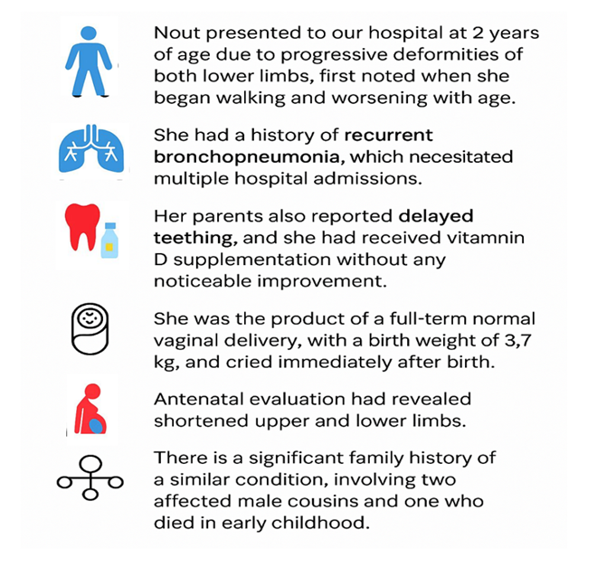
Case 1
History
Case treated by Dr. Afaf AlSagheir
Notes:
.

Slide 38
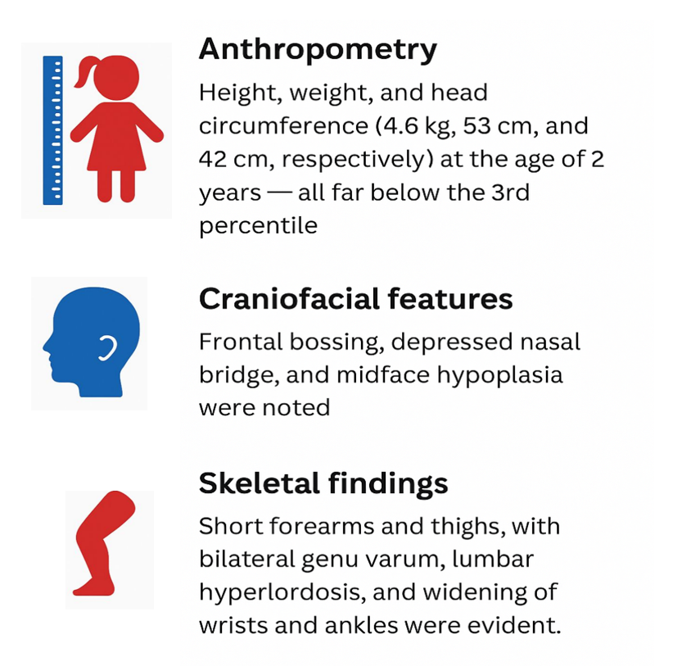
Case 1
On Exam
Case treated by Dr. Afaf AlSagheir
Notes:
.

Slide 39

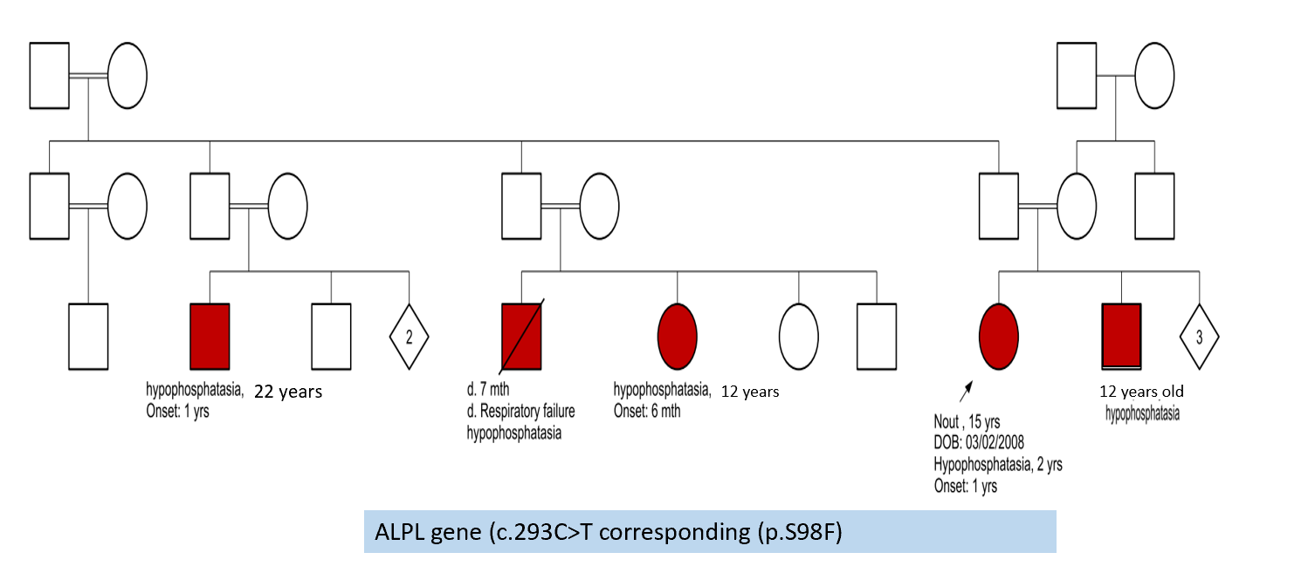

Nout's Family pedigree
Case treated by Dr. Afaf AlSagheir

Slide 40
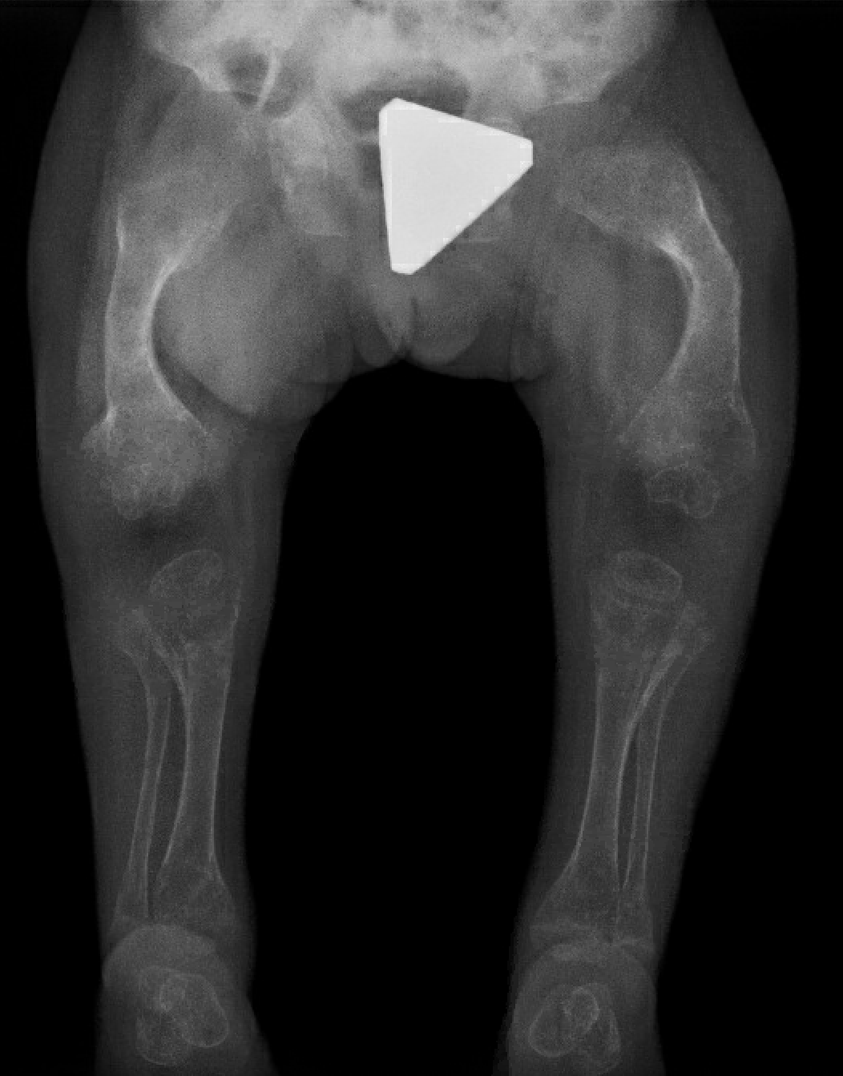
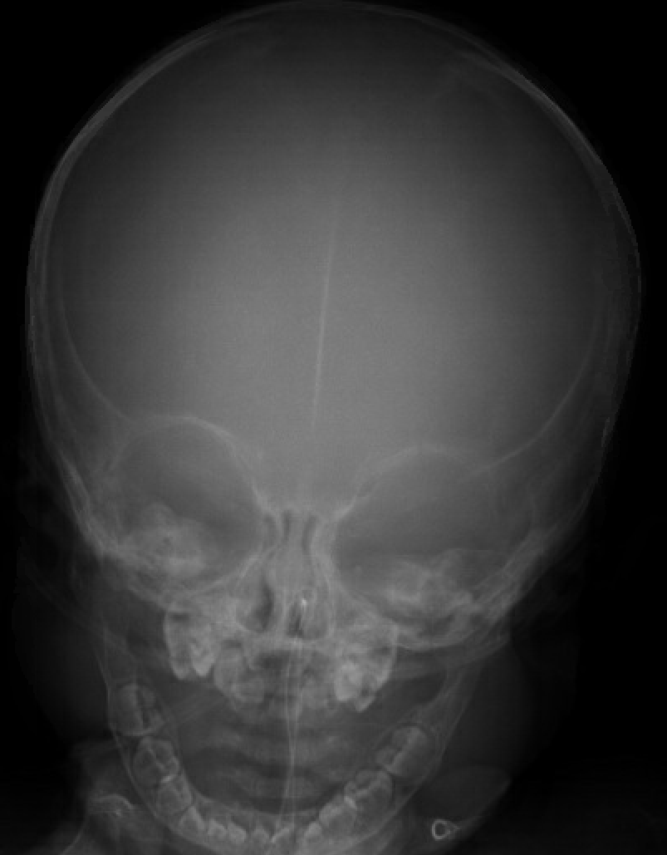
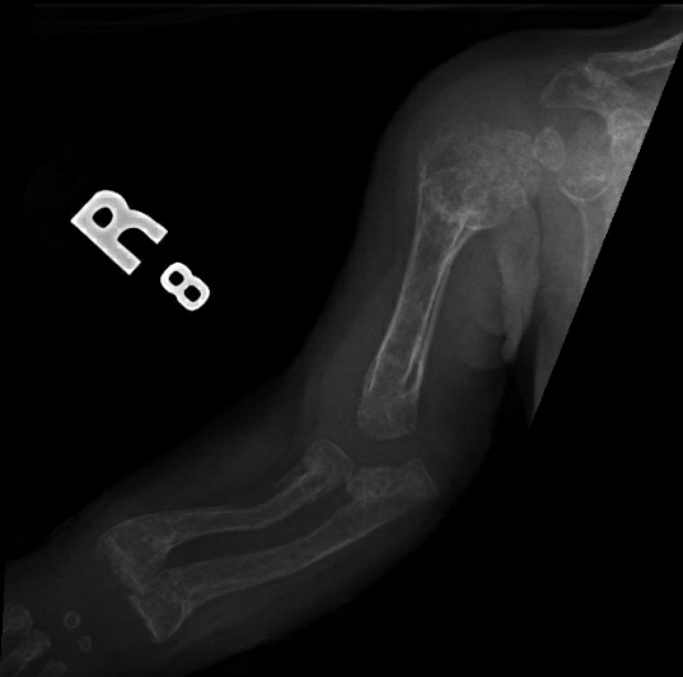
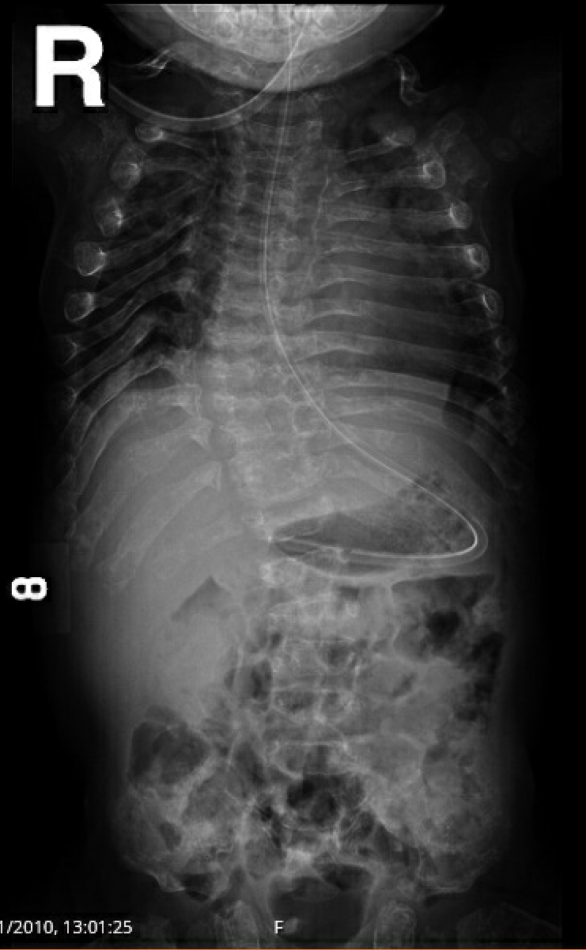
Radiological studies
Case treated by Dr. Afaf AlSagheir
Notes:
Standard dysmorphic skeletal survey series were obtained. NG tube tip seen within the stomach. Generalized osteopenia. Unremarkable skull appearance, skull base. Hypoplastic facial bones. Kyphosis at the lower thoracic and upper lumbar spine. Broadening of the long bones, ribs as well as thinning of the cortices. Bowing deformity of bilateral femurs. Multiple fractures as well as periosteal reaction. Generalized metaphyseal widening of the long bones. Broadening and widening as well as cortical thinning of the carpal, tarsal, metatarsal, and phalangeal bones.

Slide 41

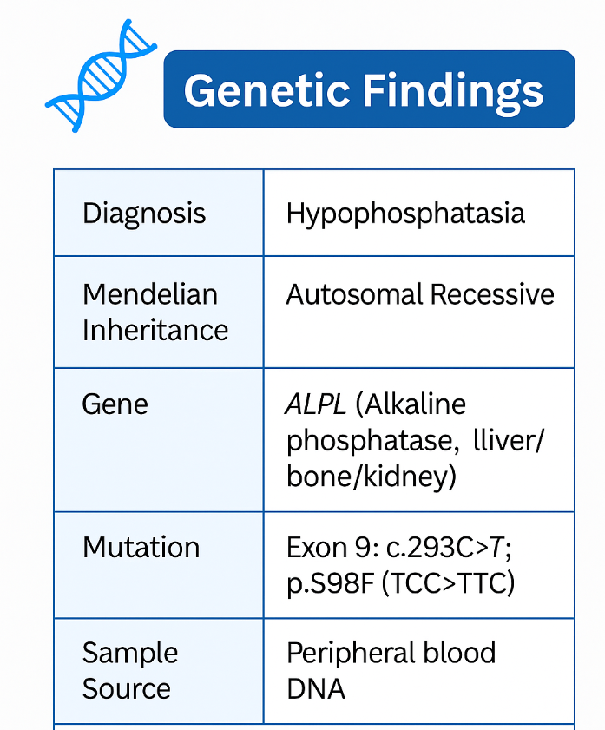
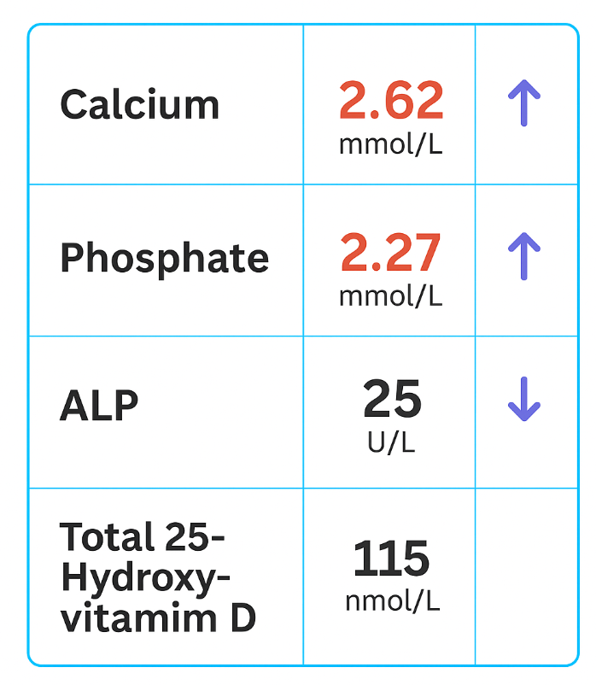
Case 1
Investigations
Final Diagnosis: Infantile hypophosphatasia
Case treated by Dr. Afaf AlSagheir
Notes:
.

Slide 42
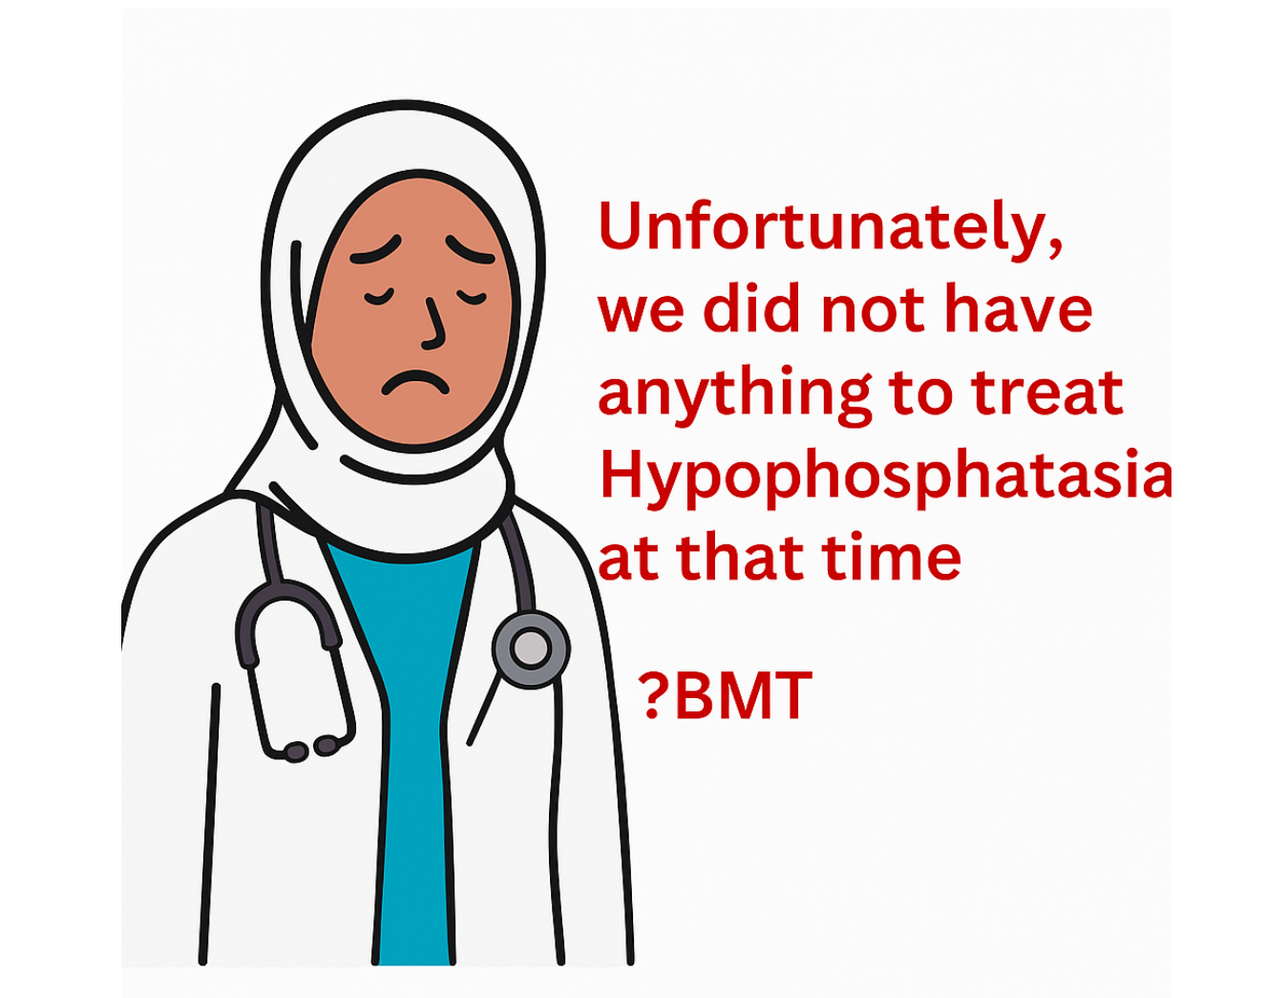

Slide 43
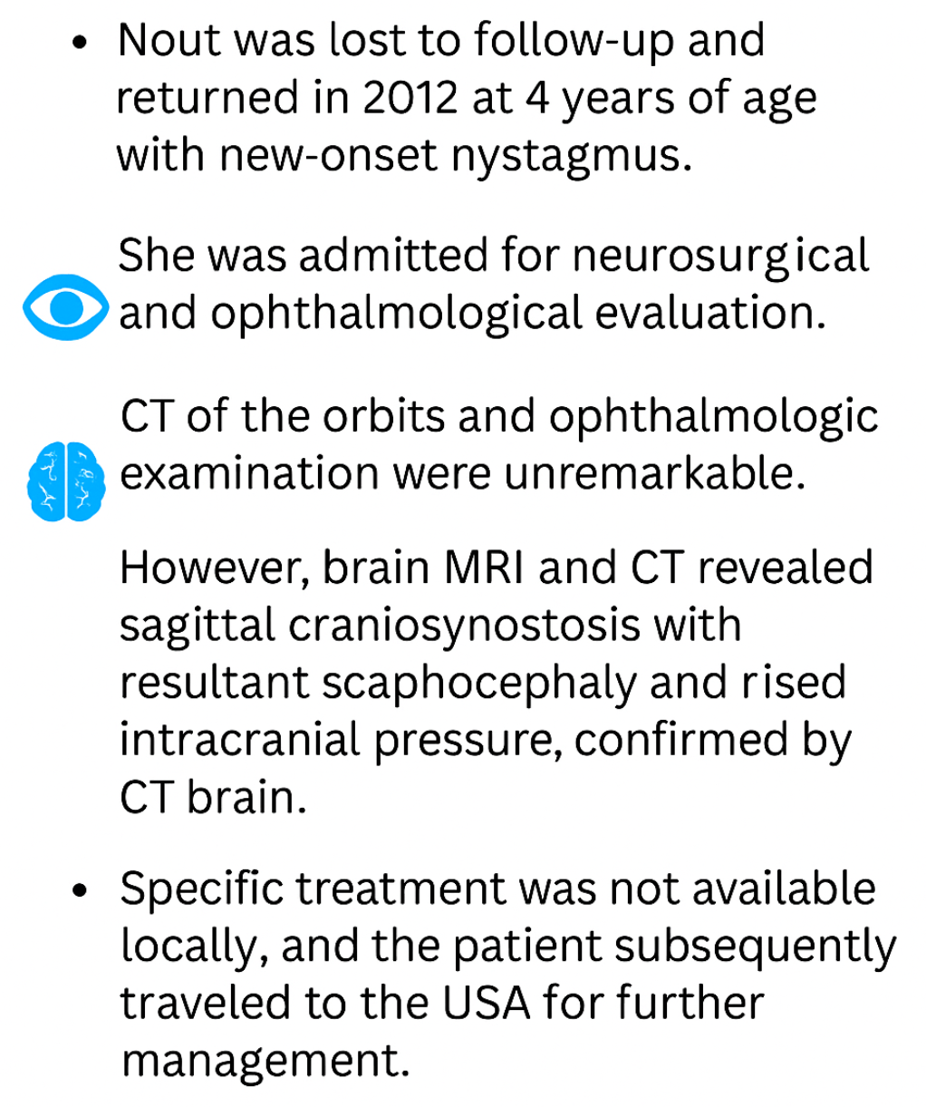
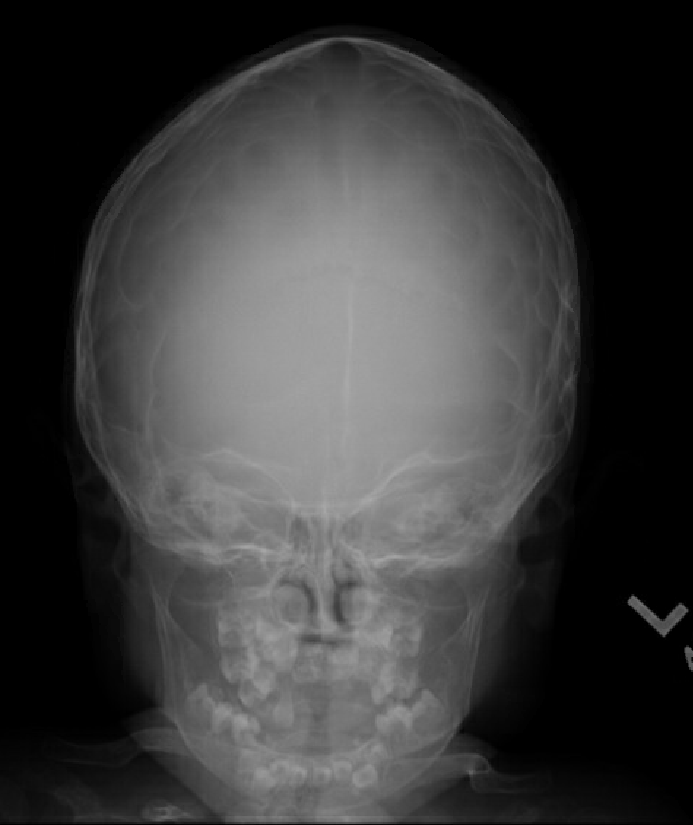
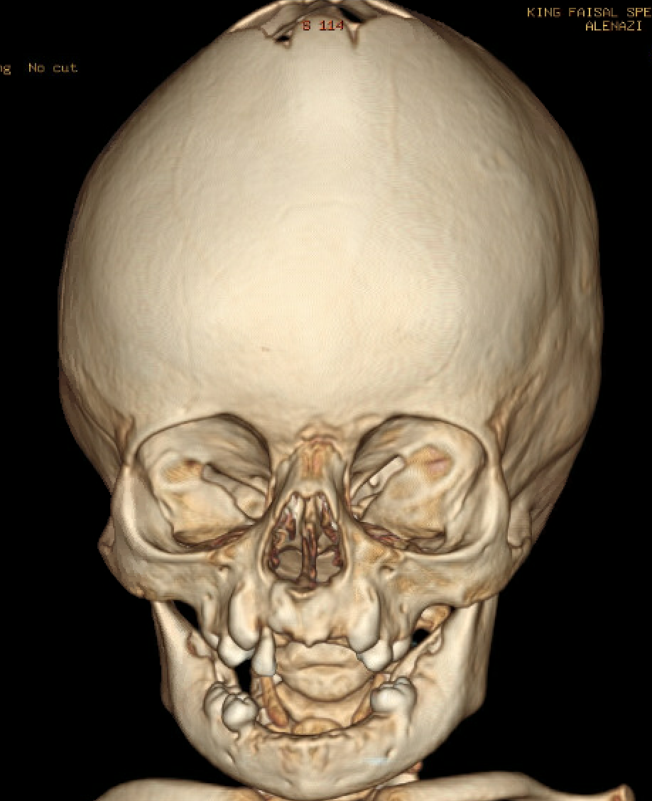
Case 1
Follow-up
Case treated by Dr. Afaf AlSagheir

Slide 44
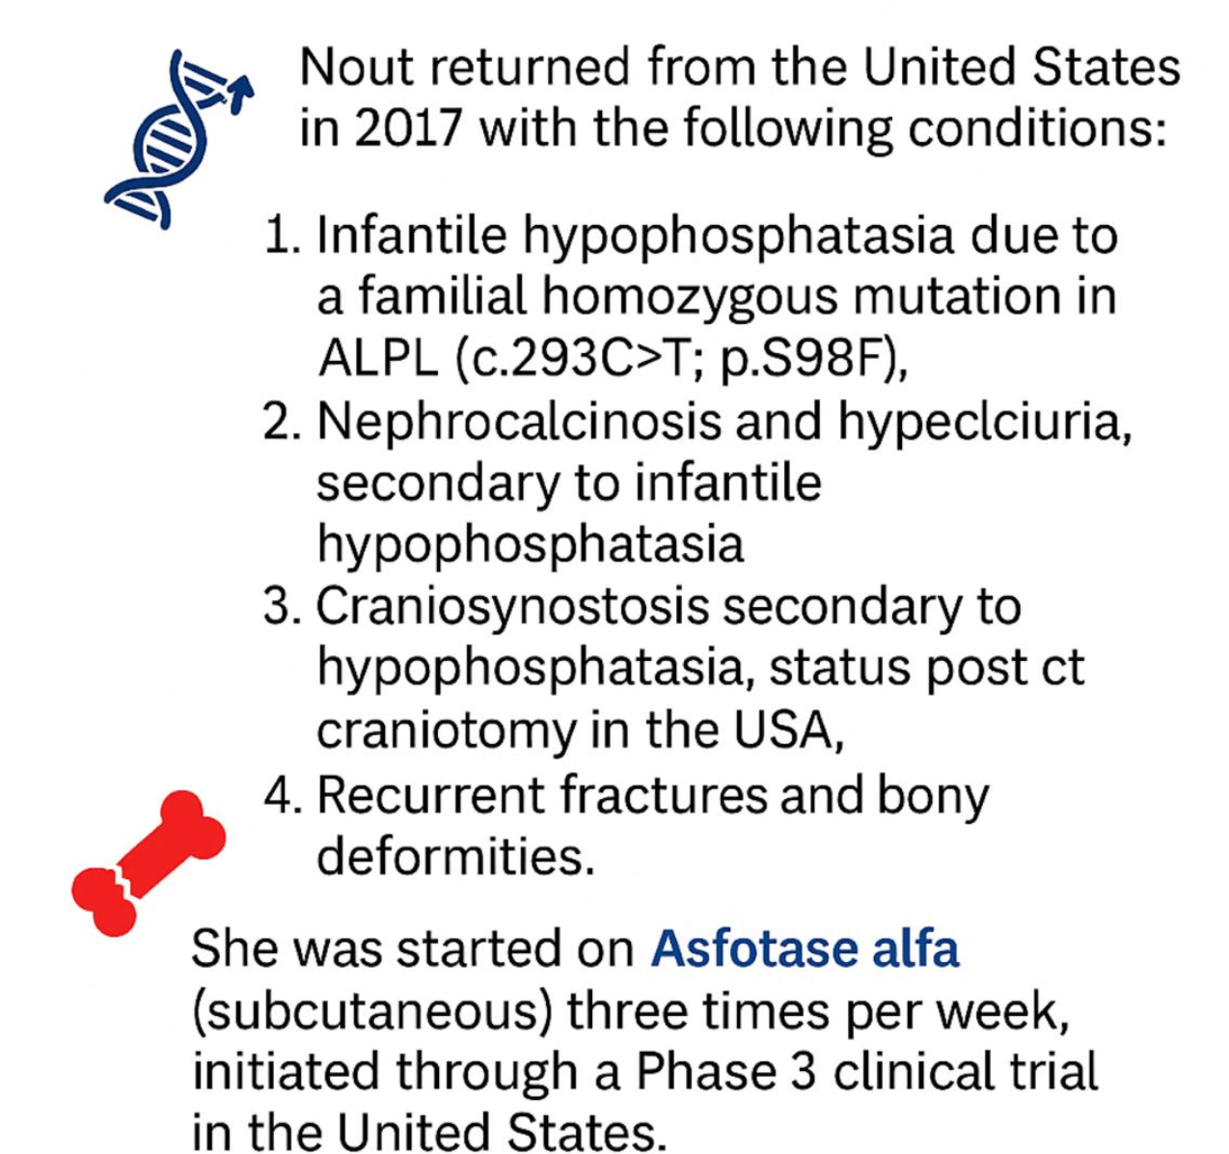
Continue the story:
Case treated by Dr. Afaf AlSagheir

Slide 45
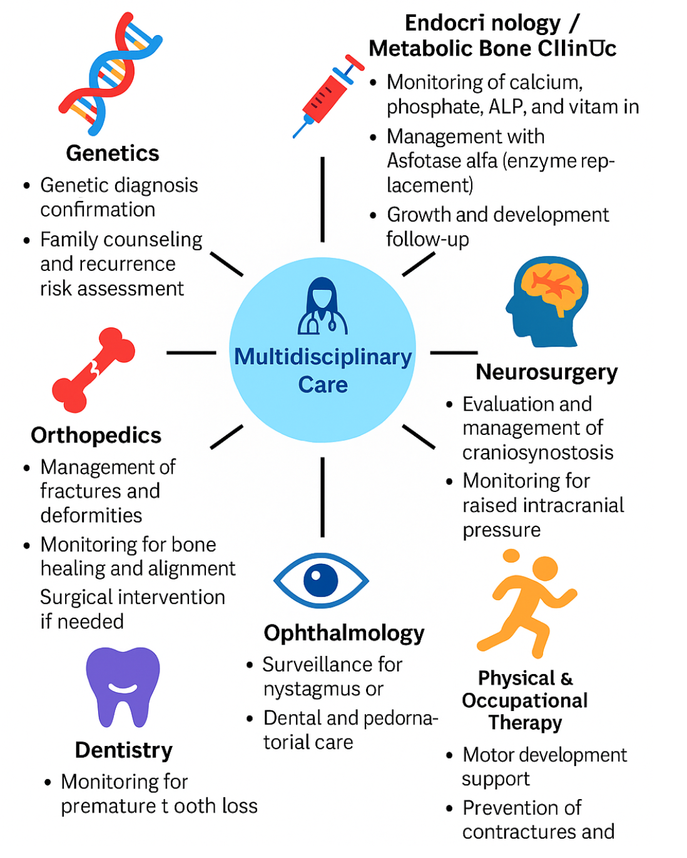


Slide 46
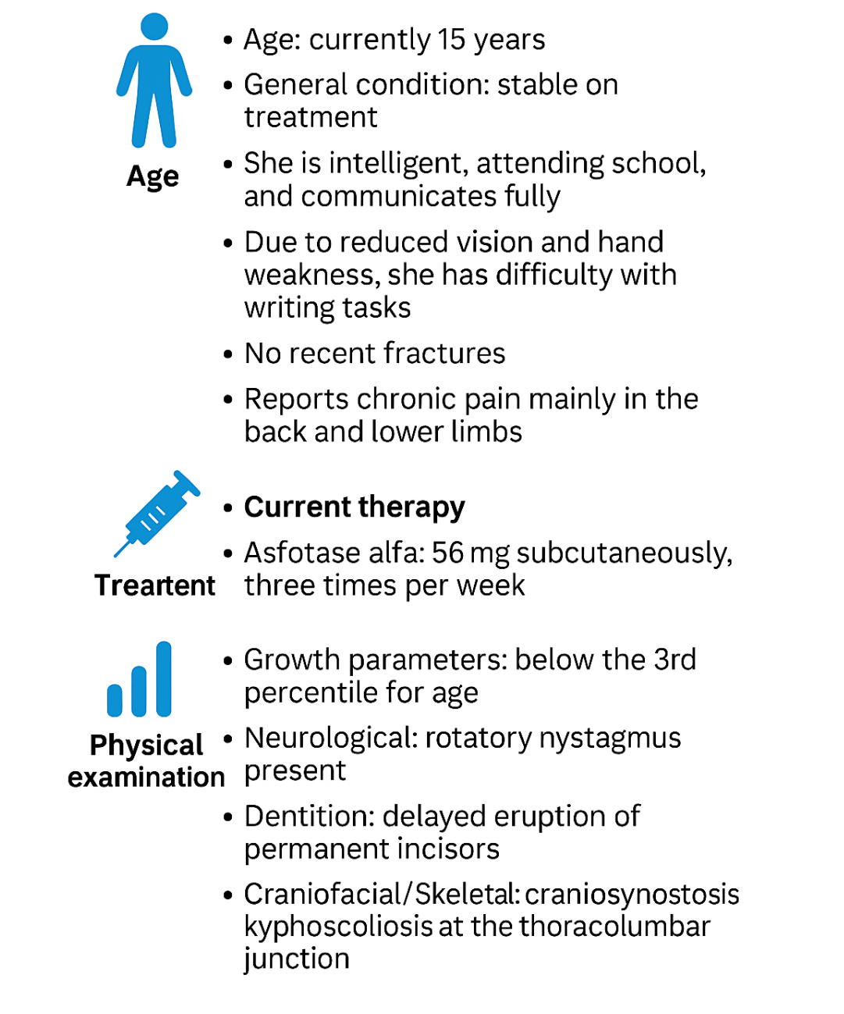
Last visit to clinic
Case treated by Dr. Afaf AlSagheir

Slide 47
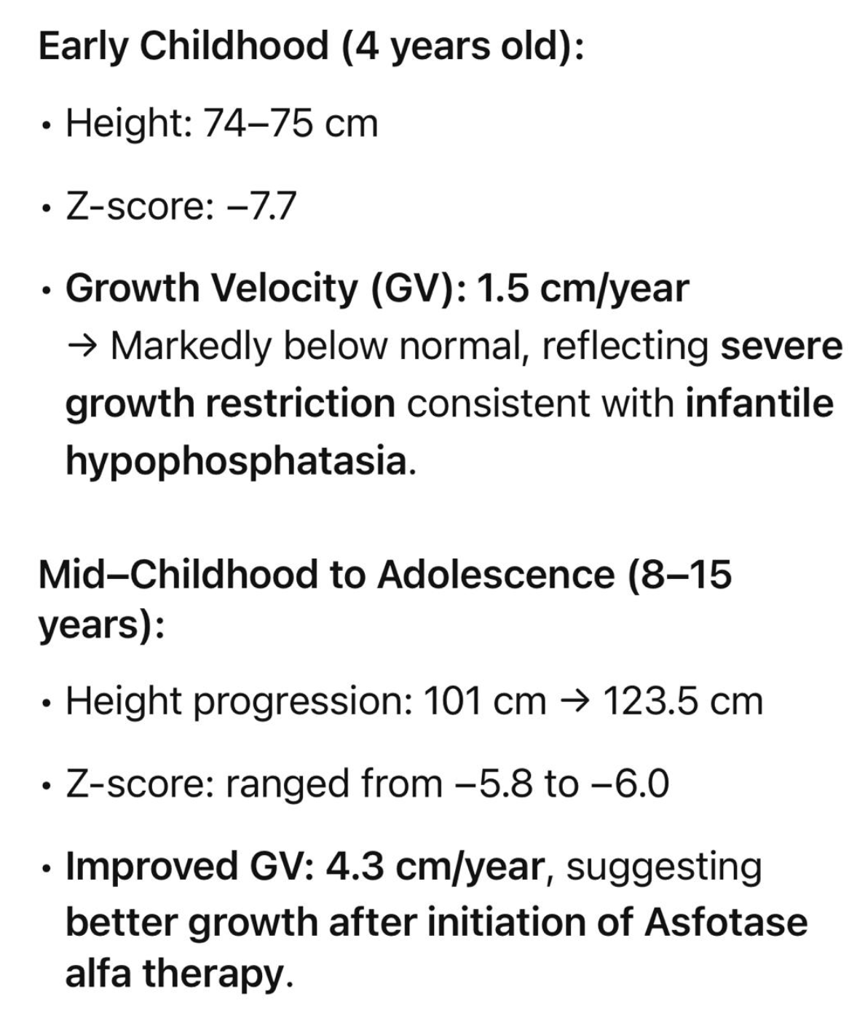
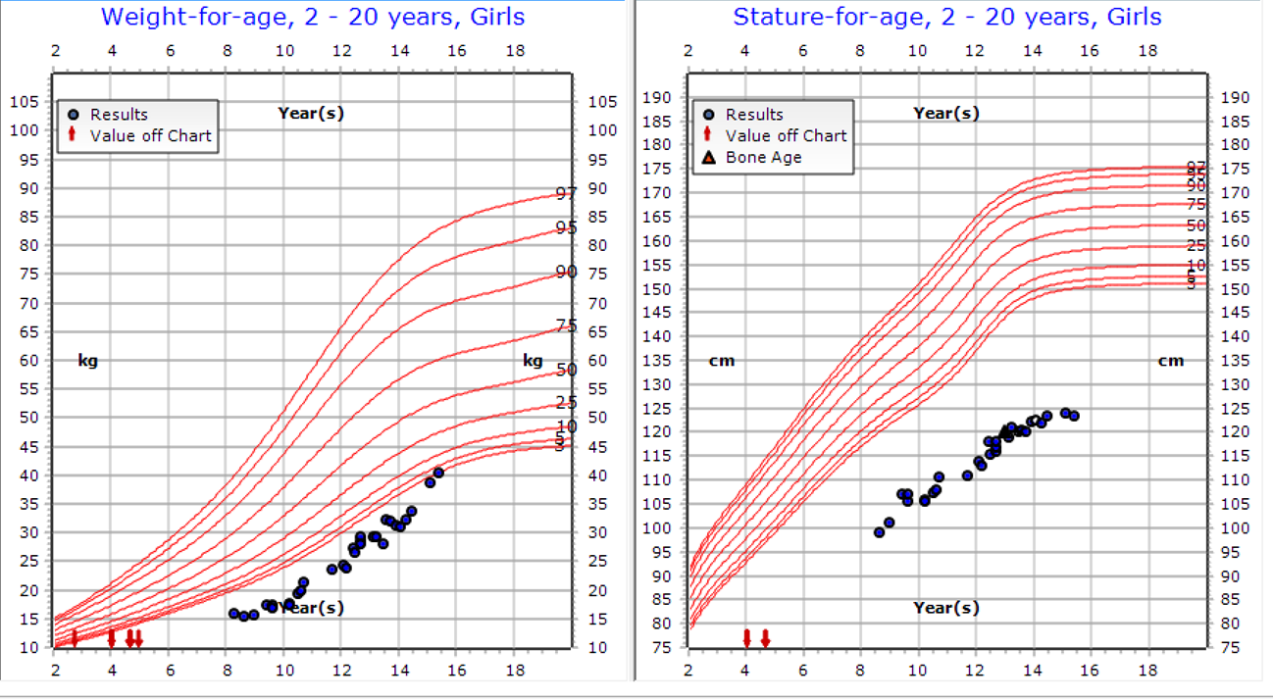
GV :1.5 cm/year
GV :4.3 cm/year
Case treated by Dr. Afaf AlSagheir

Slide 48
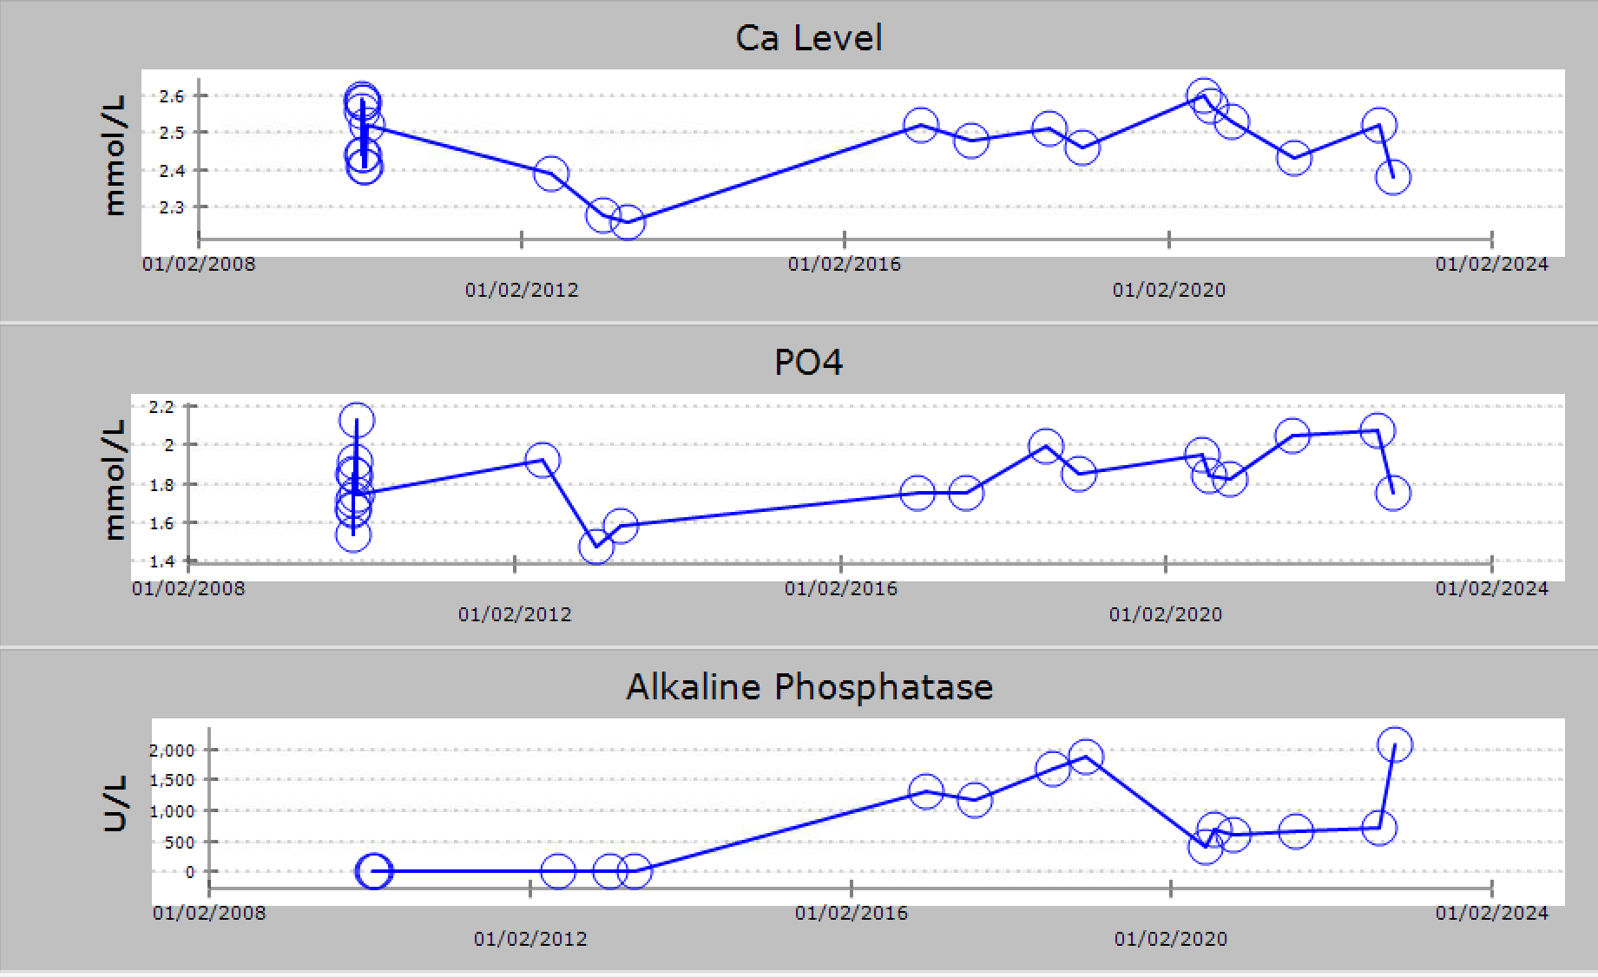
Case treated by Dr. Afaf AlSagheir

Slide 49
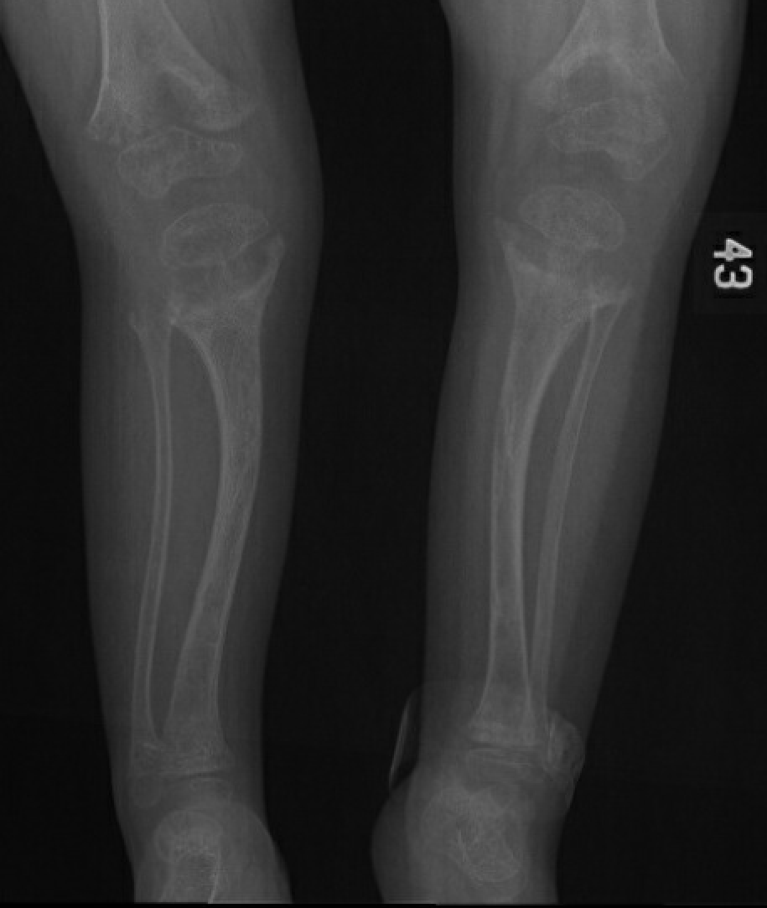
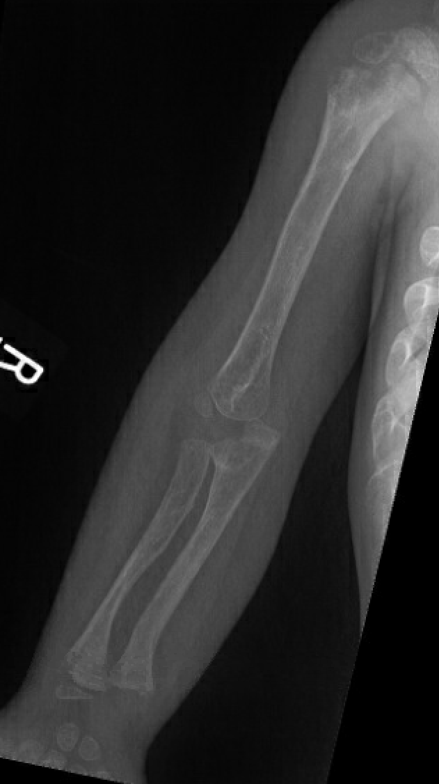
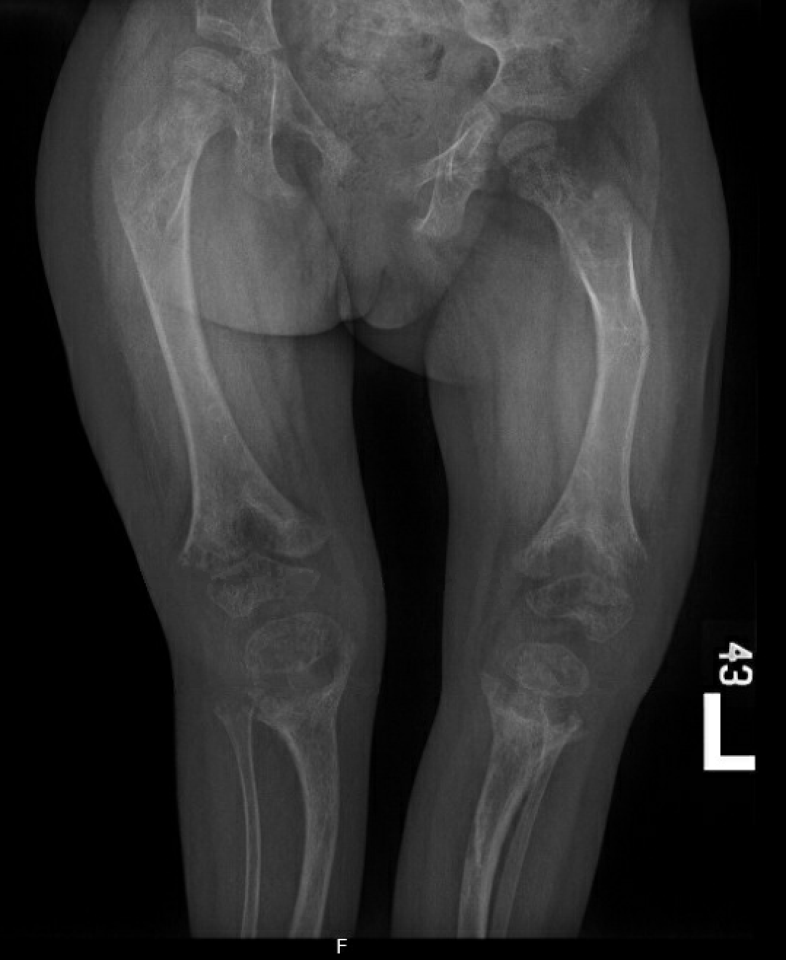
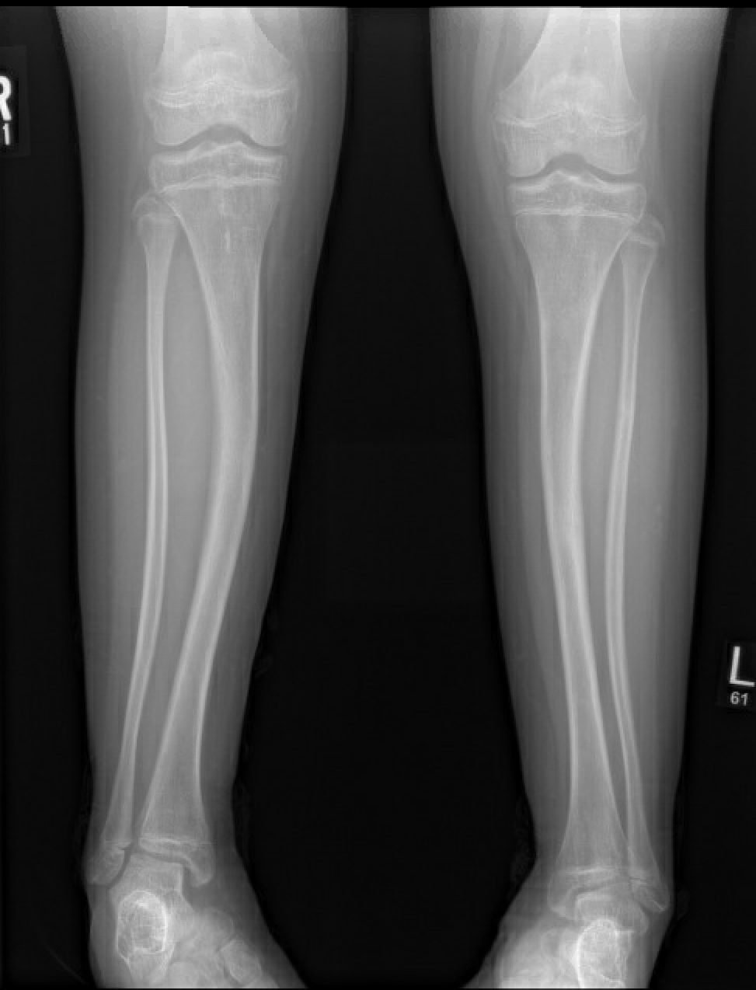
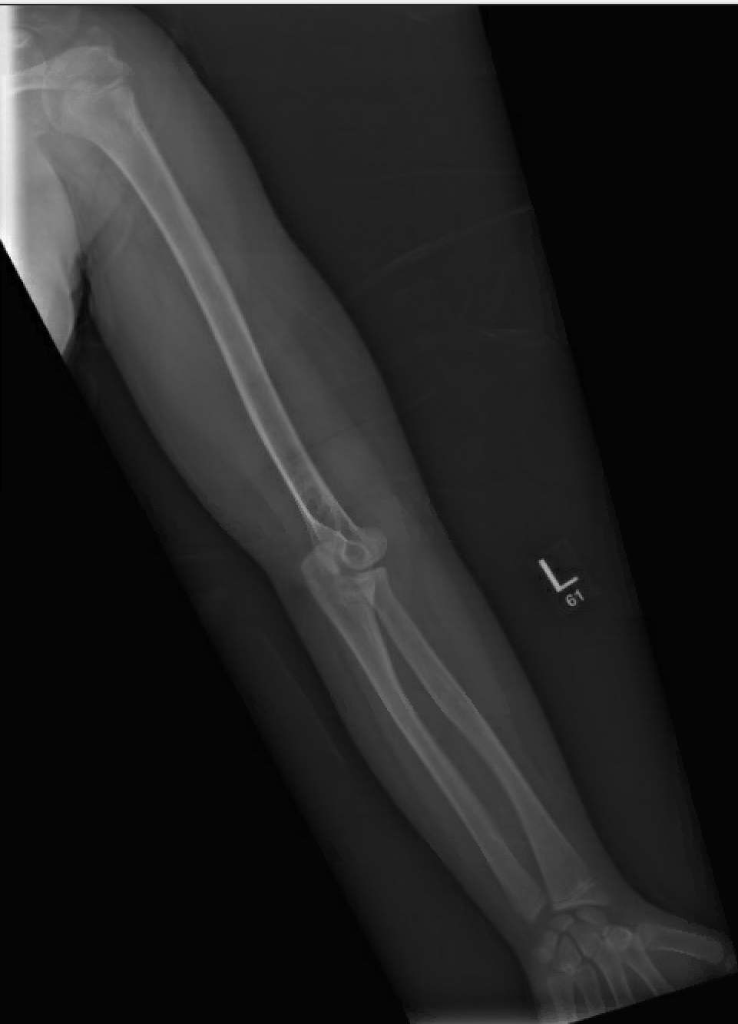
2010
2017
2023
Case treated by Dr. Afaf AlSagheir
Notes:
The skull again demonstrates lacunar appearance and mild swelling/prominent anterior fontanelle, similar to previous. There is mild deformity of the calvarium with mild mid face hypoplasia, similar to previous. Deformed dentation in both the maxilla and mandible. Mild S-shaped scoliosis of the thoracolumbar spine. Persistent moderate rachittic changes throughout the bony skeleton, which show minimal improvement compared to previous. Persistent bowing deformity of the tibia and fibula bilaterally. Focal kyphosis around the thoracolumbar junction of the spine, unchanged. No evidence of spondylolysis or spondylolisthesis. Mild negative ulnar variance bilaterally. Impression: - Compared to June 2012, there has been mild improvement in the degree of generalized osteopenia and minimal improvement of the moderate rachittic changes throughout the skeleton.

Slide 50
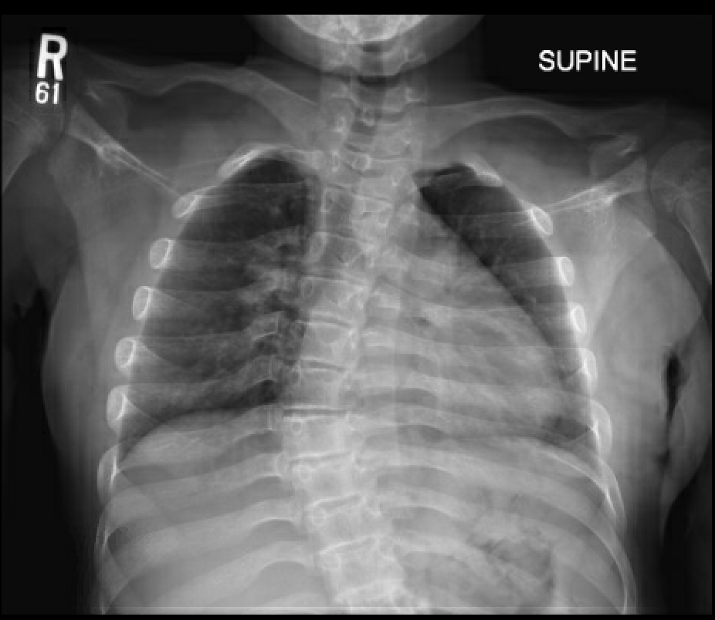
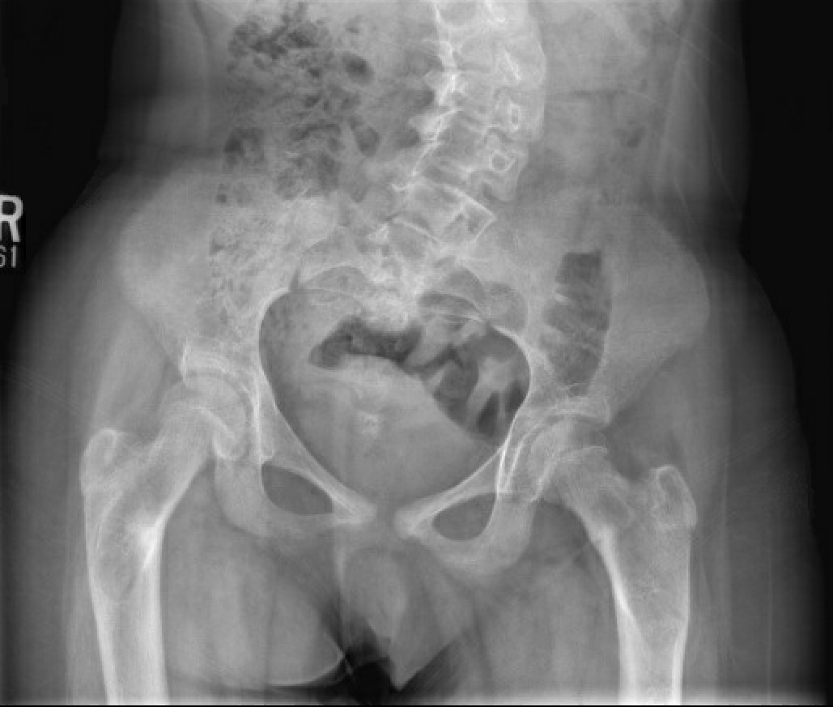
2010
2023
Case treated by Dr. Afaf AlSagheir
Notes:
worsening S-shaped scoliosis deformity of the thoracolumbar spine and focal kyphotic deformity around 48 degree at the thoracolumbar junction.

Slide 51
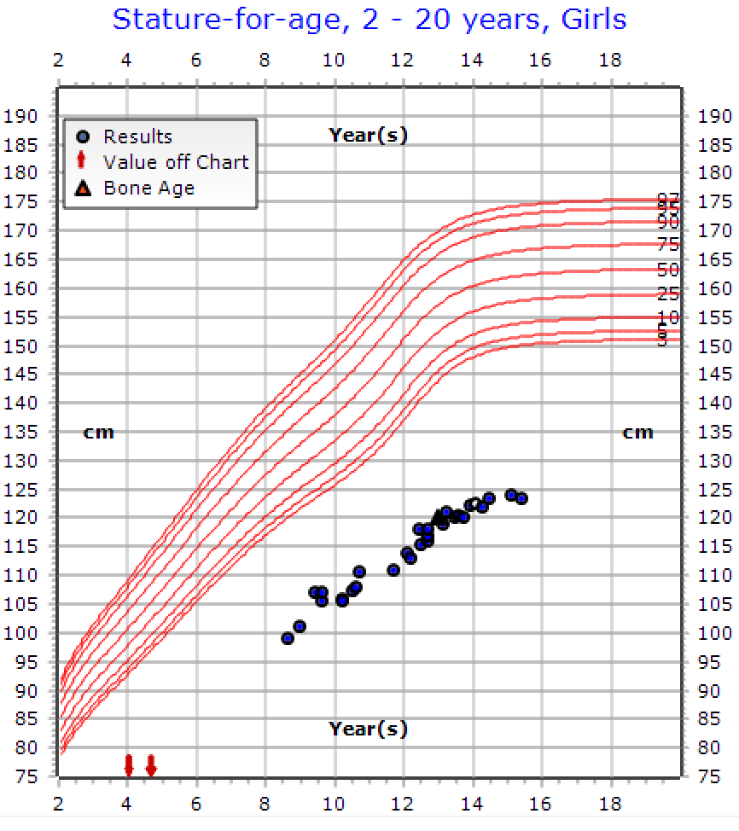
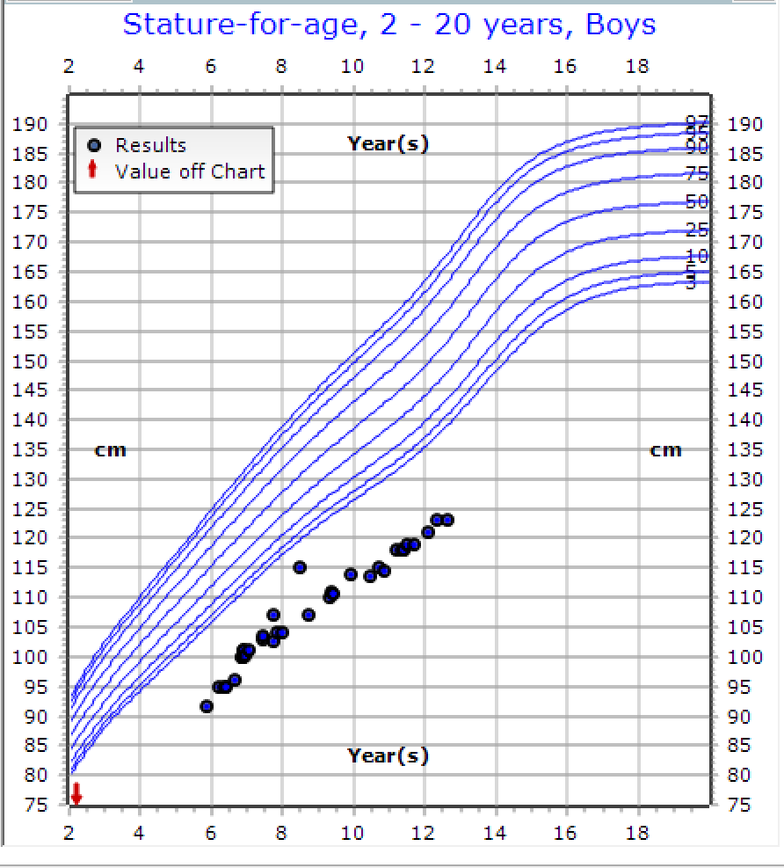
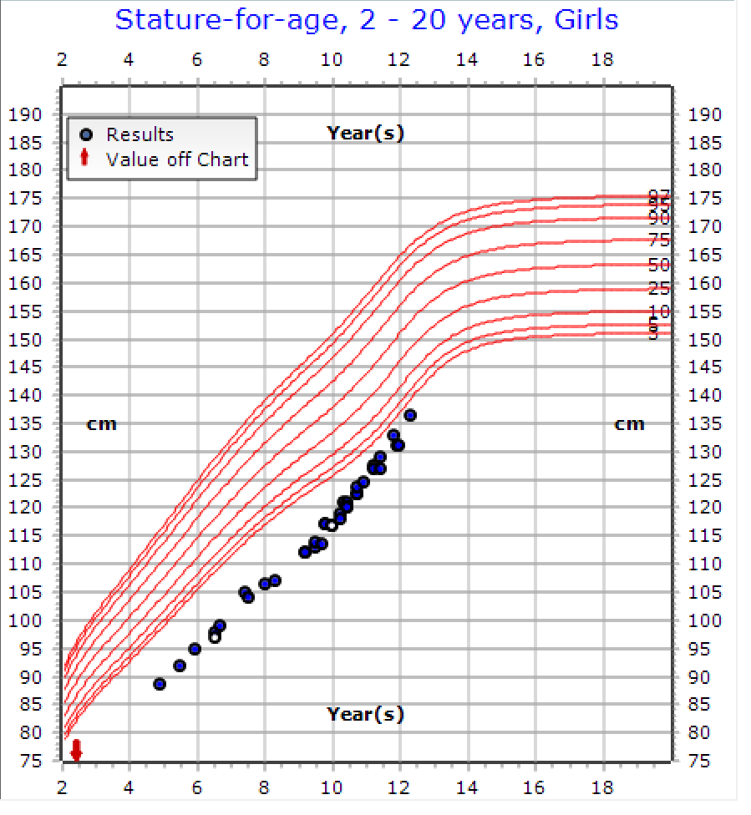
Comparing Nout with her brother and cousin on treatment
Nout
Case treated by Dr. Afaf AlSagheir

Slide 52
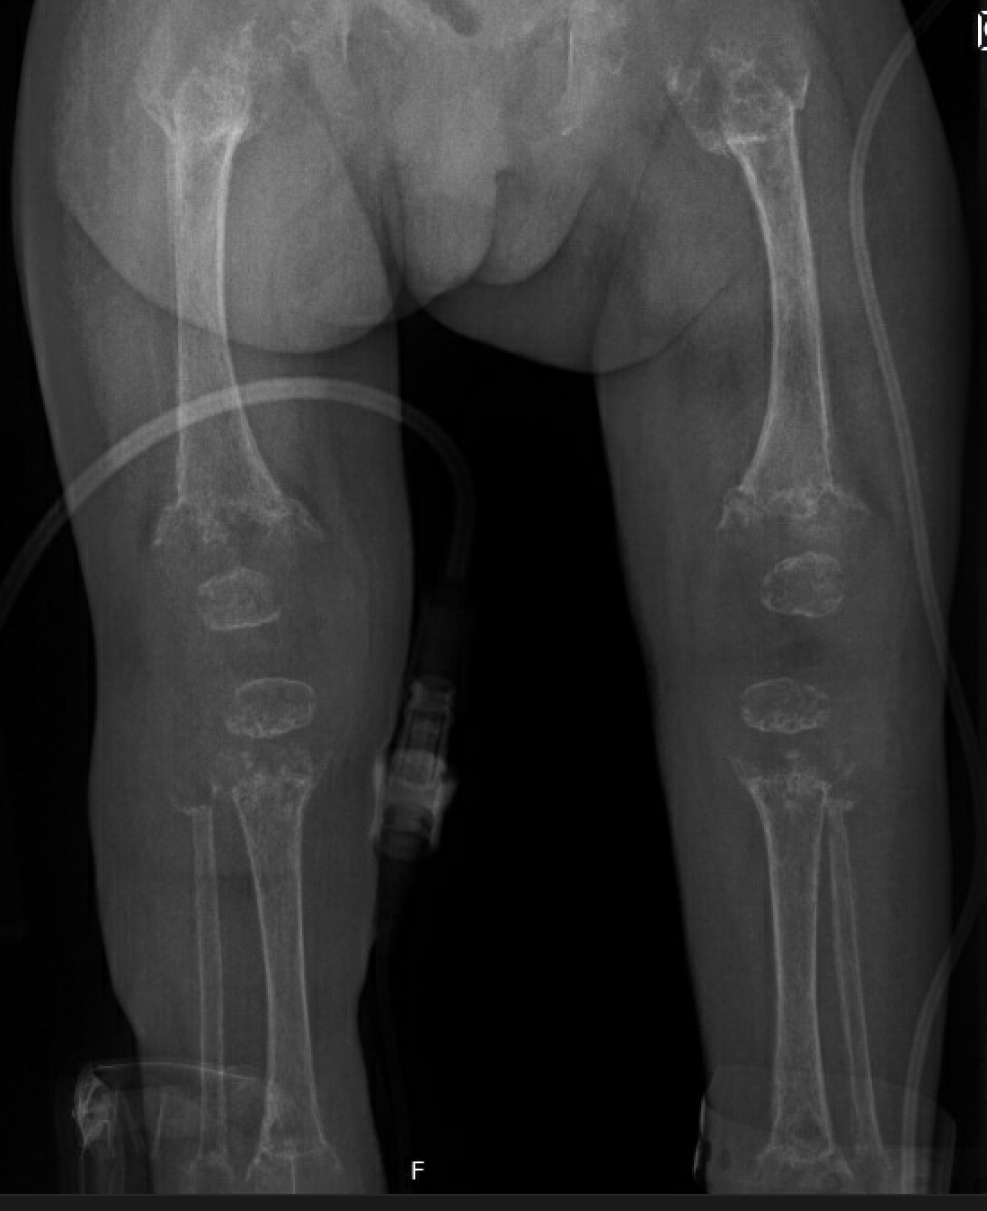
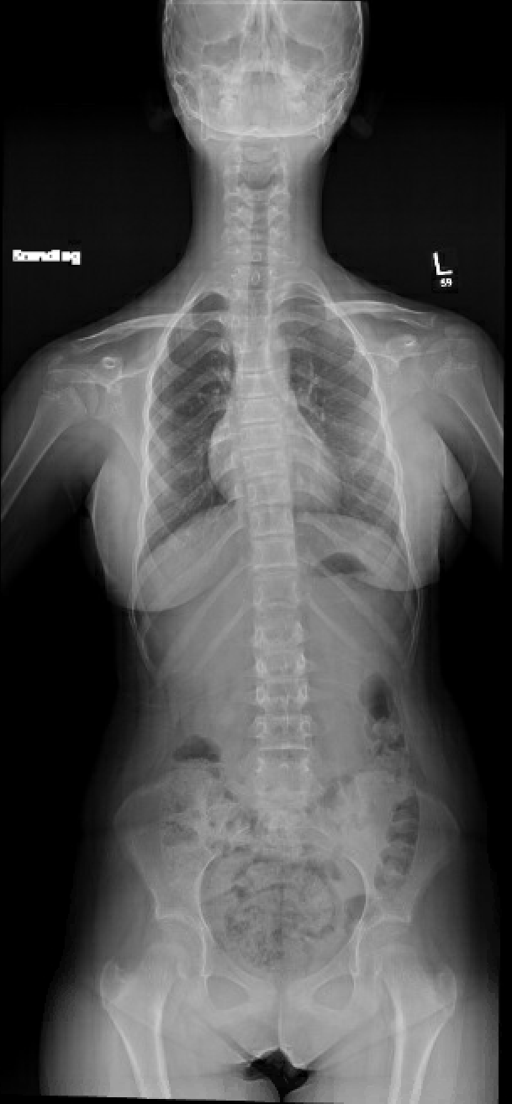
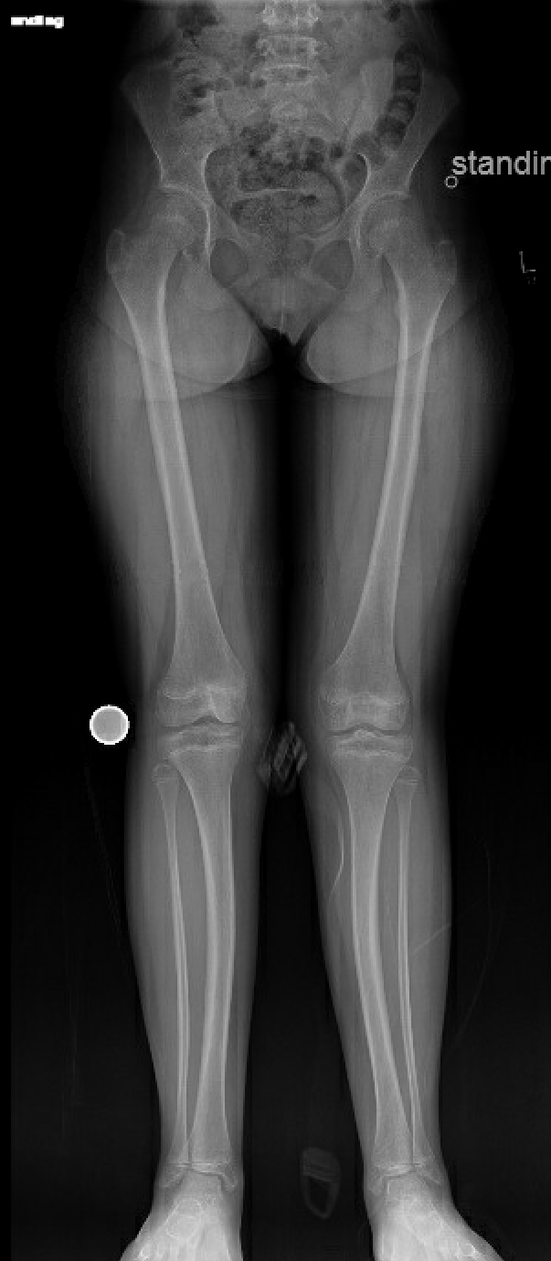
Nout’s cousin on treatment
2012
2022
Case treated by Dr. Afaf AlSagheir
Notes:
Mild to moderate bilateral genu/tibiae valgus deformities, with right femur and tibia diaphyseal valgus,

Slide 53
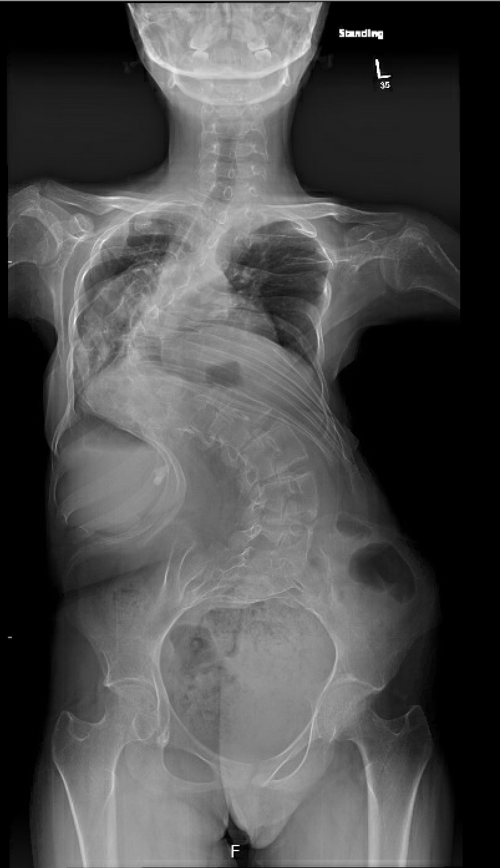
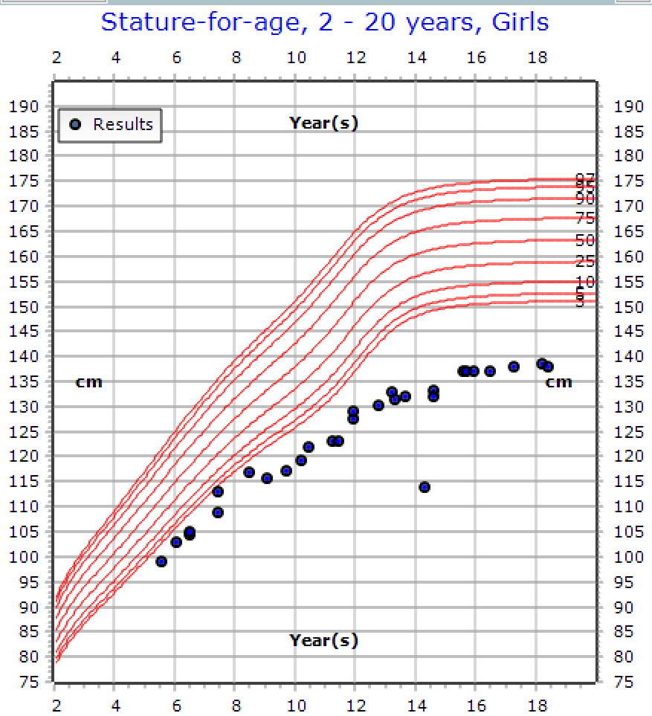
Arwa ( not treated 15 years old girl with HPP)
Case treated by Dr. Afaf AlSagheir

Slide 54
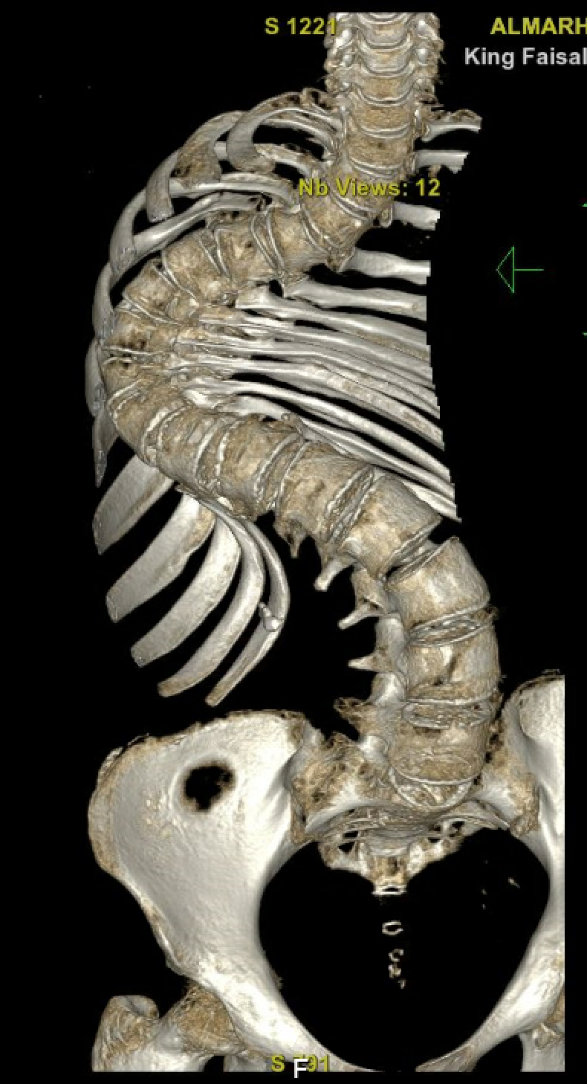
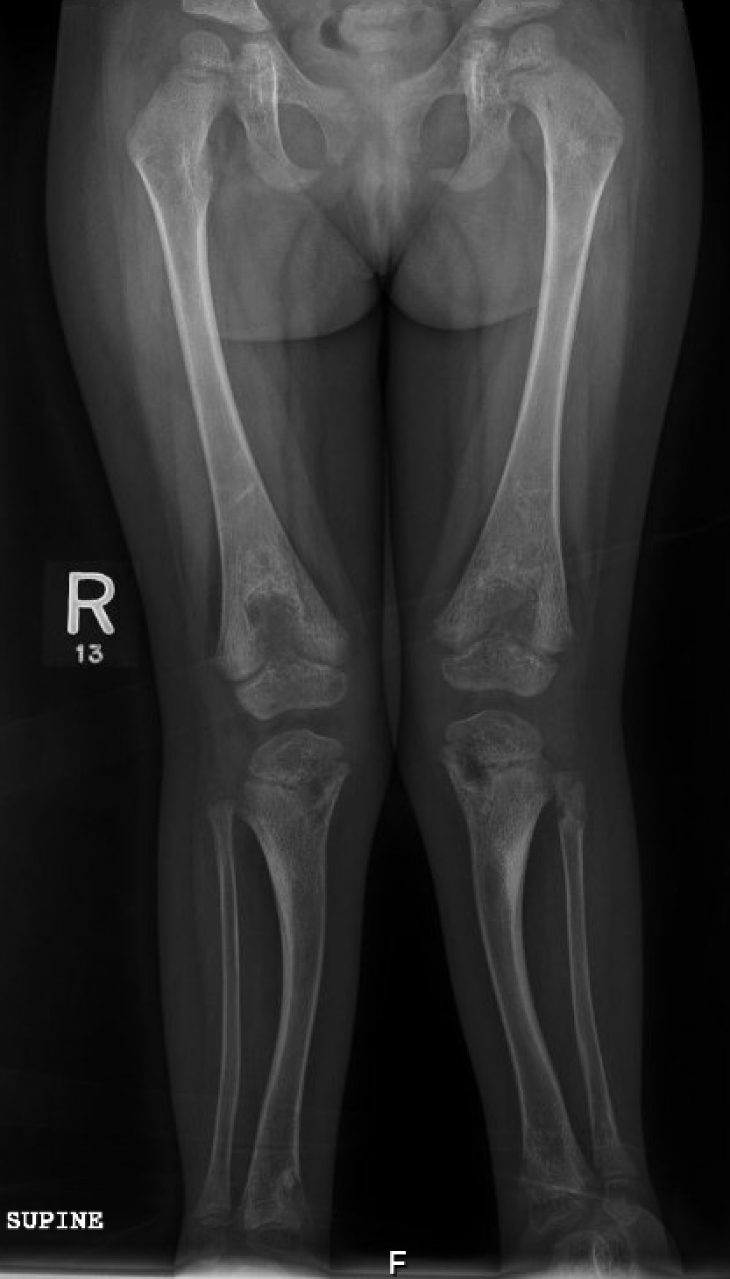
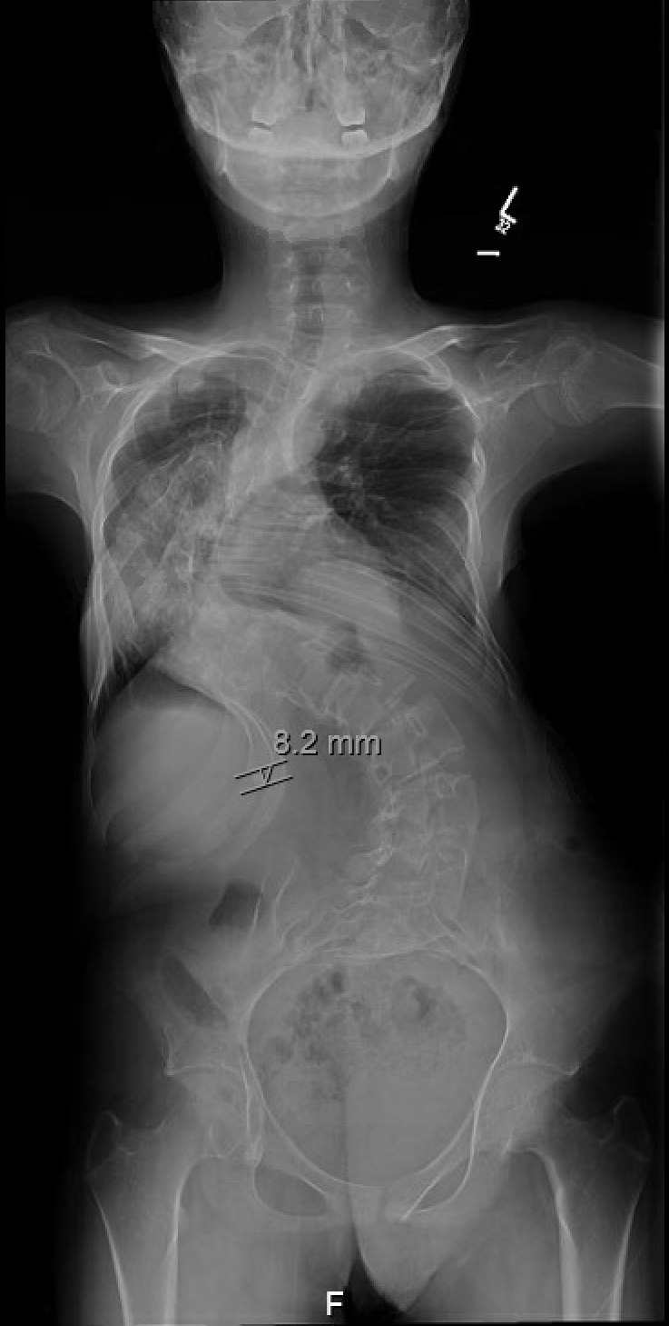
A 14 years old from has the following problems; Infantile hypophosphatasia due to familial homozygous mutation in ALPL gene (C.293C>T, p. S98F), nephrocalcinosis and nephrolithiasis secondary to infantile hypophosphatasia, Craniosynostosis, status post craniotomy
1
Notes:
There is no significant interval change of the severe thoracolumbar spine S-shaped scoliotic and kyphotic deformity.
There is a stable stone projecting at the right flank
. Severe thoracolumbar sigmoid rotary scoliosis without vertebral segmentation fusion anomalies. 2. Severely decreased bone density. 3. Right renal nonobstructive stone.

Slide 55
“These patients are often first encountered by non-endocrine or non-orthopedic specialists, making early recognition by all frontline clinicians essential.”

Slide 56
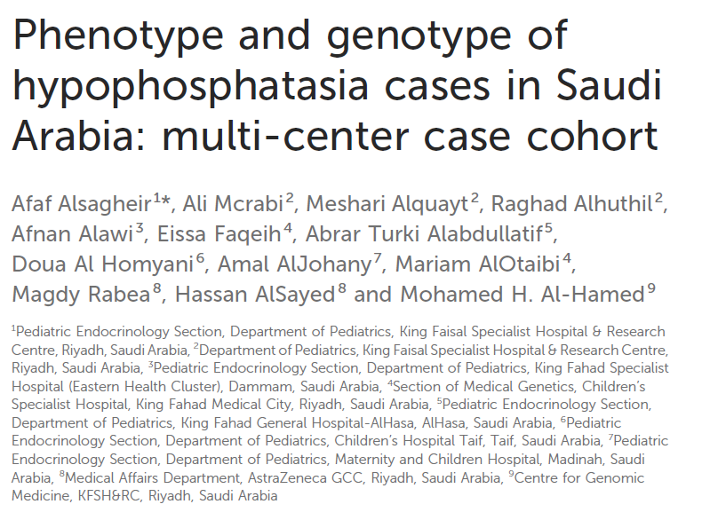
Alsagheir, A., Mcrabi, A., Alquayt, M., Alhuthil, R., Alawi, A., Faqeih, E., Alabdullatif, A. T., Homyani, D. A., AlJohany, A., AlOtaibi, M., Rabea, M., AlSayed, H., & Al-Hamed, M. H. (2026). Phenotype and genotype of hypophosphatasia cases in Saudi Arabia: multi-center case cohort. Frontiers in Genetics, 16, Article 1715818. https://doi.org/10.3389/fgene.2025.1715818

Slide 57

Home Messages on HPP
•HPP is a rare, underdiagnosed metabolic bone disorder with a wide clinical spectrum.
•Persistently low ALP is a key diagnostic clue—do not ignore!
•Early diagnosis and timely intervention, especially with Asfotase Alfa, can significantly improve outcomes.
•Multidisciplinary care and genetic counseling are essential.
•Awareness among pediatricians, endocrinologists, and geneticists can change lives.

Slide 58
Thank You Q&A

