Slide 1
An Unusual Diabetes Phenotype in Congenital Lipodystrophy
Presented by: Dr. Manar Bamashmoos.
Supervised by Dr. Afaf Alsageir .
King Faisal Specialist Hospital And Research Center in Riyadh

Slide 2

Session Outline
Case Presentation
Discussion
Key Lessons

Slide 3
A female infant old referred to us to rule out lipid disorder
•NSVD, unremarkable antenatal/perinatal history
•Presented to primary hospital with failure to thrive, and progressive abdominal distension, with sutble dysmorphism since infancy
intial labs :
  ALT: 142 U/L, AST: 147 U/L
  Triglycerides: 11.86 mmol/L
  Total cholesterol: 6.39 mmol/L
  LDL: 5.43mmol /L
  CBC, urea, electrolytes NL
Clinical presentaion

Slide 4
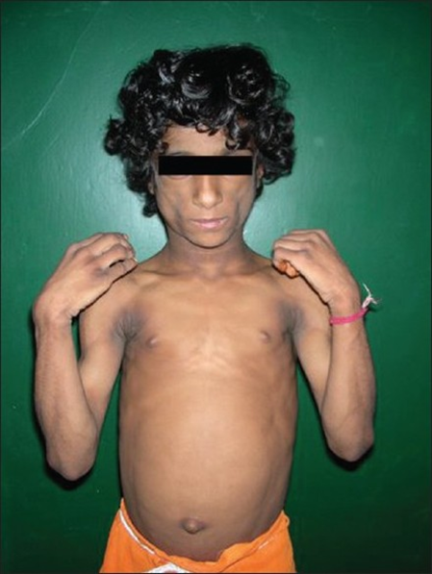
Clinical presentaion
Prsented at the age of 13 month -old
Generalized lipoatrophy
Muscular appearance
Senile facies
Acromegaly
Acanthosis nigricans
Hepatomegaly
Khandpur S et al.

Slide 5
Clinical presentaion
ALT 164.9, AST 187.1
TG 3.4 mmol/L
LDL 3.66 mmol/L
total cholesterol 5.01 mmo/L
Abdominal US: fatty liver changes, mild splenomegaly, and bilateral nephromegaly with normal echogenicity
Cardiac: PM VSD, mild LVH
Khandpur S et al.

Slide 6


Classical Clinical and Metabolic Features
Homozygous BSCL2 variant c.750dup; p.Leu251Alafs*23
Congenital generalized lipodystrophy
Khandpur S et al.

Slide 7
HbA1c 9.9
HbA1c 5.6
Early onst DM
age 5 years old
Clinical & biochemical
improvement
Diagnosis
first year of life
Patient developed symptoms of polyurea , polydipsia
BG reaching >15 mmol
She was on Metraleptin 0.13mg/kg/day (max)
Started on insulin, required high doses
Metaleptin
6 years old
Worsening glycemic
control age 8
HbA1c 8.9
Notes:
Symptomatic, BG 300 she was on max dose metraleptin

Slide 8
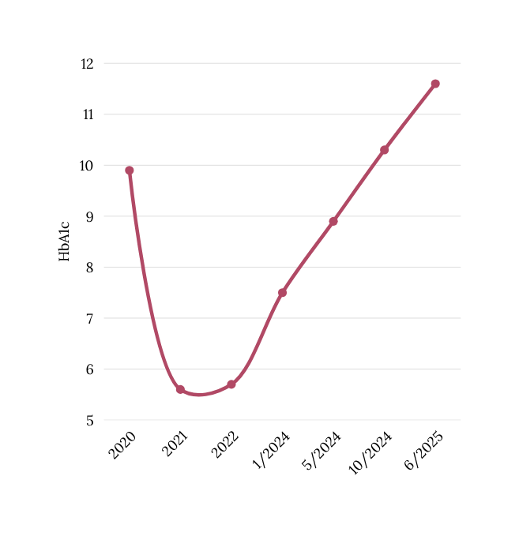
What could explain the deterioration in glycemic control?
  Poor adherence or suboptimal dosing of Metreleptin
  poor adherence to insulin and lifestyle factors
  Type 1 diabetes?

Slide 9
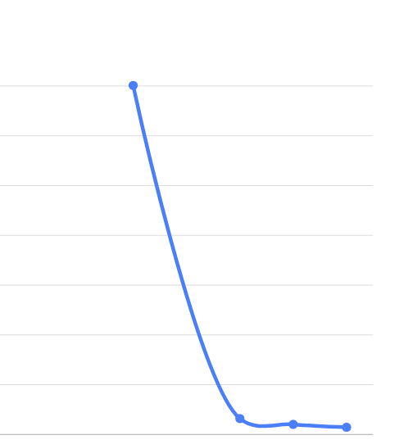
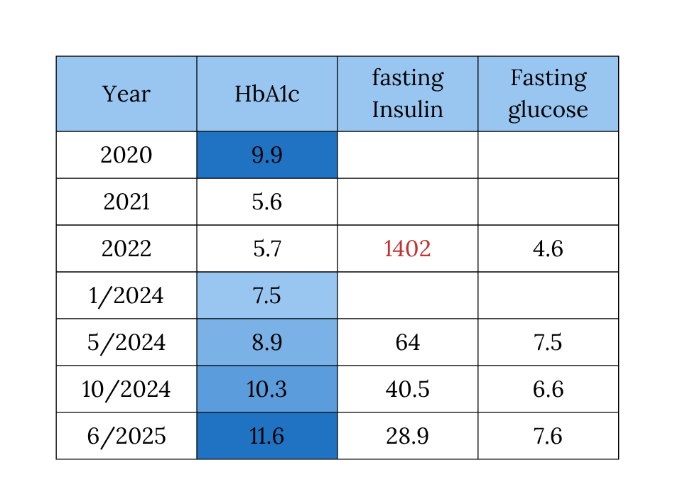
What could explain the deterioration in glycemic control?

Slide 10
What could explain the deterioration in glycemic control?
Key Investigations
•↓ Endogenous insulin levels
•Positive: Anti-insulin antibodies
•Positive Anti-islet cell antibodies
  HLA typing:
T1D susceptibility alleles:
DRB104:02 , DQB103:02 (DQ8)
Findings are consistent with autoimmune diabetes mellitus (Type 1 diabetes).
Notes:
HLA typing demonstrated T1D susceptibility alleles, including DRB104:02 and DQB103:02 (DQ8), consistent with an autoimmune predisposition.

Slide 11

Discussion

Slide 12
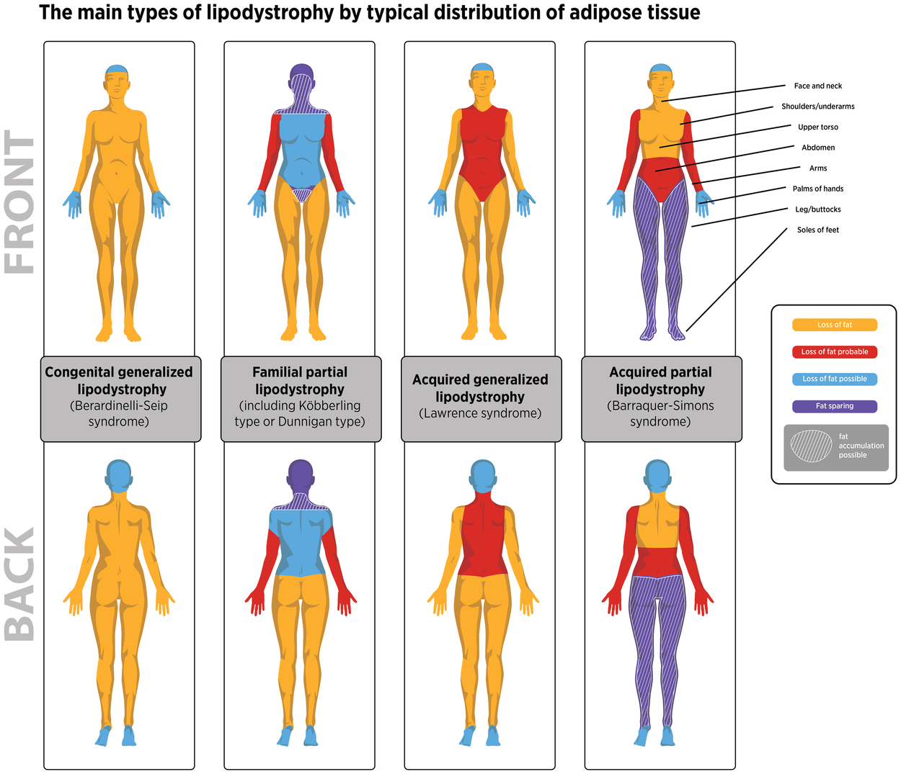
Lipodystrophy
  Lipodystrophy is a rare metabolic disease characterized by loss or absence of adipose tissue
It can be:
  Congenital vs Acquired
  Generalized (affects whole body) vs Partial (affects specific areas)
NORD. Congenital generalized lipodystrophy.

Slide 13
Congenital generalized lipodystrophy (CGL)
  Autosomal recessive disorder
  Near total absence of adipose tissue
  Characterized by inability to store fat properly due to lack of functional fat cells.
  Leptin deficiency.
  Lipid is stored in other tissues, including muscle and liver
  CGL Type 1 → AGPAT2 gene mutation
  CGL Type 2 → BSCL2 gene mutation
  CGL Type 3 → CAV1 gene mutation
  CGL Type 4 → CAVIN1 gene mutation
NORD. Congenital generalized lipodystrophy.
Notes:
Leptin is a hormone found in adipocytes .
absence of functional adipocytes, lipid is stored in other tissues, including muscle and liver. Affected individuals
develop insulin resistance and approximately 25%-35% develop diabetes mellitus between ages 15 and 20 years. Hepatomegaly secondary to hepatic steatosis and skeletal muscle hypertrophy occur in all affected individuals. Hypertrophic cardiomyopathy is reported in 20%-25% of affected individuals and is a significant cause of morbidity from cardiac failure and early mortality.
https://www.ncbi.nlm.nih.gov/books/NBK1212/
https://rarediseases.org/rare-diseases/congenital-generalized-lipodystrophy/
“CGL is classically a disease of extreme insulin resistance due to lack of adipose tissue.”

Slide 14
Congenital generalized lipodystrophy (CGL)
Clinical presentation
Prominent musculature (97%),
Acromegaloid appearance (76%)
Protuberant abdomen (80%)
Prominent veins (86%)
Acanthosis nigricans (71%)
Hirsutism (73%)
Hepatomegaly (84%)
advanced bone age (76%)
key complications:
  Severe insulin resistance
  Hypertriglyceridemia
  Fatty liver disease
Garg A et al., JCEM, 2017;102(2):363

Slide 15
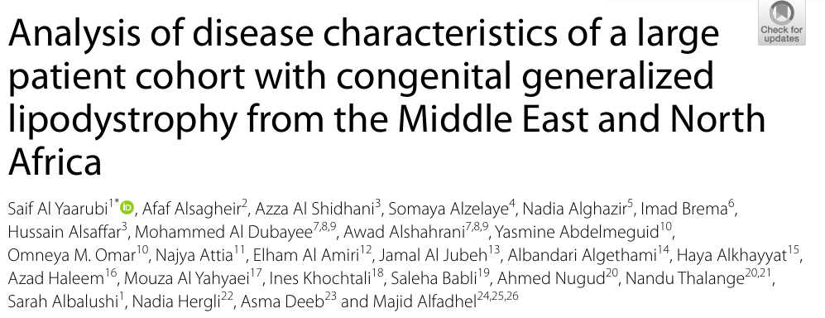
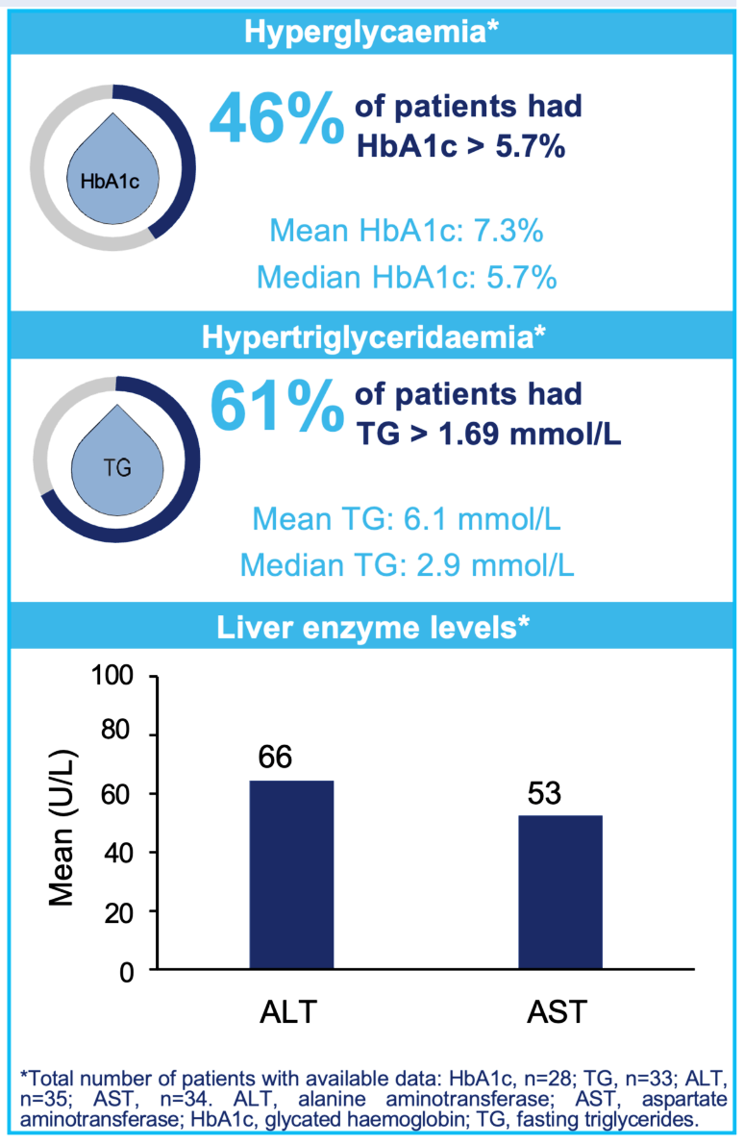
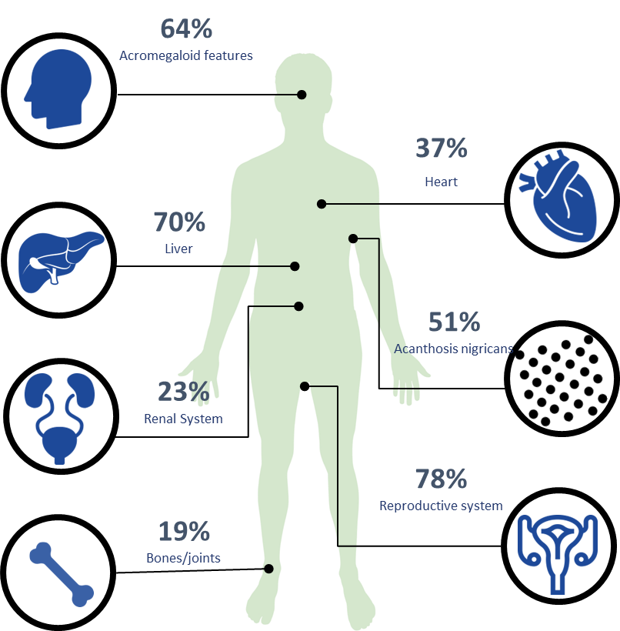
Al Yaarubi S et al., OJRD, 2024;19:118
Notes:
43 patients with CGL (37 females, 86%) were collected from centers located in eight countries. The
mean (median, range) age at diagnosis was 5.1

Slide 16
Mechanisms of Insulin Resistance in Lipodystrophy (LPD)
Lipotoxicity
  Lack of fat storage → lipid accumulation in non-adipose tissues → excess intracellular fat
  Formation of toxic intermediates leads to:
  Cellular stress and metabolic dysfunction
  Impaired insulin signaling pathways
  Decreased glucose uptake
Adipokine Abnormalities
  Low leptin:
↓ insulin sensitivity
↑ Gluconeogenesis
Notes:
xcess energy cannot be stored in adipose tissue,

Slide 17
Management: Metraleptin
Recombinant methionyl human leptin (SC)
↓ Ectopic fat (liver, muscle)
↑ Insulin sensitivity , ↓ HbA1c, ↓ Insulin requirements
↓ Triglycerides , Improves hepatic steatosis
↓ Hepatic glucose production
↓ Hyperphagia → ↓ caloric intake
Safety
Well tolerated (Hypoglycemia , Headache , Weight loss, Injection site reactions)
Oral EA et al., JCEM, 2018;103:3058–3067
Notes:
adipose tissue loss and accompanying leptin deficiency (and its ensuing hyperphagia) is noted with ectopic fat deposition in the liver and muscle [7, 8]. This leads to insulin resistance, diabetes mellitus, and hypertriglyceridemia, which are often refractory to treatment with conventional lipid- and glucose-lowering agents, as these metabolic abnormalities are typically more severe than those associated with obesity and type 2 diabetes

Slide 18



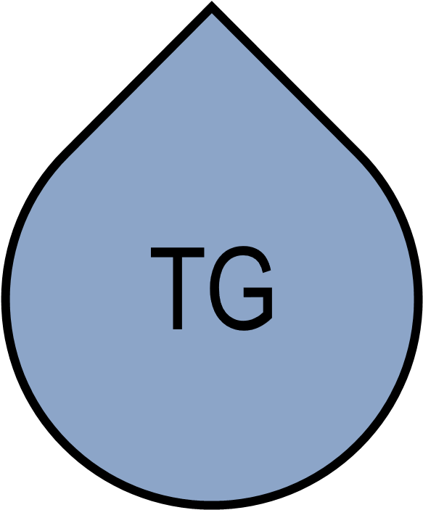
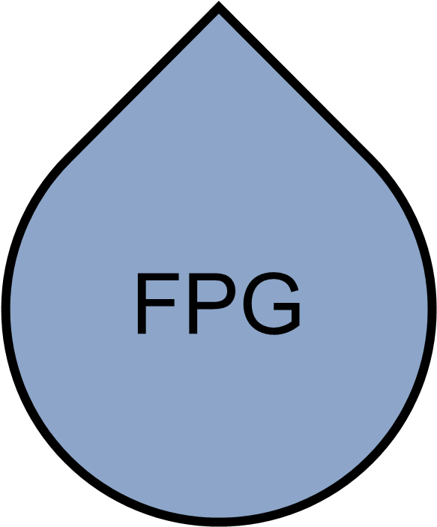
EFFICACY OF METRELEPTIN IN PATIENTS WITH GENERALIZED LIPODYSTROPHY
NIH study: 66 patients with GL treated with metreleptin¹
Change in HbA1c
(co-primary endpoint) [FAS, n=59]
Change in fasting TGs
(co-primary endpoint) [FAS, n=57]
Change in FPG
(secondary endpoint) [FAS, n=59]
-2.2%
Mean actual change from baseline
(P ≤ 0.001)
-32.1%
Mean %
change from baseline
(P ≤ 0.001)
-3.0
Mean actual change from baseline
(P ≤ 0.001)
Mean fasting TGs (mmol/L)
Mean FPG (mmol/L)
Mean HbA1c (%)
P-values for changes from baseline to month 12 were computed using available data. FAS, full analysis set; FPG, fasting plasma glucose; GL, generalised lipodystrophy; HbA1c, glycated haemoglobin; NIH, National Institute of Health; TG, triglycerides.
1. Brown RJ, et al. Endocrine (2018) 60:479–489
Notes:
Glycemic control
HbA1c ↓ ~2.2% at 12 months
Fasting glucose ↓ significantly
🔻 Lipid profile
Triglycerides ↓ ~32%
Major reduction in risk of pancreatitis
🔻 Medication burden
~41% discontinued insulin
Reduction in oral antidiabetic and lipid-lowering drugs

Slide 19
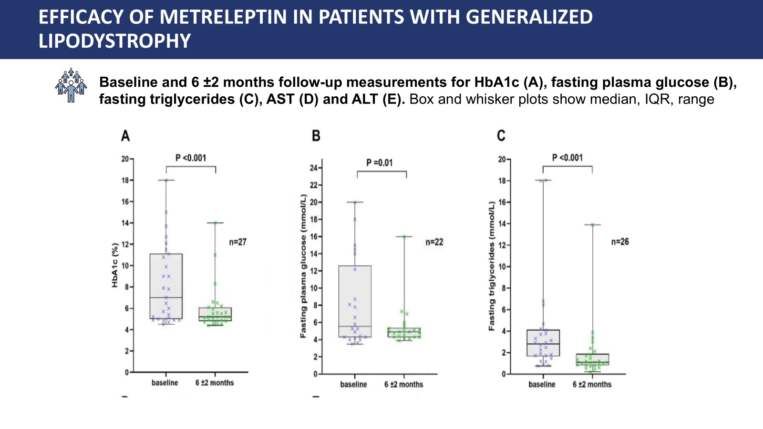
Metraleptin here
Notes:
HbA1c values were significantly lower at 6-months and 2-years than at baseline. There was a median reduction of 2.0%
fasting glucose values were values were lower at all post-Metreleptin values than at baseline. The largest reduction was at 2-years where the median reduction from baseline was 1.3 mmol/L. The results were not quite statistically significant at 3-years, but this analysis was only based on a small number of patients (n=7).
fasting triglycerides were significantly lower at 6-months and 2-years compared to the pre-Metreleptin measurements. At 6-months, the median reduction from baseline was 1.5 mmol/L.

Slide 20
Key Takeaways
Autoimmune diseases are well recognized in acquired lipodystrophy. however not reported in CGL
  This case highlights an overlap of two independent disease mechanisms: insulin resistance and type 1 diabetes mellitus, leading to extreme metabolic and therapeutic complexity.
  Always re-evaluate when the underlying diagnosis when the disease course becomes atypical or changes over time.
  Type 1 diabetes can happen to anyone!

Slide 21
References
Khandpur S, Kumar A, Khadgawat R. Congenital generalized lipodystrophy of Berardinelli-Seip type: a rare case. Indian J Dermatol Venereol Leprol. 2011;77:402. doi:10.4103/0378-
National Organization for Rare Disorders (NORD). Congenital generalized lipodystrophy. 2025. Available from: https://rarediseases.org/rare-diseases/congenital-generalized-lipodystrophy/
Garg A, et al. Clinical features and management of non-HIV–related lipodystrophy in children: a systematic review. J Clin Endocrinol Metab. 2017;102(2):363–373. doi:10.1210/jc.2016-3175.
Al Yaarubi S, et al. Analysis of disease characteristics of a large patient cohort with congenital generalized lipodystrophy from the Middle East and North Africa. Orphanet J Rare Dis. 2024;19:118. doi:10.1186/s13023-024-03118-5.
Oral EA, Simha V, Ruiz E, Andewelt A, Premkumar A, Snell P, et al. Long-term effectiveness and safety of metreleptin therapy in patients with generalized lipodystrophy. J Clin Endocrinol Metab. 2018;103(8):3058–3067. doi:10.1210/jc.2018-00500.
Brown RJ, Araujo-Vilar D, Cheung PT, et al. The diagnosis and management of lipodystrophy syndromes: a multi-society practice guideline. J Clin Endocrinol Metab. 2016;101(12):4500–4511.
Brown RJ, Araujo-Vilar D, Cheung PT, et al. Clinical management of lipodystrophy: a review. Endocrine. 2018;60(3):479–489. doi:10.1007/s12020-018-1562-9.

