Slide 1

Pediatric Pheochromocytoma:
Unusual Postoperative Hemodynamic Course.
Presented by: Dr. Abeer Hammad Alharthi
Pediatric Resident, King Abdullah Specialized Children Hospital, Ministry National Guard Health Affairs, Riyadh, Saudi Arabia
Supervised by; Dr. Amir Babiker
Pediatric Endocrinology Consultant, King Abdullah Specialized Children Hospital, Ministry National Guard Health Affairs, Saudi Arabia

Slide 2
Clinical Presentation:
A 10-year-old boy presented with 14 days history of headache and blurred vision.
On further history, he had a 2-year history of episodic occipital headache associated with hyperhidrosis and palpitation.
There is no history suggestive of infectious, renal, neurologic, or thyroid-related causes.

Slide 3
Physical Examination
Vital Signs:
Key findings :
Alert, interactive, no distress
Normal S1 & S2, Regular rate and rhythm, normal pulses, symmetrical, and equal in all four extremities
No focal neurological deficit
No abdominal mass or bruit
No neurocutaneous stigmata
BP: | 145/97 mmHg >95th percentile
HR: | 107 bpm
RR: | 24/min
Temp: | 36.7°C
SpO2: | 97% on room air

Slide 4
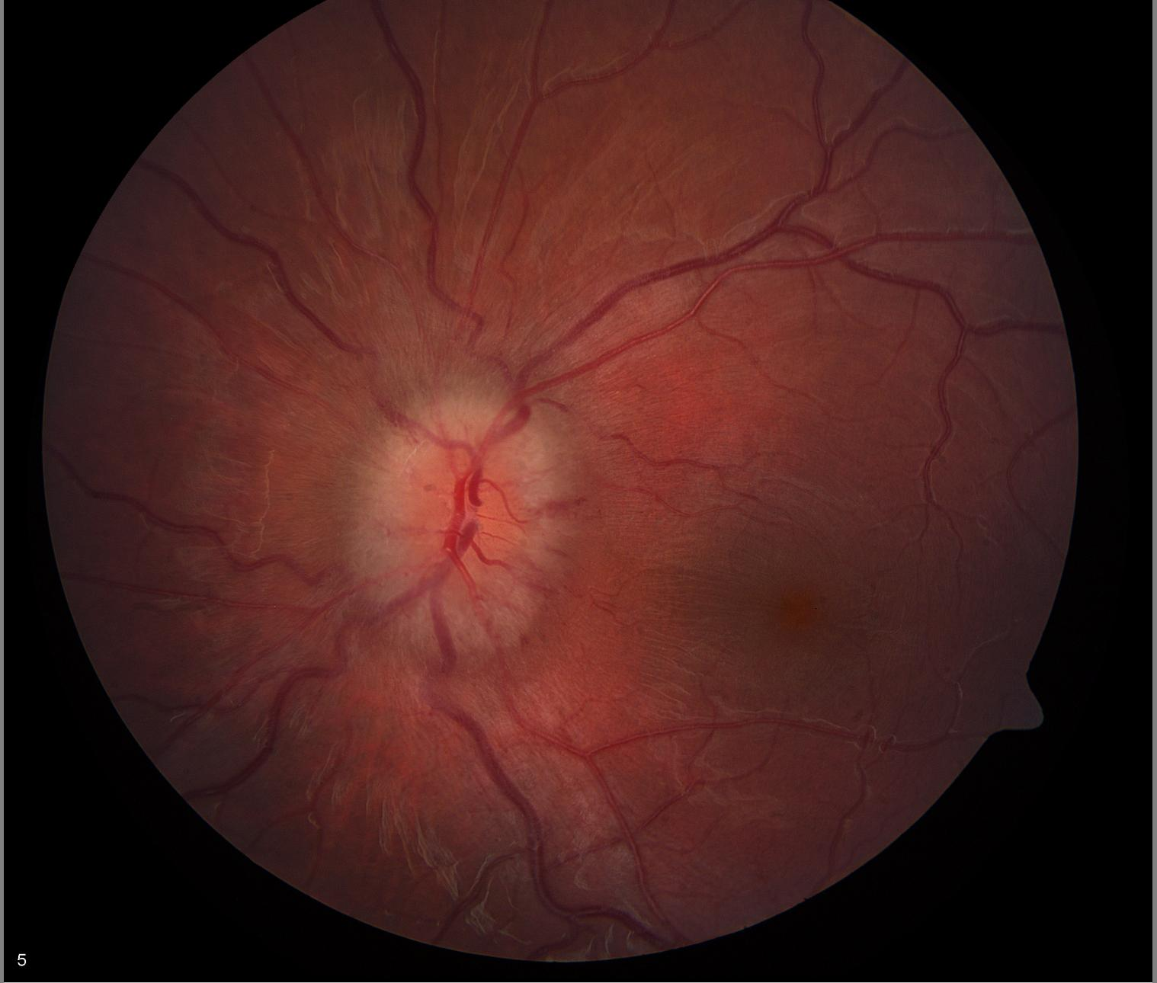
Fundus Exam:
Grade 3 papilledema
No retinopathy
Porter D, Vemulakonda GA. Blood Pressure. American Academy of Ophthalmology. EyeSmart/Eye health. Accessed January 31, 2025

Slide 5
Key Investigations
Basic Work-up:
Organ involvement:
Biochemical work-up
Echocardiography: moderate LVH, mild LV dilatation, preserved systolic function
Brain CT: Unremarkable
Normal renal function
Normal Adrenal cortical function
No electrolyte imbalance
Random normetanephrine:
3071.2 ug/L
Random normetanephrine / urine creatinine ratio:
6033.2 ug/g Crea

Slide 6
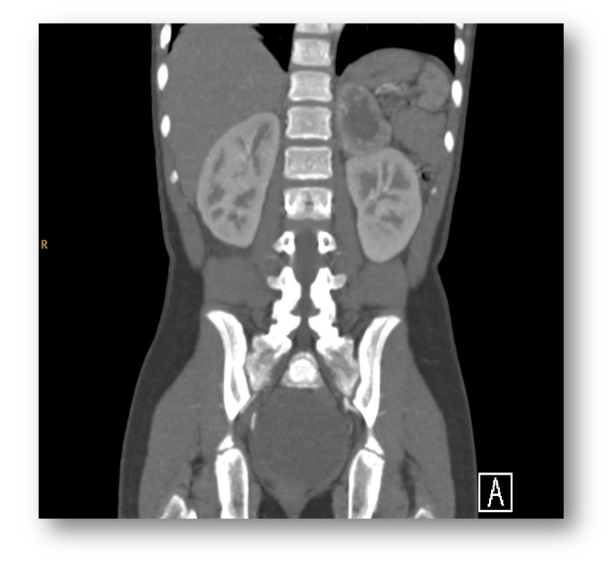
Left adrenal enhancing primarily solid mass with central necrosis.
The remainder of the study is unremarkable.
Abdomen & Pelvic CT scan:

Slide 7
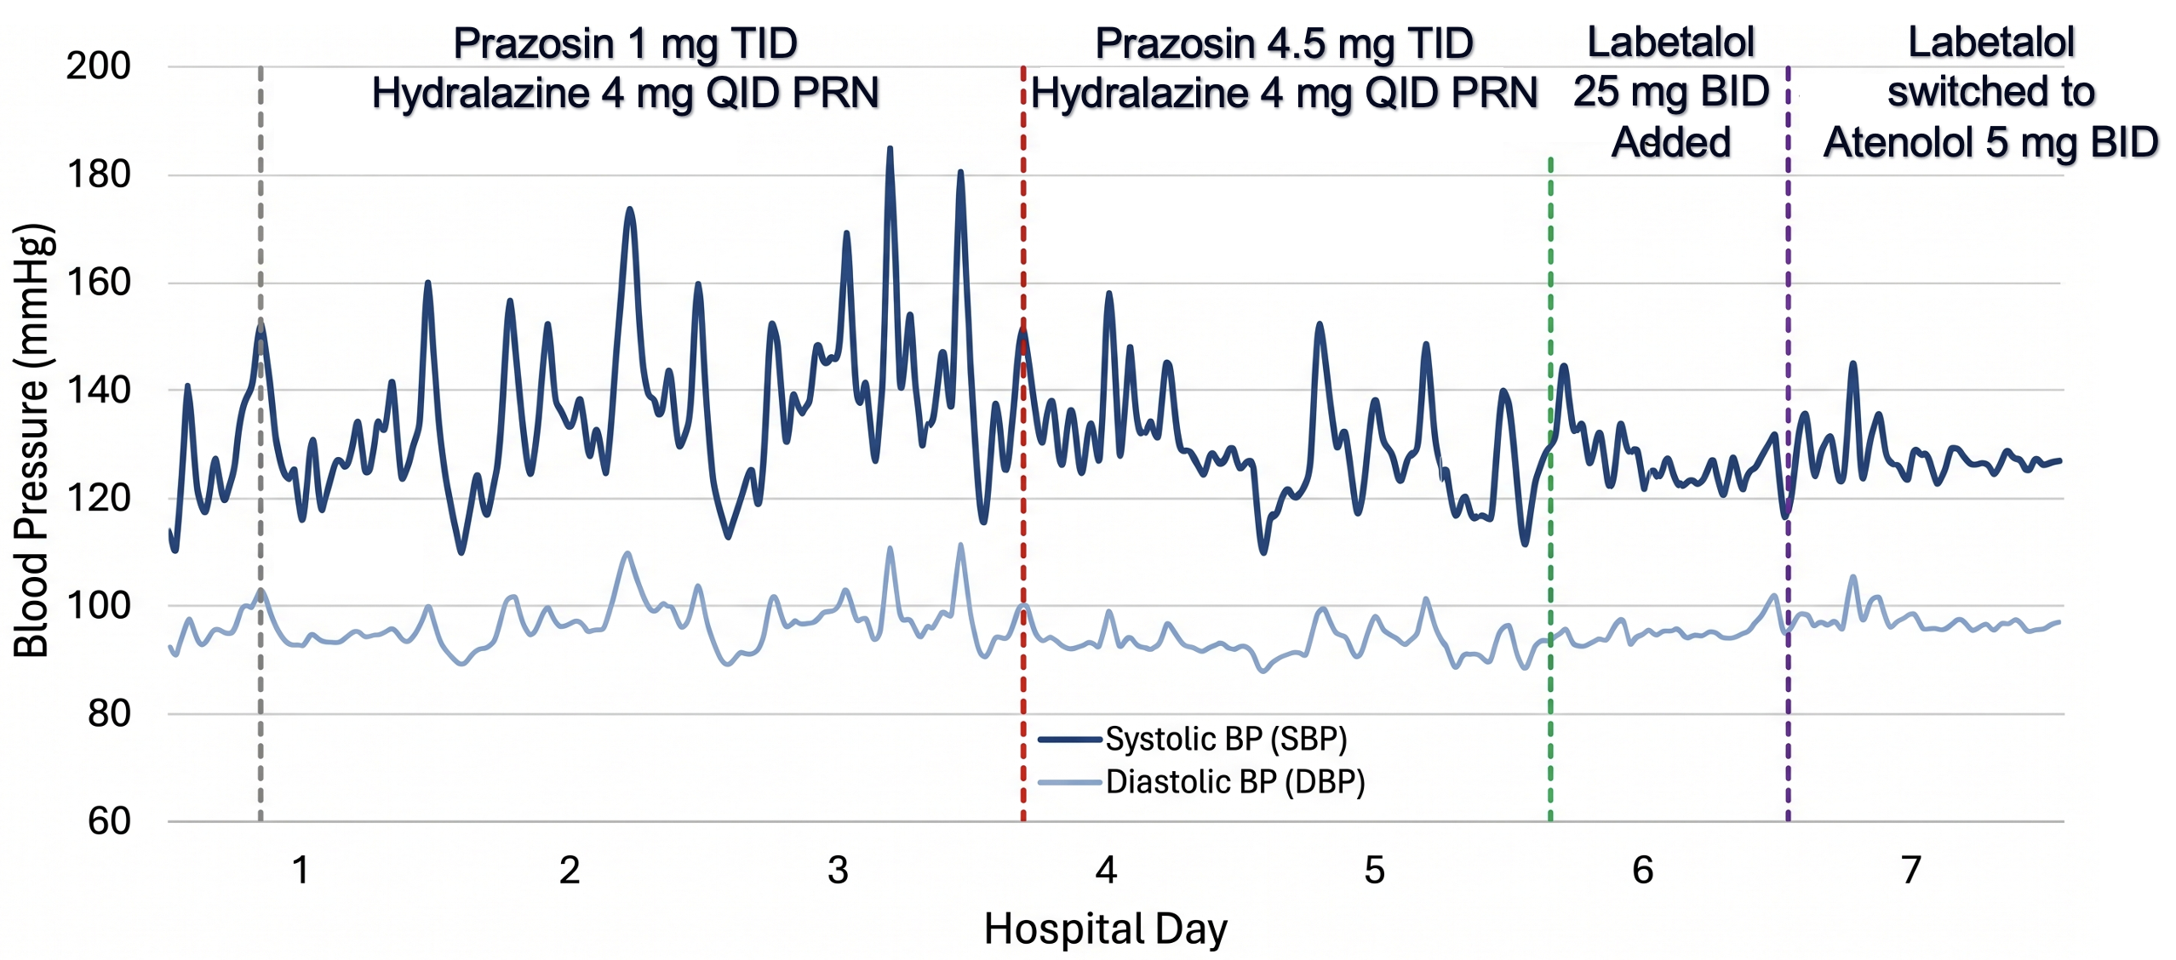
Pre-operative Blood Pressure Optimization:

Slide 8
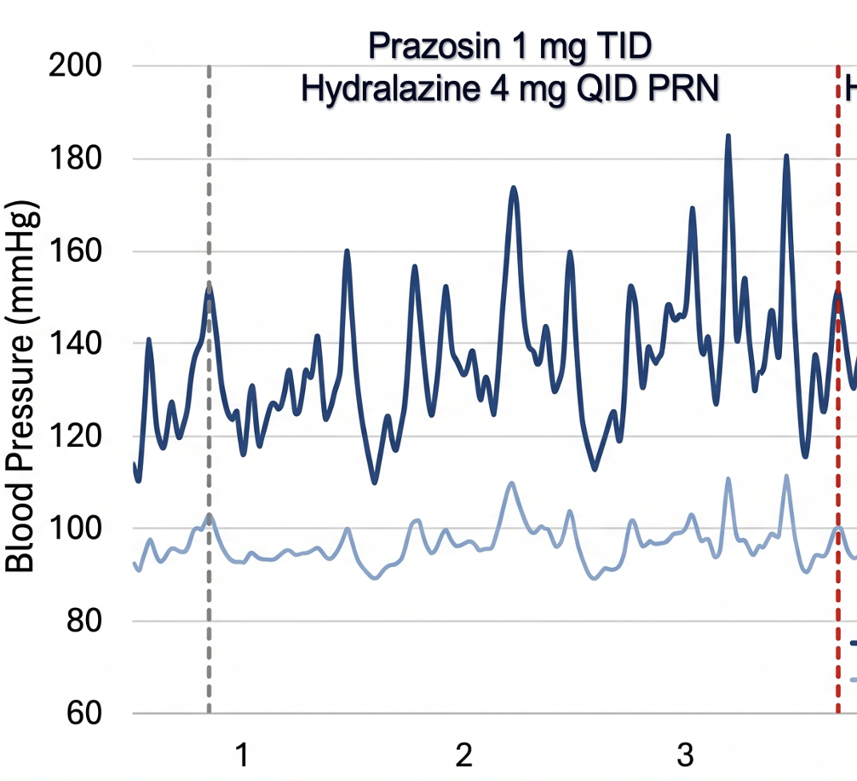
Pre-operative Blood Pressure Optimization:

Slide 9
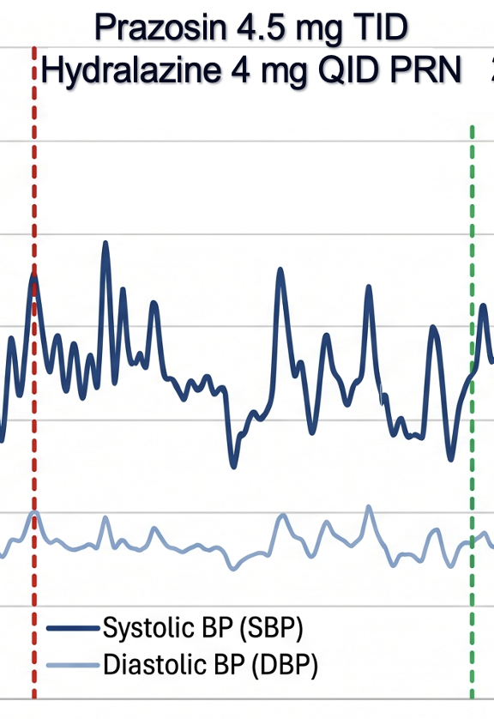
Pre-operative Blood Pressure Optimization:

Slide 10
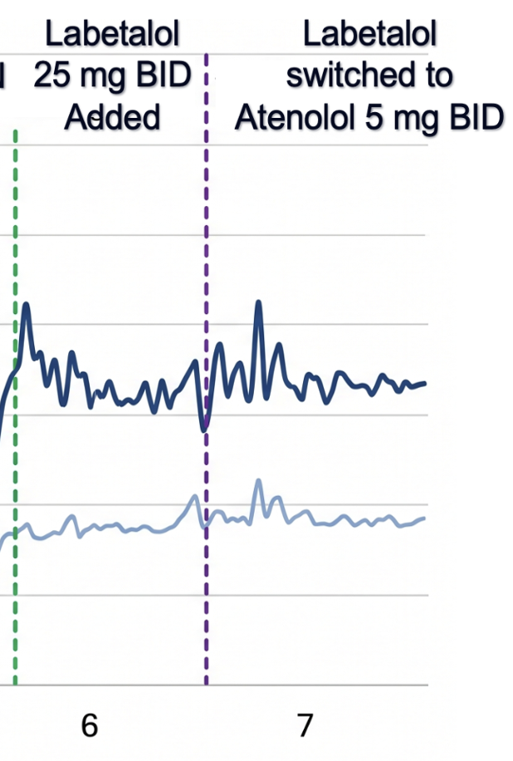
Pre-operative Blood Pressure Optimization:

Slide 11
MDT Plan :
A multidisciplinary team discussion was held between endocrinology, nephrology, pediatric surgery, and pediatric intensive care teams.
Decision was made to proceed with supra-renal mass resection with optimization of perioperative blood pressure and anticipated postoperative hemodynamic instability and hypotension.

Slide 12
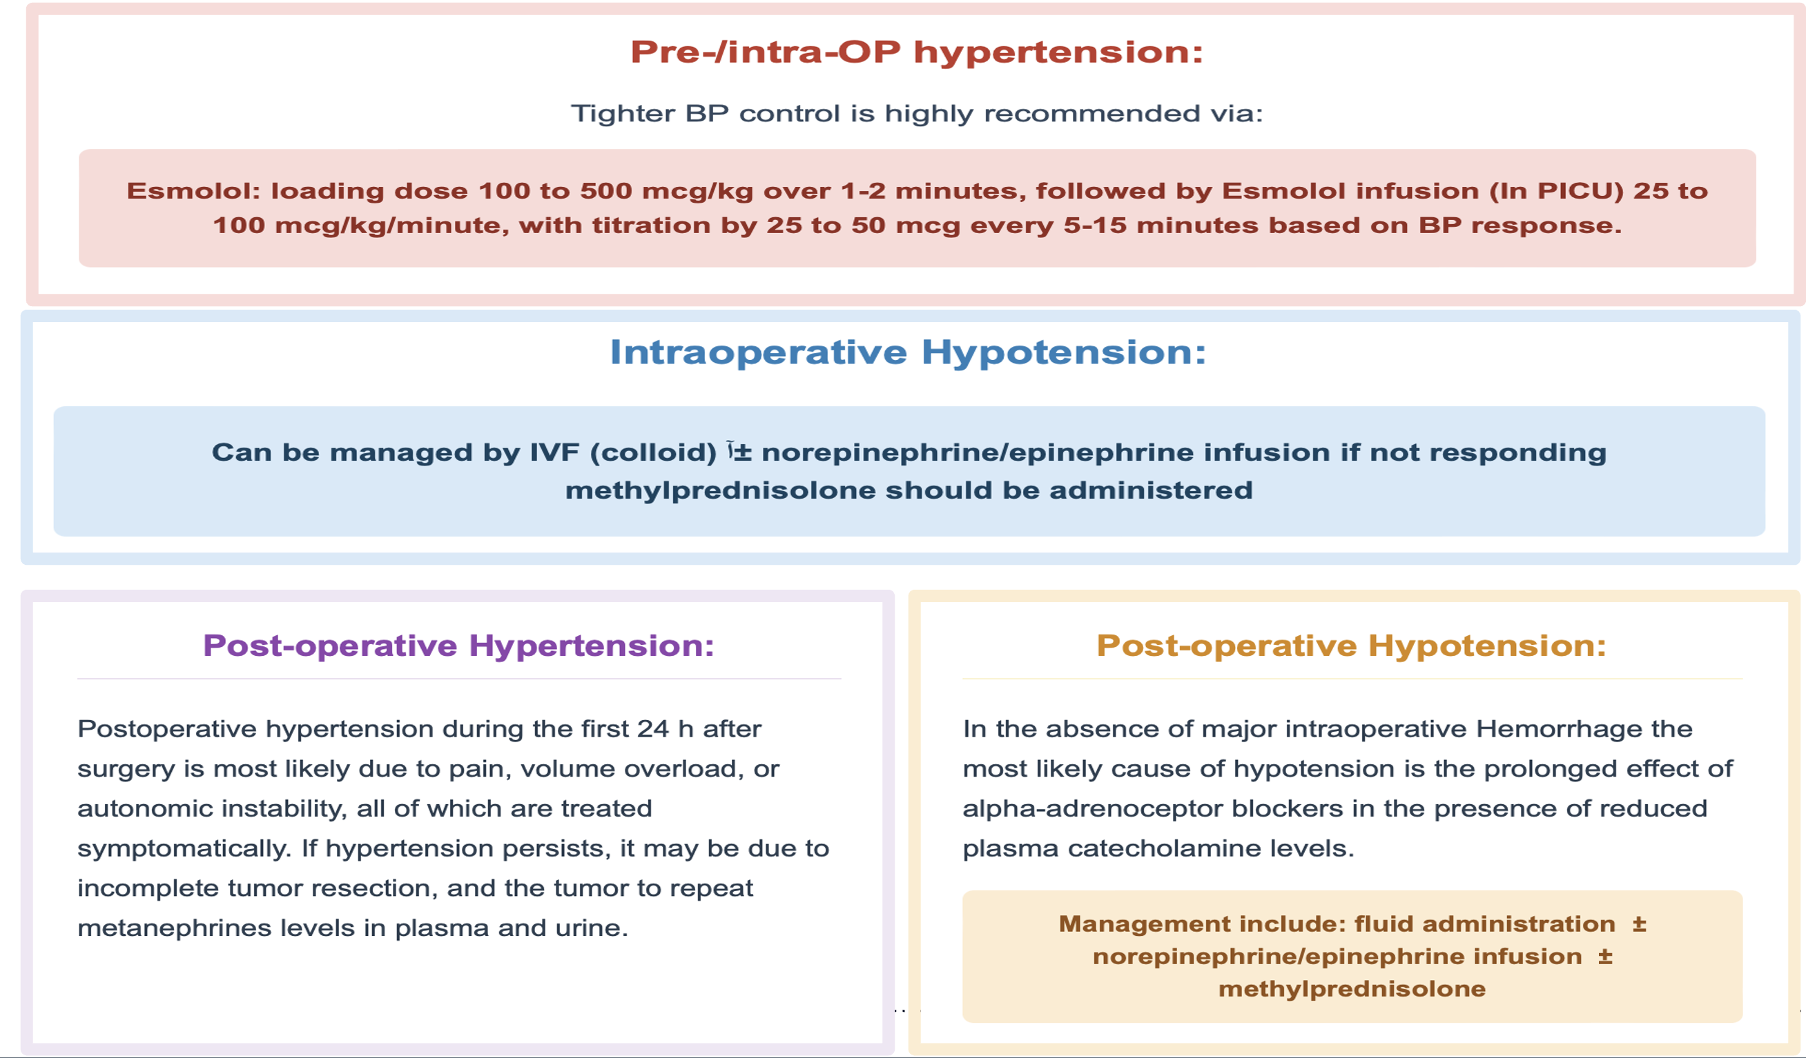

,
Postoperative hypertension during the Frist 24hr after surgery is most likely due to pain, volume overload, or autonomic instability, all of which are treated symptomatically.
If hypertension persists, it may be due to incomplete resection, which requires repeating metanephrine in plasma and urine.

Slide 13
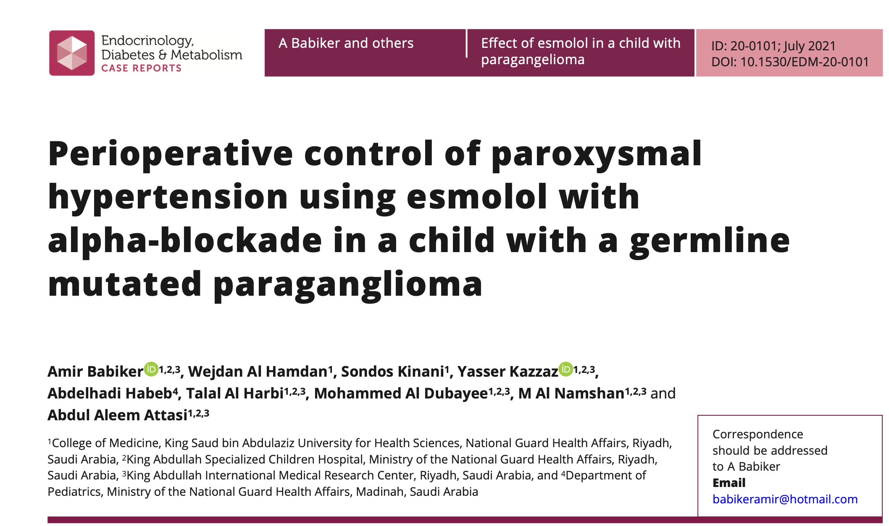

Slide 14
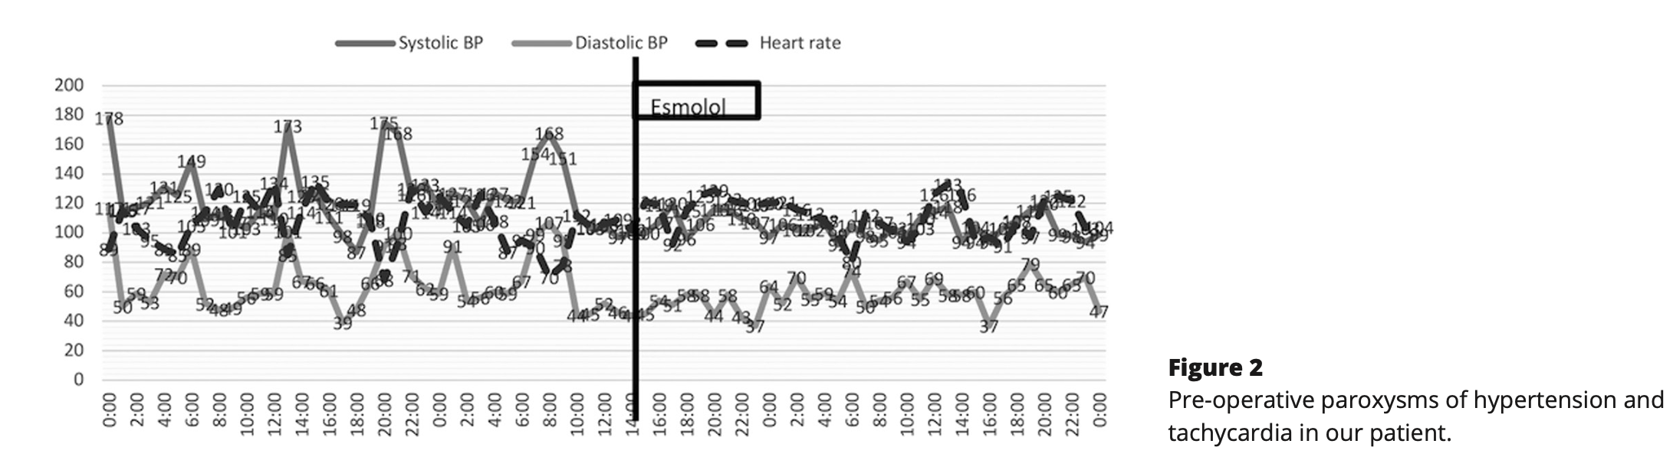

Slide 15
Operative Course:
Back to our Patient..
Laparoscopic left adrenalectomy.
Invasive monitoring with arterial and central venous access.
Esmolol used intraoperatively for short-acting beta-blockade .
No major sustained hemodynamic instability or hypotension.
No vasopressor/inotropic support required.

Slide 16
Histopathology & Final Diagnosis:
Left adrenal pheochromocytoma
Biochemically functioning, intra-adrenal, unifocal.
Tumor size: 5.5 cm.
Focal capsular invasion and tumor necrosis.
Angioinvasion present, no lymphatic invasion.
Accessory spleen specimen negative for malignancy.

Slide 17
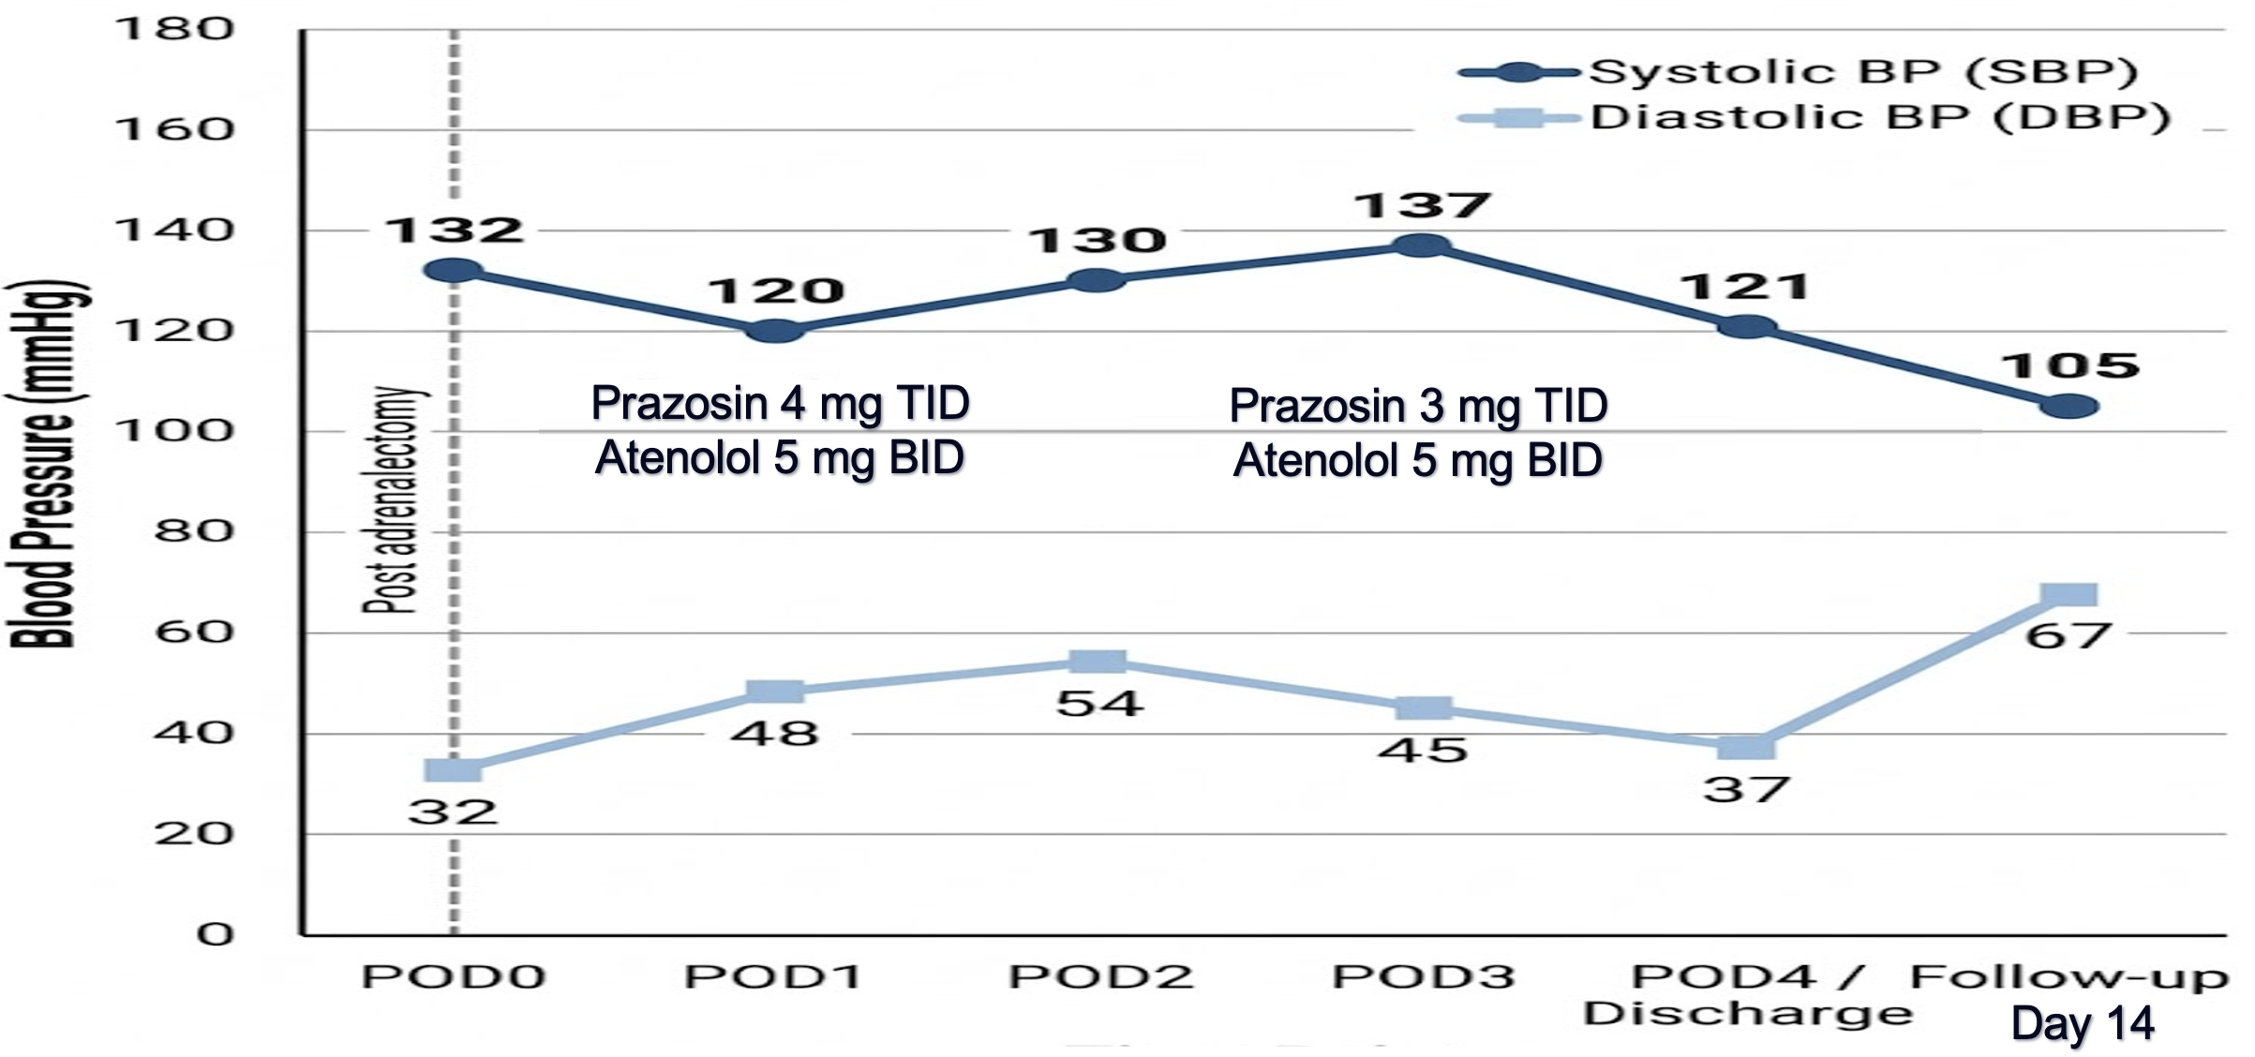
Postoperative Hemodynamic Course:

Slide 18
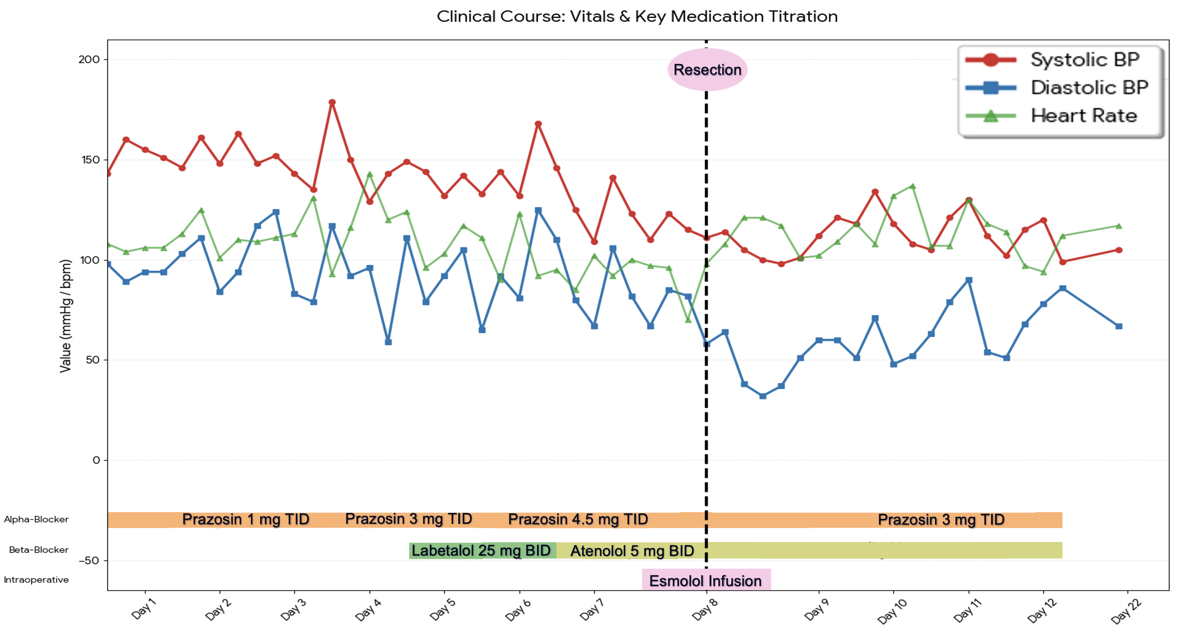

Slide 19
Why postoperative functional imaging matteres ?
Pediatric pheochromocytoma may be associated with multifocal or extra-adrenal disease.
In this patient, an unexpectedly persistent hypertensive state despite tumor resection raised concern for residual catecholamine source.
Therefore, postoperative functional imaging was important for complete evaluation and follow-up.

Slide 20
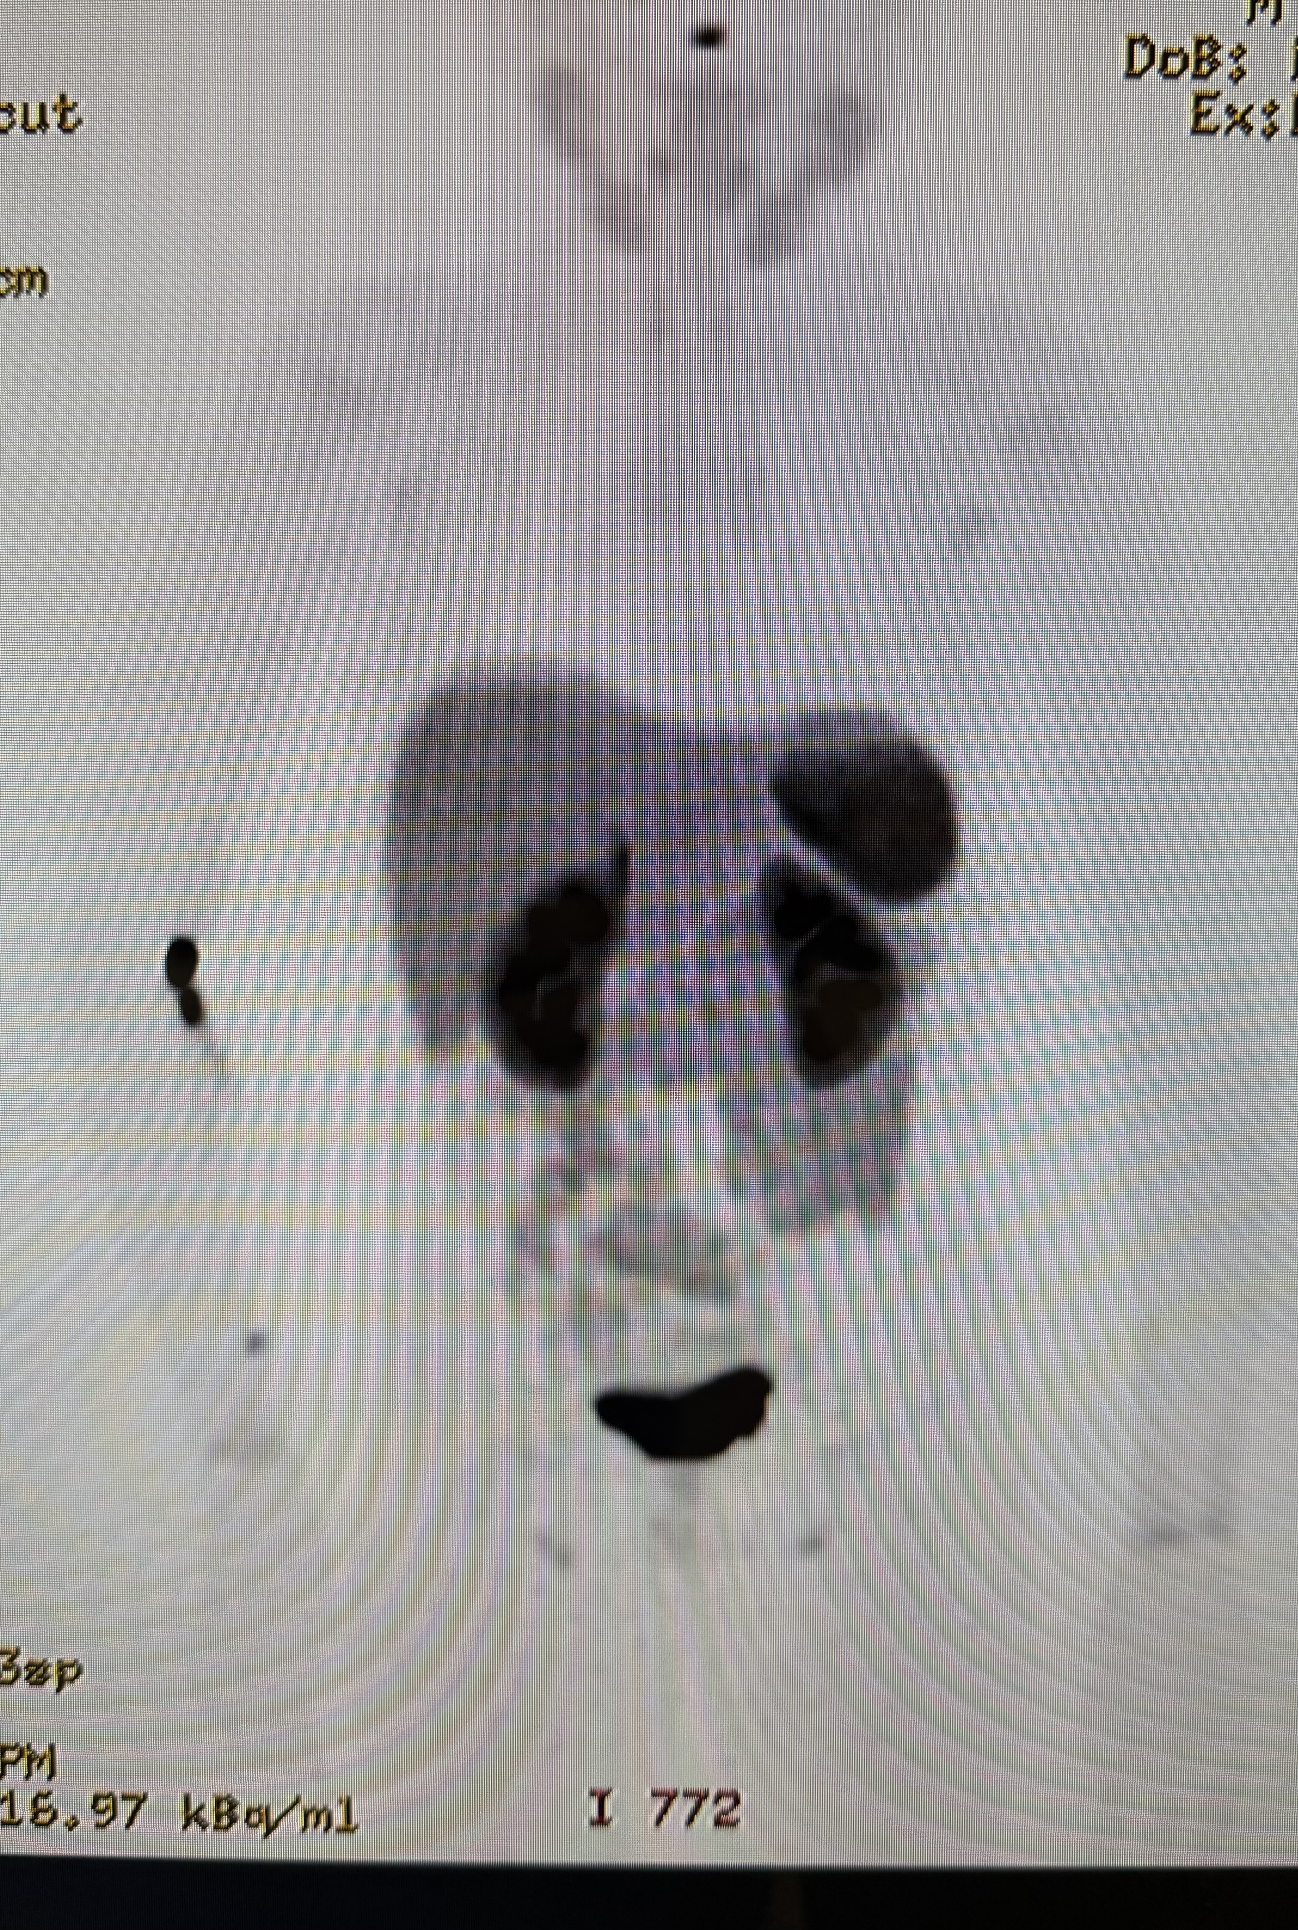
68Ga-DOTATATE PET/CT Scan:
No suspicious activity at the surgical bed.
No lymphadenopathy with no significant tracer accumulation.
The brain, lungs, solid abdominal organs and osseous structures are unremarkable for tracer avid lesions.

Slide 21
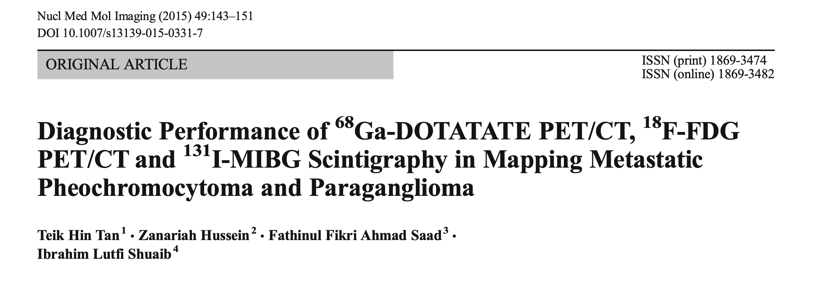
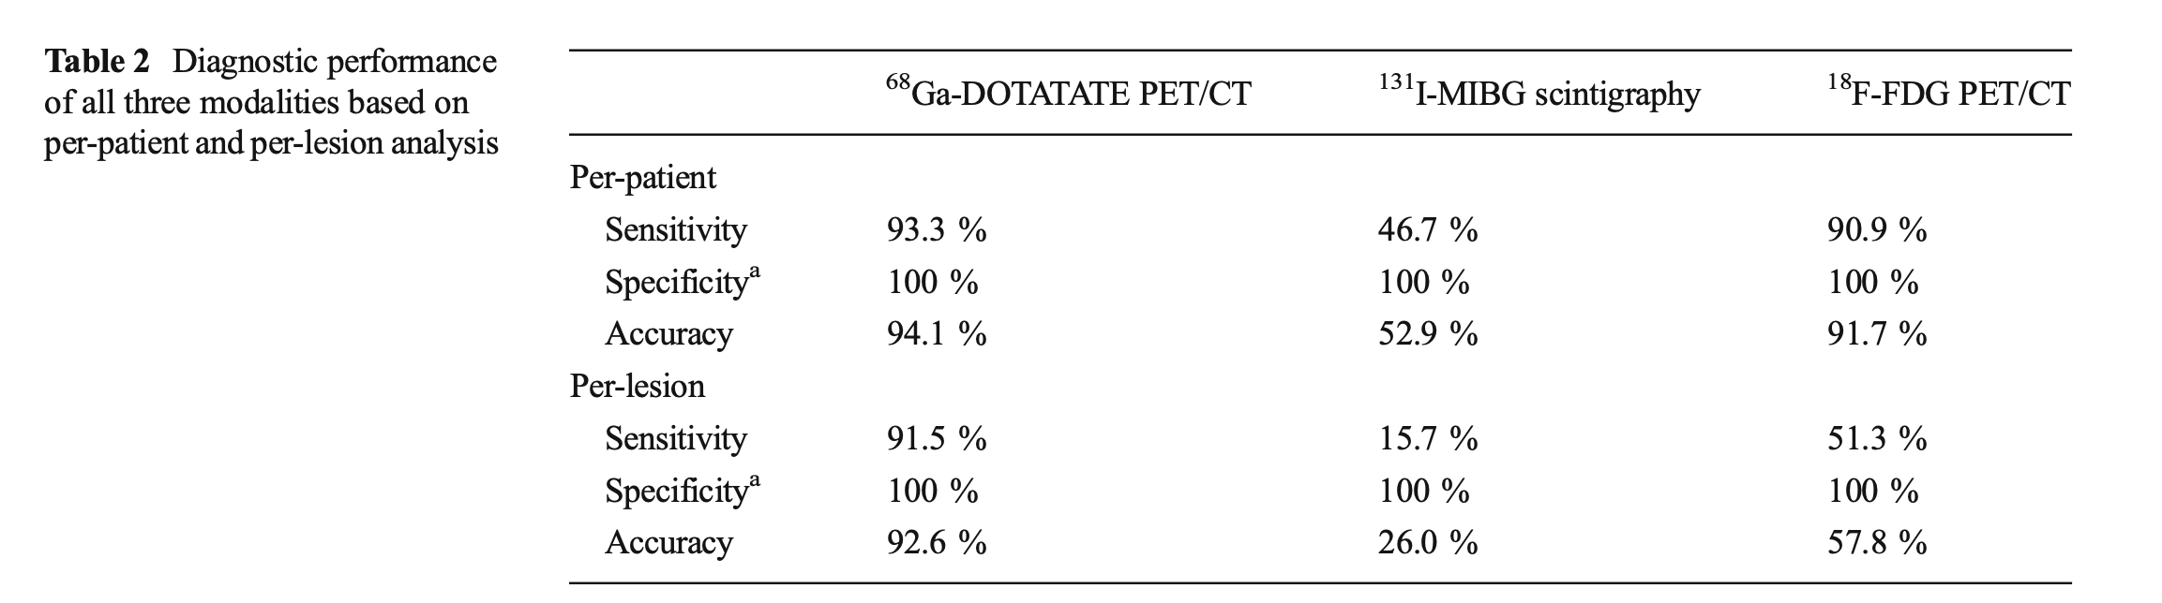
Tan TH, et al. Diagnostic Performance of 68Ga-DOTATATE PET/CT, 18F-FDG PET/CT and 131I-MIBG Scintigraphy in Mapping Metastatic Pheochromocytoma and Paraganglioma. Nucl Med Mol Imaging. 2015;49(2):143-151.

Slide 22
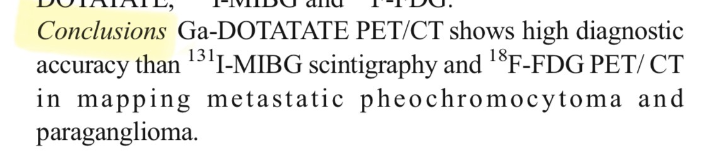
Tan TH, et al. Diagnostic Performance of 68Ga-DOTATATE PET/CT, 18F-FDG PET/CT and 131I-MIBG Scintigraphy in Mapping Metastatic Pheochromocytoma and Paraganglioma. Nucl Med Mol Imaging. 2015;49(2):143-151.
Notes:
This slide explains why postoperative imaging was important.
Pediatric pheochromocytoma may be associated with multifocal or extra-adrenal disease.
In our patient, the postoperative course was more stable than expected, but antihypertensives were still needed initially.
This raised concern for a possible residual catecholamine source, so postoperative functional imaging was important for complete evaluation and follow-up.

Slide 23
Take-Home Massages:
Pheochromocytoma should be suspected in children with severe hypertension and adrenergic symptoms.
Meticulous preoperative alpha-blockade and intraoperative titratable beta-blockade (e.g., Esmolol) are crucial to ensure hemodynamic stability.
Any deviation from the expected postoperative hemodynamic recovery should trigger an immediate search for residual catecholamine sources using high-sensitivity functional imaging (e.g., 68Ga-DOTATATE PET/CT).

Slide 24
Thank You.

